Slide 1
Proportion
CONTENTS

Slide 2
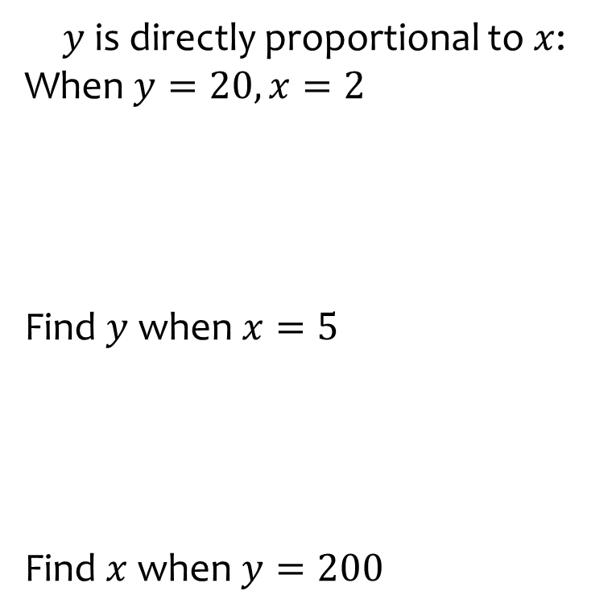
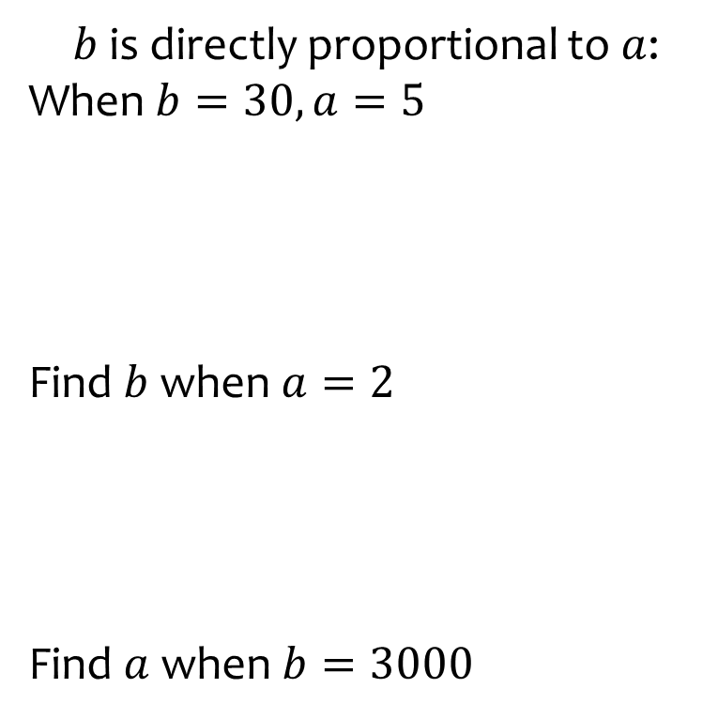
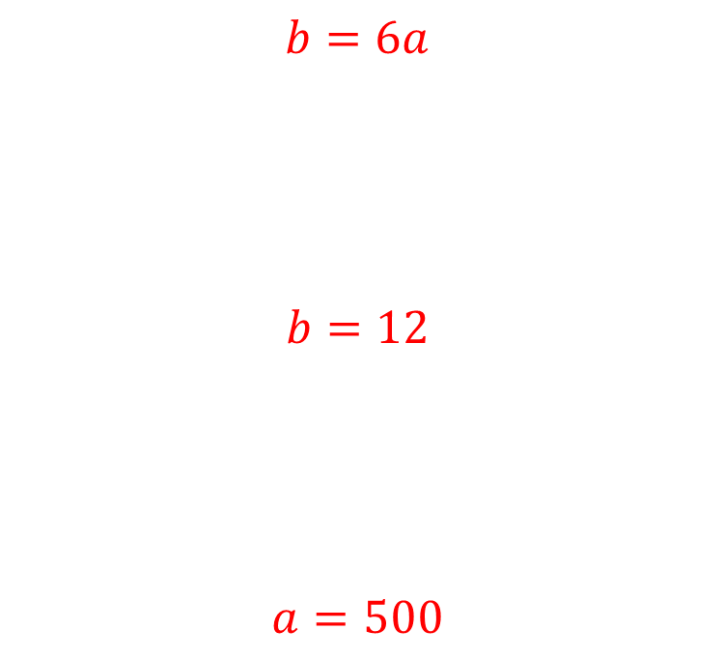
Worked example
Your turn
$y$ is directly proportional to $x$:
When $y=20, x=2$
Find $y$ when $x=5$
Find $x$ when $y=200$
$b$ is directly proportional to $a$:
When $b=30, a=5$
Find $b$ when $a=2$
Find $a$ when $b=3000$
$$b=6a$$
$$b=12$$
$$a=500$$

Slide 3
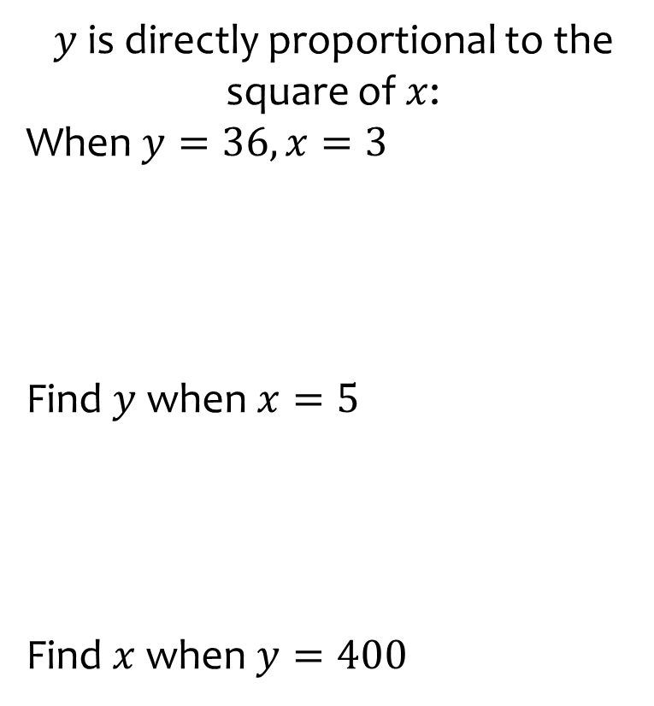
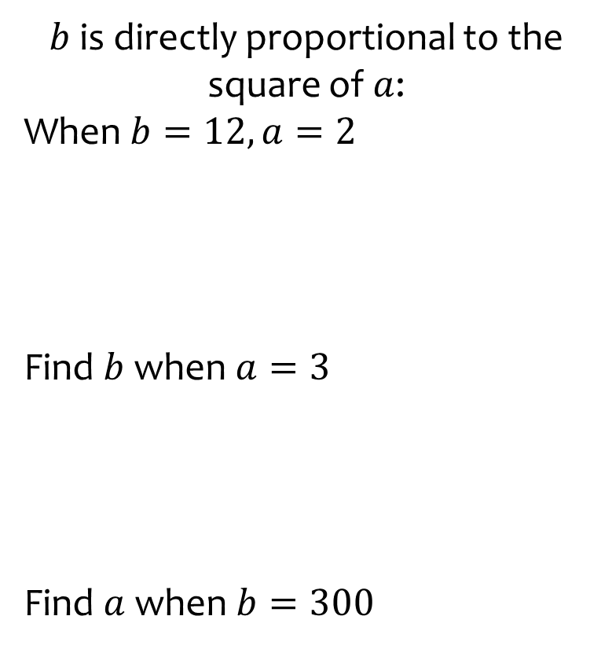
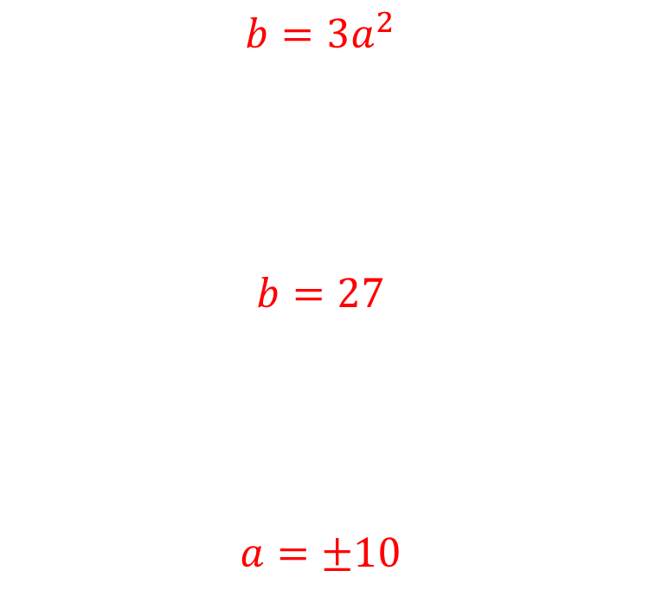
Worked example
Your turn
$y$ is directly proportional to the square of $x$:
When $y=36, x=3$
Find $y$ when $x=5$
Find $x$ when $y=400$
$b$ is directly proportional to the square of $a$:
When $b=12, a=2$
Find $b$ when $a=3$
Find $a$ when $b=300$
$$b=3a^{2}$$
$$b=27$$
$$a=±10$$

Slide 4
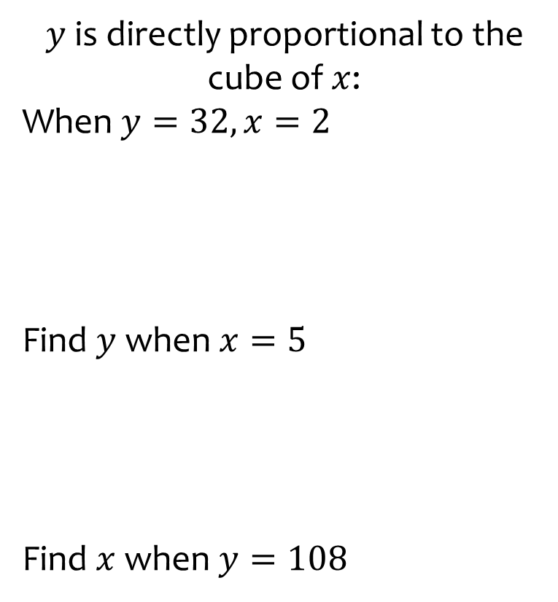
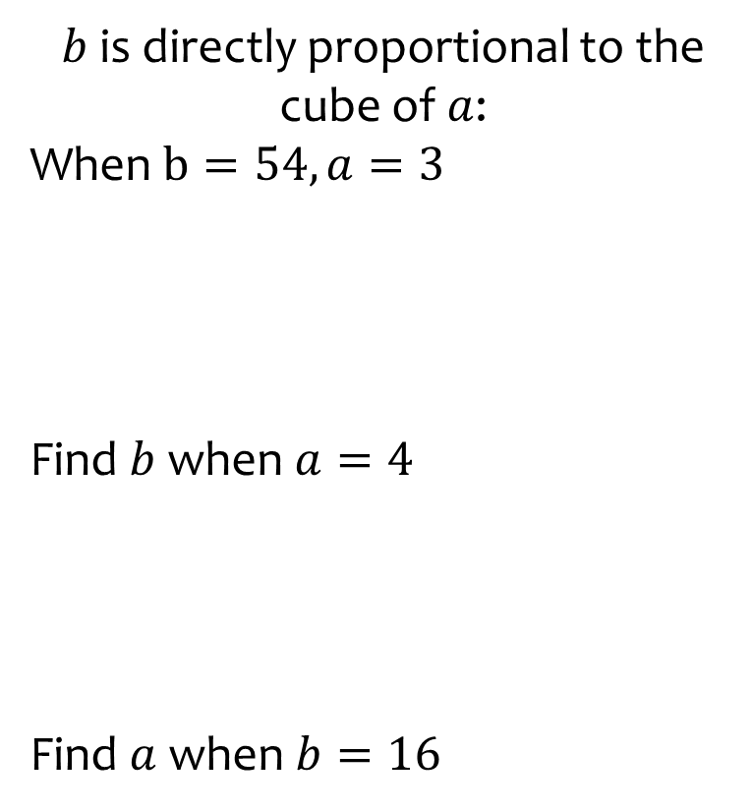
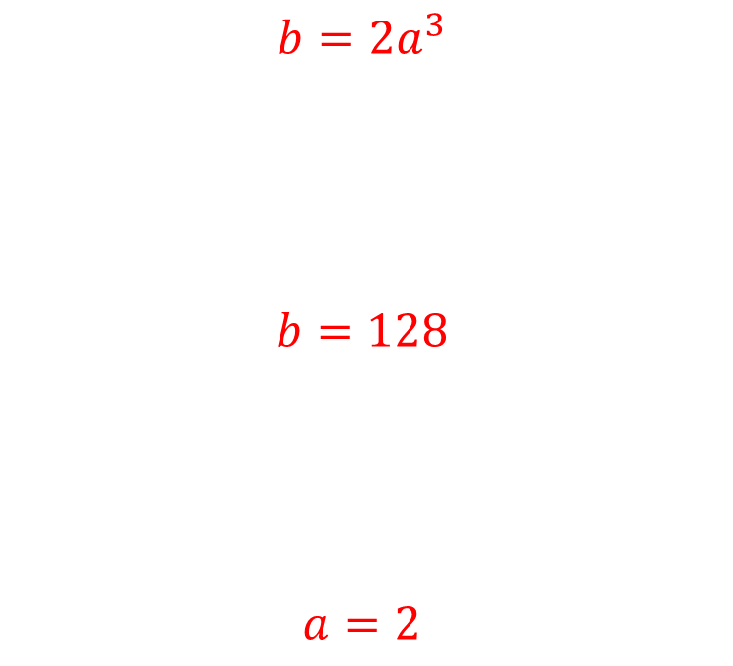
Worked example
Your turn
$y$ is directly proportional to the cube of $x$:
When $y=32, x=2$
Find $y$ when $x=5$
Find $x$ when $y=108$
$b$ is directly proportional to the cube of $a$:
When $b=54, a=3$
Find $b$ when $a=4$
Find $a$ when $b=16$
$$b=2a^{3}$$
$$b=128$$
$$a=2$$

Slide 5
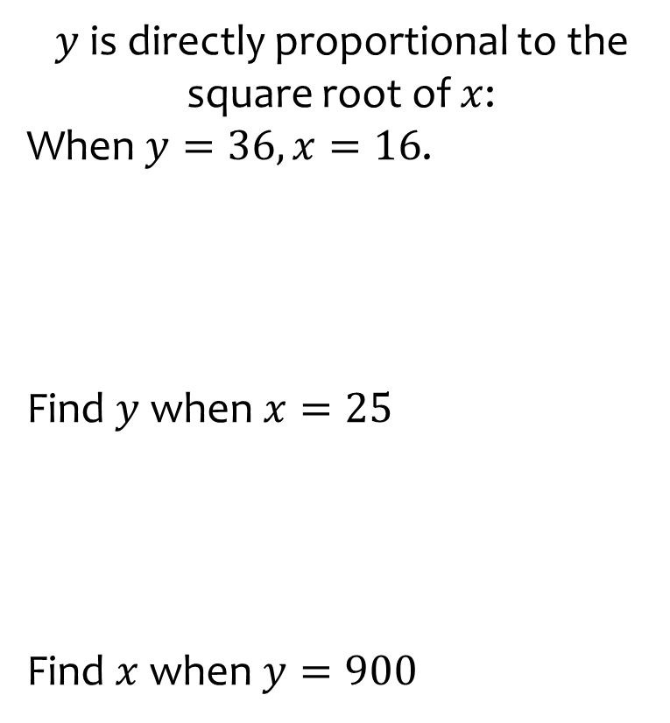
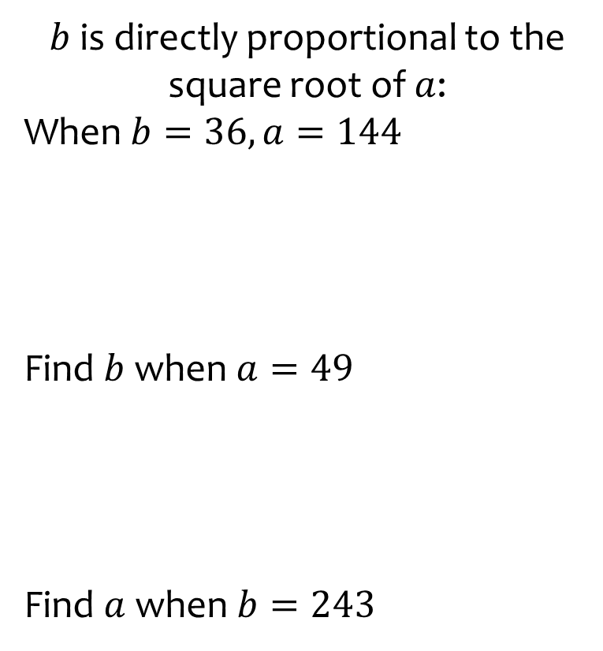
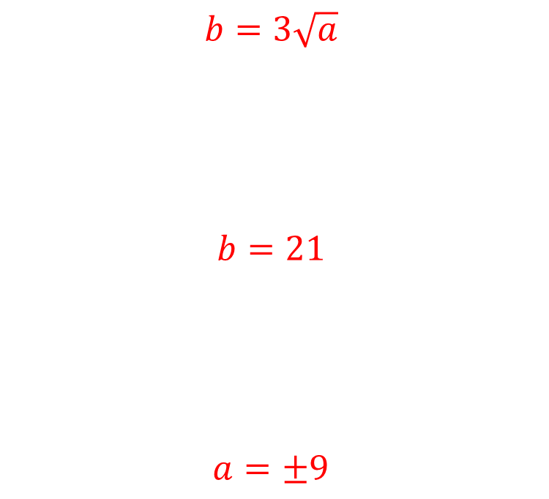
Worked example
Your turn
$y$ is directly proportional to the square root of $x$:
When $y=36, x=16$.
Find $y$ when $x=25$
Find $x$ when $y=900$
$b$ is directly proportional to the square root of $a$:
When $b=36, a=144$
Find $b$ when $a=49$
Find $a$ when $b=243$
$$b=3\sqrt{a}$$
$$b=21$$
$$a=±9$$

Slide 6
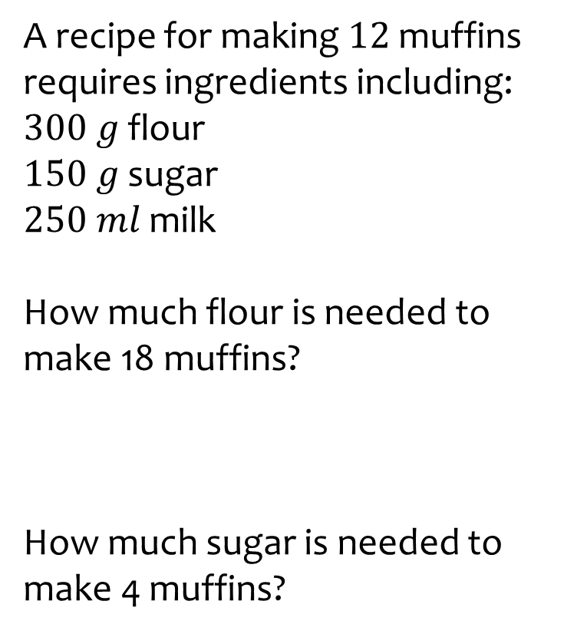
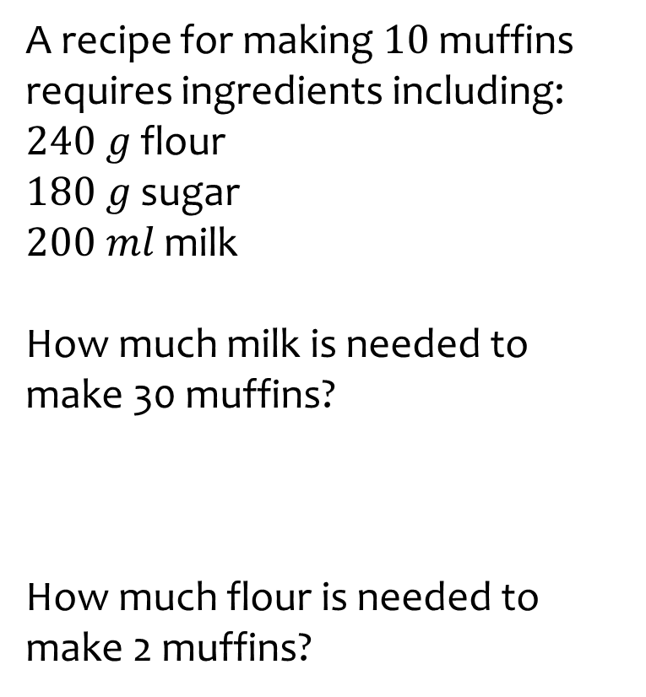
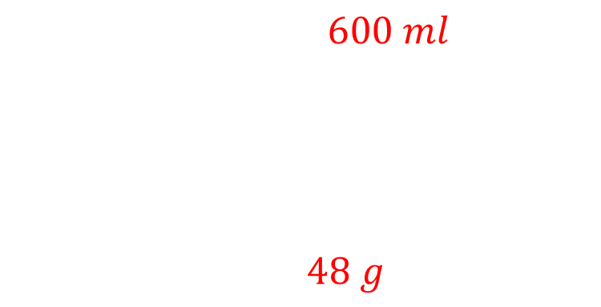
Worked example
Your turn
A recipe for making $12$ muffins requires ingredients including:
$300 g$ flour
$150 g$ sugar
$250 ml$ milk
How much flour is needed to make 18 muffins?
How much sugar is needed to make 4 muffins?
A recipe for making $10$ muffins requires ingredients including:
$240 g$ flour
$180 g$ sugar
$200 ml$ milk
How much milk is needed to make 30 muffins?
How much flour is needed to make 2 muffins?
$$600 ml$$
$48 g$

Slide 7
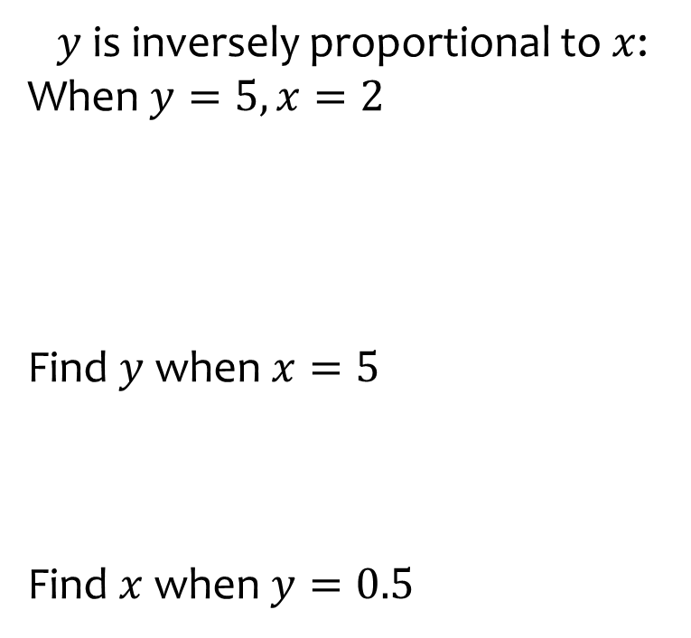
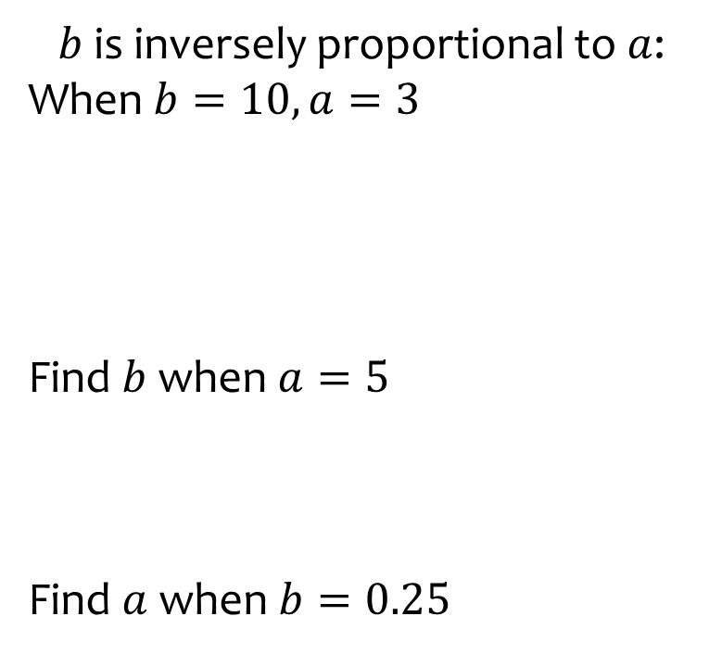
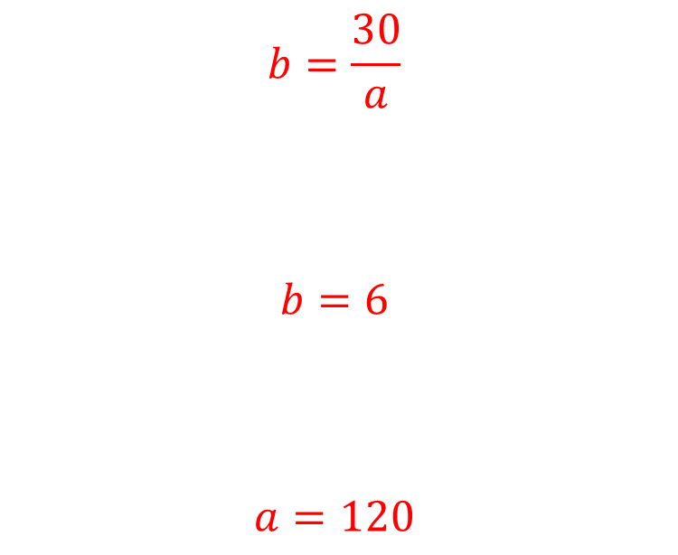
Worked example
Your turn
$y$ is inversely proportional to $x$:
When $y=5, x=2$
Find $y$ when $x=5$
Find $x$ when $y=0.5$
$b$ is inversely proportional to $a$:
When $b=10, a=3$
Find $b$ when $a=5$
Find $a$ when $b=0.25$
$$b=\frac{30}{a}$$
$$b=6$$
$$a=120$$

Slide 8
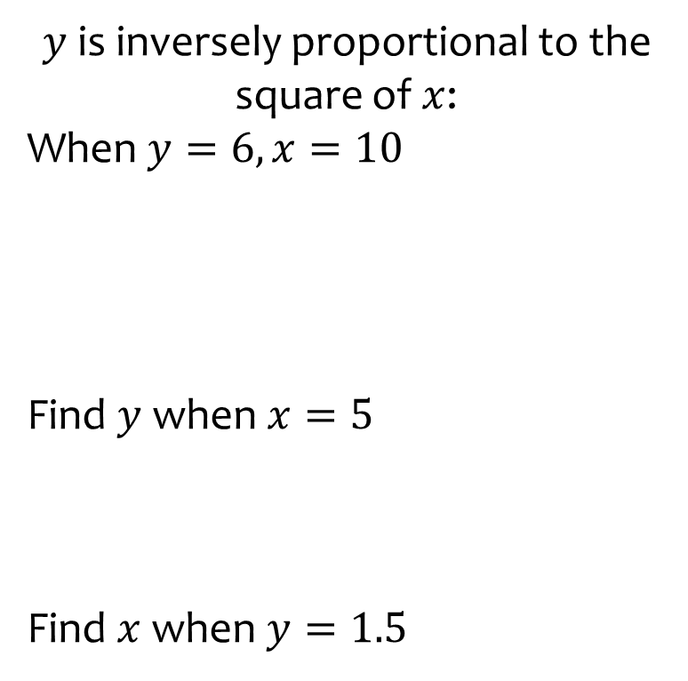
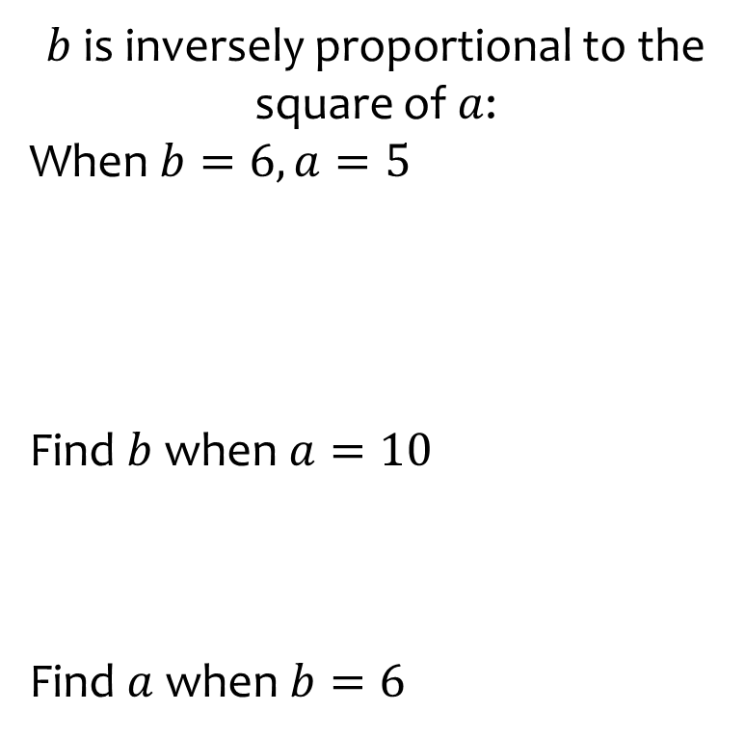
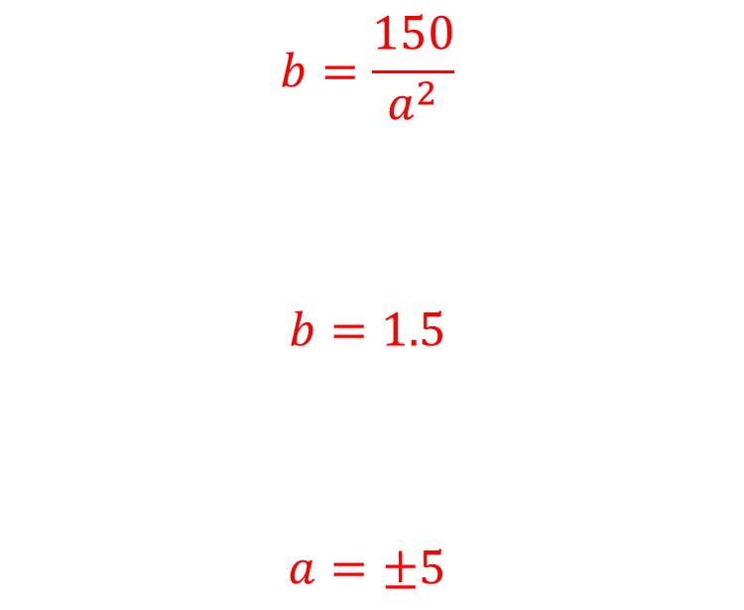
Worked example
Your turn
$y$ is inversely proportional to the square of $x$:
When $y=6, x=10$
Find $y$ when $x=5$
Find $x$ when $y=1.5$
$b$ is inversely proportional to the square of $a$:
When $b=6, a=5$
Find $b$ when $a=10$
Find $a$ when $b=6$
$$b=\frac{150}{a^{2}}$$
$$b=1.5$$
$$a=±5$$

Slide 9
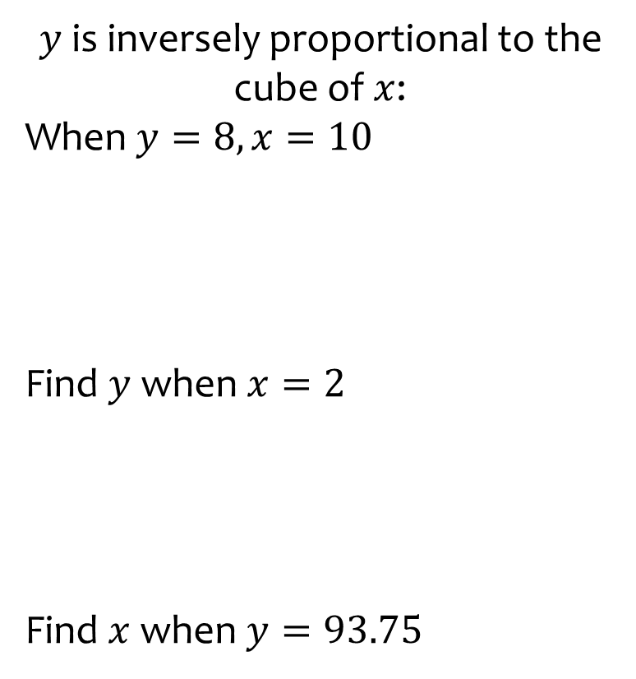
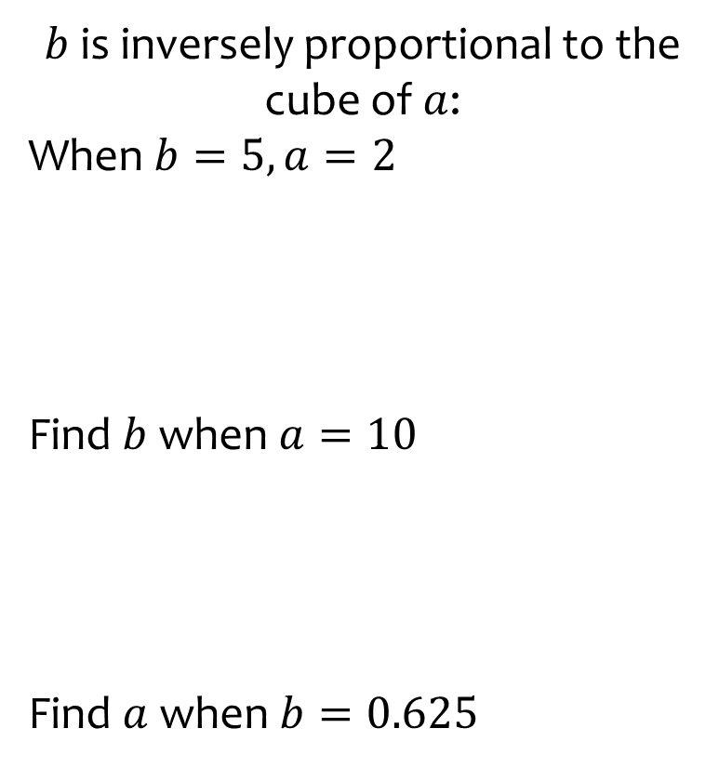
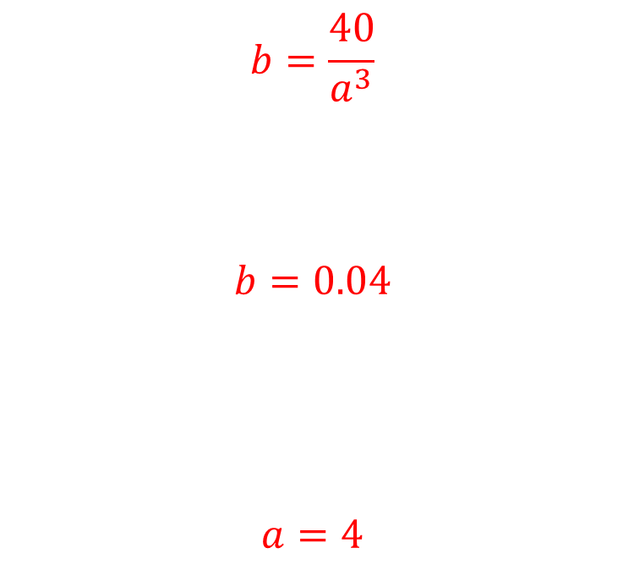
Worked example
Your turn
$y$ is inversely proportional to the cube of $x$:
When $y=8, x=10$
Find $y$ when $x=2$
Find $x$ when $y=93.75$
$b$ is inversely proportional to the cube of $a$:
When $b=5, a=2$
Find $b$ when $a=10$
Find $a$ when $b=0.625$
$$b=\frac{40}{a^{3}}$$
$$b=0.04$$
$$a=4$$

Slide 10
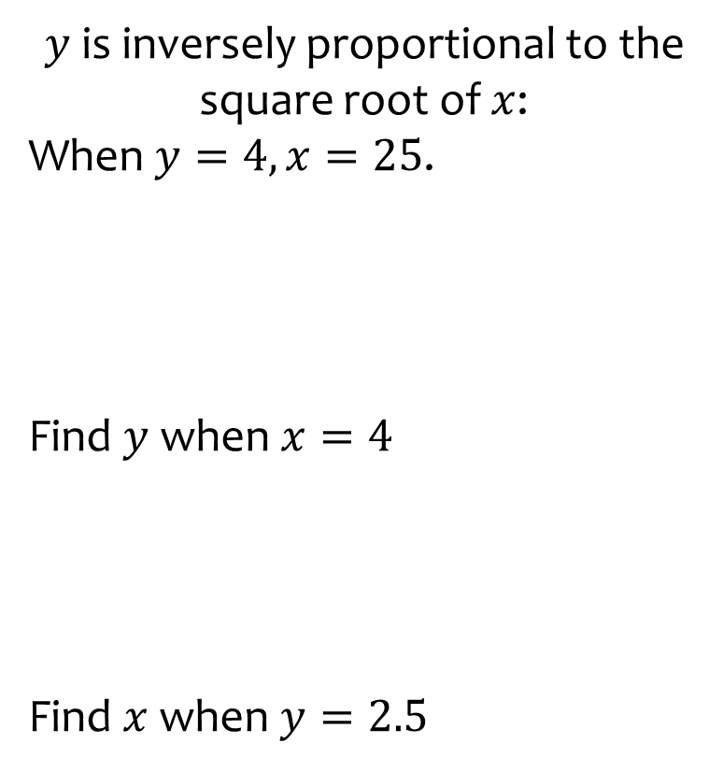
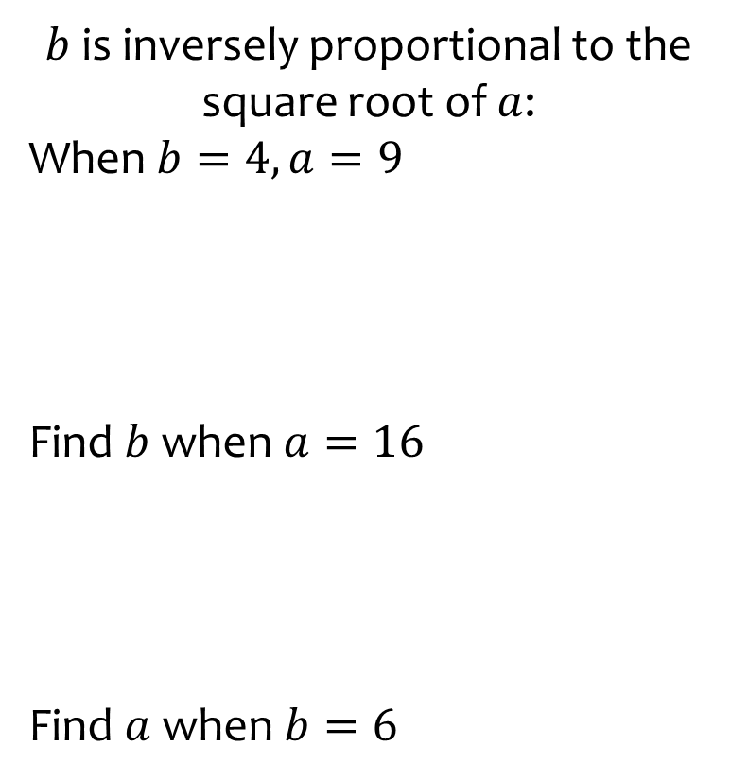
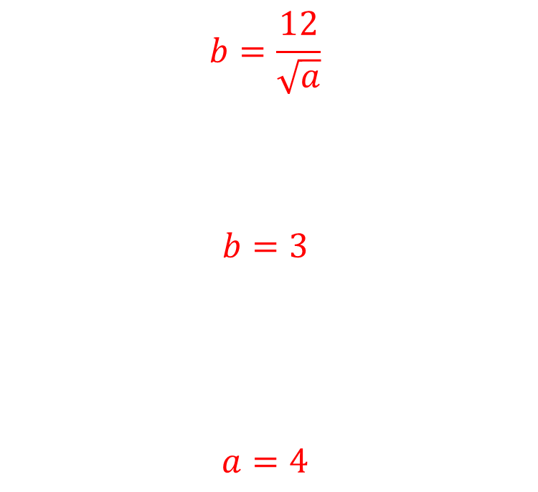
Worked example
Your turn
$y$ is inversely proportional to the square root of $x$:
When $y=4, x=25$.
Find $y$ when $x=4$
Find $x$ when $y=2.5$
$b$ is inversely proportional to the square root of $a$:
When $b=4, a=9$
Find $b$ when $a=16$
Find $a$ when $b=6$
$$b=\frac{12}{\sqrt{a}}$$
$$b=3$$
$$a=4$$

Slide 11
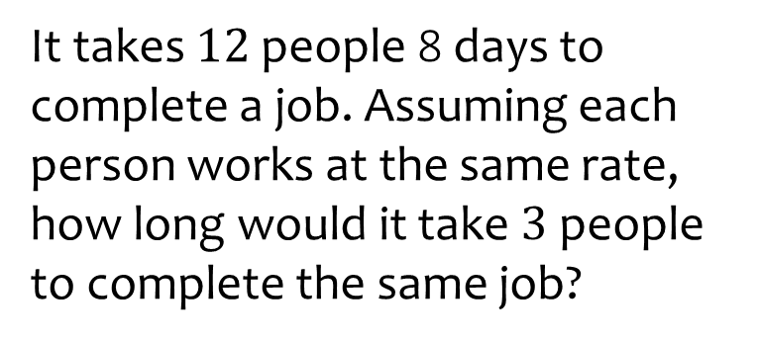
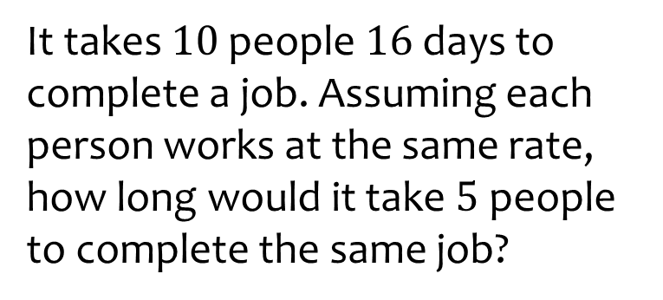

Worked example
Your turn
It takes $12$ people 8 days to complete a job. Assuming each person works at the same rate, how long would it take $3$ people to complete the same job?
It takes $10$ people $16$ days to complete a job. Assuming each person works at the same rate, how long would it take $5$ people to complete the same job?
$32$ days

Slide 12
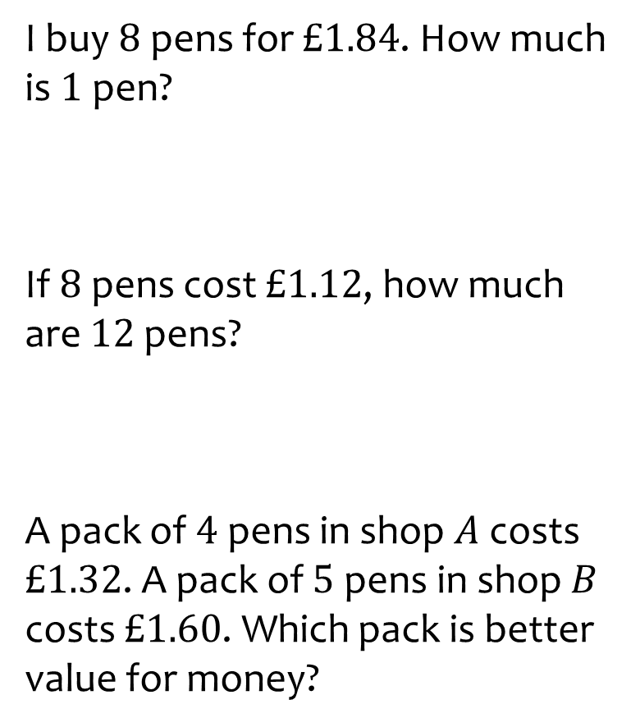
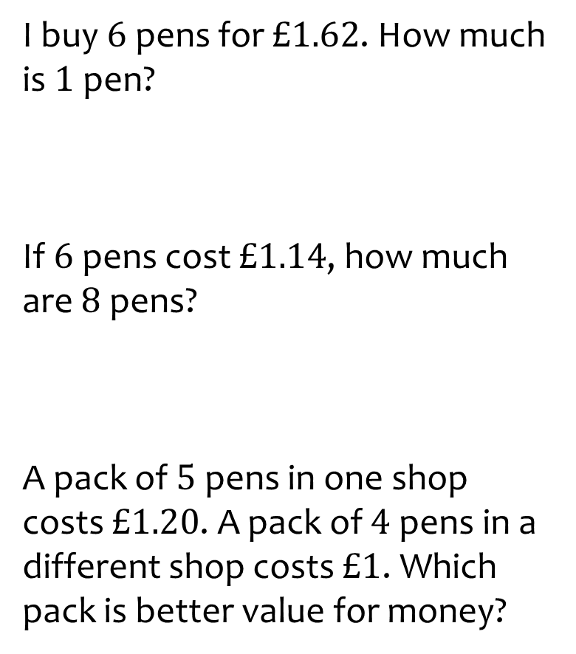
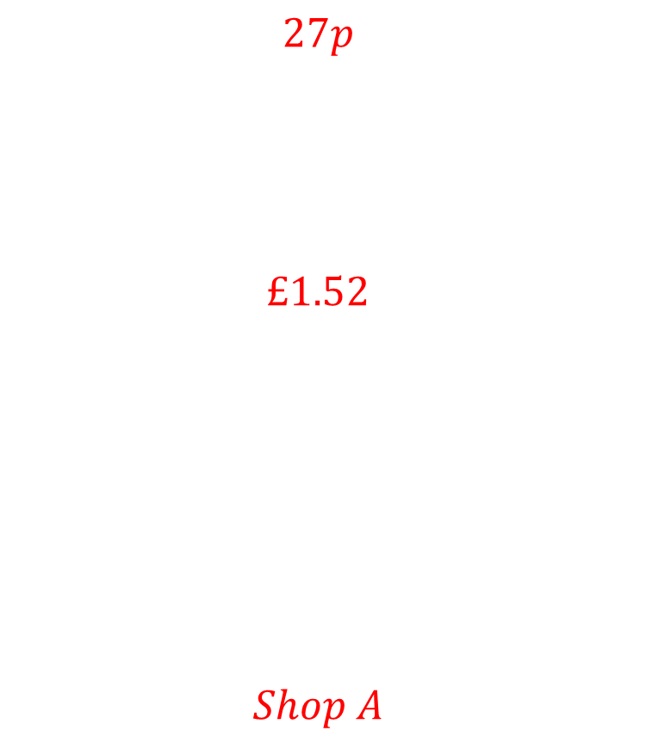
Worked example
Your turn
I buy $8$pens for $£1.84$. How much is $1$ pen?
If $8$pens cost $£1.12$, how much are $12$ pens?
A pack of $4$pens in shop $A$ costs $£1.32$. A pack of $5$ pens in shop $B$ costs $£1.60$. Which pack is better value for money?
I buy $6$pens for $£1.62$. How much is $1$ pen?
If $6$pens cost $£1.14$, how much are $8$ pens?
A pack of $5$pens in one shop costs $£1.20$. A pack of $4$ pens in a different shop costs $£1$. Which pack is better value for money?
$$27p$$
$$£1.52$$
$$Shop A$$

Slide 13
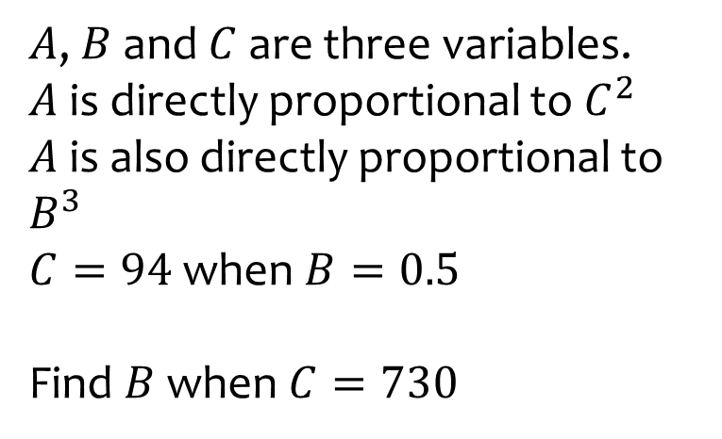
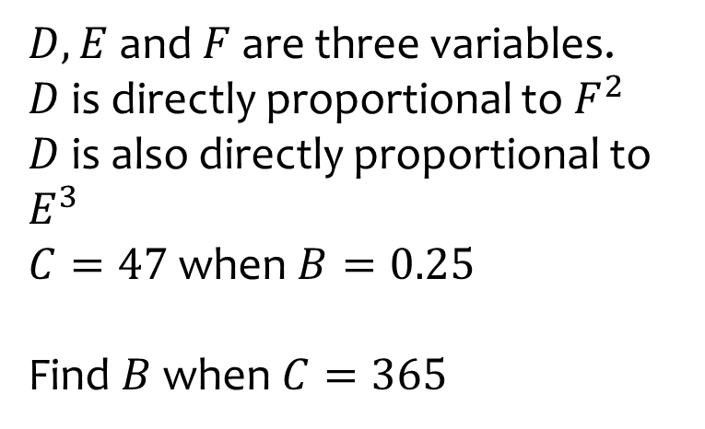

Worked example
Your turn
$A$, $B$ and $C$ are three variables.
$A$ is directly proportional to $C^{2}$
$A$ is also directly proportional to $B^{3}$
$C=94$ when $B=0.5$
Find $B$ when $C=730$
$D, E$ and $F$ are three variables.
$D$ is directly proportional to $F^{2}$
$D$ is also directly proportional to $E^{3}$
$C=47$ when $B=0.25$
Find $B$ when $C=365$
$0.980$(3 sf)

Slide 14
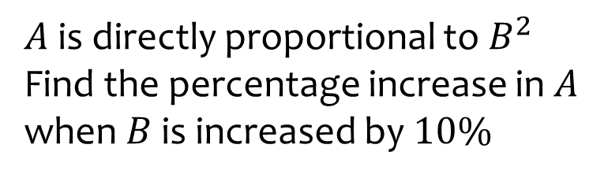
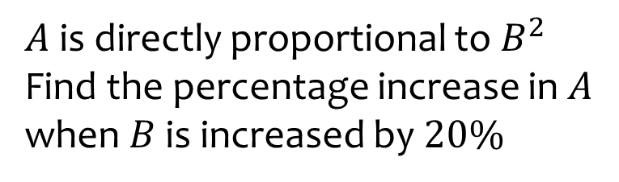

Worked example
Your turn
$A$ is directly proportional to $B^{2}$
Find the percentage increase in $A$ when $B$ is increased by $10\%$
$A$ is directly proportional to $B^{2}$
Find the percentage increase in $A$ when $B$ is increased by $20\%$
$$44\%$$

