Slide 1
Order of operations
CONTENTS

Slide 2
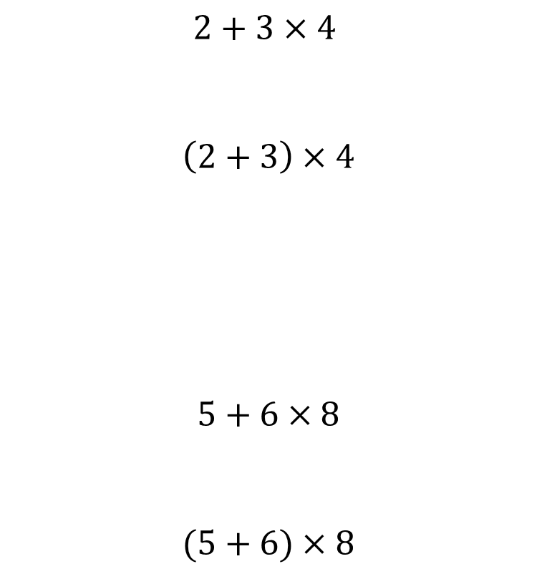
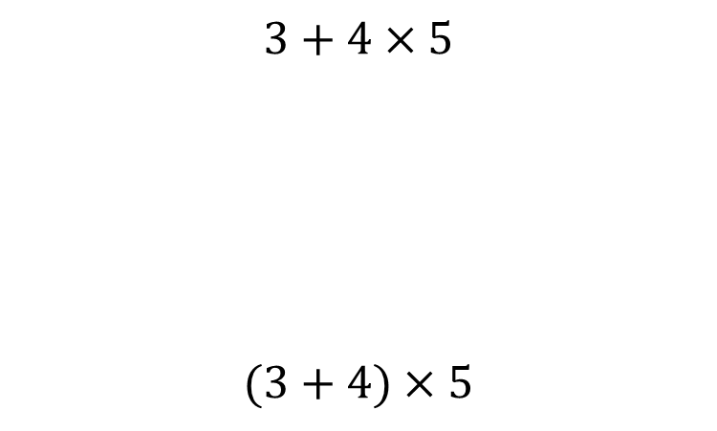
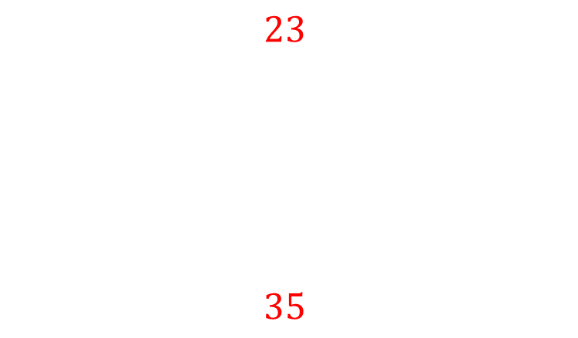
Worked example
Your turn
$$2+3×4$$
$$\left(2+3\right)×4$$
$$5+6×8$$
$$(5+6)×8$$
$$3+4×5$$
$$(3+4)×5$$
$$23$$
$$35$$

Slide 3
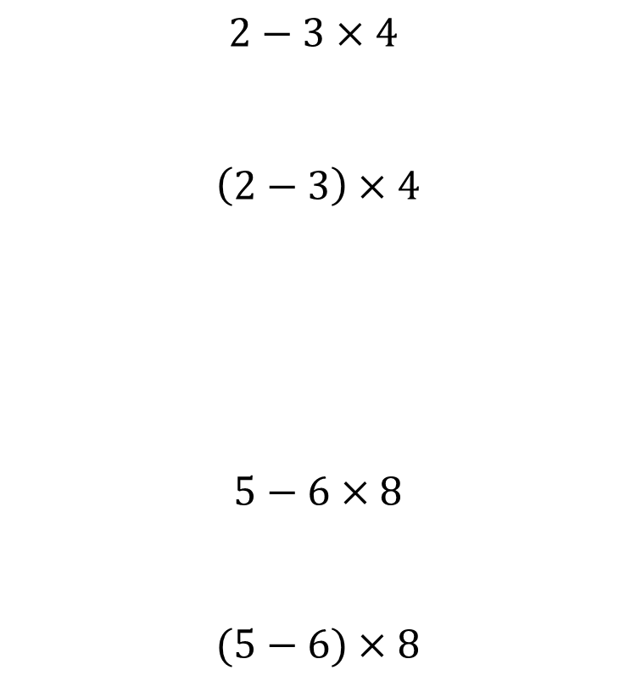
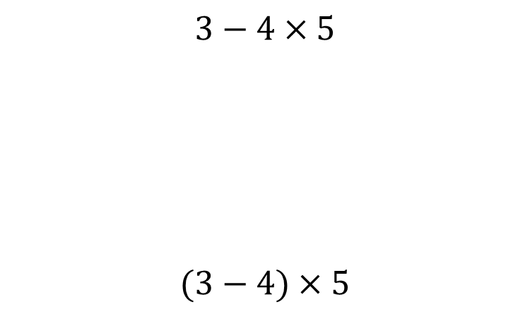
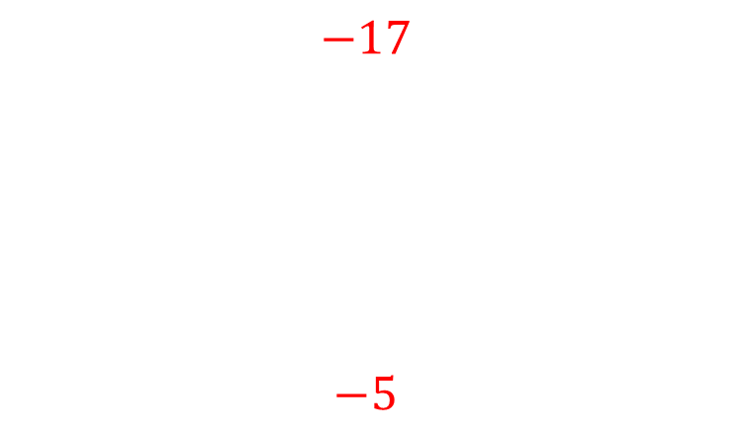
Worked example
Your turn
$$2−3×4$$
$$\left(2−3\right)×4$$
$$5−6×8$$
$$(5−6)×8$$
$$3−4×5$$
$$(3−4)×5$$
$$−17$$
$$−5$$

Slide 4
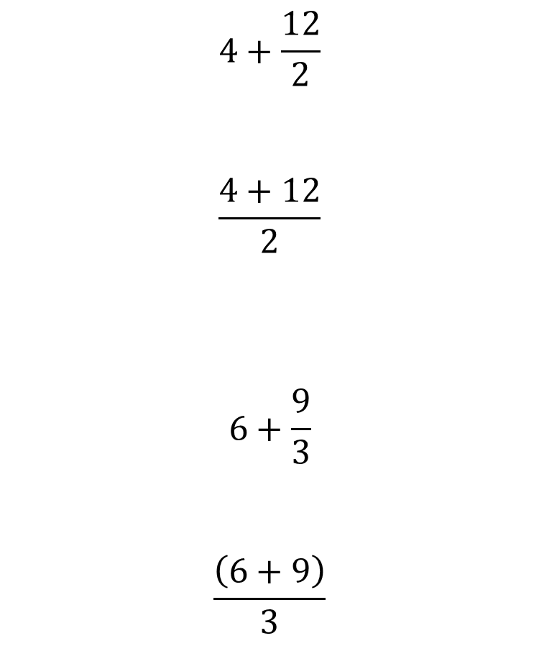
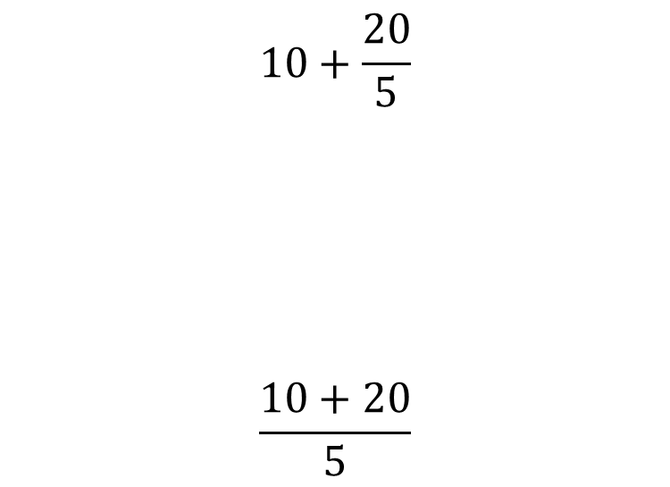
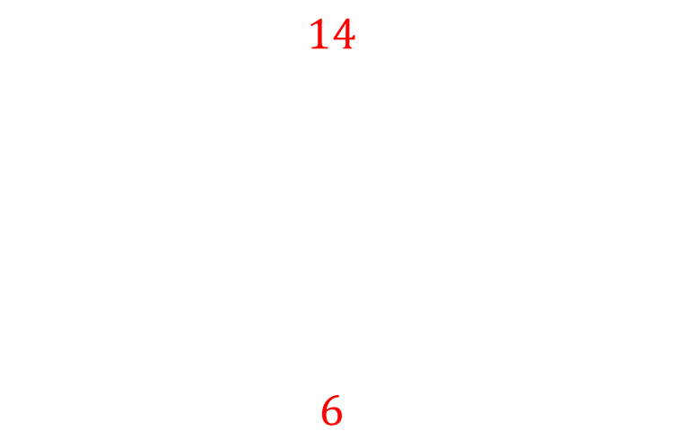
Worked example
Your turn
$$4+\frac{12}{2}$$
$$\frac{4+12}{2}$$
$$6+\frac{9}{3}$$
$$\frac{\left(6+9\right)}{3}$$
$$10+\frac{20}{5}$$
$$\frac{10+20}{5}$$
$$14$$
$$6$$

Slide 5
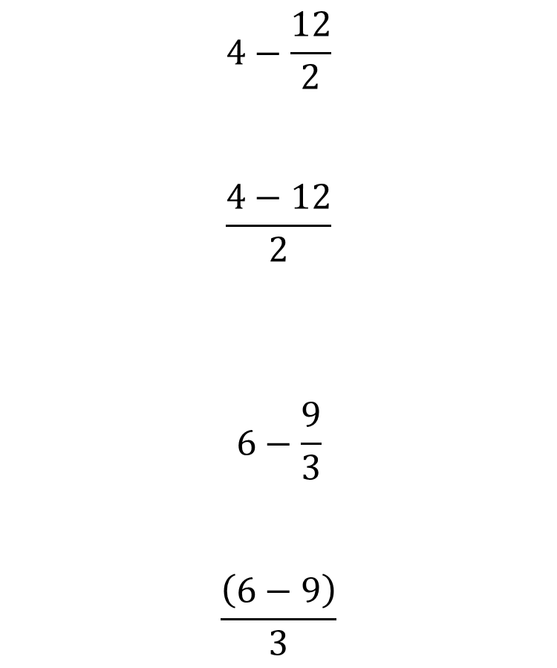
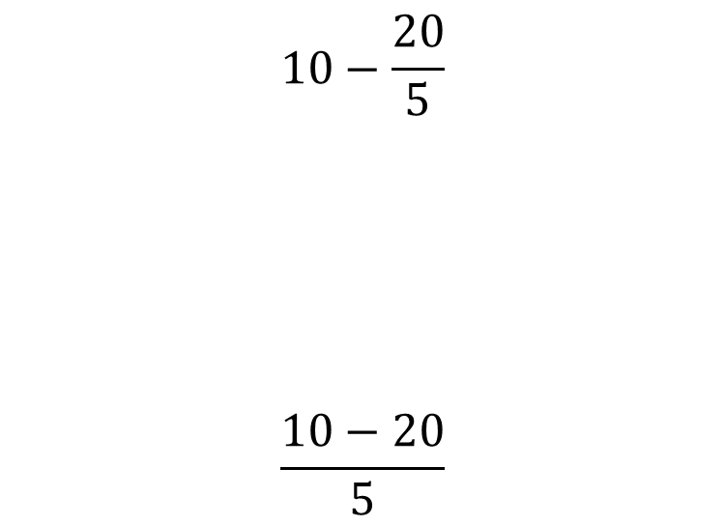
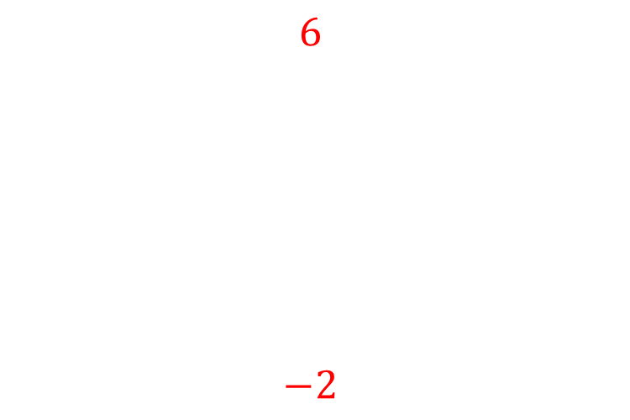
Worked example
Your turn
$$4−\frac{12}{2}$$
$$\frac{4−12}{2}$$
$$6−\frac{9}{3}$$
$$\frac{\left(6−9\right)}{3}$$
$$10−\frac{20}{5}$$
$$\frac{10−20}{5}$$
$$6$$
$$−2$$

Slide 6
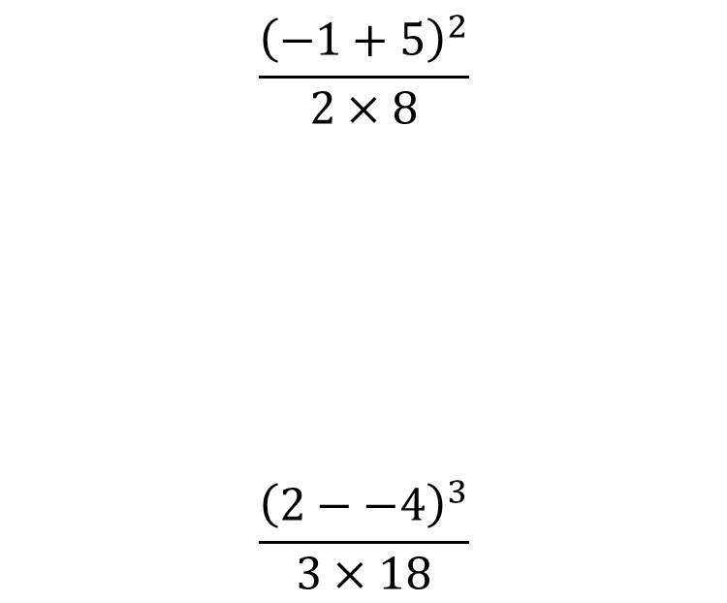


Worked example
Your turn
$$\frac{{\left(−1+5\right)}^{2}}{2×8}$$
$$\frac{{\left(2−−4\right)}^{3}}{3×18}$$
$$\frac{{\left(−2+8\right)}^{2}}{9×4}$$
$$1$$

Slide 7
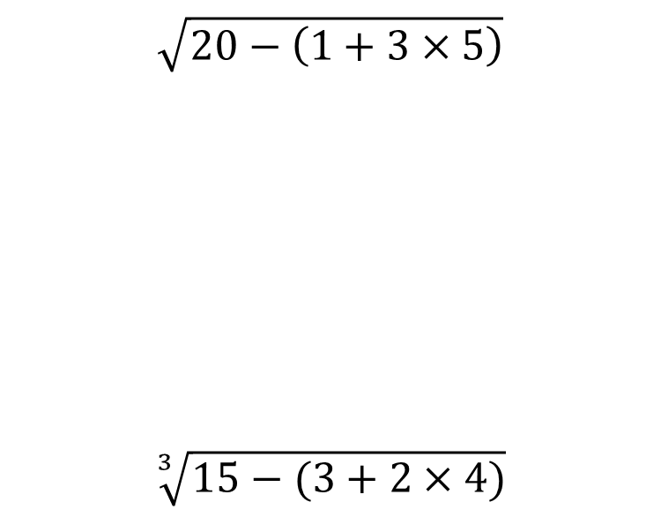


Worked example
Your turn
$$\sqrt{20−\left(1+3×5\right)}$$
$$\sqrt[3]{15−(3+2×4)}$$
$$\sqrt{30−(2+3×4)}$$
$$4$$

