Slide 1
Negative numbers
CONTENTS

Slide 2



Worked example
Your turn
Write in ascending order:
$$−2, −4, −3, 5, 0$$
Write in ascending order:
$$−7,−9, −8, 6, 0$$
$$−9, −8, −7, 0, 6$$

Slide 3
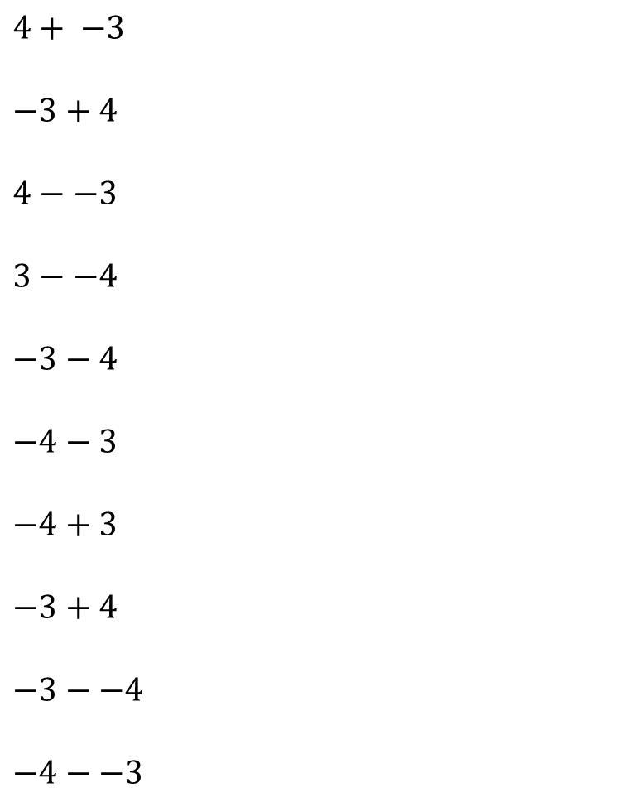
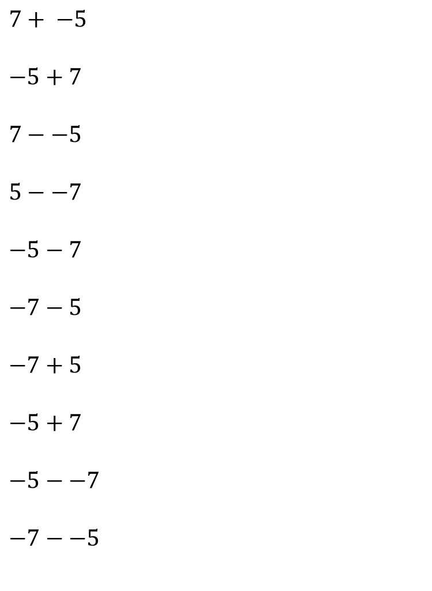
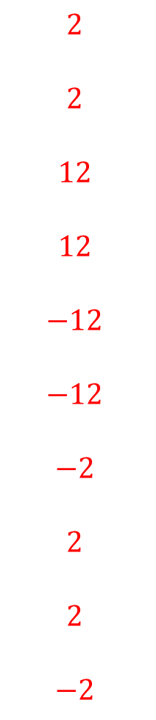
Worked example
Your turn
$$4+ −3$$
$$−3+4$$
$$4−−3$$
$$3−−4$$
$$−3−4$$
$$−4−3$$
$$−4+3$$
$$−3+4$$
$$−3−−4$$
$$−4−−3$$
$$7+ −5$$
$$−5+7$$
$$7−−5$$
$$5−−7$$
$$−5−7$$
$$−7−5$$
$$−7+5$$
$$−5+7$$
$$−5−−7$$
$$−7−−5$$
$$2$$
$$2$$
$$12$$
$$12$$
$$−12$$
$$−12$$
$$−2$$
$$2$$
$$2$$
$$−2$$

Slide 4
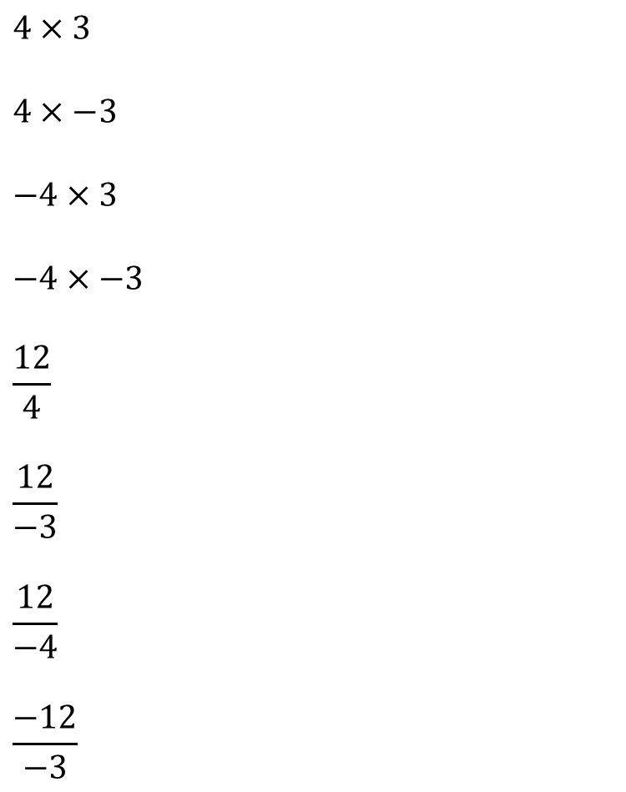
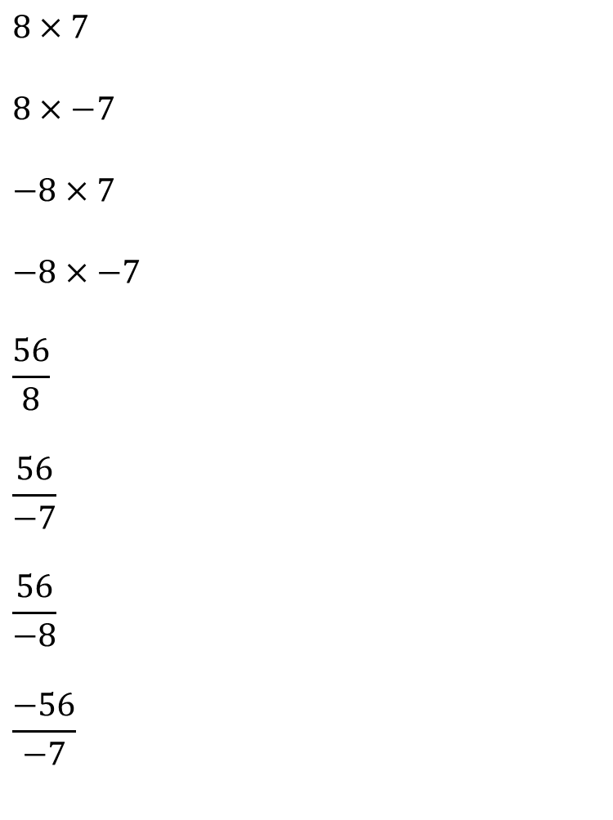
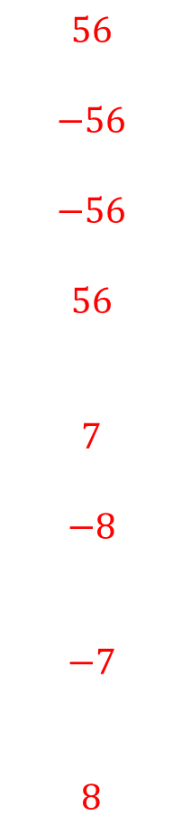
Worked example
Your turn
$$4×3$$
$$4×−3$$
$$−4×3$$
$$−4×−3$$
$$\frac{12}{4}$$
$$\frac{12}{−3}$$
$$\frac{12}{−4}$$
$$\frac{−12}{−3}$$
$$8×7$$
$$8×−7$$
$$−8×7$$
$$−8×−7$$
$$\frac{56}{8}$$
$$\frac{56}{−7}$$
$$\frac{56}{−8}$$
$$\frac{−56}{−7}$$
$$56$$
$$−56$$
$$−56$$
$$56$$
$$7$$
$$−8$$
$$−7$$
$$8$$

Slide 5
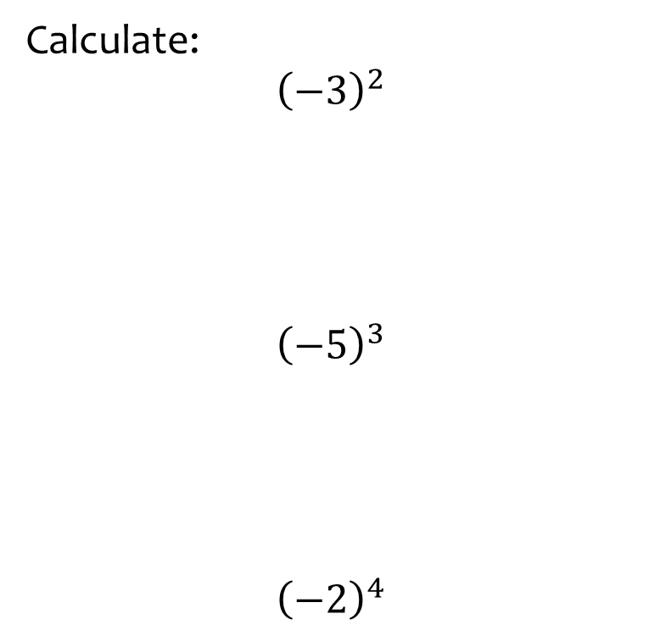
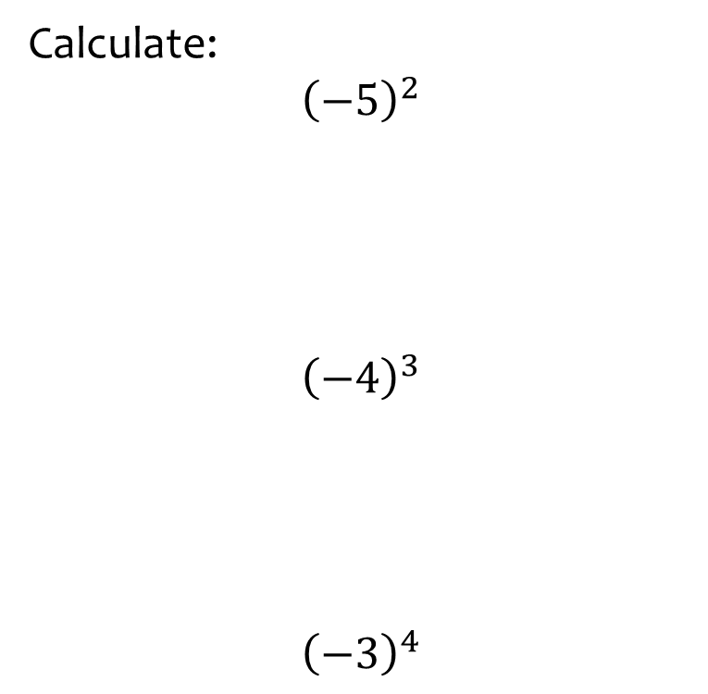
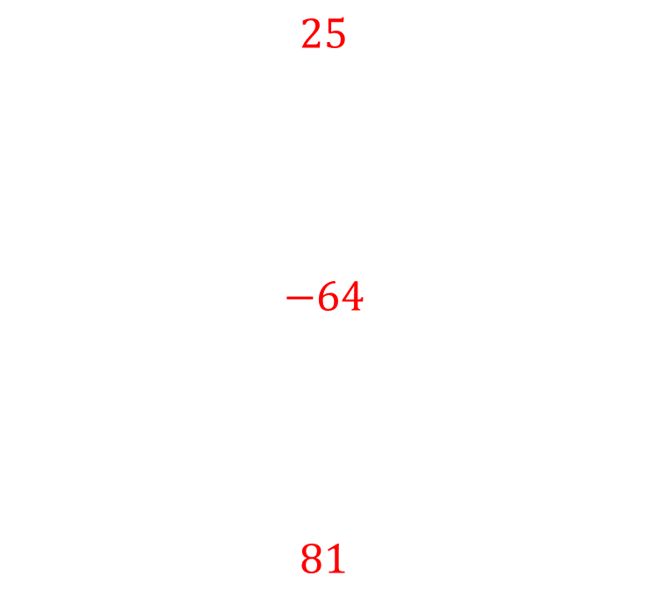
Worked example
Your turn
Calculate:
$${\left(−3\right)}^{2}$$
$${\left(−5\right)}^{3}$$
$${\left(−2\right)}^{4}$$
Calculate:
$${\left(−5\right)}^{2}$$
$${\left(−4\right)}^{3}$$
$${\left(−3\right)}^{4}$$
$$25$$
$$−64$$
$$81$$

Slide 6
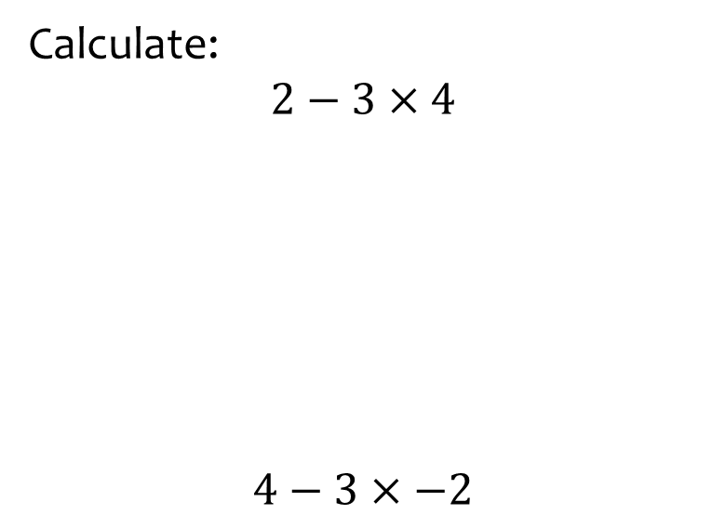
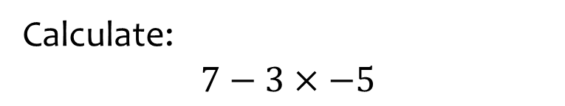

Worked example
Your turn
Calculate:
$$2−3×4$$
$$4−3×−2$$
Calculate:
$$7−3×−5$$
$$22$$

Slide 7
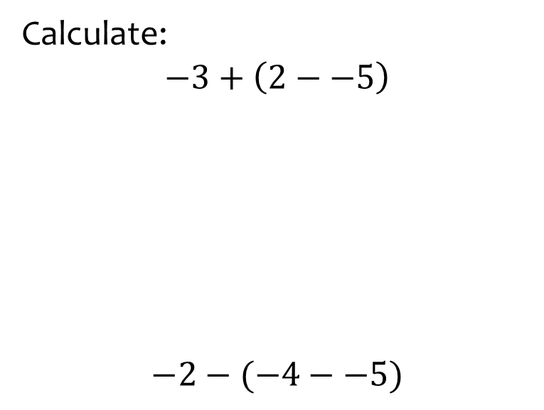
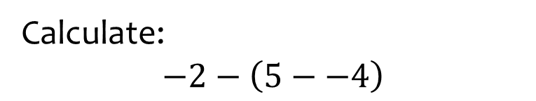

Worked example
Your turn
Calculate:
$$−3+\left(2−−5\right)$$
$$−2−(−4−−5)$$
Calculate:
$$−2−\left(5−−4\right)$$
$$−11$$

Slide 8
Worked example
Your turn
Calculate:
$$−3+\left(2−−5\right)$$
$$−2−(−4−−5)$$
Calculate:
$$−2−\left(5−−4\right)$$
$$−11$$

