Slide 1
Listing strategies
CONTENTS

Slide 2
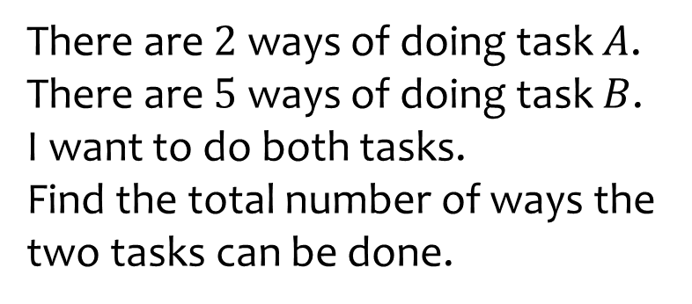
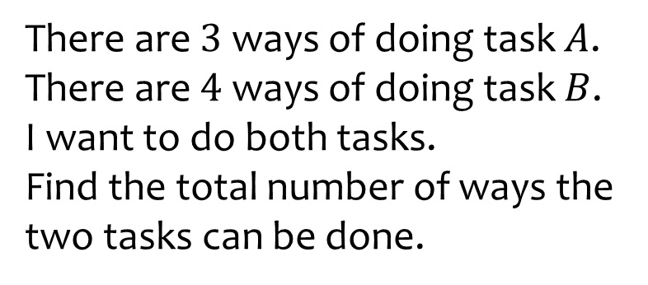

Worked example
Your turn
There are $2$ ways of doing task $A$.
There are $5$ ways of doing task $B$.
I want to do both tasks.
Find the total number of ways the two tasks can be done.
There are $3$ ways of doing task $A$.
There are $4$ ways of doing task $B$.
I want to do both tasks.
Find the total number of ways the two tasks can be done.
$$12$$

Slide 3



Worked example
Your turn
List all the ways of arranging the letters in the word:
$$CAT$$
List all the ways of arranging the letters in the word:
$$DOG$$
$$DOG$$
$$DGO$$
$$GDO$$
$$GOD$$
$$ODG$$
$$OGD$$

Slide 4






Worked example
Your turn
List all the ways of arranging the letters in the word:
$$BEAR$$
List all the ways of arranging the letters in the word:
$$FISH$$
$$FISH$$
$$FIHS$$
$$FSHI$$
$$FSIH$$
$$FHIS$$
$$FHSI$$
$$IFSH$$
$$IFHS$$
$$IHFS$$
$$IHSF$$
$$ISHF$$
$$ISFH$$
$$SFIH$$
$$SFHI$$
$$SHFI$$
$$SHIF$$
$$SIFH$$
$$SIHF$$
$$HFIS$$
$$HFSI$$
$$HIFS$$
$$HISF$$
$$HSFI$$
$$HSIF$$

Slide 5
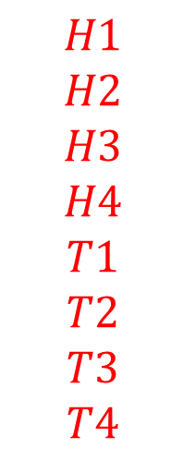
Worked example
Your turn
I flip a coin and then roll a six-sided die.
List the possible outcomes.
I flip a coin and then roll a 4-sided die.
List the possible outcomes.
$$H1$$
$$H2$$
$$H3$$
$$H4$$
$$T1$$
$$T2$$
$$T3$$
$$T4$$

Slide 6

Worked example
Your turn
I flip a coin and then roll a six-sided die.
How many possible combinations are there?
I flip a coin and then roll a 4-sided die.
How many possible combinations are there?
$$8$$

Slide 7
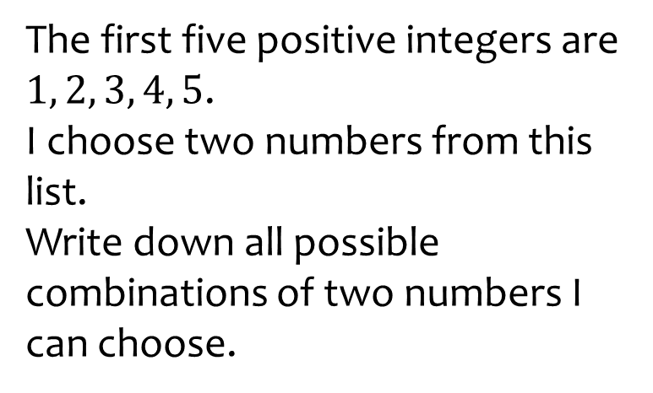
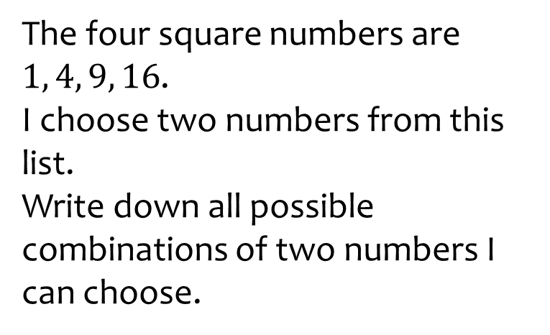
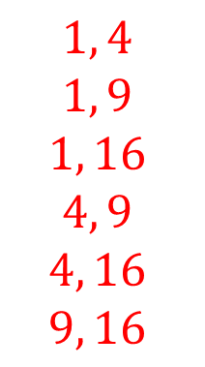
Worked example
Your turn
The first five positive integers are $1, 2, 3, 4, 5$.
I choose two numbers from this list.
Write down all possible combinations of two numbers I can choose.
The four square numbers are $1, 4, 9, 16$.
I choose two numbers from this list.
Write down all possible combinations of two numbers I can choose.
$$1, 4$$
$$1, 9$$
$$1, 16$$
$$4, 9$$
$$4, 16$$
$$9, 16$$

Slide 8
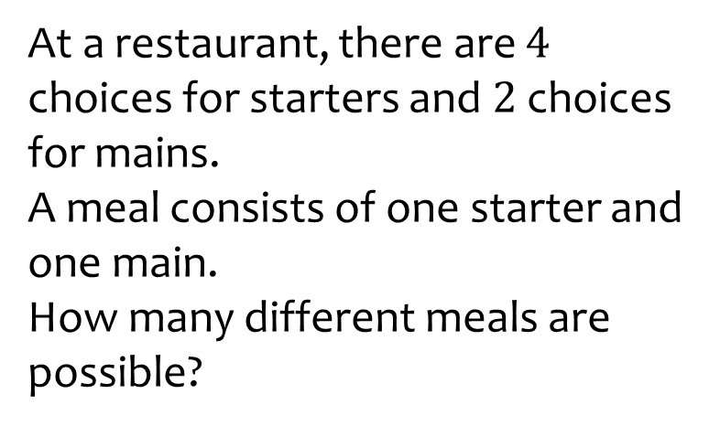
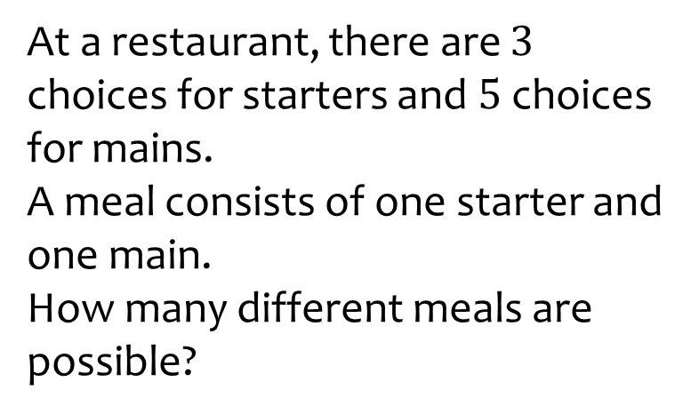

Worked example
Your turn
At a restaurant, there are $4$ choices for starters and $2$ choices for mains.
A meal consists of one starter and one main.
How many different meals are possible?
At a restaurant, there are $3$ choices for starters and $5$ choices for mains.
A meal consists of one starter and one main.
How many different meals are possible?
$$15$$

Slide 9
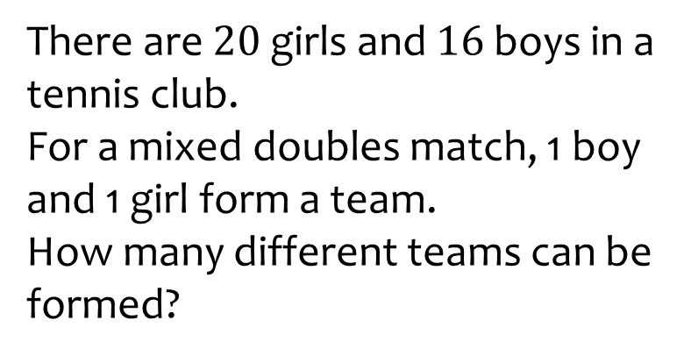
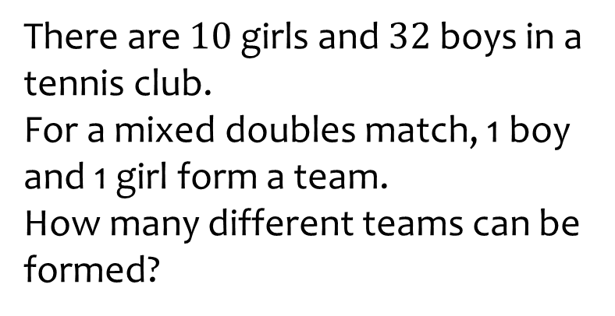

Worked example
Your turn
There are $20$ girls and $16$ boys in a tennis club.
For a mixed doubles match, 1 boy and 1 girl form a team.
How many different teams can be formed?
There are $10$ girls and $32$ boys in a tennis club.
For a mixed doubles match, 1 boy and 1 girl form a team.
How many different teams can be formed?
$$320$$

Slide 10
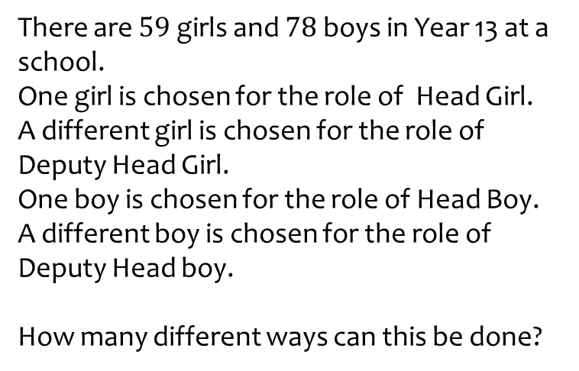
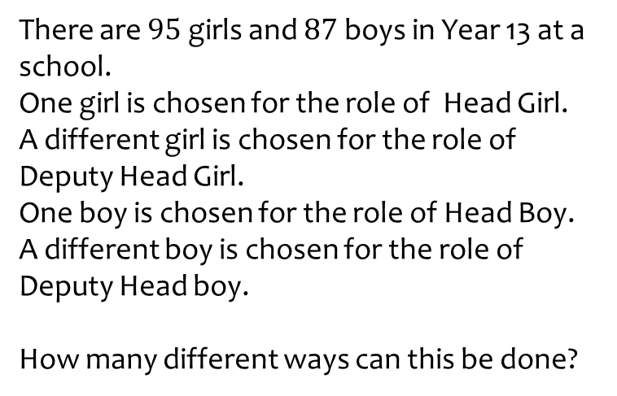

Worked example
Your turn
There are $59$ girls and $78$ boys in Year 13 at a school.
One girl is chosen for the role of Head Girl.
A different girl is chosen for the role of Deputy Head Girl.
One boy is chosen for the role of Head Boy.
A different boy is chosen for the role of Deputy Head boy.
How many different ways can this be done?
There are $95$ girls and $87$ boys in Year 13 at a school.
One girl is chosen for the role of Head Girl.
A different girl is chosen for the role of Deputy Head Girl.
One boy is chosen for the role of Head Boy.
A different boy is chosen for the role of Deputy Head boy.
How many different ways can this be done?
$$66814260$$

Slide 11
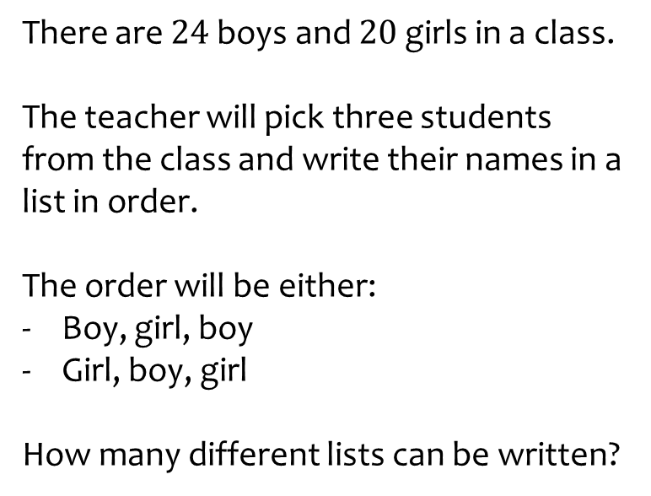
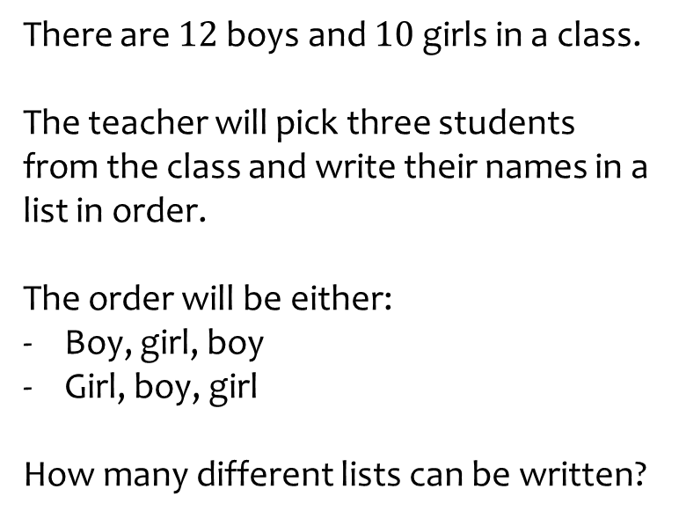

Worked example
Your turn
There are $24$ boys and $20$ girls in a class.
The teacher will pick three students from the class and write their names in a list in order.
The order will be either:
Boy, girl, boy
Girl, boy, girl
How many different lists can be written?
There are $12$ boys and $10$ girls in a class.
The teacher will pick three students from the class and write their names in a list in order.
The order will be either:
Boy, girl, boy
Girl, boy, girl
How many different lists can be written?
$$2400$$

Slide 12
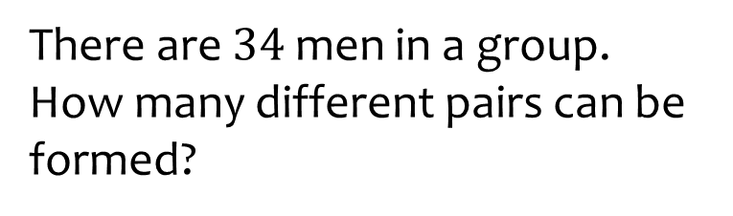
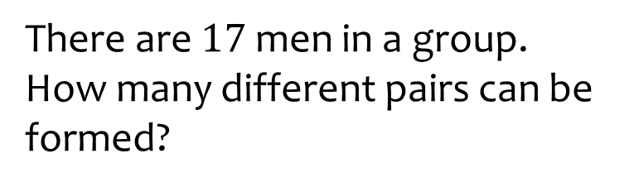

Worked example
Your turn
There are $34$ men in a group.
How many different pairs can be formed?
There are $17$ men in a group.
How many different pairs can be formed?
$$136$$

Slide 13
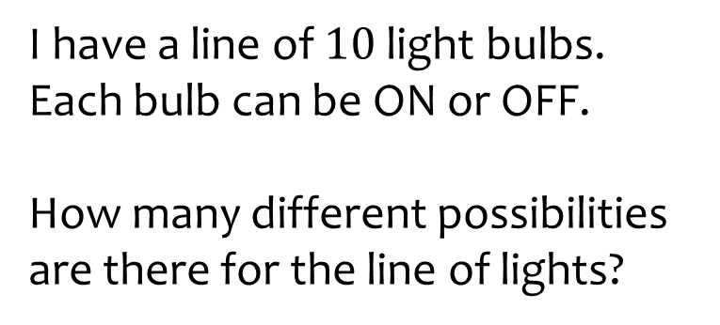
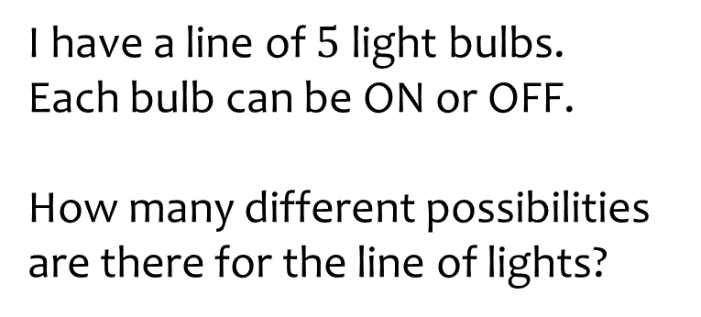

Worked example
Your turn
I have a line of $10$ light bulbs.
Each bulb can be ON or OFF.
How many different possibilities are there for the line of lights?
I have a line of $5$ light bulbs.
Each bulb can be ON or OFF.
How many different possibilities are there for the line of lights?
$$32$$

