Slide 1
Fractions
CONTENTS

Slide 2



Worked example
Your turn
Write in ascending order:
$$\frac{2}{5} , \frac{5}{12} ,\frac{1}{4} ,\frac{7}{15}$$
Write in ascending order:
$$\frac{1}{2} ,\frac{5}{3} ,\frac{13}{15},\frac{3}{10}$$
$$\frac{3}{10},\frac{1}{2},\frac{13}{15},\frac{5}{3}$$

Slide 3
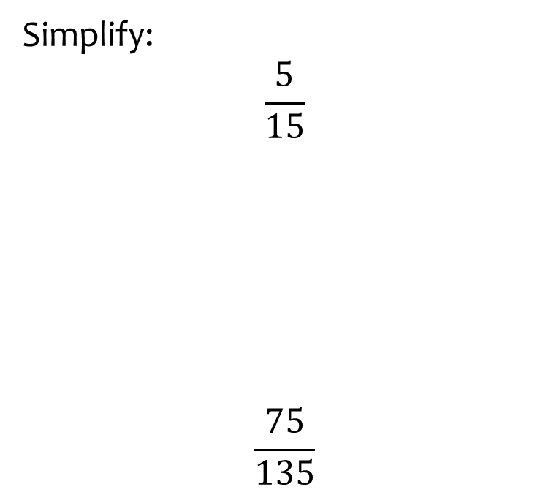


Worked example
Your turn
Simplify:
$$\frac{5}{15}$$
$$\frac{75}{135}$$
Simplify
$$\frac{81}{108}$$
$$\frac{3}{4}$$

Slide 4
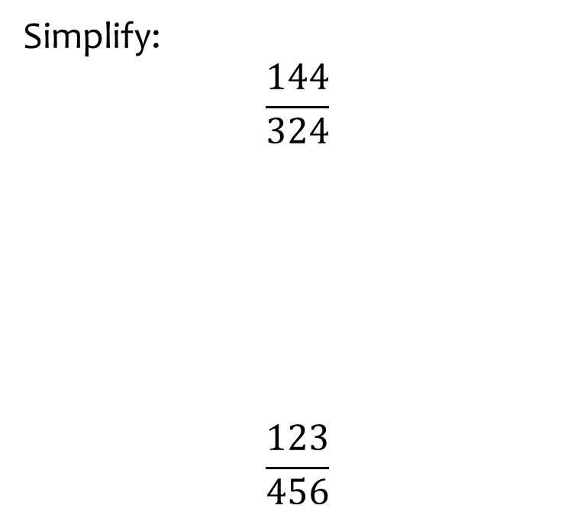


Worked example
Your turn
Simplify:
$$\frac{144}{324}$$
$$\frac{123}{456}$$
Simplify
$$\frac{184}{276}$$
$$\frac{2}{3}$$

Slide 5
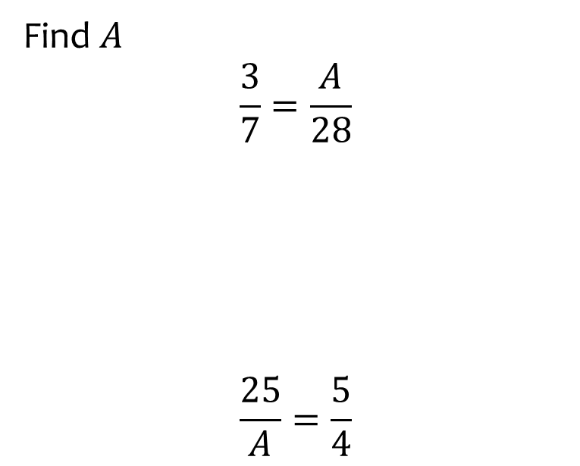


Worked example
Your turn
Find $A$
$$\frac{3}{7}=\frac{A}{28}$$
$$\frac{25}{A}=\frac{5}{4}$$
Simplify
$$\frac{2}{3}=\frac{24}{A}$$
$$36$$

Slide 6
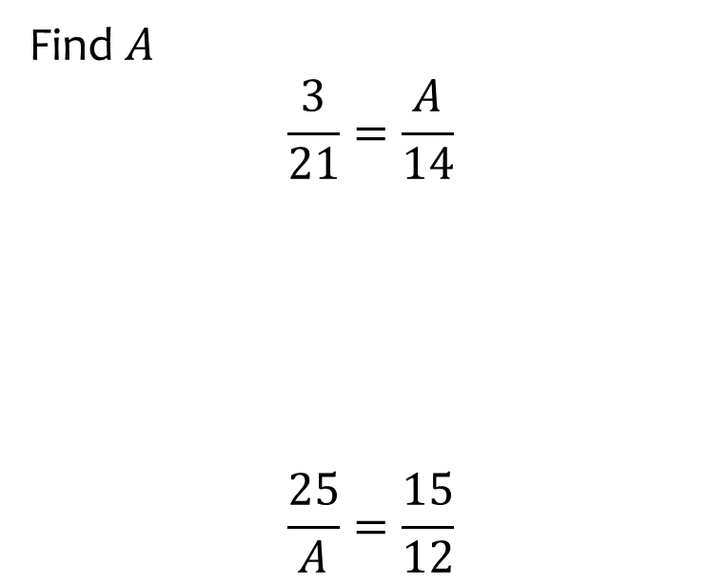


Worked example
Your turn
Find $A$
$$\frac{3}{21}=\frac{A}{14}$$
$$\frac{25}{A}=\frac{15}{12}$$
Simplify
$$\frac{8}{12}=\frac{12}{A}$$
$$18$$

Slide 7
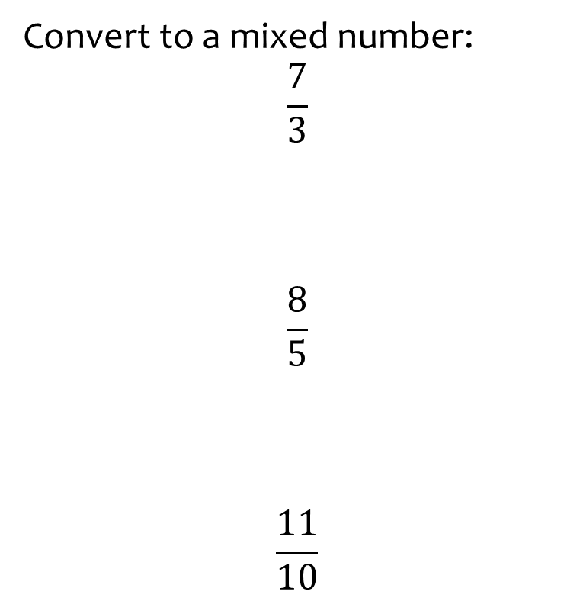
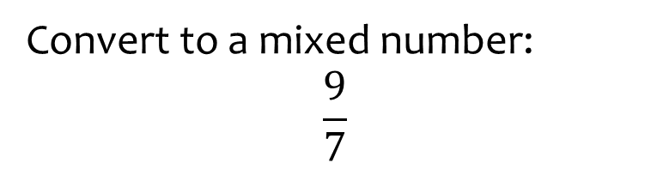

Worked example
Your turn
Convert to a mixed number:
$$\frac{7}{3}$$
$$\frac{8}{5}$$
$$\frac{11}{10}$$
Convert to a mixed number:
$$\frac{9}{7}$$
$$1\frac{2}{7}$$

Slide 8
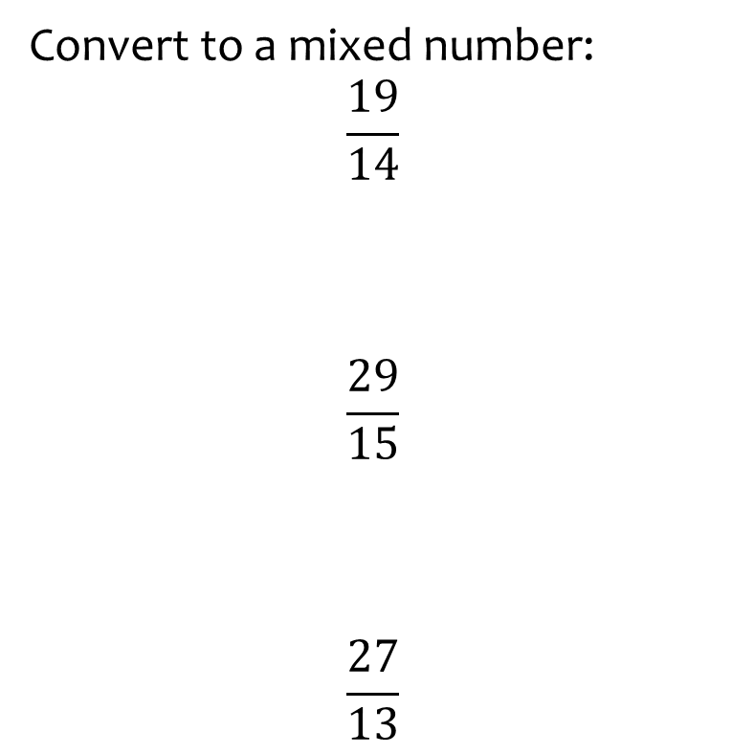
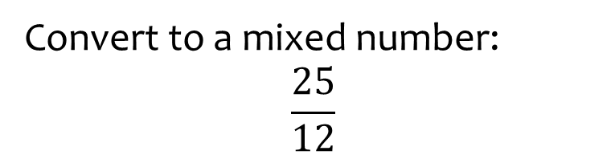

Worked example
Your turn
Convert to a mixed number:
$$\frac{19}{14}$$
$$\frac{29}{15}$$
$$\frac{27}{13}$$
Convert to a mixed number:
$$\frac{25}{12}$$
$$2\frac{1}{12}$$

Slide 9
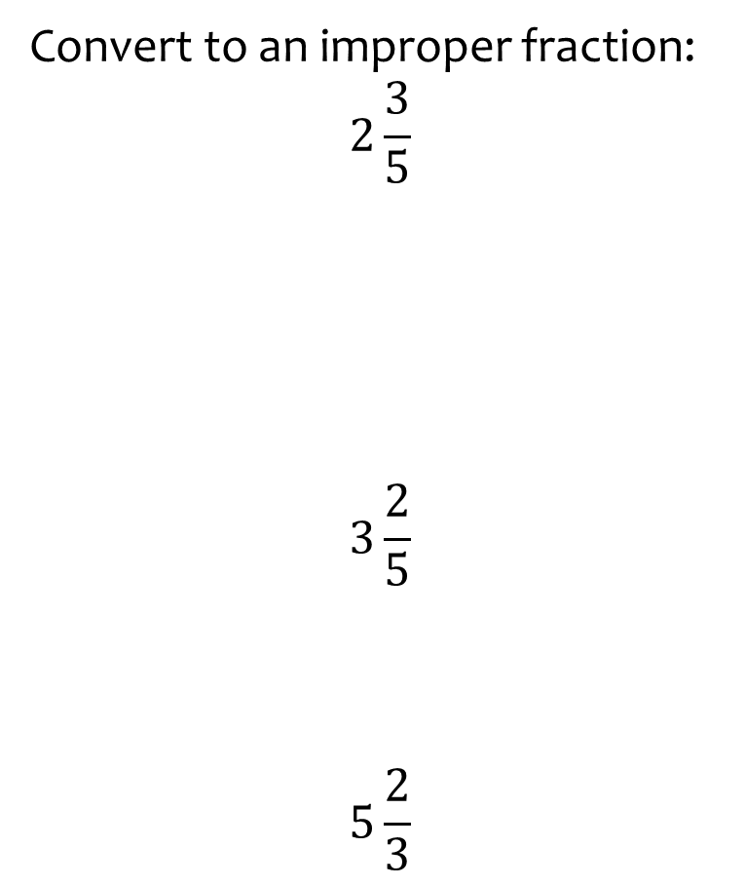
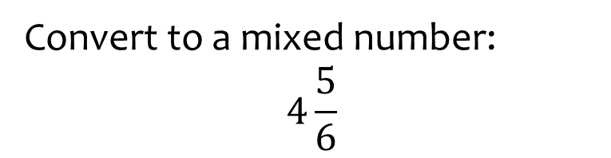

Worked example
Your turn
Convert to an improper fraction:
$$2\frac{3}{5}$$
$$3\frac{2}{5}$$
$$5\frac{2}{3}$$
Convert to a mixed number:
$$4\frac{5}{6}$$
$$\frac{29}{6}$$

Slide 10
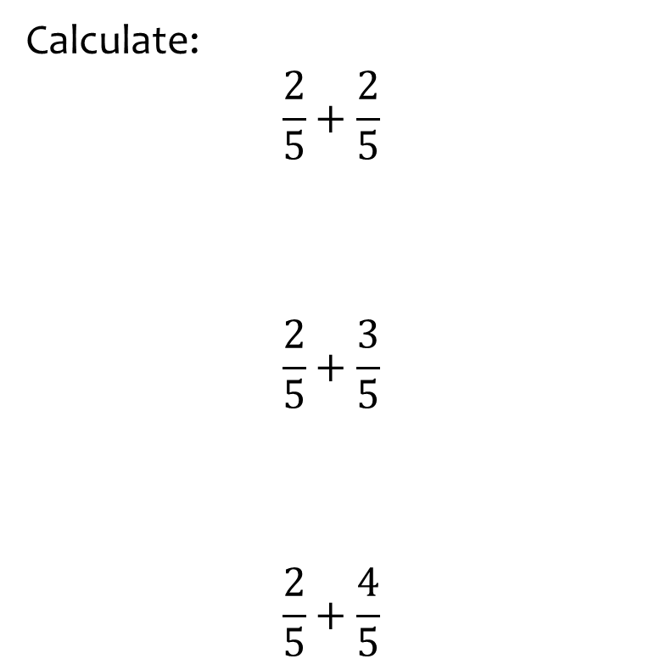
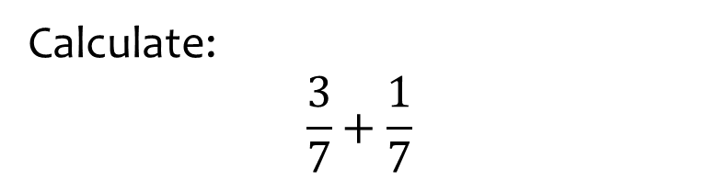

Worked example
Your turn
Calculate:
$$\frac{2}{5}+\frac{2}{5}$$
$$\frac{2}{5}+\frac{3}{5}$$
$$\frac{2}{5}+\frac{4}{5}$$
Calculate:
$$\frac{3}{7}+\frac{1}{7}$$
$$\frac{4}{7}$$

Slide 11
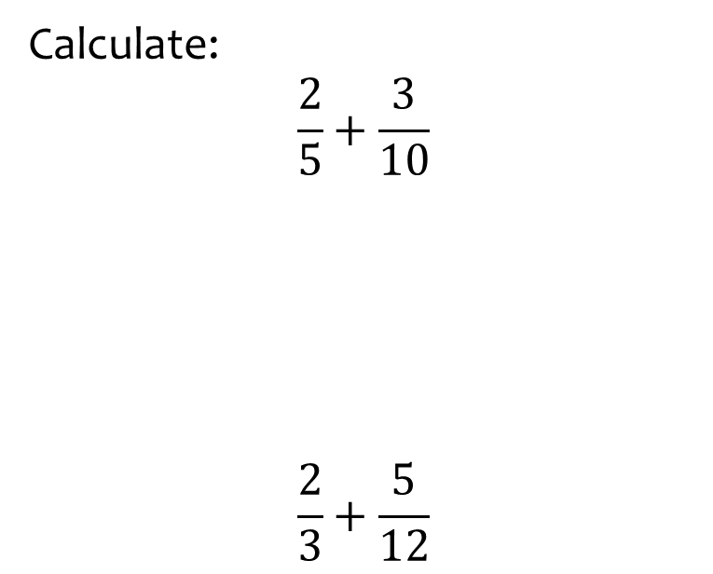
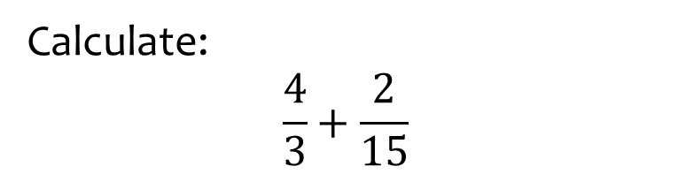

Worked example
Your turn
Calculate:
$$\frac{2}{5}+\frac{3}{10}$$
$$\frac{2}{3}+\frac{5}{12}$$
Calculate:
$$\frac{4}{3}+\frac{2}{15}$$
$$\frac{22}{15}$$

Slide 12
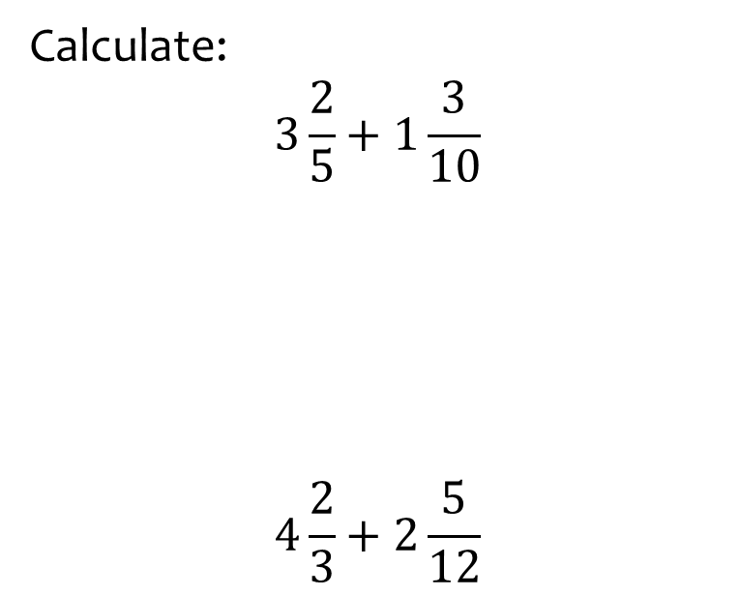
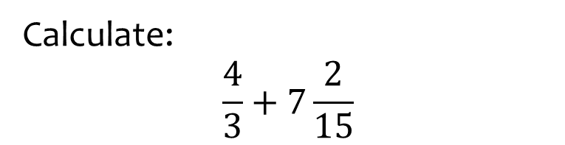

Worked example
Your turn
Calculate:
$$3\frac{2}{5}+1\frac{3}{10}$$
$$4\frac{2}{3}+2\frac{5}{12}$$
Calculate:
$$\frac{4}{3}+7\frac{2}{15}$$
$$\frac{127}{15}$$

Slide 13
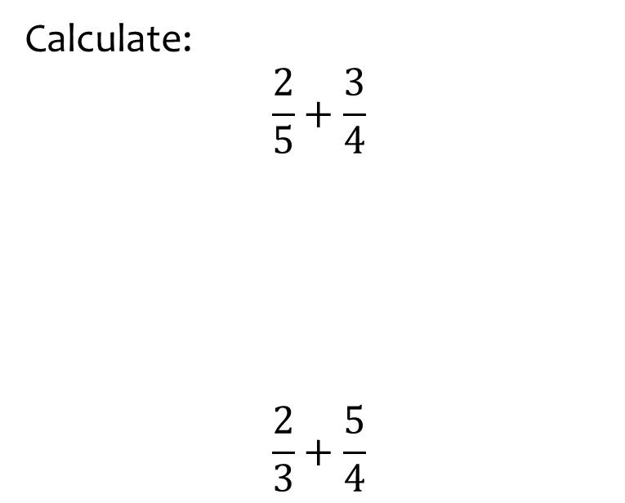
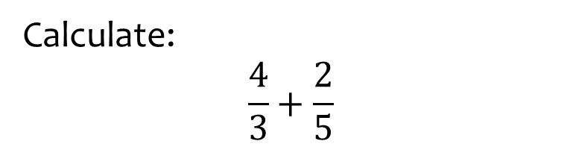

Worked example
Your turn
Calculate:
$$\frac{2}{5}+\frac{3}{4}$$
$$\frac{2}{3}+\frac{5}{4}$$
Calculate:
$$\frac{4}{3}+\frac{2}{5}$$
$$\frac{26}{15}$$

Slide 14
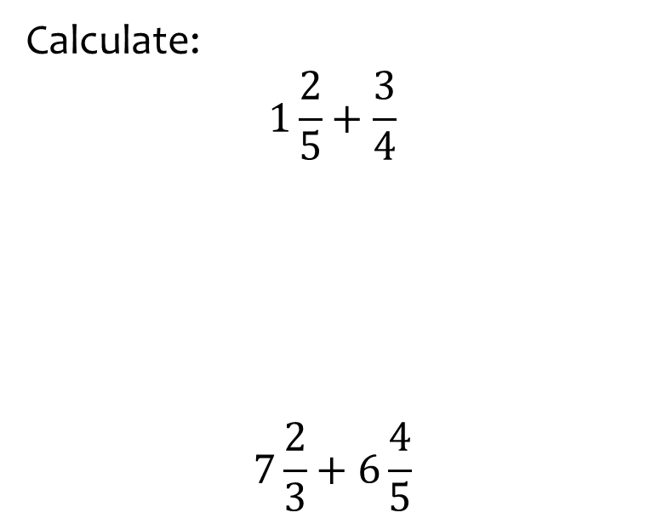
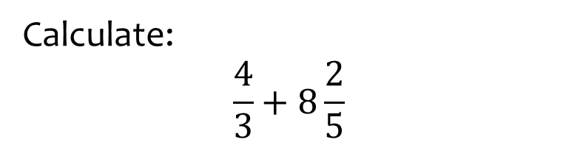

Worked example
Your turn
Calculate:
$$1\frac{2}{5}+\frac{3}{4}$$
$$7\frac{2}{3}+6\frac{4}{5}$$
Calculate:
$$\frac{4}{3}+8\frac{2}{5}$$
$$\frac{146}{15}$$

Slide 15
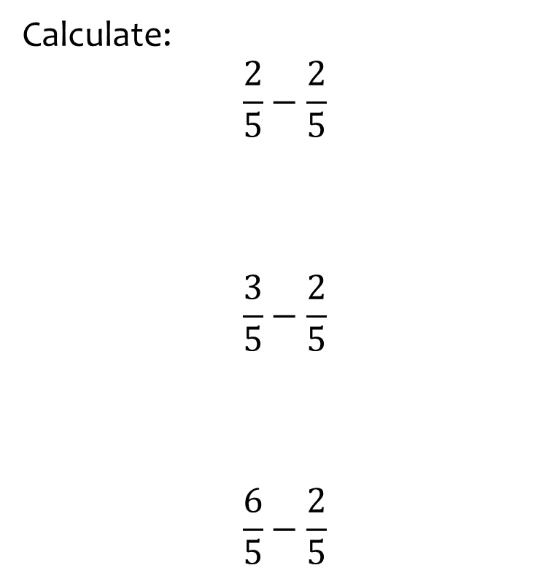
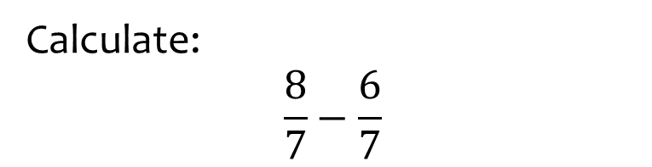

Worked example
Your turn
Calculate:
$$\frac{2}{5}−\frac{2}{5}$$
$$\frac{3}{5}−\frac{2}{5}$$
$$\frac{6}{5}−\frac{2}{5}$$
Calculate:
$$\frac{8}{7}−\frac{6}{7}$$
$$\frac{2}{7}$$

Slide 16
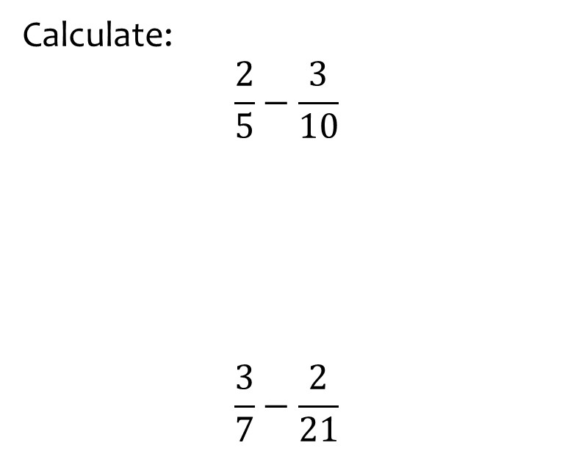
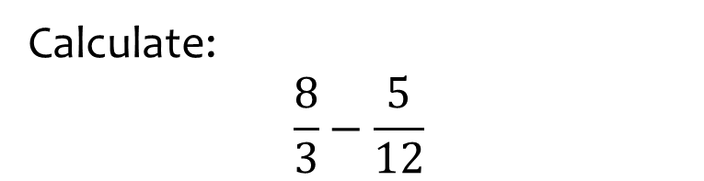

Worked example
Your turn
Calculate:
$$\frac{2}{5}−\frac{3}{10}$$
$$\frac{3}{7}−\frac{2}{21}$$
Calculate:
$$\frac{8}{3}−\frac{5}{12}$$
$$\frac{9}{4}$$

Slide 17
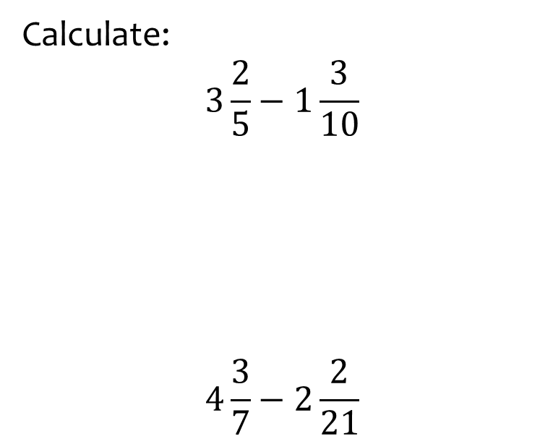
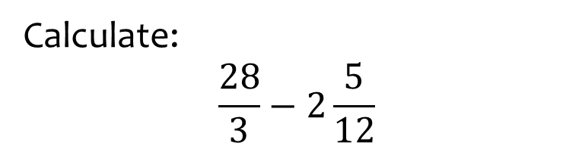

Worked example
Your turn
Calculate:
$$3\frac{2}{5}−1\frac{3}{10}$$
$$4\frac{3}{7}−2\frac{2}{21}$$
Calculate:
$$\frac{28}{3}−2\frac{5}{12}$$
$$\frac{83}{12}$$

Slide 18
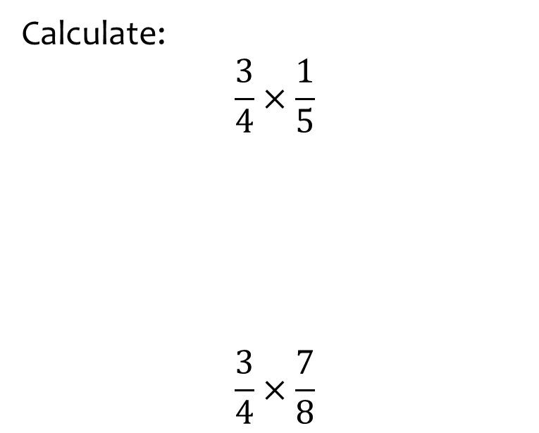
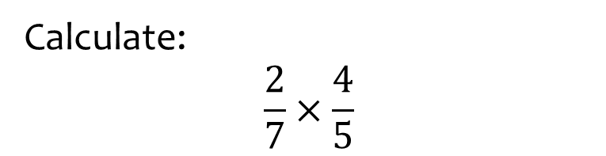

Worked example
Your turn
Calculate:
$$\frac{3}{4}×\frac{1}{5}$$
$$\frac{3}{4}×\frac{7}{8}$$
Calculate:
$$\frac{2}{7}×\frac{4}{5}$$
$$\frac{8}{35}$$

Slide 19
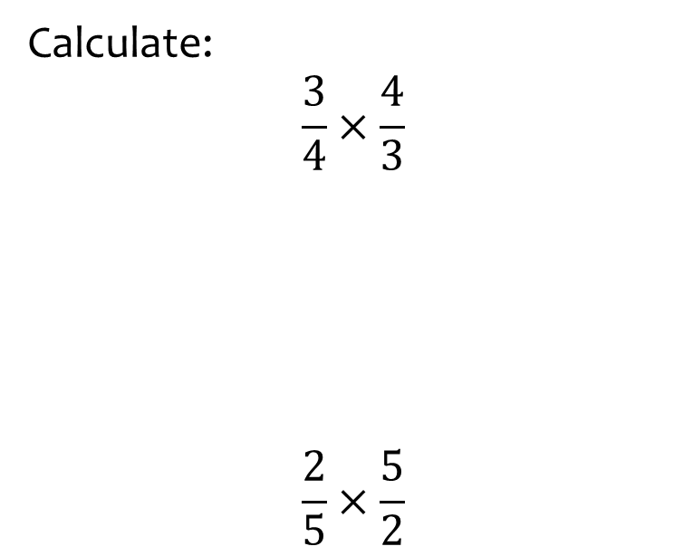
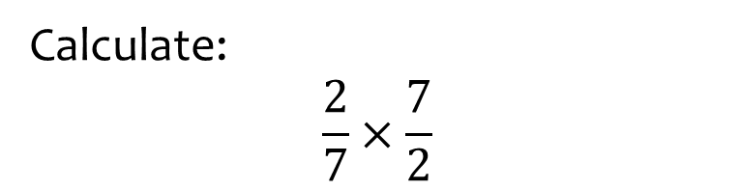

Worked example
Your turn
Calculate:
$$\frac{3}{4}×\frac{4}{3}$$
$$\frac{2}{5}×\frac{5}{2}$$
Calculate:
$$\frac{2}{7}×\frac{7}{2}$$
$$1$$

Slide 20
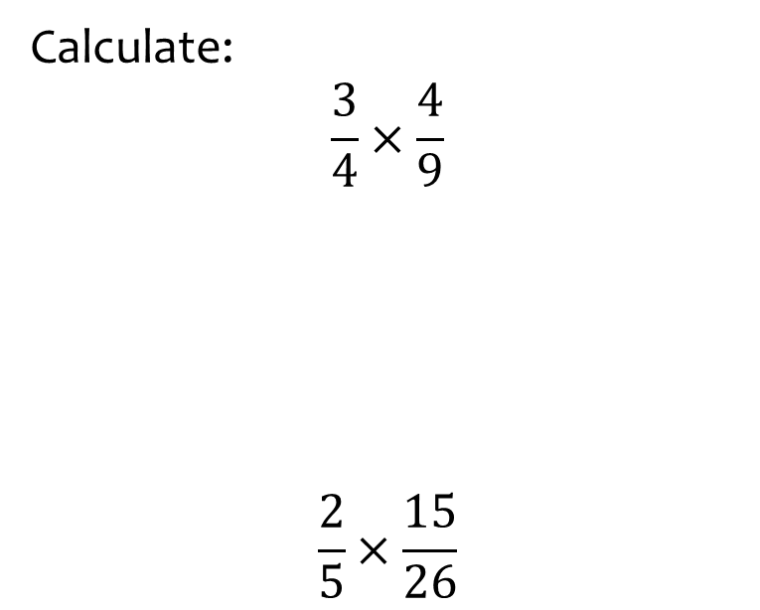
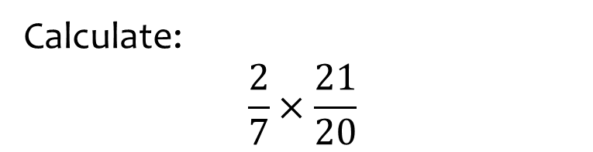

Worked example
Your turn
Calculate:
$$\frac{3}{4}×\frac{4}{9}$$
$$\frac{2}{5}×\frac{15}{26}$$
Calculate:
$$\frac{2}{7}×\frac{21}{20}$$
$$\frac{3}{10}$$

Slide 21
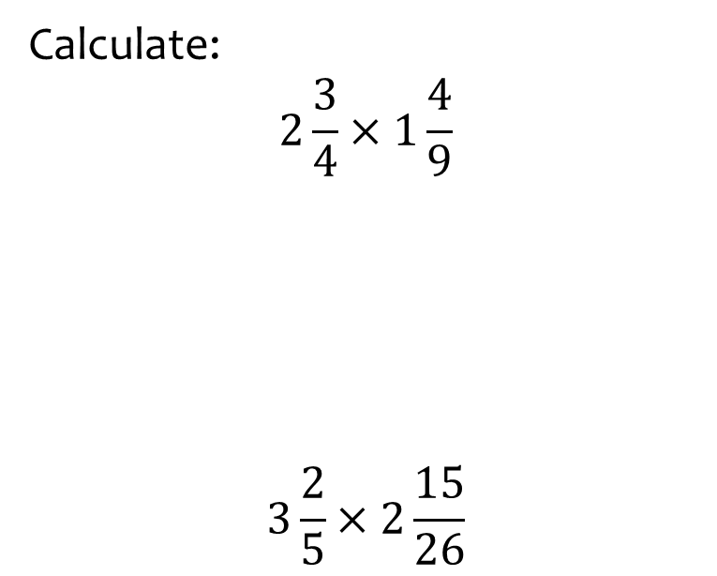
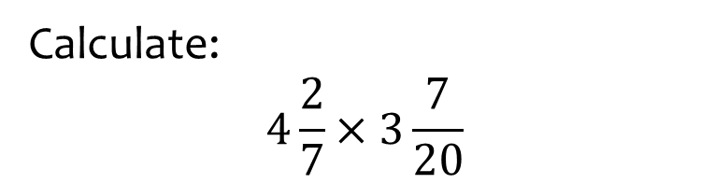

Worked example
Your turn
Calculate:
$$2\frac{3}{4}×1\frac{4}{9}$$
$$3\frac{2}{5}×2\frac{15}{26}$$
Calculate:
$$4\frac{2}{7}×3\frac{7}{20}$$
$$\frac{201}{14}$$

Slide 22
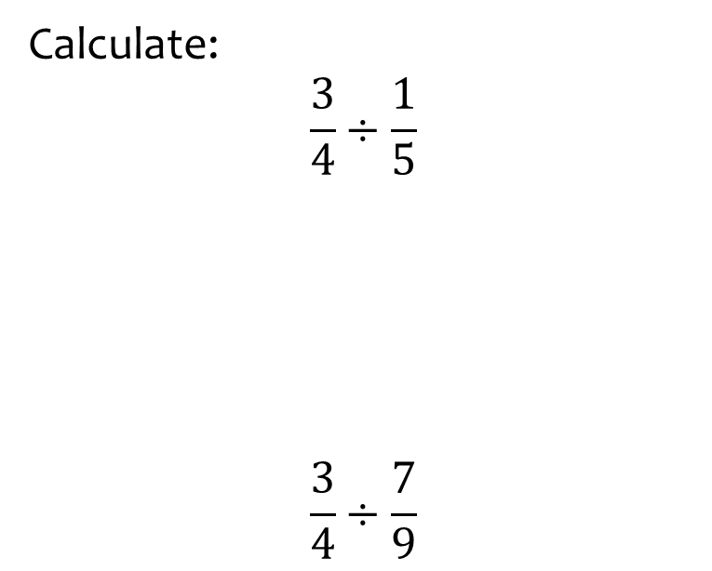
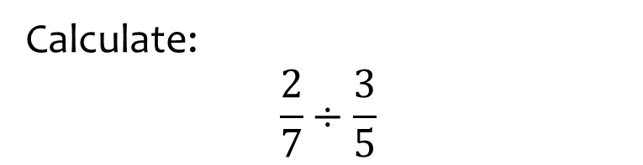

Worked example
Your turn
Calculate:
$$\frac{3}{4}÷\frac{1}{5}$$
$$\frac{3}{4}÷\frac{7}{9}$$
Calculate:
$$\frac{2}{7}÷\frac{3}{5}$$
$$\frac{10}{21}$$

Slide 23
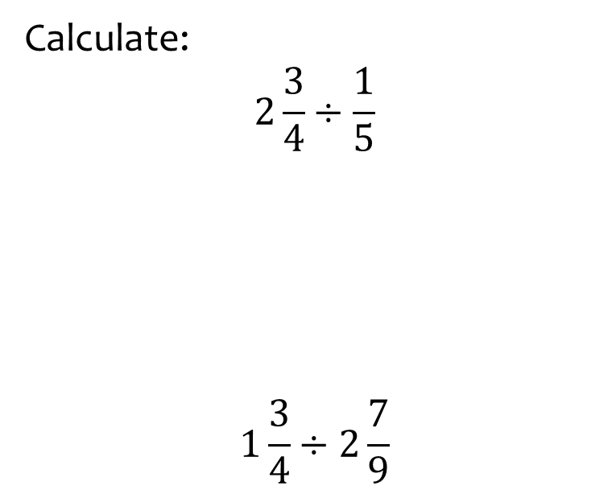
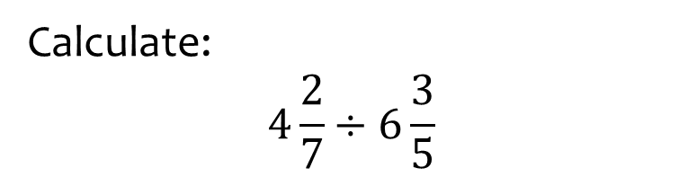

Worked example
Your turn
Calculate:
$$2\frac{3}{4}÷\frac{1}{5}$$
$$1\frac{3}{4}÷2\frac{7}{9}$$
Calculate:
$$4\frac{2}{7}÷6\frac{3}{5}$$
$$\frac{50}{77}$$

Slide 24
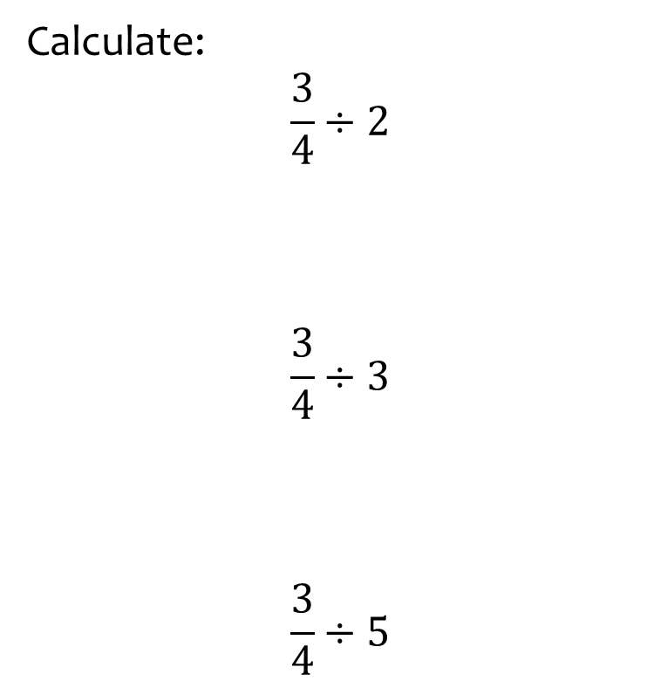
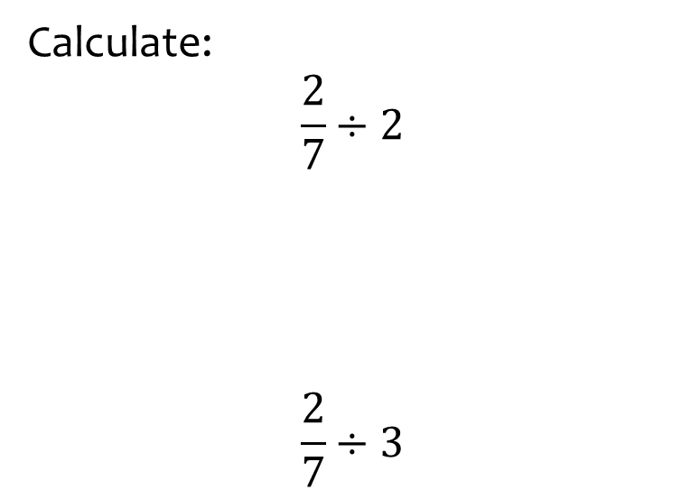
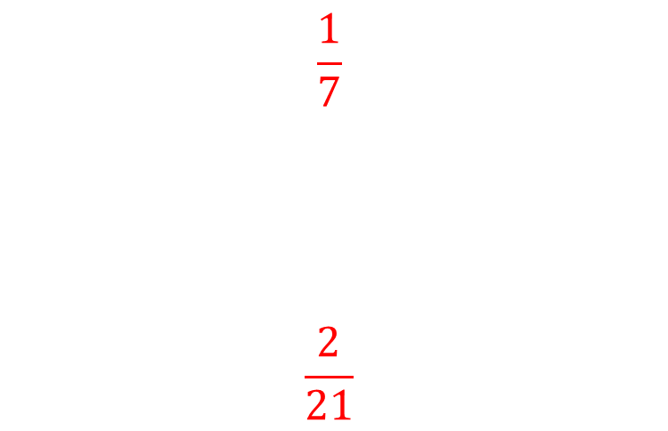
Worked example
Your turn
Calculate:
$$\frac{3}{4}÷2$$
$$\frac{3}{4}÷3$$
$$\frac{3}{4}÷5$$
Calculate:
$$\frac{2}{7}÷2$$
$$\frac{2}{7}÷3$$
$$\frac{1}{7}$$
$$\frac{2}{21}$$

Slide 25
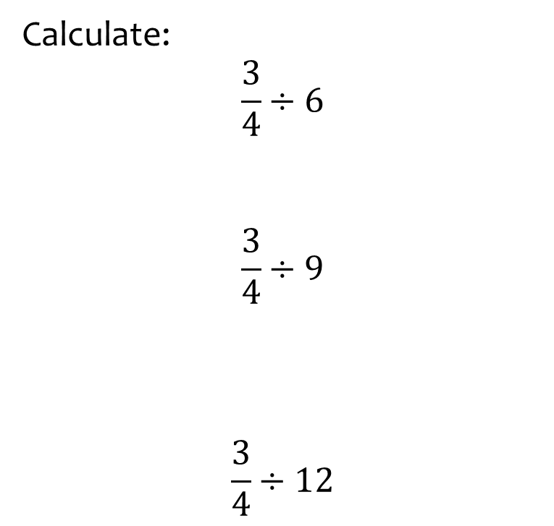
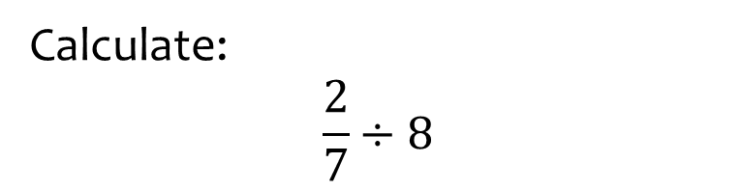

Worked example
Your turn
Calculate:
$$\frac{3}{4}÷6$$
$$\frac{3}{4}÷9$$
$$\frac{3}{4}÷12$$
Calculate:
$$\frac{2}{7}÷8$$
$$\frac{1}{28}$$

Slide 26
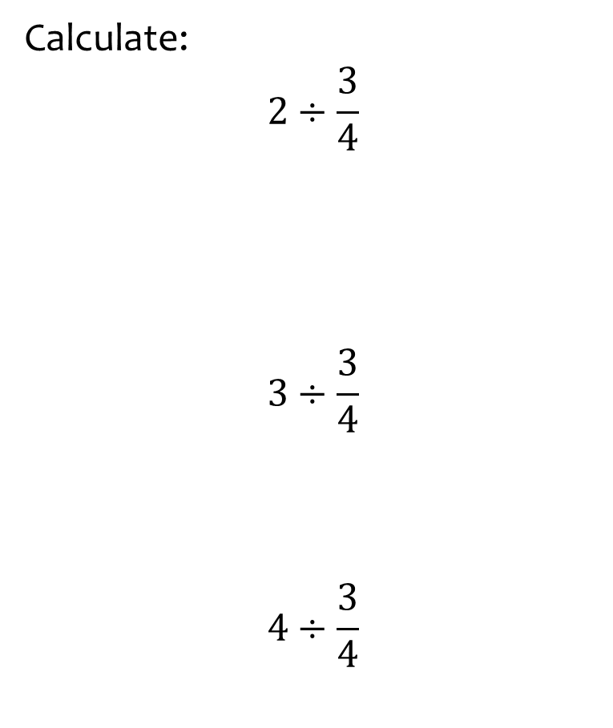
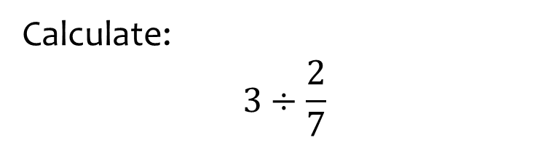

Worked example
Your turn
Calculate:
$$2÷\frac{3}{4}$$
$$3÷\frac{3}{4}$$
$$4÷\frac{3}{4}$$
Calculate:
$$3÷\frac{2}{7}$$
$$\frac{21}{2}$$

Slide 27
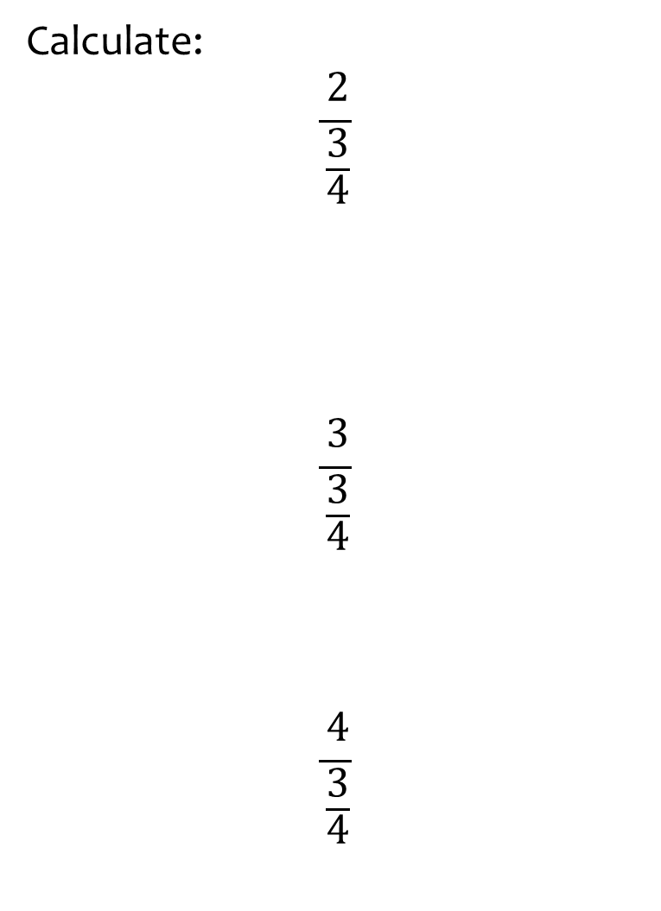
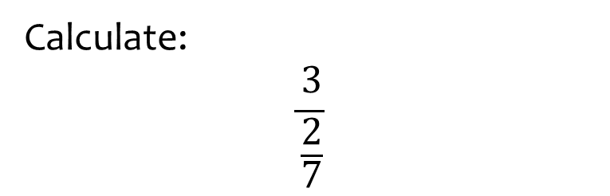

Worked example
Your turn
Calculate:
$$\frac{2}{\frac{3}{4}}$$
$$\frac{3}{\frac{3}{4}}$$
$$\frac{4}{\frac{3}{4}}$$
Calculate:
$$\frac{3}{\frac{2}{7}}$$
$$\frac{21}{2}$$

Slide 28
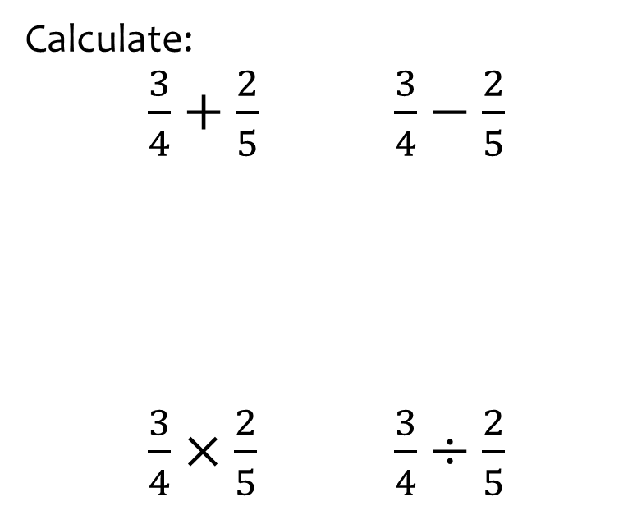
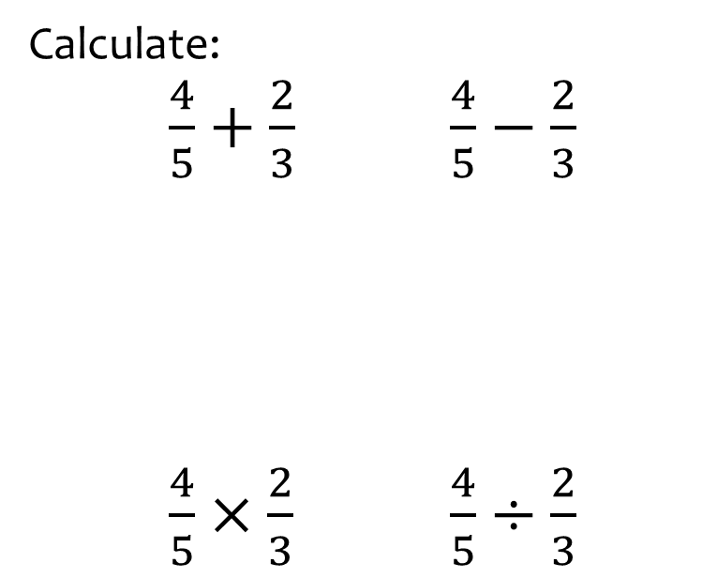
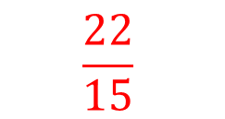



Worked example
Your turn
Calculate:
$\frac{3}{4}+\frac{2}{5}$ $\frac{3}{4}−\frac{2}{5}$
$\frac{3}{4}×\frac{2}{5}$ $\frac{3}{4}÷\frac{2}{5}$
Calculate:
$\frac{4}{5}+\frac{2}{3}$ $\frac{4}{5}−\frac{2}{3}$
$\frac{4}{5}×\frac{2}{3}$ $\frac{4}{5}÷\frac{2}{3}$
$$\frac{22}{15}$$
$$\frac{2}{15}$$
$$\frac{8}{15}$$
$$\frac{6}{5}$$

Slide 29



Worked example
Your turn
Write the reciprocals of:
$3$ $4$
$\frac{1}{3}$ $\frac{1}{4}$
$\frac{3}{4}$ $\frac{5}{2}$
Write the reciprocals of:
$$5$$
$$\frac{2}{7}$$
$$\frac{1}{5}$$
$$\frac{7}{2}$$

Slide 30



Worked example
Your turn
Calculate:
$\frac{2}{3}$ of $12$
$\frac{3}{4}$ of $12$
$\frac{3}{2}$ of $12$
Calculate:
$\frac{4}{5}$ of $35$
$$28$$

Slide 31



Worked example
Your turn
Increase:
$12$ by $\frac{2}{3}$
$12$ by $\frac{3}{4}$
$12$ by $\frac{3}{2}$
Increase:
$35$ by $\frac{4}{5}$
$$63$$

Slide 32


Worked example
Your turn
Decrease
$12$ by $\frac{2}{3}$
$12$ by $\frac{3}{4}$
$12$ by $\frac{3}{2}$
Decrease
$35$ by $\frac{4}{5}$
$$63$$

Slide 33



Worked example
Your turn
$\frac{2}{5}$ of $x$is $10$. What is $x$?
$$\frac{7}{3} \text{of} y \text{is} 14\text{. }\text{What} \text{is} y\text{?}$$
$\frac{3}{4}$ of $x$is $12$. What is $x$?
$$16$$

Slide 34



Worked example
Your turn
Write as a decimal:
$$\frac{1}{2}$$
$$\frac{1}{4}$$
$$\frac{1}{5}$$
Write as a decimal:
$$\frac{1}{10}$$
$$0.1$$

Slide 35



Worked example
Your turn
Write as a decimal:
$$\frac{3}{4}$$
$$\frac{3}{5}$$
$$\frac{3}{8}$$
Write as a decimal:
$$\frac{5}{8}$$
$$0.625$$

Slide 36



Worked example
Your turn
Write as a decimal:
$$\frac{3}{4}$$
$$\frac{4}{4}$$
$$\frac{5}{4}$$
Write as a decimal:
$$\frac{3}{2}$$
$$1.5$$

