Slide 1
Factors and multiples
CONTENTS

Slide 2
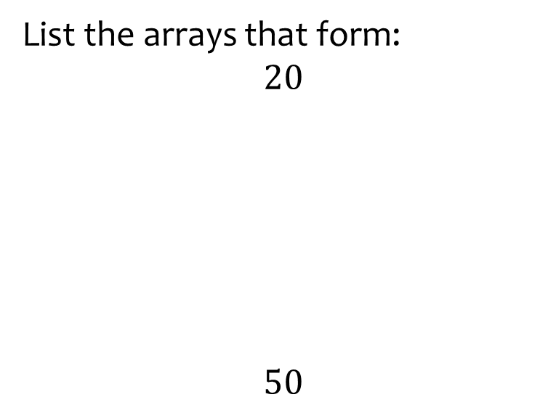

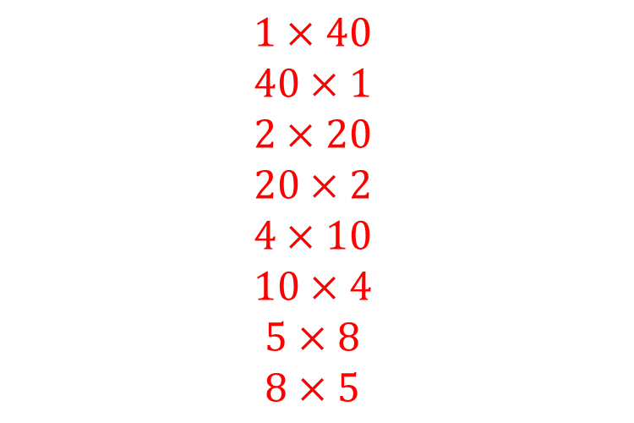
Worked example
Your turn
List the arrays that form:
$$20$$
$$50$$
List the arrays that form:
$$40$$
$$1×40$$
$$40×1$$
$$2×20$$
$$20×2$$
$$4×10$$
$$10×4$$
$$5×8$$
$$8×5$$

Slide 3
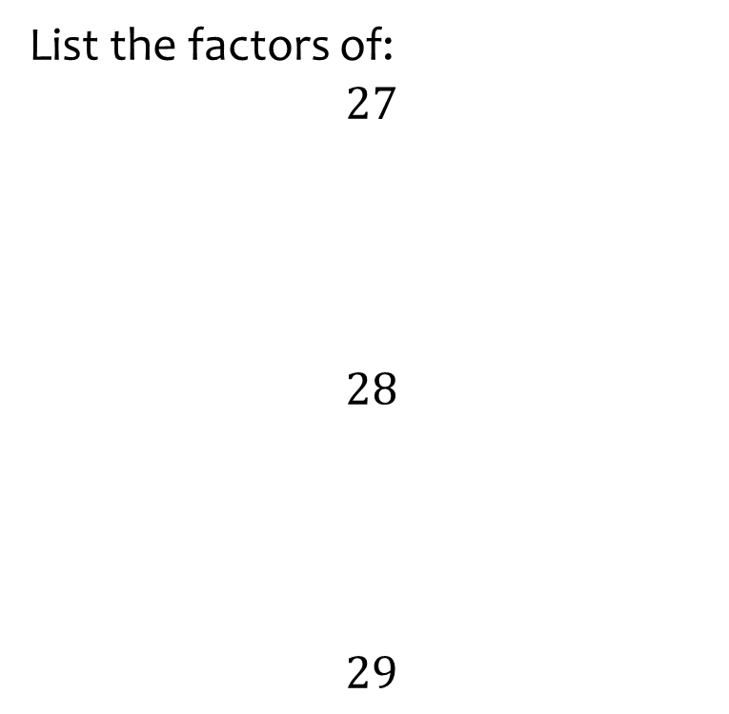
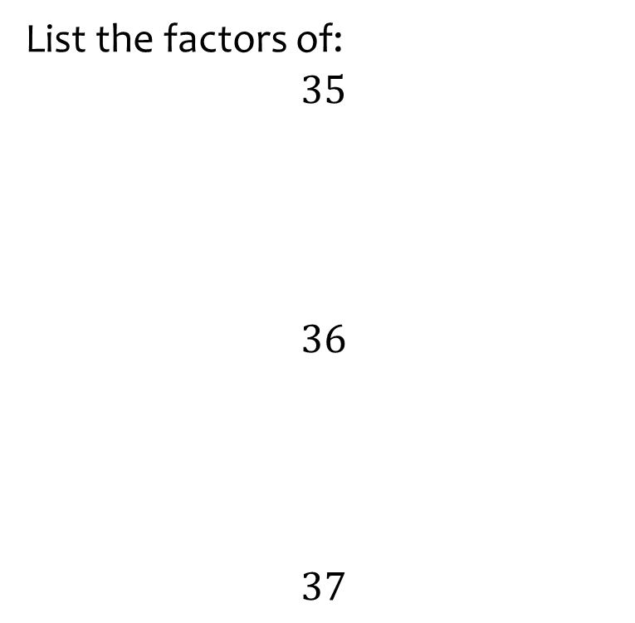
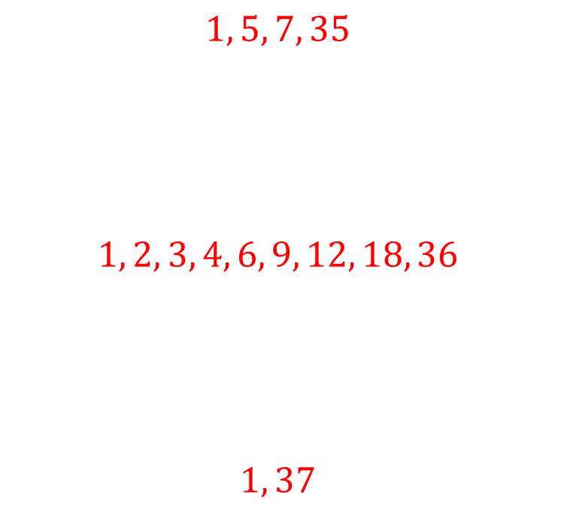
Worked example
Your turn
List the factors of:
$$27$$
$$28$$
$$29$$
List the factors of:
$$35$$
$$36$$
$$37$$
$$1, 5, 7, 35$$
$$1, 2, 3, 4, 6, 9, 12, 18, 36$$
$$1, 37$$

Slide 4
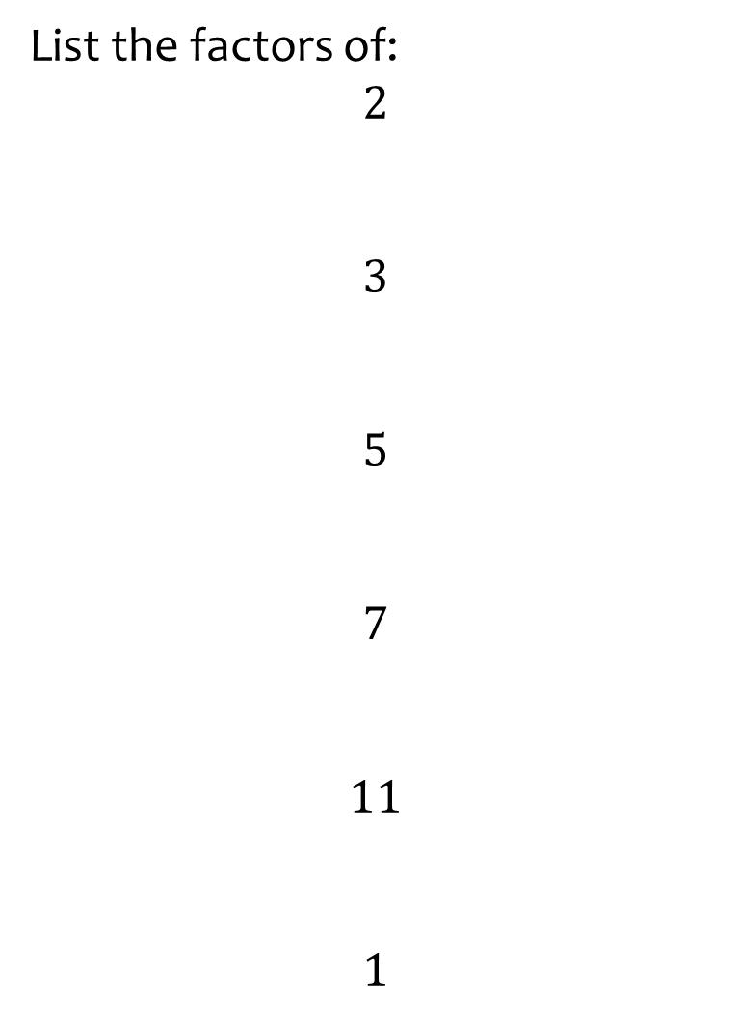
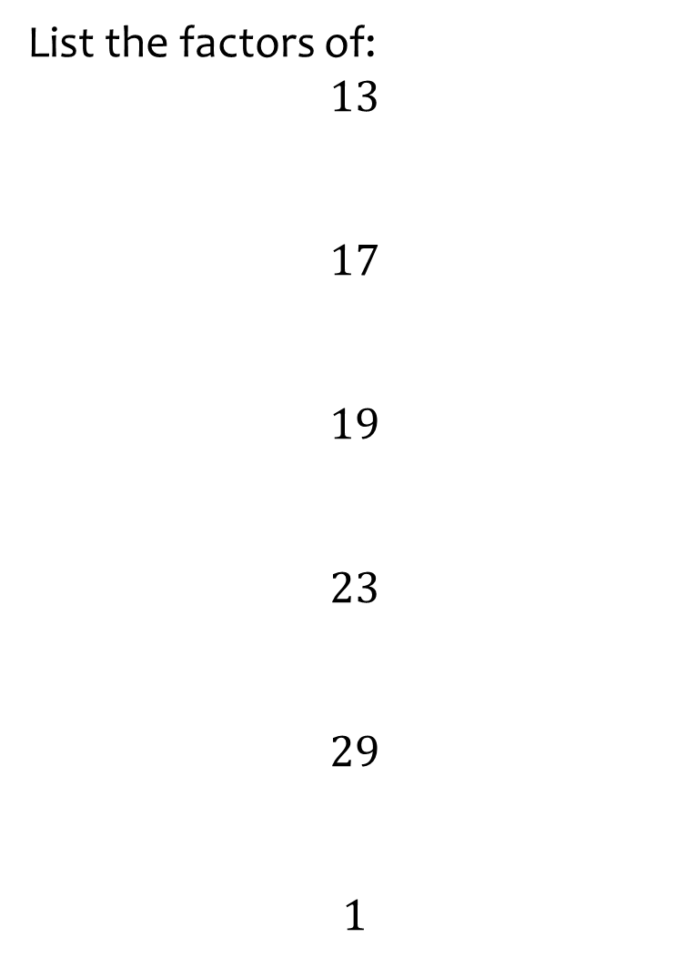
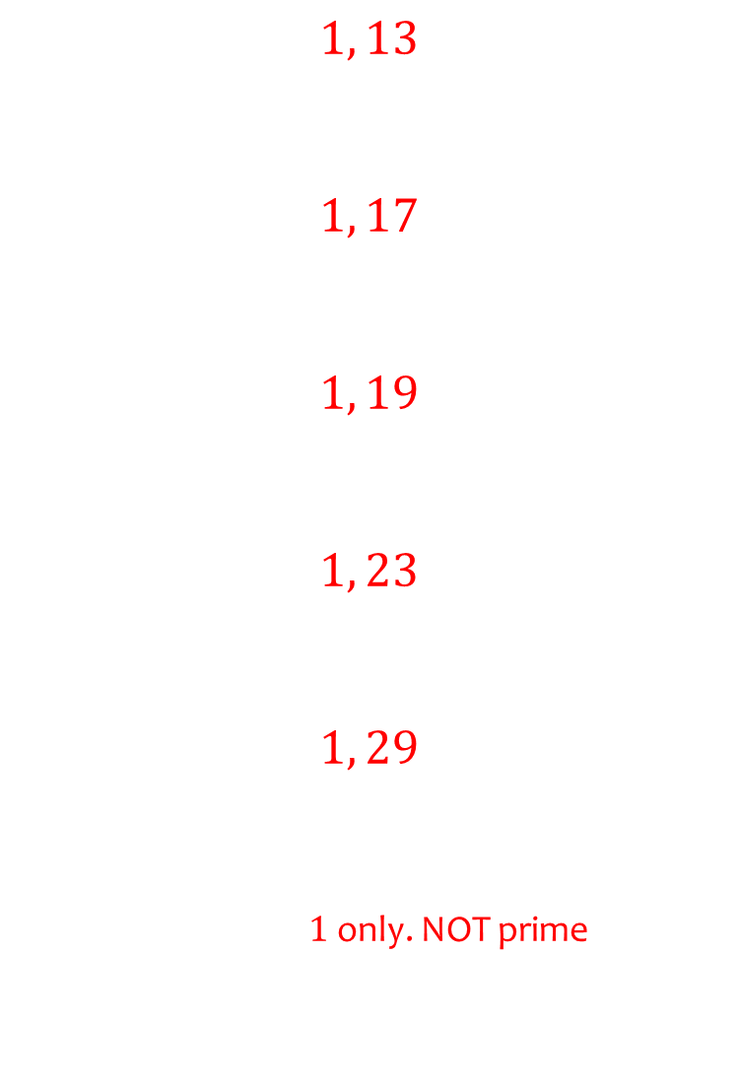
Worked example
Your turn
List the factors of:
$$2$$
$$3$$
$$5$$
$$7$$
$$11$$
$$1$$
List the factors of:
$$13$$
$$17$$
$$19$$
$$23$$
$$29$$
$$1$$
$$1, 13$$
$$1, 17$$
$$1, 19$$
$$1, 23$$
$$1, 29$$
$1$ only. NOT prime

Slide 5
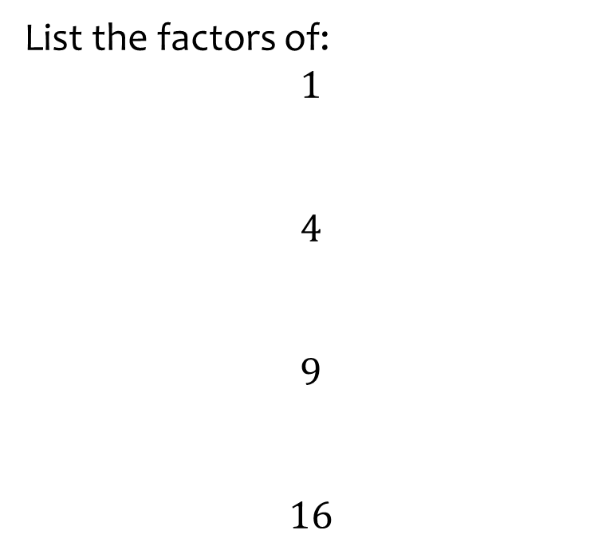


Worked example
Your turn
List the factors of:
$$1$$
$$4$$
$$9$$
$$16$$
List the factors of:
$$25$$
$$1, 5, 25$$

Slide 6
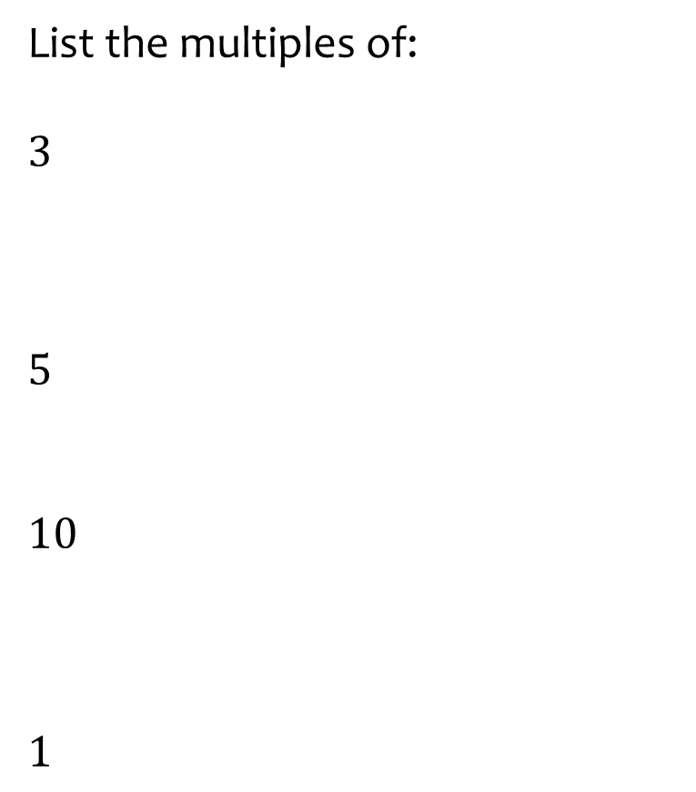
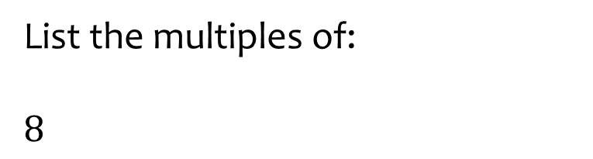

Worked example
Your turn
List the multiples of:
$$3$$
$$5$$
$$10$$
$$1$$
List the multiples of:
$$8$$
$$8, 16, 24, 32, 40, …$$

Slide 7
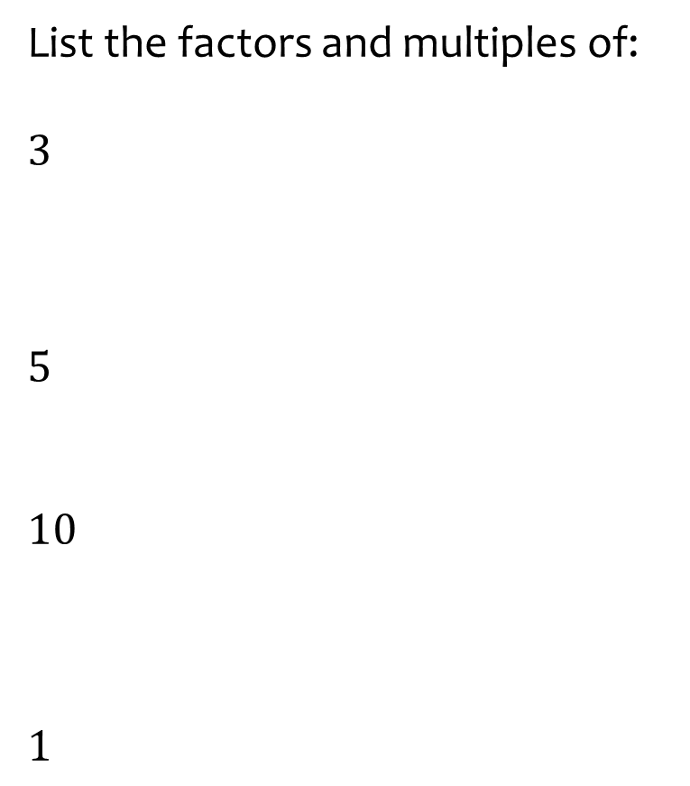
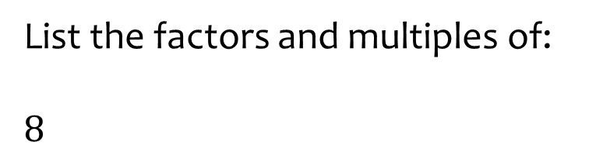
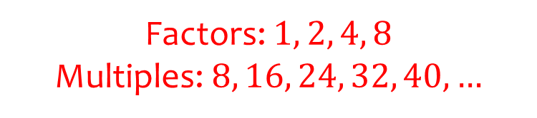
Worked example
Your turn
List the factors and multiples of:
$$3$$
$$5$$
$$10$$
$$1$$
List the factors and multiples of:
$$8$$
Factors: $1, 2, 4, 8$
Multiples: $8, 16, 24, 32, 40,…$

Slide 8
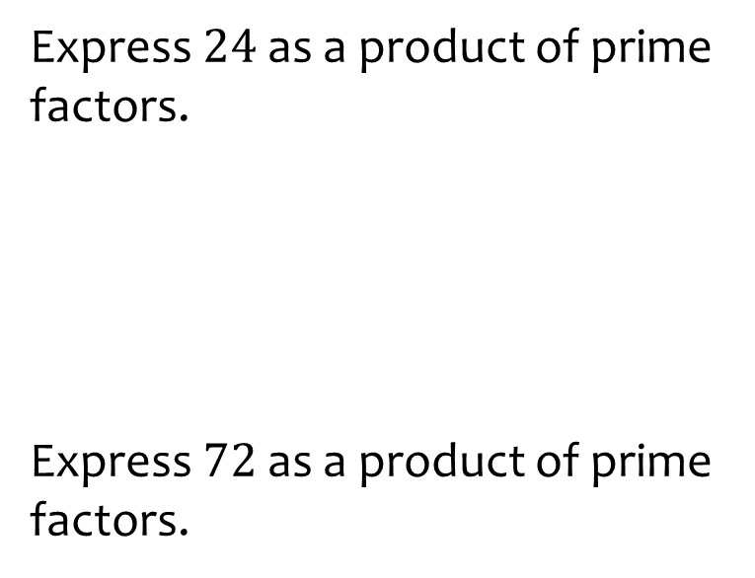
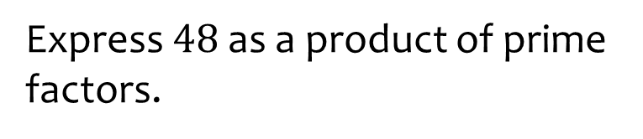

Worked example
Your turn
Express $24$ as a product of prime factors.
Express $72$ as a product of prime factors.
Express $48$ as a product of prime factors.
$$2^{4}×3$$

Slide 9
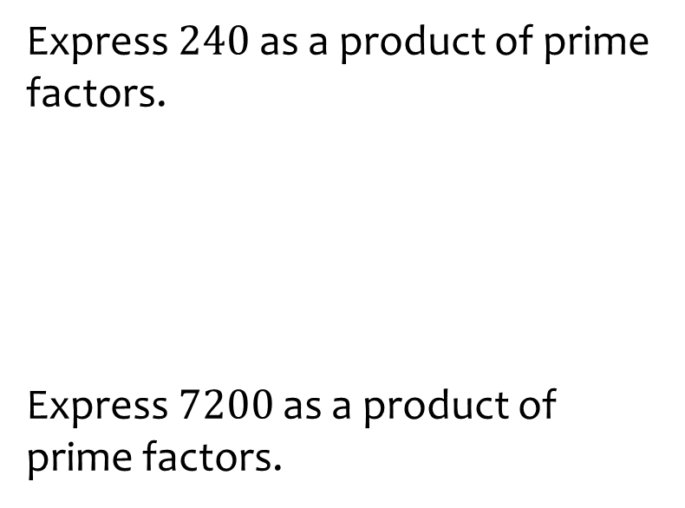
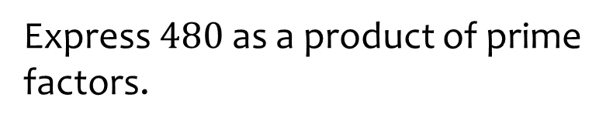

Worked example
Your turn
Express $240$ as a product of prime factors.
Express $7200$ as a product of prime factors.
Express $480$ as a product of prime factors.
$$2^{5}×3×5$$

Slide 10
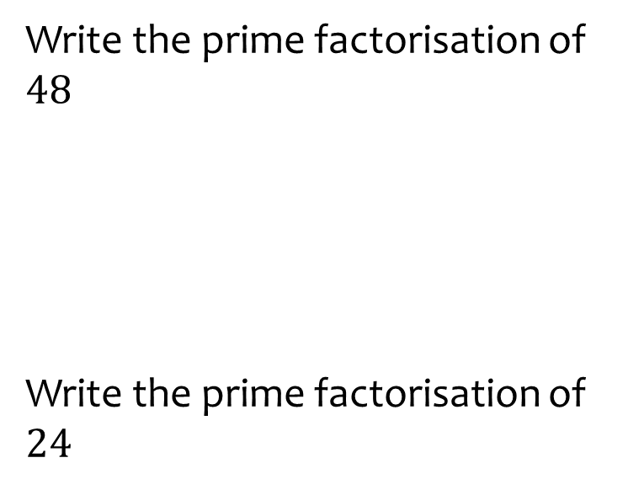
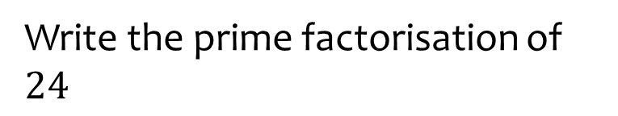

Worked example
Your turn
Write the prime factorisation of $48$
Write the prime factorisation of $24$
Write the prime factorisation of $24$
$$24=2^{3}×3$$

Slide 11
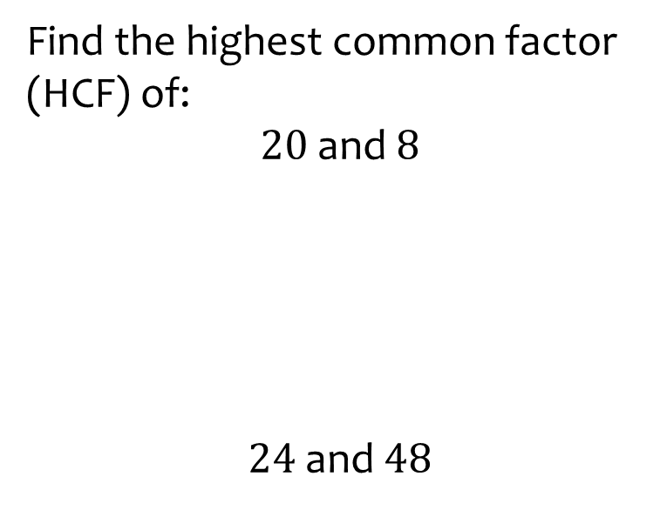
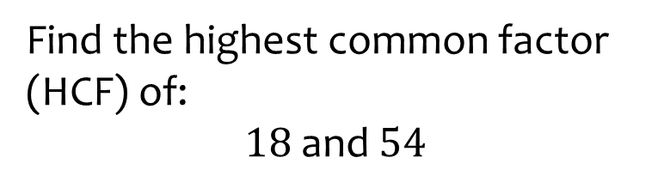

Worked example
Your turn
Find the highest common factor (HCF) of:
$20$ and $8$
$24$ and $48$
Find the highest common factor (HCF) of:
$18$ and $54$
$$18$$

Slide 12
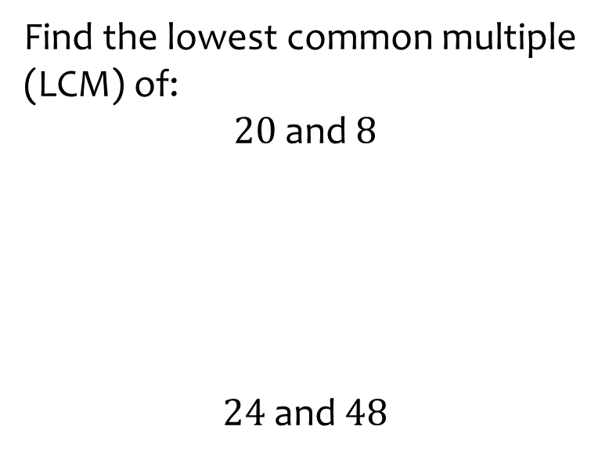
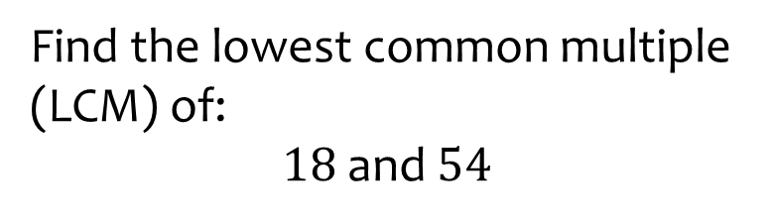

Worked example
Your turn
Find the lowest common multiple (LCM) of:
$20$ and $8$
$24$ and $48$
Find the lowest common multiple (LCM) of:
$18$ and $54$
$$54$$

Slide 13
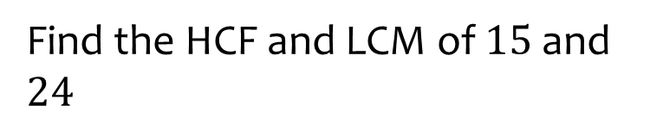
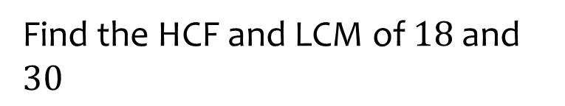

Worked example
Your turn
Find the HCF and LCM of $15$ and $24$
Find the HCF and LCM of $18$ and $30$
HCF $=6$
LCM $=90$

Slide 14
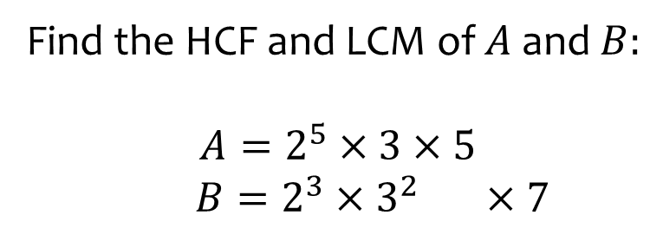
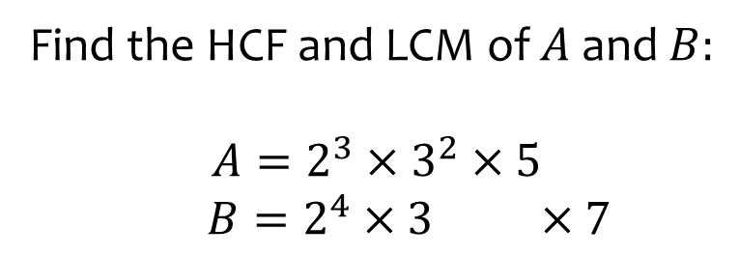

Worked example
Your turn
Find the HCF and LCM of $A$ and $B:$
$$A=2^{5}×3×5$$
$B=2^{3}×3^{2} ×7$
Find the HCF and LCM of $A$ and $B:$
$$A=2^{3}×3^{2}×5$$
$B=2^{4}×3 ×7$
HCF $=24$
LCM $=5040$

