Slide 1
Distance-Time and Speed-Time Graphs
CONTENTS

Slide 2
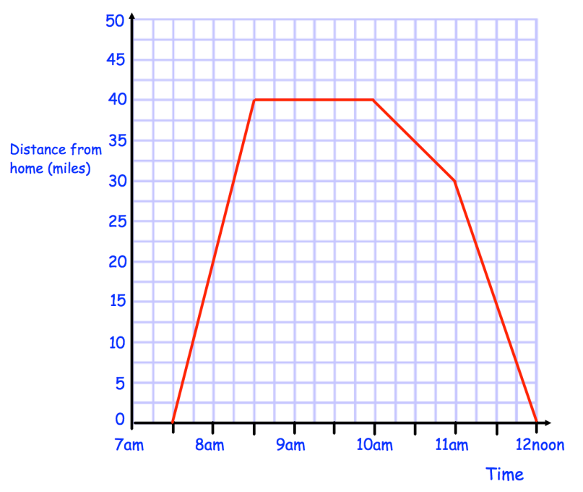
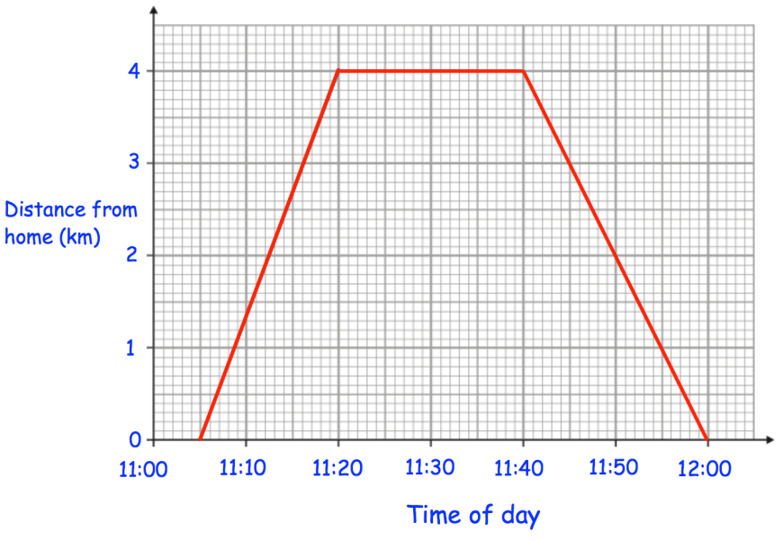
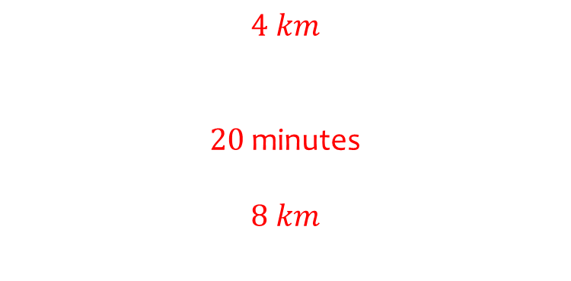
Worked example
Your turn
Study the distance-time graph below.
How far was the person from home at 8.30am?
How long did the person stop for?
How far did the person travel in total?
Study the distance-time graph below
How far was the person from home at 11.20?
How long did the person stop for?
How far did the person travel in total?
$$4 km$$
$20$ minutes
$$8 km$$
Questions used with permission from Corbettmaths: https://corbettmaths.com/

Slide 3

Worked example
Your turn
Study the distance-time graph below.
What was the person’s speed in each section of the journey:
A
B
C
D
Study the distance-time graph below.
What was the person’s speed in each section of the journey:
A
B
C
$$16 km/h$$
$0$ $km/h$
$$12 km/h$$
B
B
C
A
C
A
D
Questions used with permission from Corbettmaths: https://corbettmaths.com/

Slide 4

Worked example
Your turn
Study the distance-time graph below.
What was the person’s average speed for the whole journey?
Study the distance-time graph below.
What was the person’s average speed for the whole journey?
$$8.72 km/h$$
Questions used with permission from Corbettmaths: https://corbettmaths.com/
Notes:
Corbettmaths

Slide 5
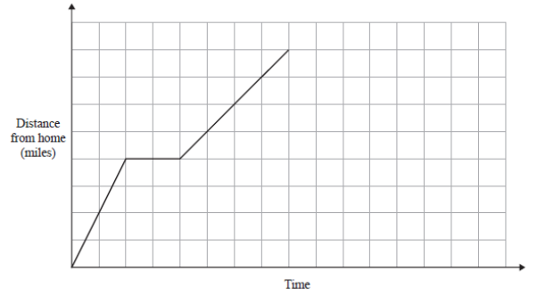
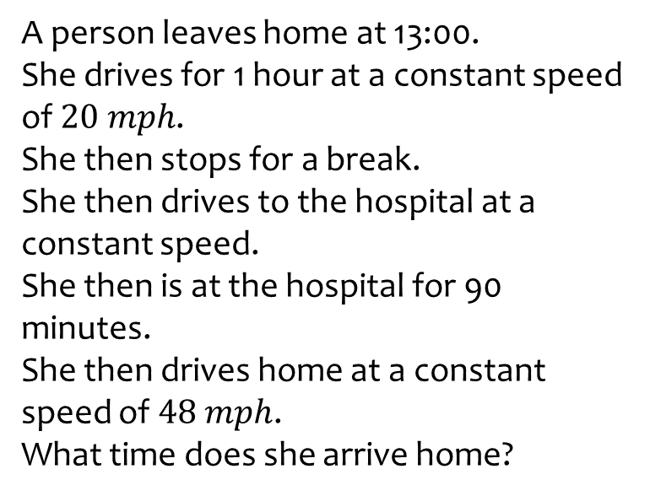
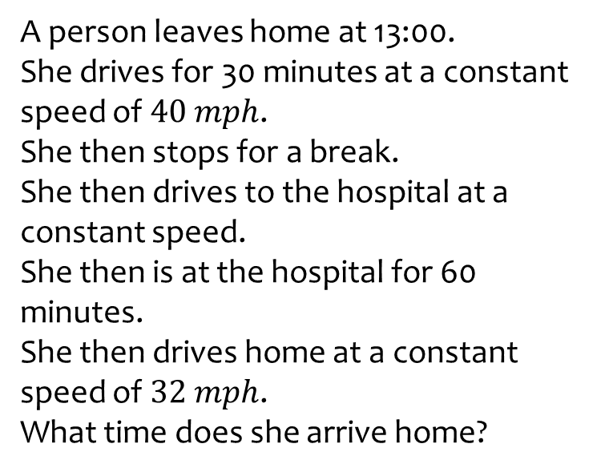
Worked example
Your turn
A person leaves home at 13:00.
She drives for 1 hour at a constant speed of $20 mph$.
She then stops for a break.
She then drives to the hospital at a constant speed.
She then is at the hospital for 90 minutes.
She then drives home at a constant speed of $48 mph$.
What time does she arrive home?
A person leaves home at 13:00.
She drives for 30 minutes at a constant speed of $40 mph$.
She then stops for a break.
She then drives to the hospital at a constant speed.
She then is at the hospital for 60 minutes.
She then drives home at a constant speed of $32 mph$.
What time does she arrive home?
$$16:45$$

Slide 6
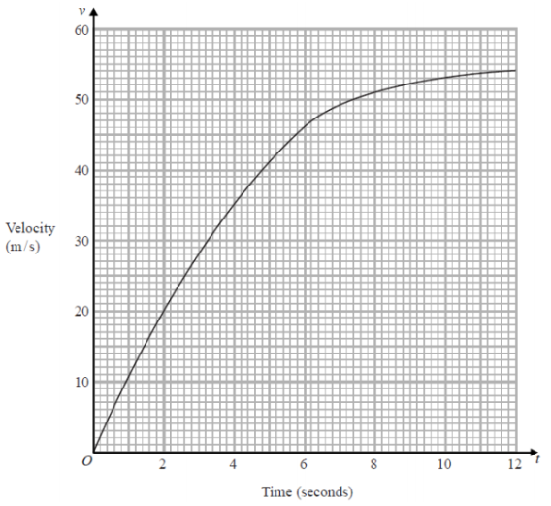
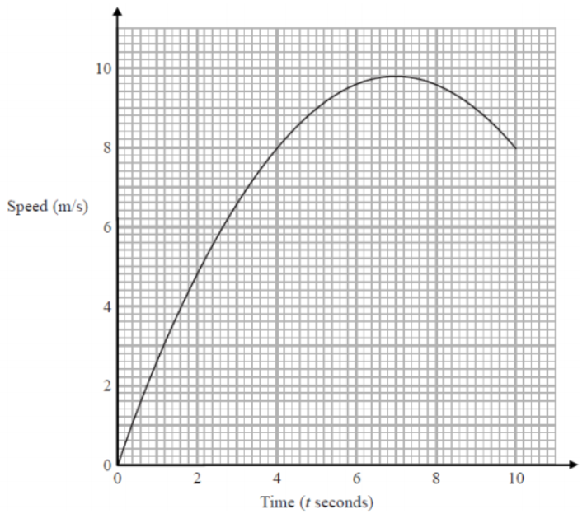
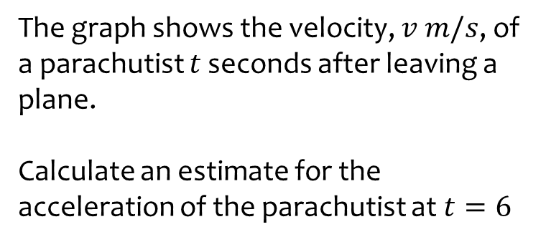
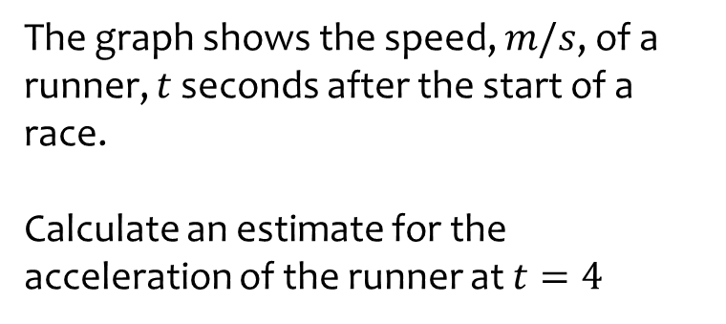

Worked example
Your turn
The graph shows the velocity, $v$ $m/s$, of a parachutist $t$ seconds after leaving a plane.
Calculate an estimate for the acceleration of the parachutist at $t=6$
The graph shows the speed, $m/s$, of a runner, $t$ seconds after the start of a race.
Calculate an estimate for the acceleration of the runner at $t=4$
Any value between $1$ and $1.3 m/s^{2}$

Slide 7
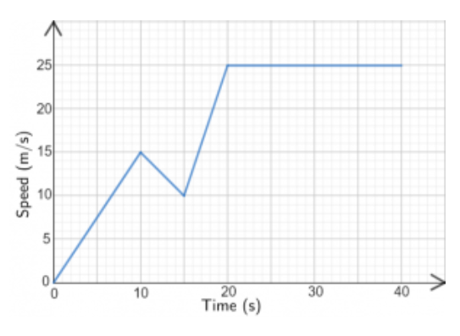
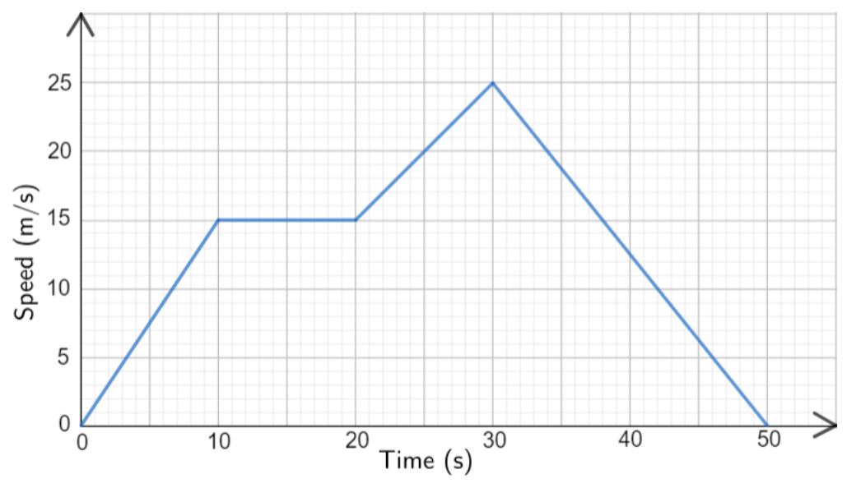
Worked example
Your turn
Below is the speed-time graph of 40-second cycle journey.
Work out the total distance travelled by the cyclist over the journey.
Below is the speed-time graph of a 50-second car journey.
Work out the total distance travelled by the car over the journey.
$$675 m$$
Questions used with permission from mathsmadeeasy: https://mathsmadeeasy.co.uk/

Slide 8
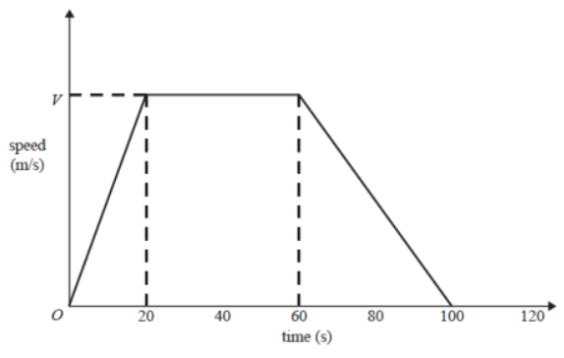
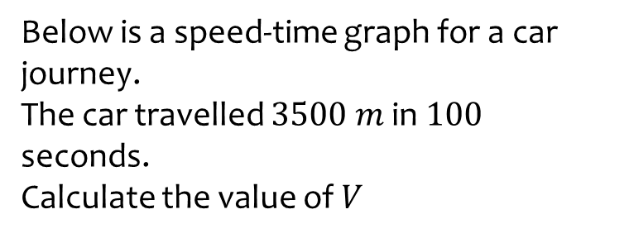
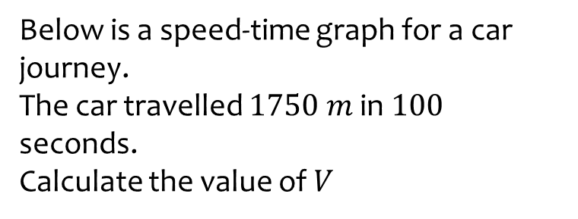
Worked example
Your turn
Below is a speed-time graph for a car journey.
The car travelled $3500 m$ in $100$ seconds.
Calculate the value of $V$
Below is a speed-time graph for a car journey.
The car travelled $1750 m$ in $100$ seconds.
Calculate the value of $V$
$$V=25$$
Questions used with permission from mathsmadeeasy: https://mathsmadeeasy.co.uk/

Slide 9
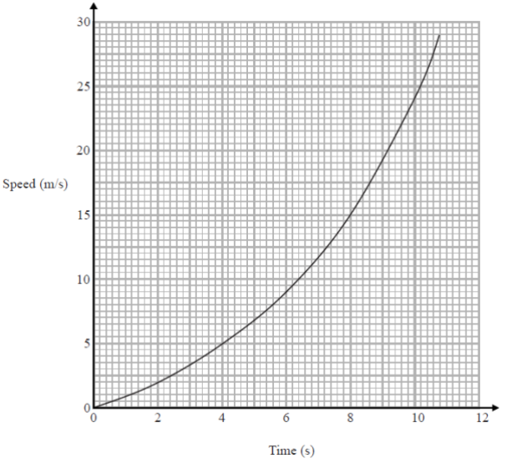
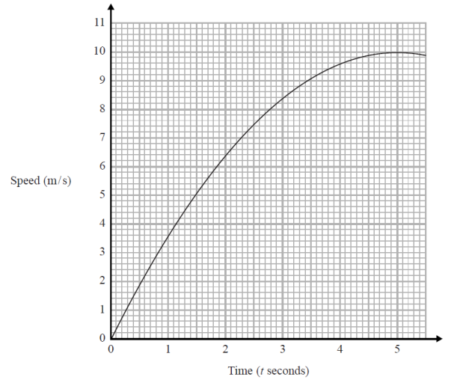
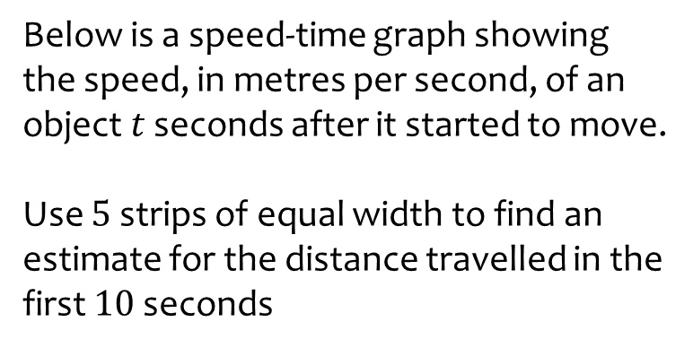
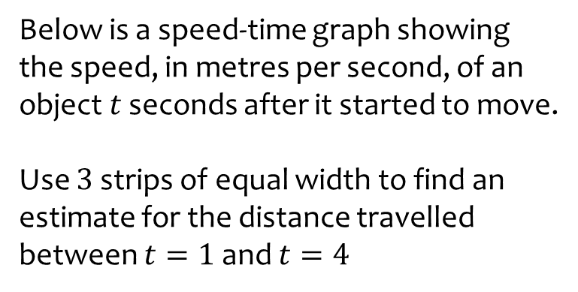

Worked example
Your turn
Below is a speed-time graph showing the speed, in metres per second, of an object $t$ seconds after it started to move.
Use $5$ strips of equal width to find an estimate for the distance travelled in the first $10$seconds
Below is a speed-time graph showing the speed, in metres per second, of an object $t$ seconds after it started to move.
Use $3$ strips of equal width to find an estimate for the distance travelled between $t=1$ and $t=4$
$$21.4 m$$
Questions used with permission from mathsmadeeasy: https://mathsmadeeasy.co.uk/

Slide 10
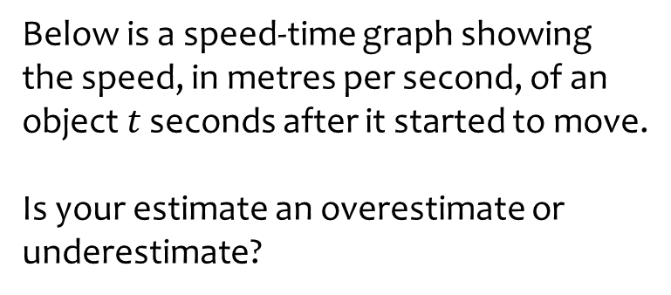
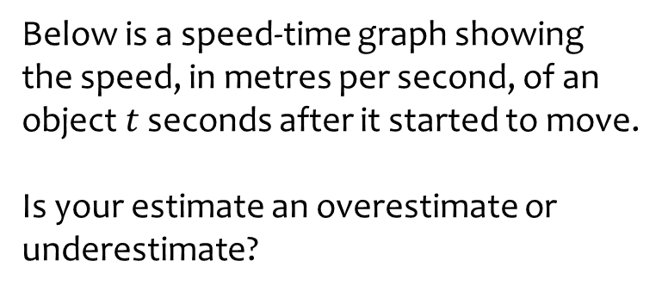
Worked example
Your turn
Below is a speed-time graph showing the speed, in metres per second, of an object $t$ seconds after it started to move.
Is your estimate an overestimate or underestimate?
Below is a speed-time graph showing the speed, in metres per second, of an object $t$ seconds after it started to move.
Is your estimate an overestimate or underestimate?
Underestimate
Questions used with permission from mathsmadeeasy: https://mathsmadeeasy.co.uk/

