Slide 1
Decimals
CONTENTS

Slide 2
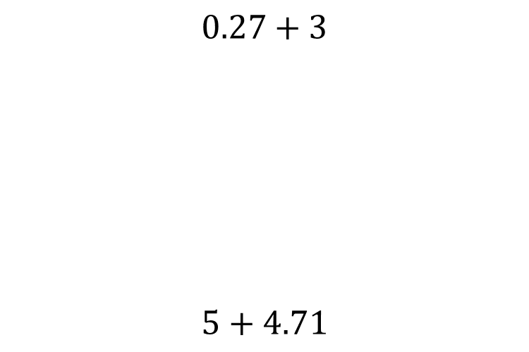


Worked example
Your turn
$$0.27+3$$
$$5+4.71$$
$$2.27+1$$
$$3.27$$

Slide 3
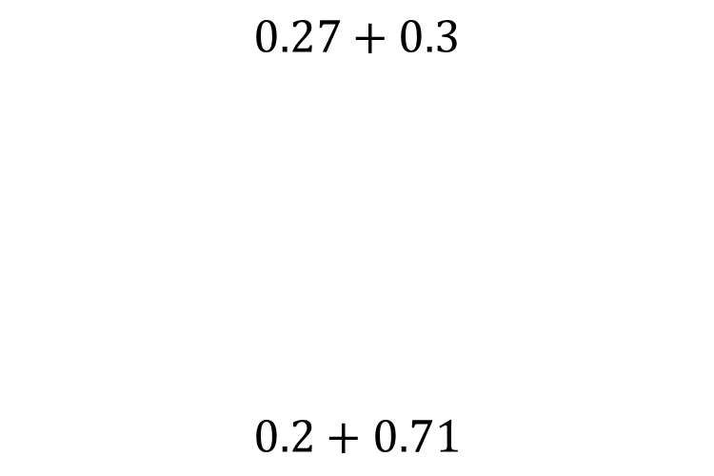


Worked example
Your turn
$$0.27+0.3$$
$$0.2+0.71$$
$$0.17+0.4$$
$$0.57$$

Slide 4
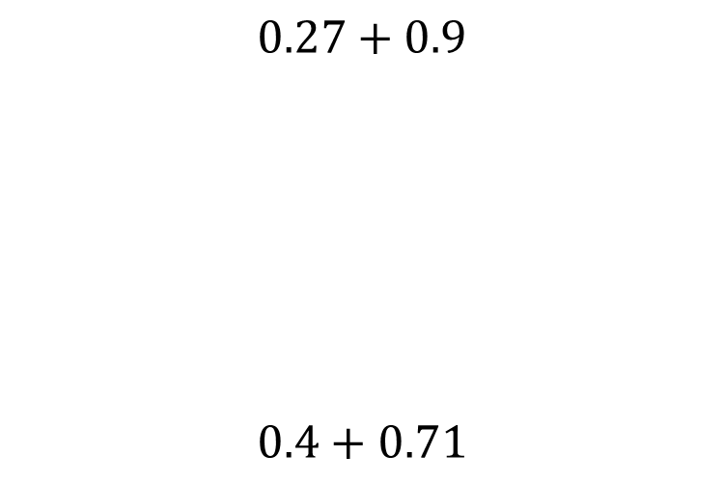


Worked example
Your turn
$$0.27+0.9$$
$$0.4+0.71$$
$$0.57+0.6$$
$$1.17$$

Slide 5
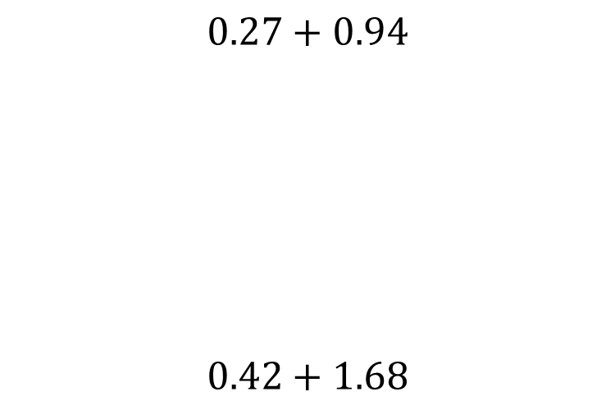


Worked example
Your turn
$$0.27+0.94$$
$$0.42+1.68$$
$$0.37+0.84$$
$$1.21$$

Slide 6
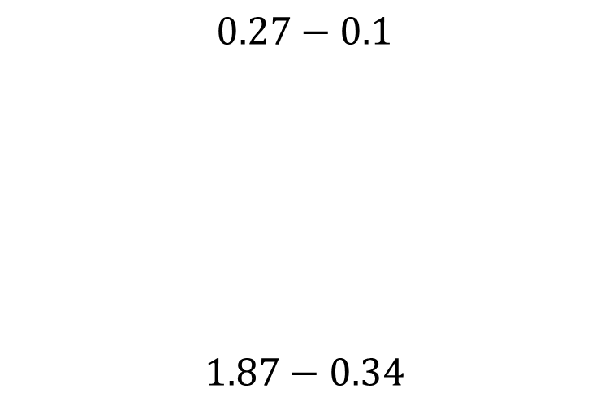


Worked example
Your turn
$$0.27−0.1$$
$$1.87−0.34$$
$$0.97−0.8$$
$$0.17$$

Slide 7
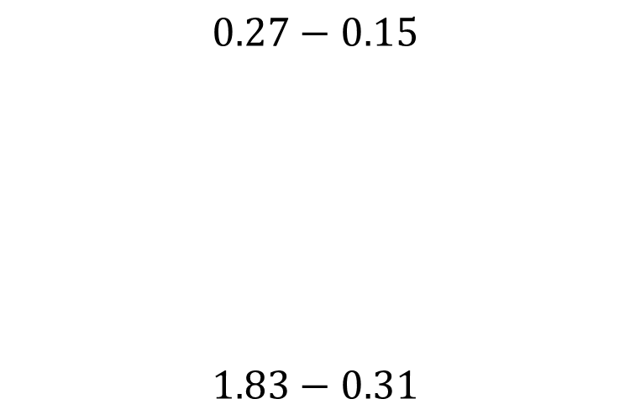


Worked example
Your turn
$$0.27−0.15$$
$$1.83−0.31$$
$$0.97−0.85$$
$$0.12$$

Slide 8
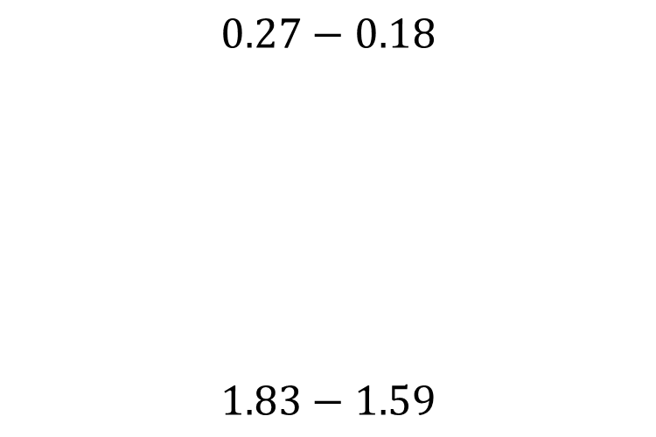


Worked example
Your turn
$$0.27−0.18$$
$$1.83−1.59$$
$$1.97−1.88$$
$$0.08$$

Slide 9
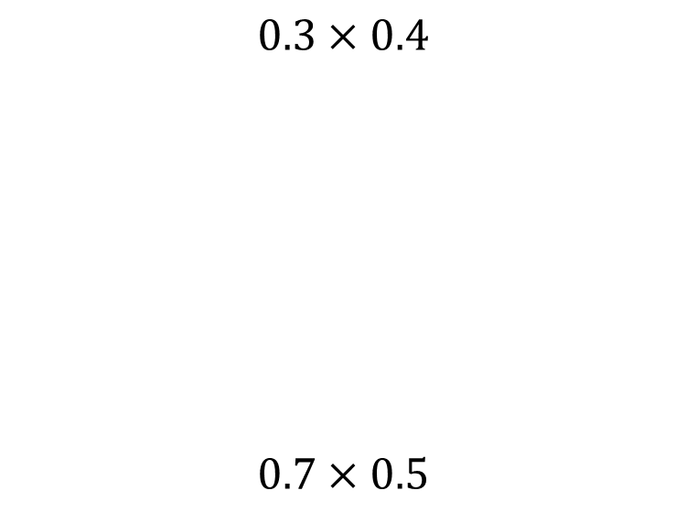

Worked example
Your turn
$$0.3×0.4$$
$$0.7×0.5$$
$$0.6×0.2$$
$$0.12$$

Slide 10
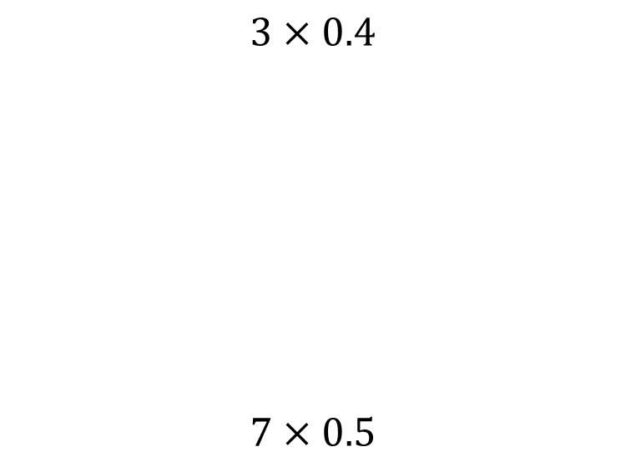


Worked example
Your turn
$$3×0.4$$
$$7×0.5$$
$$6×0.2$$
$$1.2$$

Slide 11
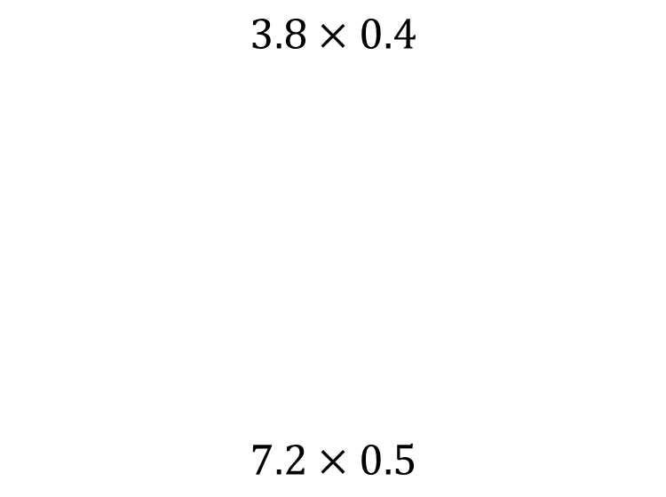


Worked example
Your turn
$$3.8×0.4$$
$$7.2×0.5$$
$$7.6×0.2$$
$$1.52$$

Slide 12
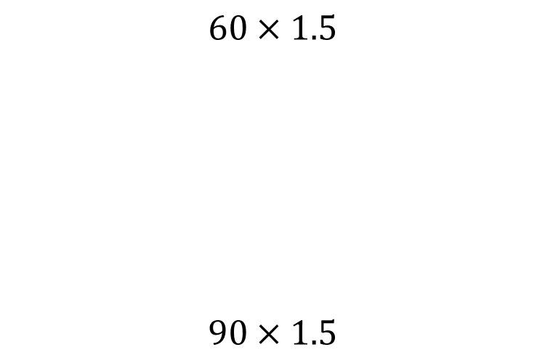


Worked example
Your turn
$$60×1.5$$
$$90×1.5$$
$$20×1.5$$
$$30$$

Slide 13
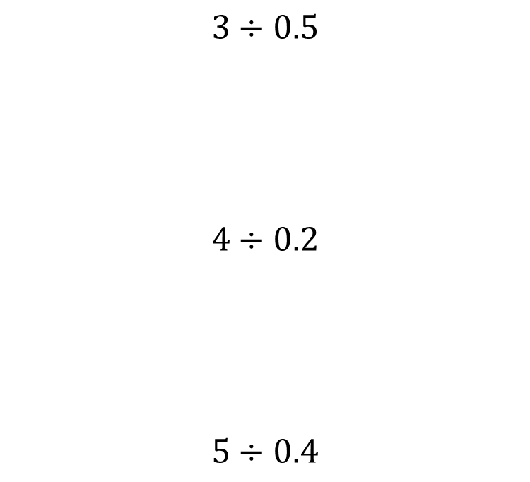


Worked example
Your turn
$$3÷0.5$$
$$4÷0.2$$
$$5÷0.4$$
$$7÷0.6$$
$$\frac{35}{3}$$

Slide 14
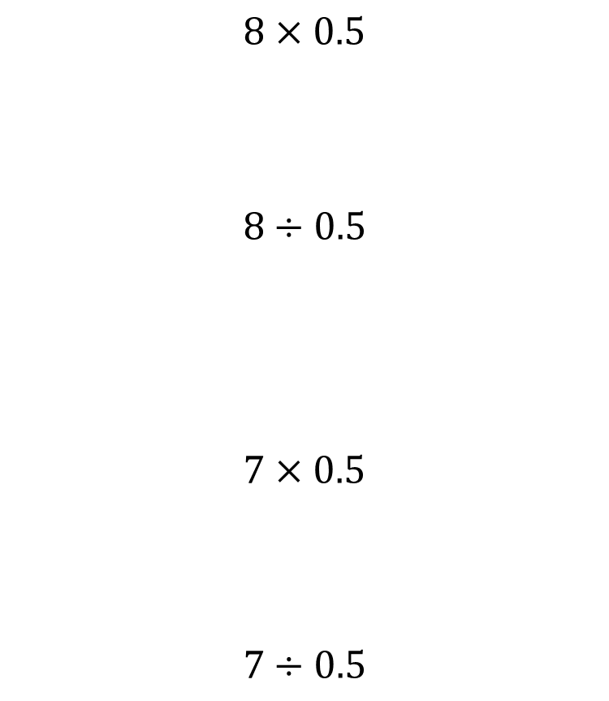
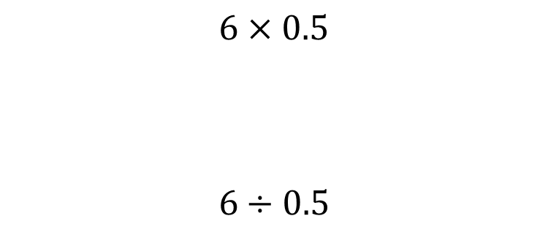

Worked example
Your turn
$$8×0.5$$
$$8÷0.5$$
$$7×0.5$$
$$7÷0.5$$
$$6×0.5$$
$$6÷0.5$$
$$3$$
$$12$$

Slide 15
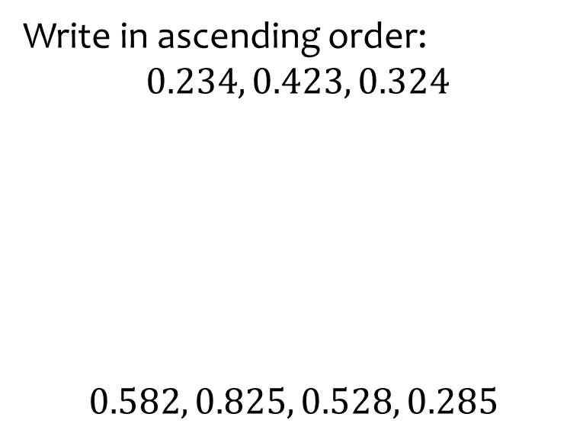
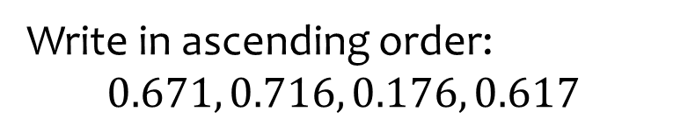
Worked example
Your turn
Write in ascending order:
$$0.234, 0.423, 0.324$$
$$0.582, 0.825, 0.528, 0.285$$
Write in ascending order:
$$0.671, 0.716, 0.176, 0.617$$
$$0.176, 0.617, 0.671, 0.716$$

Slide 16
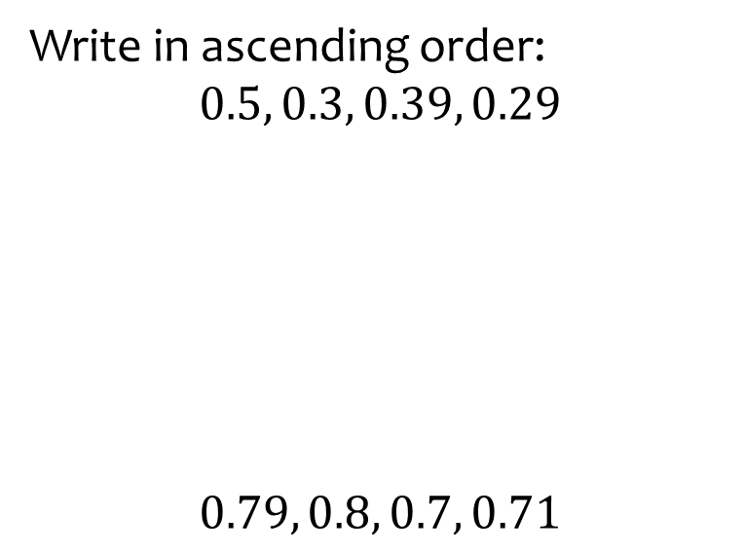


Worked example
Your turn
Write in ascending order:
$$0.5, 0.3, 0.39, 0.29$$
$$0.79, 0.8, 0.7, 0.71$$
Write in ascending order:
$$0.6, 0.59, 0.7, 0.61$$
$$0.59, 0.6, 0.61, 0.7$$

Slide 17
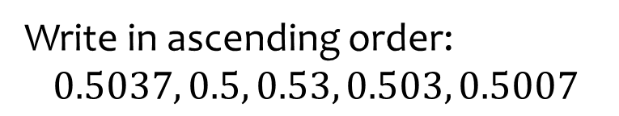
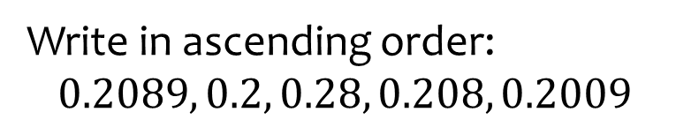
Worked example
Your turn
Write in ascending order:
$$0.5037, 0.5, 0.53, 0.503, 0.5007$$
Write in ascending order:
$$0.2089, 0.2, 0.28, 0.208, 0.2009$$
$$0.2, 0.2009, 0.208, 0.2089, 0.28$$

Slide 18



Worked example
Your turn
Write in ascending order:
$$−0.2, −0.1, 0.4, 0.3$$
Write in ascending order:
$$−0.7, −0.8, 0.8, 0.7$$
$$−0.8, −0.7, 0.7, 0.8$$

Slide 19
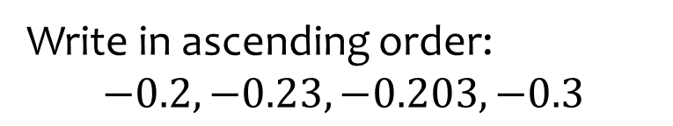
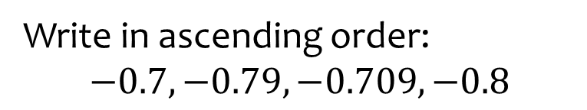
Worked example
Your turn
Write in ascending order:
$$−0.2, −0.23, −0.203, −0.3$$
Write in ascending order:
$$−0.7, −0.79, −0.709, −0.8$$
$$−0.8, −0.79, −0.709, −0.7$$

