Slide 1
Converting between units
CONTENTS

Slide 2
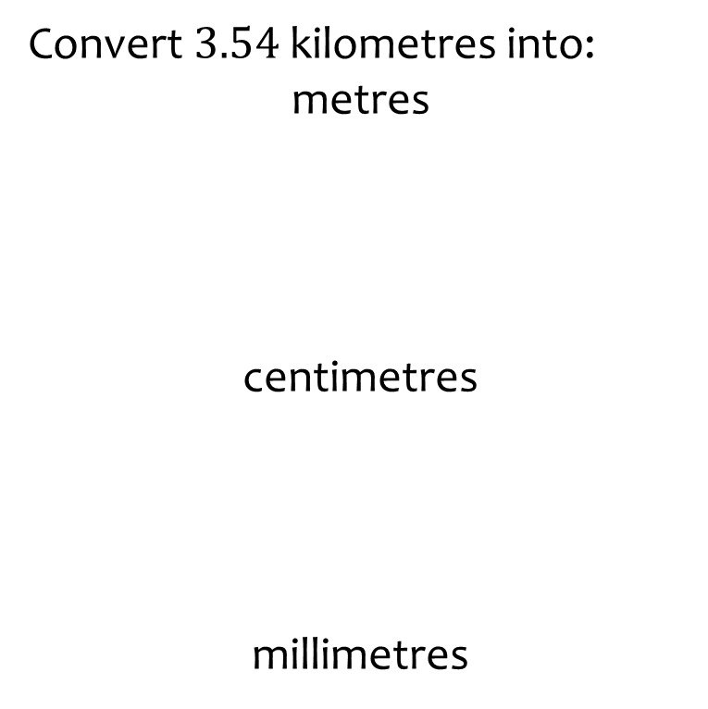
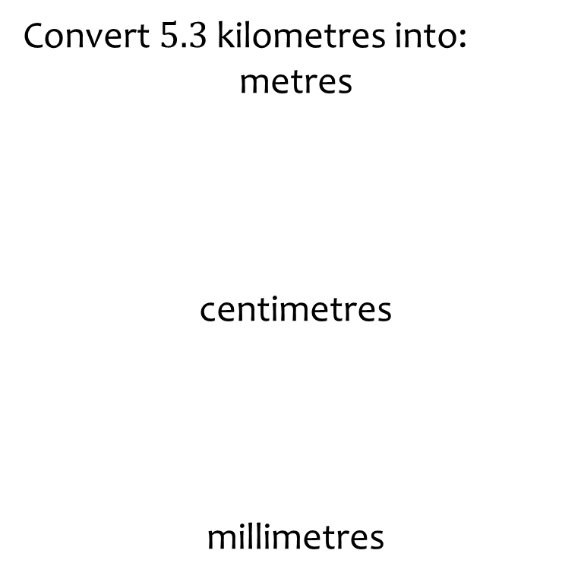
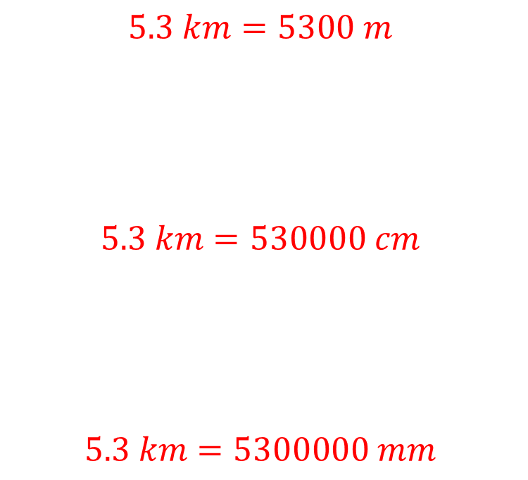
Worked example
Your turn
Convert $3.54$ kilometres into:
metres
centimetres
millimetres
Convert $5.3$ kilometres into:
metres
centimetres
millimetres
$$5.3 km=5300 m$$
$$5.3 km=530000 cm$$
$$5.3 km=5300000 mm$$

Slide 3
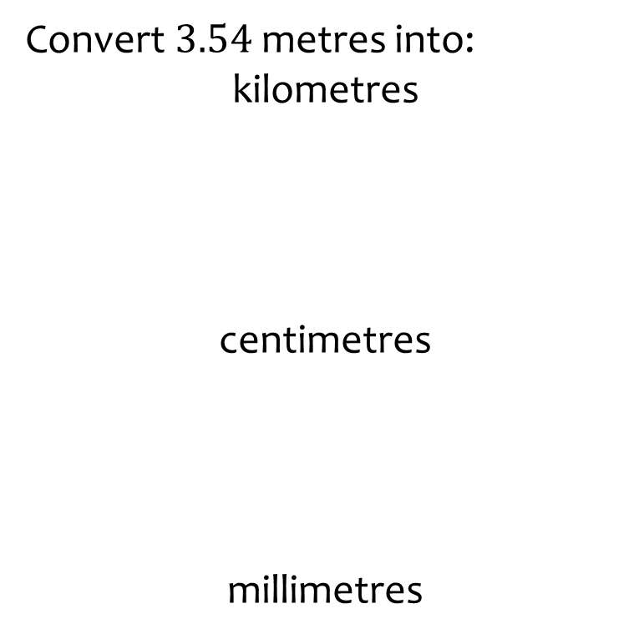
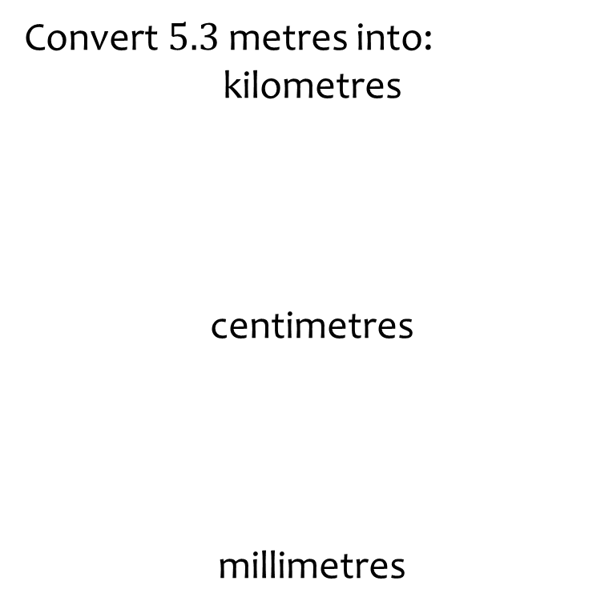
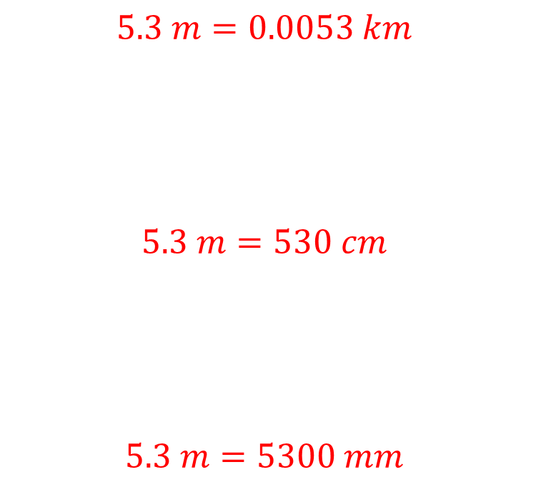
Worked example
Your turn
Convert $3.54$ metres into:
kilometres
centimetres
millimetres
Convert $5.3$ metres into:
kilometres
centimetres
millimetres
$$5.3 m=0.0053 km$$
$$5.3 m=530 cm$$
$$5.3 m=5300 mm$$

Slide 4
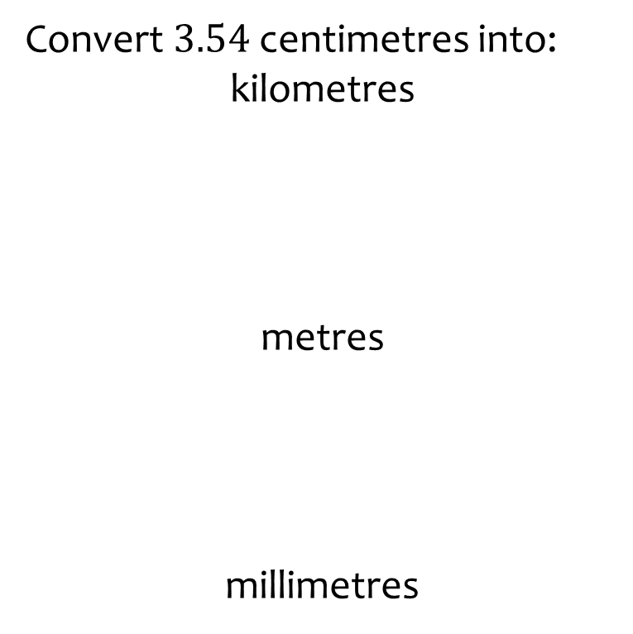
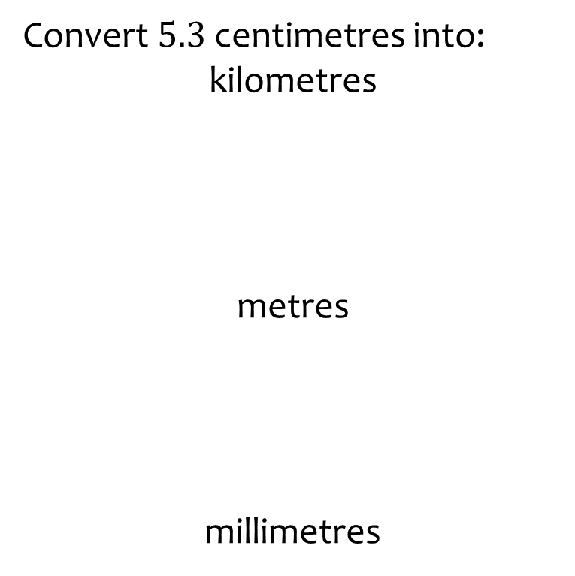
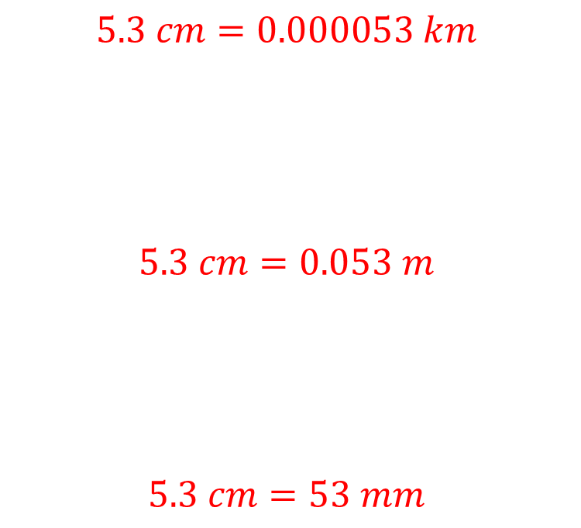
Worked example
Your turn
Convert $3.54$ centimetres into:
kilometres
metres
millimetres
Convert $5.3$ centimetres into:
kilometres
metres
millimetres
$$5.3 cm=0.000053 km$$
$$5.3 cm=0.053 m$$
$$5.3 cm=53 mm$$

Slide 5
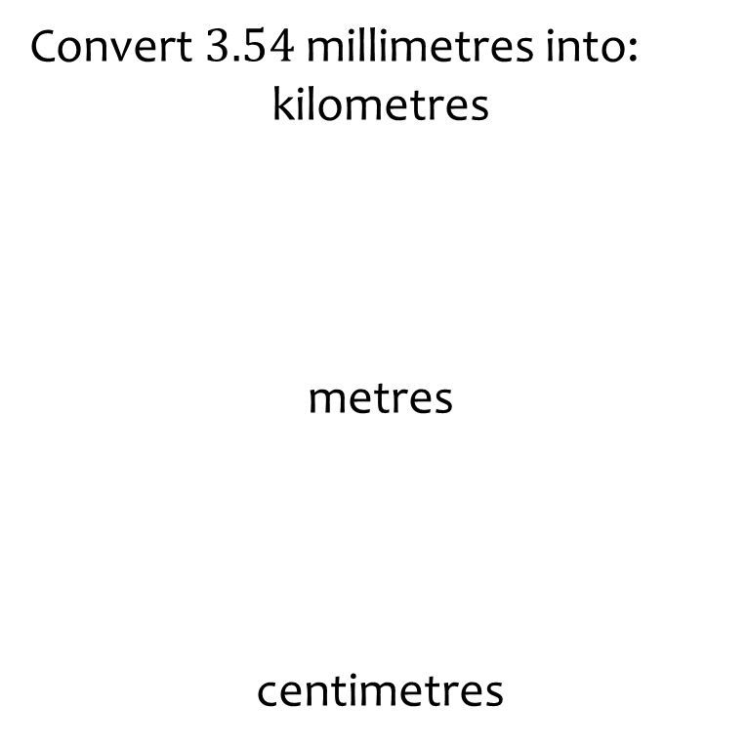
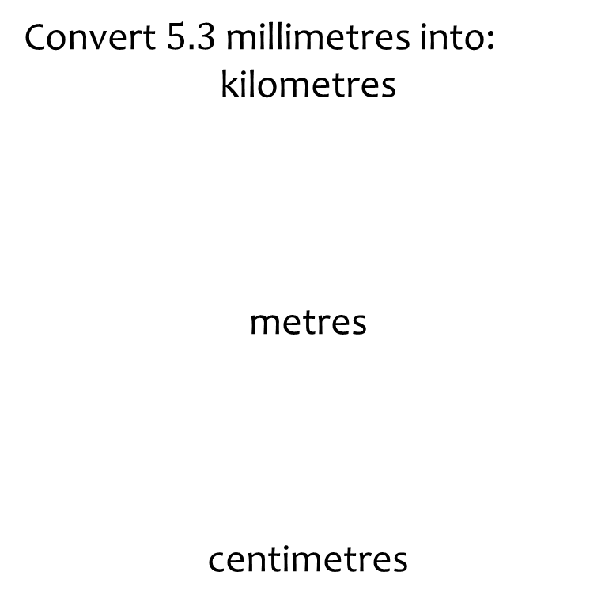
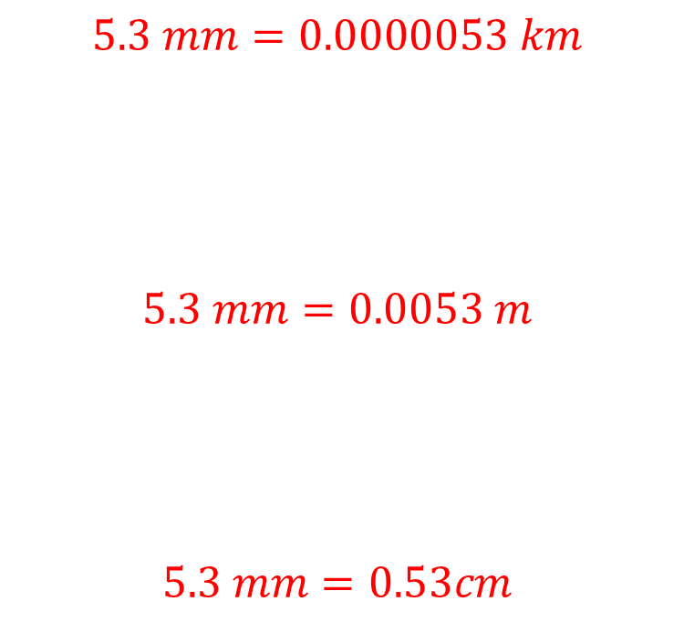
Worked example
Your turn
Convert $3.54$ millimetres into:
kilometres
metres
centimetres
Convert $5.3$ millimetres into:
kilometres
metres
centimetres
$$5.3 mm=0.0000053 km$$
$$5.3 mm=0.0053 m$$
$$5.3 mm=0.53cm$$

Slide 6
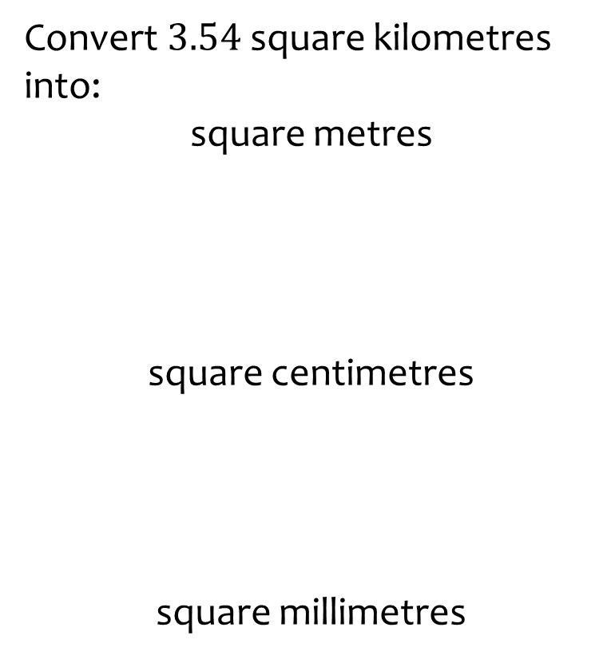
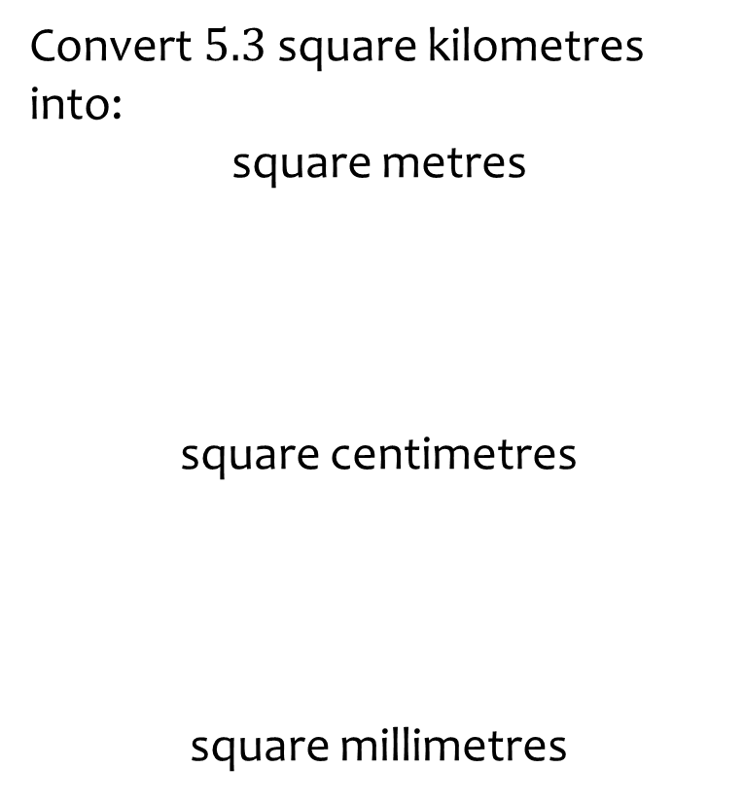
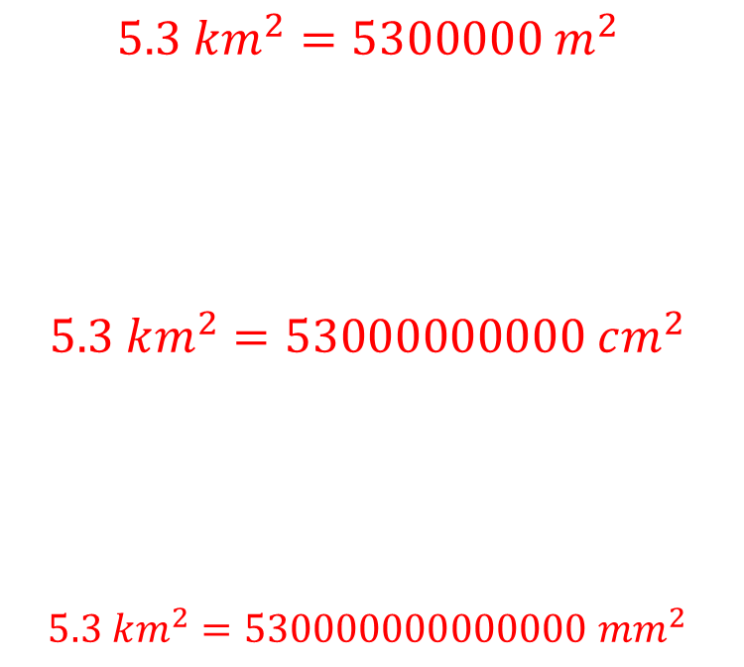
Worked example
Your turn
Convert $3.54$ square kilometres into:
square metres
square centimetres
square millimetres
Convert $5.3$ square kilometres into:
square metres
square centimetres
square millimetres
$$5.3 km^{2}=5300000 m^{2}$$
$$5.3 km^{2}=53000000000 cm^{2}$$
$$5.3 km^{2}=530000000000000 mm^{2}$$

Slide 7
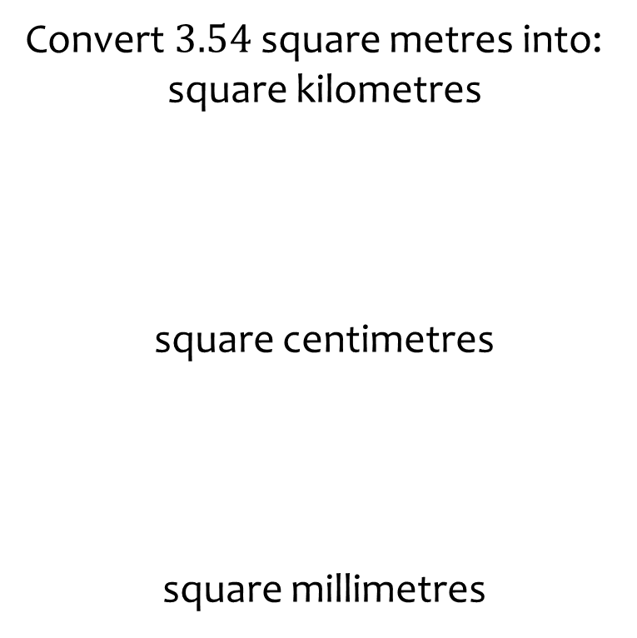
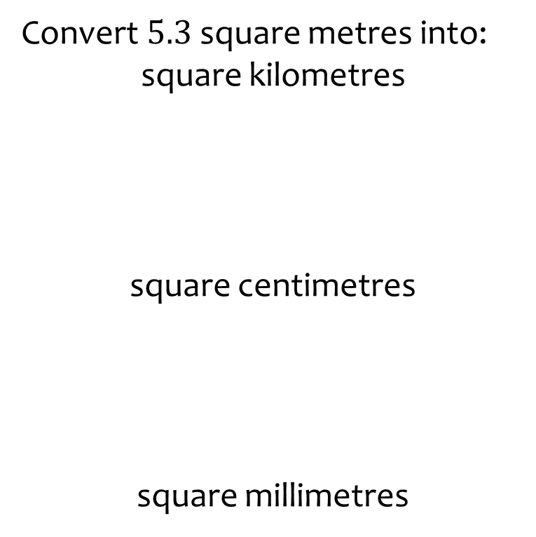
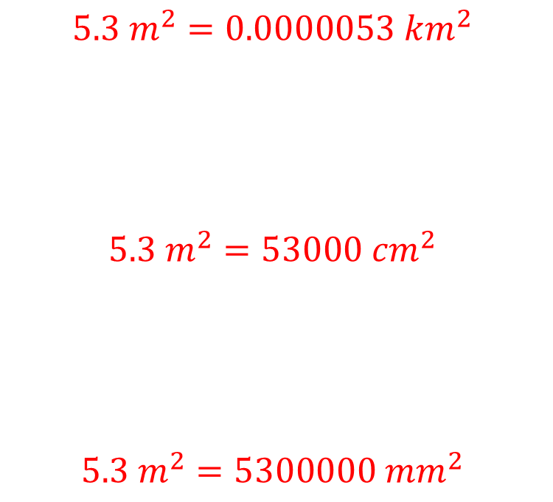
Worked example
Your turn
Convert $3.54$ square metres into:
square kilometres
square centimetres
square millimetres
Convert $5.3$ square metres into:
square kilometres
square centimetres
square millimetres
$$5.3 m^{2}=0.0000053 km^{2}$$
$$5.3 m^{2}=53000 cm^{2}$$
$$5.3 m^{2}=5300000 mm^{2}$$

Slide 8
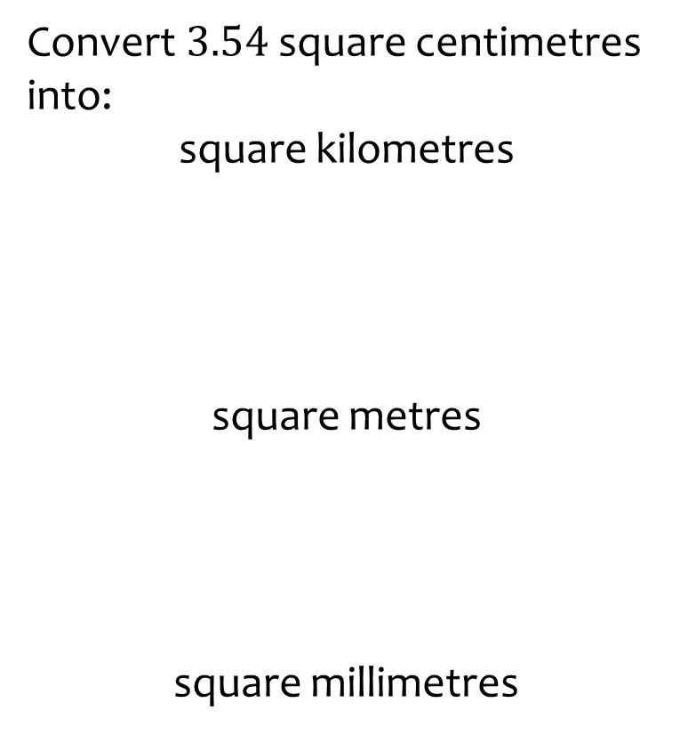
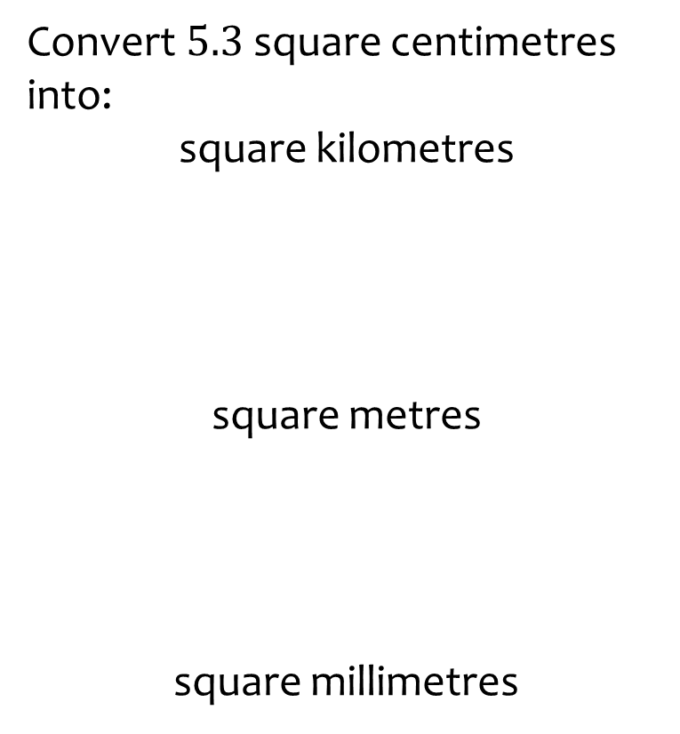
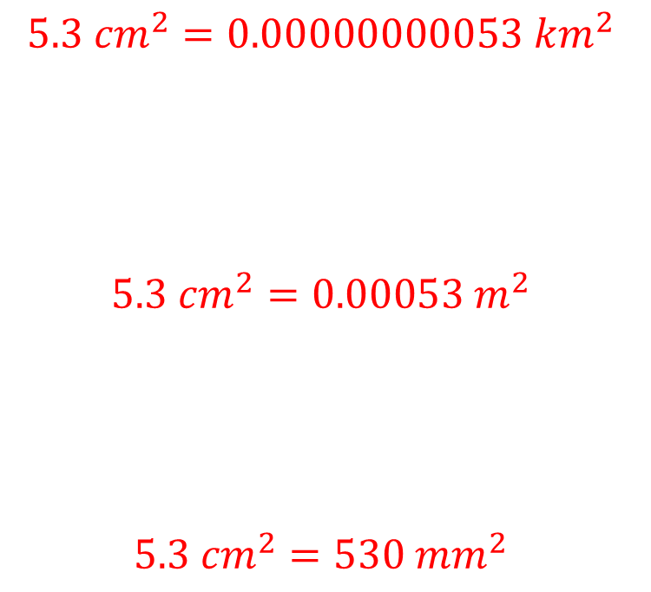
Worked example
Your turn
Convert $3.54$ square centimetres into:
square kilometres
square metres
square millimetres
Convert $5.3$ square centimetres into:
square kilometres
square metres
square millimetres
$$5.3 {cm}^{2}=0.00000000053 km^{2}$$
$$5.3 {cm}^{2}=0.00053 m^{2}$$
$$5.3 {cm}^{2}=530 mm^{2}$$

Slide 9
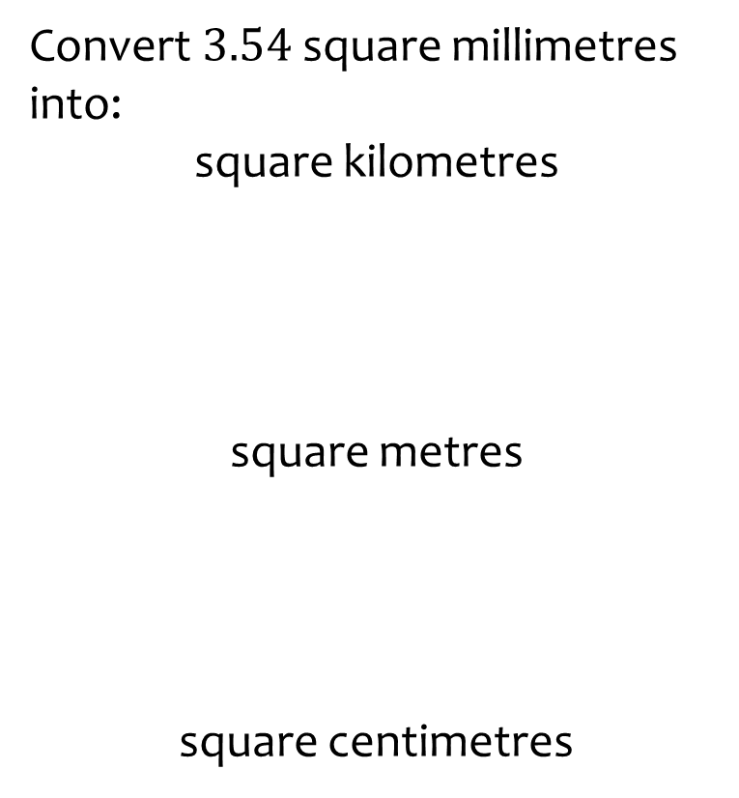
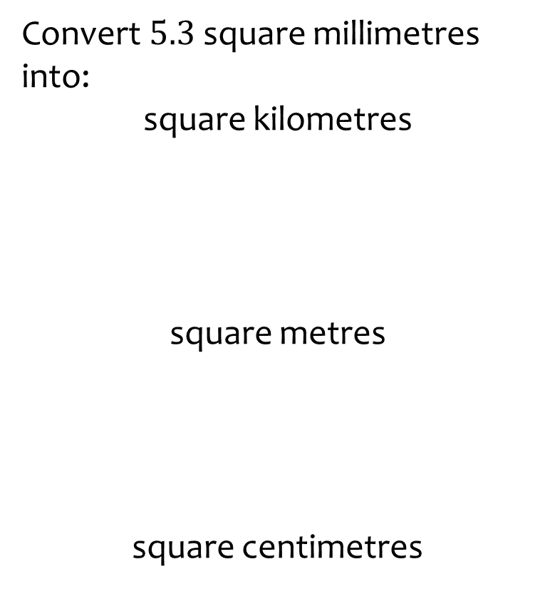
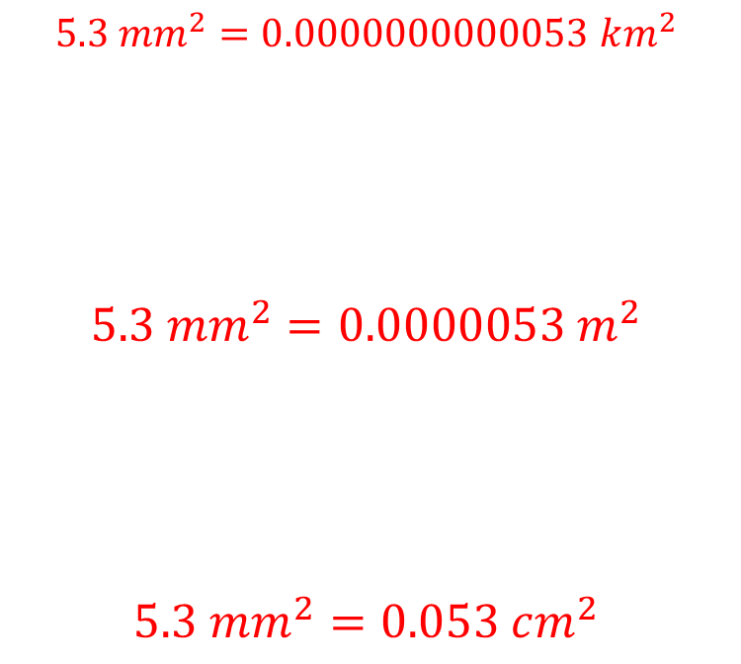
Worked example
Your turn
Convert $3.54$ square millimetres into:
square kilometres
square metres
square centimetres
Convert $5.3$ square millimetres into:
square kilometres
square metres
square centimetres
$$5.3 {mm}^{2}=0.0000000000053 km^{2}$$
$$5.3 {mm}^{2}=0.0000053 m^{2}$$
$$5.3 mm^{2}=0.053 cm^{2}$$

Slide 10
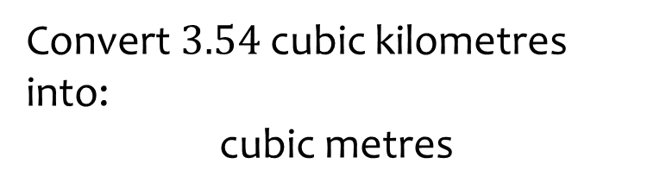
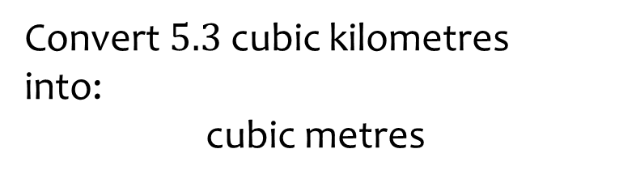

Worked example
Your turn
Convert $3.54$ cubic kilometres into:
cubic metres
Convert $5.3$ cubic kilometres
into:
cubic metres
$$5.3 km^{3}=5300000000 m^{3}$$

Slide 11
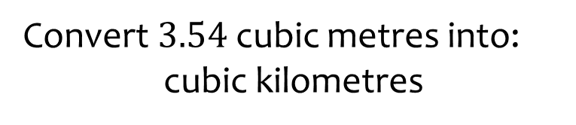
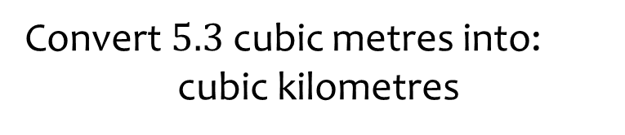

Worked example
Your turn
Convert $3.54$ cubic metres into:
cubic kilometres
Convert $5.3$ cubic metres into:
cubic kilometres
$$5.3 m^{3}=0.0000000053 {km}^{3}$$

Slide 12
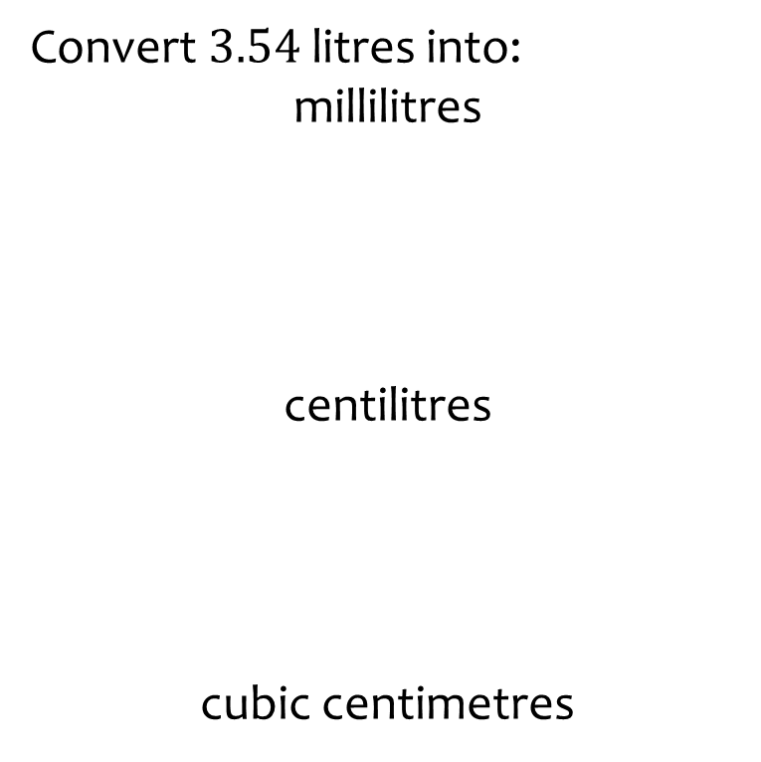
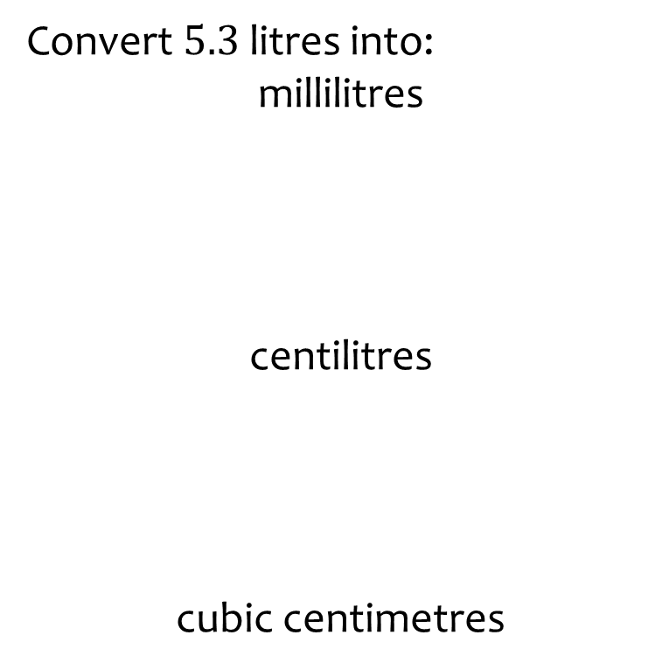
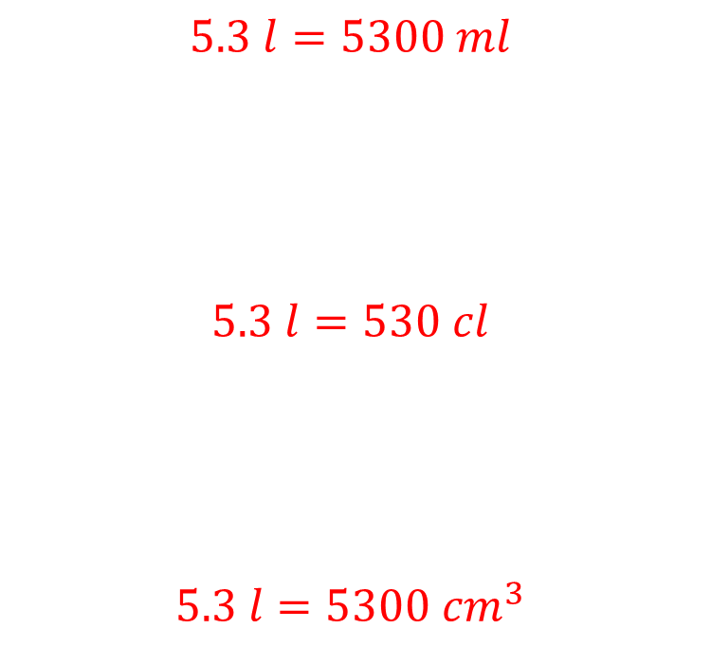
Worked example
Your turn
Convert $3.54$ litres into:
millilitres
centilitres
cubic centimetres
Convert $5.3$ litres into:
millilitres
centilitres
cubic centimetres
$$5.3 l=5300 ml$$
$$5.3 l=530 cl$$
$$5.3 l=5300 cm^{3}$$

Slide 13
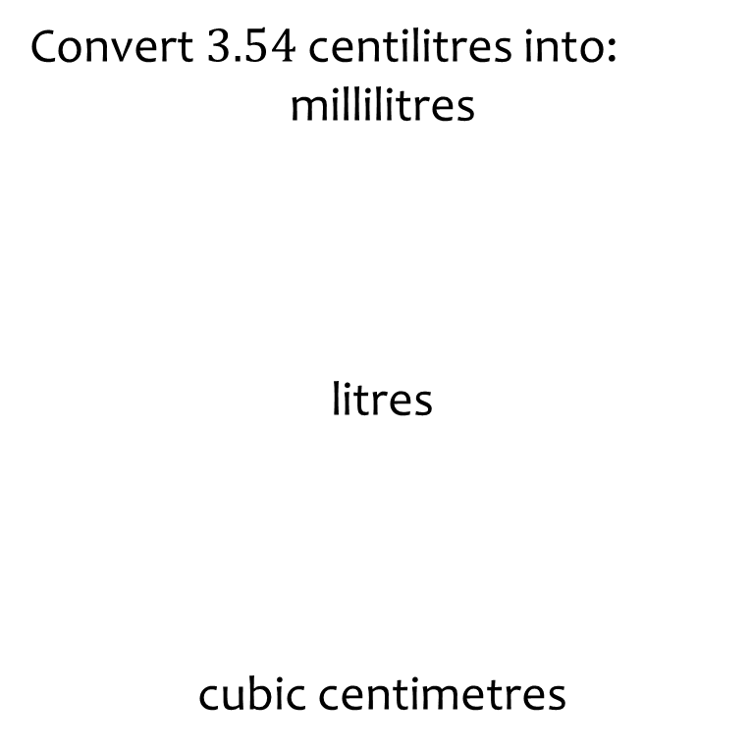
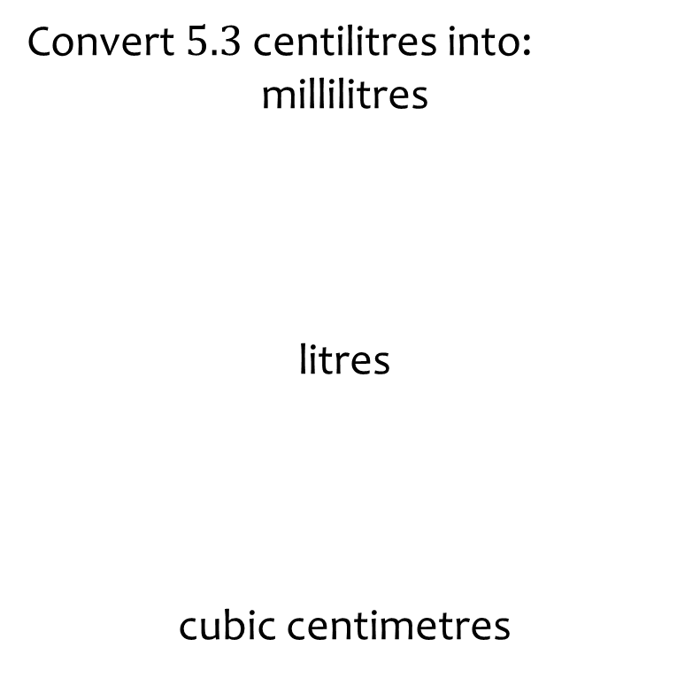
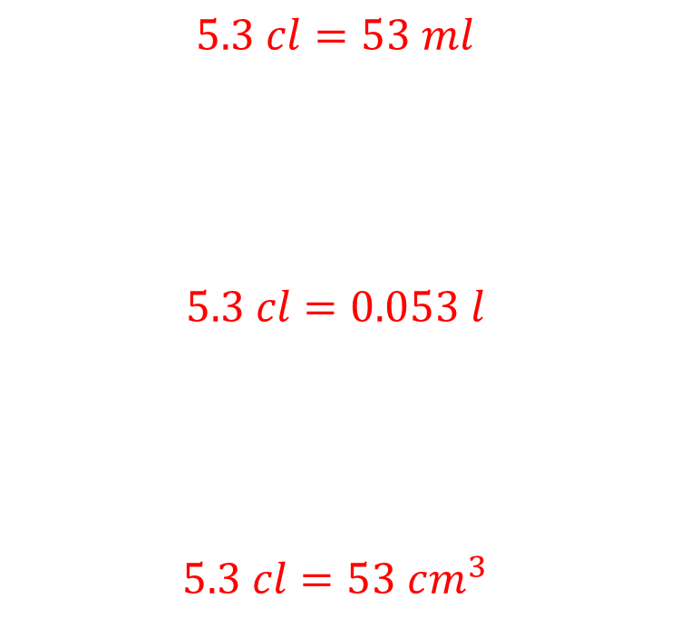
Worked example
Your turn
Convert $3.54$ centilitres into:
millilitres
litres
cubic centimetres
Convert $5.3$ centilitres into:
millilitres
litres
cubic centimetres
$$5.3 cl=53 ml$$
$$5.3 cl=0.053 l$$
$$5.3 cl=53 cm^{3}$$

Slide 14
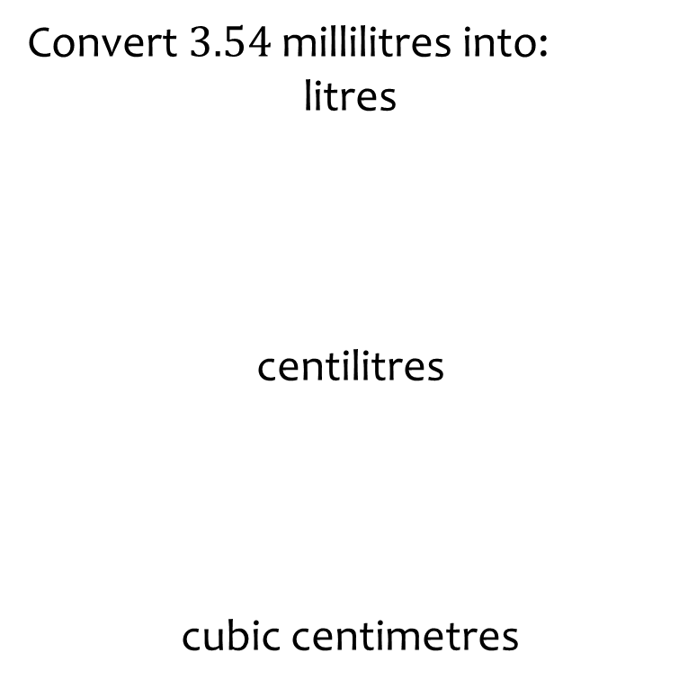
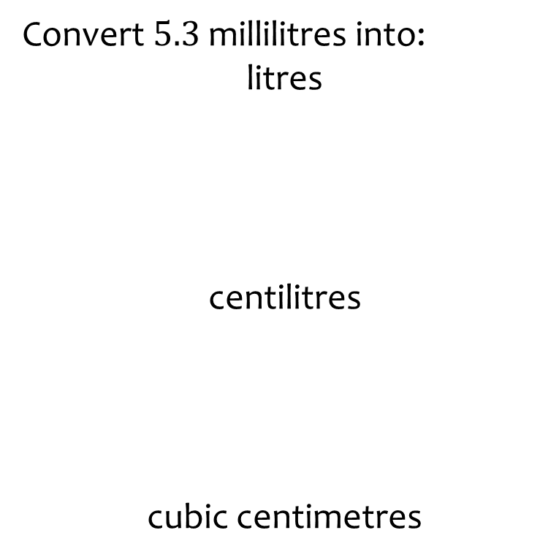
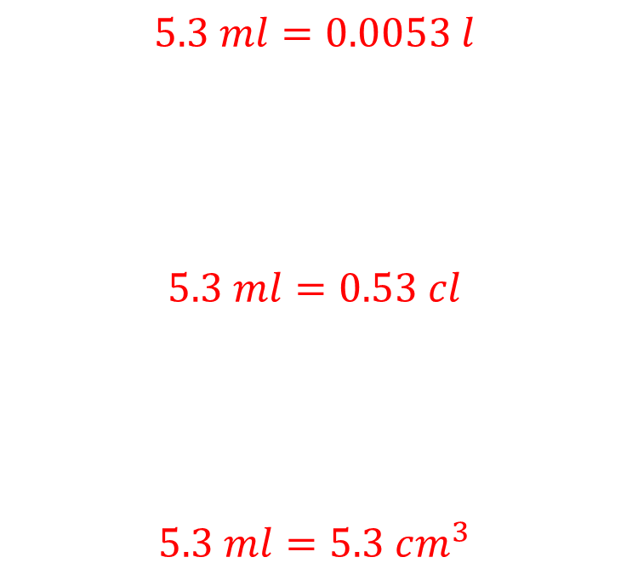
Worked example
Your turn
Convert $3.54$ millilitres into:
litres
centilitres
cubic centimetres
Convert $5.3$ millilitres into:
litres
centilitres
cubic centimetres
$$5.3 ml=0.0053 l$$
$$5.3 ml=0.53 cl$$
$$5.3 ml=5.3 cm^{3}$$

Slide 15
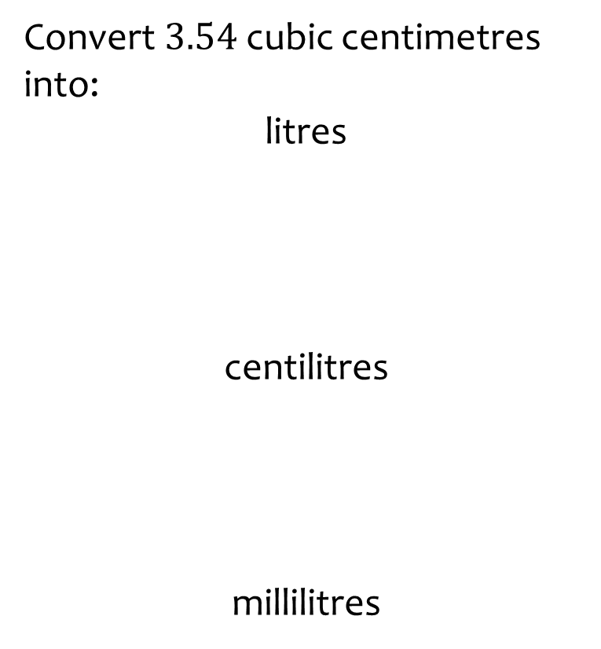
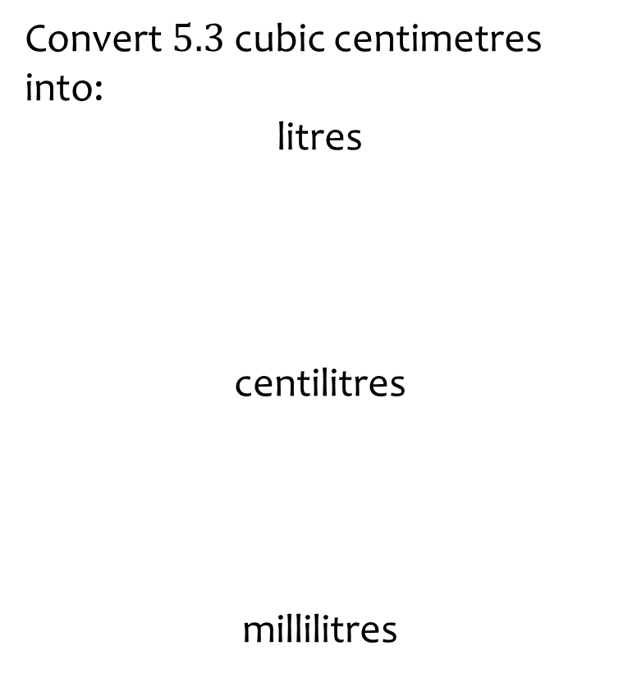
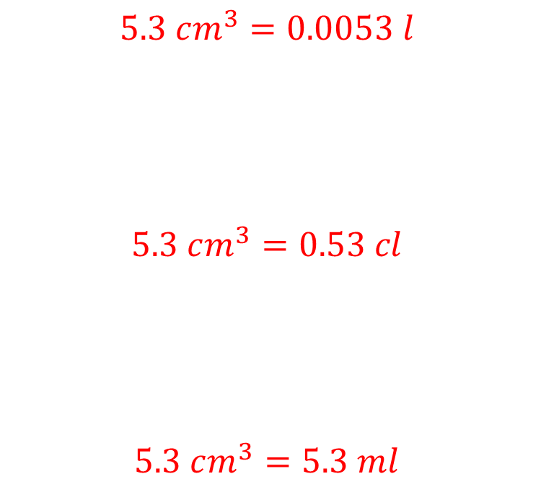
Worked example
Your turn
Convert $3.54$ cubic centimetres into:
litres
centilitres
millilitres
Convert $5.3$ cubic centimetres into:
litres
centilitres
millilitres
$$5.3 cm^{3}=0.0053 l$$
$$5.3 cm^{3}=0.53 cl$$
$$5.3 cm^{3}=5.3 ml$$

Slide 16
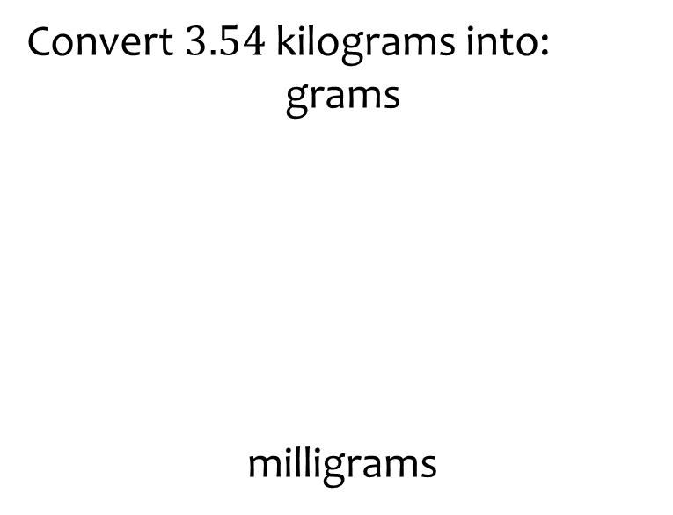
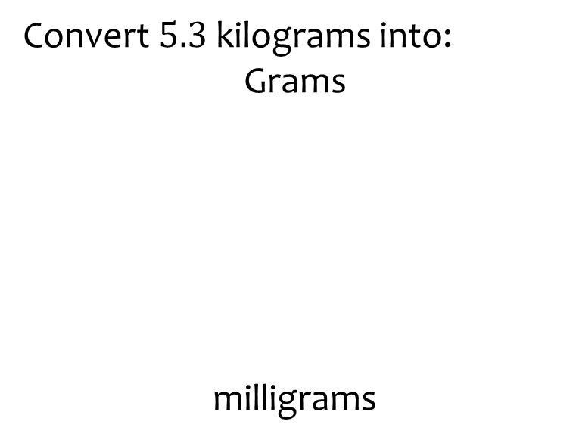
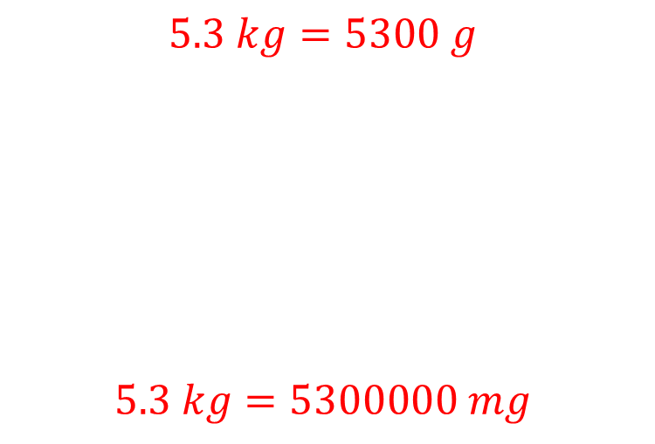
Worked example
Your turn
Convert $3.54$ kilograms into:
grams
milligrams
Convert $5.3$ kilograms into:
Grams
milligrams
$$5.3 kg=5300 g$$
$$5.3 kg=5300000 mg$$

Slide 17
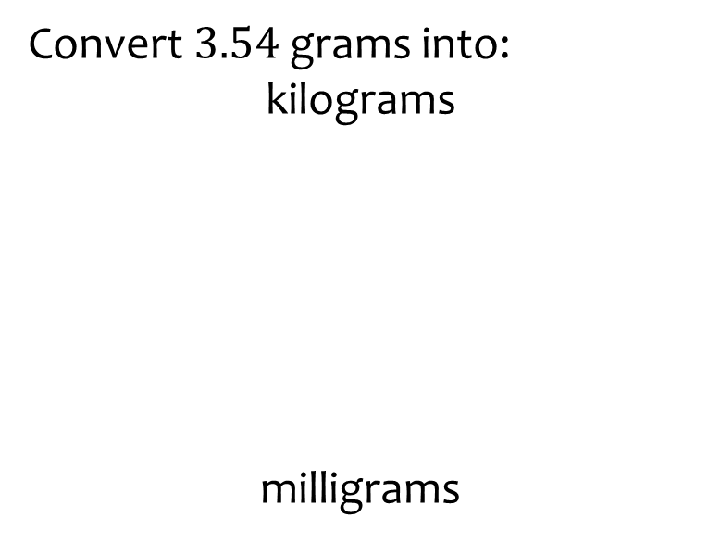
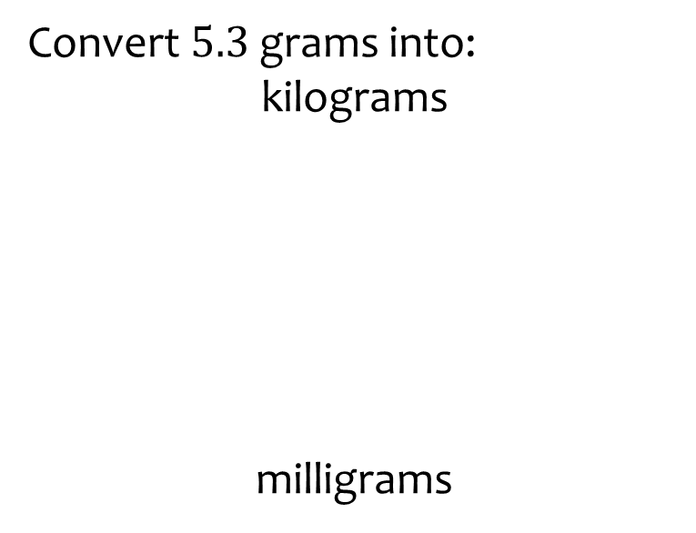
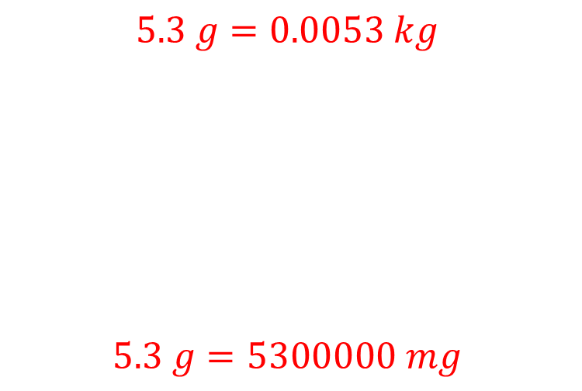
Worked example
Your turn
Convert $3.54$ grams into:
kilograms
milligrams
Convert $5.3$ grams into:
kilograms
milligrams
$$5.3 g=0.0053 kg$$
$$5.3 g=5300000 mg$$

Slide 18
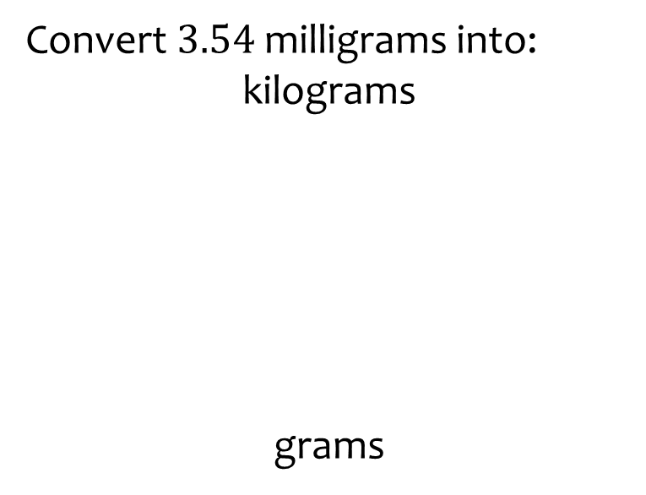
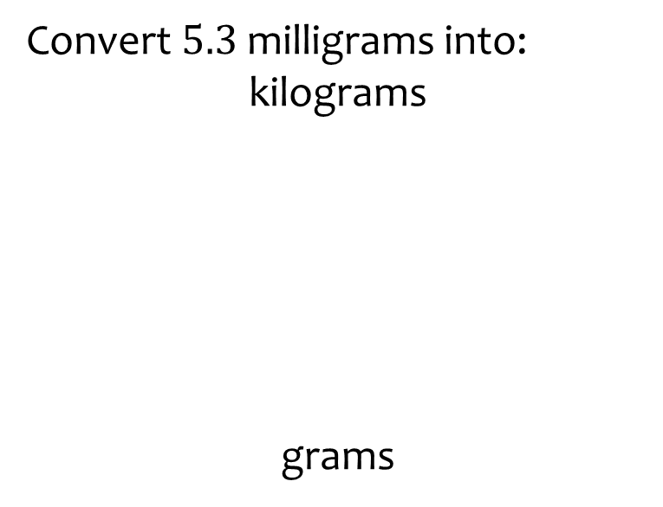
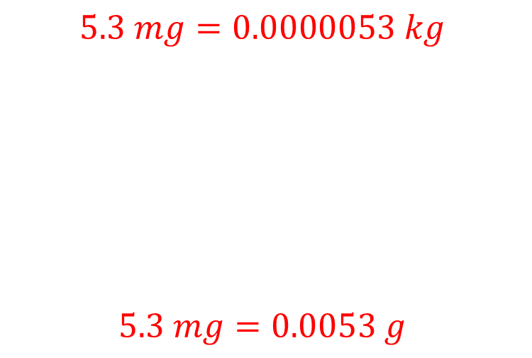
Worked example
Your turn
Convert $3.54$ milligrams into:
kilograms
grams
Convert $5.3$ milligrams into:
kilograms
grams
$$5.3 mg=0.0000053 kg$$
$$5.3 mg=0.0053 g$$

Slide 19
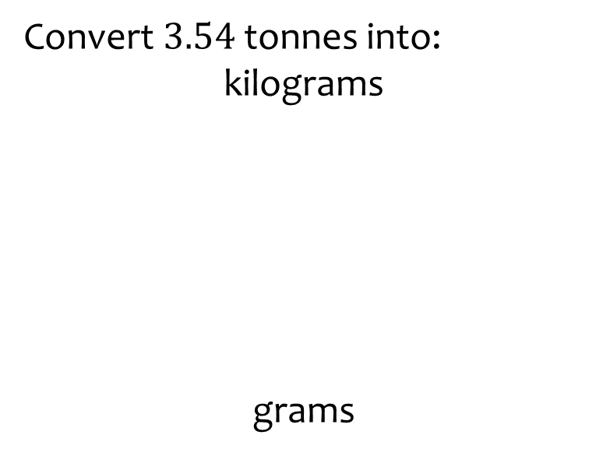


Worked example
Your turn
Convert $3.54$ tonnes into:
kilograms
grams
Convert $5.3$ tonnes into:
kilograms
grams
$$5.3 t=5300 kg$$
$$5.3 t=5300000 g$$

Slide 20



Worked example
Your turn
Convert $3.54$ kilograms into:
tonnes
grams
Convert $5.3$ kilograms into:
tonnes
grams
$$5.3 kg=0.0053 t$$
$$5.3 kg=5300 g$$

Slide 21



Worked example
Your turn
Convert $3.54$ grams into:
tonnes
kilograms
Convert $5.3$ grams into:
tonnes
kilograms
$$5.3 g=0.0000053 t$$
$$5.3 g=0.0053 kg$$

Slide 22



Worked example
Your turn
Convert:
$250$kilometres per hour to a speed in metres per second.
$500$ kilometres per hour to a speed in metres per second.
Convert:
$750$kilometres per hour to a speed in metres per second.
$$208 m/s$$

Slide 23



Worked example
Your turn
Convert:
$3600$metres per second to a speed in kilometres per hour
$5400$ metres per second to a speed in kilometres per hour
Convert:
$7200$metres per second to a speed in kilometres per hour
$$0.002 km/h$$

