Slide 1
Compound measures
CONTENTS

Slide 2
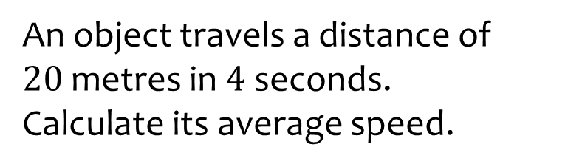
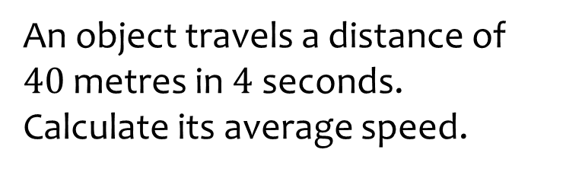

Worked example
Your turn
An object travels a distance of $20$metres in $4$ seconds.
Calculate its average speed.
An object travels a distance of $40$metres in $4$ seconds.
Calculate its average speed.
$$10 m/s$$

Slide 3
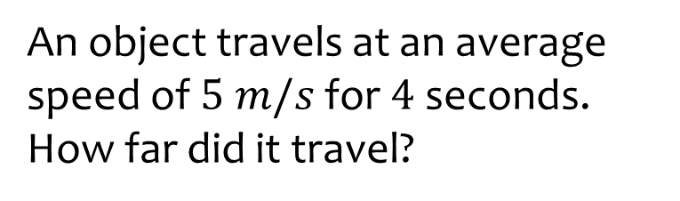
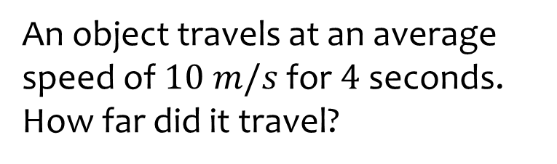

Worked example
Your turn
An object travels at an average speed of $5 m/s$ for $4$ seconds.
How far did it travel?
An object travels at an average speed of $10 m/s$ for $4$ seconds.
How far did it travel?
$$40 m$$

Slide 4
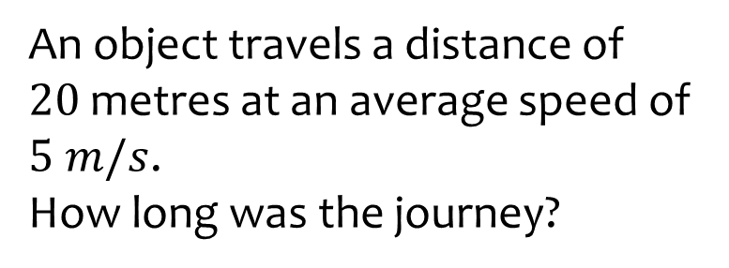
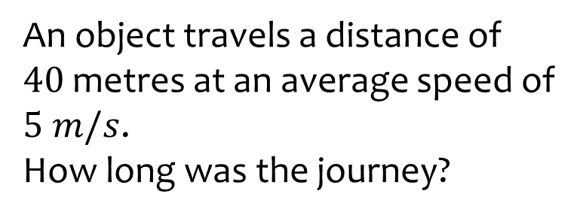

Worked example
Your turn
An object travels a distance of $20$metres at an average speed of $5 m/s$.
How long was the journey?
An object travels a distance of $40$metres at an average speed of $5 m/s$.
How long was the journey?
$10$ seconds

Slide 5
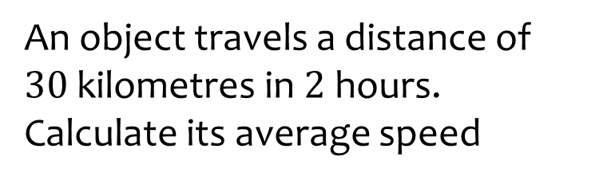
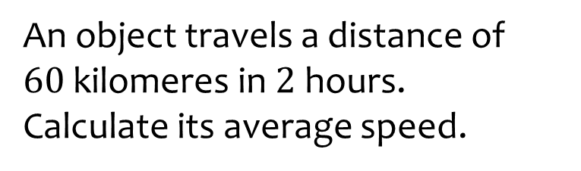

Worked example
Your turn
An object travels a distance of $30$kilometres in $2$ hours. Calculate its average speed
An object travels a distance of $60$kilomeres in $2$hours.
Calculate its average speed.
$$7.5 km/h$$

Slide 6
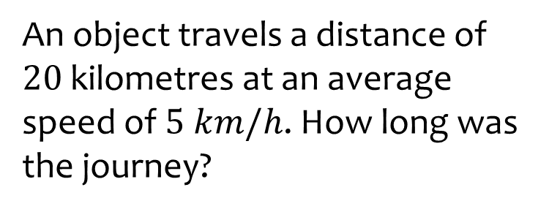
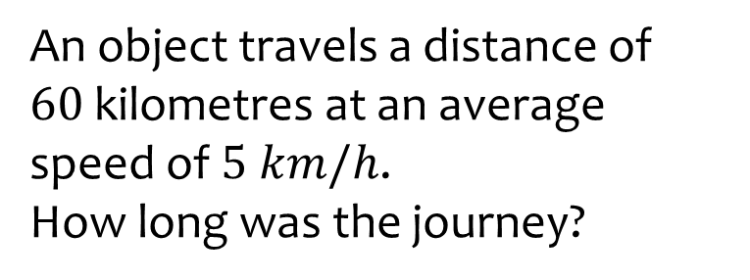

Worked example
Your turn
An object travels a distance of $20$kilometres at an average speed of $5 km/h$. How long was the journey?
An object travels a distance of $60$kilometres at an average speed of $5 km/h$.
How long was the journey?
$12$ hours

Slide 7
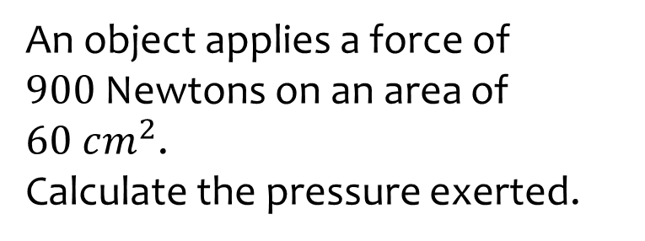
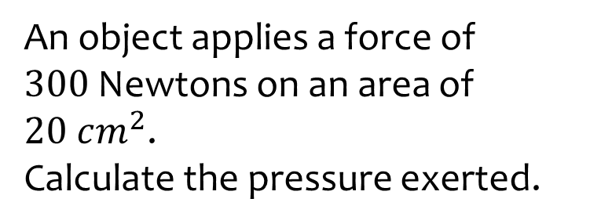

Worked example
Your turn
An object applies a force of $900$Newtons on an area of $60 cm^{2}$.
Calculate the pressure exerted.
An object applies a force of $300$Newtons on an area of $20 cm^{2}$.
Calculate the pressure exerted.
$$15 N/cm^{2}$$

Slide 8
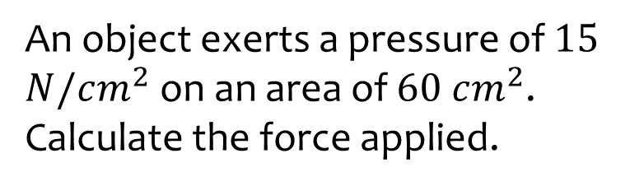
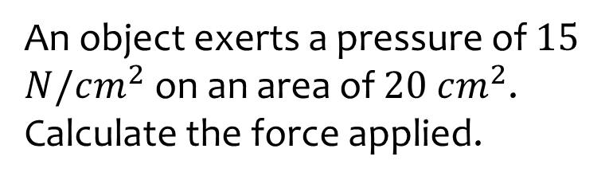

Worked example
Your turn
An object exerts a pressure of $15$ $N/cm^{2}$ on an area of $60 cm^{2}$. Calculate the force applied.
An object exerts a pressure of $15$ $N/cm^{2}$ on an area of $20 cm^{2}$. Calculate the force applied.
$$300 N$$

Slide 9
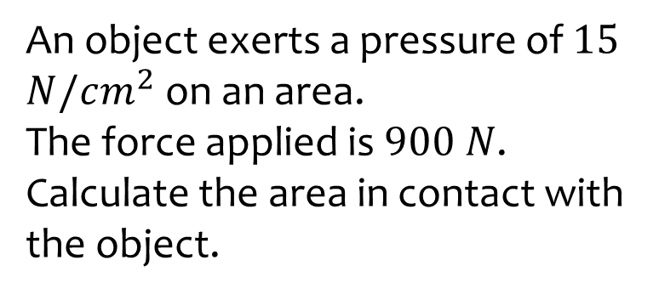
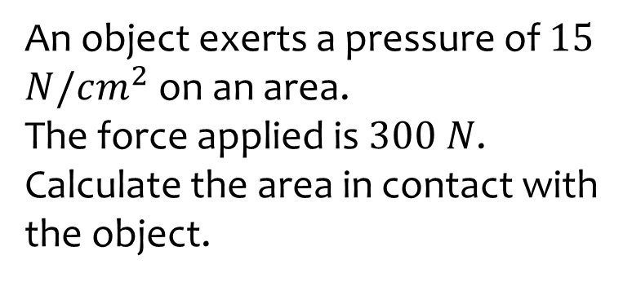

Worked example
Your turn
An object exerts a pressure of $15$ $N/cm^{2}$ on an area.
The force applied is $900 N$.
Calculate the area in contact with the object.
An object exerts a pressure of $15$ $N/cm^{2}$ on an area.
The force applied is $300 N$.
Calculate the area in contact with the object.
$$20 cm^{2}$$

Slide 10
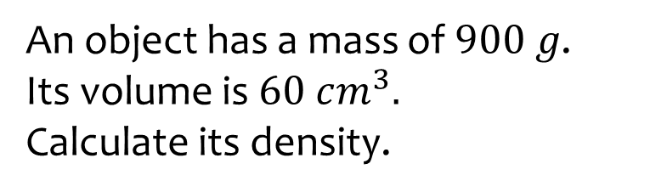
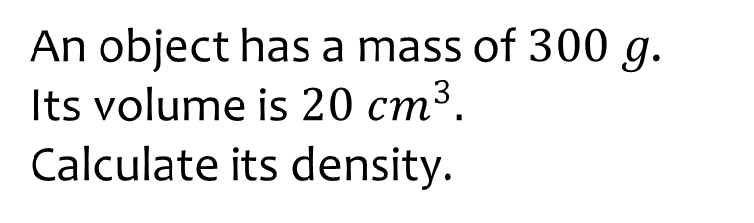

Worked example
Your turn
An object has a mass of $900 g$.
Its volume is $60 cm^{3}.$
Calculate its density.
An object has a mass of $300 g$.
Its volume is $20 cm^{3}.$
Calculate its density.
$$15 g/cm^{3}$$

Slide 11
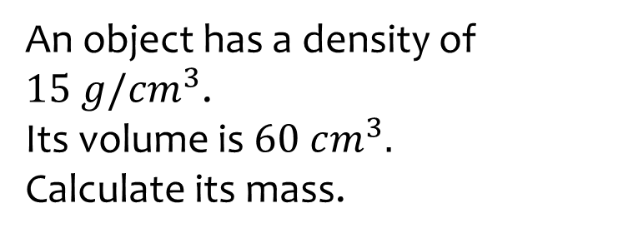
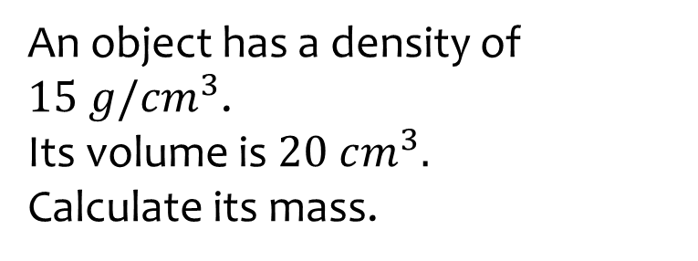

Worked example
Your turn
An object has a density of $15 g/cm^{3}$.
Its volume is $60 cm^{3}.$
Calculate its mass.
An object has a density of $15 g/cm^{3}$.
Its volume is $20 cm^{3}.$
Calculate its mass.
$$300 g$$

Slide 12
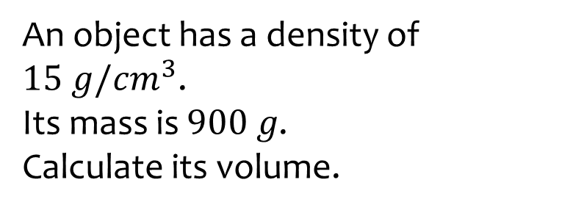
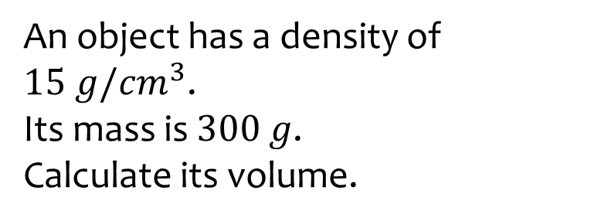

Worked example
Your turn
An object has a density of $15 g/cm^{3}$.
Its mass is $900 g$.
Calculate its volume.
An object has a density of $15 g/cm^{3}$.
Its mass is $300$ $g$.
Calculate its volume.
$$20 cm^{3}$$

Slide 13
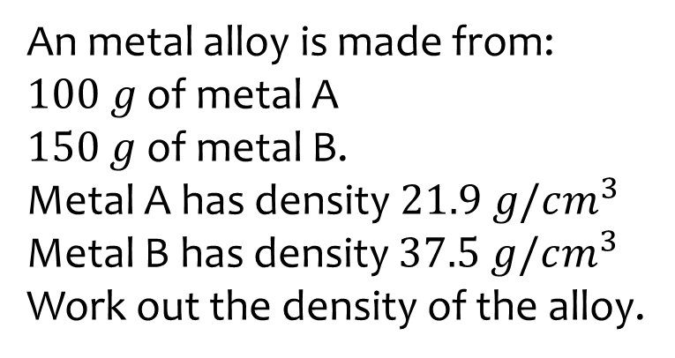
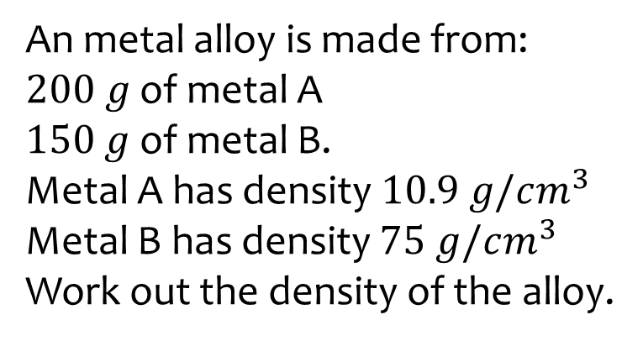

Worked example
Your turn
An metal alloy is made from:
$100 g$ of metal A
$150$ $g$ of metal B.
Metal A has density $21.9 g/cm^{3}$
Metal B has density $37.5 g/cm^{3}$
Work out the density of the alloy.
An metal alloy is made from:
$200 g$ of metal A
$150$ $g$ of metal B.
Metal A has density $10.9 g/cm^{3}$
Metal B has density $75 g/cm^{3}$
Work out the density of the alloy.
$$17.2 g/cm^{3}$$

Slide 14
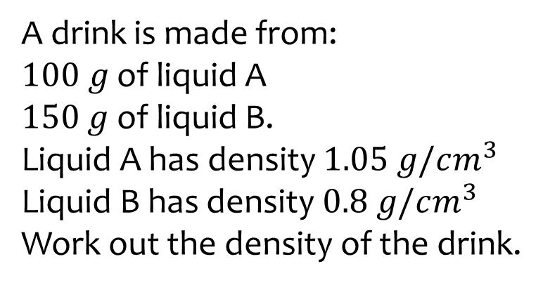
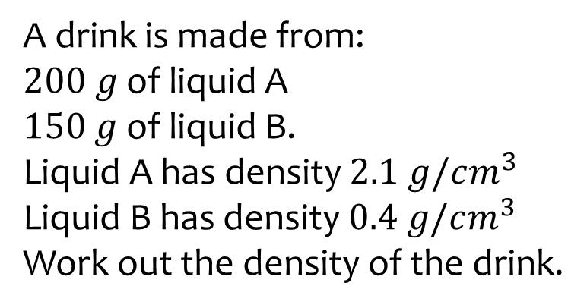

Worked example
Your turn
A drink is made from:
$100 g$ of liquid A
$150$ $g$ of liquid B.
Liquid A has density $1.05 g/cm^{3}$
Liquid B has density $0.8 g/cm^{3}$
Work out the density of the drink.
A drink is made from:
$200 g$ of liquid A
$150$ $g$ of liquid B.
Liquid A has density $2.1 g/cm^{3}$
Liquid B has density $0.4 g/cm^{3}$
Work out the density of the drink.
$0.74 g/cm^{3}$ (2 dp)

Slide 15
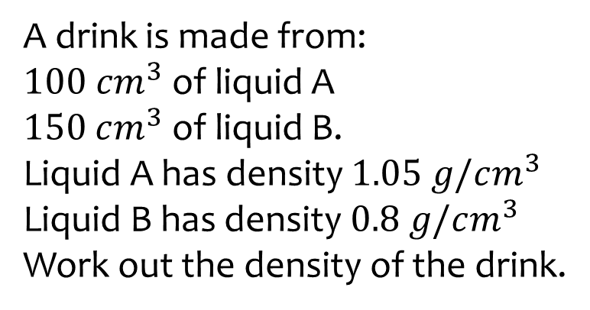
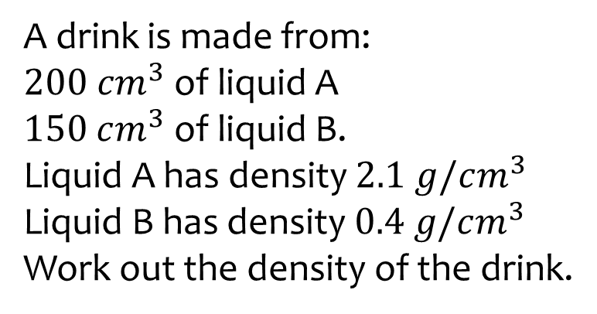

Worked example
Your turn
A drink is made from:
$100 cm^{3}$ of liquid A
$150$ $cm^{3}$ of liquid B.
Liquid A has density $1.05 g/cm^{3}$
Liquid B has density $0.8 g/cm^{3}$
Work out the density of the drink.
A drink is made from:
$200 cm^{3}$ of liquid A
$150$ $cm^{3}$ of liquid B.
Liquid A has density $2.1 g/cm^{3}$
Liquid B has density $0.4 g/cm^{3}$
Work out the density of the drink.
$1.37 g/cm^{3}$ (2 dp)

Slide 16
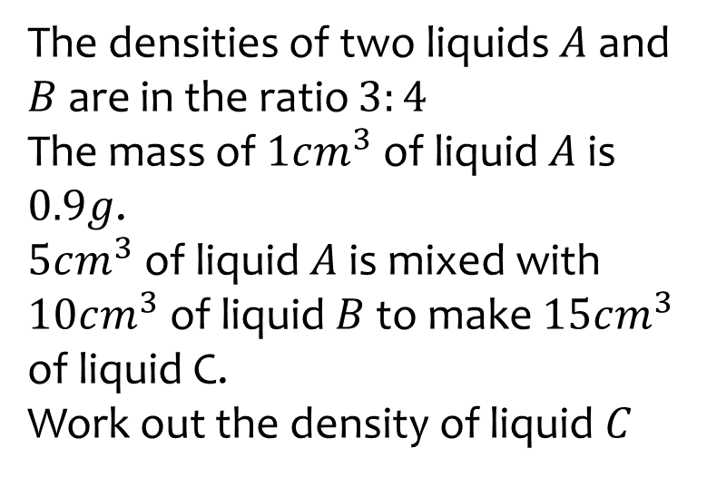
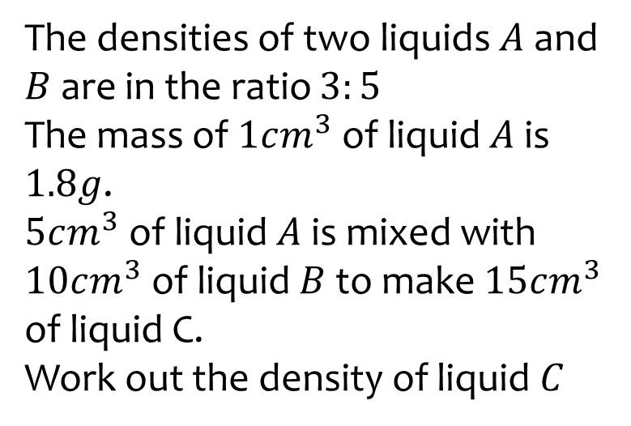

Worked example
Your turn
The densities of two liquids $A$ and $B$ are in the ratio $3:4$
The mass of $1cm^{3}$ of liquid $A$ is $0.9g$.
$5cm^{3}$ of liquid $A$ is mixed with $10cm^{3}$ of liquid $B$ to make $15cm^{3}$ of liquid C.
Work out the density of liquid $C$
The densities of two liquids $A$ and $B$ are in the ratio $3:5$
The mass of $1cm^{3}$ of liquid $A$ is $1.8g$.
$5cm^{3}$ of liquid $A$ is mixed with $10cm^{3}$ of liquid $B$ to make $15cm^{3}$ of liquid C.
Work out the density of liquid $C$
$$2.6 g/cm^{3}$$

Slide 17
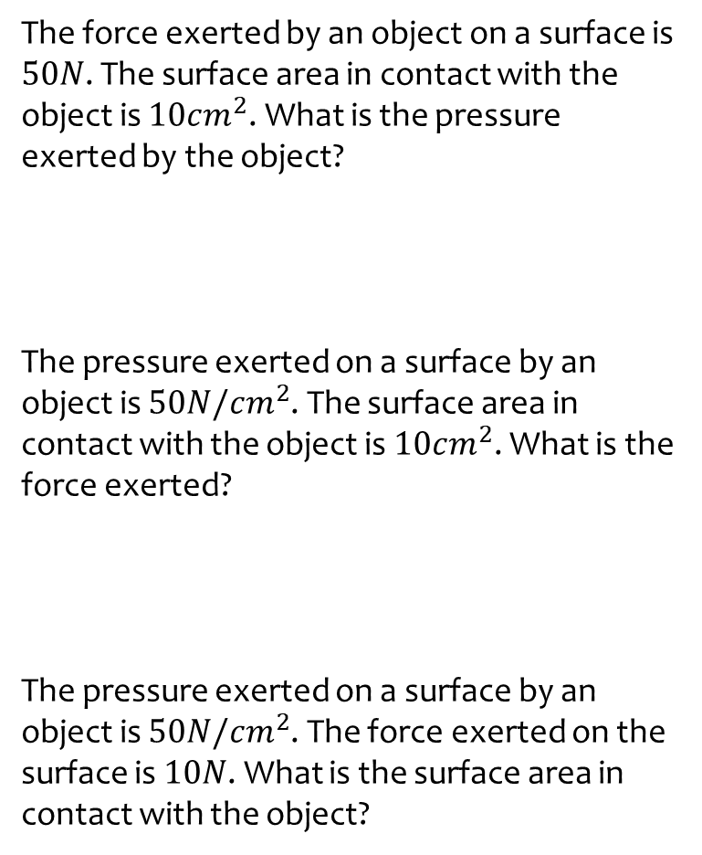
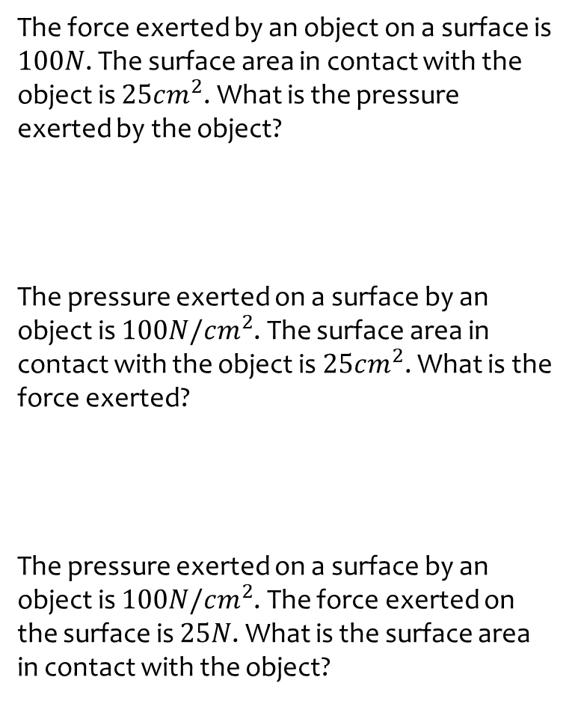
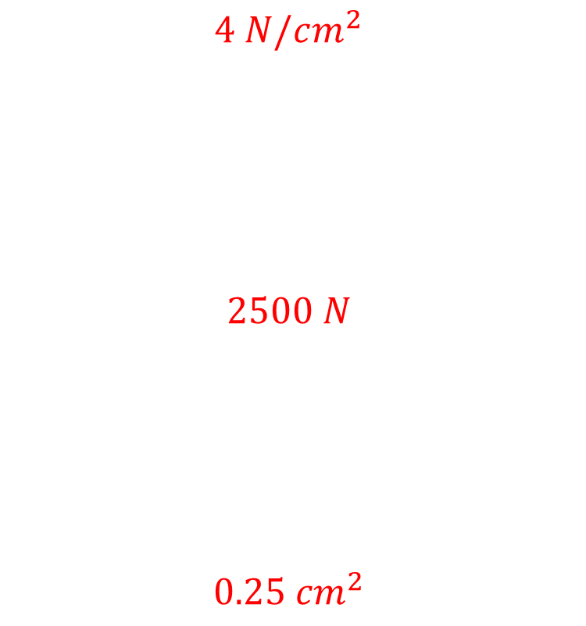
Worked example
Your turn
The force exerted by an object on a surface is $50N$. The surface area in contact with the object is $10cm^{2}$. What is the pressure exerted by the object?
The pressure exerted on a surface by an object is $50N/cm^{2}$. The surface area in contact with the object is $10cm^{2}$. What is the force exerted?
The pressure exerted on a surface by an object is $50N/cm^{2}$. The force exerted on the surface is $10N$. What is the surface area in contact with the object?
The force exerted by an object on a surface is $100N$. The surface area in contact with the object is $25cm^{2}$. What is the pressure exerted by the object?
The pressure exerted on a surface by an object is $100N/cm^{2}$. The surface area in contact with the object is $25cm^{2}$. What is the force exerted?
The pressure exerted on a surface by an object is $100N/cm^{2}$. The force exerted on the surface is $25N$. What is the surface area in contact with the object?
$4 N/cm^{2}$
$$2500 N$$
$$0.25 cm^{2}$$

Slide 18
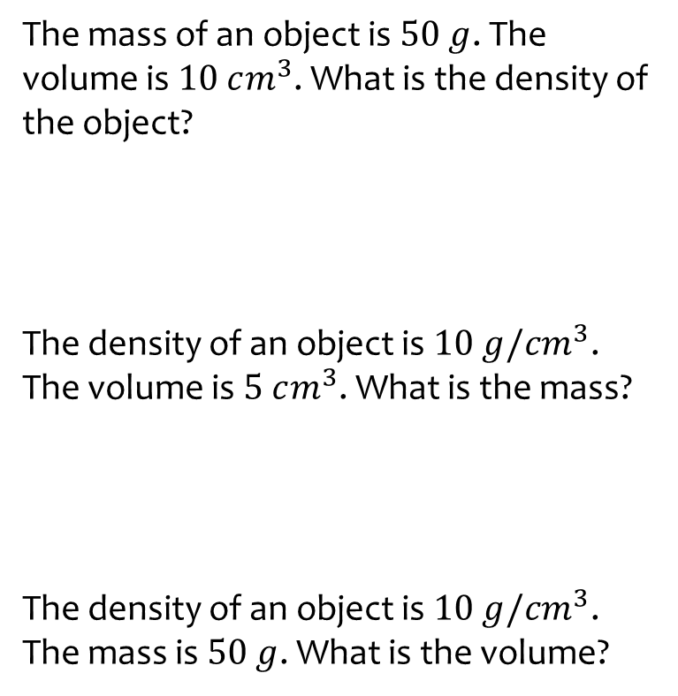
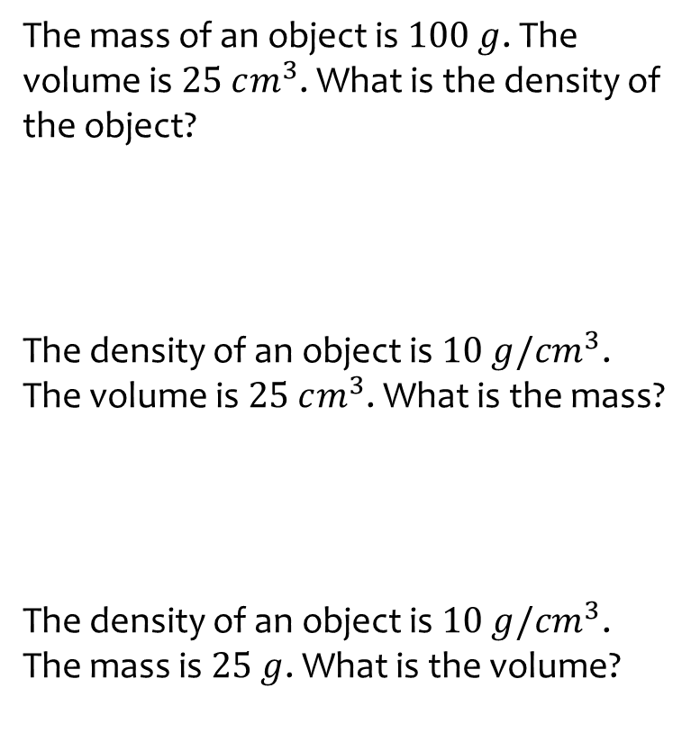
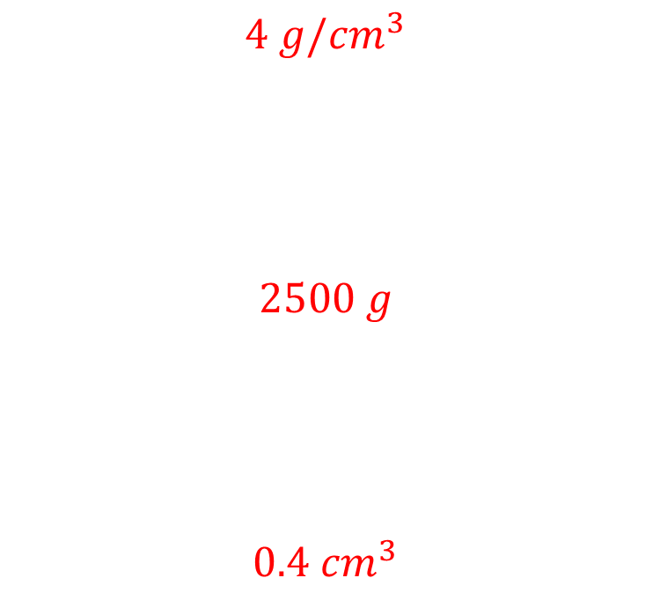
Worked example
Your turn
The mass of an object is $50 g$. The volume is $10 cm^{3}$. What is the density of the object?
The density of an object is $10 g/cm^{3}$. The volume is $5 cm^{3}$. What is the mass?
The density of an object is $10 g/cm^{3}$. The mass is $50 g$. What is the volume?
The mass of an object is $100 g$. The volume is $25 cm^{3}$. What is the density of the object?
The density of an object is $10 g/cm^{3}$. The volume is $25 cm^{3}$. What is the mass?
The density of an object is $10 g/cm^{3}$. The mass is $25 g$. What is the volume?
$$4 g/cm^{3}$$
$$2500 g$$
$$0.4 cm^{3}$$

Slide 19
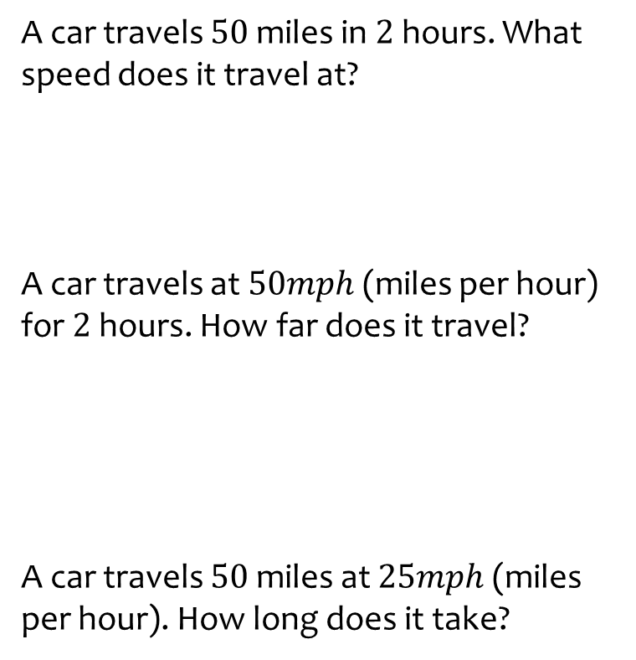
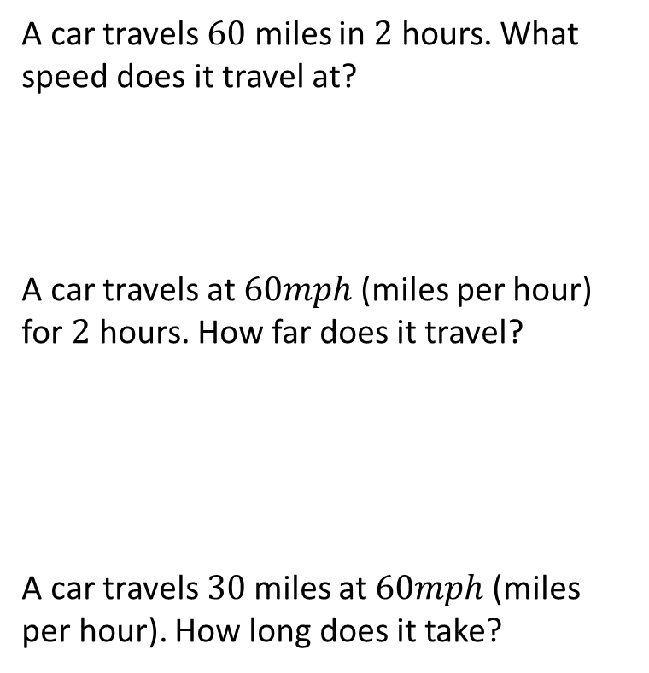
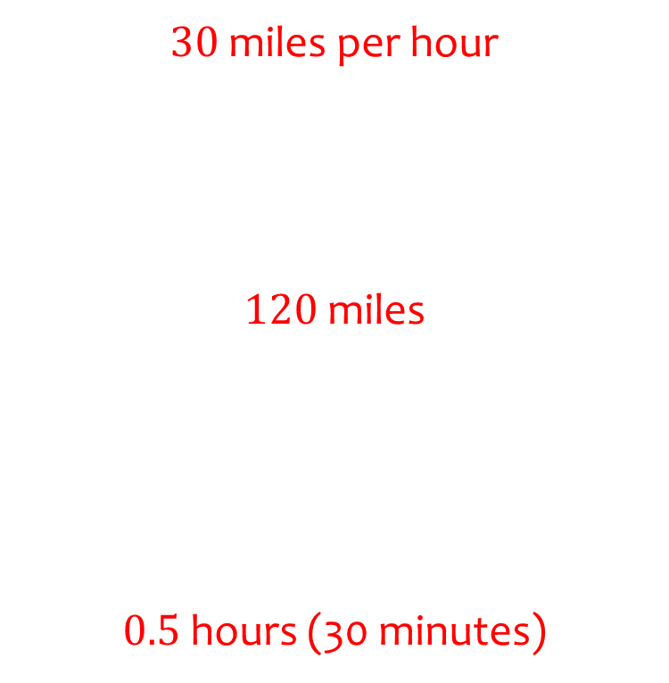
Worked example
Your turn
A car travels $50$ miles in $2$ hours. What speed does it travel at?
A car travels at $50mph$(miles per hour) for $2$ hours. How far does it travel?
A car travels $50$miles at $25mph$(miles per hour). How long does it take?
A car travels $60$ miles in $2$ hours. What speed does it travel at?
A car travels at $60mph$(miles per hour) for $2$ hours. How far does it travel?
A car travels $30$miles at $60mph$(miles per hour). How long does it take?
$30$miles per hour
$120$miles
$0.5$ hours (30 minutes)

Slide 20
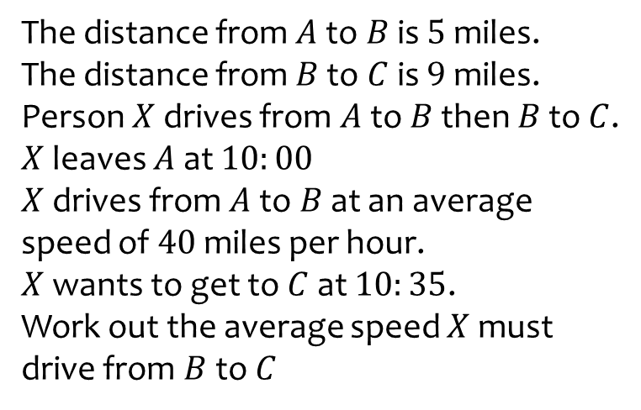
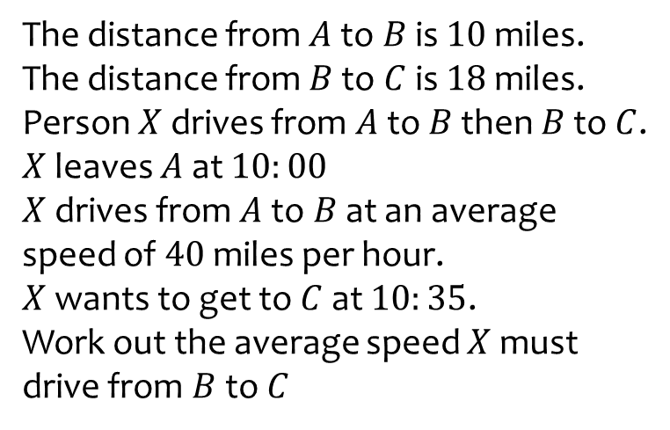

Worked example
Your turn
The distance from $A$ to $B$ is $5$ miles.
The distance from $B$ to $C$ is $9$miles.
Person $X$ drives from $A$ to $B$ then $B$ to $C$.
$X$ leaves $A$ at $10:00$
$X$ drives from $A$ to $B$ at an average speed of $40$ miles per hour.
$X$ wants to get to $C$ at $10:35$.
Work out the average speed $X$ must drive from $B$to $C$
The distance from $A$ to $B$ is $10$ miles.
The distance from $B$ to $C$ is $18$miles.
Person $X$ drives from $A$ to $B$ then $B$ to $C$.
$X$ leaves $A$ at $10:00$
$X$ drives from $A$ to $B$ at an average speed of $40$ miles per hour.
$X$ wants to get to $C$ at $10:35$.
Work out the average speed $X$ must drive from $B$to $C$
$54$ miles per hour

Slide 21
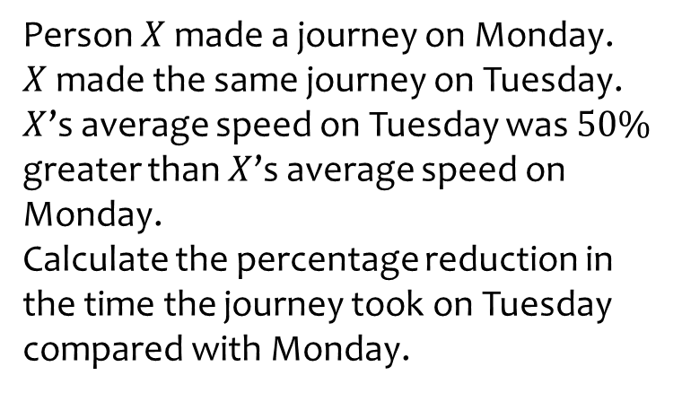
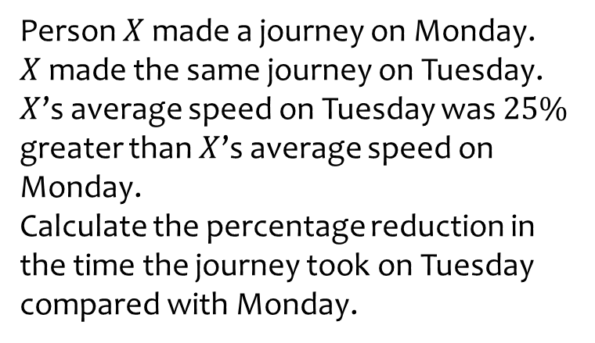

Worked example
Your turn
Person $X$ made a journey on Monday.
$X$ made the same journey on Tuesday.
$X$’s average speed on Tuesday was $50\%$ greater than $X$’s average speed on Monday.
Calculate the percentage reduction in the time the journey took on Tuesday compared with Monday.
Person $X$ made a journey on Monday.
$X$ made the same journey on Tuesday.
$X$’s average speed on Tuesday was $25\%$ greater than $X$’s average speed on Monday.
Calculate the percentage reduction in the time the journey took on Tuesday compared with Monday.
$$20\%$$

