Slide 1
Calculator skills
CONTENTS

Slide 2
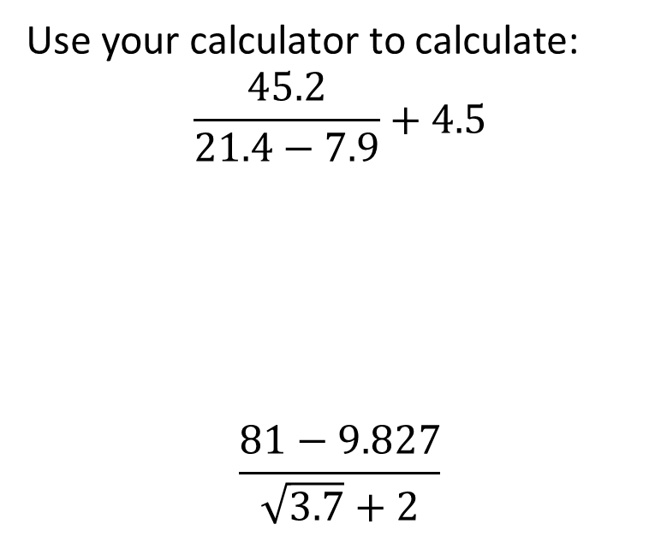
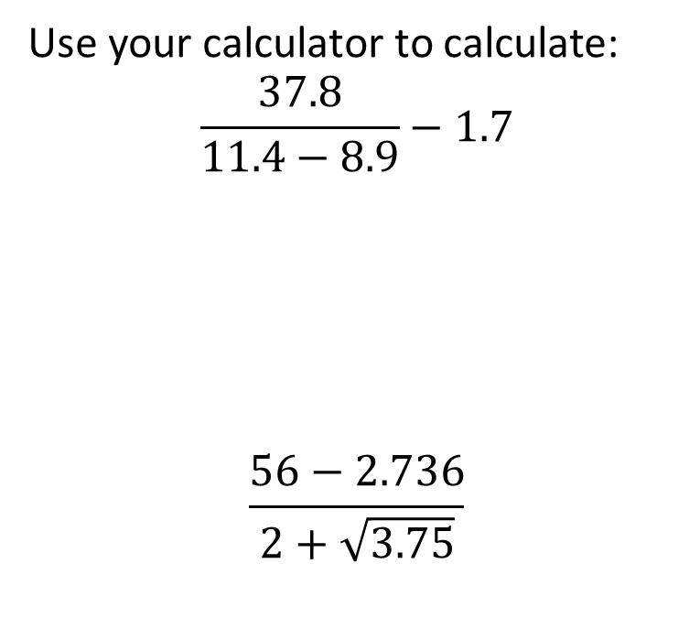
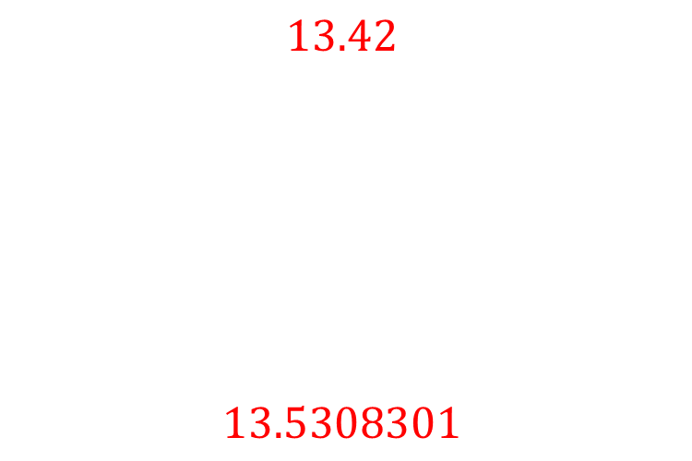
Worked example
Your turn
Use your calculator to calculate:
$$\frac{45.2}{21.4−7.9}+4.5$$
$$\frac{81−9.827}{\sqrt{3.7}+2}$$
Use your calculator to calculate:
$$\frac{37.8}{11.4−8.9}−1.7$$
$$\frac{56−2.736}{2+\sqrt{3.75}}$$
$$13.42$$
$$13.5308301$$

Slide 3
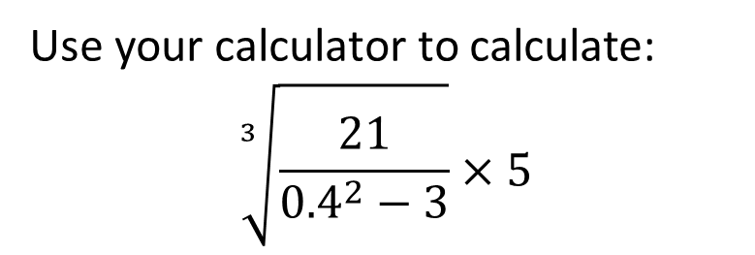
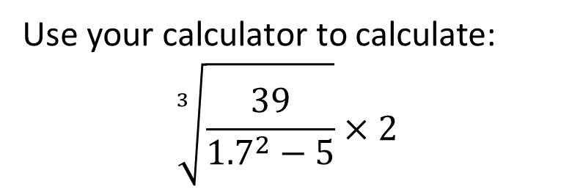

Worked example
Your turn
Use your calculator to calculate:
$$\sqrt[3]{\frac{21}{{0.4}^{2}−3}}×5$$
Use your calculator to calculate:
$$\sqrt[3]{\frac{39}{{1.7}^{2}−5}}×2$$
$$−5.287991068$$

Slide 4
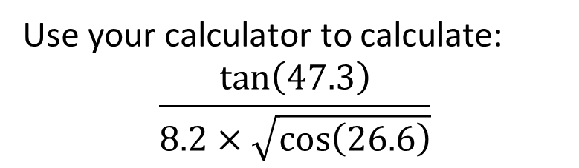
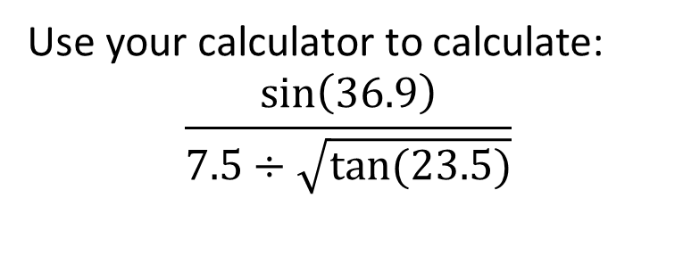

Worked example
Your turn
Use your calculator to calculate:
$$\frac{\tan\left(47.3\right)}{8.2×\sqrt{\cos\left(26.6\right)}}$$
Use your calculator to calculate:
$$\frac{\sin\left(36.9\right)}{7.5÷\sqrt{tan⁡(23.5)}}$$
$$0.05278918993$$

