Slide 1
Bounds
CONTENTS

Slide 2
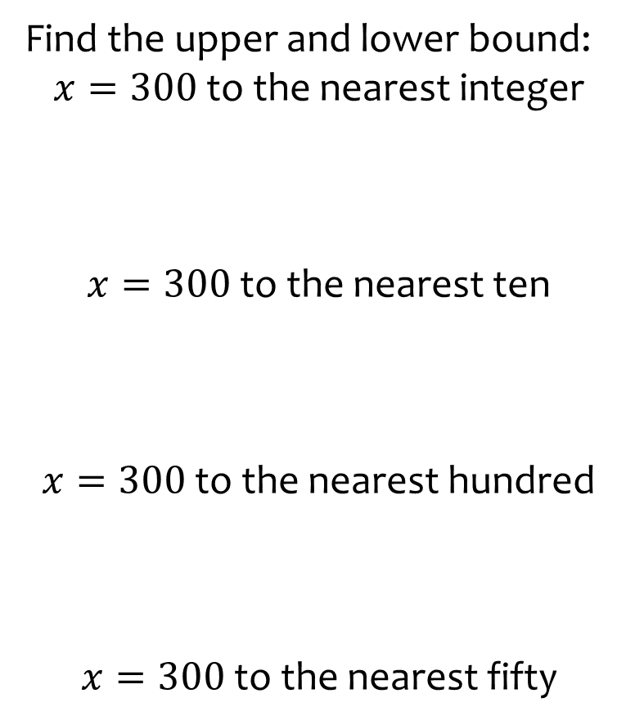
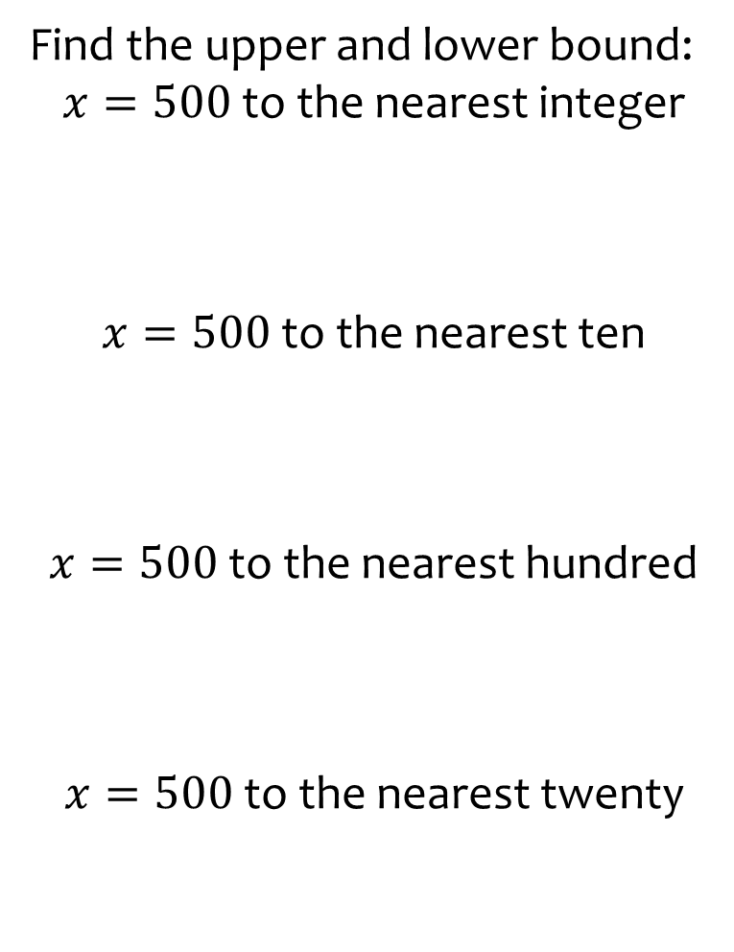
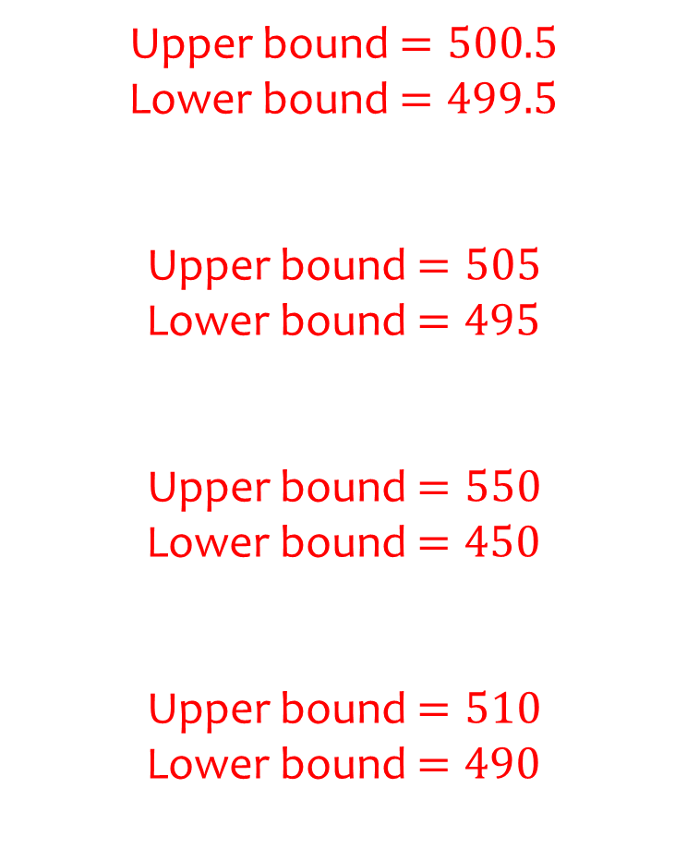
Worked example
Your turn
Find the upper and lower bound:
$x=300$ to the nearest integer
$x=300$ to the nearest ten
$x=300$ to the nearest hundred
$x=300$ to the nearest fifty
Find the upper and lower bound:
$x=500$ to the nearest integer
$x=500$ to the nearest ten
$x=500$ to the nearest hundred
$x=500$ to the nearest twenty
Upper bound $=500.5$
Lower bound $=499.5$
Upper bound $=505$
Lower bound $=495$
Upper bound $=550$
Lower bound $=450$
Upper bound $=510$
Lower bound $=490$

Slide 3
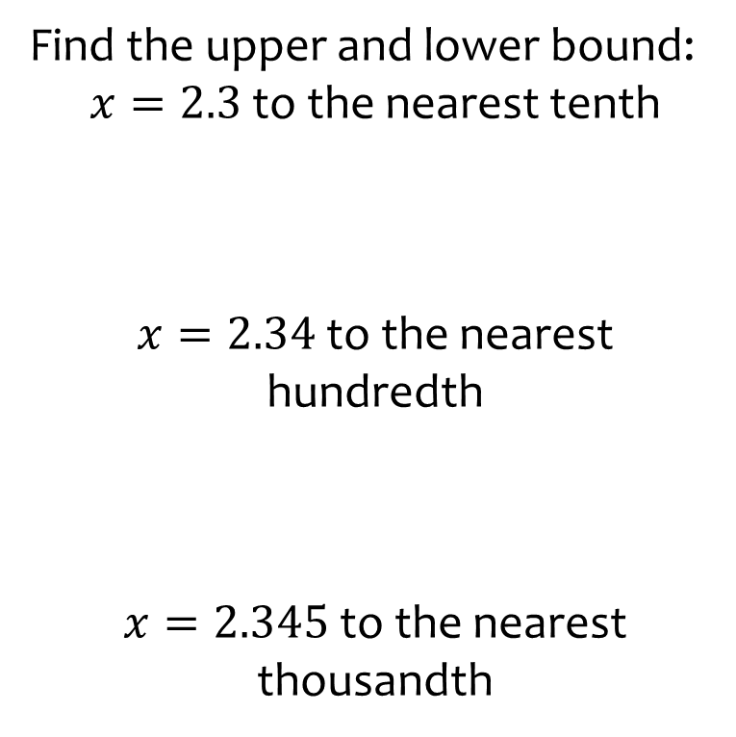
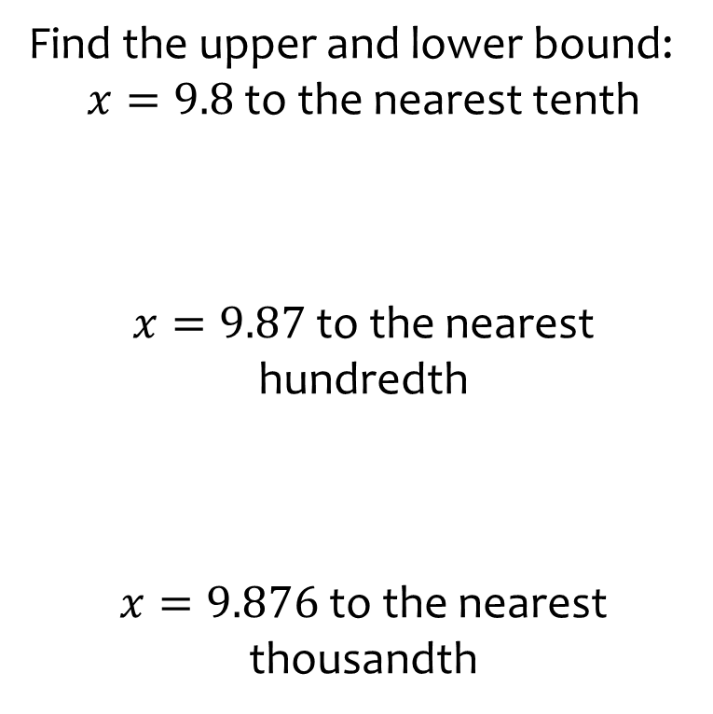
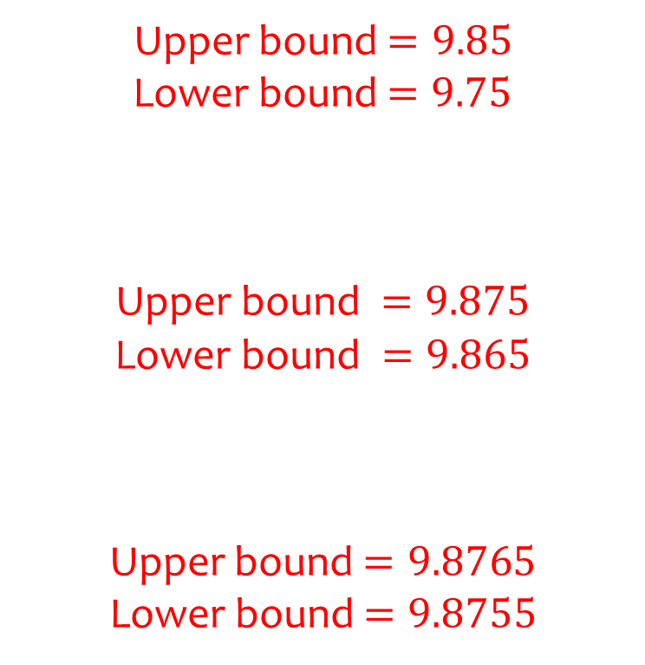
Worked example
Your turn
Find the upper and lower bound:
$x=2.3$ to the nearest tenth
$x=2.34$ to the nearest hundredth
$x=2.345$ to the nearest thousandth
Find the upper and lower bound:
$x=9.8$ to the nearest tenth
$x=9.87$ to the nearest hundredth
$x=9.876$ to the nearest thousandth
Upper bound $=9.85$
Lower bound $=9.75$
$$\text{Upper} \text{bound} =9.875$$
$$\text{Lower} \text{bound} =9.865$$
Upper bound $=9.8765$
Lower bound $=9.8755$

Slide 4
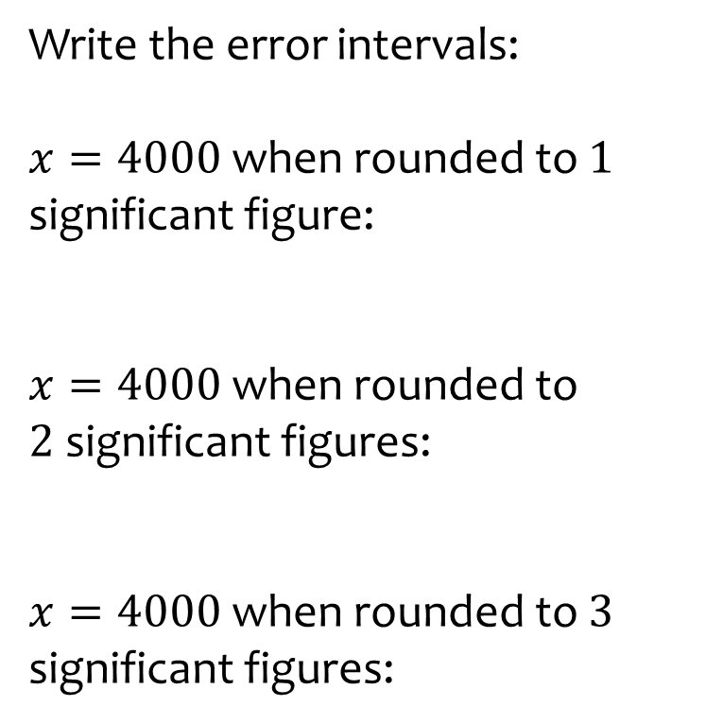
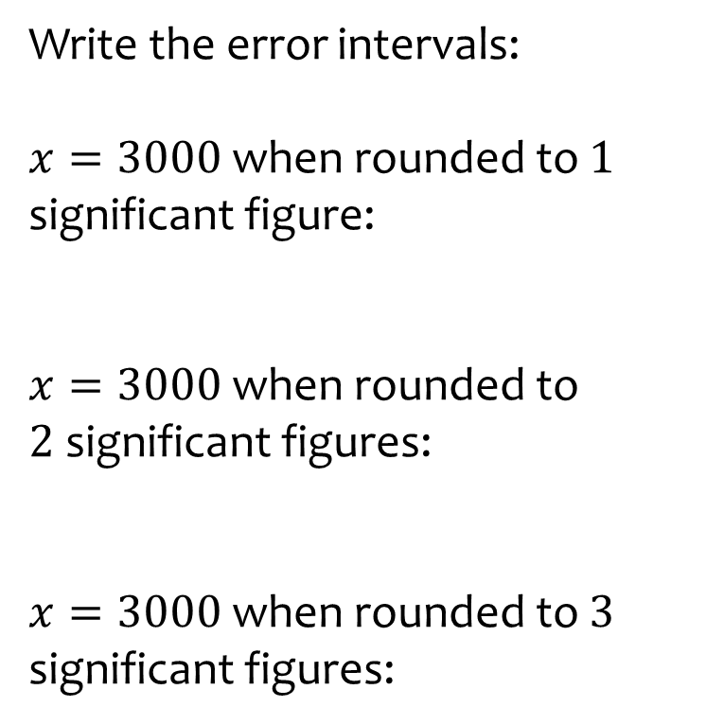
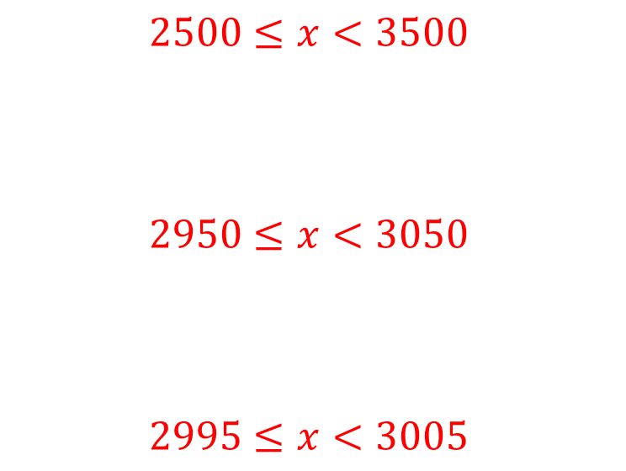
Worked example
Your turn
Write the error intervals:
$x=4000$ when rounded to $1$ significant figure:
$x=4000$ when rounded to $2$significant figures:
$x=4000$ when rounded to $3$ significant figures:
Write the error intervals:
$x=3000$ when rounded to $1$ significant figure:
$x=3000$ when rounded to $2$significant figures:
$x=3000$ when rounded to $3$ significant figures:
$$2500≤x<3500$$
$$2950≤x<3050$$
$$2995≤x<3005$$

Slide 5
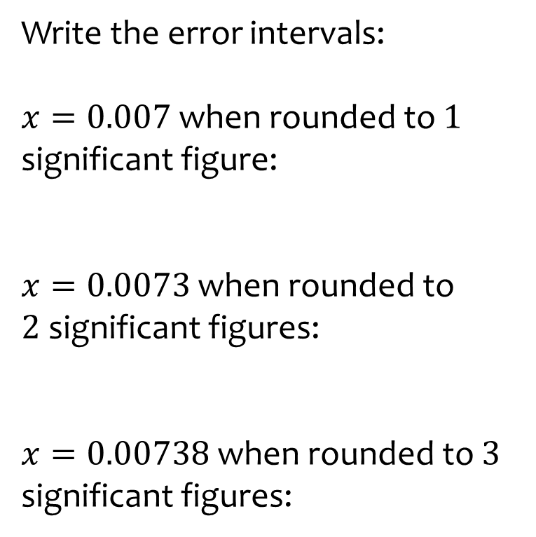
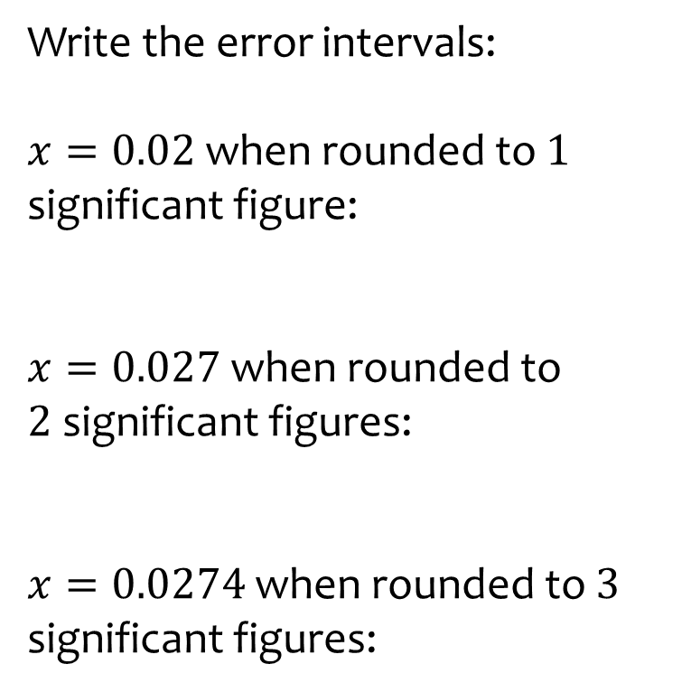
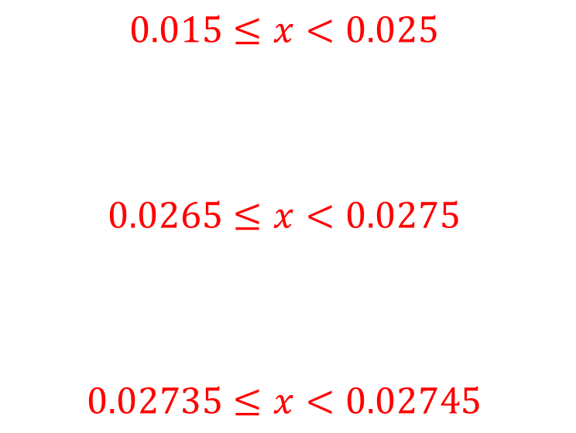
Worked example
Your turn
Write the error intervals:
$x=0.007$ when rounded to $1$ significant figure:
$x=0.0073$ when rounded to $2$significant figures:
$x=0.00738$ when rounded to $3$ significant figures:
Write the error intervals:
$x=0.02$ when rounded to $1$ significant figure:
$x=0.027$ when rounded to $2$significant figures:
$x=0.0274$ when rounded to $3$ significant figures:
$$0.015≤x<0.025$$
$$0.0265≤x<0.0275$$
$$0.02735≤x<0.02745$$

Slide 6
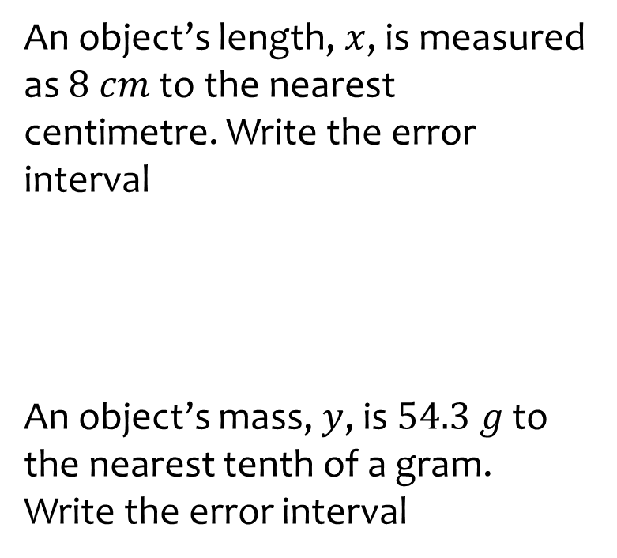
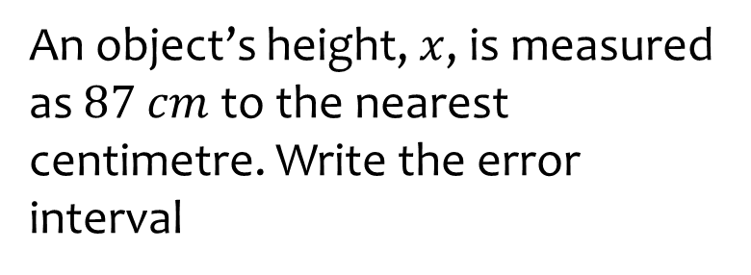

Worked example
Your turn
An object’s length, $x$, is measured as $8$ $cm$ to the nearest centimetre. Write the error interval
An object’s mass, $y$, is $54.3 g$ to the nearest tenth of a gram. Write the error interval
An object’s height, $x$, is measured as $87$ $cm$to the nearest centimetre. Write the error interval
$$86.5≤x<87.5$$

Slide 7
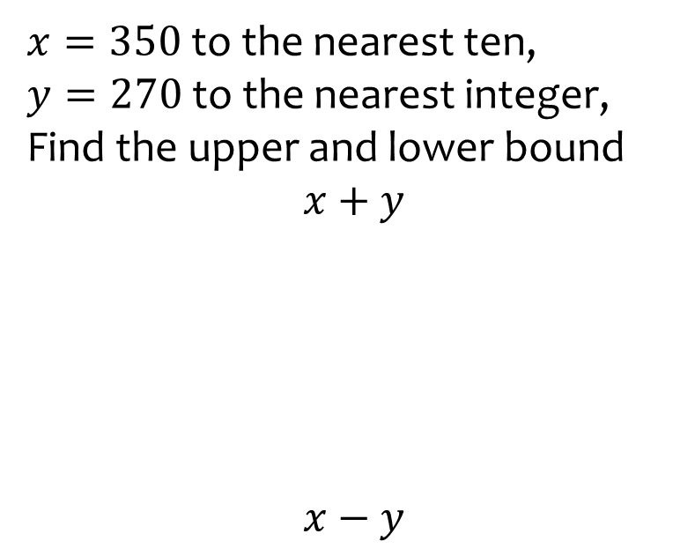
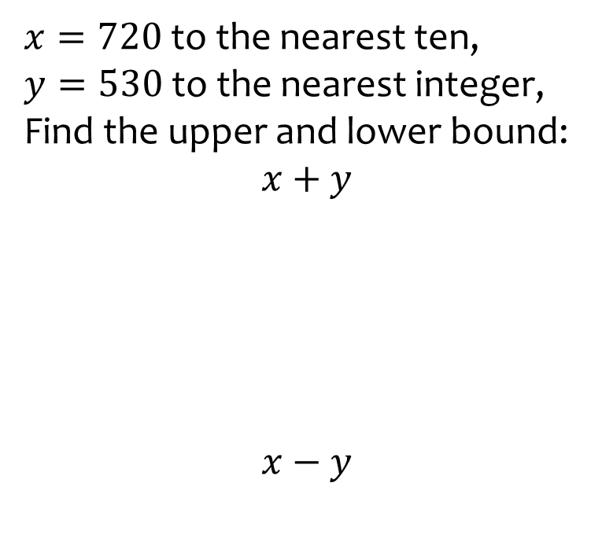
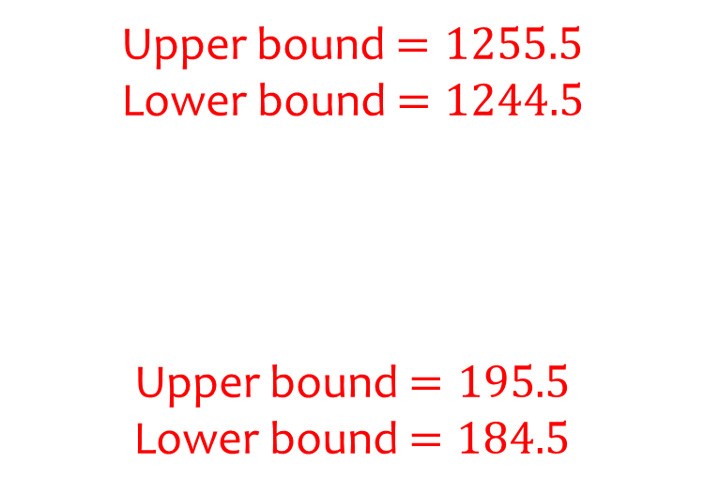
Worked example
Your turn
$x=350$ to the nearest ten,
$y=270$ to the nearest integer, Find the upper and lower bound
$$x+y$$
$$x−y$$
$x=720$ to the nearest ten,
$y=530$ to the nearest integer, Find the upper and lower bound:
$$x+y$$
$$x−y$$
Upper bound $=1255.5$
Lower bound $=1244.5$
Upper bound $=195.5$
Lower bound $=184.5$

Slide 8
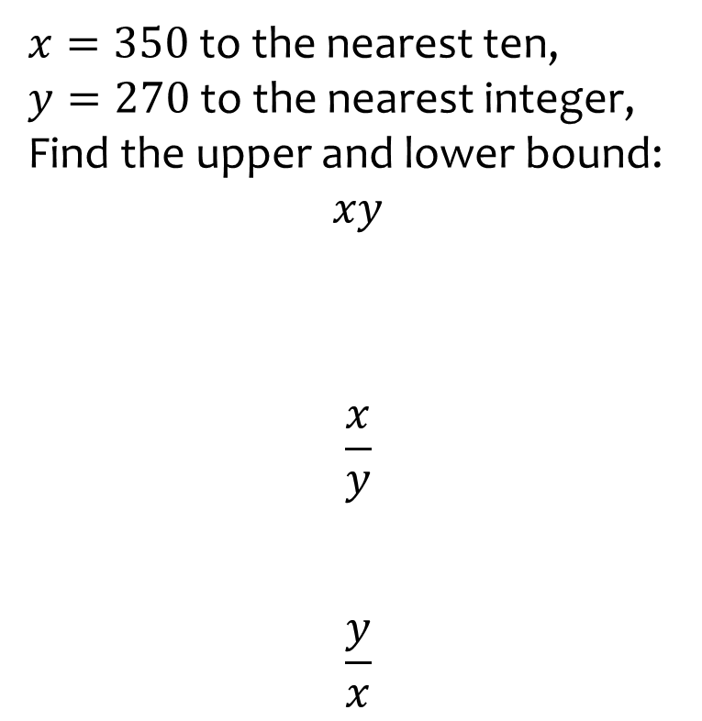
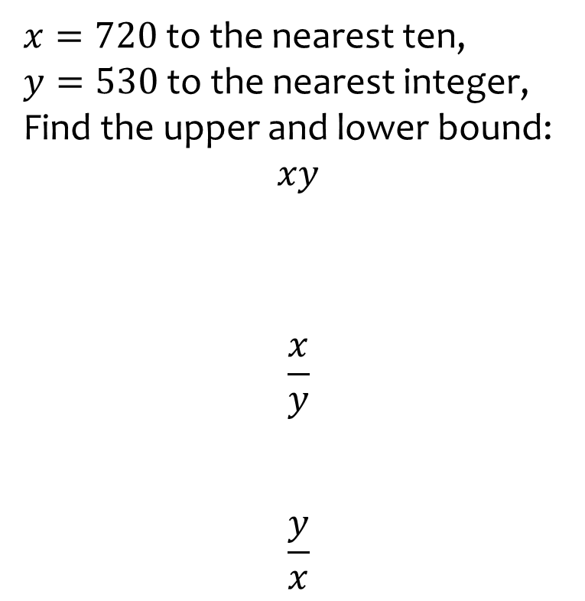
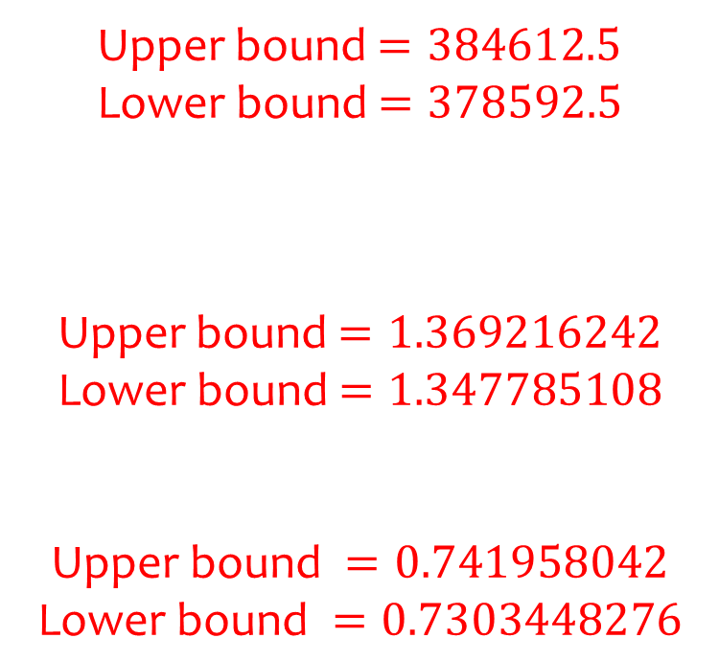
Worked example
Your turn
$x=350$ to the nearest ten,
$y=270$ to the nearest integer, Find the upper and lower bound:
$$xy$$
$$\frac{x}{y}$$
$$\frac{y}{x}$$
$x=720$ to the nearest ten,
$y=530$ to the nearest integer, Find the upper and lower bound:
$$xy$$
$$\frac{x}{y}$$
$$\frac{y}{x}$$
Upper bound $=384612.5$
Lower bound $=378592.5$
Upper bound $=1.369216242$
Lower bound $=1.347785108$
$$\text{Upper} \text{bound} =0.741958042$$
$$\text{Lower} \text{bound} =0.7303448276$$

Slide 9
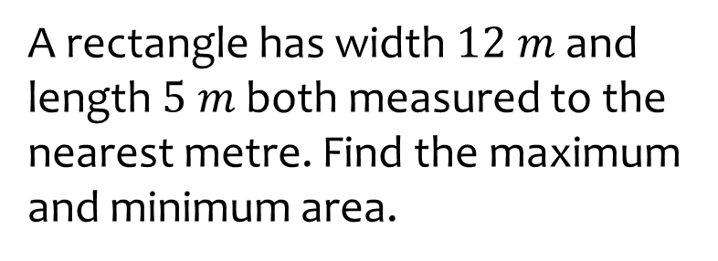
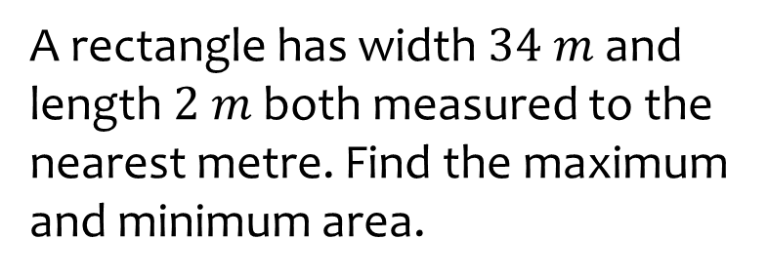
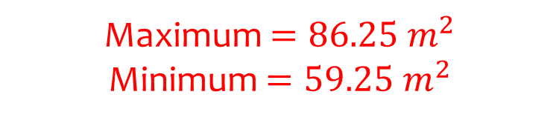
Worked example
Your turn
A rectangle has width $12 m$ and length $5 m$ both measured to the nearest metre. Find the maximum and minimum area.
A rectangle has width $34 m$ and length $2 m$ both measured to the nearest metre. Find the maximum and minimum area.
Maximum $=86.25 m^{2}$
Minimum $=59.25 m^{2}$

Slide 10
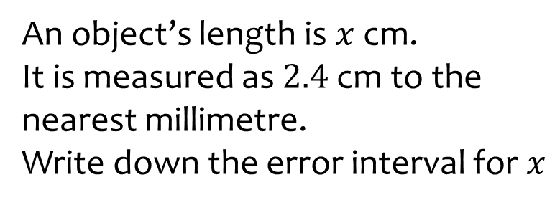
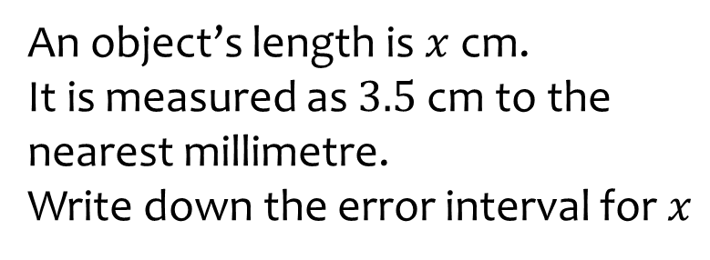

Worked example
Your turn
An object’s length is $x$ cm.
It is measured as $2.4$ cm to the nearest millimetre.
Write down the error interval for $x$
An object’s length is $x$ cm.
It is measured as $3.5$ cm to the nearest millimetre.
Write down the error interval for $x$
$$3.45≤x<3.55$$

Slide 11
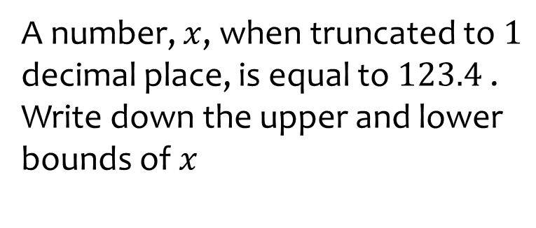
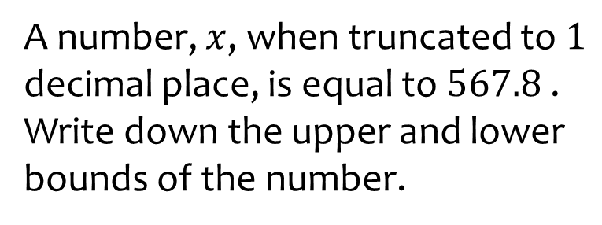
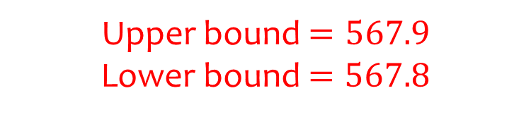
Worked example
Your turn
A number, $x$, when truncated to $1$ decimal place, is equal to $123.4$ .
Write down the upper and lower bounds of $x$
A number, $x$, when truncated to $1$ decimal place, is equal to $567.8$ .
Write down the upper and lower bounds of the number.
Upper bound $=567.9$
Lower bound $=567.8$

Slide 12
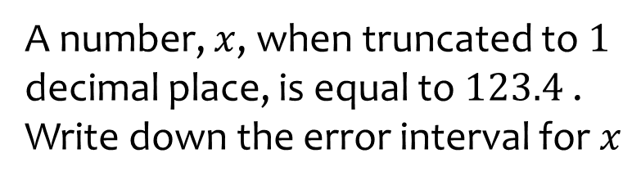
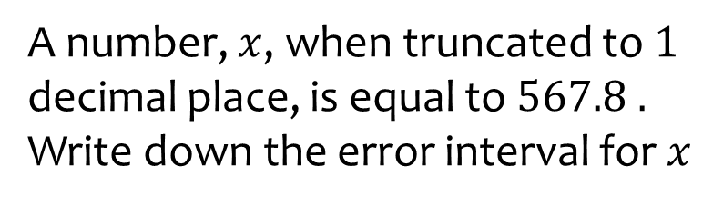

Worked example
Your turn
A number, $x$, when truncated to $1$ decimal place, is equal to $123.4$ .
Write down the error interval for $x$
A number, $x$, when truncated to $1$ decimal place, is equal to $567.8 .$ Write down the error interval for $x$
$$567.8≤x<567.9$$

Slide 13
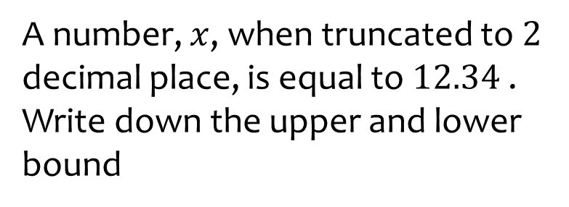
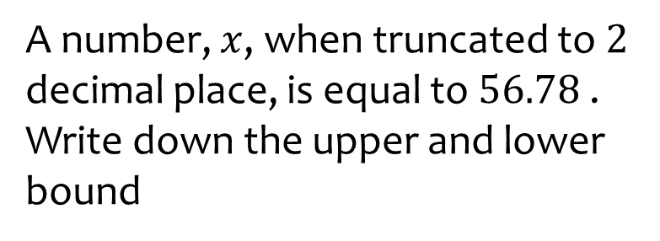
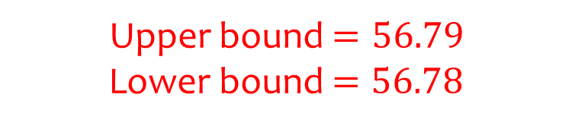
Worked example
Your turn
A number, $x$, when truncated to $2$ decimal place, is equal to $12.34$. Write down the upper and lower bound
A number, $x$, when truncated to $2$ decimal place, is equal to $56.78$ .
Write down the upper and lower bound
Upper bound $=56.79$
Lower bound $=56.78$

Slide 14
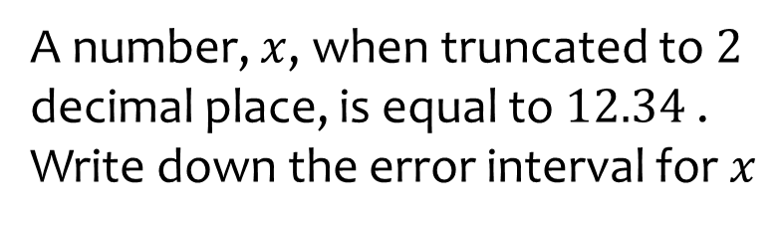
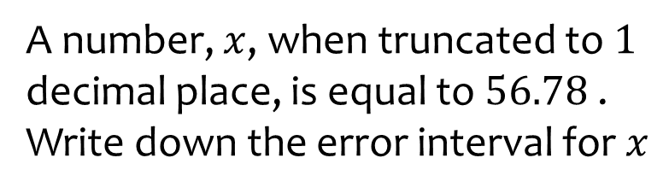

Worked example
Your turn
A number, $x$, when truncated to $2$ decimal place, is equal to $12.34$. Write down the error interval for $x$
A number, $x$, when truncated to $1$ decimal place, is equal to $56.78$ . Write down the error interval for $x$
$$56.78≤x<56.79$$

Slide 15
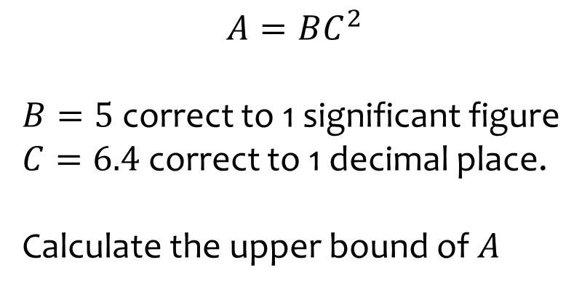
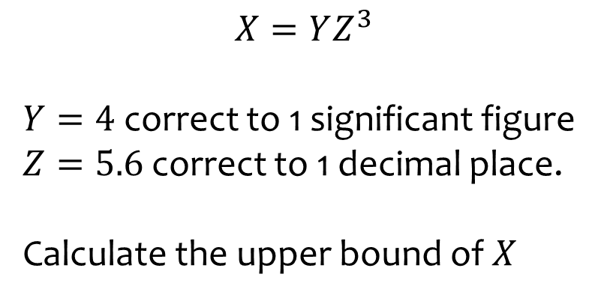

Worked example
Your turn
$$A=BC^{2}$$
$B=5$ correct to 1 significant figure
$C=6.4$ correct to 1 decimal place.
Calculate the upper bound of $A$
$$X=YZ^{3}$$
$Y=4$ correct to 1 significant figure
$Z=5.6$ correct to 1 decimal place.
Calculate the upper bound of $X$
$$811.6295625$$

Slide 16
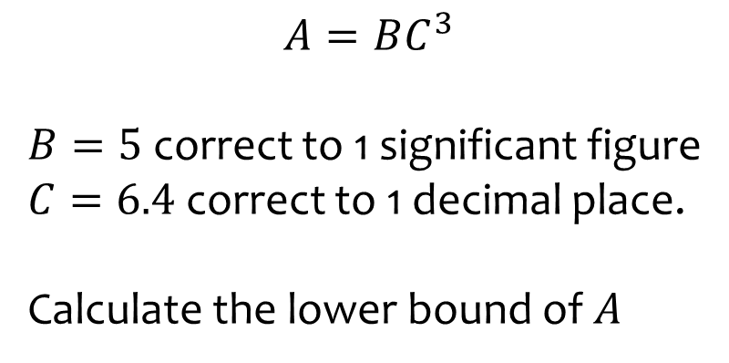
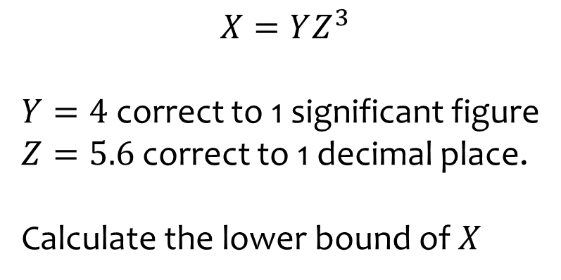

Worked example
Your turn
$$A=BC^{3}$$
$B=5$ correct to 1 significant figure
$C=6.4$ correct to 1 decimal place.
Calculate the lower bound of $A$
$$X=YZ^{3}$$
$Y=4$ correct to 1 significant figure
$Z=5.6$ correct to 1 decimal place.
Calculate the lower bound of $X$
$$598.3385625$$

Slide 17
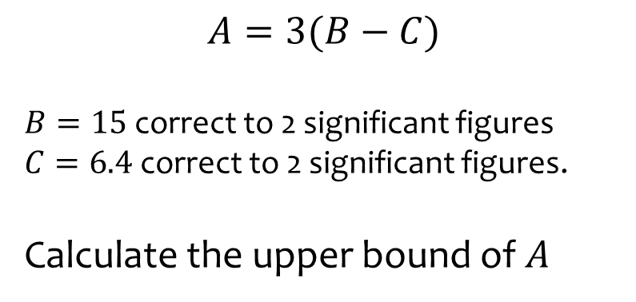
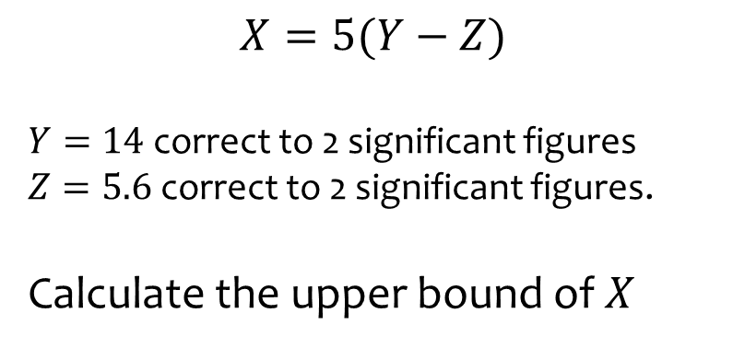

Worked example
Your turn
$$A=3(B−C)$$
$B=15$ correct to 2 significant figures
$C=6.4$ correct to 2 significant figures.
Calculate the upper bound of $A$
$$X=5(Y−Z)$$
$Y=14$ correct to 2 significant figures
$Z=5.6$ correct to 2 significant figures.
Calculate the upper bound of $X$
$$44.75$$

Slide 18
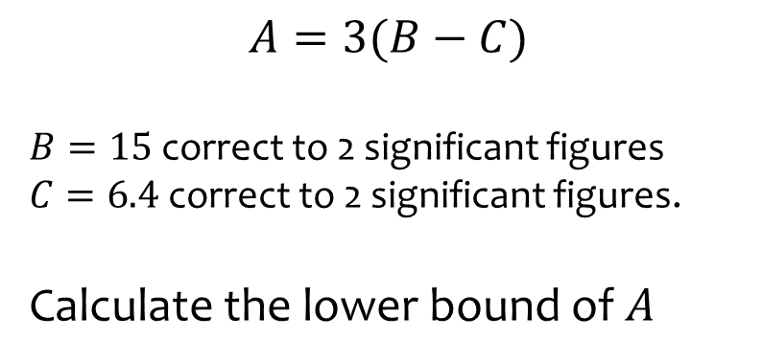
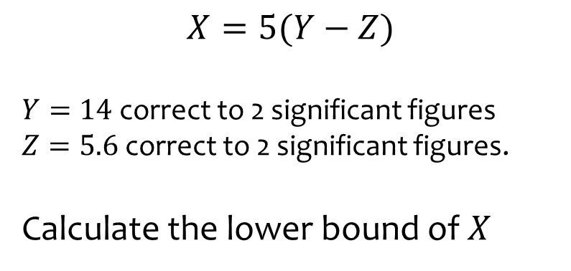

Worked example
Your turn
$$A=3(B−C)$$
$B=15$ correct to 2 significant figures
$C=6.4$ correct to 2 significant figures.
Calculate the lower bound of $A$
$$X=5(Y−Z)$$
$Y=14$ correct to 2 significant figures
$Z=5.6$ correct to 2 significant figures.
Calculate the lower bound of $X$
$$39.25$$

Slide 19
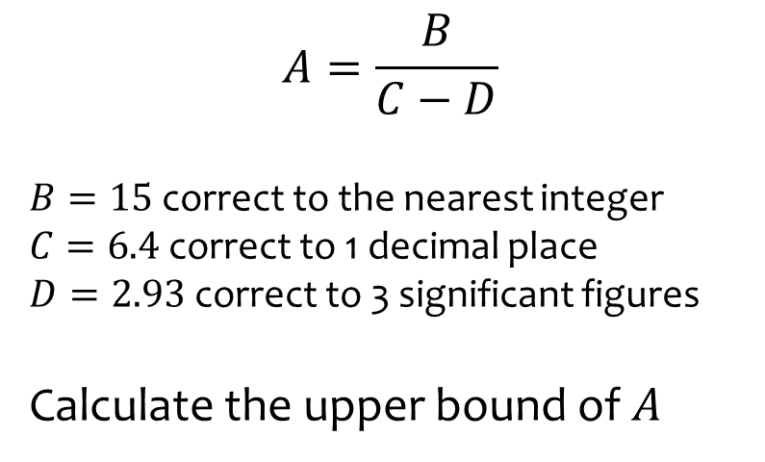
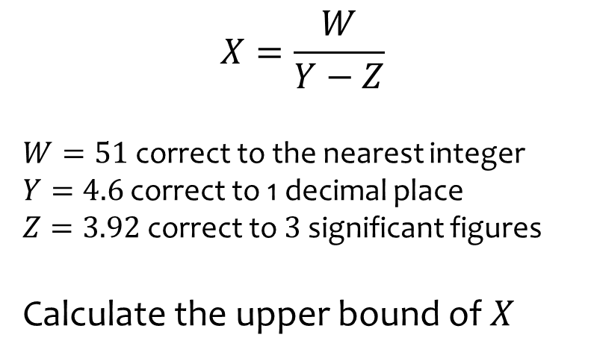

Worked example
Your turn
$$A=\frac{B}{C−D}$$
$B=15$ correct to the nearest integer
$C=6.4$ correct to 1 decimal place
$D=2.93$ correct to 3 significant figures
Calculate the upper bound of $A$
$$X=\frac{W}{Y−Z}$$
$W=51$ correct to the nearest integer
$Y=4.6$ correct to 1 decimal place
$Z=3.92$ correct to $3$ significant figures
Calculate the upper bound of $X$
$$82.4$$

Slide 20
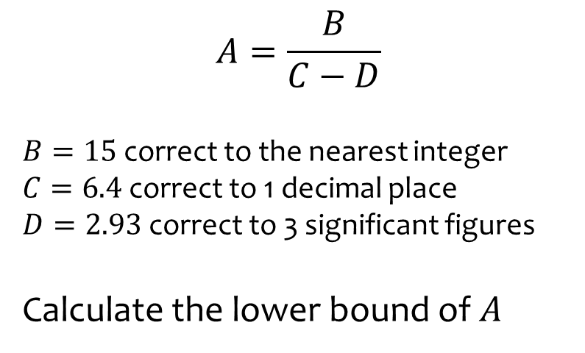
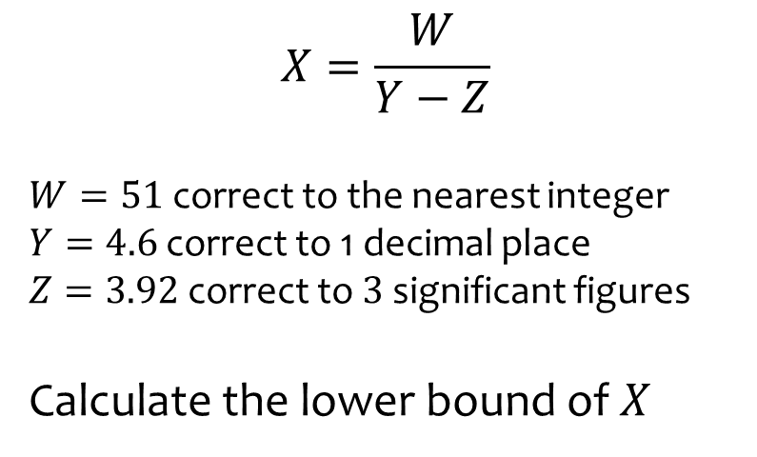

Worked example
Your turn
$$A=\frac{B}{C−D}$$
$B=15$ correct to the nearest integer
$C=6.4$ correct to 1 decimal place
$D=2.93$ correct to 3 significant figures
Calculate the lower bound of $A$
$$X=\frac{W}{Y−Z}$$
$W=51$ correct to the nearest integer
$Y=4.6$ correct to 1 decimal place
$Z=3.92$ correct to $3$ significant figures
Calculate the lower bound of $X$
$$68.70748299$$

Slide 21
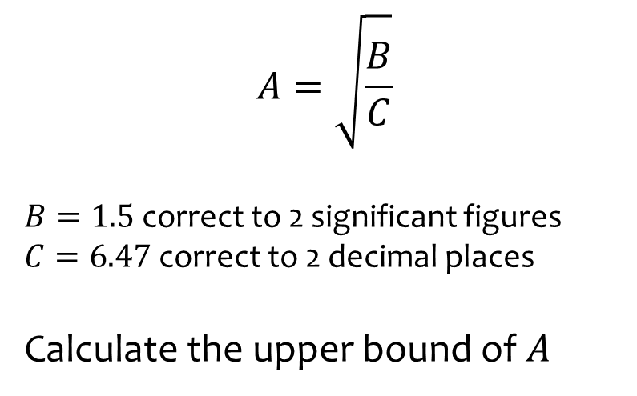
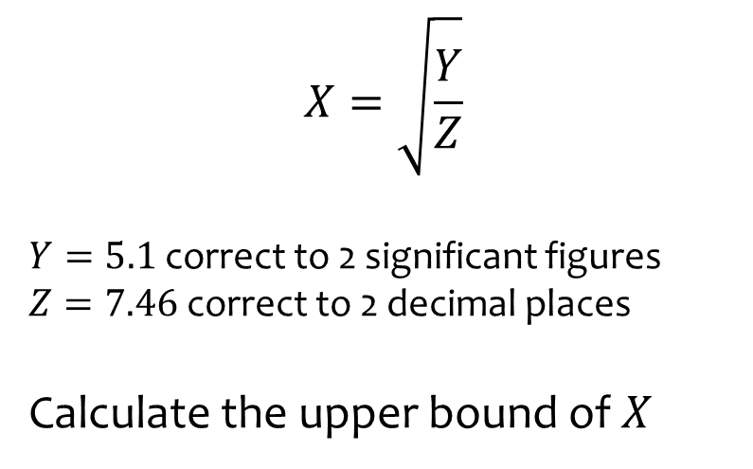

Worked example
Your turn
$$A=\sqrt{\frac{B}{C}}$$
$B=1.5$ correct to 2 significant figures
$C=6.47$ correct to 2 decimal places
Calculate the upper bound of $A$
$$X=\sqrt{\frac{Y}{Z}}$$
$Y=5.1$ correct to 2 significant figures
$Z=7.46$ correct to 2 decimal places
Calculate the upper bound of $X$
$$0.8311507299$$

Slide 22
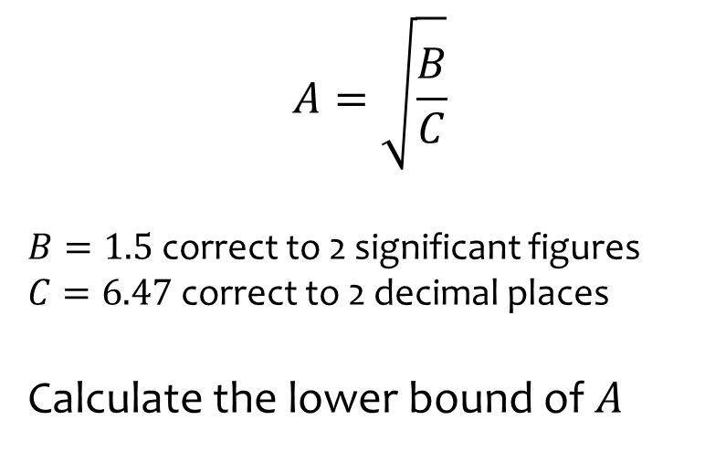


Worked example
Your turn
$$A=\sqrt{\frac{B}{C}}$$
$B=1.5$ correct to 2 significant figures
$C=6.47$ correct to 2 decimal places
Calculate the lower bound of $A$
$$X=\sqrt{\frac{Y}{Z}}$$
$Y=5.1$ correct to 2 significant figures
$Z=7.46$ correct to 2 decimal places
Calculate the lower bound of $X$
$$0.8224902966$$

Slide 23



Worked example
Your turn
A road is $3540$m long, correct to the nearest $10$m.
A person drives along the road in $315$ seconds, to the nearest $5$ seconds.
What could the person’s greatest speed have been, to 1 decimal place, in kilometres per hour?
A road is $4530$m long, correct to the nearest $10$m.
A person drives along the road in $205$ seconds, to the nearest $5$ seconds.
What could the person’s greatest speed have been, to 1 decimal place, in kilometres per hour?
$$80.6 km/h$$

Slide 24



Worked example
Your turn
Correct to two significant figures, the area of a square is $630 cm^{2}$.
Calculate the lower bound for the perimeter of the square.
Correct to two significant figures, the area of a square is $230 cm^{2}$.
Calculate the lower bound for the perimeter of the square.
$60$ $cm$

Slide 25



Worked example
Your turn
Correct to two decimal places, the volume of a solid cube is $15.63 cm^{3}$.
Calculate the lower bound for the surface area of the cube.
Correct to two decimal places, the volume of a solid cube is $42.88 cm^{3}$.
Calculate the lower bound for the surface area of the cube.
$$73.5 cm^{2}$$

Slide 26



Worked example
Your turn
Estimate:
$$12.3+456.78$$
$$13579−2468$$
$$\frac{86.42}{135.79}×0.0456$$
Estimate:
$$8.76+54.321$$
$$86420−7531$$
$$\frac{246.8}{9.7531}×0.00654$$
$$59$$
$$82000$$
$$0.14$$

