Slide 1
Basic numeracy
CONTENTS

Slide 2
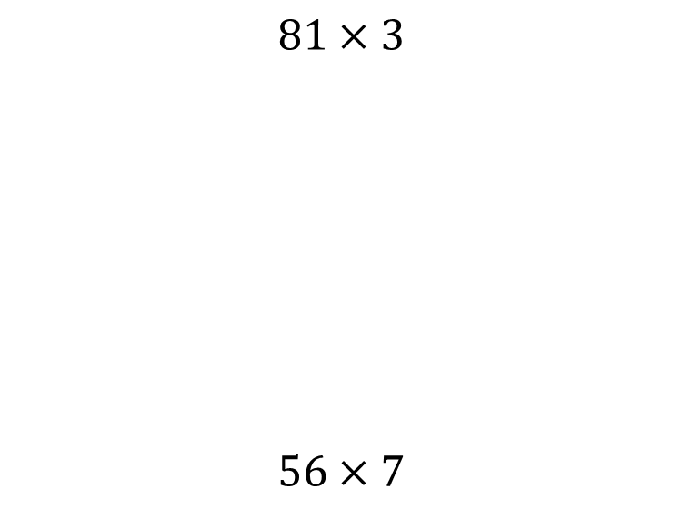


Worked example
Your turn
$$81×3$$
$$56×7$$
$$27×9$$
$$243$$

Slide 3
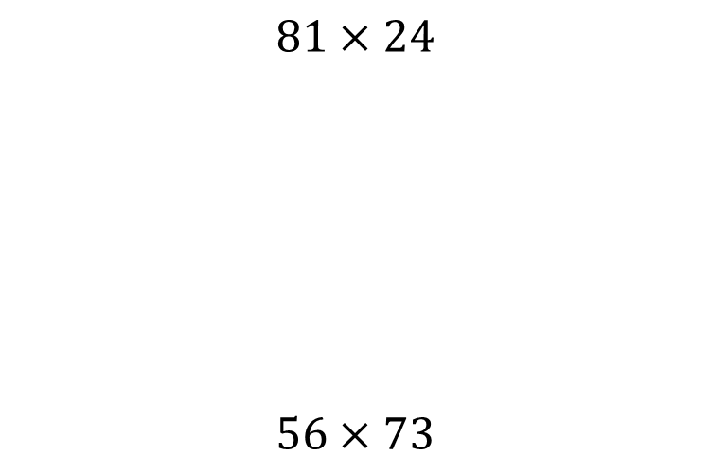


Worked example
Your turn
$$81×24$$
$$56×73$$
$$27×72$$
$$1944$$

Slide 4
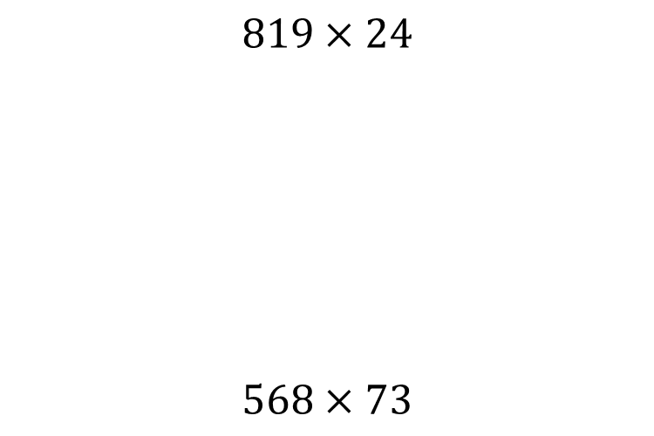


Worked example
Your turn
$$819×24$$
$$568×73$$
$$273×72$$
$$19656$$

Slide 5
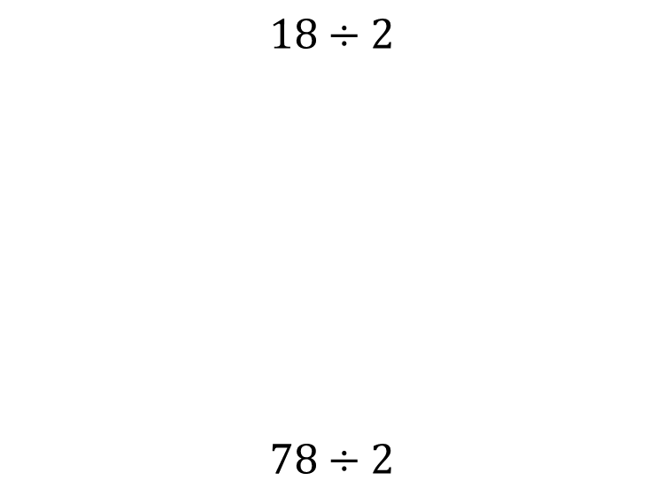


Worked example
Your turn
$$18÷2$$
$$78÷2$$
$$96÷2$$
$$48$$

Slide 6
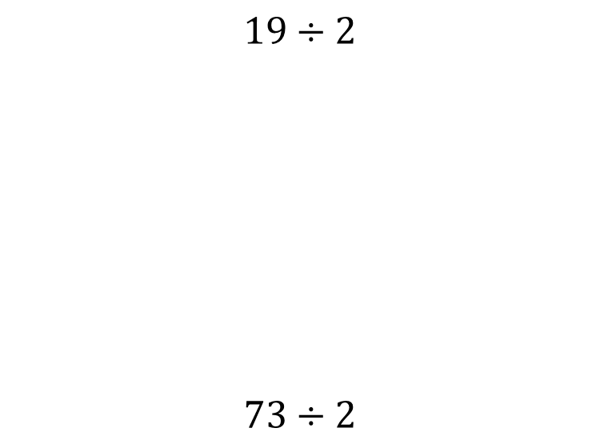


Worked example
Your turn
$$19÷2$$
$$73÷2$$
$$91÷2$$
$$40.5$$

Slide 7
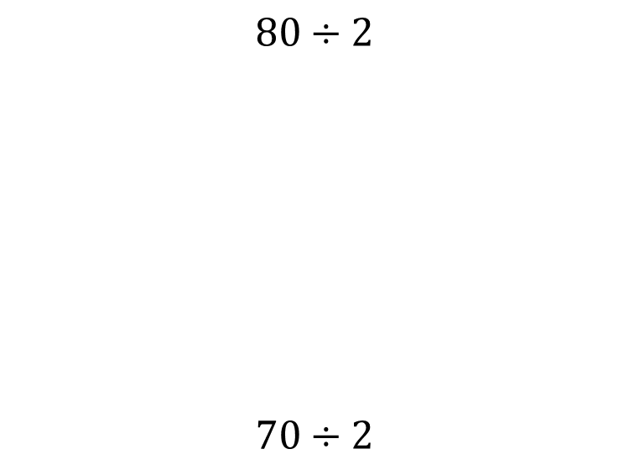


Worked example
Your turn
$$80÷2$$
$$70÷2$$
$$90÷2$$
$$45$$

Slide 8
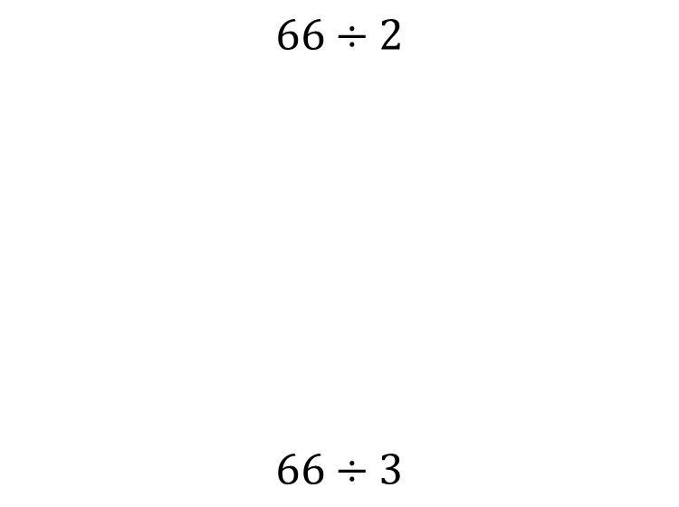


Worked example
Your turn
$$66÷2$$
$$66÷3$$
$$84÷4$$
$$21$$

Slide 9
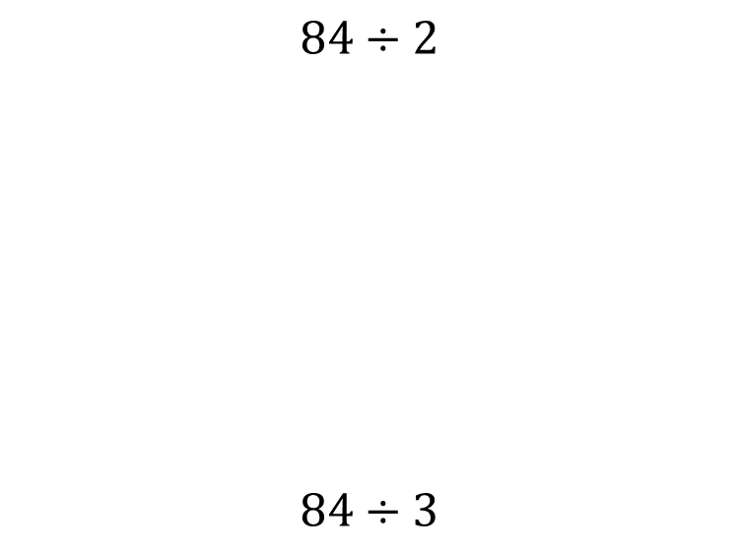


Worked example
Your turn
$$84÷2$$
$$84÷3$$
$$78÷3$$
$$26$$

Slide 10
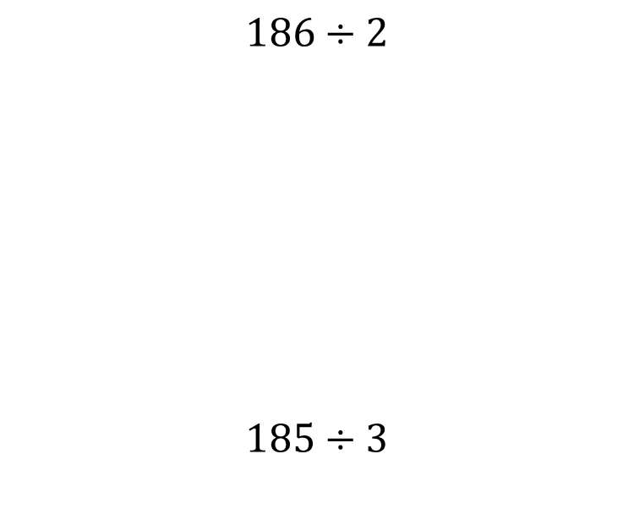


Worked example
Your turn
$$186÷2$$
$$185÷3$$
$$372÷2$$
$$186$$

Slide 11
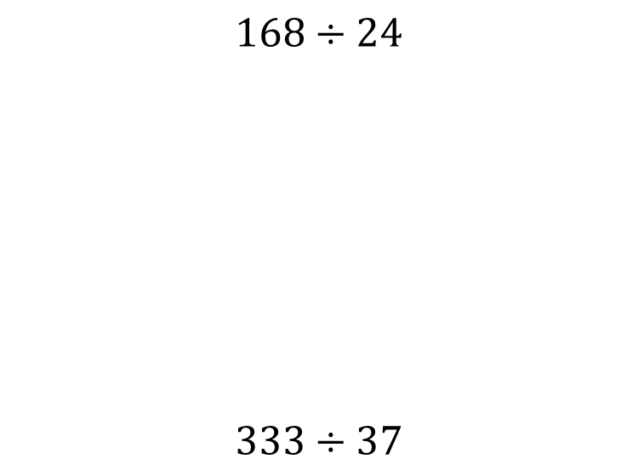


Worked example
Your turn
$$168÷24$$
$$333÷37$$
$$216÷27$$
$$8$$

Slide 12
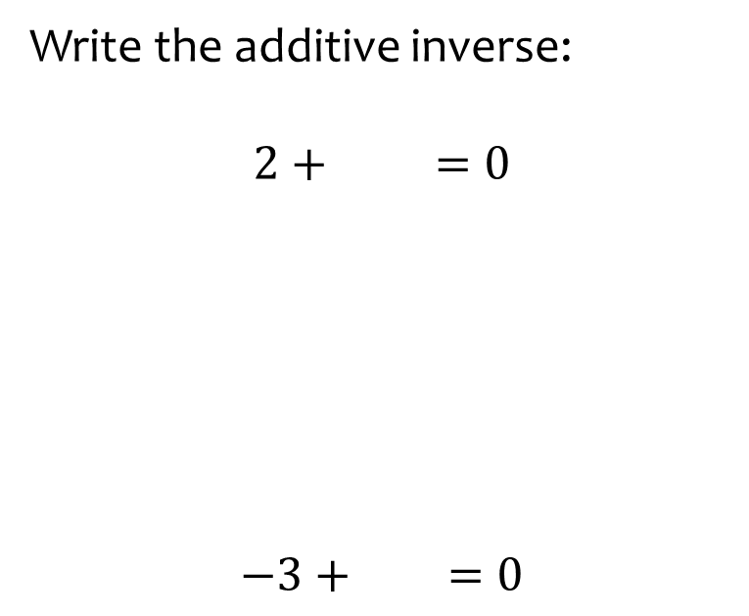
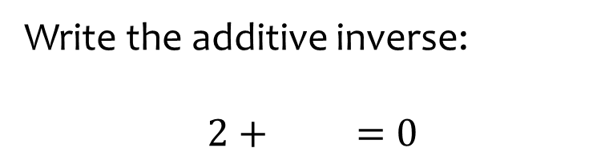

Worked example
Your turn
Write the additive inverse:
$$2 + =0$$
$$−3 + =0$$
Write the additive inverse:
$$2 + =0$$
$$−2$$

Slide 13
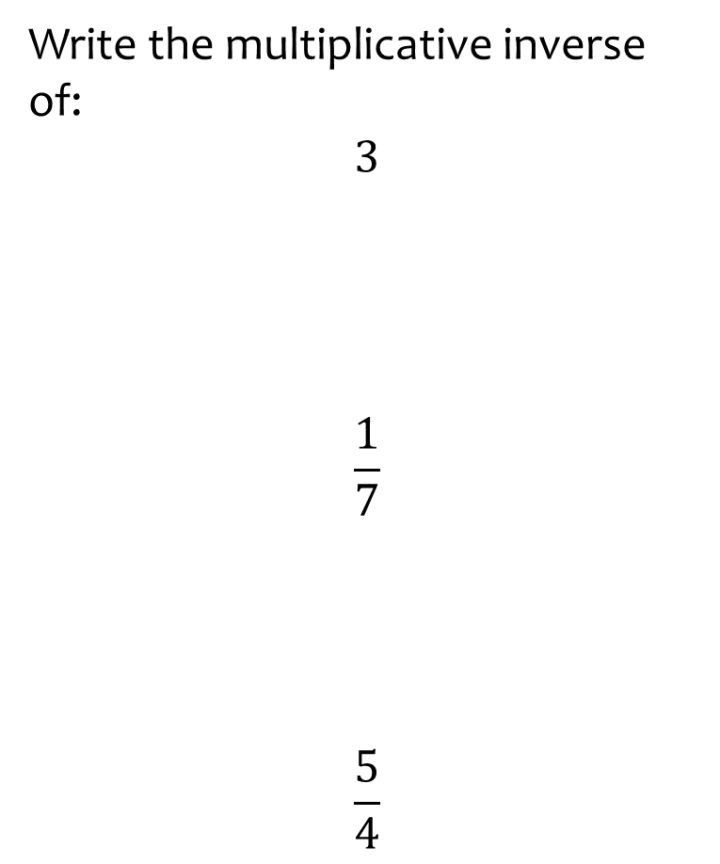
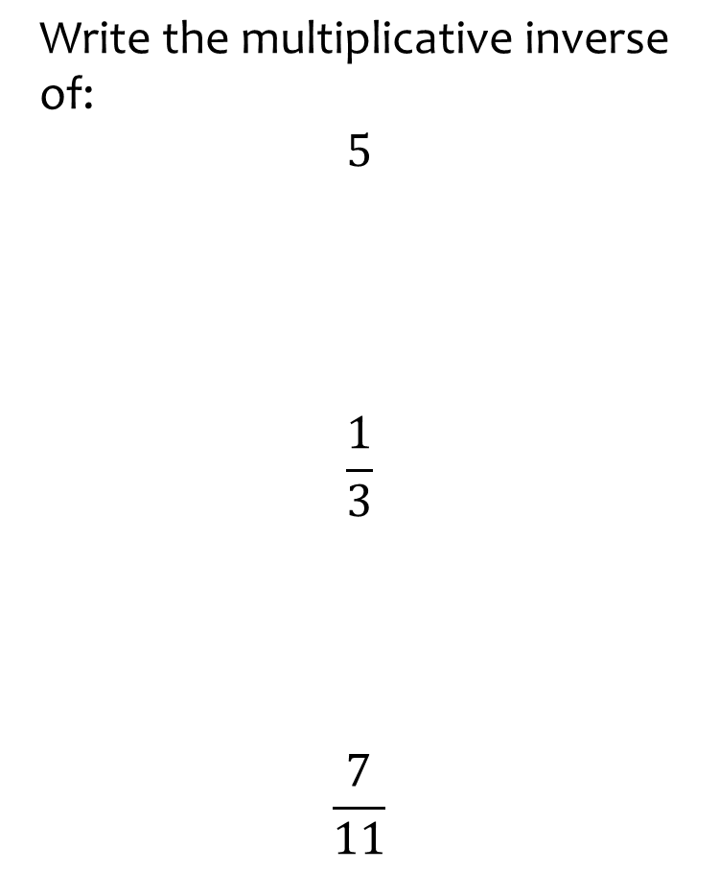
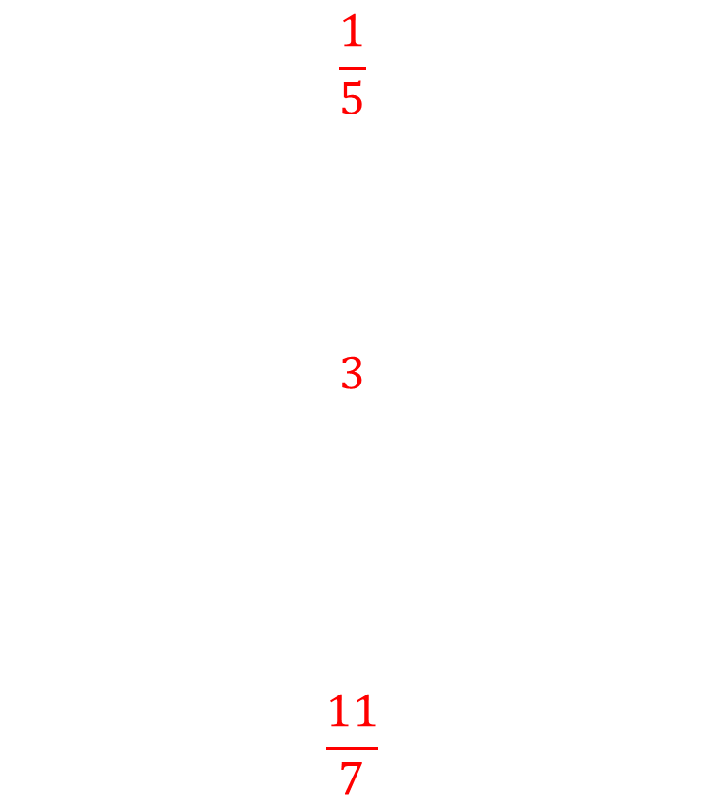
Worked example
Your turn
Write the multiplicative inverse of:
$$3$$
$$\frac{1}{7}$$
$$\frac{5}{4}$$
$$\text{Write} \text{the} \text{multiplicative} \text{inverse} \text{of}\text{:}$$
$$5$$
$$\frac{1}{3}$$
$$\frac{7}{11}$$
$$\frac{1}{5}$$
$$3$$
$$\frac{11}{7}$$

Slide 14
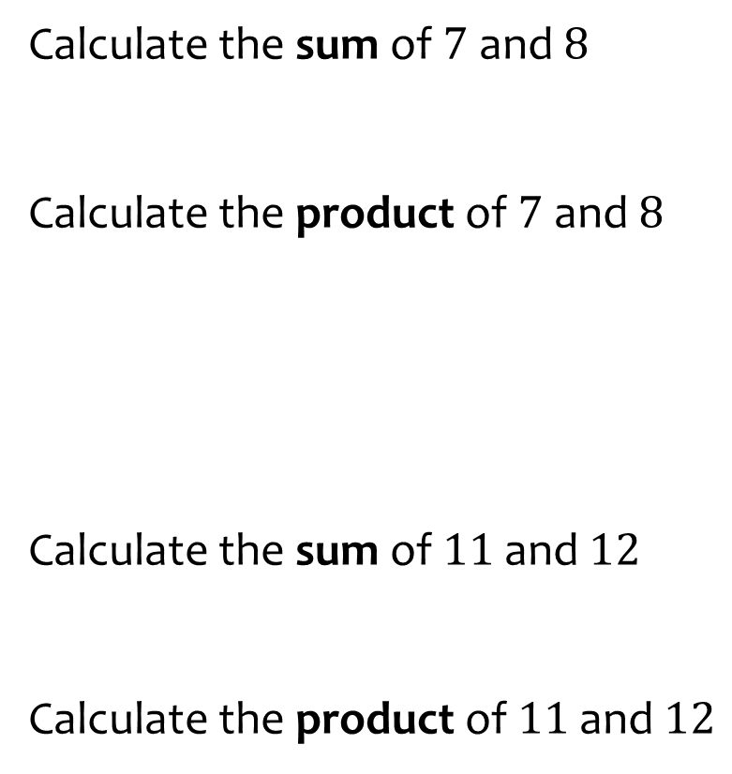
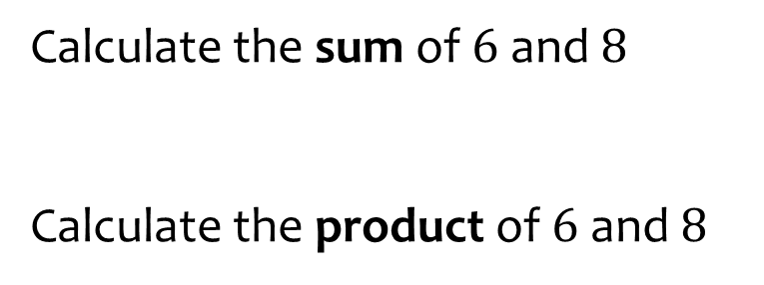

Worked example
Your turn
Calculate the sum of $7$ and $8$
Calculate the product of $7$ and $8$
Calculate the sum of $11$ and $12$
Calculate the product of $11$ and $12$
Calculate the sum of $6$ and $8$
Calculate the product of $6$ and $8$
$$14$$
$$56$$

Slide 15
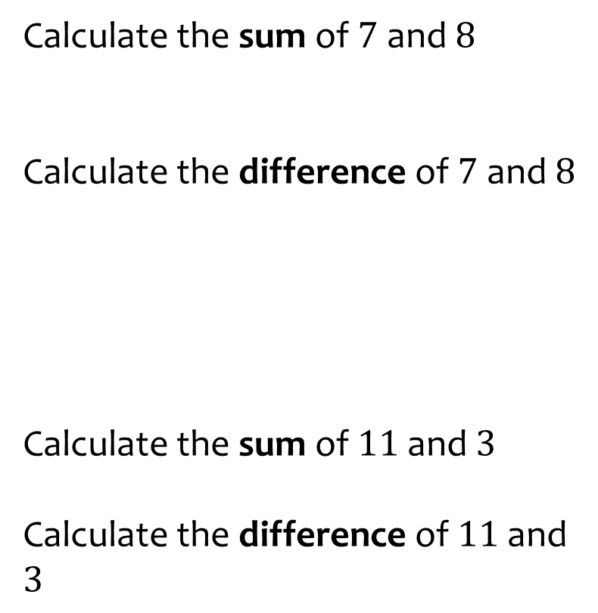
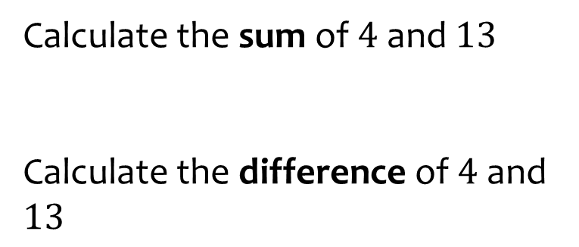

Worked example
Your turn
Calculate the sum of $7$ and $8$
Calculate the difference of $7$ and $8$
Calculate the sum of $11$and $3$
Calculate the difference of $11$and $3$
Calculate the sum of $4$ and $13$
Calculate the difference of $4$ and $13$
$$17$$
$$9$$

Slide 16
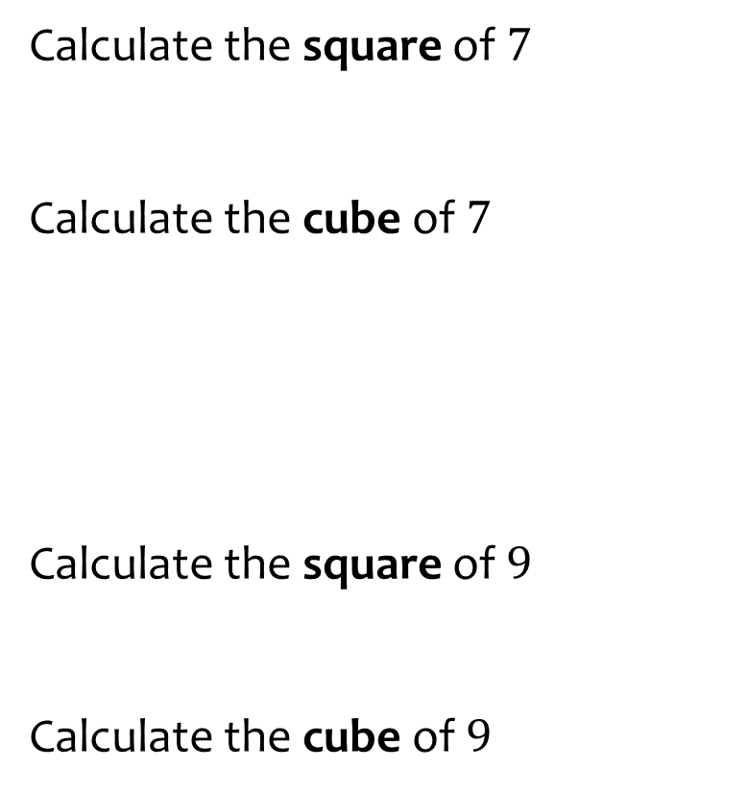
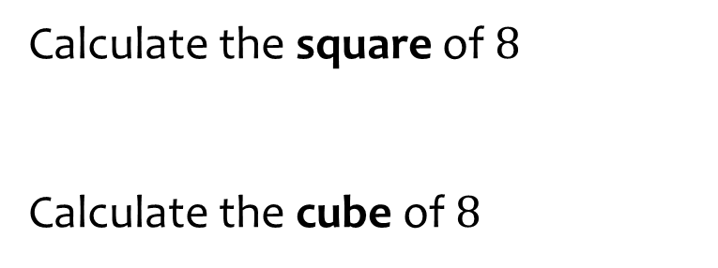

Worked example
Your turn
Calculate the square of $7$
Calculate the cube of $7$
Calculate the square of $9$
Calculate the cube of $9$
Calculate the square of $8$
Calculate the cube of $8$
$$64$$
$$512$$

Slide 17
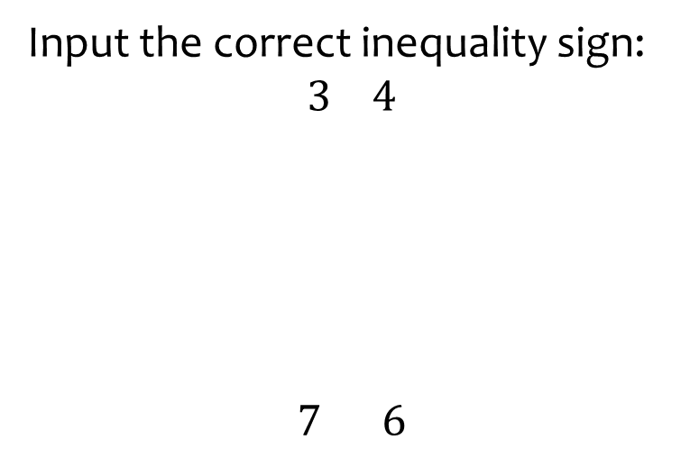
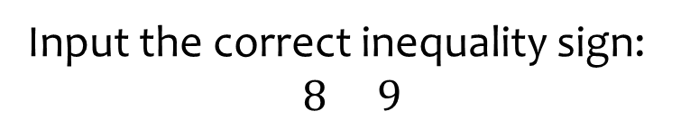

Worked example
Your turn
Input the correct inequality sign:
$$3 4$$
$$7 6$$
Input the correct inequality sign:
$$8 9$$
$$<$$

Slide 18
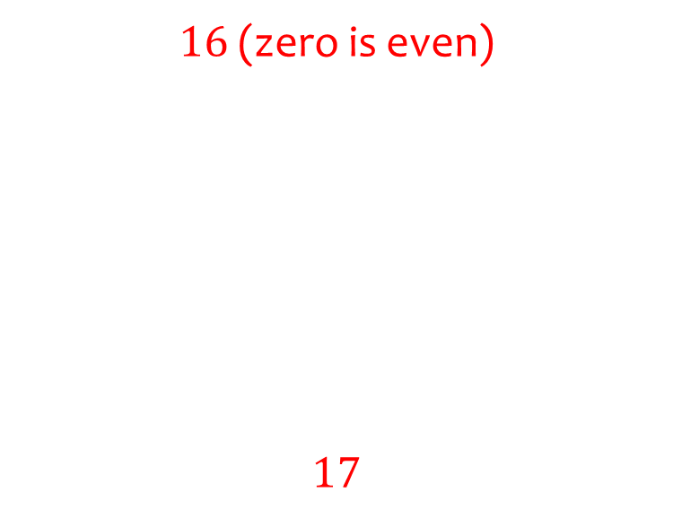
Worked example
Your turn
What is the seventh even number?
What is the sixth odd number?
What is the ninth even number?
What is the ninth odd number?
$16$ (zero is even)
$$17$$

