Slide 1
Volume
(Elevations included at end)
CONTENTS

Slide 2




Worked example
Your turn
Calculate the volume of the cube:
Calculate the volume of the cube:
$$3 cm$$
$$5 cm$$
$$125 cm^{3}$$
$$4 cm$$

Slide 3
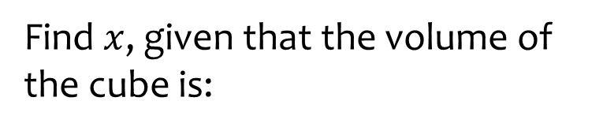
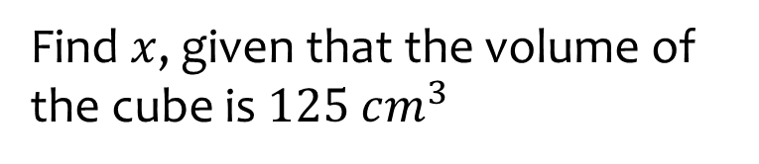






Worked example
Your turn
Find $x$, given that the volume of the cube is:
Find $x$, given that the volume of the cube is $125 cm^{3}$
$$27 cm^{3}$$
$$x cm$$
$$x cm$$
$$x=5$$
$$64 cm^{3}$$
$$x cm$$

Slide 4










Worked example
Your turn
Calculate the volume of the cuboid:
Calculate the volume of the cuboid:
$$2 cm$$
$$4 cm$$
$$3 cm$$
$$10 cm$$
$$6 cm$$
$$20 cm$$
$$480 cm^{3}$$
$$11 cm$$
$$7 cm$$
$$5 cm$$

Slide 5
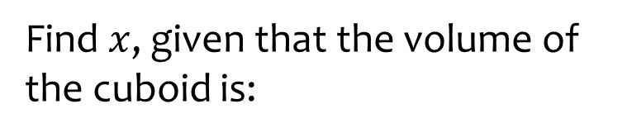
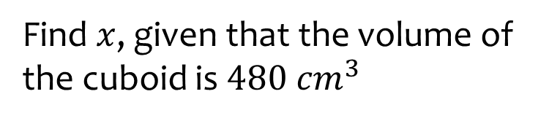






Worked example
Your turn
Find $x$, given that the volume of the cuboid is:
Find $x$, given that the volume of the cuboid is $480 cm^{3}$
$$2 cm$$
$$4 cm$$
$$60 cm^{3}$$
$$3 cm$$
$$x cm$$
$$x cm$$
$$20 cm$$
$$x=6$$
$$x cm$$
$$385 cm^{3}$$
$$7 cm$$
$$5 cm$$

Slide 6
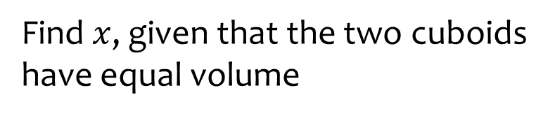
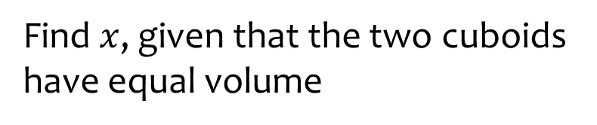









Worked example
Your turn
Find $x$, given that the two cuboids have equal volume
Find $x$, given that the two cuboids have equal volume
$$2 cm$$
$$4 cm$$
$$3 cm$$
$$6 cm$$
$$x cm$$
$$x cm$$
$$7 cm$$
$$32 cm$$
$$6 cm$$
$$3 cm$$
$$5 cm$$
$$5 cm$$
$$x=20$$

Slide 7

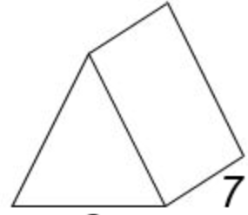










Worked example
Your turn
Calculate the volume of the triangular prism:
Calculate the volume of the triangular prism:
$$2 cm$$
$$4 cm$$
$$10 cm$$
$$3 cm$$
$$20 cm$$
$$6 cm$$
$$240 cm^{3}$$
$$11 cm$$
$$5 cm$$
$$7 cm$$

Slide 8
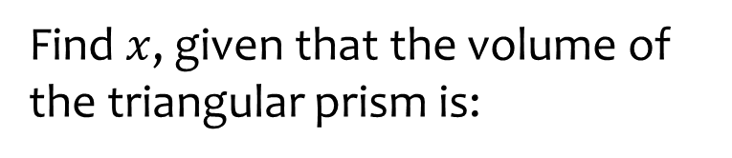
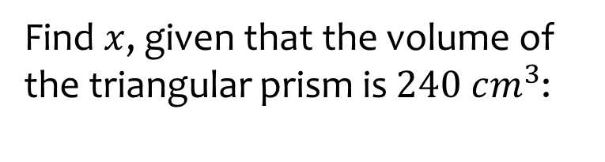






Worked example
Your turn
Find $x$, given that the volume of the triangular prism is:
Find $x$, given that the volume of the triangular prism is $240 cm^{3}$:
$$2 cm$$
$$x cm$$
$$30 cm^{3}$$
$$x cm$$
$$3 cm$$
$$20 cm$$
$$6 cm$$
$$x=4$$
$$11 cm$$
$$192.5 cm^{3}$$
$$x cm$$
$$7 cm$$

Slide 9
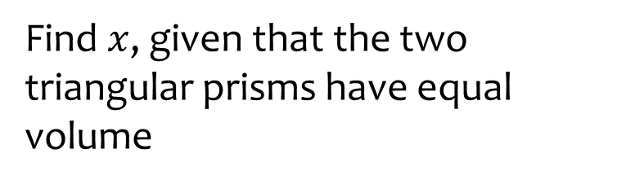
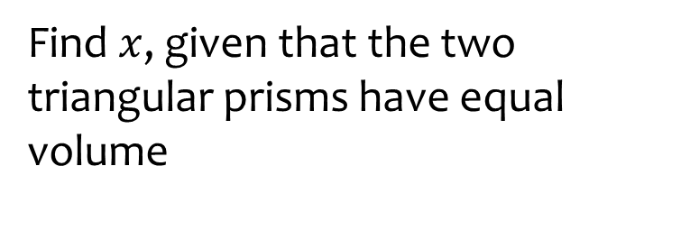













Worked example
Your turn
Find $x$, given that the two triangular prisms have equal volume
Find $x$, given that the two triangular prisms have equal volume
$$2 cm$$
$$4 cm$$
$$x cm$$
$$3 cm$$
$$x cm$$
$$6 cm$$
$$5 cm$$
$$32 cm$$
$$6 cm$$
$$3 cm$$
$$7 cm$$
$$5 cm$$
$$x=20$$

Slide 10
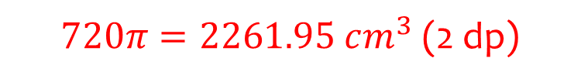






Worked example
Your turn
Calculate the volume of the cylinder:
Calculate the volume of the cylinder:
$$10 cm$$
$$20 cm$$
$$3 cm$$
$$6 cm$$
$720π=2261.95 cm^{3}$ (2 dp)
$$10 cm$$
$$3 cm$$

Slide 11



Worked example
Your turn
Calculate the volume of the cylinder:
Calculate the volume of the cylinder:
$$10 cm$$
$$20 cm$$
$$6 cm$$
$$12 cm$$
$720π=2261.95 cm^{3}$ (2 dp)
$$20 cm$$
$$3 cm$$

Slide 12
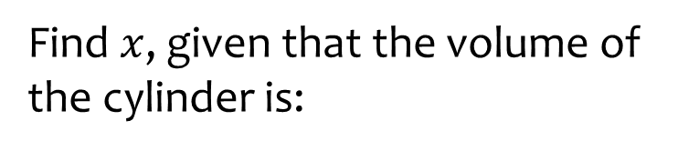
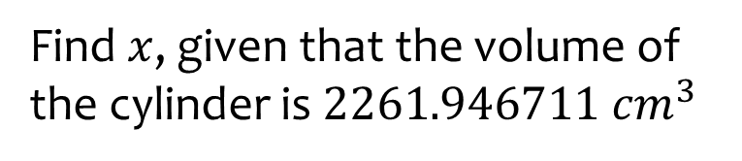






Worked example
Your turn
Find $x$, given that the volume of the cylinder is:
Find $x$, given that the volume of the cylinder is $2261.946711 cm^{3}$
$$282.7433388 cm^{3}$$
$$10 cm$$
$$20 cm$$
$$x cm$$
$$x cm$$
$$942.4777961 cm^{3}$$
$$x=6$$
$$x cm$$
$$3 cm$$

Slide 13
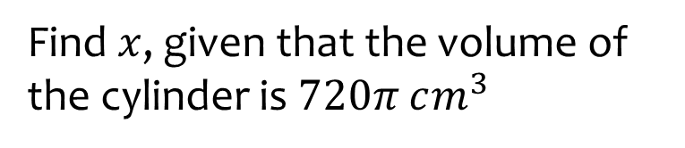


Worked example
Your turn
Find $x$, given that the volume of the cylinder is:
Find $x$, given that the volume of the cylinder is $720π cm^{3}$
$$90π cm^{3}$$
$$10 cm$$
$$20 cm$$
$$x cm$$
$$x cm$$
$$300π cm^{3}$$
$$x=6$$
$$x cm$$
$$3 cm$$

Slide 14





Worked example
Your turn
Find $x$, given that the volume of the cylinder is:
Find $x$, given that the volume of the cylinder is $720π cm^{3}$
$$90π cm^{3}$$
$$x cm$$
$$x cm$$
$$3 cm$$
$$6 cm$$
$$300π cm^{3}$$
$$x=20$$
$$10 cm$$
$$x cm$$

Slide 15




Worked example
Your turn
Find $x$, given that the volume of the cylinder is:
Find $x$, given that the volume of the cylinder is $720π cm^{3}$
$$90π cm^{3}$$
$$10 cm$$
$$20 cm$$
$$x cm$$
$$x cm$$
$$300π cm^{3}$$
$$x=12$$
$$x cm$$
$$3 cm$$

Slide 16
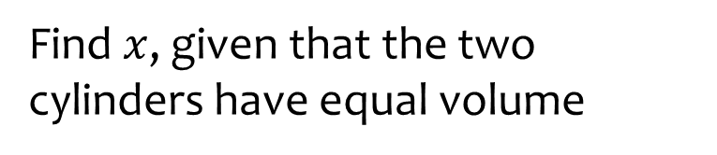
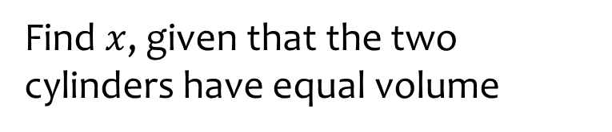







Worked example
Your turn
Find $x$, given that the two cylinders have equal volume
Find $x$, given that the two cylinders have equal volume
$$x cm$$
$$x cm$$
$$4 cm$$
$$5 cm$$
$$10 cm$$
$$20 cm$$
$$4 cm$$
$$5 cm$$
$$x=80$$

Slide 17








Worked example
Your turn
Find $x$, given that the two cylinders have equal volume
Find $x$, given that the two cylinders have equal volume
$$4 cm$$
$$5 cm$$
$$x cm$$
$$x cm$$
$$4 cm$$
$$5 cm$$
$$10 cm$$
$$20 cm$$
$$x=10$$

Slide 18
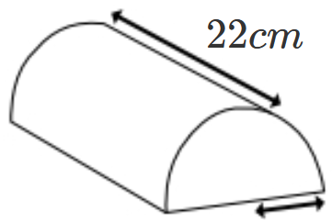
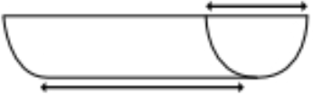
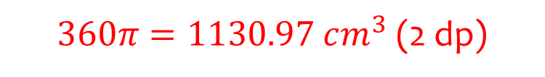






Worked example
Your turn
Calculate the volume of:
Calculate the volume of:
$$10 cm$$
$$20 cm$$
$$3 cm$$
$$6 cm$$
$$20 cm$$
$360π=1130.97 cm^{3}$ (2 dp)
$$3 cm$$

Slide 19
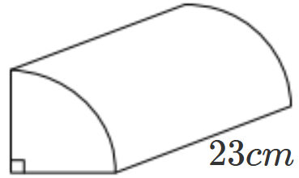
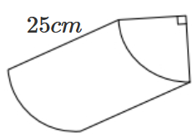
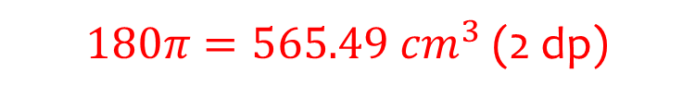






Worked example
Your turn
Calculate the volume of:
Calculate the volume of:
$$20 cm$$
$$20 cm$$
$$3 cm$$
$$6 cm$$
$180π=565.49 cm^{3}$ (2 dp)
$$10 cm$$
$$3 cm$$

Slide 20
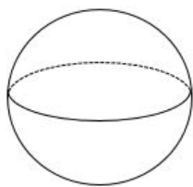
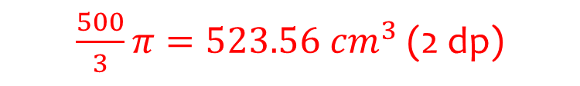



Worked example
Your turn
Calculate the volume of the sphere:
Calculate the volume of the sphere:
$$3 cm$$
$$5 cm$$
$\frac{500}{3}π=523.56 cm^{3}$ (2 dp)
$$4 cm$$

Slide 21



Worked example
Your turn
Calculate the volume of the sphere:
Calculate the volume of the sphere:
$$6 cm$$
$$10 cm$$
$\frac{500}{3}π=523.56 cm^{3}$ (2 dp)
$$8 cm$$

Slide 22
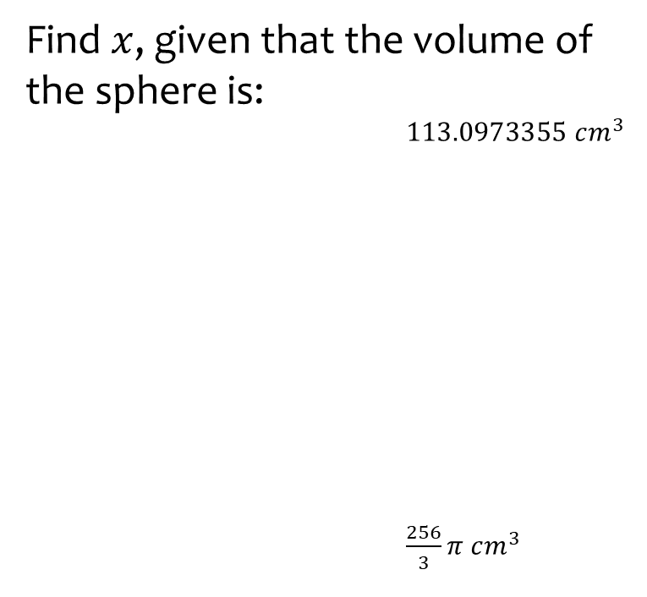
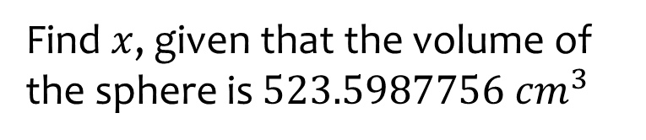


Worked example
Your turn
Find $x$, given that the volume of the sphere is:
$113.0973355 cm^{3}$
$\frac{256}{3}π cm^{3}$
Find $x$, given that the volume of the sphere is $523.5987756 cm^{3}$
$$x cm$$
$$x cm$$
$$x=5$$
$$x cm$$

Slide 23

Worked example
Your turn
Find $x$, given that the volume of the sphere is:
$113.0973355 cm^{3}$
$\frac{256}{3}π cm^{3}$
Find $x$, given that the volume of the sphere is $523.5987756 cm^{3}$
$$x cm$$
$$x cm$$
$$x=10$$
$$x cm$$

Slide 24
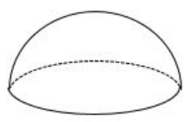
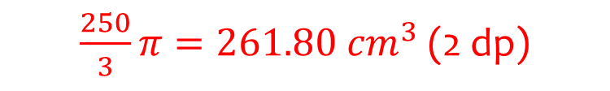



Worked example
Your turn
Calculate the volume of the hemisphere:
Calculate the volume of the hemisphere:
$$3 cm$$
$$5 cm$$
$\frac{250}{3}π=261.80 cm^{3}$ (2 dp)
$$4 cm$$

Slide 25



Worked example
Your turn
Calculate the volume of the hemisphere:
Calculate the volume of the hemisphere:
$$6 cm$$
$$10 cm$$
$\frac{250}{3}π=261.80 cm^{3}$ (2 dp)
$$8 cm$$

Slide 26
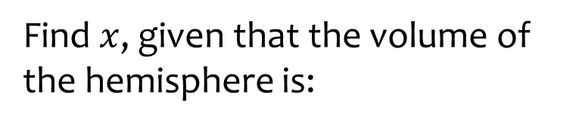
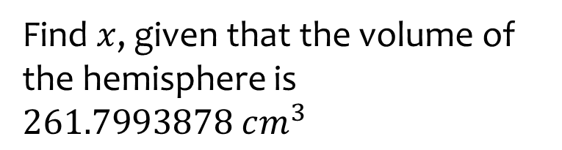



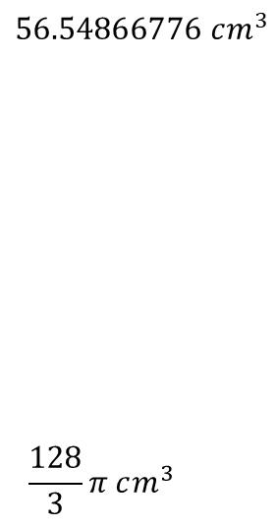
Worked example
Your turn
Find $x$, given that the volume of the hemisphere is:
Find $x$, given that the volume of the hemisphere is $261.7993878 cm^{3}$
$$56.54866776 cm^{3}$$
$$\frac{128}{3}π cm^{3}$$
$$x cm$$
$$x cm$$
$$x=5$$
$$x cm$$

Slide 27
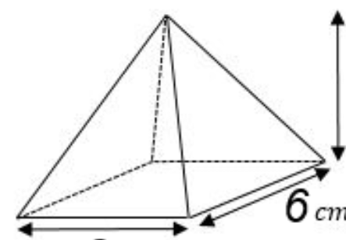





Worked example
Your turn
Calculate the volume of the rectangular-based pyramid:
Calculate the volume of the rectangular-based pyramid:
$$5 cm$$
$$10 cm$$
$$4 cm$$
$$8 cm$$
$$3 cm$$
$$6 cm$$
$$160 cm^{3}$$
$$4 cm$$
$$3 cm$$
$$5 cm$$

Slide 28
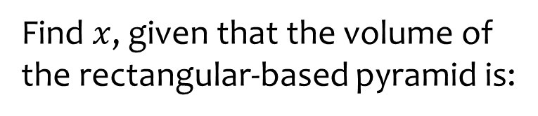
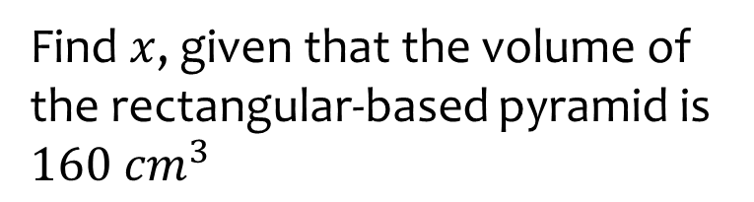





Worked example
Your turn
Find $x$, given that the volume of the rectangular-based pyramid is:
Find $x$, given that the volume of the rectangular-based pyramid is $160 cm^{3}$
$$20 cm^{3}$$
$$x cm$$
$$10 cm$$
$$4 cm$$
$$3 cm$$
$$8 cm$$
$$x cm$$
$$20 cm^{3}$$
$$x=6$$
$$4 cm$$
$$x cm$$
$$5 cm$$

Slide 29
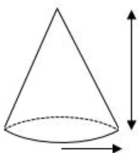
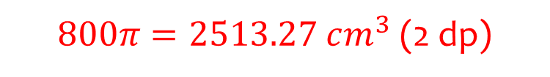


Worked example
Your turn
Calculate the volume of the cone:
Calculate the volume of the cone:
$$3 cm$$
$$6 cm$$
$$10 cm$$
$$20 cm$$
$800π=2513.27 cm^{3}$ (2 dp)
$$10 cm$$
$$3 cm$$

Slide 30
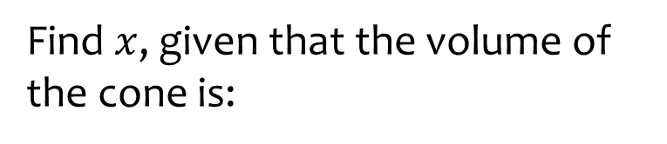
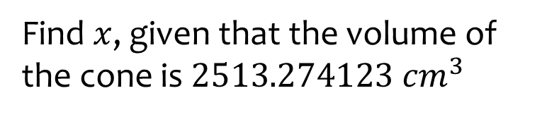



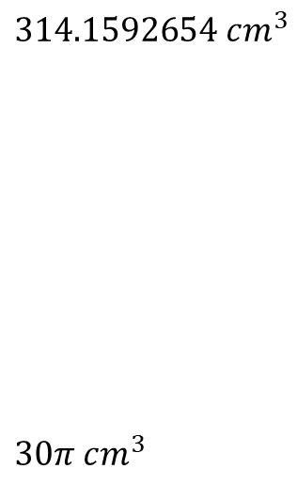
Worked example
Your turn
Find $x$, given that the volume of the cone is:
Find $x$, given that the volume of the cone is $2513.274123 cm^{3}$
$$314.1592654 cm^{3}$$
$$30π cm^{3}$$
$$x cm$$
$$x cm$$
$$10 cm$$
$$20 cm$$
$$x=6$$
$$10 cm$$
$$3 cm$$

Slide 31


Worked example
Your turn
Find $x$, given that the volume of the cone is:
Find $x$, given that the volume of the cone is $2513.274123 cm^{3}$
$$314.1592654 cm^{3}$$
$$30π cm^{3}$$
$$3 cm$$
$$6 cm$$
$$x cm$$
$$x cm$$
$$x=20$$
$$10 cm$$
$$x cm$$

Slide 32
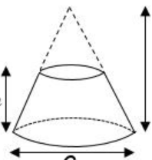






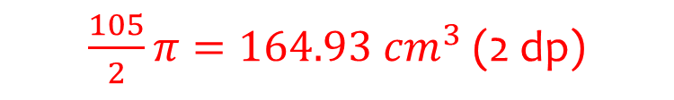
Worked example
Your turn
Calculate the volume of the frustum:
Calculate the volume of the frustum:
$$30 cm$$
$$20 cm$$
$$10 cm$$
$$10 cm$$
$$6 cm$$
$$6 cm$$
$\frac{105}{2}π=164.93 cm^{3}$ (2 dp)

Slide 33
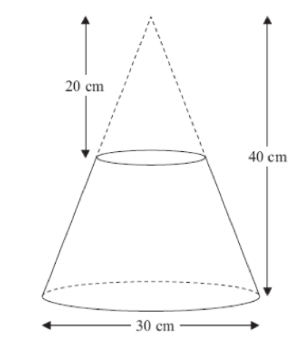




Worked example
Your turn
A frustum is made by removing a small cone from a similar large one.
Work out the volume of the frustum.
A frustum is made by removing a small cone from a similar large one.
Work out the volume of the frustum.
$$40 cm$$
$$80 cm$$
$$60 cm$$
$8246.68 cm^{3}$ (2 dp)

Slide 34
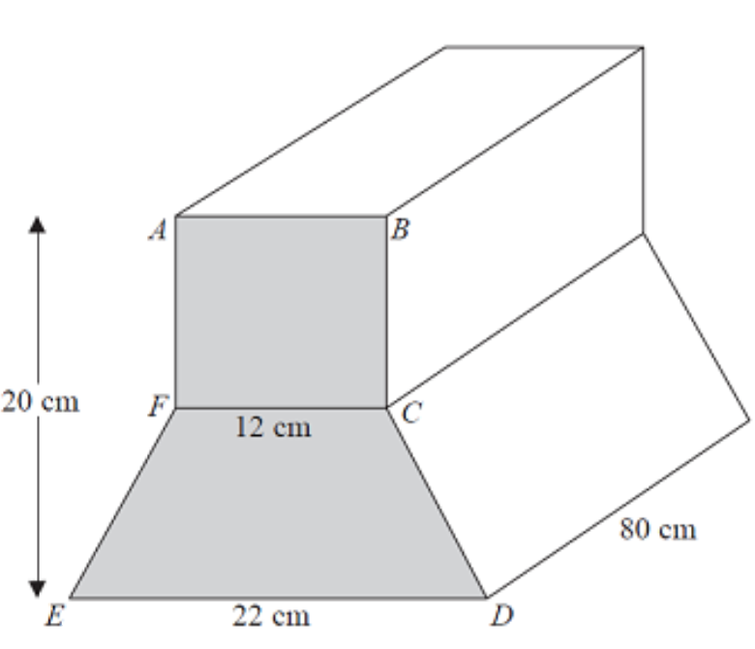





Worked example
Your turn
Calculate the total volume of this prism
Calculate the total volume of this prism
$$10 cm$$
$$6 cm$$
$$40 cm$$
$$11 cm$$
$$22400 cm^{3}$$

Slide 35
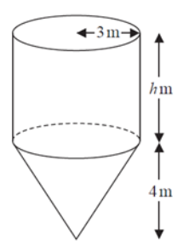







Worked example
Your turn
Calculate the volume of this composite shape
Calculate the volume of this composite shape
$$6 cm$$
$$3 cm$$
$$10 cm$$
$$5 cm$$
$$8 cm$$
$$4 cm$$
$57π=179.07 cm^{3}$ (2 dp)

Slide 36
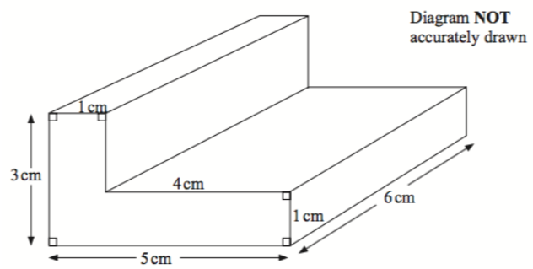







Worked example
Your turn
Calculate the total volume of this L-shaped prism
Calculate the total volume of this L-shaped prism
$$2 cm$$
$$6 cm$$
$$8cm$$
$$2 cm$$
$$12 cm$$
$$10 cm$$
$$42 cm^{3}$$

Slide 37
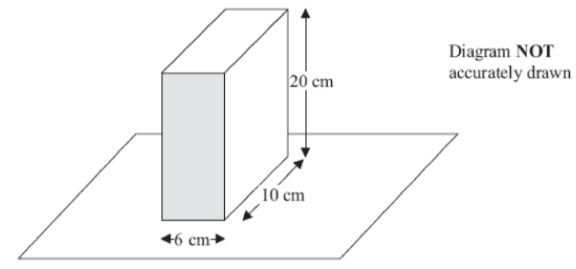
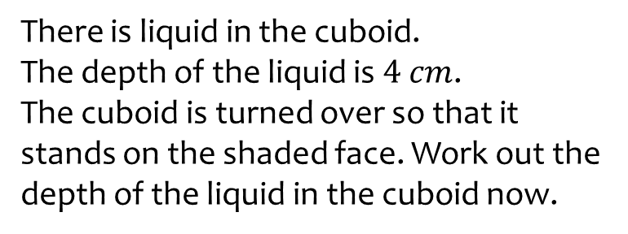
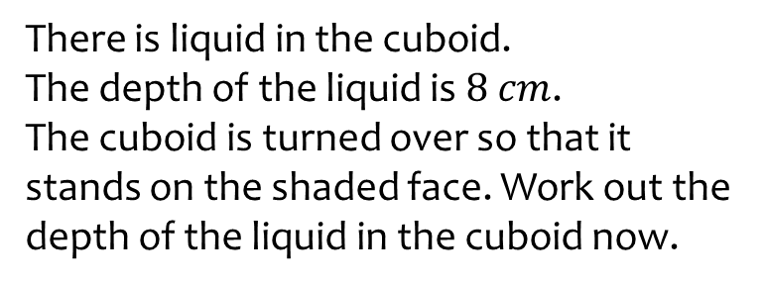




Worked example
Your turn
There is liquid in the cuboid.
The depth of the liquid is $4 cm$.
The cuboid is turned over so that it stands on the shaded face. Work out the depth of the liquid in the cuboid now.
There is liquid in the cuboid.
The depth of the liquid is $8 cm$.
The cuboid is turned over so that it stands on the shaded face. Work out the depth of the liquid in the cuboid now.
$$10 cm$$
$$5 cm$$
$$3 cm$$
$$4 cm$$

Slide 38
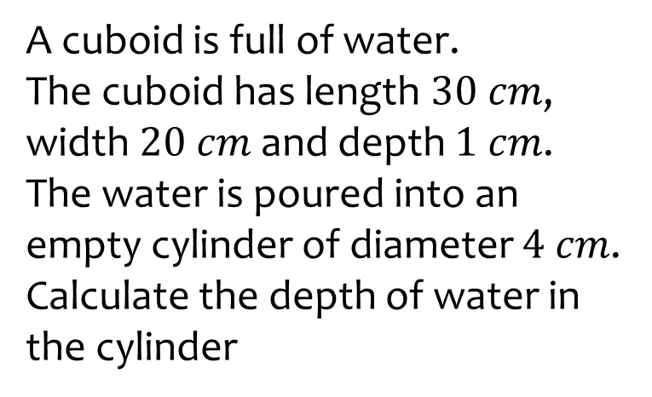


Worked example
Your turn
A cuboid is full of water.
The cuboid has length $30 cm$, width $20 cm$ and depth $1 cm$.
The water is poured into an empty cylinder of diameter $4 cm$.
Calculate the depth of water in the cylinder
A cuboid is full of water.
The cuboid has length $60 cm$, width $40 cm$ and depth $2 cm$.
The water is poured into an empty cylinder of diameter $8 cm$.
Calculate the depth of water in the cylinder
$$95.49 cm$$

Slide 39



Worked example
Your turn
A shape is made of centimeter cubes. On the centimeter square grid, draw the elevations:
Front:
Side:
Plan
A shape is made of centimeter cubes. On the centimeter square grid, draw the elevations:
Front:
Side:
Plan
Questions used with permission from Corbettmaths: https://corbettmaths.com/

Slide 40





Worked example
Your turn
Given the elevations
Draw the plan view
Sketch the solid shape
Given the elevations
Draw the plan view
Sketch the solid shape
Questions used with permission from Corbettmaths: https://corbettmaths.com/

Slide 41





Worked example
Your turn
For the cuboid, write down the:
Number of faces (F)
The number of edges (E)
The number of vertices (V)
Calculate $V+E−F$
For the cuboid, write down the:
Number of faces (F)
The number of edges (E)
The number of vertices (V)
Calculate $V+E−F$
$$5$$
$$9$$
$$6$$
$$2$$

Slide 42







Worked example
Your turn
Draw a net for the cuboid.
Each square represents $1 cm^{2}$
Draw a net for the cuboid.
Each square represents $1 cm^{2}$
Questions used with permission from Corbettmaths: https://corbettmaths.com/

Slide 43



Worked example
Your turn
A cuboid is drawn on a 3D grid
Write the coordinates of:
A
C
F
A cuboid is drawn on a 3D grid
Write the coordinates of:
A
E
D
(5, 2, 3)
$$\left(0, 2, 0\right)$$
$$\left(5, 0, 0\right)$$
$$(0, 2, 3)$$
Questions used with permission from Corbettmaths: https://corbettmaths.com/

