Slide 1
Vectors
CONTENTS

Slide 2
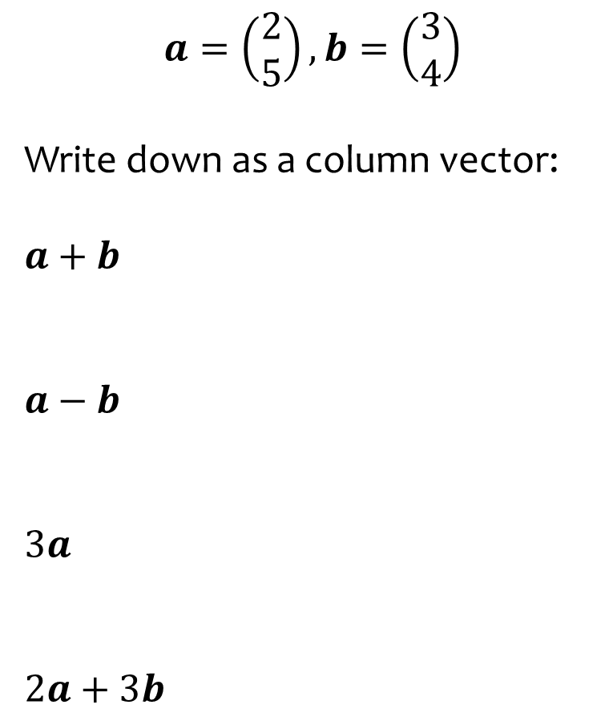
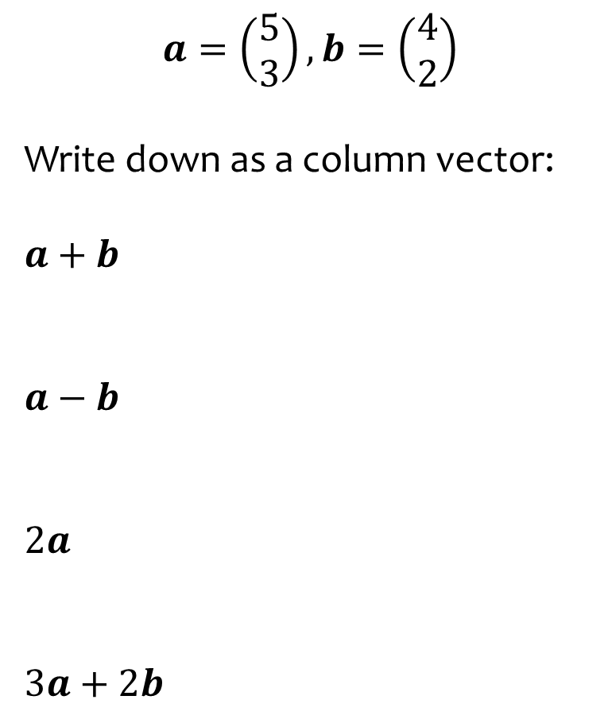
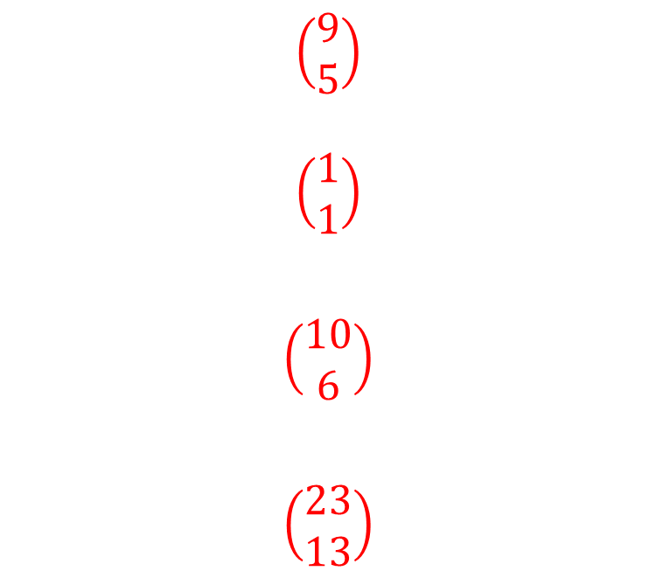
Worked example
Your turn
$$a=\left(\begin{aligned}2 \\ 5\end{aligned}\right), b=\left(\begin{aligned}3 \\ 4\end{aligned}\right)$$
Write down as a column vector:
$$a+b$$
$$a−b$$
$$3a$$
$$2a+3b$$
$$a=\left(\begin{aligned}5 \\ 3\end{aligned}\right), b=\left(\begin{aligned}4 \\ 2\end{aligned}\right)$$
Write down as a column vector:
$$a+b$$
$$a−b$$
$$2a$$
$$3a+2b$$
$$\left(\begin{aligned}9 \\ 5\end{aligned}\right)$$
$$\left(\begin{aligned}1 \\ 1\end{aligned}\right)$$
$$\left(\begin{aligned}10 \\ 6\end{aligned}\right)$$
$$\left(\begin{aligned}23 \\ 13\end{aligned}\right)$$

Slide 3
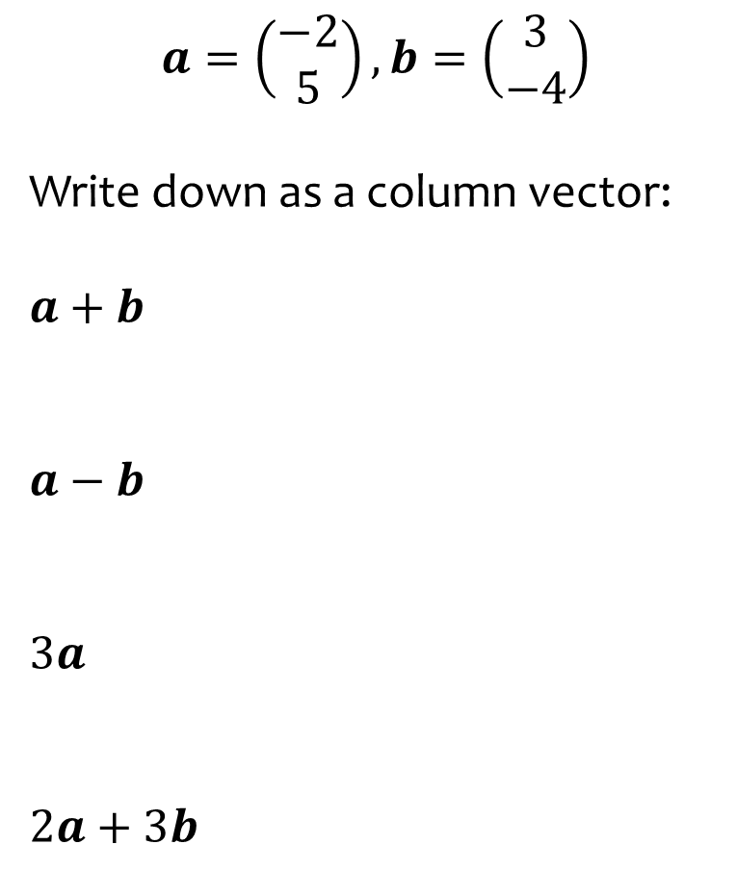
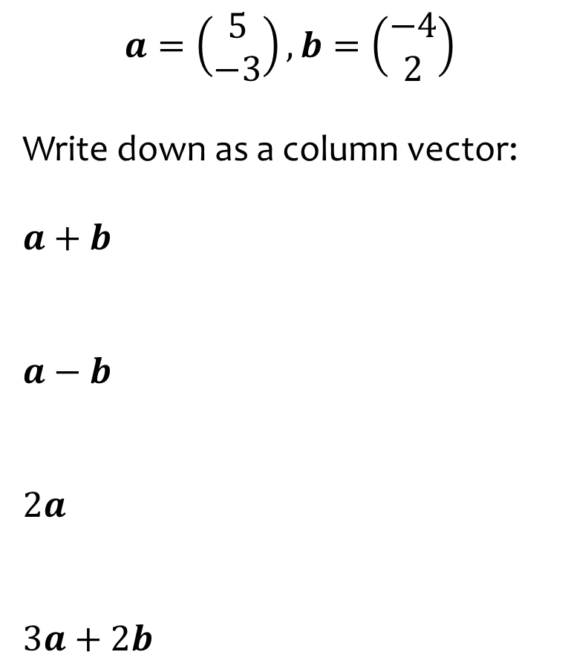
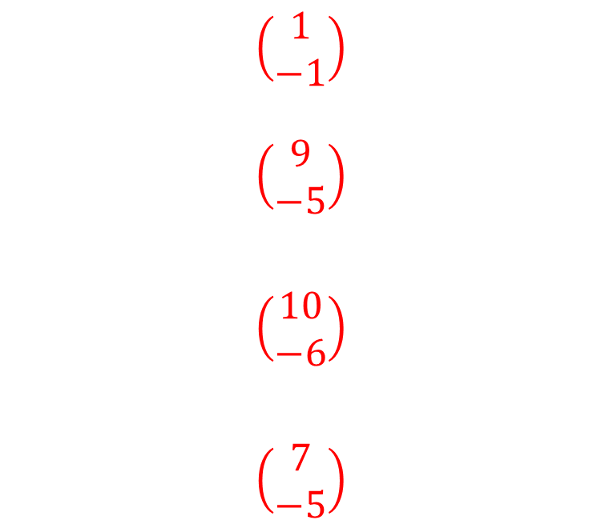
Worked example
Your turn
$$a=\left(\begin{aligned}−2 \\ 5\end{aligned}\right), b=\left(\begin{aligned}3 \\ −4\end{aligned}\right)$$
Write down as a column vector:
$$a+b$$
$$a−b$$
$$3a$$
$$2a+3b$$
$$a=\left(\begin{aligned}5 \\ −3\end{aligned}\right), b=\left(\begin{aligned}−4 \\ 2\end{aligned}\right)$$
Write down as a column vector:
$$a+b$$
$$a−b$$
$$2a$$
$$3a+2b$$
$$\left(\begin{aligned}1 \\ −1\end{aligned}\right)$$
$$\left(\begin{aligned}9 \\ −5\end{aligned}\right)$$
$$\left(\begin{aligned}10 \\ −6\end{aligned}\right)$$
$$\left(\begin{aligned}7 \\ −5\end{aligned}\right)$$

Slide 4
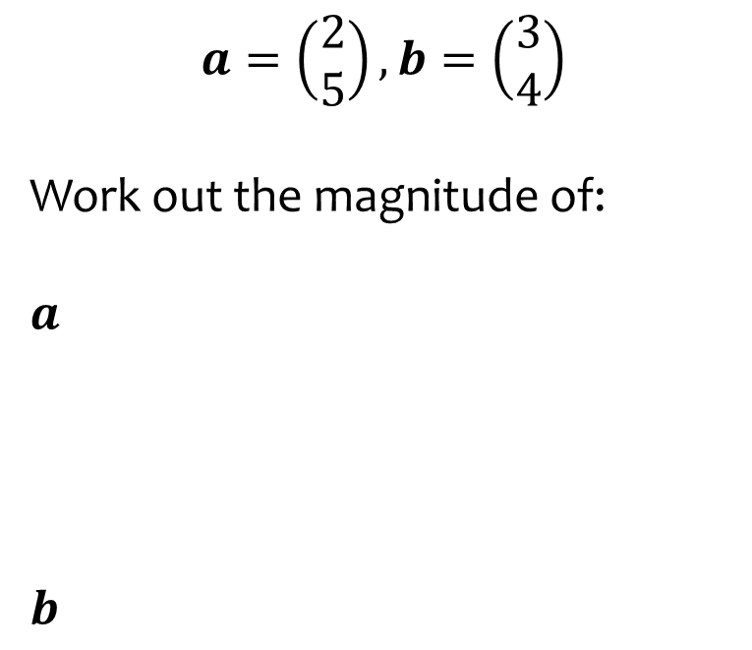
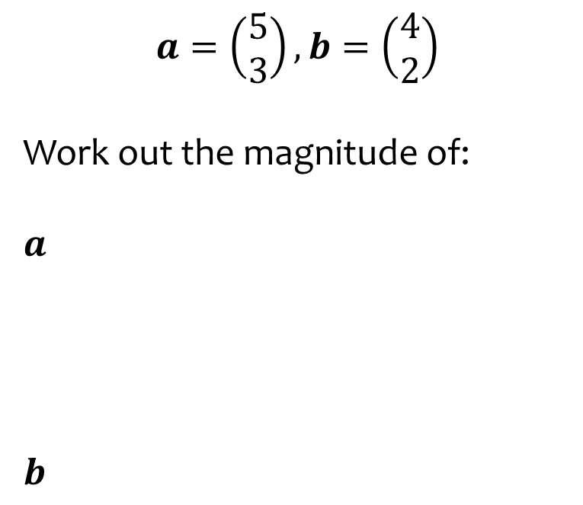
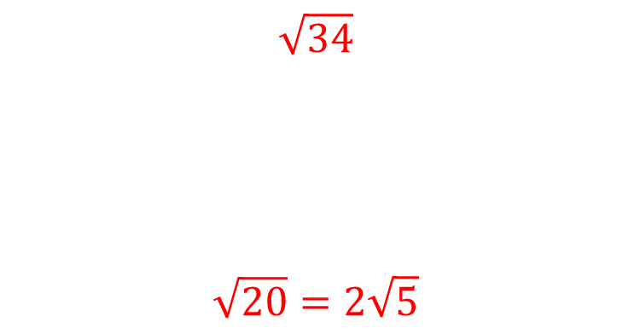
Worked example
Your turn
$$a=\left(\begin{aligned}2 \\ 5\end{aligned}\right), b=\left(\begin{aligned}3 \\ 4\end{aligned}\right)$$
Work out the magnitude of:
$$a$$
$$b$$
$$a=\left(\begin{aligned}5 \\ 3\end{aligned}\right), b=\left(\begin{aligned}4 \\ 2\end{aligned}\right)$$
Work out the magnitude of:
$$a$$
$$b$$
$$\sqrt{34}$$
$$\sqrt{20}=2\sqrt{5}$$

Slide 5
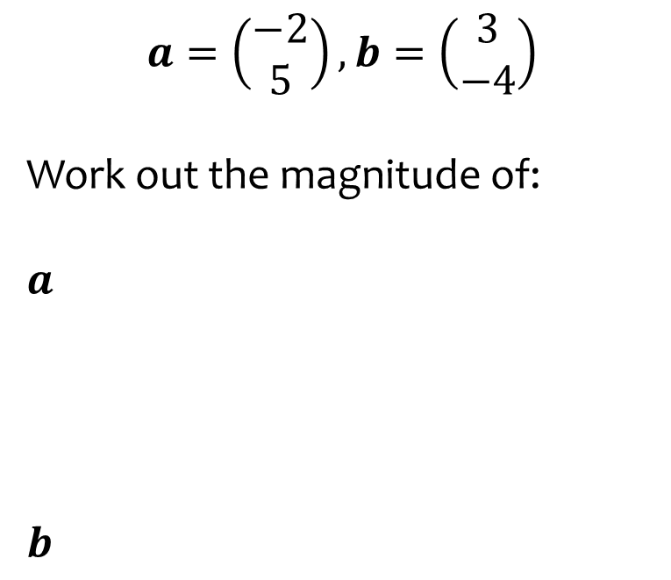
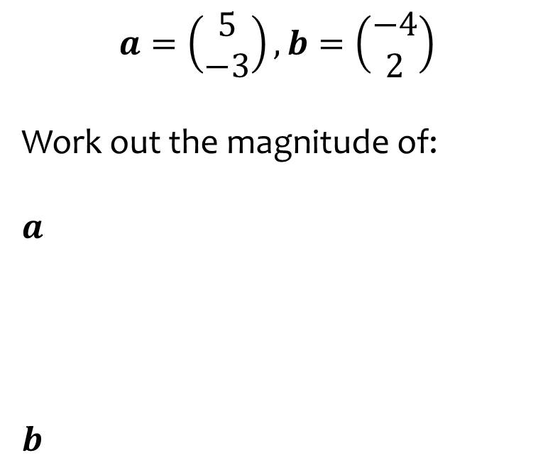
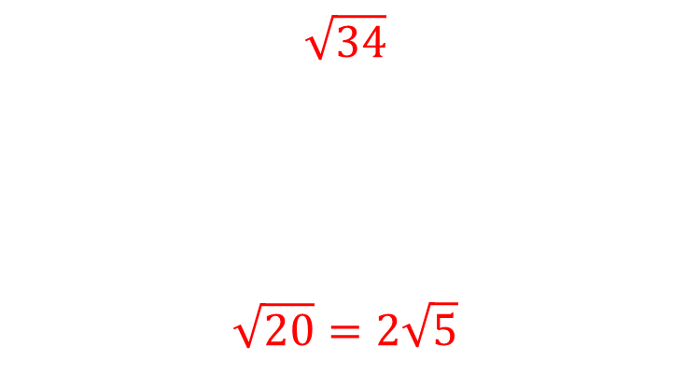
Worked example
Your turn
$$a=\left(\begin{aligned}−2 \\ 5\end{aligned}\right), b=\left(\begin{aligned}3 \\ −4\end{aligned}\right)$$
Work out the magnitude of:
$$a$$
$$b$$
$$a=\left(\begin{aligned}5 \\ −3\end{aligned}\right), b=\left(\begin{aligned}−4 \\ 2\end{aligned}\right)$$
Work out the magnitude of:
$$a$$
$$b$$
$$\sqrt{34}$$
$$\sqrt{20}=2\sqrt{5}$$

Slide 6
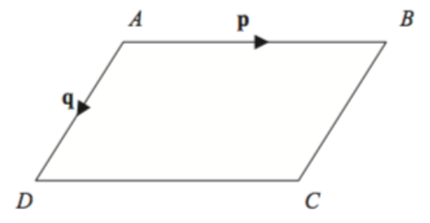
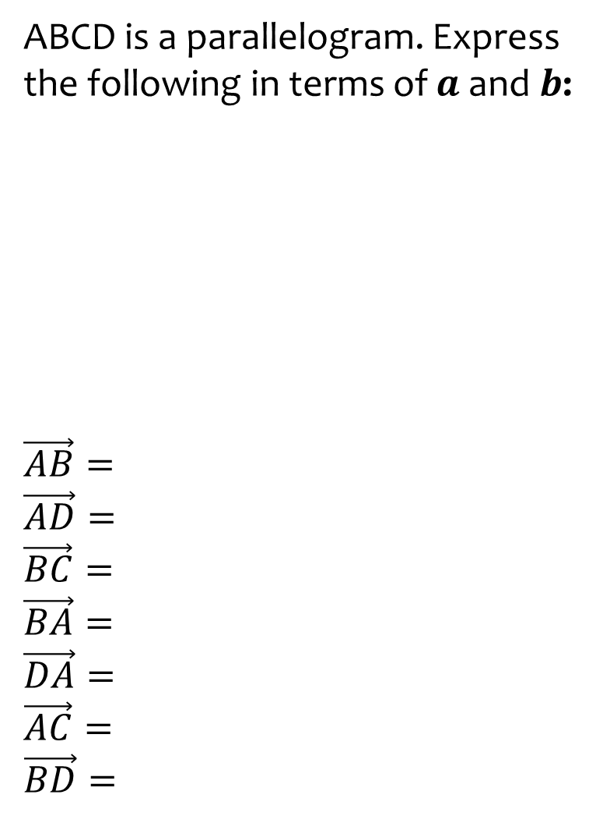
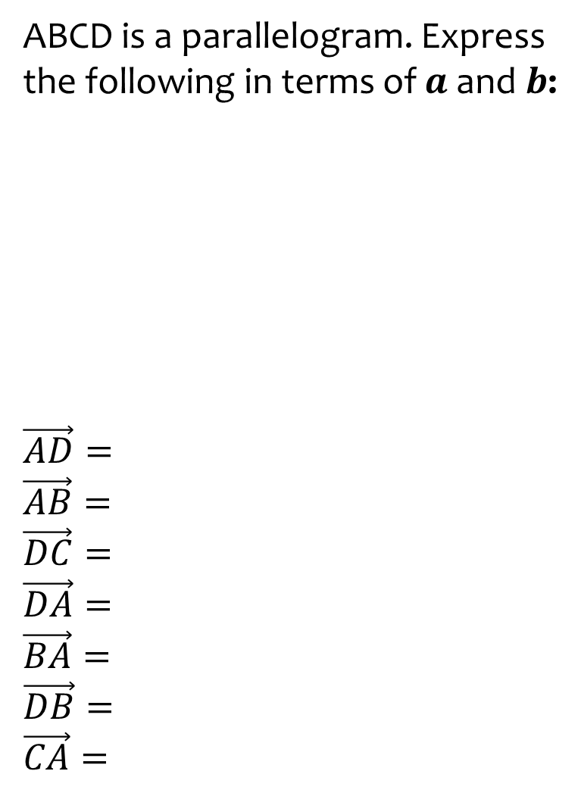
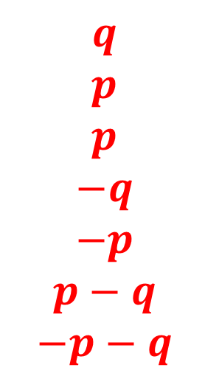


Worked example
Your turn
ABCD is a parallelogram. Express the following in terms of $a$ and $b$:
$$\vec{AB}=$$
$$\vec{AD}=$$
$$\vec{BC}=$$
$$\vec{BA}=$$
$$\vec{DA}=$$
$$\vec{AC}=$$
$$\vec{BD}=$$
ABCD is a parallelogram. Express the following in terms of $a$ and $b$:
$$\vec{AD}=$$
$$\vec{AB}=$$
$$\vec{DC}=$$
$$\vec{DA}=$$
$$\vec{BA}=$$
$$\vec{DB}=$$
$$\vec{CA}=$$
$$a$$
$$b$$
$$q$$
$$p$$
$$p$$
$$−q$$
$$−p$$
$$p−q$$
$$−p−q$$

Slide 7
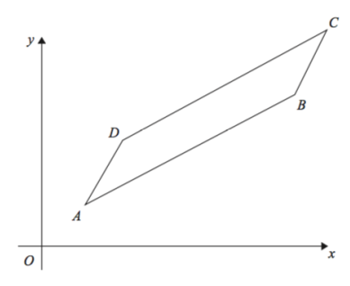
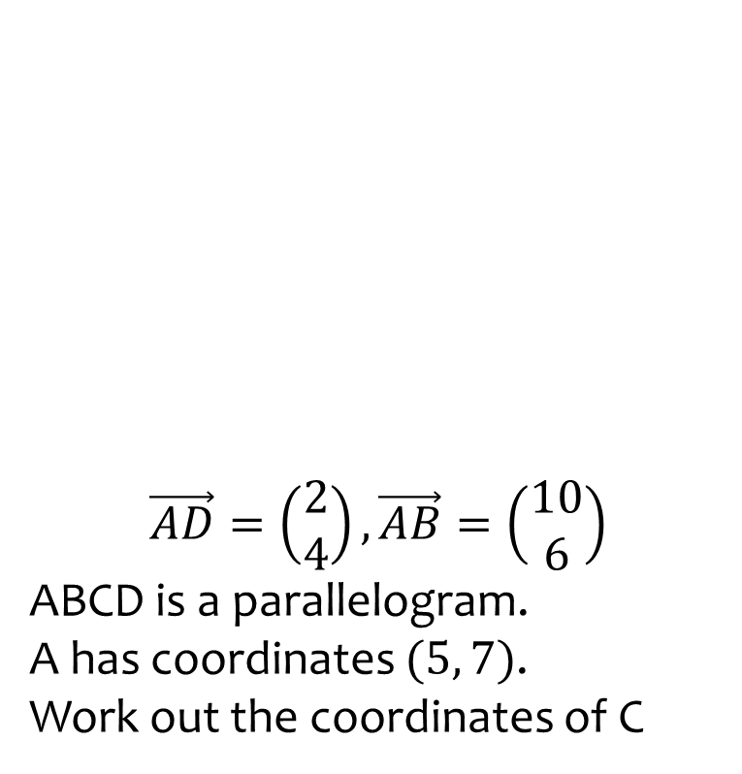
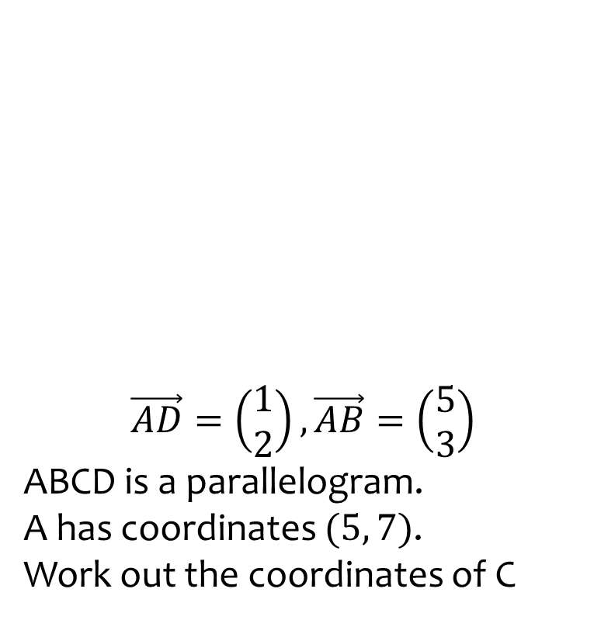

Worked example
Your turn
$$\vec{AD}=\left(\begin{aligned}2 \\ 4\end{aligned}\right),\vec{AB}=\left(\begin{aligned}10 \\ 6\end{aligned}\right)$$
ABCD is a parallelogram.
A has coordinates $(5, 7)$.
Work out the coordinates of C
$$\vec{AD}=\left(\begin{aligned}1 \\ 2\end{aligned}\right),\vec{AB}=\left(\begin{aligned}5 \\ 3\end{aligned}\right)$$
ABCD is a parallelogram.
A has coordinates $(5, 7)$.
Work out the coordinates of C
$$(11, 12)$$

Slide 8
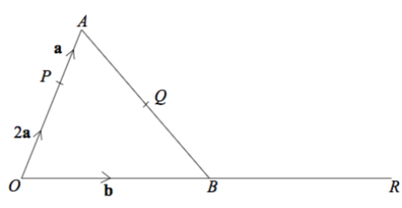
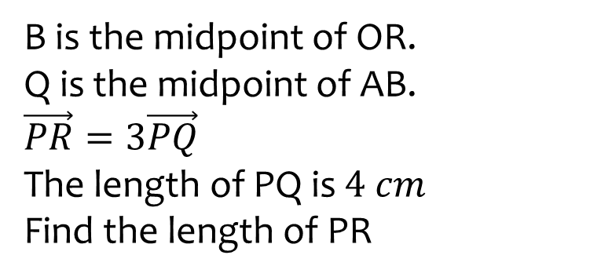
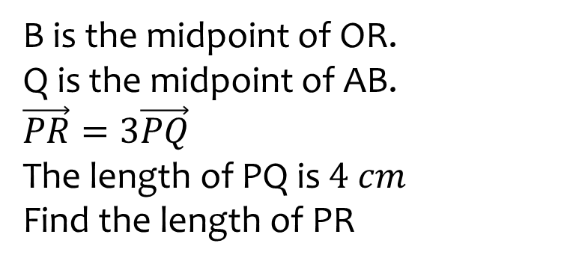

Worked example
Your turn
B is the midpoint of OR.
Q is the midpoint of AB.
$$\vec{PR}=3\vec{PQ}$$
The length of PQ is $4 cm$
Find the length of PR
B is the midpoint of OR.
Q is the midpoint of AB.
$$\vec{PR}=3\vec{PQ}$$
The length of PQ is $4 cm$
Find the length of PR
$$12 cm$$

Slide 9
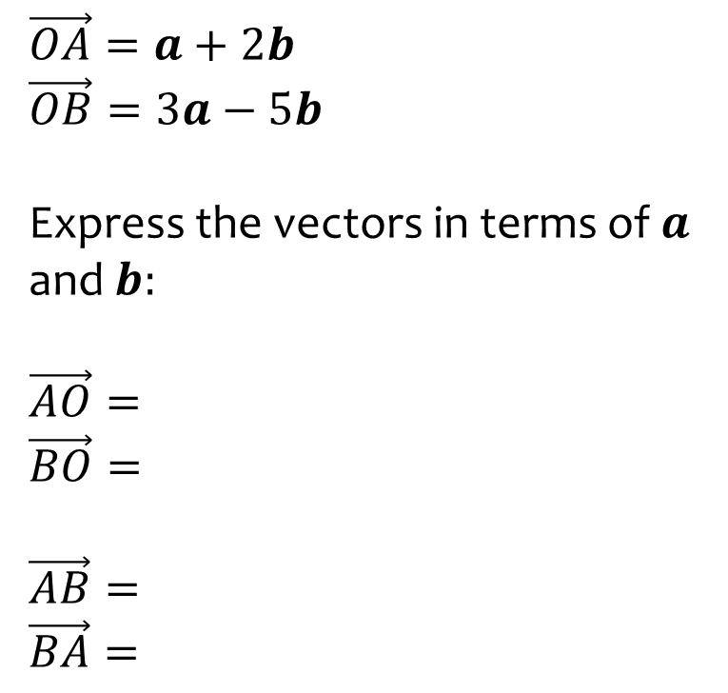
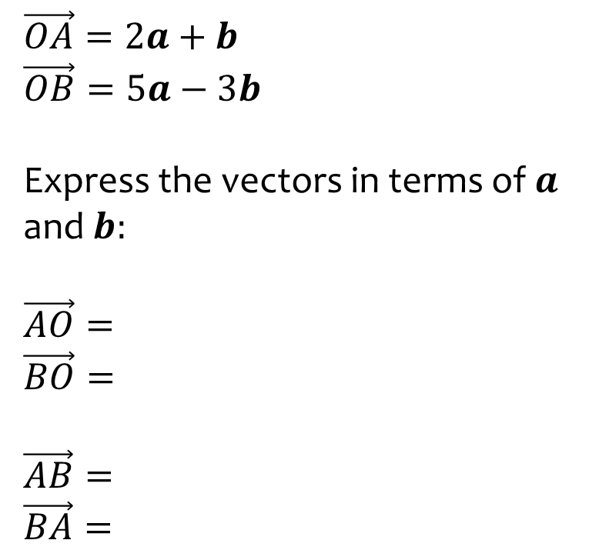
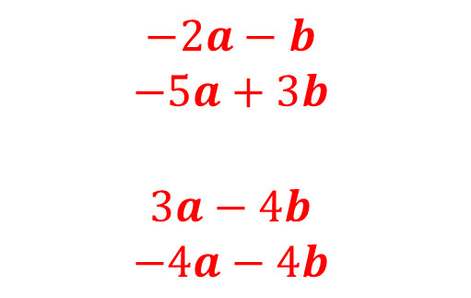
Worked example
Your turn
$$\vec{OA}=a+2b$$
$$\vec{OB}=3a−5b$$
Express the vectors in terms of $a$ and $b:$
$$\vec{AO}=$$
$$\vec{BO}=$$
$$\vec{AB}=$$
$$\vec{BA}=$$
$$\vec{OA}=2a+b$$
$$\vec{OB}=5a−3b$$
Express the vectors in terms of $a$ and $b:$
$$\vec{AO}=$$
$$\vec{BO}=$$
$$\vec{AB}=$$
$$\vec{BA}=$$
$$−2a−b$$
$$−5a+3b$$
$$3a−4b$$
$$−4a−4b$$

Slide 10
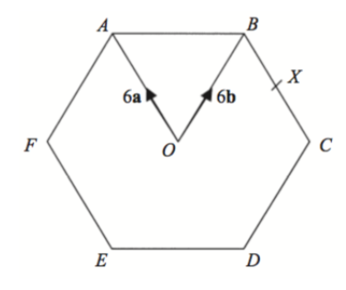
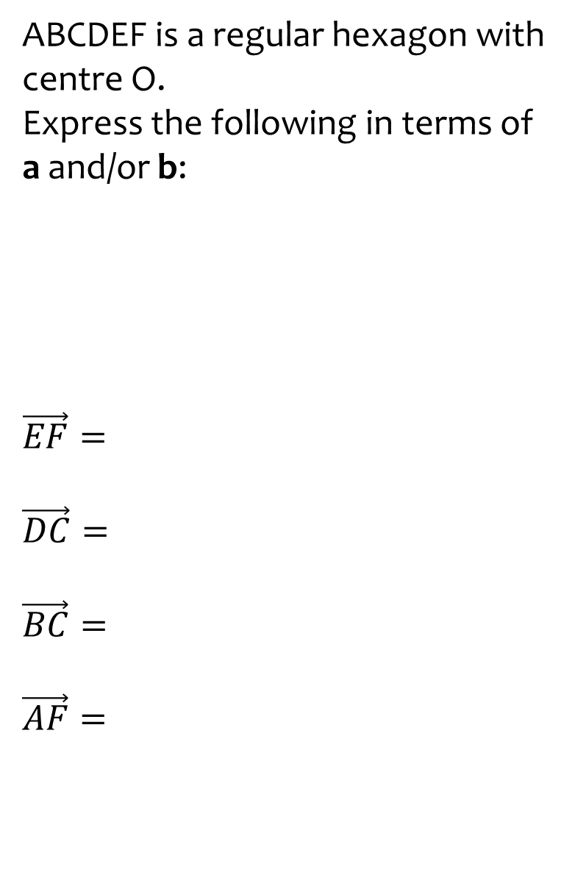
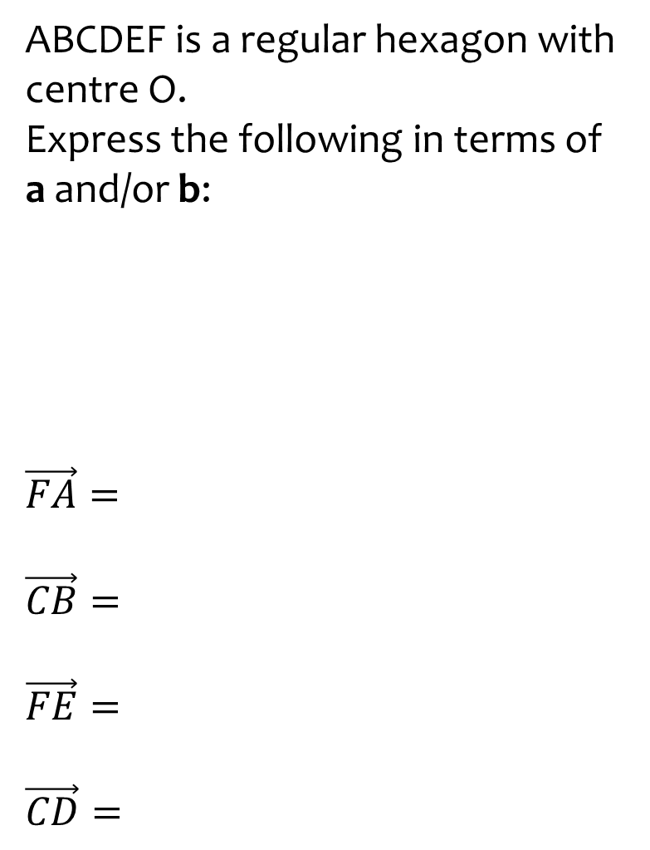
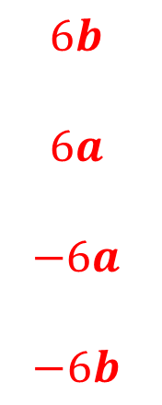


Worked example
Your turn
ABCDEF is a regular hexagon with centre O.
Express the following in terms of a and/or b:
$$\vec{EF}=$$
$$\vec{DC}=$$
$$\vec{BC}=$$
$$\vec{AF}=$$
ABCDEF is a regular hexagon with centre O.
Express the following in terms of a and/or b:
$$\vec{FA}=$$
$$\vec{CB}=$$
$$\vec{FE}=$$
$$\vec{CD}=$$
$$5b$$
$$5a$$
$$6b$$
$$6a$$
$$−6a$$
$$−6b$$

Slide 11
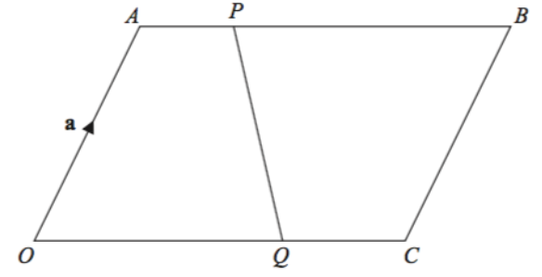
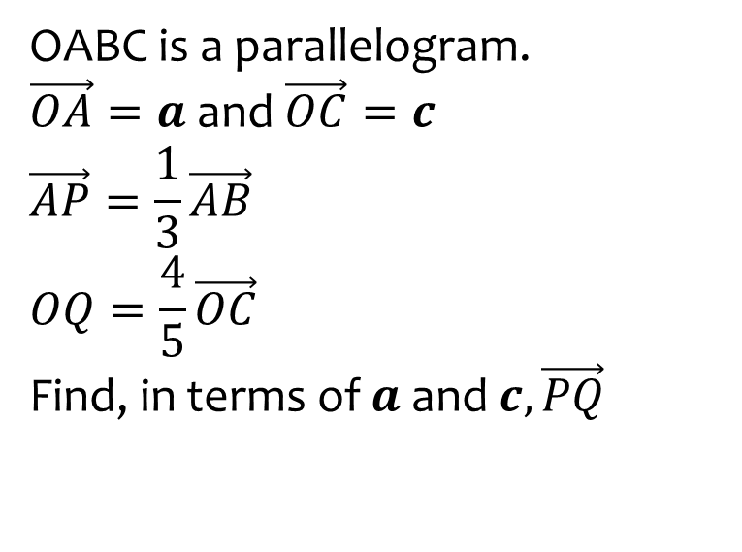
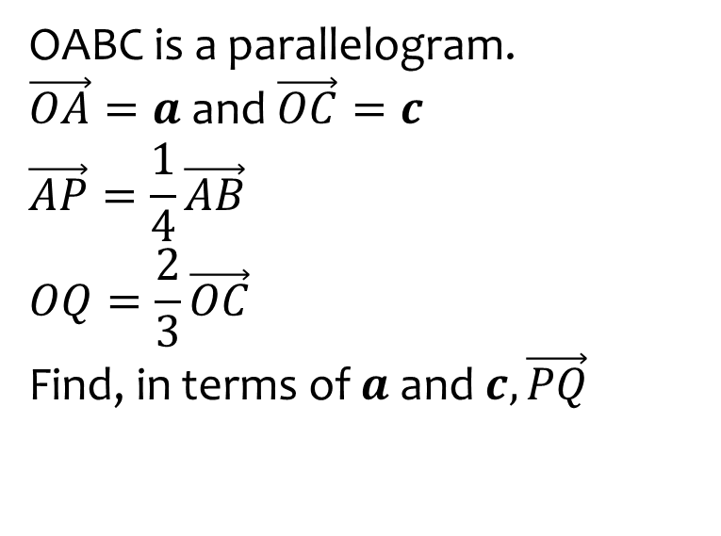

Worked example
Your turn
OABC is a parallelogram.
$\vec{OA}=a$ and $\vec{OC}=c$
$$\vec{AP}=\frac{1}{3}\vec{AB}$$
$$OQ=\frac{4}{5}\vec{OC}$$
Find, in terms of $a$ and $c,\vec{PQ}$
OABC is a parallelogram.
$\vec{OA}=a$ and $\vec{OC}=c$
$$\vec{AP}=\frac{1}{4}\vec{AB}$$
$$OQ=\frac{2}{3}\vec{OC}$$
Find, in terms of $a$ and $c,\vec{PQ}$
$$\frac{5}{12}c−a$$

Slide 12
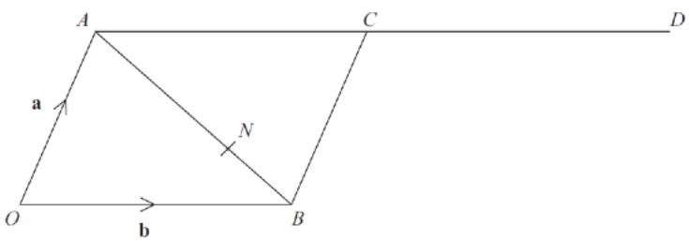
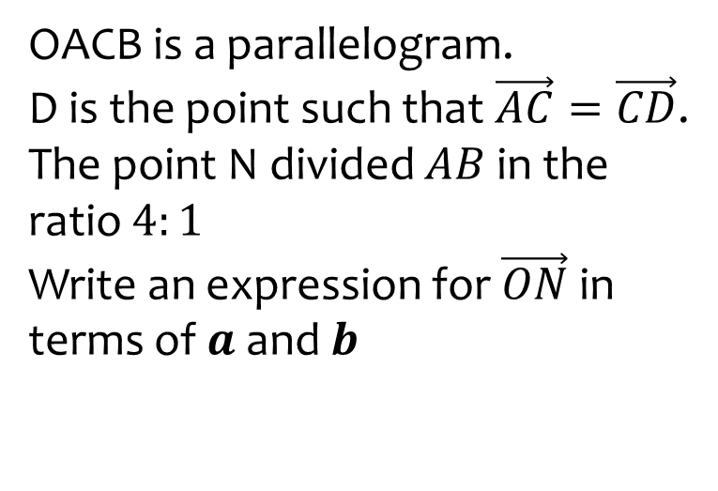
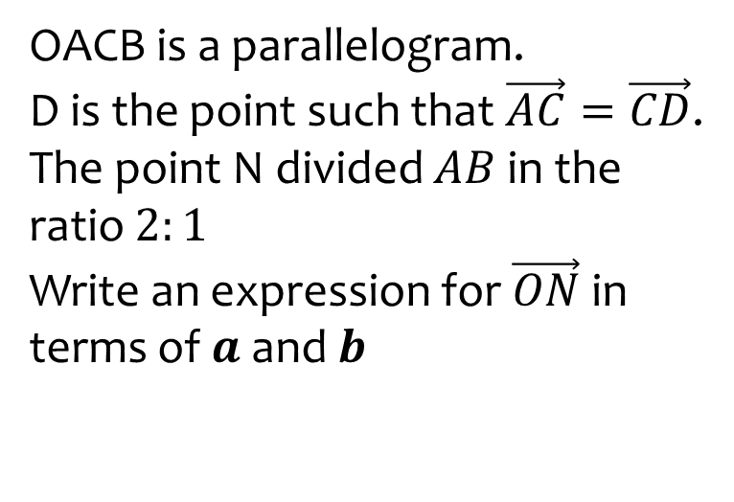

Worked example
Your turn
OACB is a parallelogram.
D is the point such that $\vec{AC}=\vec{CD}$.
The point N divided $AB$in the ratio $4:1$
Write an expression for $\vec{ON}$ in terms of $a$ and $b$
OACB is a parallelogram.
D is the point such that $\vec{AC}=\vec{CD}$.
The point N divided $AB$in the ratio $2:1$
Write an expression for $\vec{ON}$ in terms of $a$ and $b$
$$\frac{1}{3}a+\frac{2}{3}b$$

Slide 13
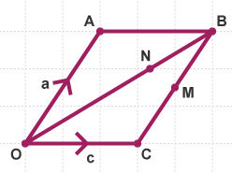
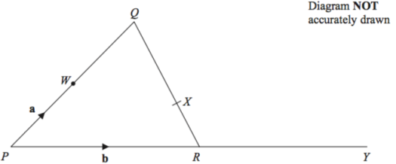
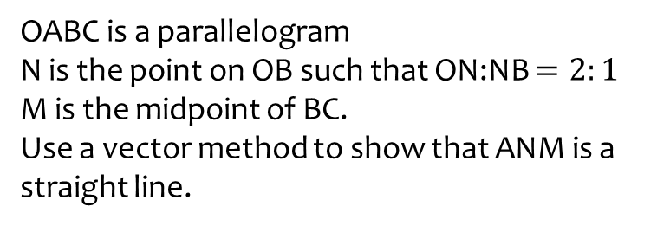
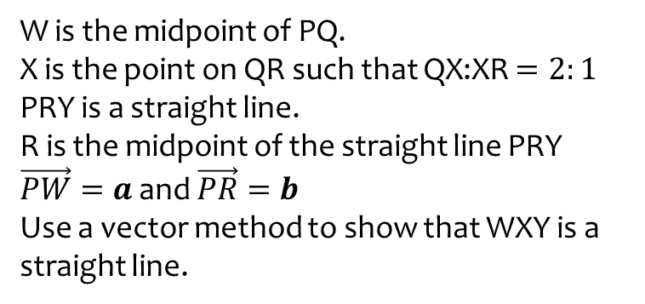
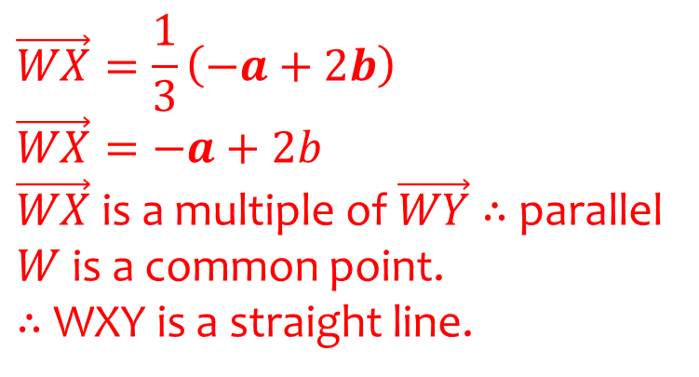
Worked example
Your turn
OABC is a parallelogram
N is the point on OB such that ON:NB $=2:1$
M is the midpoint of BC.
Use a vector method to show that ANM is a straight line.
W is the midpoint of PQ.
X is the point on QR such that QX:XR $=2:1$
PRY is a straight line.
R is the midpoint of the straight line PRY
$\vec{PW}=a$ and $\vec{PR}=b$
Use a vector method to show that WXY is a straight line.
$$\vec{WX}=\frac{1}{3}\left(−a+2b\right)$$
$$\vec{WX}=−a+2b$$
$\vec{WX}$is a multiple of $\vec{WY}$ $∴$ parallel
$W$ is a common point.
$∴$ WXY is a straight line.

Slide 14
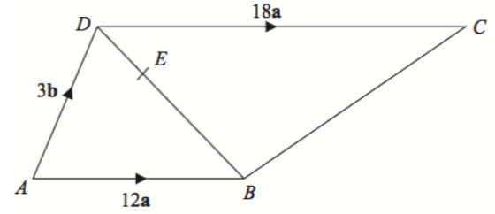
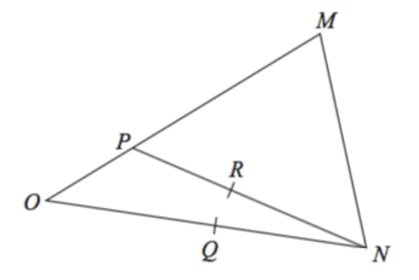
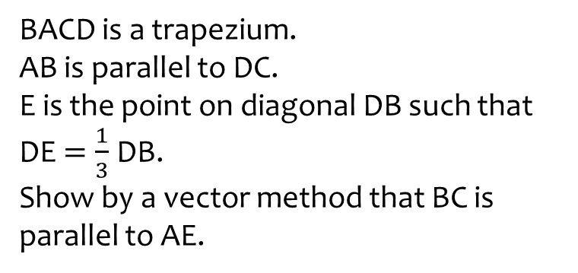
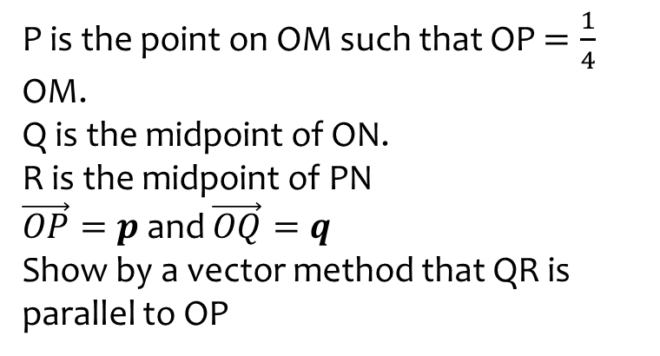
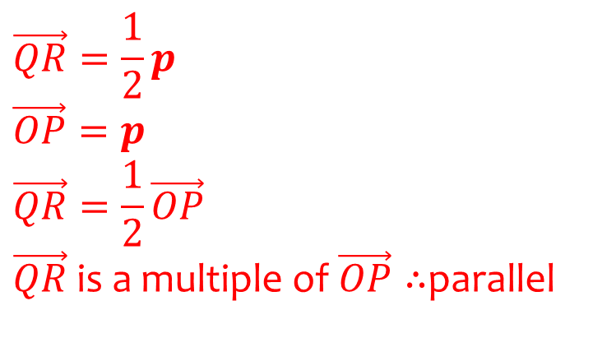
Worked example
Your turn
BACD is a trapezium.
AB is parallel to DC.
E is the point on diagonal DB such that DE $=\frac{1}{3}$ DB.
Show by a vector method that BC is parallel to AE.
P is the point on OM such that OP $=\frac{1}{4}$ OM.
Q is the midpoint of ON.
R is the midpoint of PN
$\vec{OP}=p$ and $\vec{OQ}=q$
Show by a vector method that QR is parallel to OP
$$\vec{QR}=\frac{1}{2}p$$
$$\vec{OP}=p$$
$$\vec{QR}=\frac{1}{2}\vec{OP}$$
$\vec{QR}$ is a multiple of $\vec{OP}∴$parallel

Slide 15
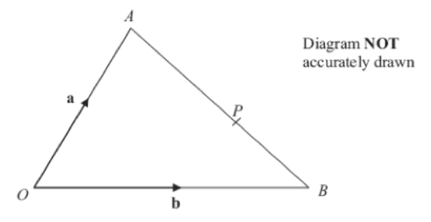
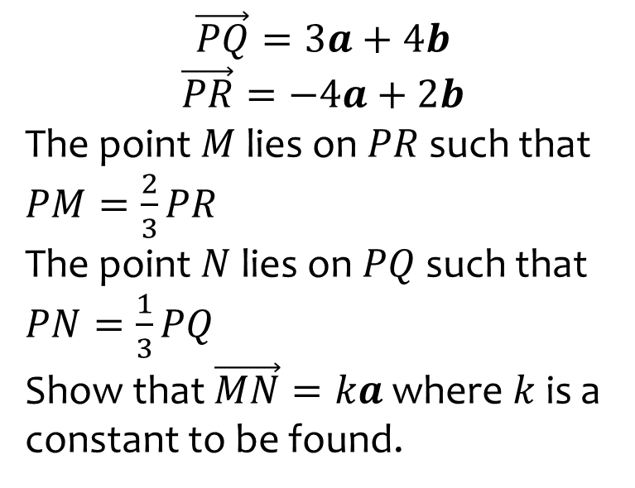
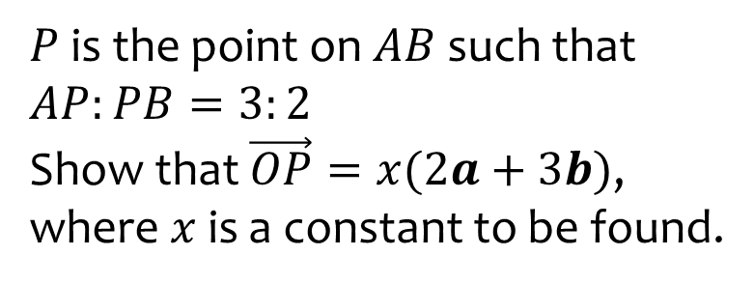

Worked example
Your turn
$$\vec{PQ}=3a+4b$$
$$\vec{PR}=−4a+2b$$
The point $M$ lies on $PR$ such that $PM=\frac{2}{3}PR$
The point $N$ lies on $PQ$ such that $PN=\frac{1}{3}PQ$
Show that $\vec{MN}=ka$ where $k$ is a constant to be found.
$P$ is the point on $AB$ such that $AP:PB=3:2$
Show that $\vec{OP}=x(2a+3b)$, where $x$ is a constant to be found.
$$x=\frac{1}{5}$$

Slide 16
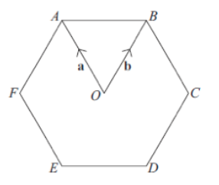
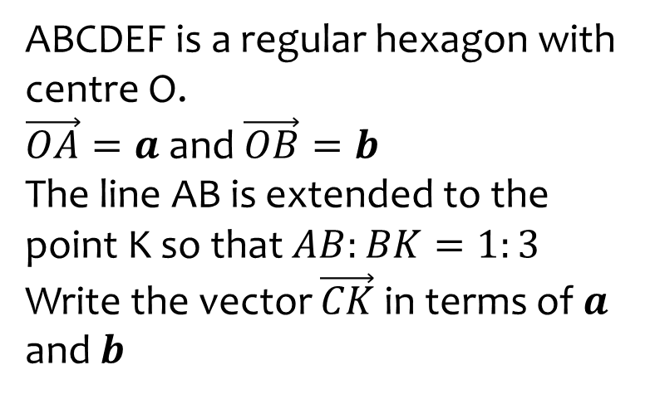


Worked example
Your turn
ABCDEF is a regular hexagon with centre O.
$\vec{OA}=a$ and $\vec{OB}=b$
The line AB is extended to the point K so that $AB:BK=1:3$
Write the vector $\vec{CK}$ in terms of $a$ and $b$
ABCDEF is a regular hexagon with centre O.
$\vec{OA}=a$ and $\vec{OB}=b$
The line AB is extended to the point K so that $AB:BK=1:2$
Write the vector $\vec{CK}$ in terms of $a$ and $b$
$$\vec{CK}=2b−a$$

Slide 17






Worked example
Your turn
ABC is a straight line.
$$AB:BC=2:7$$
Express $\vec{OC}$ in terms of $a$ and $b$
ABC is a straight line.
$$AB:BC=2:5$$
Express $\vec{OC}$ in terms of $a$ and $b$
$$2a+3b$$
$$a+2b$$
$$\vec{OC}=\frac{11}{2}a+\frac{9}{2}b$$

