Slide 1
Trigonometry (basic)
CONTENTS

Slide 2
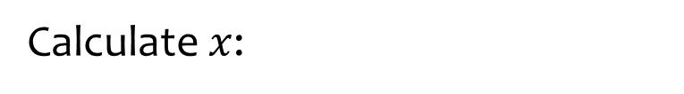
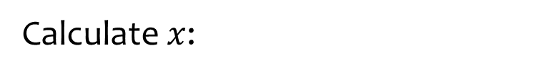







Worked example
Your turn
Calculate $x$:
Calculate $x$:
$$5 cm$$
$$5 cm$$
$$x cm$$
$$x cm$$
$$30°$$
$$40°$$
$x=3.21$(2 dp)

Slide 3







Worked example
Your turn
Calculate $x$:
Calculate $x$:
$$5 cm$$
$$5 cm$$
$$30°$$
$$40°$$
$$x cm$$
$$x cm$$
$x=3.83$(2 dp)

Slide 4







Worked example
Your turn
Calculate $x$:
Calculate $x$:
$$x cm$$
$$x cm$$
$$30°$$
$$40°$$
$$5 cm$$
$$5 cm$$
$x=4.20$(2 dp)

Slide 5







Worked example
Your turn
Calculate $x$:
Calculate $x$:
$$x cm$$
$$x cm$$
$$5 cm$$
$$5 cm$$
$$30°$$
$$40°$$
$x=7.78$(2 dp)

Slide 6







Worked example
Your turn
Calculate $x$:
Calculate $x$:
$$x cm$$
$$x cm$$
$$30°$$
$$40°$$
$$5 cm$$
$$5 cm$$
$x=6.53$ (2 dp)

Slide 7







Worked example
Your turn
Calculate $x$:
Calculate $x$:
$$5 cm$$
$$5 cm$$
$$30°$$
$$40°$$
$$x cm$$
$$x cm$$
$x=5.96$ (2 dp)

Slide 8
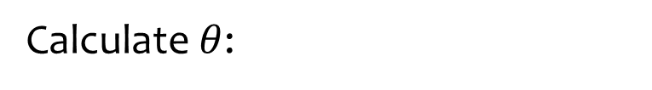
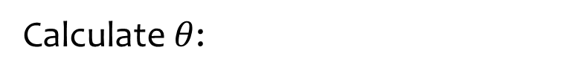







Worked example
Your turn
Calculate $θ$:
Calculate $θ$:
$$5 cm$$
$$5 cm$$
$$4 cm$$
$$4.5 cm$$
$$θ°$$
$$θ°$$
$θ=64.16$ (2 dp)

Slide 9







Worked example
Your turn
Calculate $θ$:
Calculate $θ$:
$$5 cm$$
$$5 cm$$
$$θ°$$
$$θ°$$
$$4 cm$$
$$4.5 cm$$
$θ=25.84$ (2 dp)

Slide 10







Worked example
Your turn
Calculate $θ$:
Calculate $θ$:
$$4 cm$$
$$4.5 cm$$
$$θ°$$
$$θ°$$
$$5 cm$$
$$5 cm$$
$θ=41.99$ (2 dp)

Slide 11
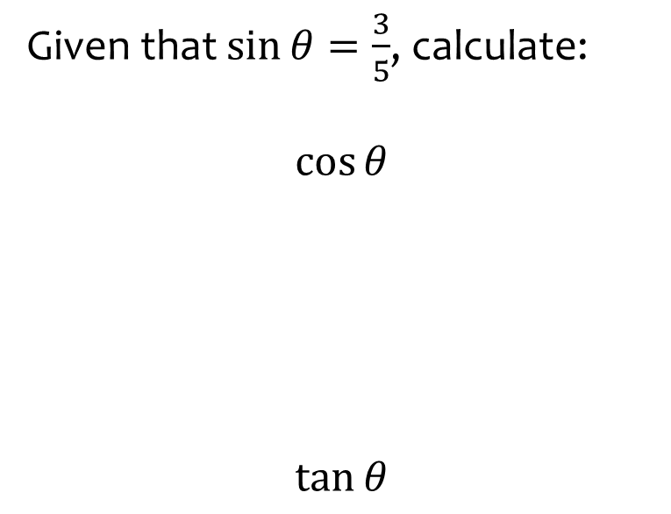
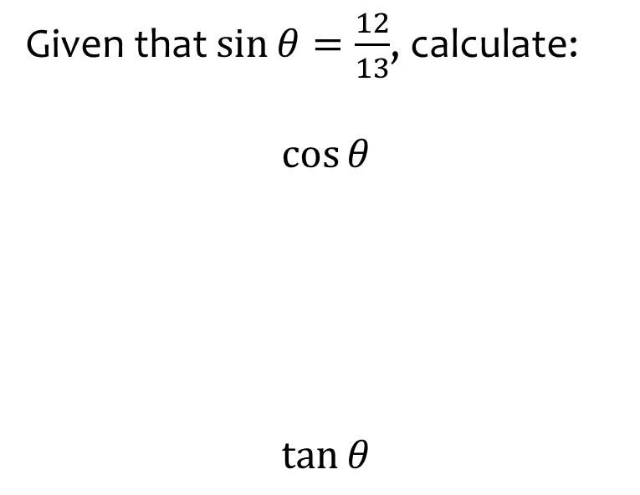
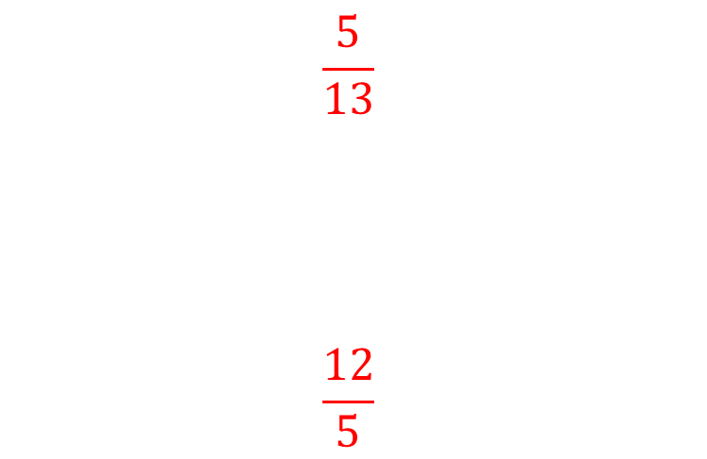
Worked example
Your turn
Given that $\sin{θ}=\frac{3}{5}$, calculate:
$$\cos{θ}$$
$$\tan{θ}$$
Given that $\sin{θ}=\frac{12}{13}$, calculate:
$$\cos{θ}$$
$$\tan{θ}$$
$$\frac{5}{13}$$
$$\frac{12}{5}$$

Slide 12
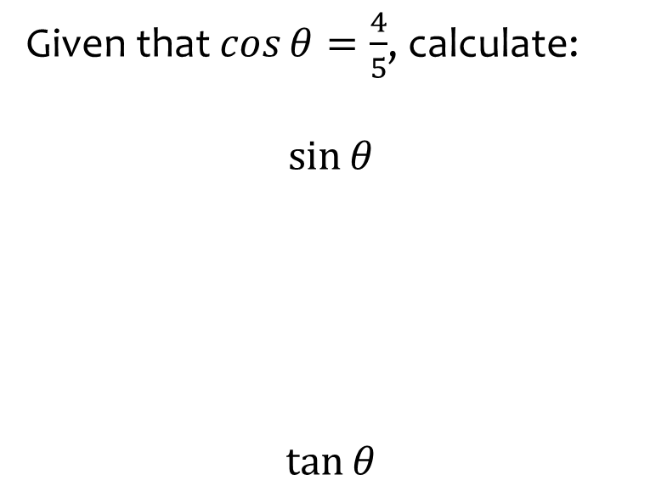
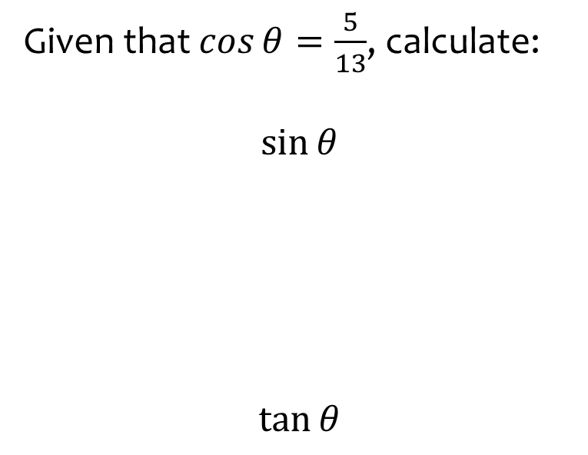
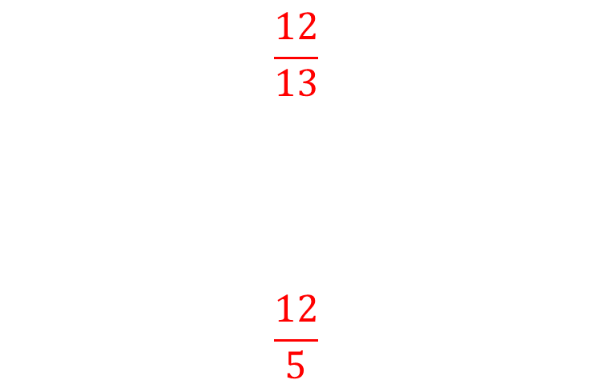
Worked example
Your turn
Given that $\cos{θ}=\frac{4}{5}$, calculate:
$$\sin{θ}$$
$$\tan{θ}$$
Given that $\cos{θ}=\frac{5}{13}$, calculate:
$$\sin{θ}$$
$$\tan{θ}$$
$$\frac{12}{13}$$
$$\frac{12}{5}$$

Slide 13
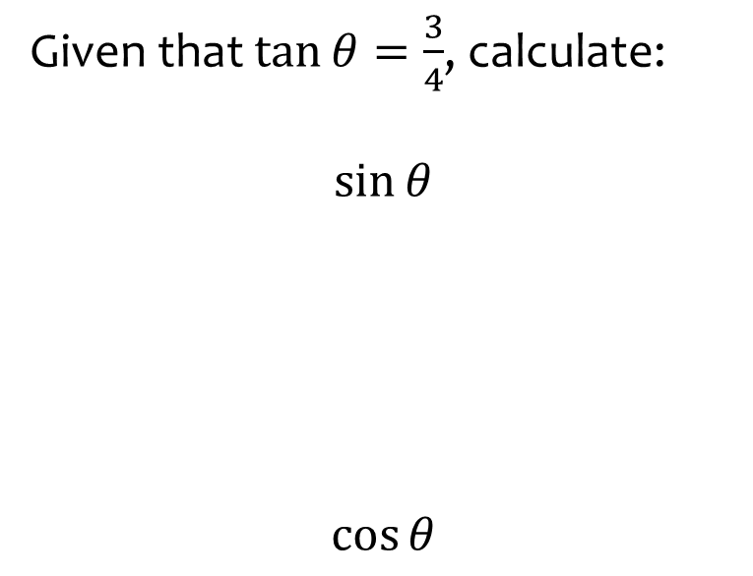
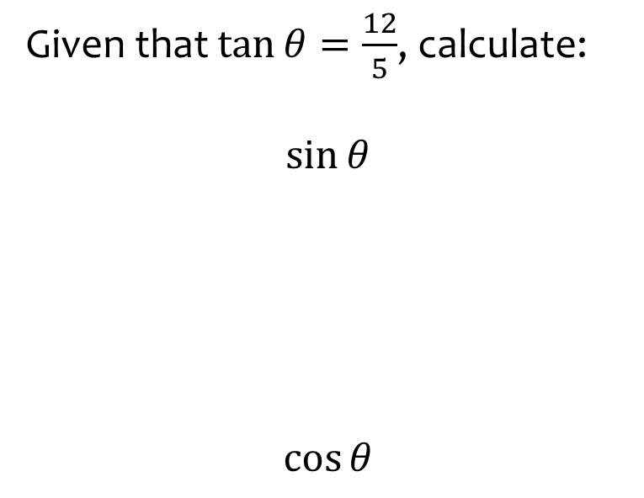
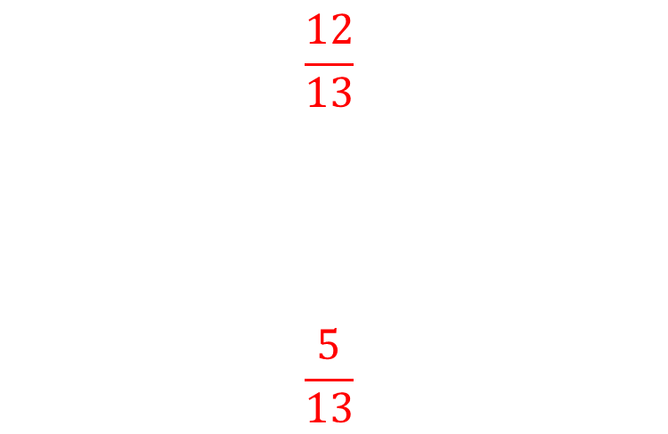
Worked example
Your turn
Given that $\tan{θ}=\frac{3}{4}$, calculate:
$$\sin{θ}$$
$$\cos{θ}$$
Given that $\tan{θ}=\frac{12}{5}$, calculate:
$$\sin{θ}$$
$$\cos{θ}$$
$$\frac{12}{13}$$
$$\frac{5}{13}$$

Slide 14
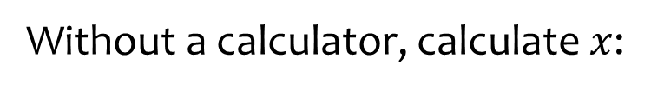
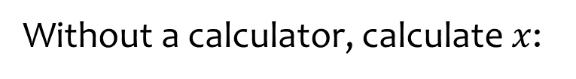







Worked example
Your turn
Without a calculator, calculate $x$:
Without a calculator, calculate $x$:
$$4 cm$$
$$4 cm$$
$$x cm$$
$$x cm$$
$$60°$$
$$30°$$
$$x=2$$

Slide 15




Worked example
Your turn
Without a calculator, calculate $x$:
Without a calculator, calculate $x$:
$$x cm$$
$$x cm$$
$$4 cm$$
$$4 cm$$
$$60°$$
$$30°$$
$$x=8$$

Slide 16






Worked example
Your turn
Without a calculator, calculate $x$:
Without a calculator, calculate $x$:
$$4 cm$$
$$4 cm$$
$$60°$$
$$30°$$
$$x cm$$
$$x cm$$
$$x=2\sqrt{3}$$

Slide 17





Worked example
Your turn
Without a calculator, calculate $x$:
Without a calculator, calculate $x$:
$$x cm$$
$$x cm$$
$$60°$$
$$30°$$
$$4 cm$$
$$4 cm$$
$$x=\frac{8\sqrt{3}}{3}$$

Slide 18



Worked example
Your turn
Without a calculator, calculate $x$:
Without a calculator, calculate $x$:
$$x cm$$
$$x cm$$
$$60°$$
$$30°$$
$$4 cm$$
$$4 cm$$
$$x=\frac{4\sqrt{3}}{3}$$

Slide 19



Worked example
Your turn
Without a calculator, calculate $x$:
Without a calculator, calculate $x$:
$$4 cm$$
$$4 cm$$
$$60°$$
$$30°$$
$$x cm$$
$$x cm$$
$$x=4\sqrt{3}$$

Slide 20
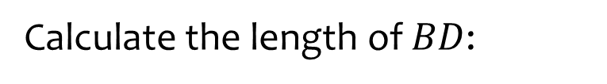
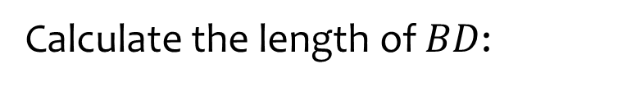













Worked example
Your turn
Calculate the length of $BD$:
Calculate the length of $BD$:
$$A$$
$$A$$
$$20 cm$$
$$10 cm$$
$$50°$$
$$30°$$
$$60°$$
$$30°$$
$$B$$
D
$$C$$
$$B$$
D
$$C$$
$2.89 cm$ (2 dp)

Slide 21
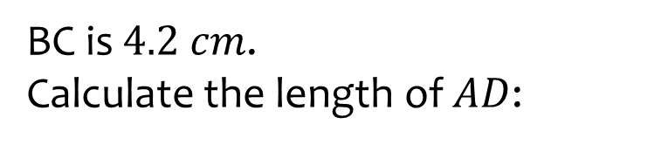
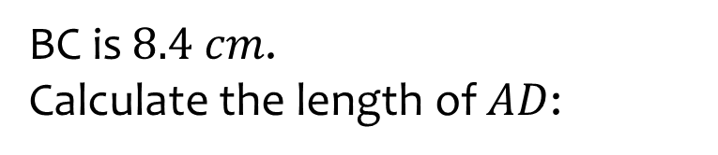















Worked example
Your turn
BC is $4.2 cm$.
Calculate the length of $AD$:
BC is $8.4 cm$.
Calculate the length of $AD$:
$$A$$
$$A$$
$$22°$$
$$44°$$
$$19°$$
$$38°$$
$$D$$
$$B$$
$$4.2 cm$$
$$C$$
$$D$$
$$B$$
$$8.4 cm$$
$$C$$
$9.12 cm$ (2 dp)

Slide 22
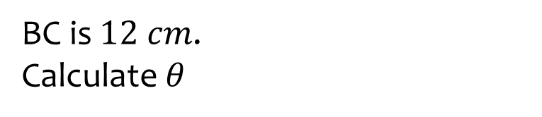
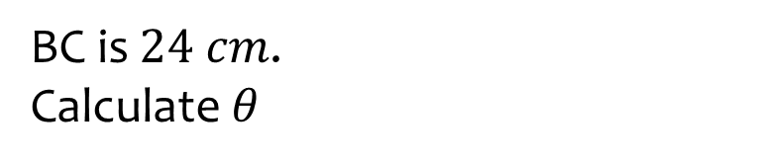













Worked example
Your turn
BC is $12 cm$.
Calculate $θ$
BC is $24 cm$.
Calculate $θ$
$$A$$
$$A$$
$$7.5 cm$$
$$15 cm$$
$$14°$$
$$28°$$
$$θ°$$
$$θ°$$
$$D$$
$$B$$
$$12 cm$$
$$C$$
$$D$$
$$B$$
$$24 cm$$
$$C$$
$θ=28.89$ (2 dp)

Slide 23
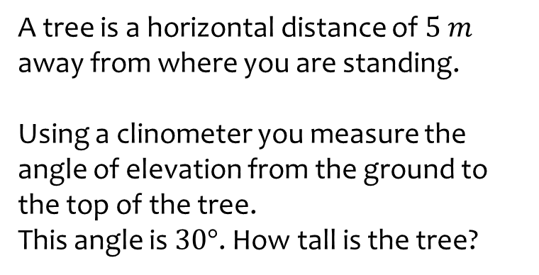
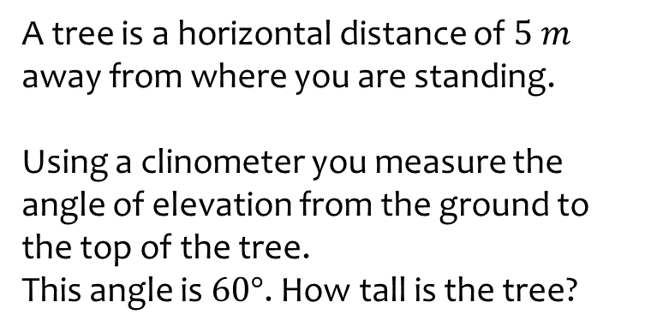

Worked example
Your turn
A tree is a horizontal distance of $5 m$ away from where you are standing.
Using a clinometer you measure the angle of elevation from the ground to the top of the tree.
This angle is $30°$. How tall is the tree?
A tree is a horizontal distance of $5 m$ away from where you are standing.
Using a clinometer you measure the angle of elevation from the ground to the top of the tree.
This angle is $60°$. How tall is the tree?
$8.66 m$(2 dp)

Slide 24







Worked example
Your turn
Calculate $x$:
Calculate $x$:
$$3$$
$$12−5\sqrt{3}$$
$$x°$$
$$x°$$
$$\sqrt{27}$$
$$4\sqrt{3}−5$$
$$x=60$$

Slide 25
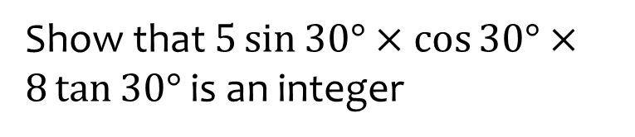
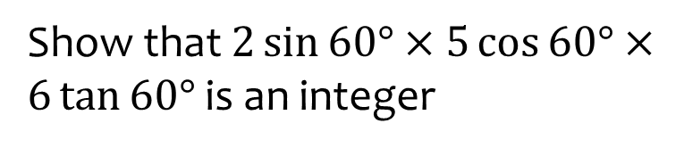

Worked example
Your turn
Show that $5\sin{30°}×\cos{30°}×8\tan{30°}$ is an integer
Show that $2\sin{60°}×5\cos{60°}×6\tan{60°}$ is an integer
$$45$$

Slide 26
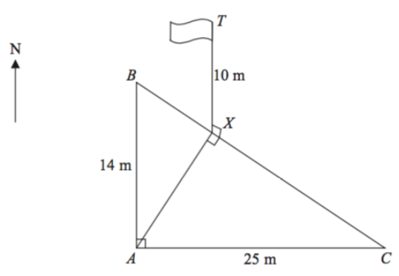
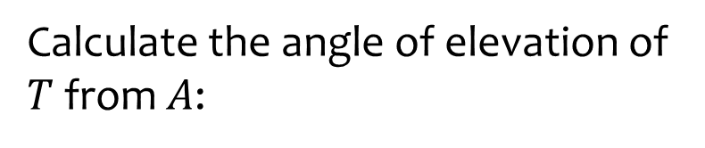
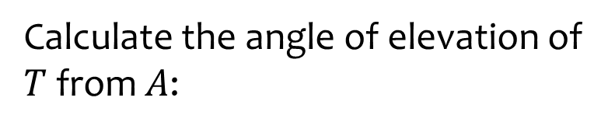




Worked example
Your turn
Calculate the angle of elevation of $T$ from $A$:
Calculate the angle of elevation of $T$ from $A$:
$$5 cm$$
$$7 cm$$
$$12.5 m$$
$$39.3°$$

Slide 27
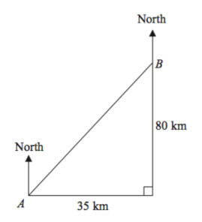
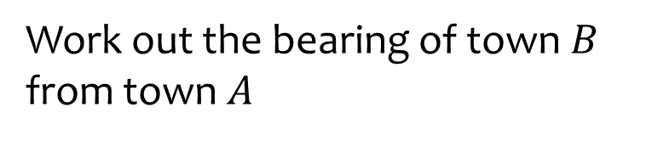
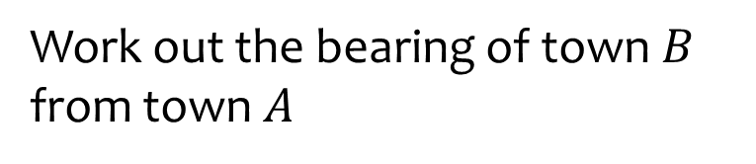



Worked example
Your turn
Work out the bearing of town $B$ from town $A$
Work out the bearing of town $B$ from town $A$
$$40 km$$
$$17.5 km$$
$23.63°$(2 dp)

Slide 28
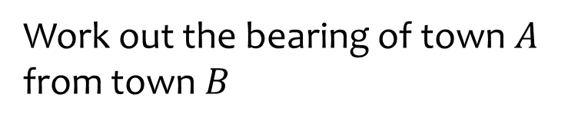
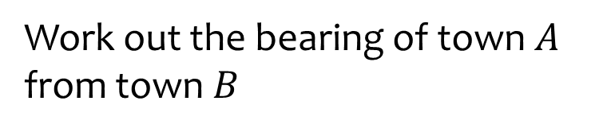

Worked example
Your turn
Work out the bearing of town $A$ from town $B$
Work out the bearing of town $A$ from town $B$
$$40 km$$
$$17.5 km$$
$203.63°$ (2 dp)

