Slide 1
Trigonometry (advanced) – sine/cosine rules and area
CONTENTS

Slide 2











Worked example
Your turn
Find the value of $x$
Find the value of $x$
$$5 cm$$
$$x cm$$
$$5 cm$$
$$x cm$$
$$70°$$
$$30°$$
$$60°$$
$$40°$$
$x=6.74$ (2 dp)

Slide 3









Worked example
Your turn
Find the value of $x$
Find the value of $x$
$$x cm$$
$$x cm$$
$$5 cm$$
$$5 cm$$
$$110°$$
$$30°$$
$$100°$$
$$40°$$
$x=7.66$ (2 dp)

Slide 4










Worked example
Your turn
Find the possible values of $x$
Find the possible values of $x$
$$4.44 cm$$
$$8 cm$$
$$10.53 cm$$
$$16 cm$$
$$x°$$
$$30°$$
$$x°$$
$$40°$$
$x=77.61°$ or $102.39°$

Slide 5






Worked example
Your turn
Find the value of $x$
Find the value of $x$
$$5 cm$$
$$x cm$$
$$10 cm$$
$$x cm$$
$$70°$$
$$60°$$
$$8 cm$$
$$16 cm$$
$x=14$ (2 dp)

Slide 6







Worked example
Your turn
Find the value of $θ$
Find the value of $θ$
$$5 cm$$
$$9 cm$$
$$10 cm$$
$$18 cm$$
$$θ°$$
$$θ°$$
$$8 cm$$
$$16 cm$$
$θ=84.26$ (2 dp)

Slide 7



Worked example
Your turn
Calculate the area of the triangle:
Calculate the area of the triangle:
$$8 cm$$
$$16 cm$$
$$30°$$
$$40°$$
$$5 cm$$
$$10 cm$$
$51.42 cm^{2}$ (2 dp)

Slide 8
Worked example
Your turn
Calculate the area of the triangle:
Calculate the area of the triangle:
$$4.44 cm$$
$$8 cm$$
$$10.53 cm$$
$$16 cm$$
$$30°$$
$$40°$$
$$5 cm$$
$$10 cm$$
$51.42 cm^{2}$ (2 dp)

Slide 9
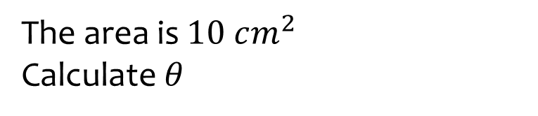
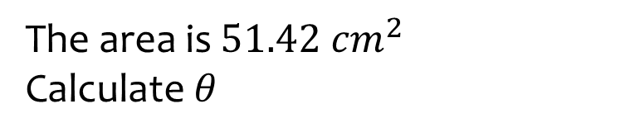







Worked example
Your turn
The area is $10 cm^{2}$
Calculate $θ$
The area is $51.42 cm^{2}$
Calculate $θ$
$$8 cm$$
$$16 cm$$
$$θ°$$
$$θ°$$
$$5 cm$$
$$10 cm$$
$$θ=40$$

Slide 10
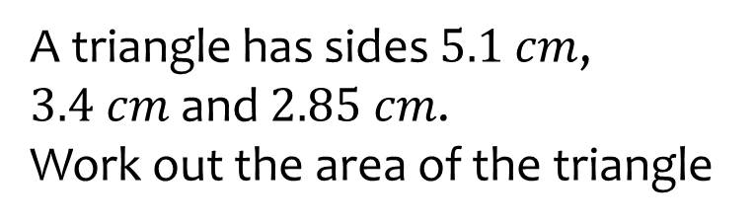
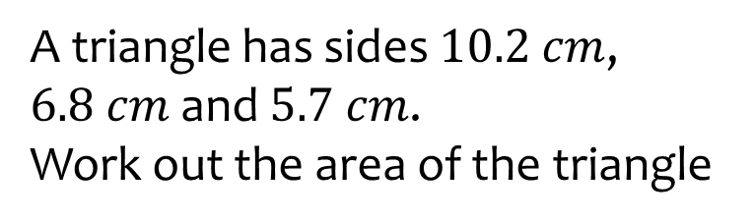

Worked example
Your turn
A triangle has sides $5.1$ $cm$, $3.4 cm$ and $2.85 cm$.
Work out the area of the triangle
A triangle has sides $10.2$ $cm$, $6.8 cm$ and $5.7 cm$.
Work out the area of the triangle
$18.3 cm^{2}$ (1 dp)

Slide 11
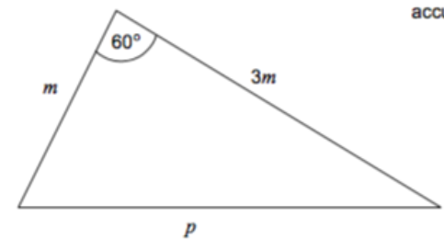
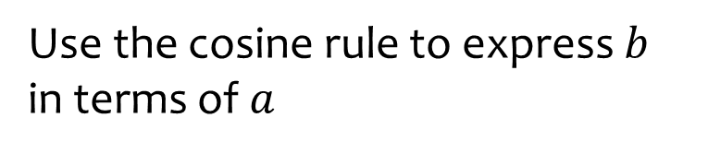
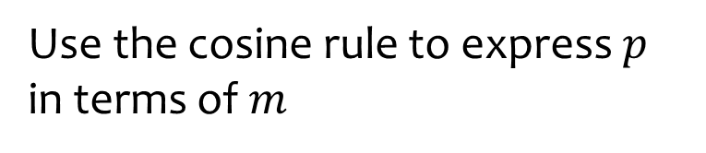





Worked example
Your turn
Use the cosine rule to express $b$ in terms of $a$
Use the cosine rule to express $p$ in terms of $m$
$$b cm$$
$$a cm$$
$$30°$$
$$5a cm$$
$$p=m\sqrt{7}$$

Slide 12
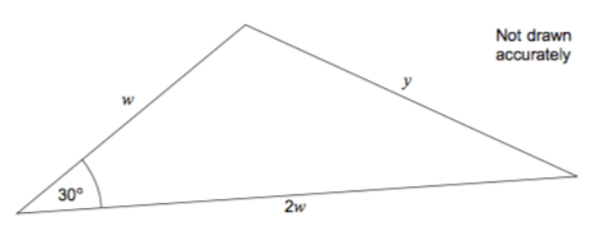
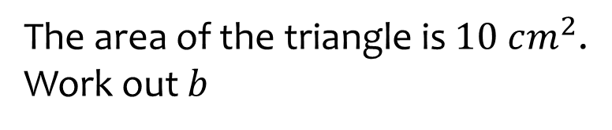
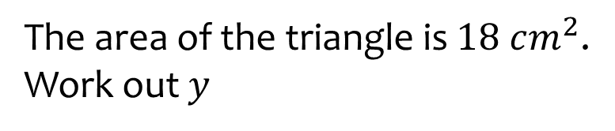

Worked example
Your turn
The area of the triangle is $10 cm^{2}$.
Work out $b$
The area of the triangle is $18 cm^{2}$.
Work out $y$
$$b cm$$
$$a cm$$
$$30°$$
$$5a cm$$
$$y=7.4 cm$$

Slide 13
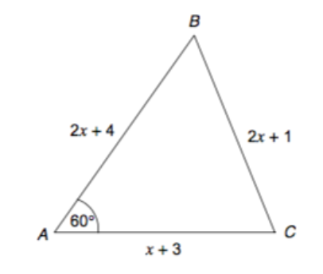
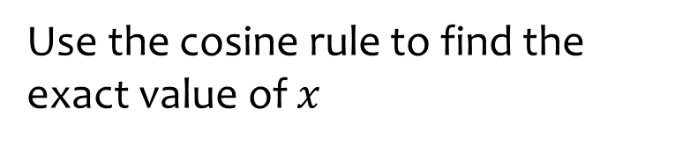
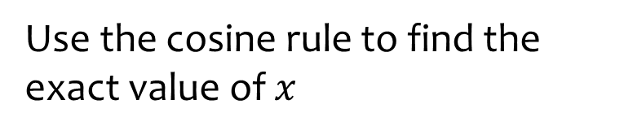




Worked example
Your turn
Use the cosine rule to find the exact value of $x$
Use the cosine rule to find the exact value of $x$
$$2x−1$$
$$41.171°$$
$$2x−1$$
$$x=4+2\sqrt{7}$$

Slide 14
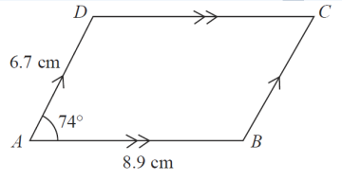




Worked example
Your turn
Calculate the area of the parallelogram
Calculate the area of the parallelogram
$$3.35 cm$$
$$75°$$
$$4.95 cm$$
$57.32 cm^{2}$ (2 dp)

Slide 15
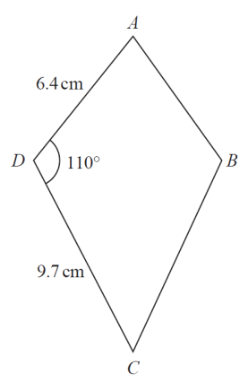



Worked example
Your turn
Calculate the area of the kite
Calculate the area of the kite
$$3.2 cm$$
$$4.85 cm$$
$58.34 cm^{2}$(2 dp)

Slide 16
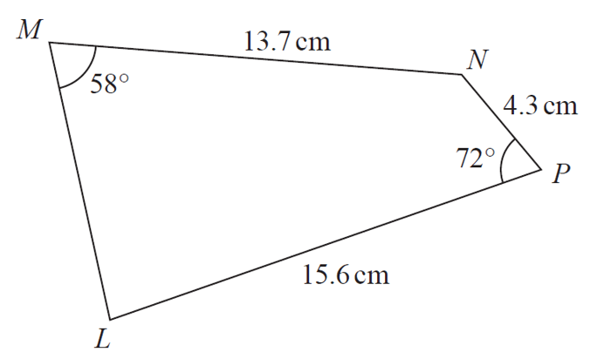






Worked example
Your turn
Calculate the size of angle MLP
Calculate the size of angle MLP
$$17.3 cm$$
$$72°$$
$$3.4 cm$$
$$58°$$
$$16.5 cm$$
$67.49°$(2 dp)

Slide 17
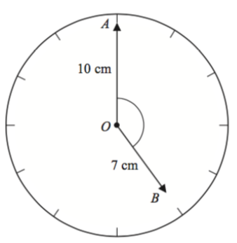
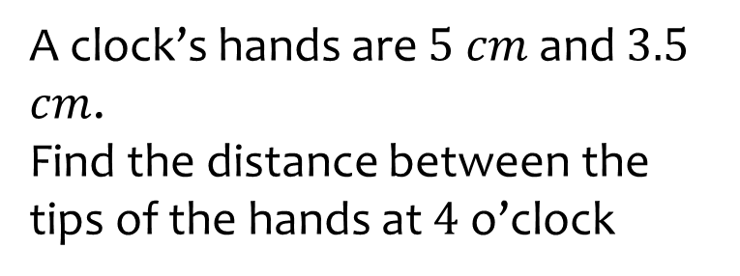
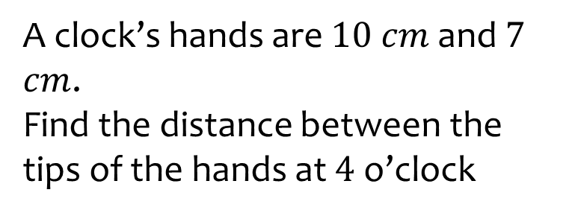

Worked example
Your turn
A clock’s hands are $5 cm$ and $3.5$ $cm$.
Find the distance between the tips of the hands at $4$ o’clock
A clock’s hands are $10 cm$ and $7$ $cm$.
Find the distance between the tips of the hands at $4$ o’clock
$16.4 cm$ (1 dp)

Slide 18
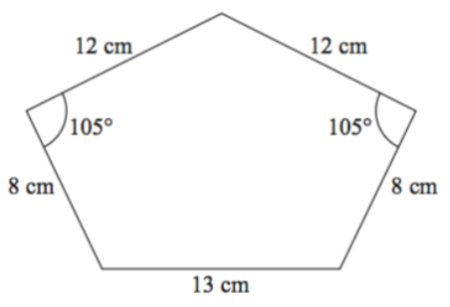






Worked example
Your turn
Work out the area of the pentagon
Work out the area of the pentagon
$$6 cm$$
$$6 cm$$
$$125°$$
$$125°$$
$$4 cm$$
$$4 cm$$
$$6.5 cm$$
$$188−188.5 cm^{2}$$

