Slide 1
Trigonometry (3D)
CONTENTS

Slide 2
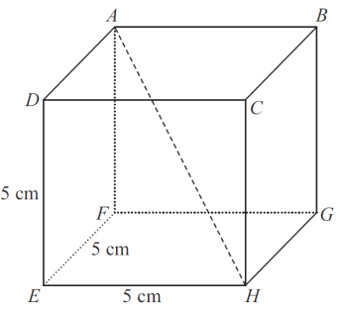
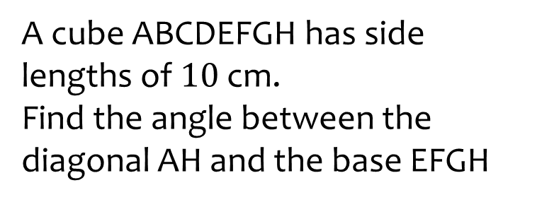
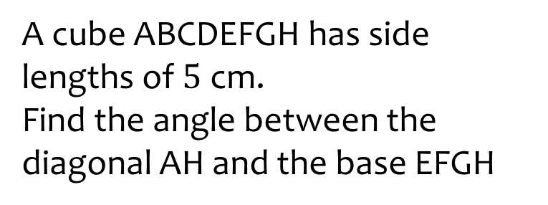

Worked example
Your turn
A cube ABCDEFGH has side lengths of $10$ cm.
Find the angle between the diagonal AH and the base EFGH
A cube ABCDEFGH has side lengths of $5$ cm.
Find the angle between the diagonal AH and the base EFGH
$35.26°$(2 dp)

Slide 3
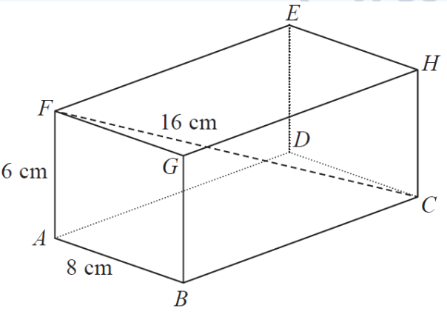
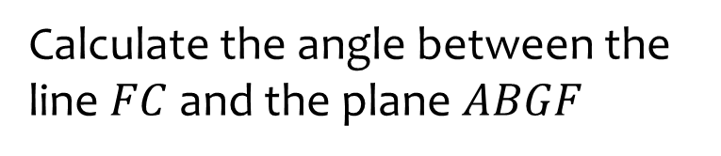
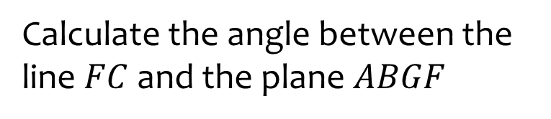




Worked example
Your turn
Calculate the angle between the line $FC$ and the plane $ABGF$
Calculate the angle between the line $FC$ and the plane $ABGF$
$$8 cm$$
$$3 cm$$
$$4 cm$$
$51.32°$(2 dp)

Slide 4
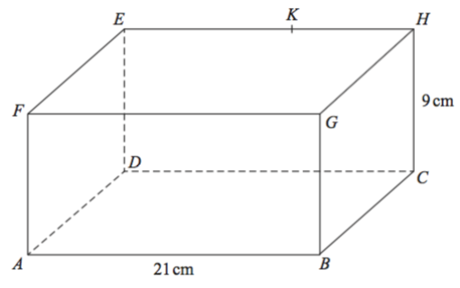
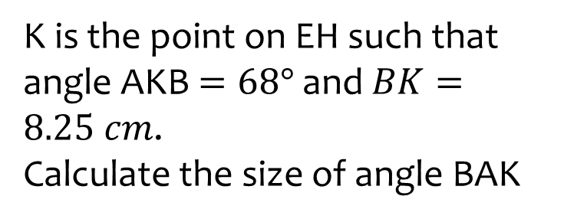
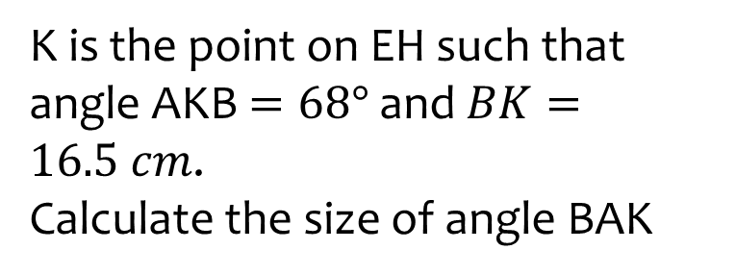



Worked example
Your turn
K is the point on EH such that angle AKB $=68°$ and $BK=8.25 cm$.
Calculate the size of angle BAK
K is the point on EH such that angle AKB $=68°$ and $BK=16.5 cm$.
Calculate the size of angle BAK
$$4.5 cm$$
$$10.5 cm$$
$33.1°$(1 dp)

Slide 5
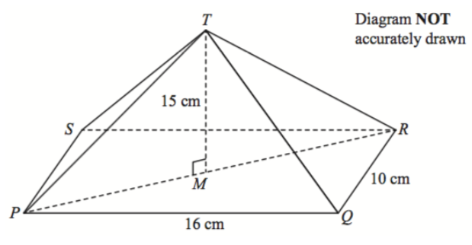
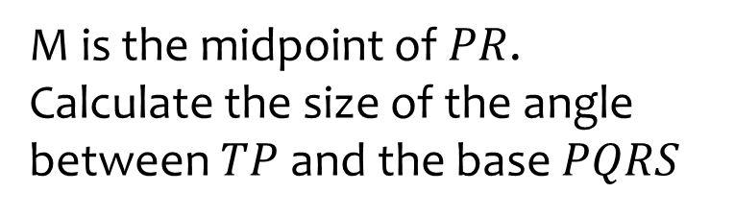
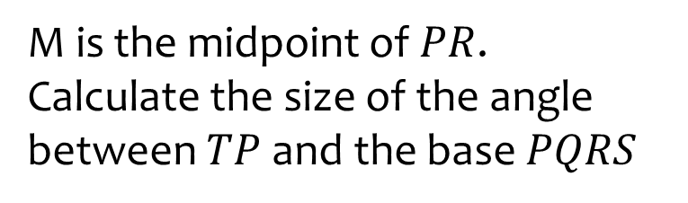





Worked example
Your turn
M is the midpoint of $PR$.
Calculate the size of the angle between $TP$ and the base $PQRS$
M is the midpoint of $PR$.
Calculate the size of the angle between $TP$ and the base $PQRS$
$$7.5 cm$$
$$15 cm$$
$$5 cm$$
$$8 cm$$
$57.8°$(1 dp)

Slide 6
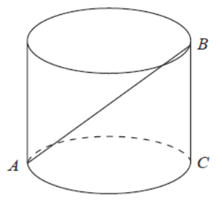
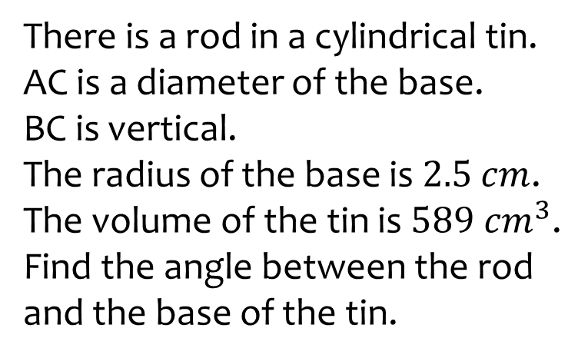
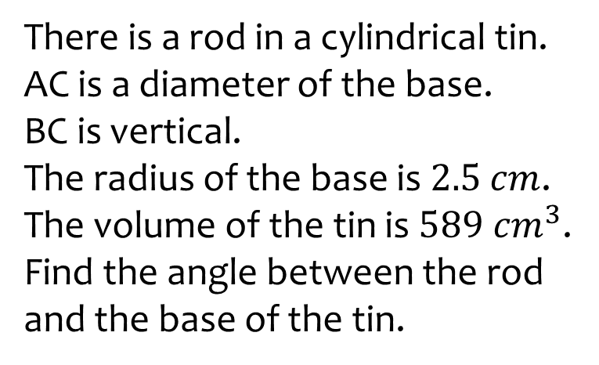

Worked example
Your turn
There is a rod in a cylindrical tin.
AC is a diameter of the base.
BC is vertical.
The radius of the base is $2.5$ $cm$.
The volume of the tin is $589 cm^{3}$.
Find the angle between the rod and the base of the tin.
There is a rod in a cylindrical tin.
AC is a diameter of the base.
BC is vertical.
The radius of the base is $2.5$ $cm$.
The volume of the tin is $589 cm^{3}$.
Find the angle between the rod and the base of the tin.
$$56°$$

Slide 7
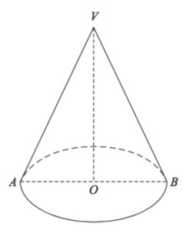
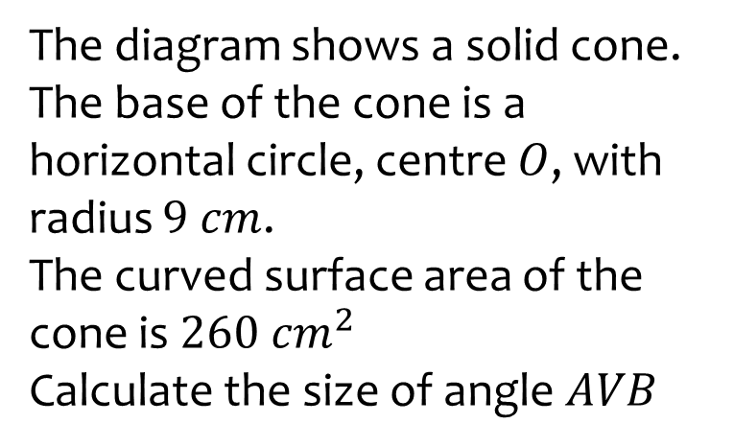
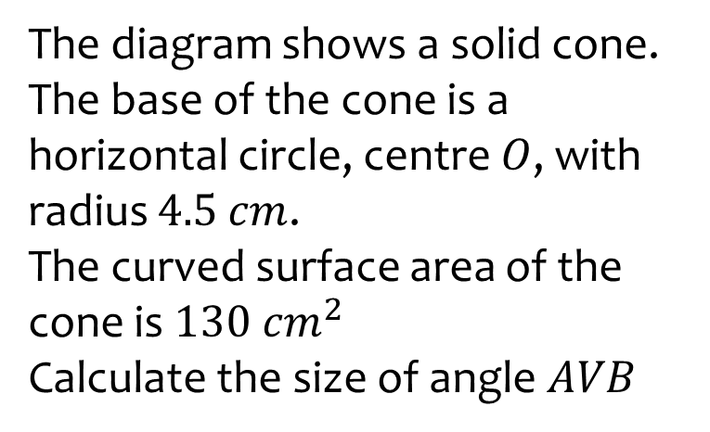

Worked example
Your turn
The diagram shows a solid cone.
The base of the cone is a horizontal circle, centre $O$, with radius $9$ $cm$.
The curved surface area of the cone is $260 cm^{2}$
Calculate the size of angle $AVB$
The diagram shows a solid cone.
The base of the cone is a horizontal circle, centre $O$, with radius $4.5$ $cm$.
The curved surface area of the cone is $130 cm^{2}$
Calculate the size of angle $AVB$
$59.60°$(2 dp)

Slide 8
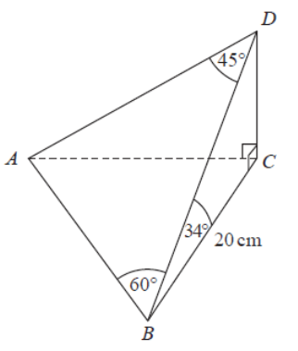
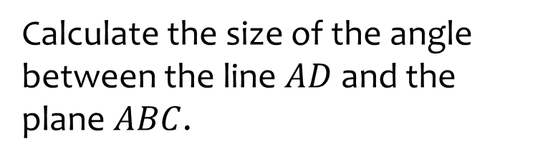
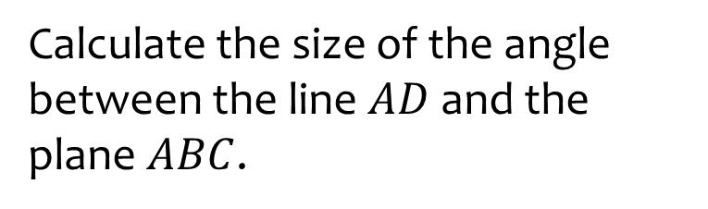





Worked example
Your turn
Calculate the size of the angle between the line $AD$ and the plane $ABC$.
Calculate the size of the angle between the line $AD$ and the plane $ABC$.
$$46°$$
$$35°$$
$$10 cm$$
$$61°$$
$38.5−38.6°$ (1 dp)

Slide 9
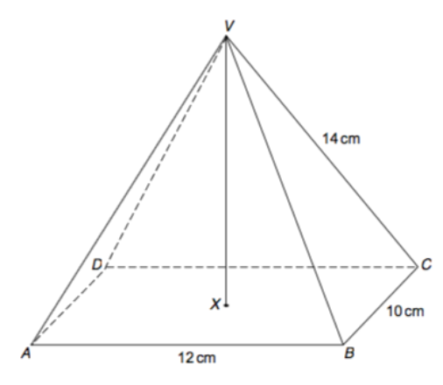




Worked example
Your turn
VABCD is a rectangular based pyramid.
Calculate the angle between VC and the plane ABCD
VABCD is a rectangular based pyramid.
Calculate the angle between VC and the plane ABCD
$$7 cm$$
$$5 cm$$
$$6 cm$$
$56.1°$(1 dp)

