Slide 1
Surface area
CONTENTS

Slide 2




Worked example
Your turn
Calculate the surface area of the cube:
Calculate the surface area of the cube:
$$3 cm$$
$$5 cm$$
$$150cm^{2}$$
$$4 cm$$

Slide 3
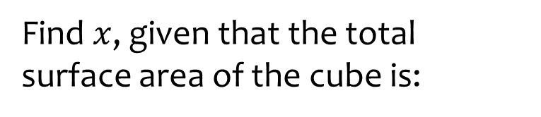
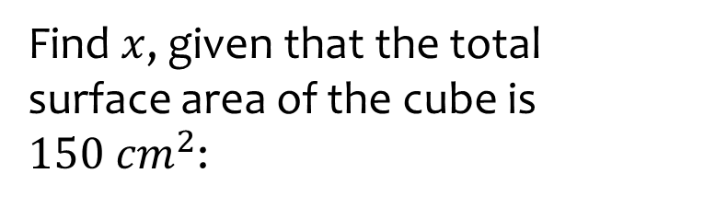






Worked example
Your turn
Find $x$, given that the total surface area of the cube is:
Find $x$, given that the total surface area of the cube is $150 cm^{2}$:
$$54 cm^{2}$$
$$x cm$$
$$96 cm^{2}$$
$$x cm$$
$$x=5$$
$$x cm$$

Slide 4










Worked example
Your turn
Calculate the total surface area of the cuboid:
Calculate the total surface area of the cuboid:
$$2 cm$$
$$4 cm$$
$$3 cm$$
$$10 cm$$
$$6 cm$$
$$20 cm$$
$$448 cm^{2}$$
$$11 cm$$
$$7 cm$$
$$5 cm$$

Slide 5
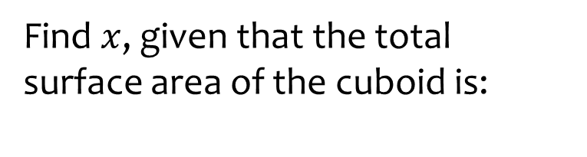
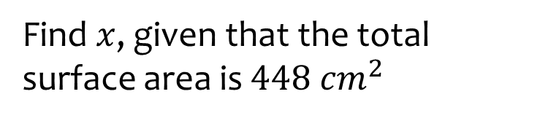






Worked example
Your turn
Find $x$, given that the total surface area of the cuboid is:
Find $x$, given that the total surface area is $448 cm^{2}$
$$112 cm^{2}$$
$$2 cm$$
$$4 cm$$
$$3 cm$$
$$x cm$$
$$x cm$$
$$20 cm$$
$$x=6$$
$$334 cm^{2}$$
$$x cm$$
$$7 cm$$
$$5 cm$$

Slide 6
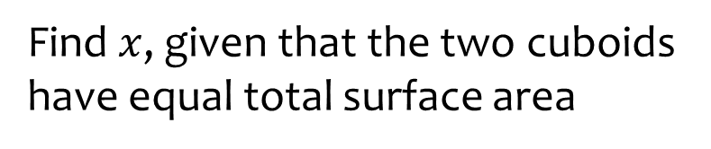
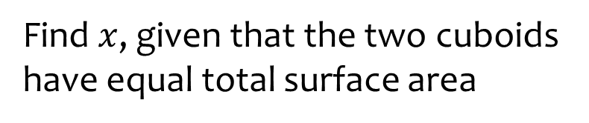









Worked example
Your turn
Find $x$, given that the two cuboids have equal total surface area
Find $x$, given that the two cuboids have equal total surface area
$$2 cm$$
$$4 cm$$
$$3 cm$$
$$6 cm$$
$$x cm$$
$$x cm$$
$$7 cm$$
$$32 cm$$
$$6 cm$$
$$3 cm$$
$$5 cm$$
$$5 cm$$
$$x=24.7$$

Slide 7

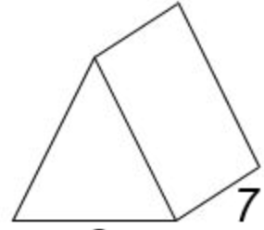










Worked example
Your turn
Calculate the total surface area of the triangular prism:
Calculate the total surface area of the triangular prism:
$$2 cm$$
$$4 cm$$
$$10 cm$$
$$3 cm$$
$$20 cm$$
$$6 cm$$
$$346.38 cm^{2}$$
$$11 cm$$
$$5 cm$$
$$7 cm$$

Slide 8







Worked example
Your turn
Calculate the total surface area of the cylinder:
Calculate the total surface area of the cylinder
$$10 cm$$
$$20 cm$$
$$3 cm$$
$$6 cm$$
$$312π=980.18 cm^{2}$$
$$10 cm$$
$$3 cm$$

Slide 9



Worked example
Your turn
Calculate the total surface area of the cylinder:
Calculate the total surface area of the cylinder:
$$10 cm$$
$$20 cm$$
$$6 cm$$
$$12 cm$$
$$312π=980.18 cm^{2}$$
$$20 cm$$
$$3 cm$$

Slide 10
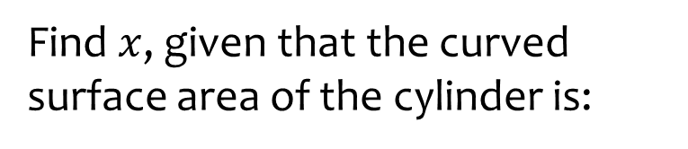
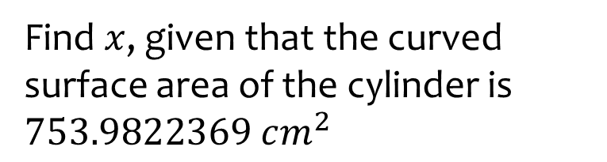







Worked example
Your turn
Find $x$, given that the curved surface area of the cylinder is:
Find $x$, given that the curved surface area of the cylinder is $753.9822369 cm^{2}$
$$188.4955592 cm^{2}$$
$$10 cm$$
$$20 cm$$
$$x cm$$
$$x cm$$
$$60π cm^{2}$$
$$x=6$$
$$x cm$$
$$3 cm$$

Slide 11
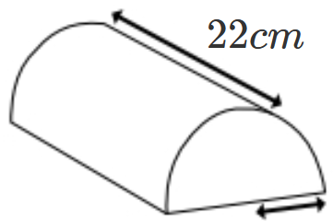
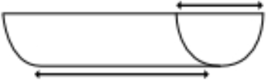
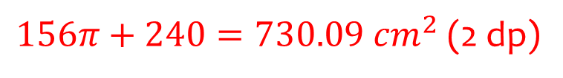






Worked example
Your turn
Calculate the total surface area of:
Calculate the total surface area of:
$$20 cm$$
$$10 cm$$
$$3 cm$$
$$6 cm$$
$$20 cm$$
$156π+240=730.09 cm^{2}$ (2 dp)
$$3 cm$$

Slide 12
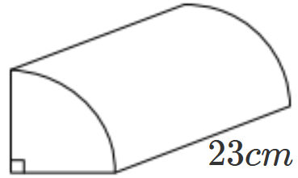
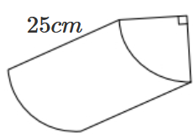
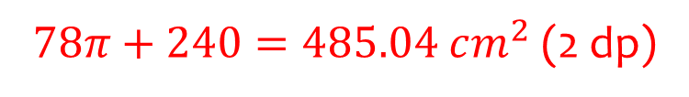






Worked example
Your turn
Calculate the total surface area of:
Calculate the total surface area of:
$$20 cm$$
$$20 cm$$
$$3 cm$$
$$6 cm$$
$78π+240=485.04 cm^{2}$ (2 dp)
$$10 cm$$
$$3 cm$$

Slide 13
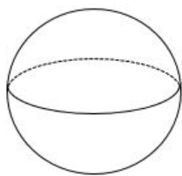
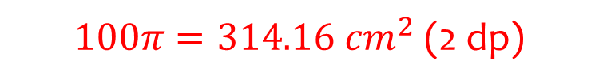



Worked example
Your turn
Calculate the surface area of the sphere:
Calculate the surface area of the sphere:
$$3 cm$$
$$5 cm$$
$100π=314.16 cm^{2}$ (2 dp)
$$4 cm$$

Slide 14



Worked example
Your turn
Calculate the surface area of the sphere:
Calculate the surface area of the sphere:
$$6 cm$$
$$10 cm$$
$100π=314.16 cm^{2}$ (2 dp)
$$8 cm$$

Slide 15
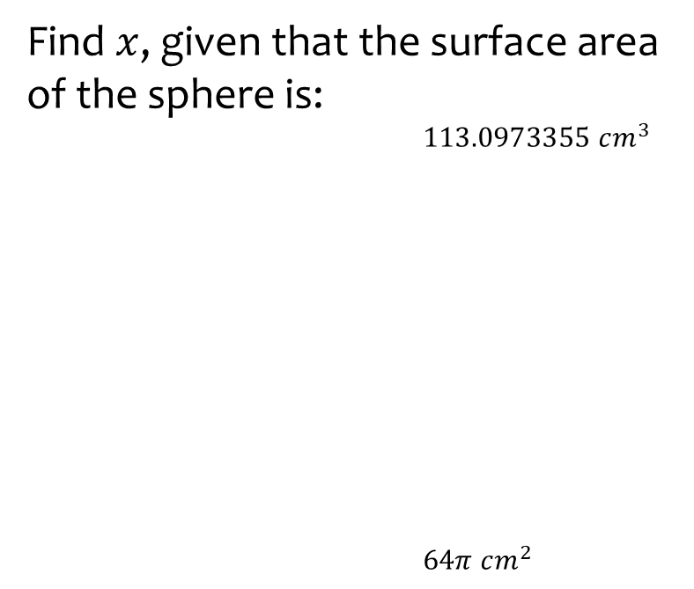
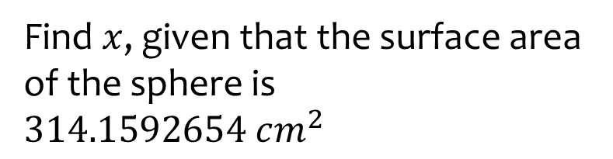



Worked example
Your turn
Find $x$, given that the surface area of the sphere is:
$113.0973355 cm^{3}$
$64π cm^{2}$
Find $x$, given that the surface area of the sphere is $314.1592654 cm^{2}$
$$x cm$$
$$x cm$$
$$x=5$$
$$x cm$$

Slide 16
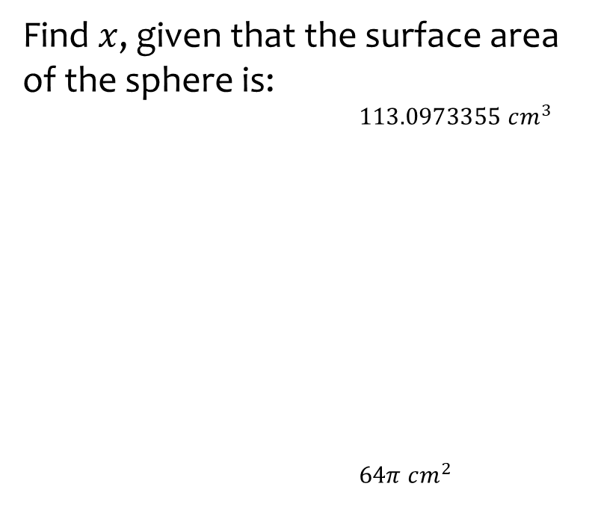

Worked example
Your turn
Find $x$, given that the surface area of the sphere is:
$113.0973355 cm^{3}$
$64π cm^{2}$
Find $x$, given that the surface area of the sphere is $314.1592654 cm^{2}$
$$x cm$$
$$x cm$$
$$x=10$$
$$x cm$$

Slide 17
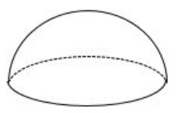




Worked example
Your turn
Calculate the total surface area of the hemisphere:
Calculate the total surface area of the hemisphere:
$$3 cm$$
$$5 cm$$
$75π=235.62 cm^{2}$ (2 dp)
$$4 cm$$

Slide 18



Worked example
Your turn
Calculate the total surface area of the hemisphere:
Calculate the total surface area of the hemisphere:
$$6 cm$$
$$10 cm$$
$75π=235.62 cm^{2}$ (2 dp)
$$8 cm$$

Slide 19
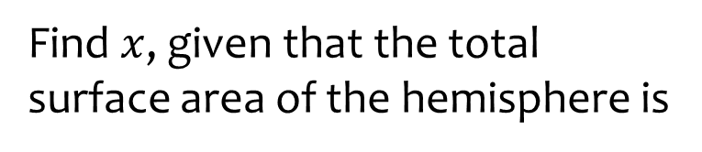
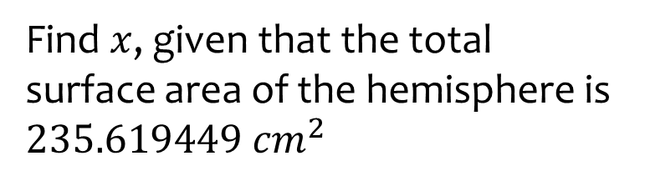



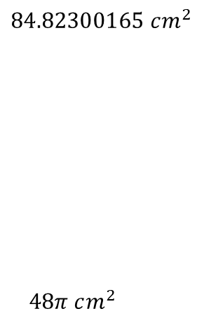
Worked example
Your turn
Find $x$, given that the total surface area of the hemisphere is
Find $x$, given that the total surface area of the hemisphere is $235.619449 cm^{2}$
$$84.82300165 cm^{2}$$
$$48π cm^{2}$$
$$x cm$$
$$X cm$$
$$x=5$$
$$x cm$$

Slide 20
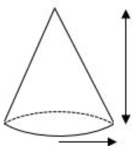







Worked example
Your turn
Calculate the curved surface area of the cone:
Calculate the curved surface area of the cone:
$$3 cm$$
$$6 cm$$
$$10 cm$$
$$20 cm$$
$1311.97 cm^{2}$ (2 dp)
$$10 cm$$
$$3 cm$$

Slide 21

Worked example
Your turn
Calculate the total surface area of the cone:
Calculate the total surface area of the cone:
$$3 cm$$
$$6 cm$$
$$10 cm$$
$$20 cm$$
$2568.60 cm^{2}$ (2 dp)
$$10 cm$$
$$3 cm$$

Slide 22
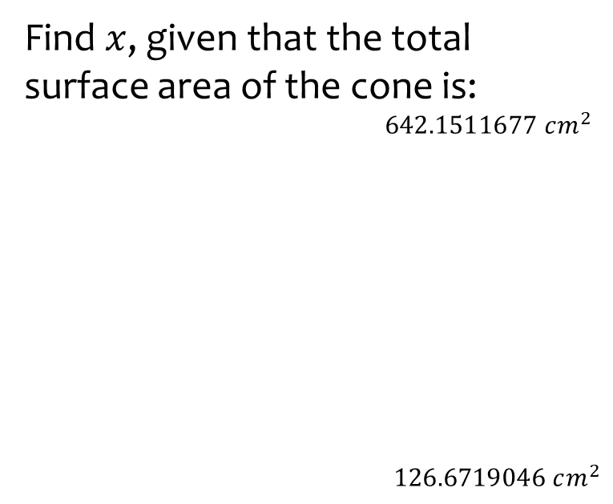
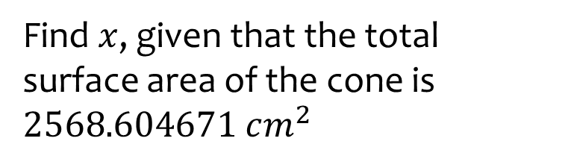


Worked example
Your turn
Find $x$, given that the total surface area of the cone is:
$642.1511677 cm^{2}$
$$126.6719046 cm^{2}$$
Find $x$, given that the total surface area of the cone is $2568.604671 cm^{2}$
$$3 cm$$
$$6 cm$$
$$x cm$$
$$x cm$$
$$x=20$$
$$10 cm$$
$$x cm$$

Slide 23
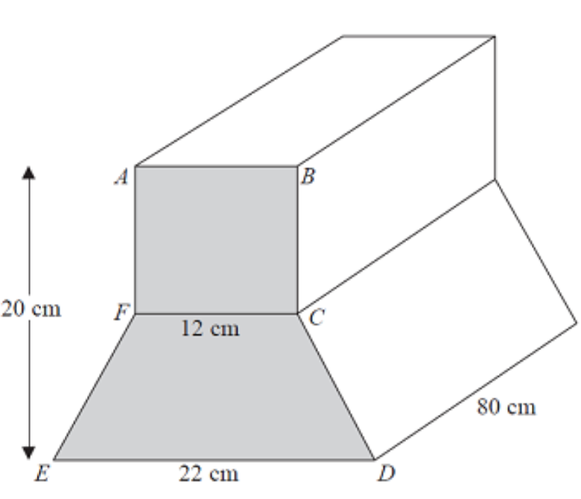





Worked example
Your turn
ABCF is a square.
FCDE is an isosceles trapezium.
Calculate the total surface area of this prism
ABCF is a square.
FCDE is an isosceles trapezium.
Calculate the total surface area of this prism
$$10 cm$$
$$6 cm$$
$$40 cm$$
$$11 cm$$
$6709.44 cm^{2}$ (2 dp)

Slide 24
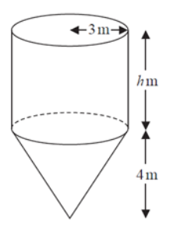







Worked example
Your turn
Calculate the total surface area of this composite shape
Calculate the total surface area of this composite shape
$$6 cm$$
$$3 cm$$
$$10 cm$$
$$5 cm$$
$$8 cm$$
$$4 cm$$
$54π=169.65 cm^{2}$ (2 dp)

Slide 25
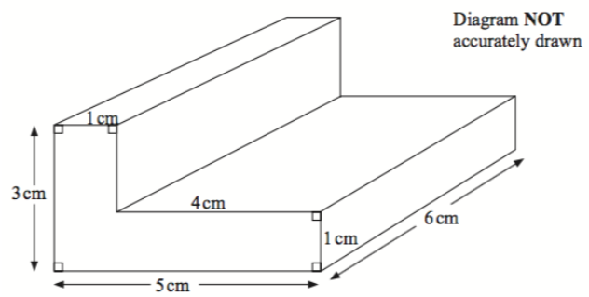







Worked example
Your turn
Calculate the total surface area of this L-shaped prism
Calculate the total surface area of this L-shaped prism
$$2 cm$$
$$6 cm$$
$$8cm$$
$$2 cm$$
$$12 cm$$
$$10 cm$$
$$110 cm^{2}$$

Slide 26
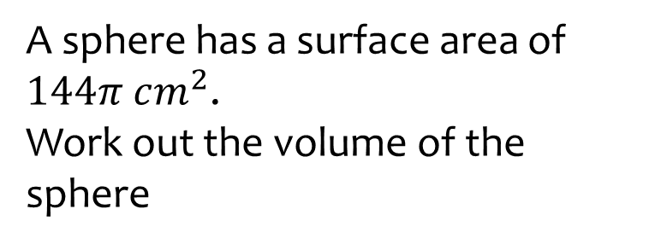
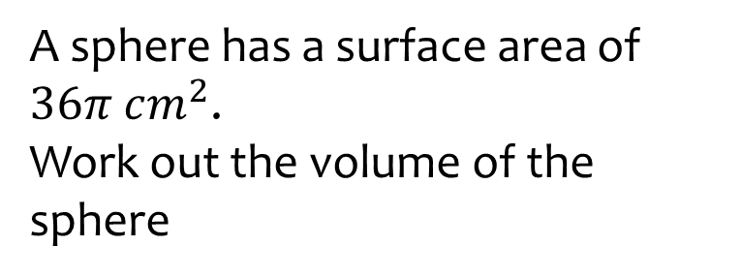

Worked example
Your turn
A sphere has a surface area of $144π cm^{2}$.
Work out the volume of the sphere
A sphere has a surface area of $36π cm^{2}$.
Work out the volume of the sphere
$$36π cm^{3}$$

Slide 27
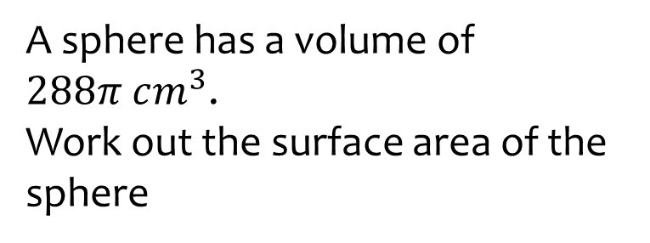
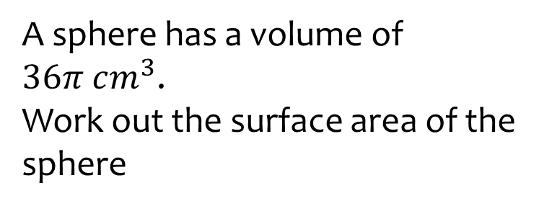

Worked example
Your turn
A sphere has a volume of $288π cm^{3}$.
Work out the surface area of the sphere
A sphere has a volume of $36π cm^{3}$.
Work out the surface area of the sphere
$$36π cm^{2}$$

