Slide 1
Similarity and congruence
CONTENTS

Slide 2
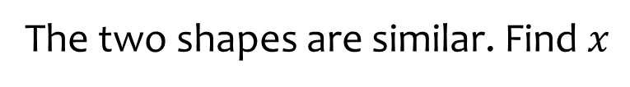
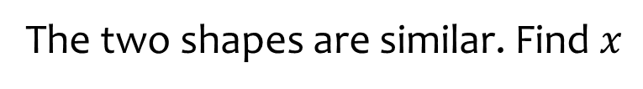









Worked example
Your turn
The two shapes are similar. Find $x$
The two shapes are similar. Find $x$
$$2 cm$$
$$6 cm$$
$$4 cm$$
$$15 cm$$
$$x cm$$
$$x cm$$
$$2 cm$$
$$5 cm$$
$$x=2$$

Slide 3





Worked example
Your turn
The two shapes are similar. Find $x$
The two shapes are similar. Find $x$
$$2 cm$$
$$6 cm$$
$$x cm$$
$$x cm$$
$$1 cm$$
$$2 cm$$
$$2 cm$$
$$5 cm$$
$$x=15$$

Slide 4
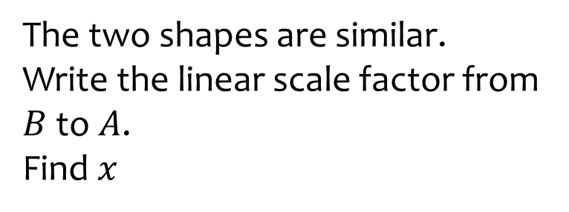
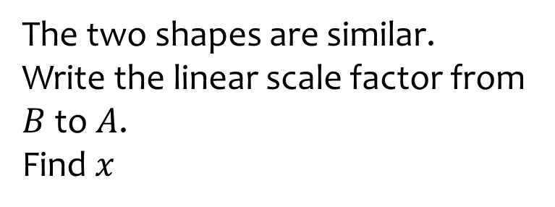











Worked example
Your turn
The two shapes are similar.
Write the linear scale factor from $B$ to $A$.
Find $x$
The two shapes are similar.
Write the linear scale factor from $B$ to $A$.
Find $x$
$$A$$
$$2 cm$$
$$A$$
$$6 cm$$
$$4 cm$$
$$15 cm$$
$$B$$
$$B$$
$$x cm$$
$$x cm$$
$$2 cm$$
$$5 cm$$
$$3$$

Slide 5
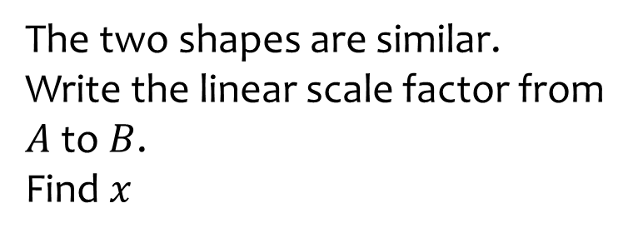
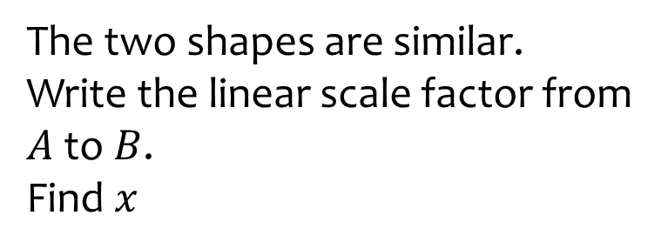

Worked example
Your turn
The two shapes are similar.
Write the linear scale factor from $A$to $B$.
Find $x$
The two shapes are similar.
Write the linear scale factor from $A$to $B$.
Find $x$
$$A$$
$$2 cm$$
$$A$$
$$6 cm$$
$$4 cm$$
$$15 cm$$
$$B$$
$$B$$
$$x cm$$
$$x cm$$
$$2 cm$$
$$5 cm$$
$$\frac{1}{3}$$

Slide 6


Worked example
Your turn
These two shapes are similar. Find the missing lengths
These two shapes are similar. Find the missing lengths
X
X
A
A
5cm
3cm
$$10.5 cm$$
$$20 cm$$
70cm
9cm
B
B
8cm
C
4cm
C
Y
Y
28cm
10cm
Z
Z

Slide 7







Worked example
Your turn
Calculate length ST
Calculate length ST
S
S
Q
Q
$$4 cm$$
$$2 cm$$
P
P
$$5 cm$$
$$3 cm$$
R
$$9 cm$$
T
R
$$10 cm$$
T
$$8 cm$$

Slide 8










Worked example
Your turn
Calculate the missing lengths
Calculate the missing lengths
E
E
B
$$10 cm$$
B
$$15 cm$$
$$9 cm$$
$$12 cm$$
$$24 cm$$
$$12 cm$$
C
C
$$5 cm$$
$$5 cm$$
A
$$18 cm$$
A
$$18 cm$$
D
D

Slide 9
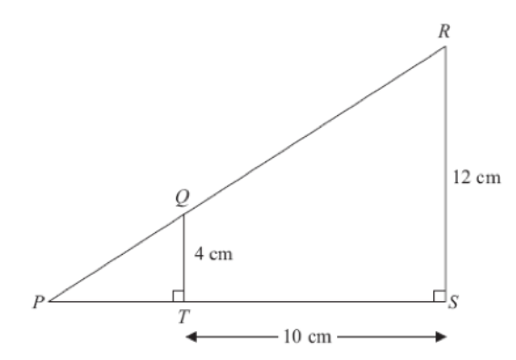




Worked example
Your turn
Calculate the length of PT
Calculate the length of PT
$$6 cm$$
$$2 cm$$
$$5 cm$$
$$5 cm$$

Slide 10
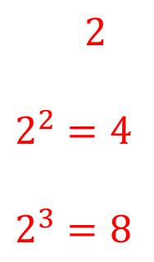




Worked example
Your turn
Cuboids A and B are similar.
Write down the scale factor for:
(Linear) Side lengths of A -> B
Surface area of A -> B
Volume of A -> B
Cuboids A and B are similar.
Write down the scale factor for:
(Linear) Side lengths of A -> B
Surface area of A -> B
Volume of A -> B
AB
AA
AB
AA
$$4 cm$$
$$4 cm$$
$$12 cm$$
$$8 cm$$
$$2$$
$$2^{2}=4$$
$$2^{3}=8$$

Slide 11
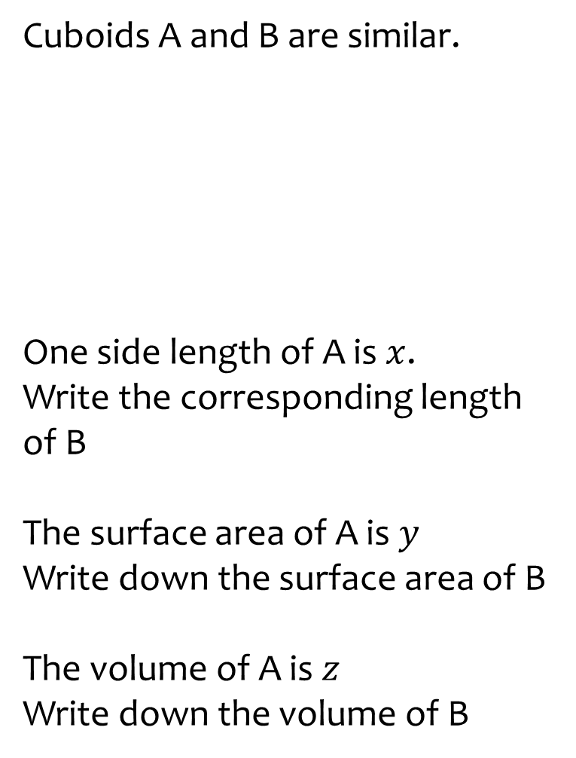
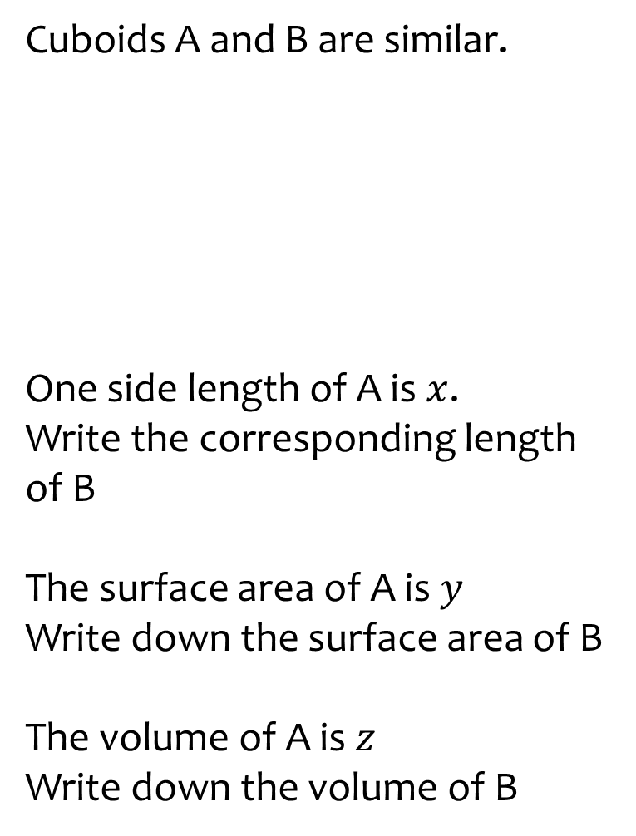
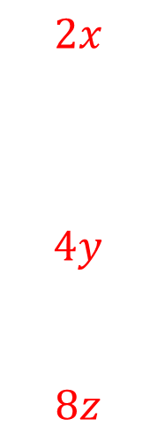



Worked example
Your turn
Cuboids A and B are similar.
One side length of A is $x$.
Write the corresponding length of B
The surface area of A is $y$
Write down the surface area of B
The volume of A is $z$
Write down the volume of B
Cuboids A and B are similar.
One side length of A is $x$.
Write the corresponding length of B
The surface area of A is $y$
Write down the surface area of B
The volume of A is $z$
Write down the volume of B
AA
AB
AA
AB
$$4 cm$$
$$4 cm$$
$$12 cm$$
$$8 cm$$
$$2x$$
$$4y$$
$$8z$$

Slide 12
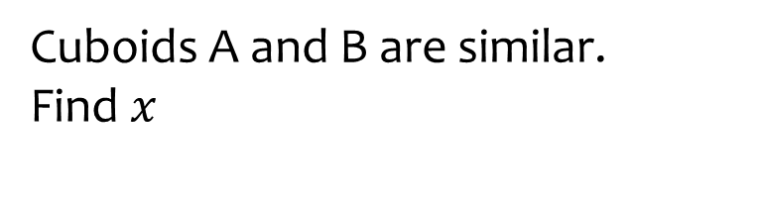
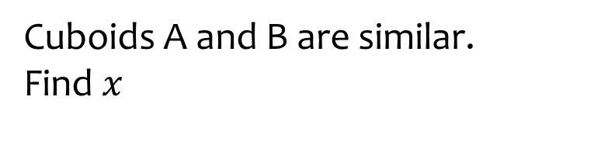









Worked example
Your turn
Cuboids A and B are similar.
Find $x$
Cuboids A and B are similar.
Find $x$
AB
AA
AB
AA
$$2 cm$$
$$2 cm$$
$$4 cm$$
$$x cm$$
$$4 cm$$
$$x cm$$
$$12 cm$$
$$8 cm$$
$$x=4$$

Slide 13





Worked example
Your turn
Cuboids A and B are similar.
Find $x$
Cuboids A and B are similar.
Find $x$
AB
AA
AB
AA
$$x cm$$
$$x cm$$
$$4 cm$$
$$6 cm$$
$$4 cm$$
$$4 cm$$
$$12 cm$$
$$8 cm$$
$$x=2$$

Slide 14
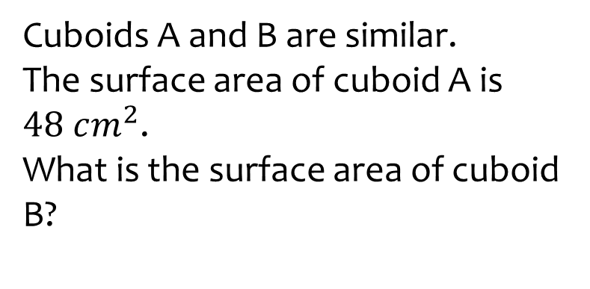
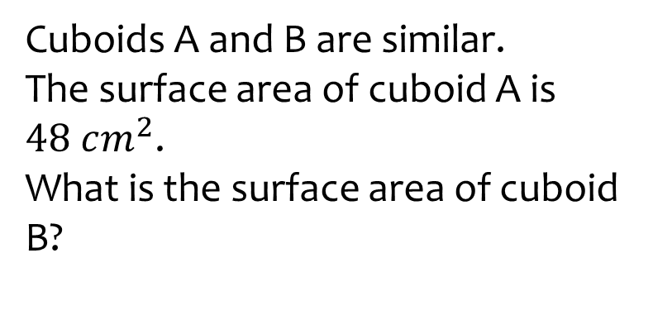





Worked example
Your turn
Cuboids A and B are similar.
The surface area of cuboid A is $48 cm^{2}$.
What is the surface area of cuboid B?
Cuboids A and B are similar.
The surface area of cuboid A is $48 cm^{2}$.
What is the surface area of cuboid B?
AA
AB
AA
AB
$$4 cm$$
$$4 cm$$
$$12 cm$$
$$8 cm$$
$$192 cm^{2}$$

Slide 15
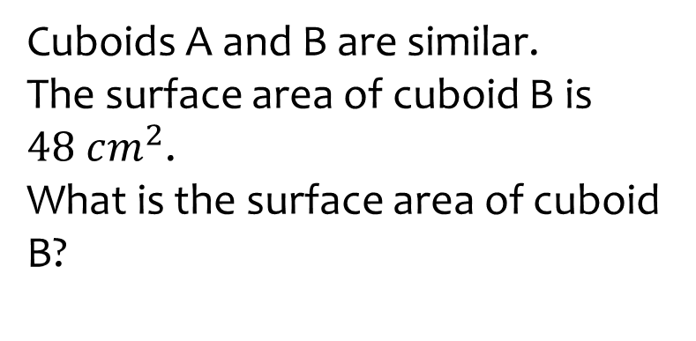
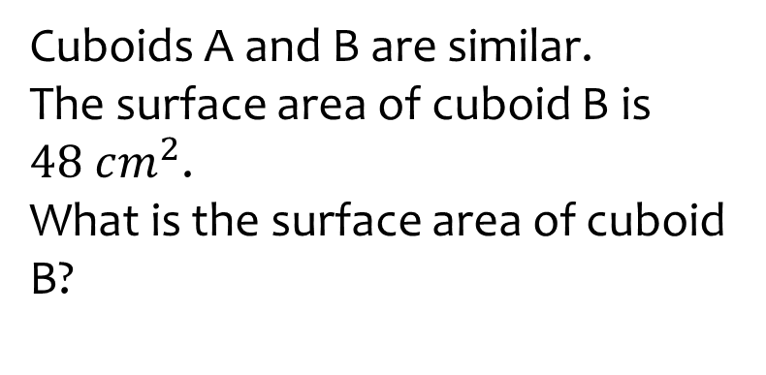

Worked example
Your turn
Cuboids A and B are similar.
The surface area of cuboid B is $48 cm^{2}$.
What is the surface area of cuboid B?
Cuboids A and B are similar.
The surface area of cuboid B is $48 cm^{2}$.
What is the surface area of cuboid B?
AA
AB
AA
AB
$$4 cm$$
$$4 cm$$
$$12 cm$$
$$8 cm$$
$$12 cm^{2}$$

Slide 16
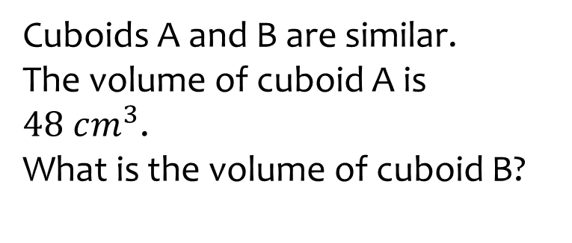
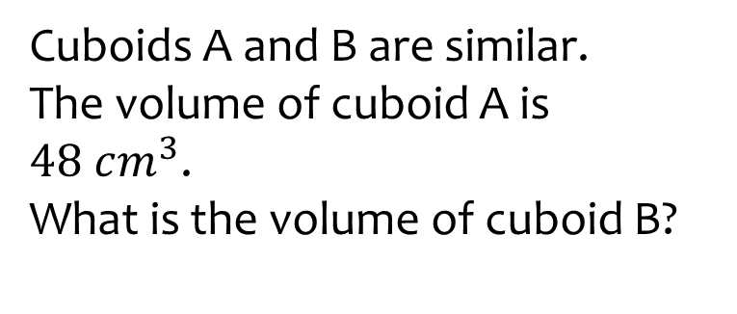

Worked example
Your turn
Cuboids A and B are similar.
The volume of cuboid A is $48 cm^{3}$.
What is the volume of cuboid B?
Cuboids A and B are similar.
The volume of cuboid A is $48 cm^{3}$.
What is the volume of cuboid B?
AA
AB
AA
AB
$$4 cm$$
$$4 cm$$
$$12 cm$$
$$8 cm$$
$$384 cm^{3}$$

Slide 17
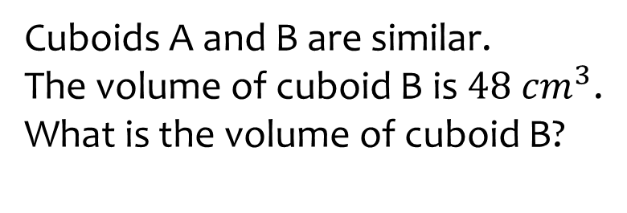
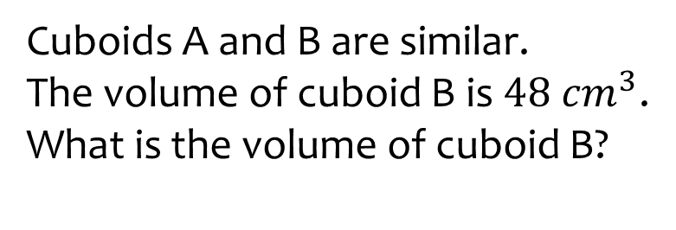

Worked example
Your turn
Cuboids A and B are similar.
The volume of cuboid B is $48 cm^{3}$.
What is the volume of cuboid B?
Cuboids A and B are similar.
The volume of cuboid B is $48 cm^{3}$.
What is the volume of cuboid B?
AA
AB
AA
AB
$$4 cm$$
$$4 cm$$
$$12 cm$$
$$8 cm$$
$$6 cm^{3}$$

Slide 18
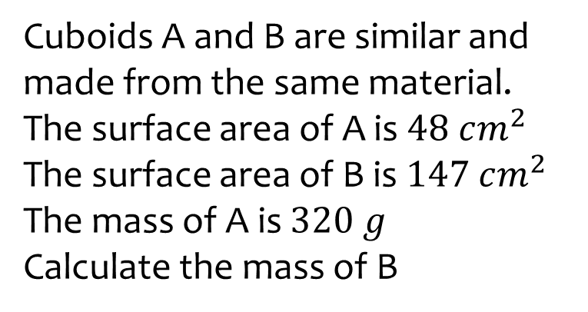
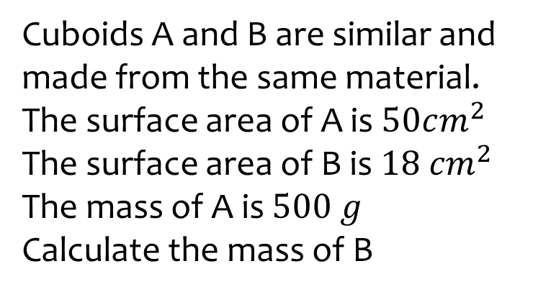

Worked example
Your turn
Cuboids A and B are similar and made from the same material.
The surface area of A is $48 cm^{2}$
The surface area of B is $147 cm^{2}$
The mass of A is $320 g$
Calculate the mass of B
Cuboids A and B are similar and made from the same material.
The surface area of A is $50cm^{2}$
The surface area of B is $18 cm^{2}$
The mass of A is $500 g$
Calculate the mass of B
$$108 g$$

Slide 19
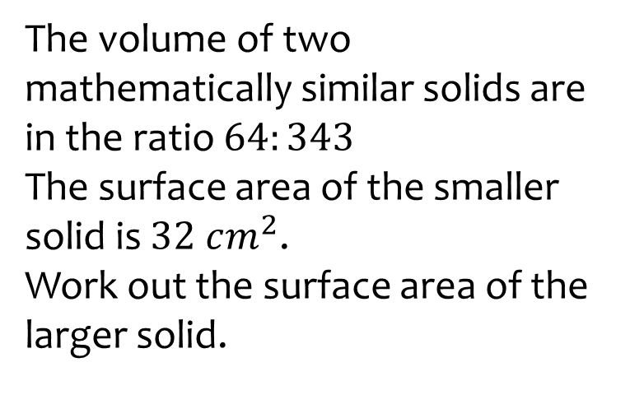
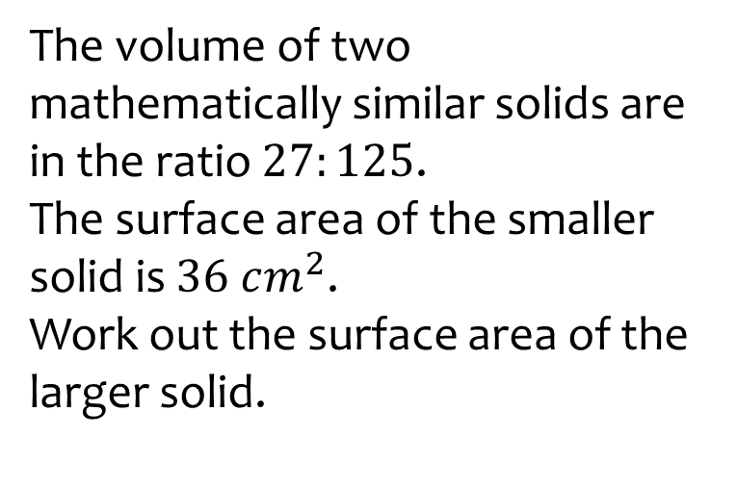

Worked example
Your turn
The volume of two mathematically similar solids are in the ratio $64:343$
The surface area of the smaller solid is $32 cm^{2}$.
Work out the surface area of the larger solid.
The volume of two mathematically similar solids are in the ratio $27:125$.
The surface area of the smaller solid is $36 cm^{2}$.
Work out the surface area of the larger solid.
$$100 cm^{2}$$

Slide 20
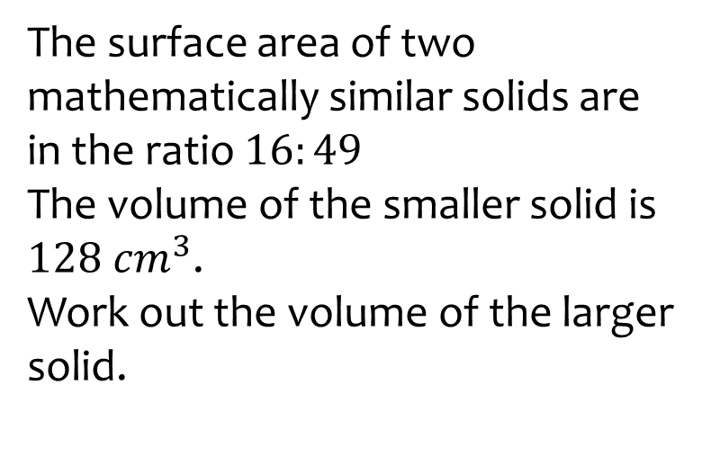
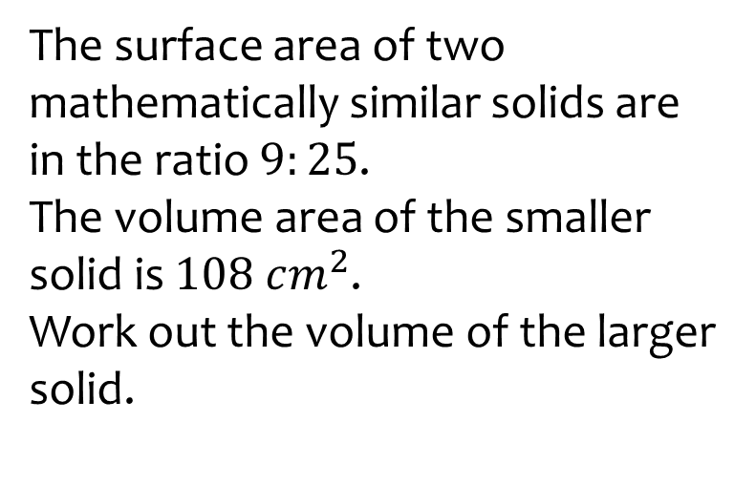

Worked example
Your turn
The surface area of two mathematically similar solids are in the ratio $16:49$
The volume of the smaller solid is $128 cm^{3}$.
Work out the volume of the larger solid.
The surface area of two mathematically similar solids are in the ratio $9:25$.
The volume area of the smaller solid is $108 cm^{2}$.
Work out the volume of the larger solid.
$$500 cm^{2}$$

Slide 21
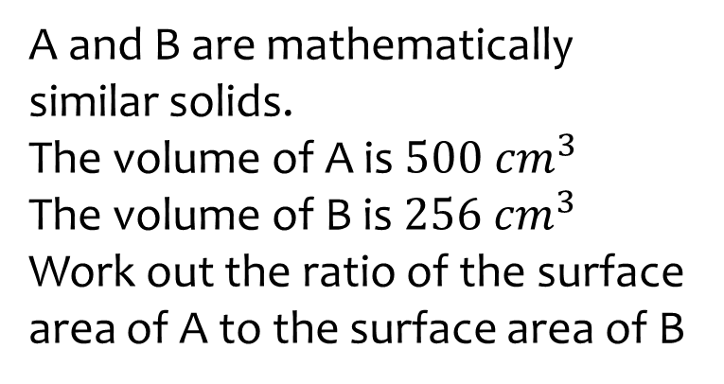
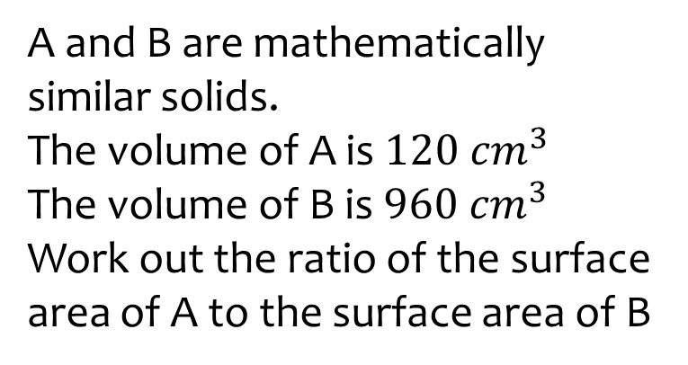

Worked example
Your turn
A and B are mathematically similar solids.
The volume of A is $500 cm^{3}$
The volume of B is $256 cm^{3}$
Work out the ratio of the surface area of A to the surface area of B
A and B are mathematically similar solids.
The volume of A is $120 cm^{3}$
The volume of B is $960 cm^{3}$
Work out the ratio of the surface area of A to the surface area of B
$$1:4$$

Slide 22
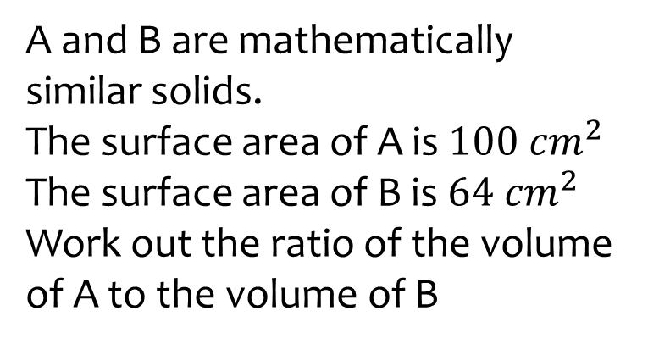
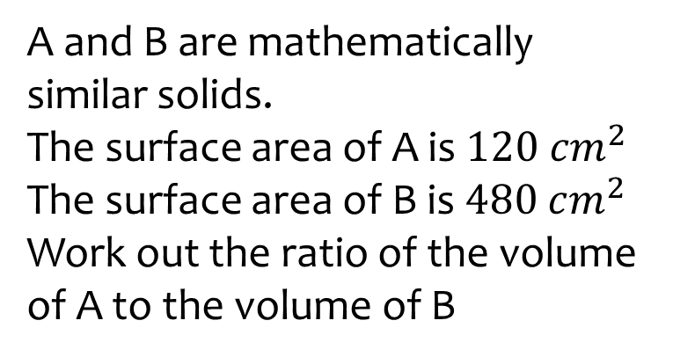

Worked example
Your turn
A and B are mathematically similar solids.
The surface area of A is $100 cm^{2}$
The surface area of B is $64 cm^{2}$
Work out the ratio of the volume of A to the volume of B
A and B are mathematically similar solids.
The surface area of A is $120 cm^{2}$
The surface area of B is $480 cm^{2}$
Work out the ratio of the volume of A to the volume of B
$$1:8$$

Slide 23
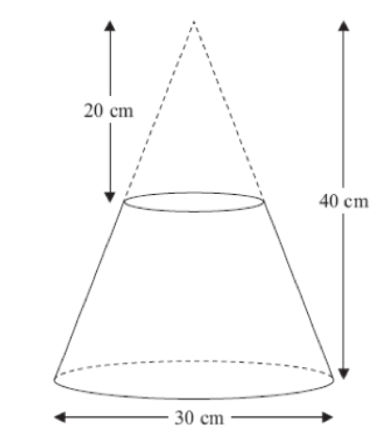




Worked example
Your turn
A frustum is made by removing a small cone from a similar large one.
Work out the volume of the frustum.
A frustum is made by removing a small cone from a similar large one.
Work out the volume of the frustum.
$$40 cm$$
$$80 cm$$
$$60 cm$$
$8246.68 cm^{3}$ (2 dp)

Slide 24
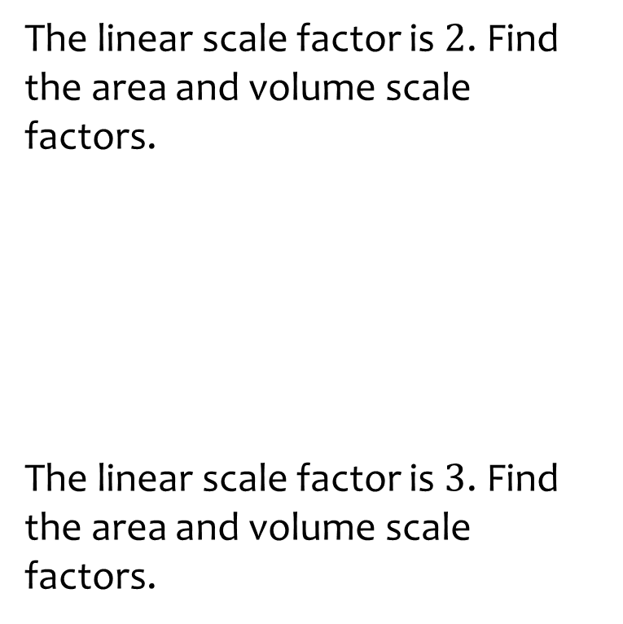
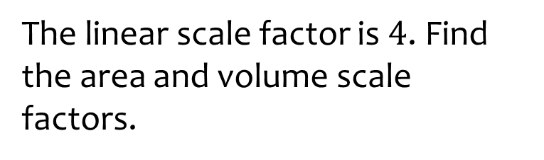
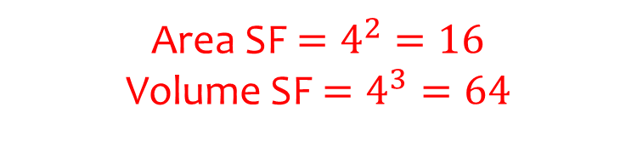
Worked example
Your turn
The linear scale factor is $2$. Find the area and volume scale factors.
The linear scale factor is $3$. Find the area and volume scale factors.
The linear scale factor is $4$. Find the area and volume scale factors.
Area SF $=4^{2}=16$
Volume SF $=4^{3}=64$

Slide 25
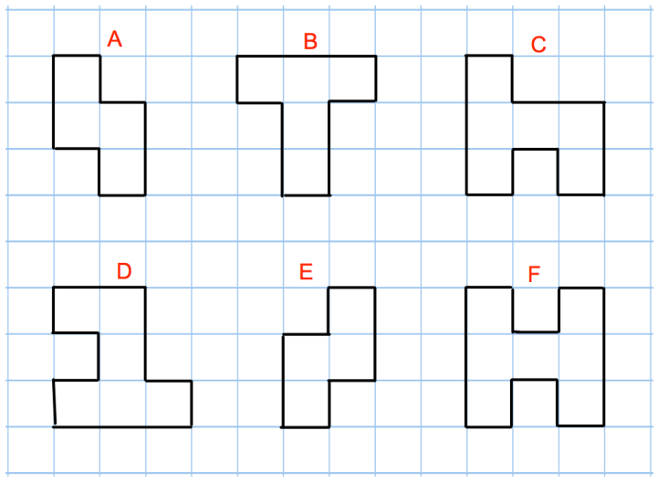
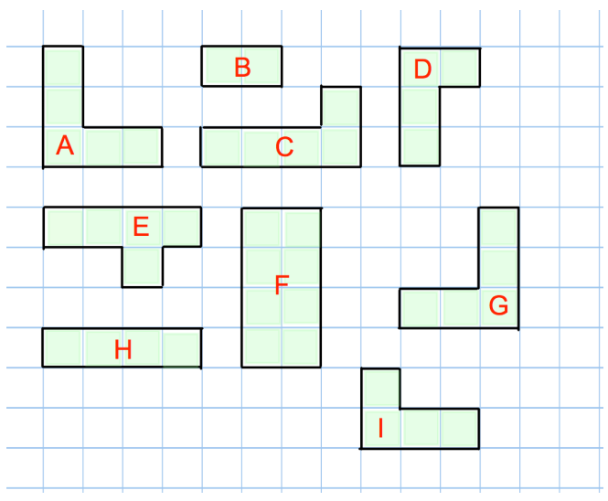
Worked example
Your turn
Which two shapes are congruent?
Which two shapes are congruent?
A and G
D and I

Slide 26
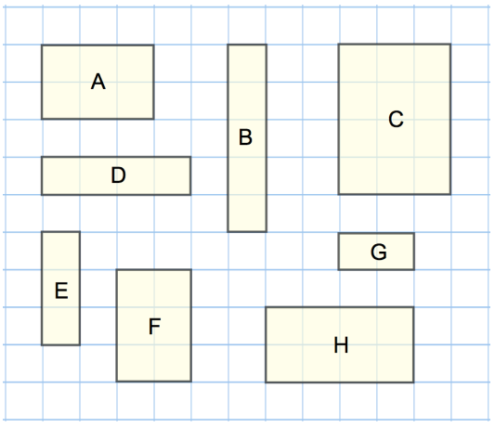
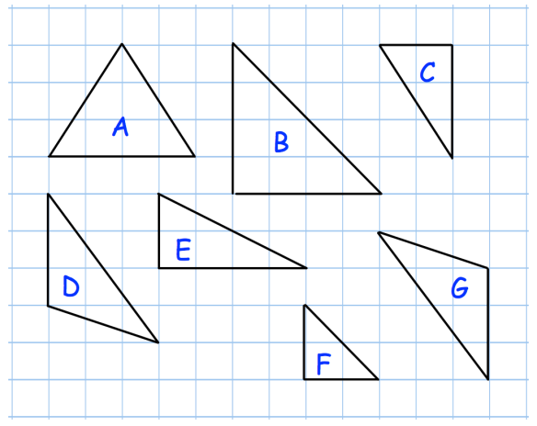
Worked example
Your turn
Which two shapes are congruent?
Which two shapes are similar?
Which two shapes are congruent?
Which two shapes are similar?
D and G
B and F
Questions used with permission from Corbettmaths: https://corbettmaths.com/

Slide 27
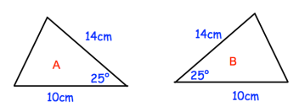
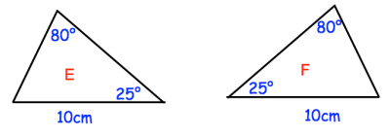
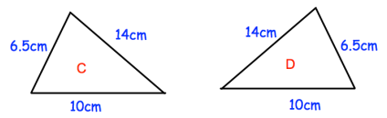
Worked example
Your turn
State the condition why these two triangles are congruent:
State the condition why these two triangles are congruent:
ASA / AAS (Angle side angle)
Questions used with permission from Corbettmaths: https://corbettmaths.com/

Slide 28
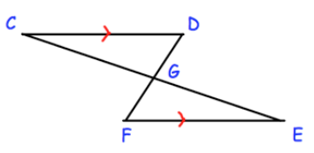
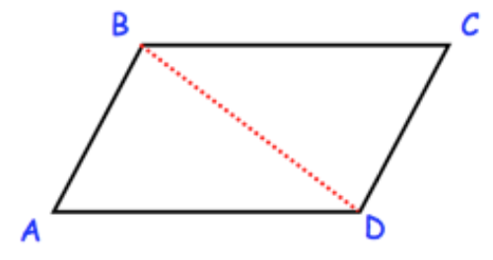
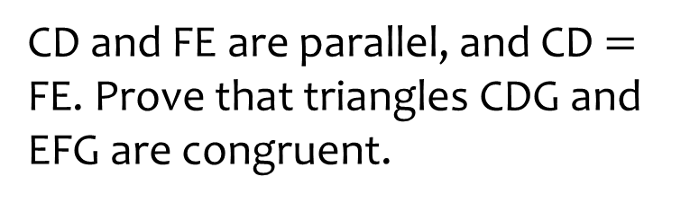
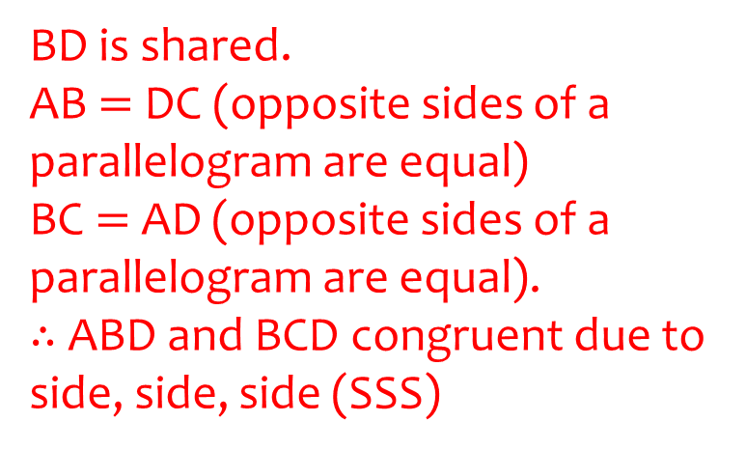
Worked example
Your turn
CD and FE are parallel, and CD $=$ FE. Prove that triangles CDG and EFG are congruent.
ABCD is a parallelogram. Prove that triangles ABD and BCD are congruent.
BD is shared.
AB $=$DC (opposite sides of a parallelogram are equal)
BC $=$ AD (opposite sides of a parallelogram are equal).
$∴$ABD and BCD congruent due to side, side, side (SSS)
Questions used with permission from Corbettmaths: https://corbettmaths.com/

