Slide 1
Perimeter
Note lots of perimeter questions in circle geometry
CONTENTS

Slide 2
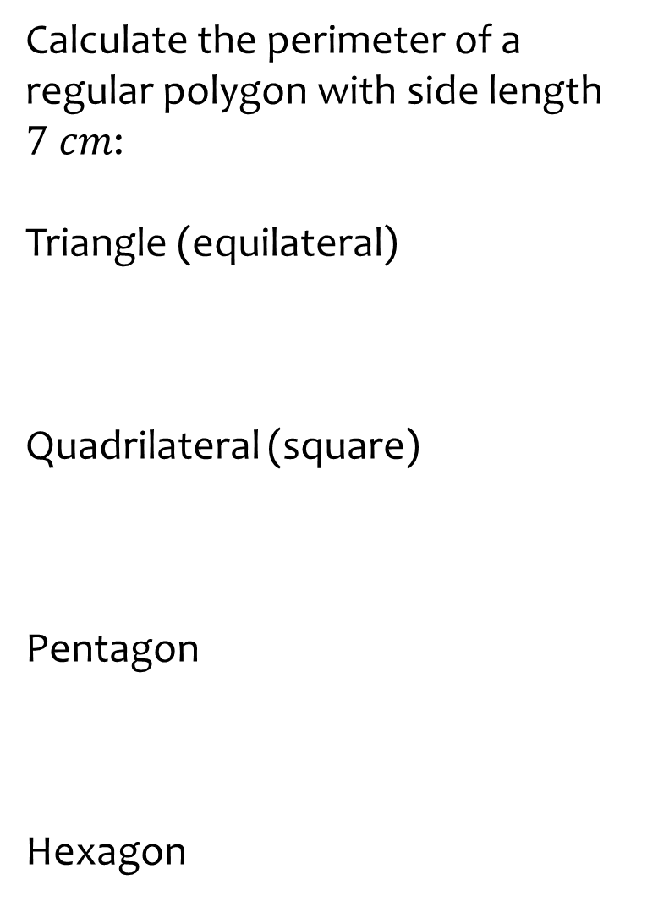
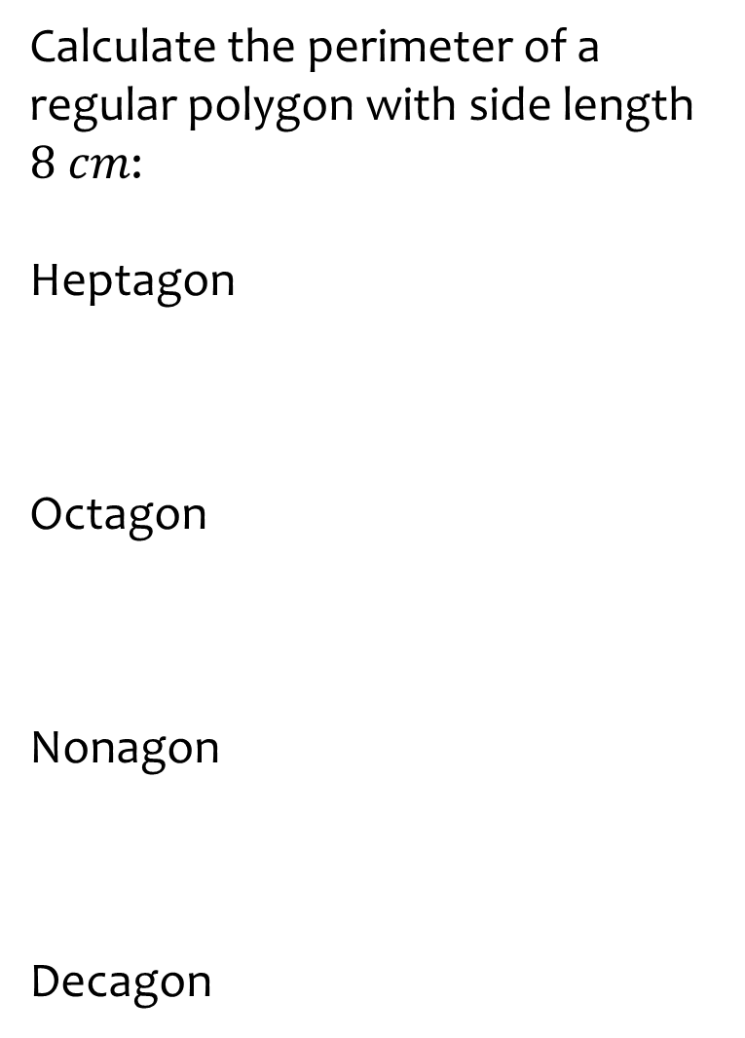
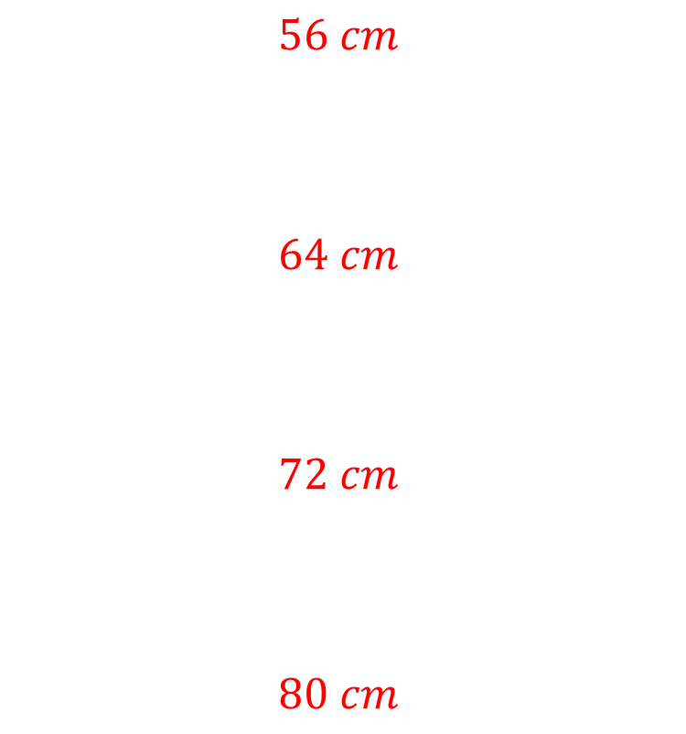
Worked example
Your turn
Calculate the perimeter of a regular polygon with side length $7 cm$:
Triangle (equilateral)
Quadrilateral (square)
Pentagon
Hexagon
Calculate the perimeter of a regular polygon with side length $8 cm$:
Heptagon
Octagon
Nonagon
Decagon
$$56 cm$$
$$64 cm$$
$$72 cm$$
$$80 cm$$

Slide 3





Worked example
Your turn
Calculate the perimeter of the rectangle:
Calculate the perimeter of the rectangle:
$$2 cm$$
$$4 cm$$
$$4 cm$$
$$8 cm$$
$$24 cm$$

Slide 4
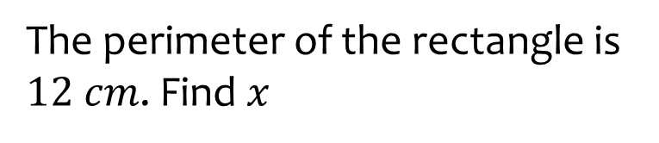
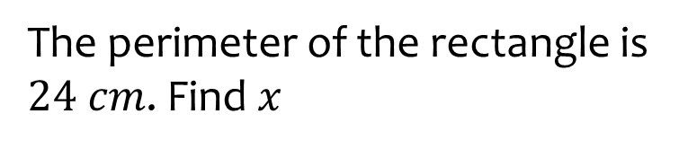



Worked example
Your turn
The perimeter of the rectangle is $12 cm$. Find $x$
The perimeter of the rectangle is $24 cm$. Find $x$
$$2 cm$$
$$4 cm$$
$$x cm$$
$$x cm$$
$$x=8$$

Slide 5






Worked example
Your turn
Calculate the perimeter of the triangle
Calculate the perimeter of the triangle
$$5 cm$$
$$10 cm$$
$$3 cm$$
$$6 cm$$
$$4 cm$$
$$8 cm$$
$$24 cm$$

Slide 6
Worked example
Your turn
Calculate the perimeter of the triangle
Calculate the perimeter of the triangle
$$3 cm$$
$$6 cm$$
$$4 cm$$
$$8 cm$$
$$24 cm$$

Slide 7









Worked example
Your turn
Calculate the perimeter of the triangle
Calculate the perimeter of the triangle
$$6 cm$$
$$12 cm$$
$$2 cm$$
$$4 cm$$
$$2.5 cm$$
$$5 cm$$
$$4 cm$$
$$8 cm$$
$$25 cm$$

Slide 8







Worked example
Your turn
Calculate the perimeter of the parallelogram
Calculate the perimeter of the parallelogram
$$2.5 cm$$
$$5 cm$$
$$4 cm$$
$$2 cm$$
$$4 cm$$
$$8 cm$$
$$26 cm$$

Slide 9
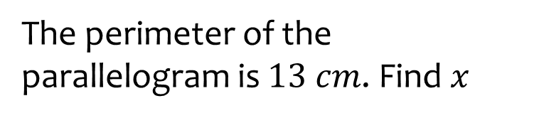
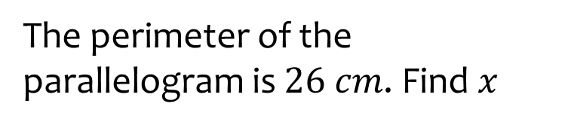



Worked example
Your turn
The perimeter of the parallelogram is $13 cm$. Find $x$
The perimeter of the parallelogram is $26 cm$. Find $x$
$$2.5 cm$$
$$5 cm$$
$$4 cm$$
$$2 cm$$
$$x cm$$
$$x cm$$
$$x=8$$

Slide 10











Worked example
Your turn
Calculate the perimeter of the trapezium
Calculate the perimeter of the trapezium
$$4 cm$$
$$8 cm$$
$$2.24 cm$$
$$2 cm$$
$$2.24 cm$$
$$4.47 cm$$
$$4 cm$$
$$4.47 cm$$
$$6 cm$$
$$12 cm$$
$$28.94 cm$$

Slide 11









Worked example
Your turn
Calculate the perimeter of this hexagon
Calculate the perimeter of this hexagon
$$2 cm$$
$$4 cm$$
$$2 cm$$
$$4 cm$$
$$4 cm$$
$$8 cm$$
$$6 cm$$
$$12 cm$$
$$40 cm$$

Slide 12
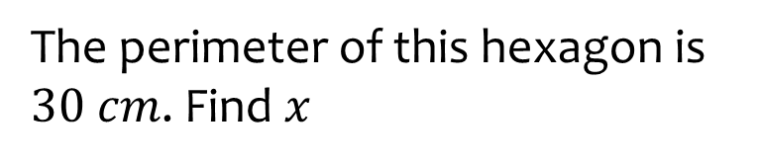
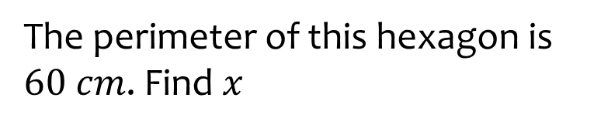








Worked example
Your turn
The perimeter of this hexagon is $30 cm$. Find $x$
The perimeter of this hexagon is $60 cm$. Find $x$
$$2 cm$$
$$4 cm$$
$$3 cm$$
$$6 cm$$
$$x cm$$
$$x cm$$
$$10 cm$$
$$20 cm$$
$$x=10$$

Slide 13
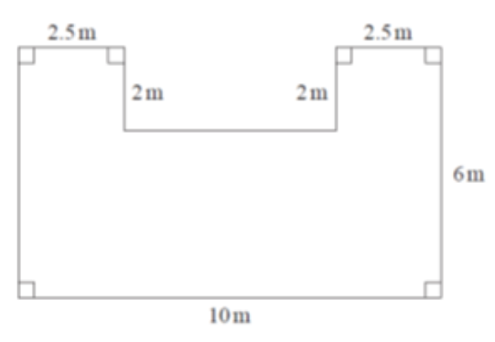






Worked example
Your turn
Calculate the perimeter:
Calculate the perimeter:
$$1.25 m$$
$$1.25 m$$
$$1 m$$
$$1 m$$
$$3 m$$
$$5 m$$
$$32 m$$

Slide 14
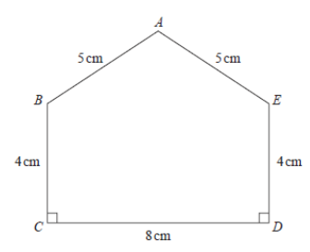







Worked example
Your turn
Calculate the perimeter of the pentagon
Calculate the perimeter of the pentagon
$$10 cm$$
$$10 cm$$
$$8 cm$$
$$8 cm$$
$$6 m$$
$$16 cm$$
$$26 cm$$

