Slide 1
Constructions and loci
No answers here, as requires careful checking of student work for accuracy / use of visualiser
CONTENTS

Slide 2
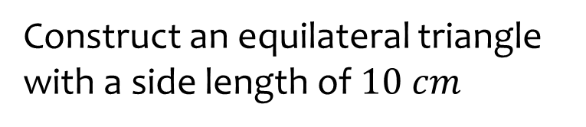
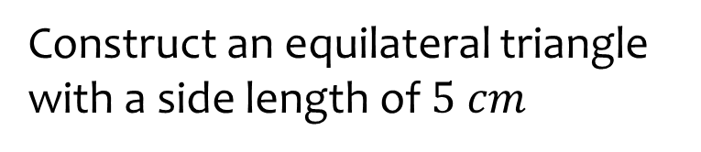
Worked example
Your turn
Construct an equilateral triangle with a side length of $10 cm$
Construct an equilateral triangle with a side length of $5 cm$

Slide 3
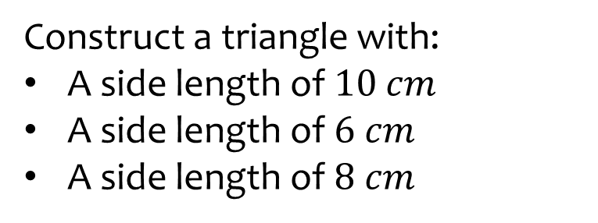
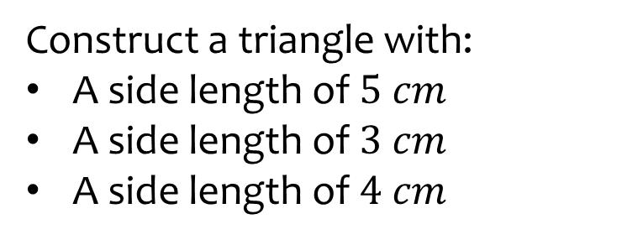
Worked example
Your turn
Construct a triangle with:
A side length of $10$ $cm$
A side length of $6 cm$
A side length of $8 cm$
Construct a triangle with:
A side length of $5$ $cm$
A side length of $3$ $cm$
A side length of $4 cm$

Slide 4
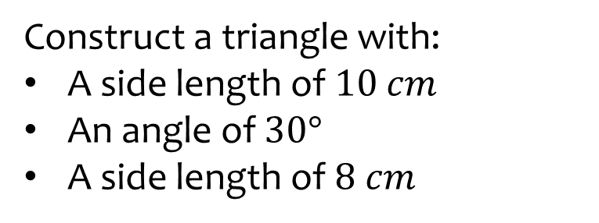
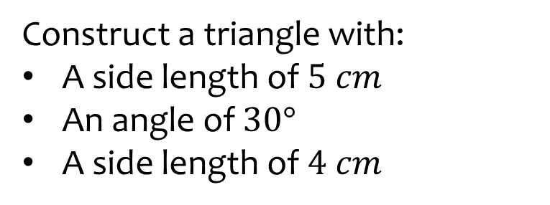
Worked example
Your turn
Construct a triangle with:
A side length of $10$ $cm$
An angle of $30°$
A side length of $8 cm$
Construct a triangle with:
A side length of $5$ $cm$
An angle of $30°$
A side length of $4 cm$

Slide 5
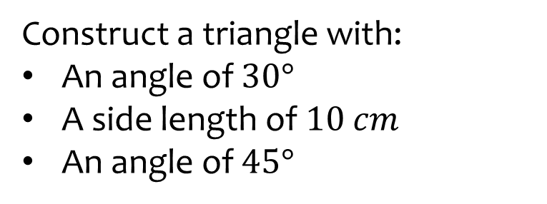
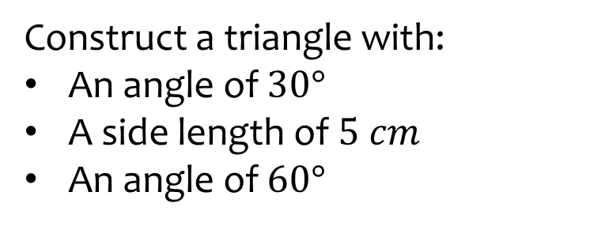
Worked example
Your turn
Construct a triangle with:
An angle of $30°$
A side length of $10$ $cm$
An angle of $45°$
Construct a triangle with:
An angle of $30°$
A side length of $5$ $cm$
An angle of $60°$

Slide 6
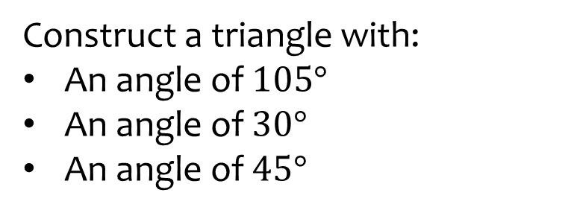
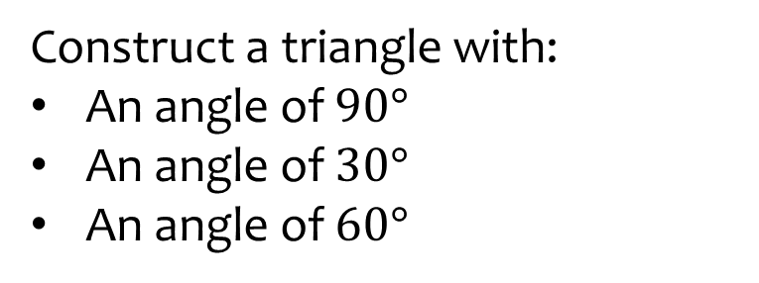
Worked example
Your turn
Construct a triangle with:
An angle of $105°$
An angle of $30°$
An angle of $45°$
Construct a triangle with:
An angle of $90°$
An angle of $30°$
An angle of $60°$

Slide 7
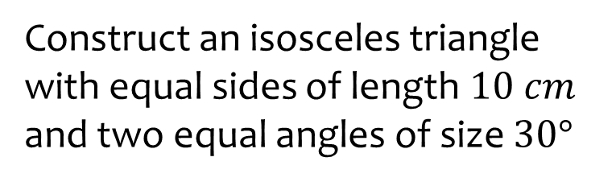
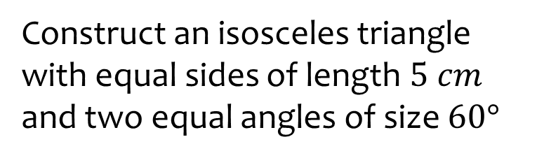
Worked example
Your turn
Construct an isosceles triangle with equal sides of length $10 cm$ and two equal angles of size $30°$
Construct an isosceles triangle with equal sides of length $5 cm$ and two equal angles of size $60°$

Slide 8
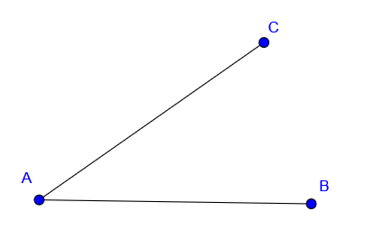
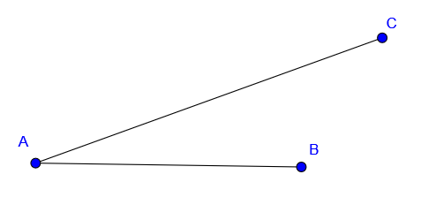
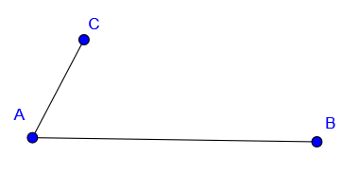
Worked example
Your turn
Bisect angle BAC:
Bisect angle BAC:

Slide 9
Worked example
Your turn
Construct the perpendicular bisector of the line:
Construct the perpendicular bisector of the line:

Slide 10
Worked example
Your turn
Construct a perpendicular to the line which passes through the marked point
x
Construct a perpendicular to the line which passes through the marked point
x

Slide 11
Worked example
Your turn
Construct a perpendicular to the line which passes through the marked point
x
Construct a perpendicular to the line which passes through the marked point
x

Slide 12
Worked example
Your turn
Construct a perpendicular to the line which passes through the marked point
x
Construct a perpendicular to the line which passes through the marked point
x

Slide 13
Worked example
Your turn
Construct a perpendicular to the line which passes through the marked point
x
Construct a perpendicular to the line which passes through the marked point
x

Slide 14
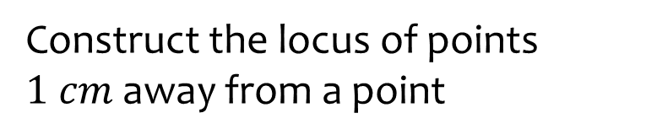
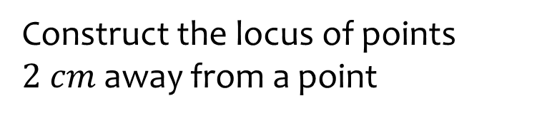
Worked example
Your turn
Construct the locus of points $1 cm$ away from a point
Construct the locus of points $2 cm$ away from a point

Slide 15
Worked example
Your turn
Construct the locus of points equidistant from two points
Construct the locus of points equidistant from two points

Slide 16
Worked example
Your turn
Construct the locus of points equidistant from a line
Construct the locus of points equidistant from a line

Slide 17
Worked example
Your turn
Construct the locus of points equidistant from two intersecting lines
Construct the locus of points equidistant from two intersecting lines

Slide 18
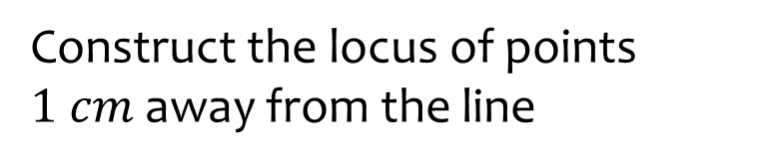
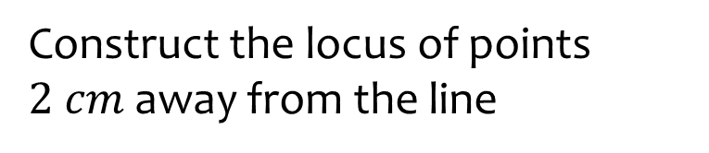
Worked example
Your turn
Construct the locus of points $1 cm$ away from the line
Construct the locus of points $2 cm$ away from the line

Slide 19
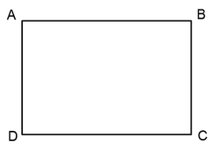
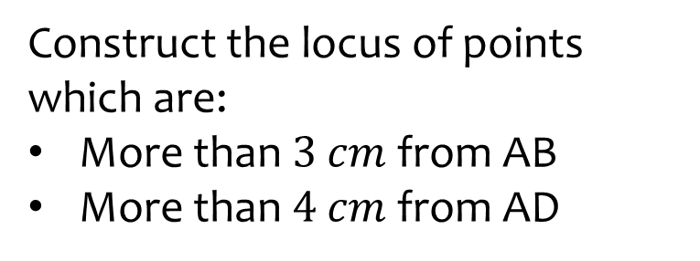
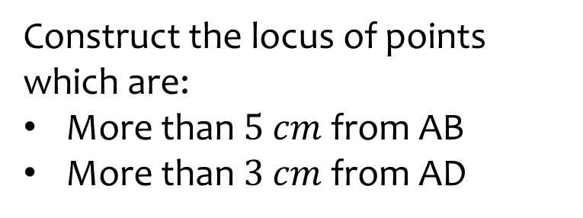
Worked example
Your turn
Construct the locus of points which are:
More than $3$ $cm$ from AB
More than $4$ $cm$ from AD
Construct the locus of points which are:
More than $5$ $cm$ from AB
More than $3$ $cm$ from AD

Slide 20
Worked example
Your turn
Construct the locus of points which are:
Closer to B than A
Closer to C than D
Construct the locus of points which are:
Closer to C than B
Closer to D than A

Slide 21
Worked example
Your turn
Construct the locus of points which are:
Closer to AD than AB
Construct the locus of points which are:
Closer to BC than DC

Slide 22
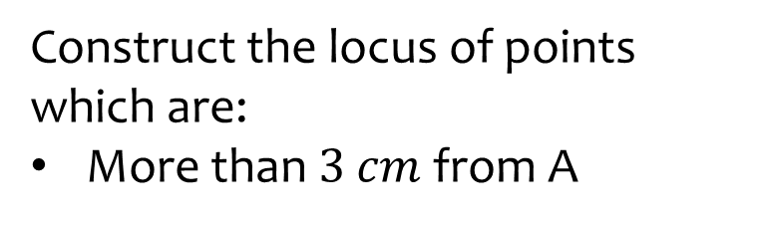
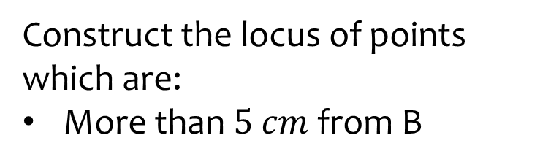
Worked example
Your turn
Construct the locus of points which are:
More than $3$ $cm$ from A
Construct the locus of points which are:
More than $5$ $cm$ from B

Slide 23
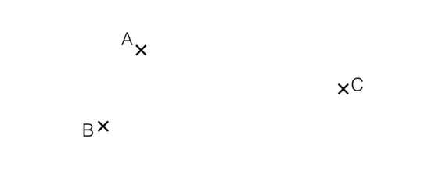
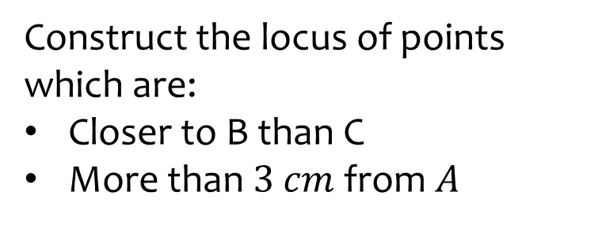
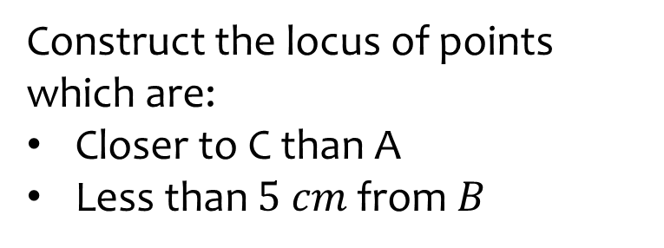
Worked example
Your turn
Construct the locus of points which are:
Closer to B than C
More than $3$ $cm$ from $A$
Construct the locus of points which are:
Closer to C than A
Less than $5 cm$ from $B$

Slide 24
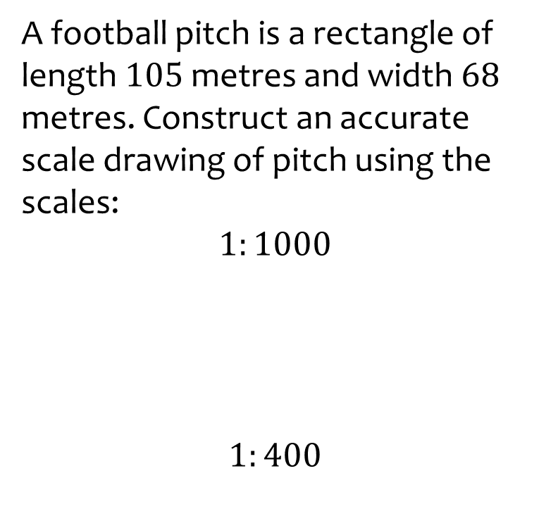
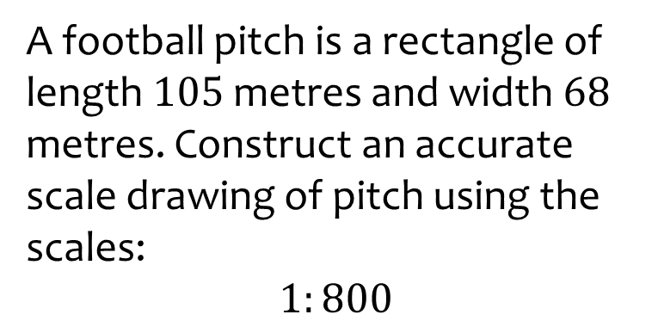
Worked example
Your turn
A football pitch is a rectangle of length $105$metres and width $68$ metres. Construct an accurate scale drawing of pitch using the scales:
$$1:1000$$
$$1:400$$
A football pitch is a rectangle of length $105$metres and width $68$ metres. Construct an accurate scale drawing of pitch using the scales:
$$1:800$$

Slide 25
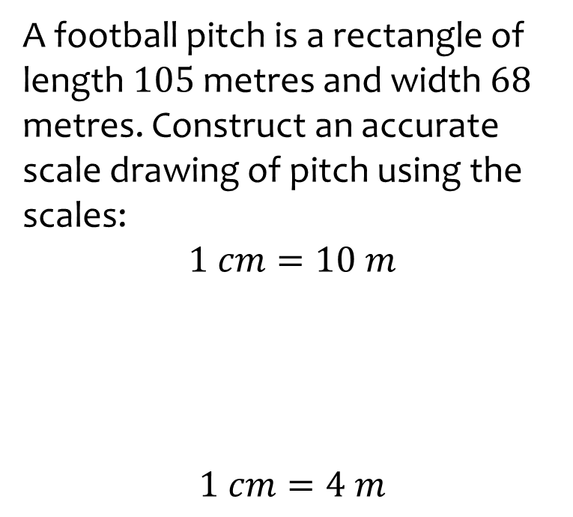
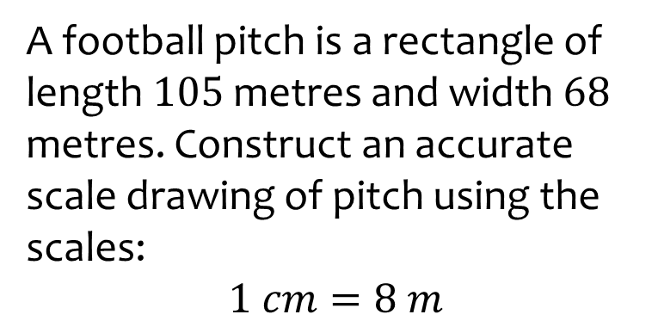
Worked example
Your turn
A football pitch is a rectangle of length $105$metres and width $68$ metres. Construct an accurate scale drawing of pitch using the scales:
$$1 cm=10 m$$
$$1 cm=4 m$$
A football pitch is a rectangle of length $105$metres and width $68$ metres. Construct an accurate scale drawing of pitch using the scales:
$$1 cm=8 m$$

