Slide 1
Circle theorems
CONTENTS

Slide 2
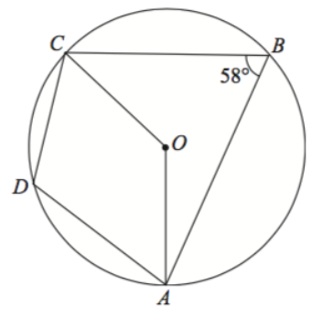


Worked example
Your turn
Calculate the obtuse angle AOC
Calculate the obtuse angle AOC
$$85°$$
$$116°$$

Slide 3
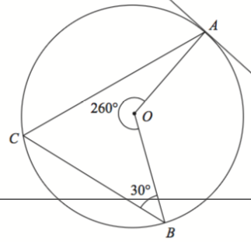


Worked example
Your turn
Calculate the size of angle ACB
Calculate the size of angle ACB
$$206°$$
$$50°$$

Slide 4
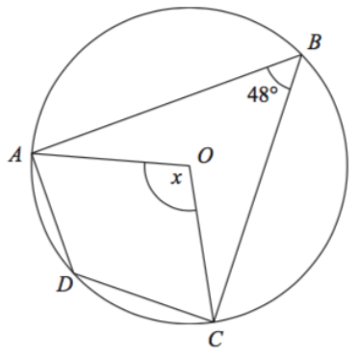


Worked example
Your turn
Calculate the size of angle ADC
Calculate the size of angle ADC
$$84°$$
$$132°$$

Slide 5
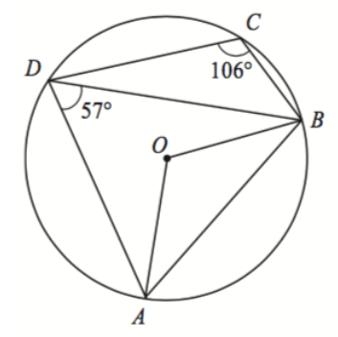



Worked example
Your turn
Calculate the size of:
Angle BAD
Angle ABC
Calculate the size of:
Angle BAD
Angle ABC
$$160°$$
$$75°$$
$$74°$$
$$123°$$

Slide 6
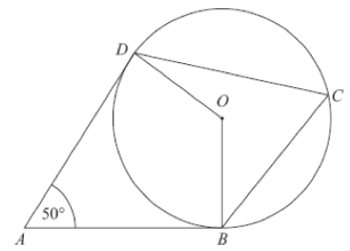


Worked example
Your turn
Calculate the size of angle BCD
Calculate the size of angle BCD
$$30°$$
$$65°$$

Slide 7
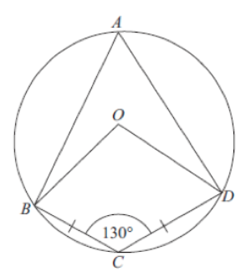

Worked example
Your turn
Calculate the size of angle CDO
Calculate the size of angle CDO
$$150°$$
$$65°$$

Slide 8
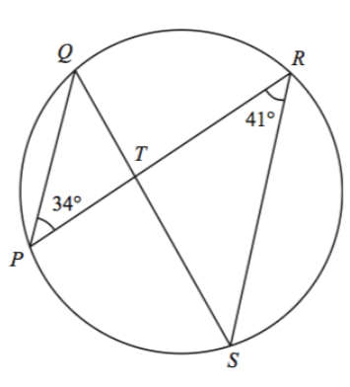



Worked example
Your turn
Calculate the size of acute angle PTS
Calculate the size of acute angle PTS
$$14°$$
$$43°$$
$$75°$$

Slide 9
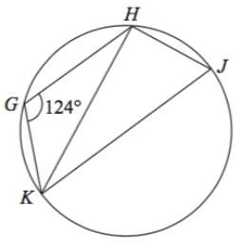


Worked example
Your turn
Calculate the size of angle HKJ
Calculate the size of angle HKJ
$$142°$$
$$34°$$

Slide 10
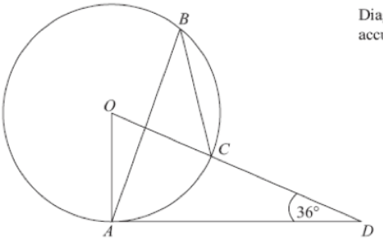


Worked example
Your turn
Calculate the size of angle ABC
Calculate the size of angle ABC
$$37°$$
$$27°$$

Slide 11
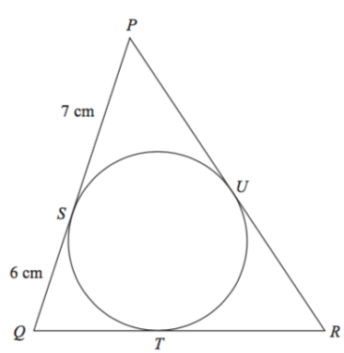
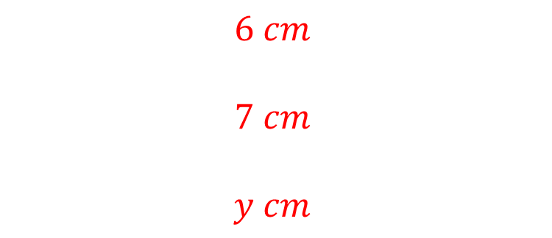




Worked example
Your turn
Calculate the length of:
QT
PU
RT
Calculate the length of:
QT
PU
RT
$$14 cm$$
$$37°$$
$$12 cm$$
$$x cm$$
$$y cm$$
$$6 cm$$
$$7 cm$$
$$y cm$$

Slide 12
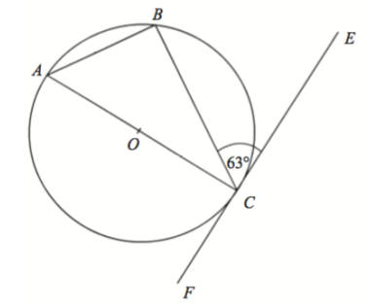


Worked example
Your turn
Calculate the size of angle BAC
Calculate the size of angle BAC
$$62°$$
$$63°$$

Slide 13
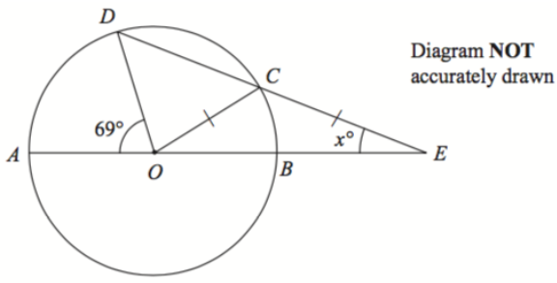
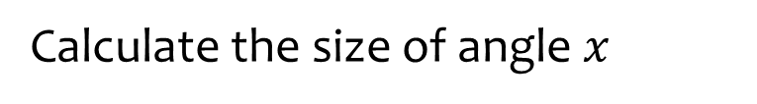
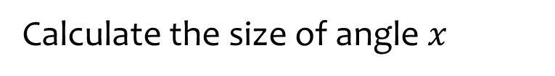



Worked example
Your turn
Calculate the size of angle $x$
Calculate the size of angle $x$
$$78°$$
$$87°$$
$$29°$$

Slide 14
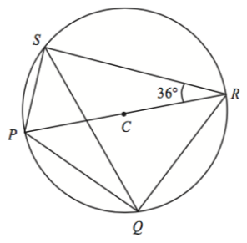


Worked example
Your turn
Calculate the size of angle RQS
Calculate the size of angle RQS
$$63°$$
$$54°$$

Slide 15
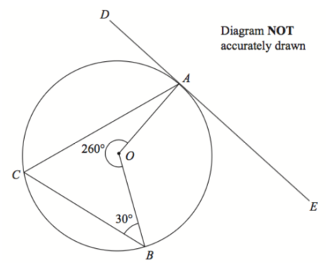



Worked example
Your turn
Calculate the size of angle CAD
Calculate the size of angle CAD
$$206°$$
$$40°$$
$$70°$$

Slide 16
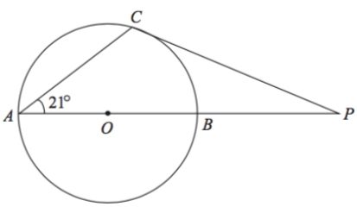


Worked example
Your turn
Calculate the size of angle APC
Calculate the size of angle APC
$$12°$$
$$48°$$

Slide 17
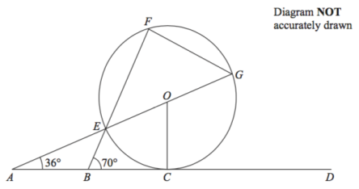



Worked example
Your turn
Calculate the size of angle CGF
Calculate the size of angle CGF
$$37°$$
$$80°$$
$$83°$$

Slide 18
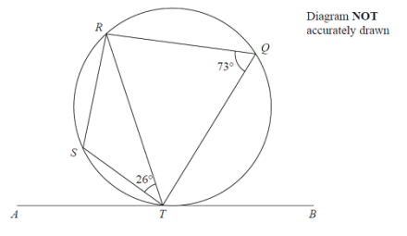



Worked example
Your turn
Calculate the size of angle STA
Calculate the size of angle STA
$$72°$$
$$25°$$
$$47°$$

Slide 19
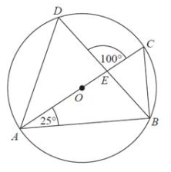



Worked example
Your turn
Calculate the size of angle DAC
Calculate the size of angle DAC
$$110°$$
$$15°$$
$$35°$$

Slide 20
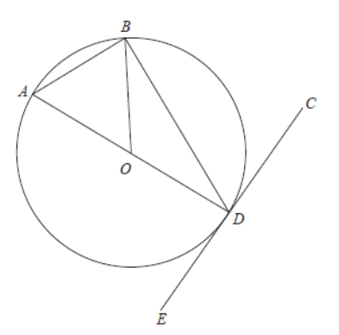



Worked example
Your turn
Calculate the size of angle AOB
Calculate the size of angle AOB
$$75°$$
$$57°$$
$$66°$$

Slide 21
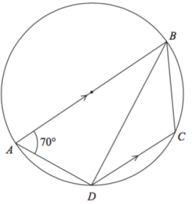


Worked example
Your turn
The tangent to the circle at D meets the line BC extended at T
Calculate the size of angle BTD
The tangent to the circle at D meets the line BC extended at T
Calculate the size of angle BTD
$$60°$$
$$60°$$

Slide 22
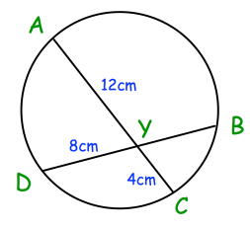
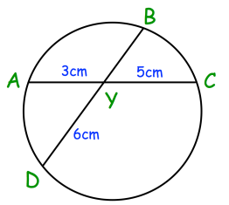

Worked example
Your turn
Calculate BY
Calculate BY
$$2.5 cm$$
Questions used with permission from Corbettmaths: https://corbettmaths.com/

Slide 23
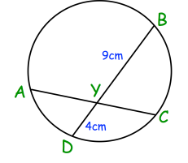



Worked example
Your turn
Chord BD bisects AC. Find the length of CY
Chord BD bisects AC. Find the length of CY
$$32 cm$$
$$2 cm$$
$$6 cm$$
Questions used with permission from Corbettmaths: https://corbettmaths.com/

Slide 24
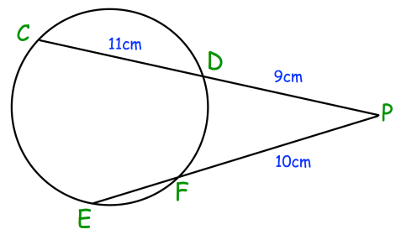




Worked example
Your turn
Find the length of EF
Find the length of EF
$$12 cm$$
$$10 cm$$
$$8 cm$$
$$7 cm$$
Questions used with permission from Corbettmaths: https://corbettmaths.com/

Slide 25
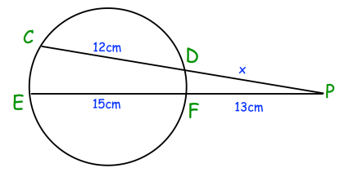






Worked example
Your turn
Find the value of $x$
Find the value of $x$
$$10 cm$$
$$5 cm$$
$$3 cm$$
$$x=2 cm$$
Questions used with permission from Corbettmaths: https://corbettmaths.com/

