Slide 1
Circle area/circumference
CONTENTS

Slide 2
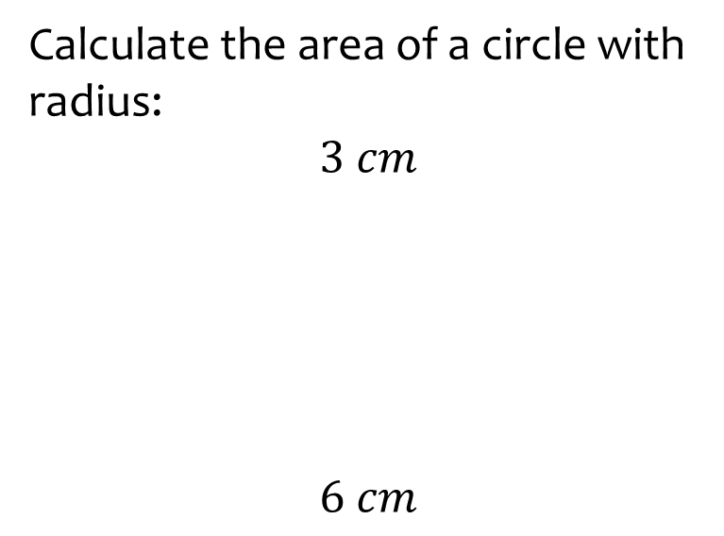
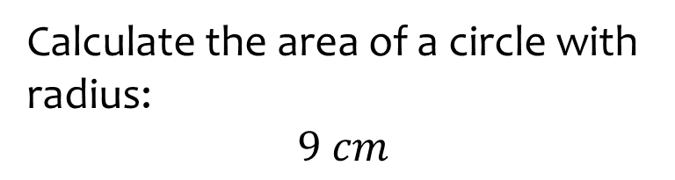

Worked example
Your turn
Calculate the area of a circle with radius:
$$3 cm$$
$$6 cm$$
Calculate the area of a circle with radius:
$$9 cm$$
$81π=254.47 cm^{2}$ (2 dp)

Slide 3
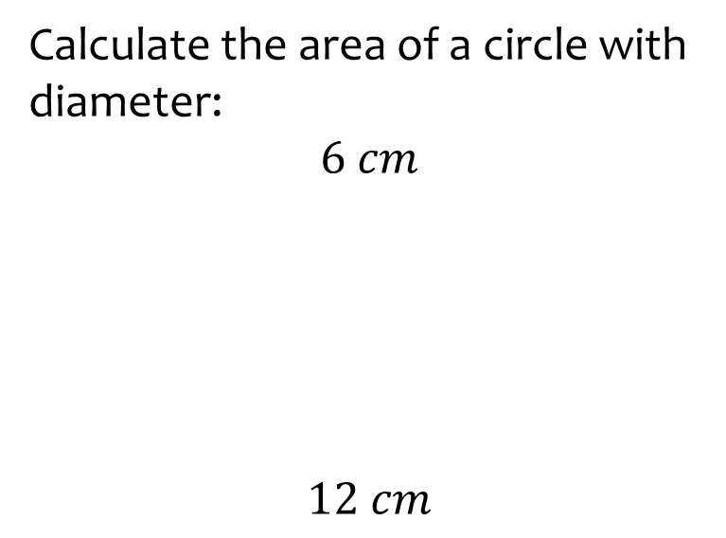
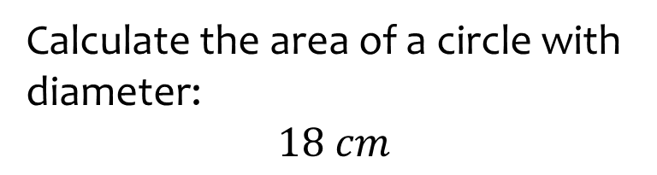
Worked example
Your turn
Calculate the area of a circle with diameter:
$$6 cm$$
$$12 cm$$
Calculate the area of a circle with diameter:
$$18 cm$$
$81π=254.47 cm^{2}$ (2 dp)

Slide 4
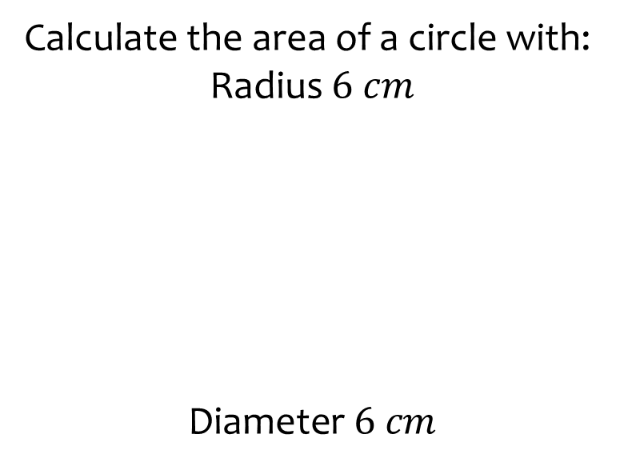
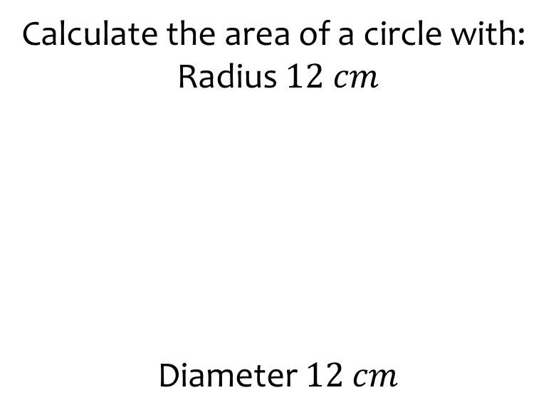
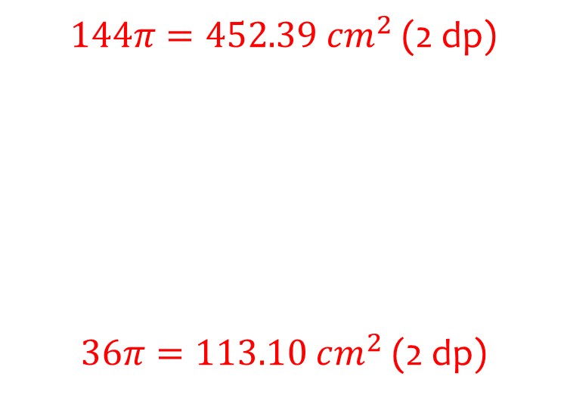
Worked example
Your turn
Calculate the area of a circle with:
Radius $6 cm$
$$\text{Diameter} 6 cm$$
Calculate the area of a circle with:
Radius $12 cm$
$$\text{Diameter} 12 cm$$
$144π=452.39 cm^{2}$ (2 dp)
$36π=113.10 cm^{2}$ (2 dp)

Slide 5
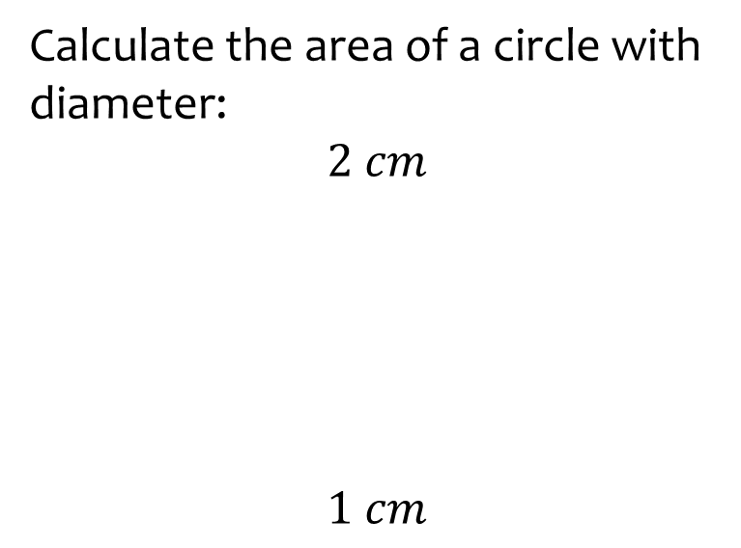
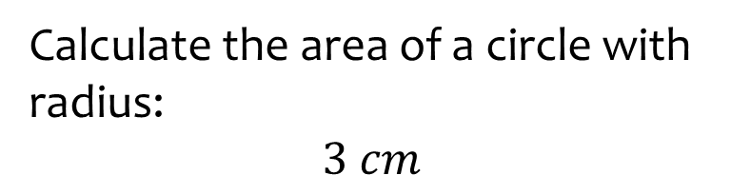

Worked example
Your turn
Calculate the area of a circle with diameter:
$$2 cm$$
$$1 cm$$
Calculate the area of a circle with radius:
$$3 cm$$
$\frac{9}{4}π=7.07 cm^{2}$ (2 dp)

Slide 6
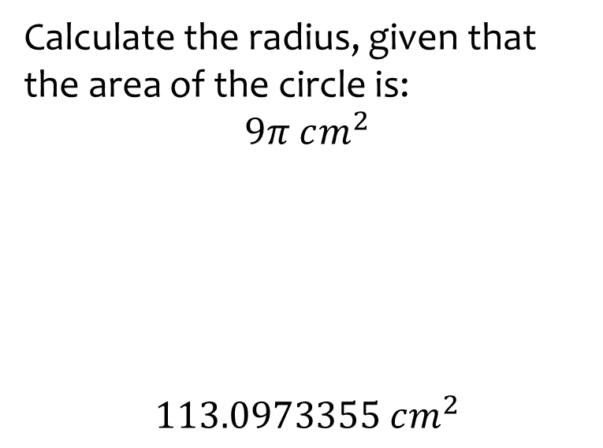
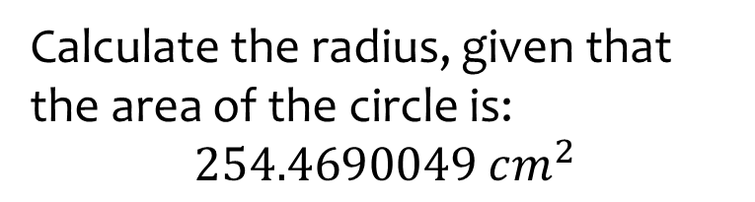

Worked example
Your turn
Calculate the radius, given that the area of the circle is:
$$9π cm^{2}$$
$$113.0973355 cm^{2}$$
Calculate the radius, given that the area of the circle is:
$$254.4690049 cm^{2}$$
$$9 cm$$

Slide 7
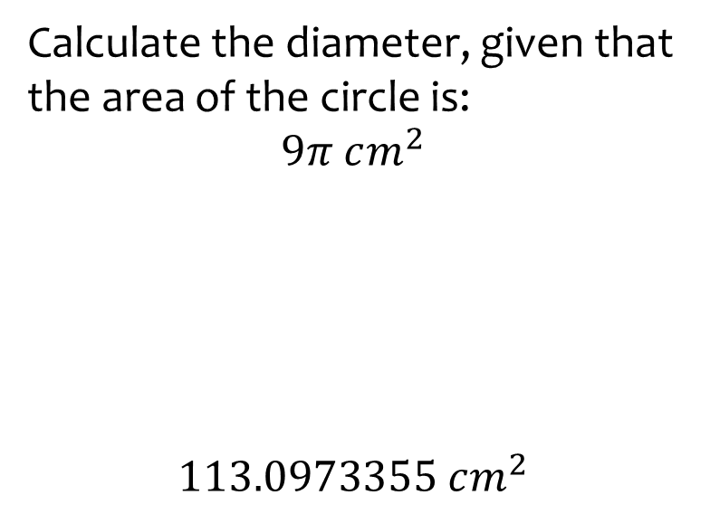

Worked example
Your turn
Calculate the diameter, given that the area of the circle is:
$$9π cm^{2}$$
$$113.0973355 cm^{2}$$
Calculate the radius, given that the area of the circle is:
$$254.4690049 cm^{2}$$
$$18 cm$$

Slide 8
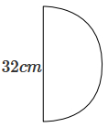
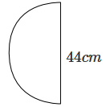
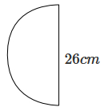
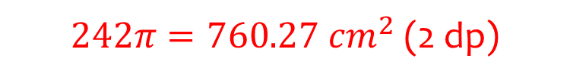



Worked example
Your turn
Calculate the area of the sector:
Calculate the area of the sector:
$$22 cm$$
$$44 cm$$
$242π=760.27 cm^{2}$ (2 dp)
$$11 cm$$

Slide 9
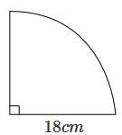
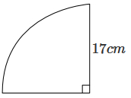
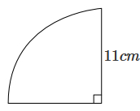
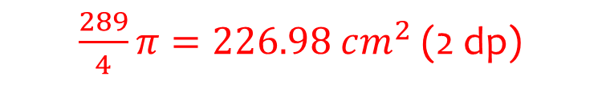



Worked example
Your turn
Calculate the area of the sector:
Calculate the area of the sector:
$$17 cm$$
$$34 cm$$
$\frac{289}{4}π=226.98 cm^{2}$ (2 dp)
$$68 cm$$

Slide 10
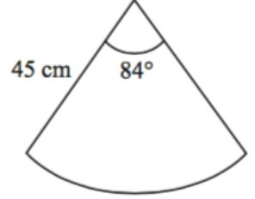
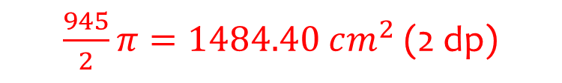


Worked example
Your turn
Calculate the area of the sector:
Calculate the area of the sector:
$$4.5 cm$$
$$4.5 cm$$
$$42°$$
$\frac{945}{2}π=1484.40 cm^{2}$ (2 dp)

Slide 11
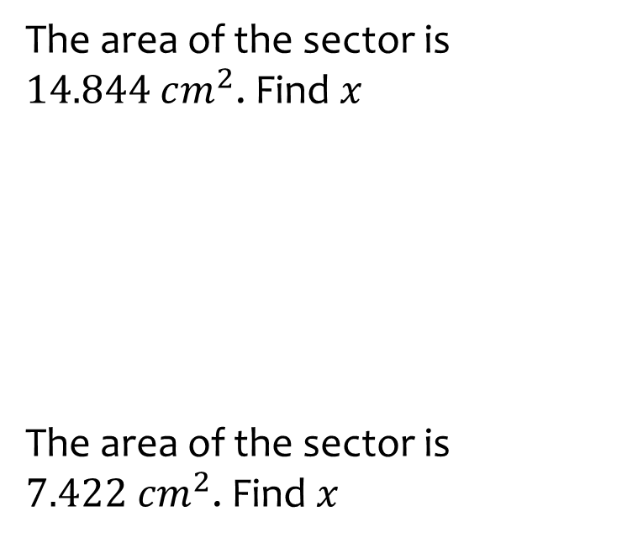
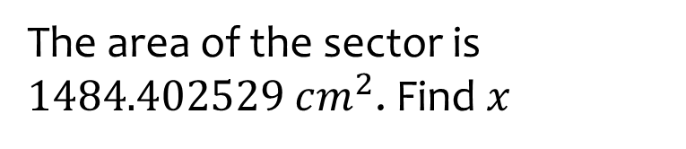




Worked example
Your turn
The area of the sector is $14.844 cm^{2}$. Find $x$
The area of the sector is $7.422 cm^{2}$. Find $x$
The area of the sector is $1484.402529 cm^{2}$. Find $x$
$$x cm$$
$$x cm$$
$$x=45$$
$$x cm$$
$$42°$$

Slide 12
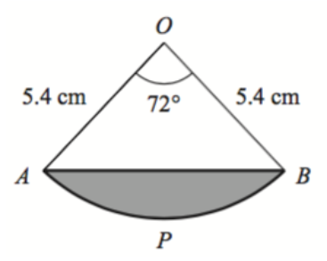



Worked example
Your turn
Calculate the area of the shaded segment APB
Calculate the area of the shaded segment APB
$$2.7 cm$$
$$2.7 cm$$
$$36°$$
$4.46 cm^{2}$ (2 dp)

Slide 13
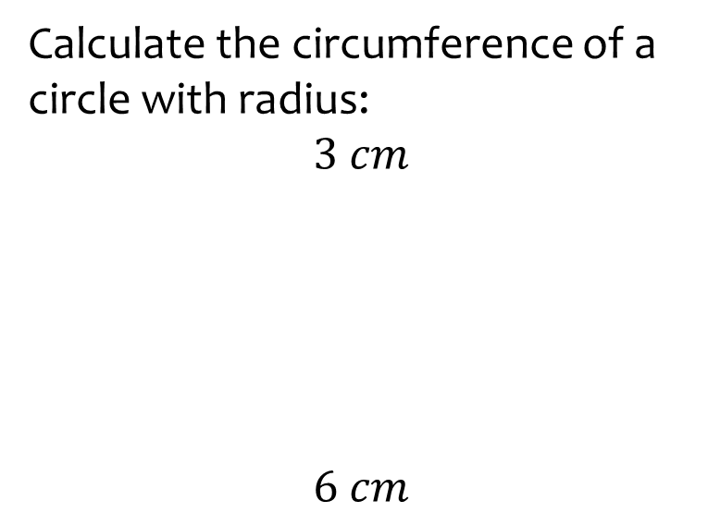
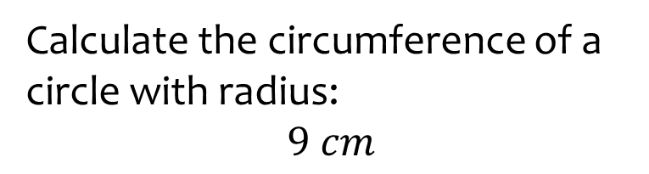

Worked example
Your turn
Calculate the circumference of a circle with radius:
$$3 cm$$
$$6 cm$$
Calculate the circumference of a circle with radius:
$$9 cm$$
$18π=56.55 cm^{2}$ (2 dp)

Slide 14
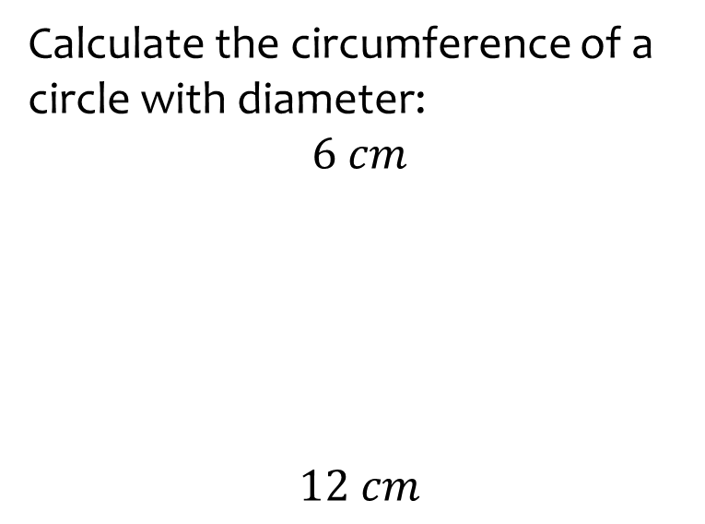
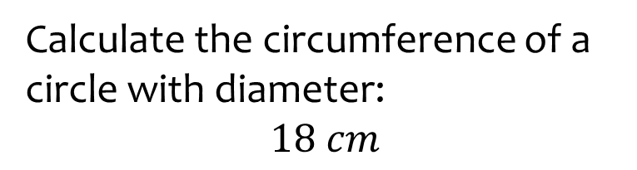
Worked example
Your turn
Calculate the circumference of a circle with diameter:
$$6 cm$$
$$12 cm$$
Calculate the circumference of a circle with diameter:
$$18 cm$$
$18π=56.55 cm^{2}$ (2 dp)

Slide 15
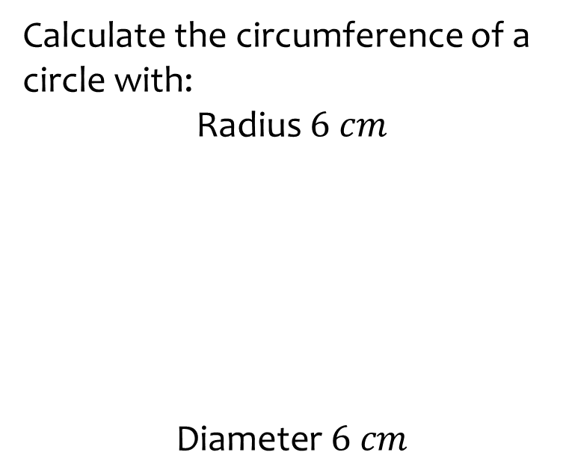
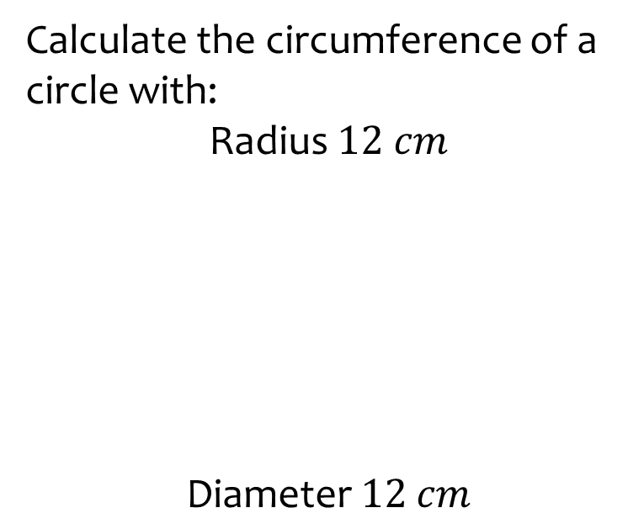
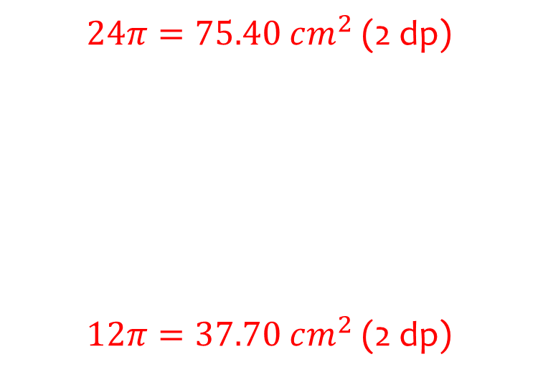
Worked example
Your turn
Calculate the circumference of a circle with:
Radius $6 cm$
$$\text{Diameter} 6 cm$$
Calculate the circumference of a circle with:
Radius $12 cm$
$$\text{Diameter} 12 cm$$
$24π=75.40 cm^{2}$ (2 dp)
$12π=37.70 cm^{2}$ (2 dp)

Slide 16
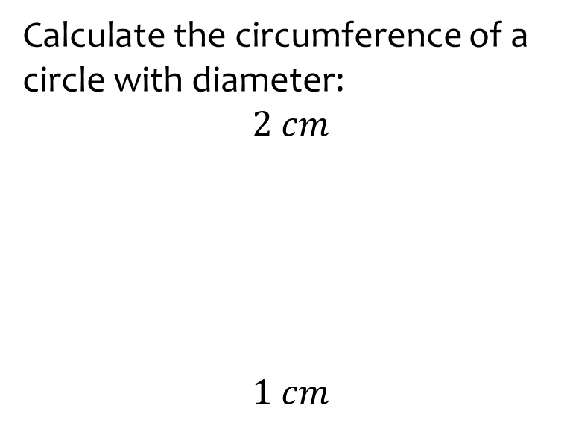
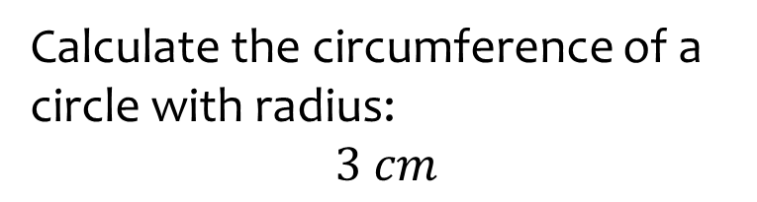

Worked example
Your turn
Calculate the circumference of a circle with diameter:
$$2 cm$$
$$1 cm$$
Calculate the circumference of a circle with radius:
$$3 cm$$
$6π=18.85 cm^{2}$ (2 dp)

Slide 17
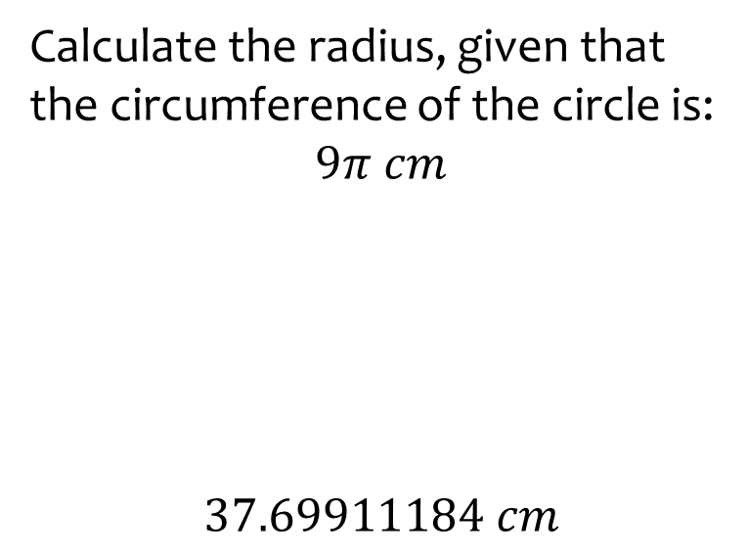
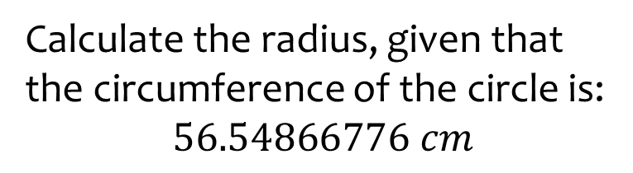
Worked example
Your turn
Calculate the radius, given that the circumference of the circle is:
$$9π cm$$
$$37.69911184 cm$$
Calculate the radius, given that the circumference of the circle is:
$$56.54866776 cm$$
$$9 cm$$

Slide 18
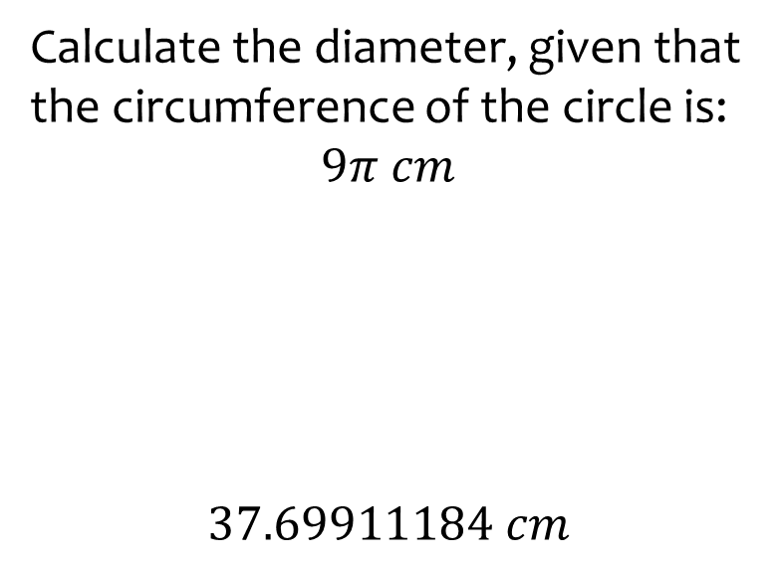
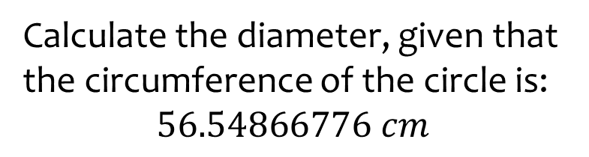
Worked example
Your turn
Calculate the diameter, given that the circumference of the circle is:
$$9π cm$$
$$37.69911184 cm$$
Calculate the diameter, given that the circumference of the circle is:
$$56.54866776 cm$$
$$18 cm$$

Slide 19

Worked example
Your turn
Calculate the arc length of the sector:
Calculate the arc length of the sector:
$$4.5 cm$$
$$4.5 cm$$
$$42°$$
$21π=65.97 cm$ (2 dp)

Slide 20
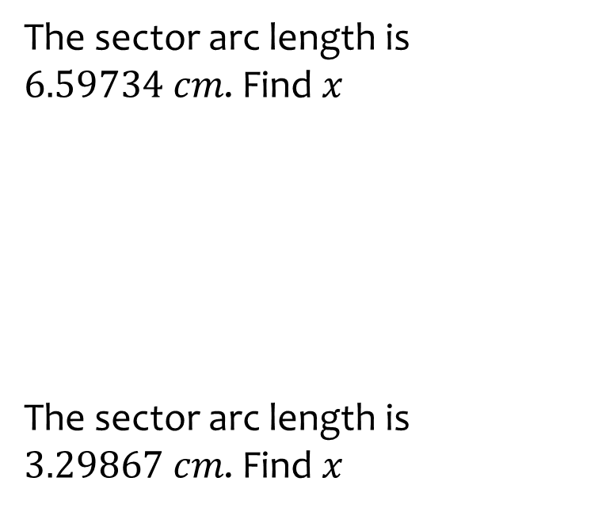
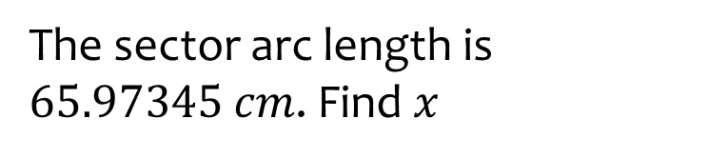
Worked example
Your turn
The sector arc length is $6.59734 cm$. Find $x$
The sector arc length is $3.29867 cm$. Find $x$
The sector arc length is $65.97345 cm$. Find $x$
$$x cm$$
$$x cm$$
$$x=45$$
$$x cm$$
$$42°$$

Slide 21
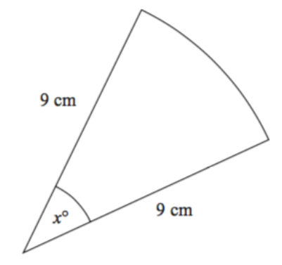
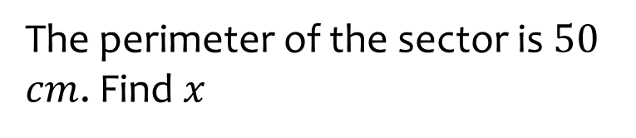
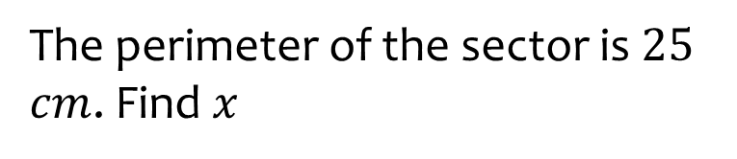


Worked example
Your turn
The perimeter of the sector is $50$ $cm$. Find $x$
The perimeter of the sector is $25$ $cm$. Find $x$
$$18 cm$$
$$18 cm$$
$x=44.56$(2 dp)

Slide 22
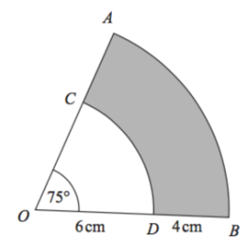
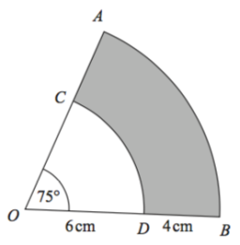




Worked example
Your turn
Calculate the perimeter of the shaded region
Calculate the perimeter of the shaded region
$$57°$$
$$3 cm$$
$$2 cm$$
$28.94 cm$(2 dp)

Slide 23

Worked example
Your turn
Calculate the perimeter of the shaded segment APB
Calculate the perimeter of the shaded segment APB
$$2.7 cm$$
$$2.7 cm$$
$$36°$$
$13.13 cm$ (2 dp)

Slide 24
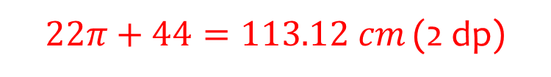
Worked example
Your turn
Calculate the perimeter of the sector:
Calculate the perimeter of the sector:
$22π+44=113.12 cm$ (2 dp)

Slide 25
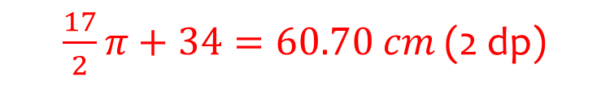
Worked example
Your turn
Calculate the perimeter of the sector:
Calculate the perimeter of the sector:
$\frac{17}{2}π+34=60.70 cm$ (2 dp)

Slide 26
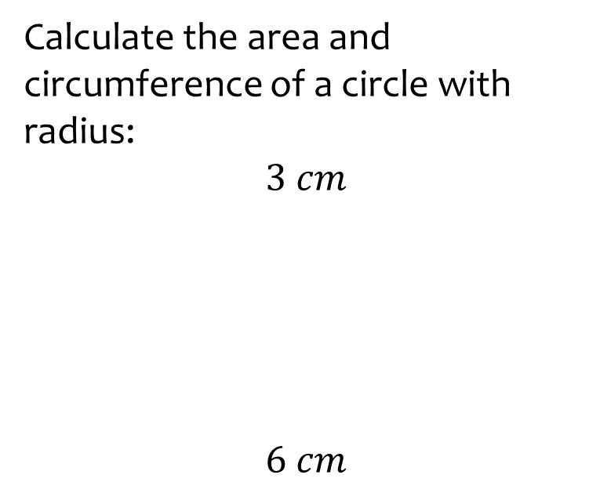
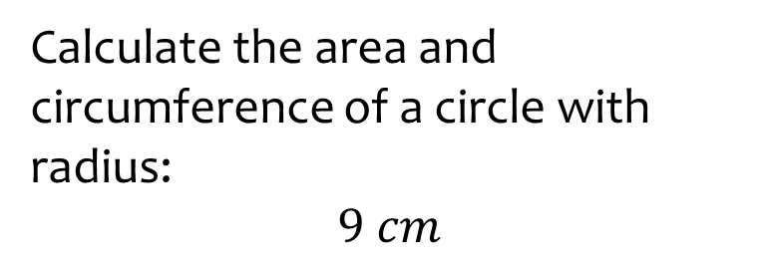
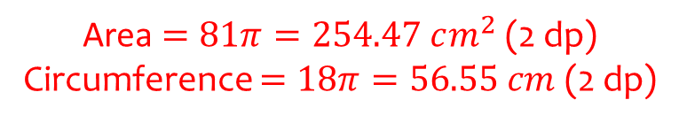
Worked example
Your turn
Calculate the area and circumference of a circle with radius:
$$3 cm$$
$$6 cm$$
Calculate the area and circumference of a circle with radius:
$$9 cm$$
Area $=81π=254.47 cm^{2}$ (2 dp)
Circumference $=18π=56.55 cm$ (2 dp)

Slide 27



Worked example
Your turn
What is the circumference of a circle, given that its area is:
$$9π cm^{2}$$
$$113.0973355 cm^{2}$$
What is the circumference of a circle, given that its area is:
$$81π=254.4690049 cm^{2}$$
$18π=54.55 cm$ (2 dp)

Slide 28



Worked example
Your turn
What is the area of a circle, given that its circumference is:
$$6π cm$$
$$37.69911184 cm$$
What is the area of a circle, given that its circumference is:
$$18π=54.54866776 cm$$
$$81π=254.4690049 cm^{2}$$

Slide 29




Worked example
Your turn
AB, BC and CD are three sides of a square.
Calculate the area of ABCDEA
AB, BC and CD are three sides of a square.
Calculate the area of ABCDEA
$$4 cm$$
$$8 cm$$
$8π+64=89.13 cm^{2}$ (2 dp)

Slide 30





Worked example
Your turn
The circle, of radius $1.05 cm$, is inside a square.
Work out the shaded area
The circle, of radius $2.1 cm$, is inside a square.
Work out the shaded area
$$1.05 cm$$
$$3.79 cm^{2}$$

Slide 31



Worked example
Your turn
ABCD is a square inside a circle.
Work out the total area of the four shaded segments
ABCD is a square inside a circle.
Work out the total area of the four shaded segments
$$4 cm$$
$$36.5−36.6 cm^{2}$$

