Slide 1
Bearings
CONTENTS

Slide 2
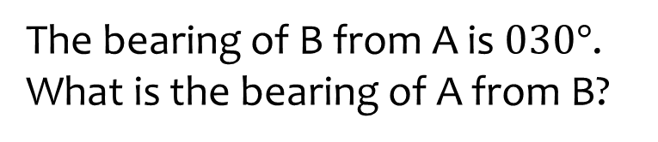
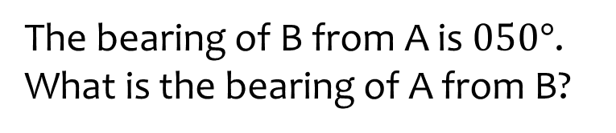

Worked example
Your turn
The bearing of B from A is $030°$.
What is the bearing of A from B?
The bearing of B from A is $050°$.
What is the bearing of A from B?
$$230°$$

Slide 3
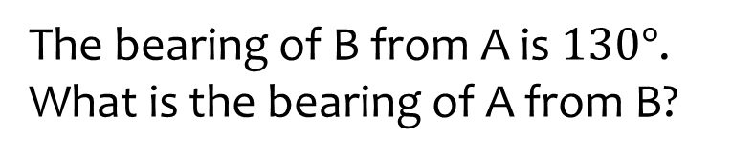
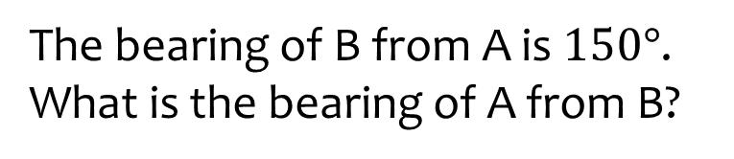

Worked example
Your turn
The bearing of B from A is $130°$.
What is the bearing of A from B?
The bearing of B from A is $150°$.
What is the bearing of A from B?
$$310°$$

Slide 4
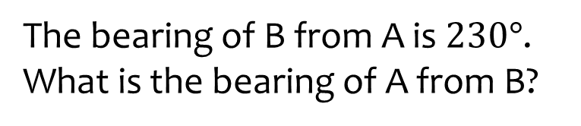
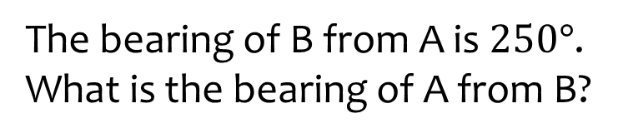

Worked example
Your turn
The bearing of B from A is $230°$.
What is the bearing of A from B?
The bearing of B from A is $250°$.
What is the bearing of A from B?
$$070°$$

Slide 5
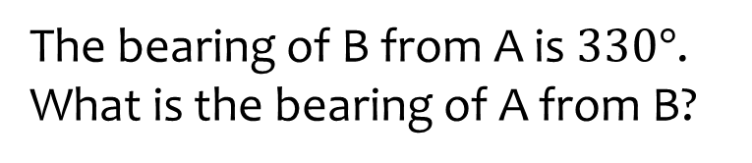
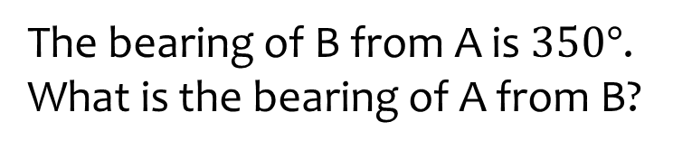

Worked example
Your turn
The bearing of B from A is $330°$.
What is the bearing of A from B?
The bearing of B from A is $350°$.
What is the bearing of A from B?
$$170°$$

Slide 6
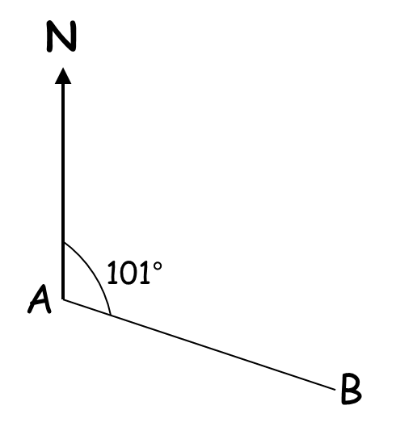
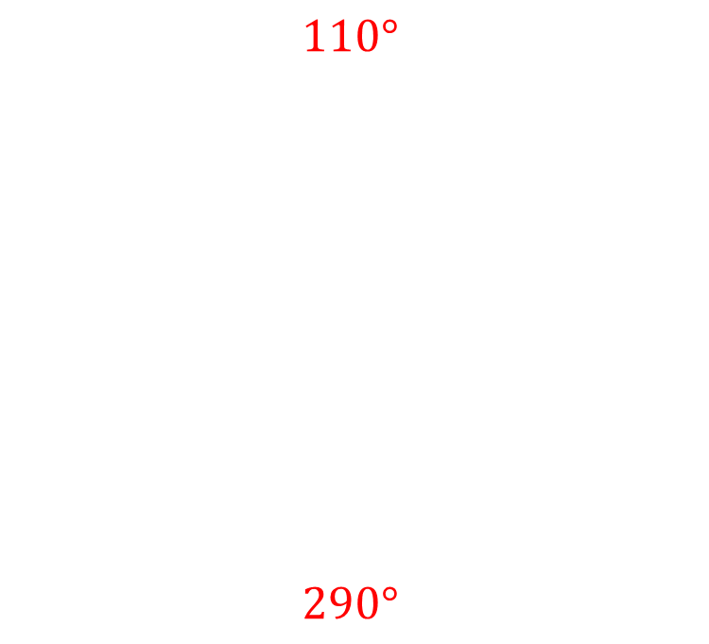

Worked example
Your turn
Find the bearing of B from A
Find the bearing of A from B
Find the bearing of B from A
Find the bearing of A from B
$$110°$$
$$290°$$
$$110°$$

Slide 7
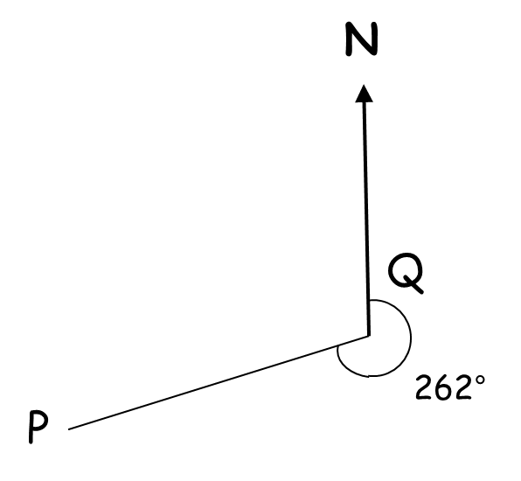


Worked example
Your turn
Find the bearing of P from Q
Find the bearing of Q from P
Find the bearing of P from Q
Find the bearing of Q from P
$$262°$$
$$082°$$
$$257°$$

Slide 8
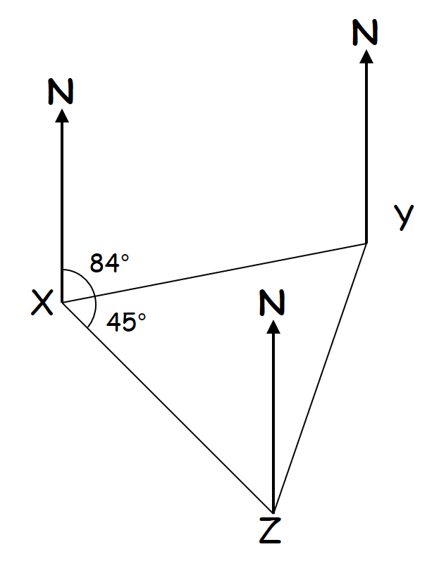
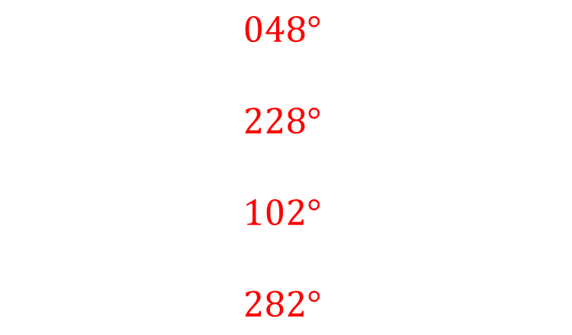


Worked example
Your turn
Find the bearing of:
Y from X
X from Y
Z From X
X from Z
Find the bearing of:
Y from X
X from Y
Z From X
X from Z
$$48°$$
$$54°$$
$$048°$$
$$228°$$
$$102°$$
$$282°$$

Slide 9
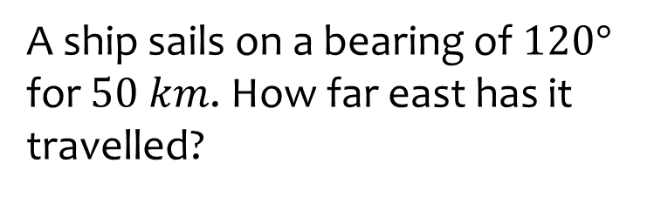
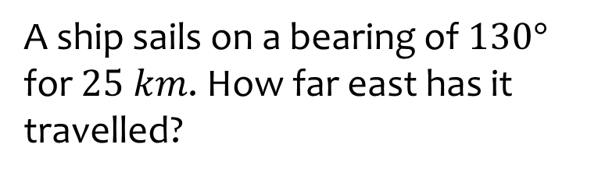

Worked example
Your turn
A ship sails on a bearing of $120°$ for $50 km$. How far east has it travelled?
A ship sails on a bearing of $130°$ for $25 km$. How far east has it travelled?
$19.15 km$(2 dp)

Slide 10
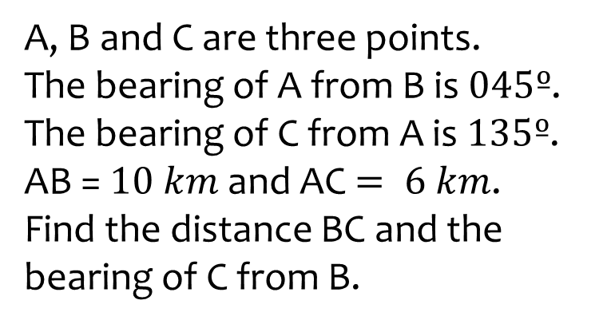
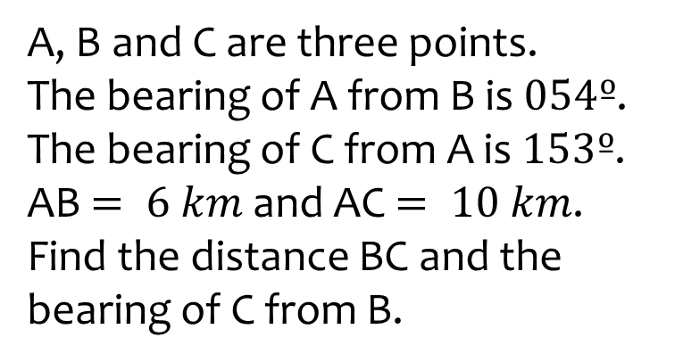
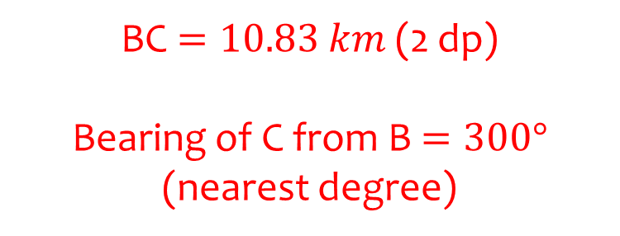
Worked example
Your turn
A, B and C are three points.
The bearing of A from B is $045º$.
The bearing of C from A is $135º$.
AB = $10 km$ and AC $= 6 km$.
Find the distance BC and the bearing of C from B.
A, B and C are three points.
The bearing of A from B is $054º$.
The bearing of C from A is $153º$.
AB $= 6 km$and AC $= 10 km$.
Find the distance BC and the bearing of C from B.
BC $=10.83 km$ (2 dp)
Bearing of C from B $=300°$ (nearest degree)

Slide 11
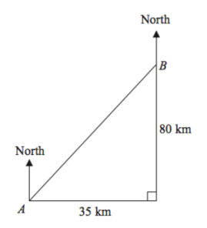
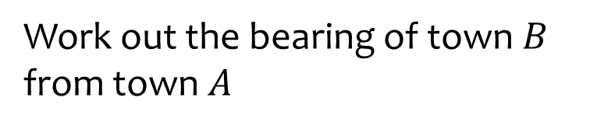
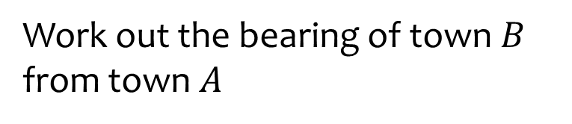



Worked example
Your turn
Work out the bearing of town $B$ from town $A$
Work out the bearing of town $B$ from town $A$
$$40 km$$
$$17.5 km$$
$23.63°$(2 dp)

Slide 12



Worked example
Your turn
Work out the bearing of town $A$ from town $B$
Work out the bearing of town $A$ from town $B$
$$40 km$$
$$17.5 km$$
$203.63°$ (2 dp)

Slide 13
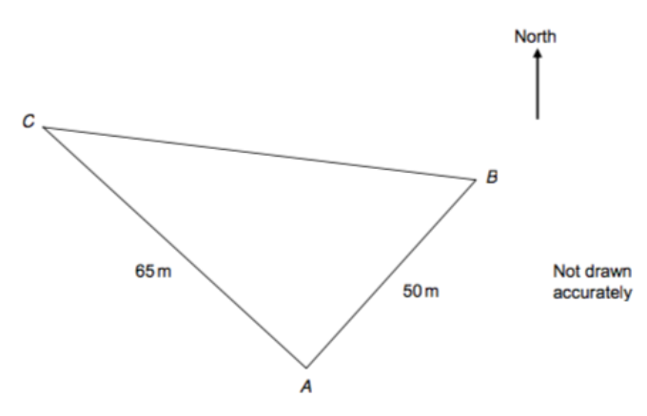
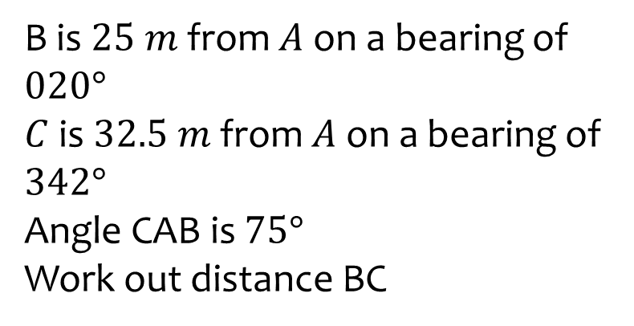
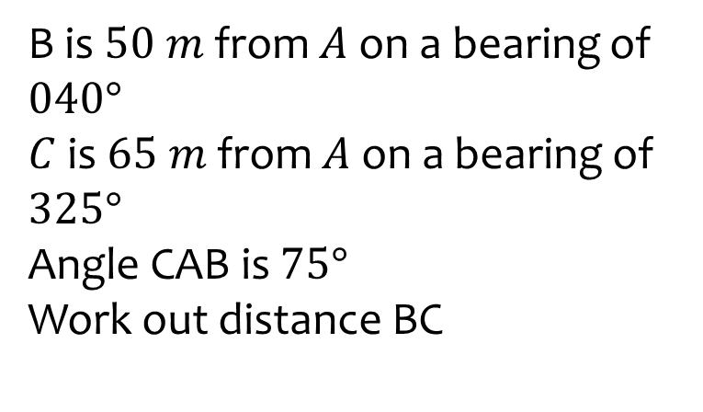



Worked example
Your turn
B is $25 m$ from $A$ on a bearing of $020°$
$C$ is $32.5 m$ from $A$ on a bearing of $342°$
Angle CAB is $75°$
Work out distance BC
B is $50 m$ from $A$ on a bearing of $040°$
$C$ is $65 m$ from $A$ on a bearing of $325°$
Angle CAB is $75°$
Work out distance BC
$$32.5 m$$
$$25 m$$
$$71 m$$

Slide 14
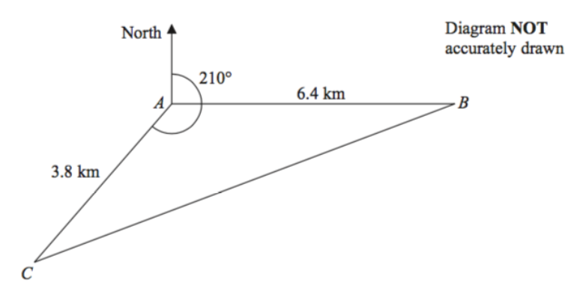




Worked example
Your turn
Calculate the bearing of B from C
Calculate the bearing of B from C
$$201°$$
$$3.2 km$$
$$1.9 km$$
$068°$ (nearest degree)

Slide 15
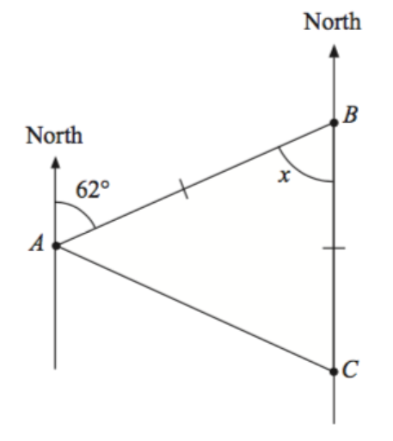


Worked example
Your turn
Calculate the bearing of C from A
Calculate the bearing of C from A
$$26°$$
$$121°$$

