Slide 1
Area
CONTENTS

Slide 2





Worked example
Your turn
Calculate the area of the rectangle:
Calculate the area of the rectangle:
$$2 cm$$
$$4 cm$$
$$4 cm$$
$$8 cm$$
$$64 cm^{2}$$

Slide 3
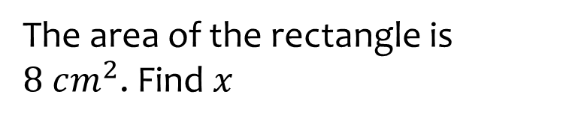
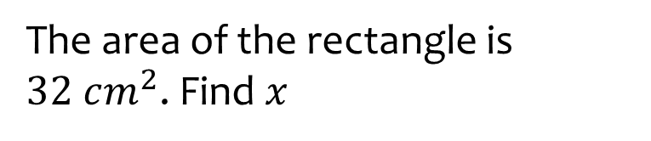



Worked example
Your turn
The area of the rectangle is $8 cm^{2}$. Find $x$
The area of the rectangle is $32 cm^{2}$. Find $x$
$$2 cm$$
$$4 cm$$
$$x cm$$
$$x cm$$
$$x=8$$

Slide 4





Worked example
Your turn
Calculate the area of the triangle
Calculate the area of the triangle
$$2 cm$$
$$4 cm$$
$$4 cm$$
$$8 cm$$
$$16 cm^{2}$$

Slide 5
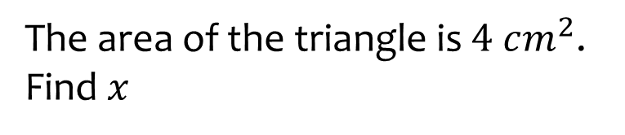
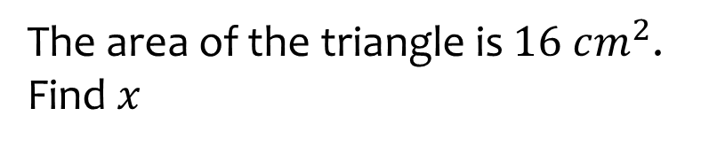


Worked example
Your turn
The area of the triangle is $4 cm^{2}$. Find $x$
The area of the triangle is $16 cm^{2}$. Find $x$
$$2 cm$$
$$4 cm$$
$$x cm$$
$$x cm$$
$$x=8$$

Slide 6







Worked example
Your turn
Calculate the area of the triangle
Calculate the area of the triangle
$$4 cm$$
$$2 cm$$
$$4.47 cm$$
$$8.94 cm$$
$$8 cm$$
$$4 cm$$
$$16 cm^{2}$$

Slide 7









Worked example
Your turn
Calculate the area of the triangle
Calculate the area of the triangle
$$6 cm$$
$$12 cm$$
$$2 cm$$
$$4 cm$$
$$2.5 cm$$
$$5 cm$$
$$4 cm$$
$$8 cm$$
$$16 cm^{2}$$

Slide 8









Worked example
Your turn
Calculate the area of the triangle
Calculate the area of the triangle
$$12 cm$$
$$6 cm$$
$$2 cm$$
$$4 cm$$
$$2.5 cm$$
$$5 cm$$
$$4 cm$$
$$8 cm$$
$$16 cm^{2}$$

Slide 9







Worked example
Your turn
Calculate the area of the parallelogram
Calculate the area of the parallelogram
$$2.5 cm$$
$$5 cm$$
$$4 cm$$
$$2 cm$$
$$4 cm$$
$$8 cm$$
$$32 cm^{2}$$

Slide 10
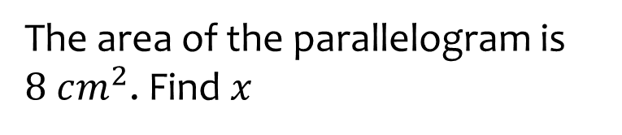
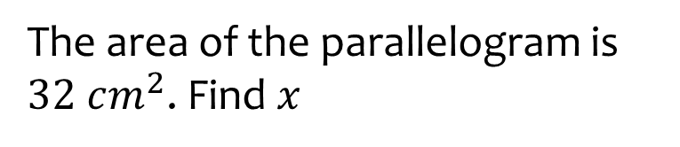



Worked example
Your turn
The area of the parallelogram is $8 cm^{2}$. Find $x$
The area of the parallelogram is $32 cm^{2}$. Find $x$
$$2.5 cm$$
$$5 cm$$
$$4 cm$$
$$2 cm$$
$$x cm$$
$$x cm$$
$$x=8$$

Slide 11


Worked example
Your turn
Calculate the area of the parallelogram
Calculate the area of the parallelogram
$$2.5 cm$$
$$5 cm$$
$$4 cm$$
$$2 cm$$
$$4 cm$$
$$8 cm$$
$$32 cm^{2}$$

Slide 12




Worked example
Your turn
Calculate the area of the parallelogram
Calculate the area of the parallelogram
$$2 cm$$
$$4 cm$$
$$4 cm$$
$$8 cm$$
$$32 cm^{2}$$

Slide 13






Worked example
Your turn
Calculate the area of the rhombus
Calculate the area of the rhombus
$$1 cm$$
$$2 cm$$
$$2 cm$$
$$4 cm$$
$$1 cm$$
$$2 cm$$
$$2 cm$$
$$4 cm$$
$$32 cm^{2}$$

Slide 14

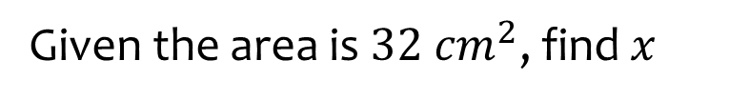





Worked example
Your turn
Given the area is $8 cm^{2}$, find $x$
Given the area is $32 cm^{2}$, find $x$
$$1 cm$$
$$2 cm$$
$$x cm$$
$$x cm$$
$$1 cm$$
$$2 cm$$
$$x cm$$
$$x cm$$
$$x=4$$

Slide 15







Worked example
Your turn
Calculate the area of the trapezium
Calculate the area of the trapezium
$$4 cm$$
$$8 cm$$
$$2 cm$$
$$4 cm$$
$$6 cm$$
$$12 cm$$
$$40 cm^{2}$$

Slide 16









Worked example
Your turn
Calculate the area of the trapezium
Calculate the area of the trapezium
$$4 cm$$
$$8 cm$$
$$2.24 cm$$
$$2 cm$$
$$2.24 cm$$
$$4.47 cm$$
$$4 cm$$
$$4.47 cm$$
$$6 cm$$
$$12 cm$$
$$40 cm^{2}$$

Slide 17








Worked example
Your turn
Calculate the area of the trapezium
Calculate the area of the trapezium
$$4 cm$$
$$8 cm$$
$$3 cm$$
$$6 cm$$
$$2 cm$$
$$4 cm$$
$$6 cm$$
$$12 cm$$
$$40 cm^{2}$$

Slide 18
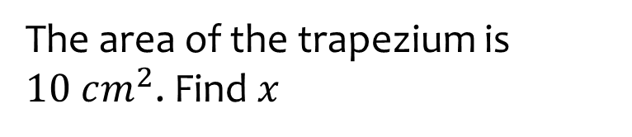
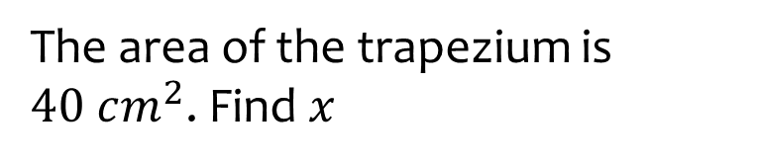



Worked example
Your turn
The area of the trapezium is $10 cm^{2}$. Find $x$
The area of the trapezium is $40 cm^{2}$. Find $x$
$$4 cm$$
$$8 cm$$
$$3 cm$$
$$6 cm$$
$$x cm$$
$$x cm$$
$$6 cm$$
$$12 cm$$
$$x=4$$

Slide 19



Worked example
Your turn
The area of the trapezium is $10 cm^{2}$. Find $x$
The area of the trapezium is $40 cm^{2}$. Find $x$
$$x cm$$
$$x cm$$
$$3 cm$$
$$6 cm$$
$$2 cm$$
$$4 cm$$
$$6 cm$$
$$12 cm$$
$$x=8$$

Slide 20









Worked example
Your turn
Calculate the area of this hexagon
Calculate the area of this hexagon
$$2 cm$$
$$4 cm$$
$$2 cm$$
$$4 cm$$
$$4 cm$$
$$8 cm$$
$$6 cm$$
$$12 cm$$
$$64 cm^{2}$$

Slide 21








Worked example
Your turn
Calculate the area of this hexagon
Calculate the area of this hexagon
$$2 cm$$
$$4 cm$$
$$3 cm$$
$$6 cm$$
$$5 cm$$
$$10 cm$$
$$10 cm$$
$$20 cm$$
$$104 cm^{2}$$

Slide 22
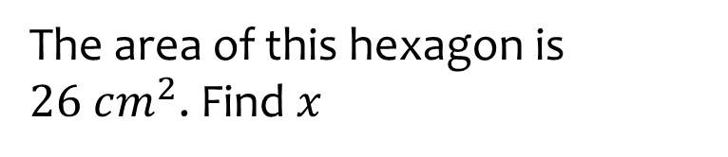
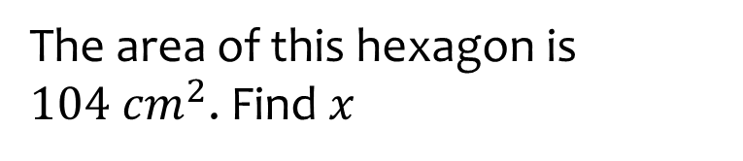



Worked example
Your turn
The area of this hexagon is $26 cm^{2}$. Find $x$
The area of this hexagon is $104 cm^{2}$. Find $x$
$$2 cm$$
$$4 cm$$
$$3 cm$$
$$6 cm$$
$$x cm$$
$$x cm$$
$$10 cm$$
$$20 cm$$
$$x=10$$

Slide 23
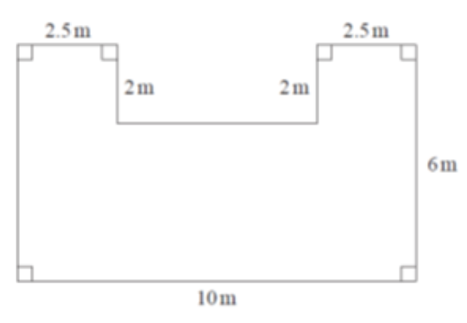






Worked example
Your turn
Calculate the area:
Calculate the area:
$$1.25 m$$
$$1.25 m$$
$$1 m$$
$$1 m$$
$$3 m$$
$$5 m$$
$$50 m^{2}$$

Slide 24
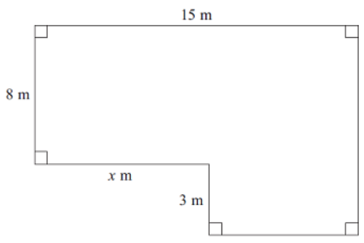
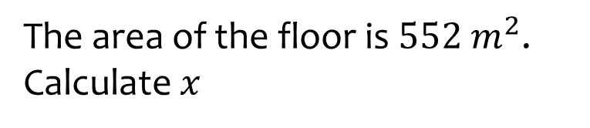
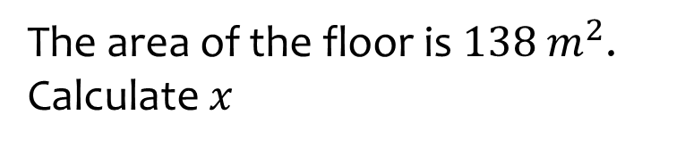




Worked example
Your turn
The area of the floor is $552 m^{2}$.
Calculate $x$
The area of the floor is $138 m^{2}$.
Calculate $x$
$$30 m$$
$$16 m$$
$$6 m$$
$$x=9$$

Slide 25
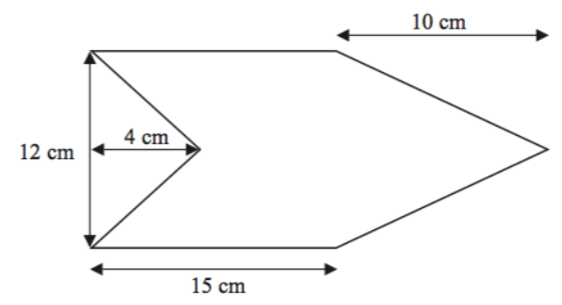





Worked example
Your turn
Calculate the area of this hexagon. The shape has one line of symmetry.
Calculate the area of this hexagon. The shape has one line of symmetry.
$$5 cm$$
$$2 cm$$
$$6 cm$$
$$7.5 cm$$
$$216 cm^{2}$$

Slide 26
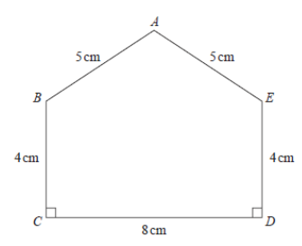






Worked example
Your turn
Calculate the area of this pentagon.
Calculate the area of this pentagon.
$$10 cm$$
$$10 cm$$
$$8 cm$$
$$8 cm$$
$$6 m$$
$$16 cm$$
$$44 cm^{2}$$

