Slide 1
Angles in polygons
CONTENTS

Slide 2
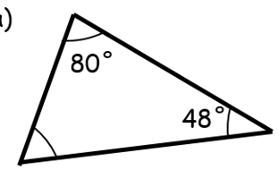
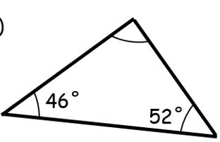
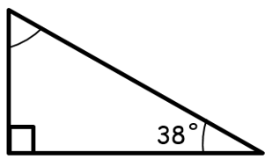

Worked example
Your turn
Find the missing angles:
Find the missing angles:
$$82°$$

Slide 3
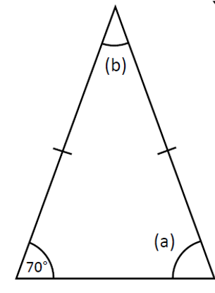
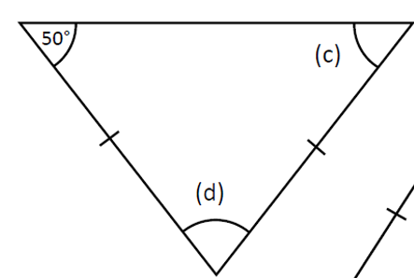

Worked example
Your turn
Find the missing angles:
Find the missing angles:
$$c=50°$$
$$d=80°$$

Slide 4
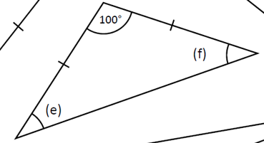
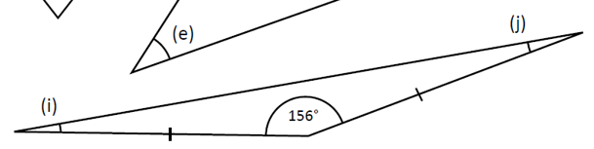

Worked example
Your turn
Find the missing angles:
Find the missing angles:
$$i=12°$$
$$j=12°$$

Slide 5
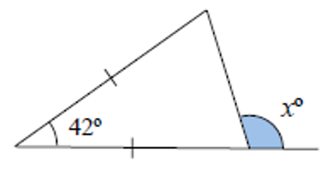
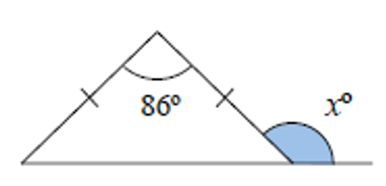



Worked example
Your turn
Find $x$:
Find $x$:
$$x=133$$
Questions used with permission from maths4everyone: https://maths4everyone.com/

Slide 6
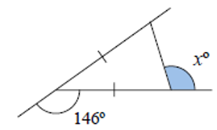
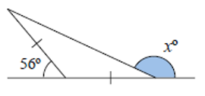

Worked example
Your turn
Find $x$:
Find $x$:
$$x=107$$
Questions used with permission from maths4everyone: https://maths4everyone.com/

Slide 7
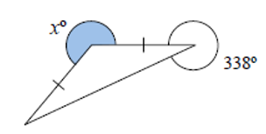
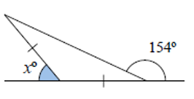

Worked example
Your turn
Find $x$:
Find $x$:
$$x=52$$
Questions used with permission from maths4everyone: https://maths4everyone.com/

Slide 8
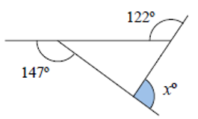
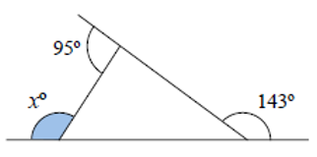

Worked example
Your turn
Find $x$:
Find $x$:
$$x=122$$
Questions used with permission from maths4everyone: https://maths4everyone.com/

Slide 9
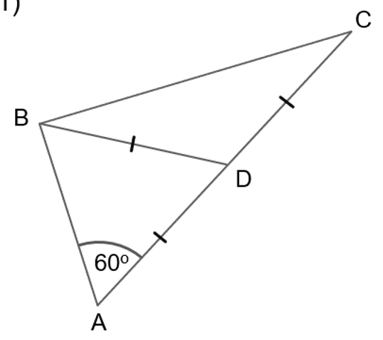
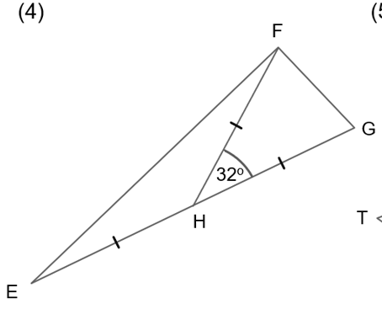
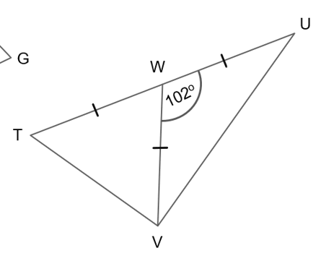





Worked example
Your turn
Find the missing angles:
Find the missing angles:
$$16°$$
$$74°$$
$$74°$$
$$148°$$
$$16°$$

Slide 10








Worked example
Your turn
Find $x$:
Find $x$:
$$27°$$
$$35°$$
$$x°$$
$$x°$$
$$35°$$
$$72°$$
$$27°$$
$$53°$$
$$x=25$$

Slide 11
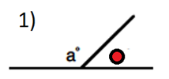
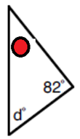
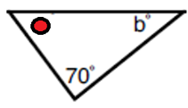
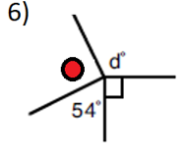

Worked example
Your turn
Write an expression for the angle:
Write an expression for the angle:
$$98−d$$

Slide 12
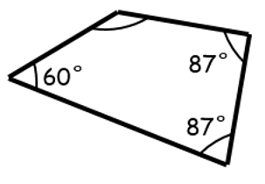
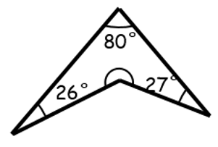
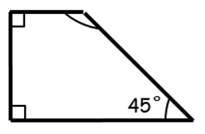

Worked example
Your turn
Find the missing angles:
Find the missing angles:
$$227°$$

Slide 13
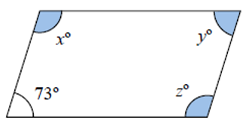
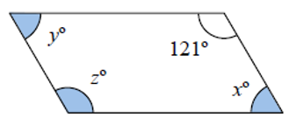

Worked example
Your turn
Find the missing angles:
Find the missing angles:
$$x=59$$
$$y=59$$
$$z=121$$
Questions used with permission from maths4everyone: https://maths4everyone.com/

Slide 14
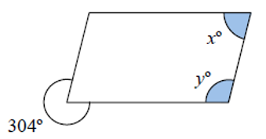
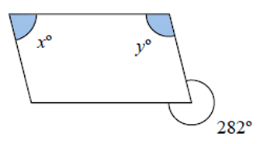

Worked example
Your turn
Find the missing angles:
Find the missing angles:
$$x=78$$
$$y=102$$
Questions used with permission from maths4everyone: https://maths4everyone.com/

Slide 15
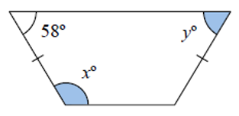
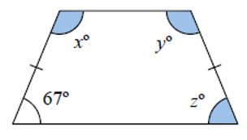

Worked example
Your turn
Find the missing angles:
Find the missing angles:
$$x=113$$
$$y=113$$
$$z=67$$
Questions used with permission from maths4everyone: https://maths4everyone.com/

Slide 16
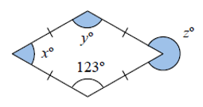
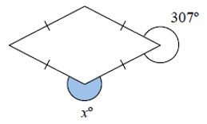

Worked example
Your turn
Find the missing angles:
Find the missing angles:
$$x=233$$
Questions used with permission from maths4everyone: https://maths4everyone.com/

Slide 17
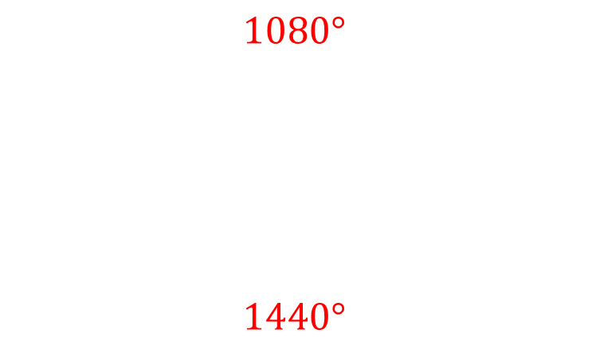
Worked example
Your turn
Calculate the sum of the interior angles of the polygons:
Quadrilateral
Pentagon
Hexagon
Heptagon
Calculate the sum of the interior angles of the polygons:
Octagon
Decagon
$$1080°$$
$$1440°$$

Slide 18
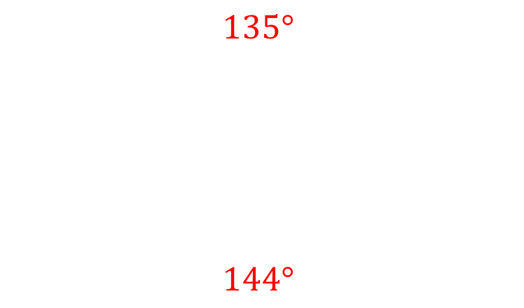
Worked example
Your turn
Calculate the size of one interior angle of the regular polygons:
Quadrilateral
Pentagon
Hexagon
Heptagon
Calculate the size of one interior angle of the regular polygons:
Octagon
Decagon
$$135°$$
$$144°$$

Slide 19
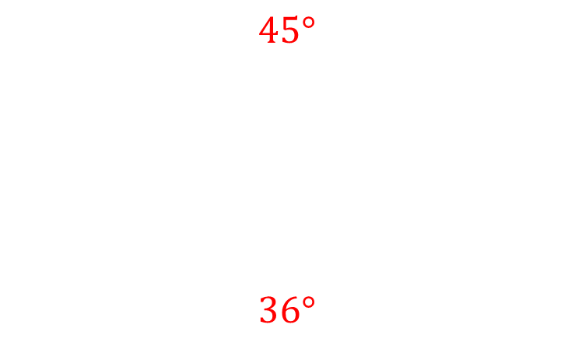
Worked example
Your turn
Calculate the size of one interior angle of the regular polygons :
Quadrilateral
Pentagon
Hexagon
Heptagon
Calculate the size of one interior angle of the regular polygons:
Octagon
Decagon
$$45°$$
$$36°$$

Slide 20
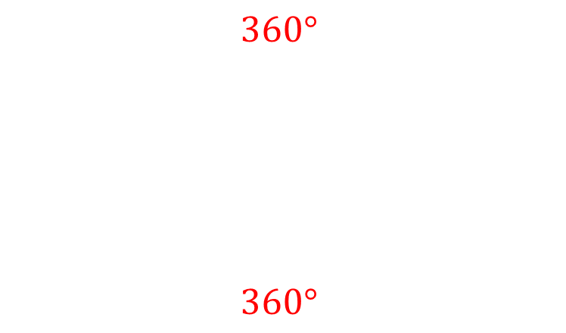
Worked example
Your turn
Calculate the sum of the exterior angles of the polygons:
Quadrilateral
Pentagon
Hexagon
Heptagon
Calculate the sum of the exterior angles of the polygons:
Octagon
Decagon
$$360°$$
$$360°$$

Slide 21
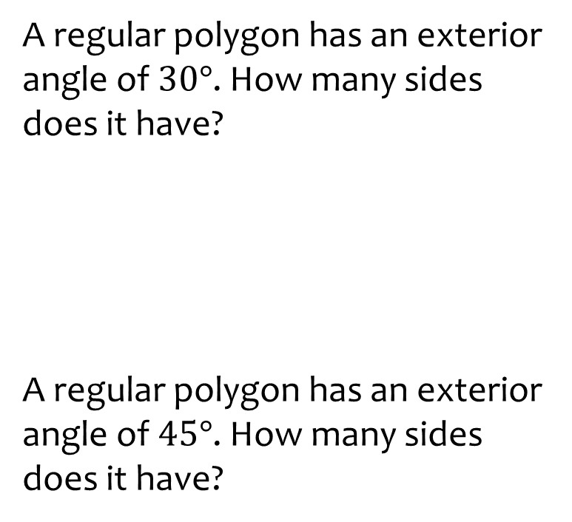
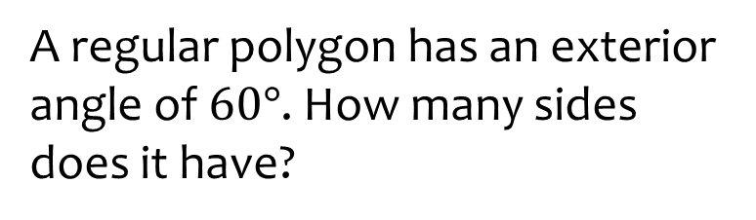
Worked example
Your turn
A regular polygon has an exterior angle of $30°$. How many sides does it have?
A regular polygon has an exterior angle of $45°$. How many sides does it have?
A regular polygon has an exterior angle of $60°$. How many sides does it have?
Six: Hexagon

Slide 22
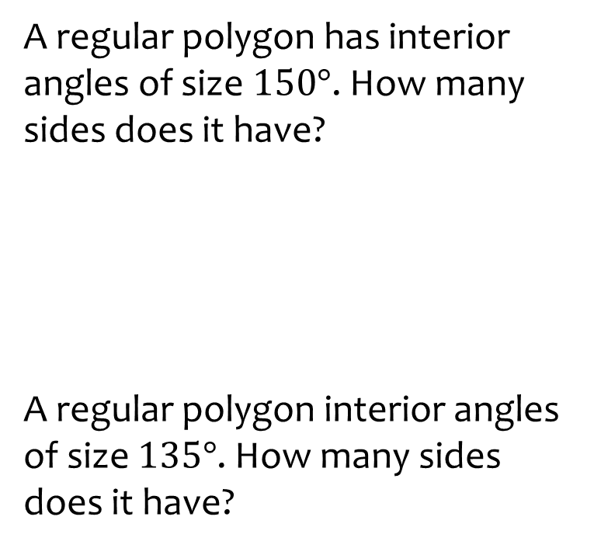
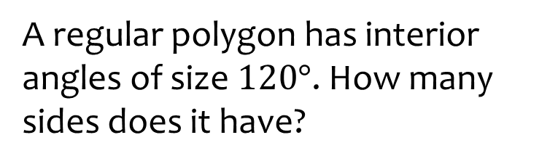
Worked example
Your turn
A regular polygon has interior angles of size $150°$. How many sides does it have?
A regular polygon interior angles of size $135°$. How many sides does it have?
A regular polygon has interior angles of size $120°$. How many sides does it have?
Six: Hexagon

Slide 23
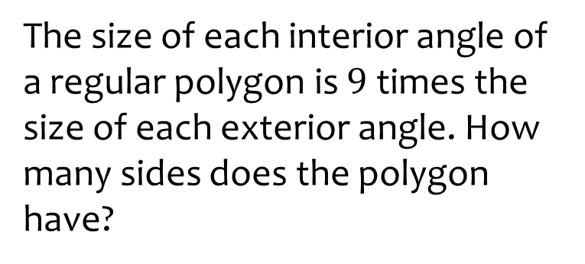
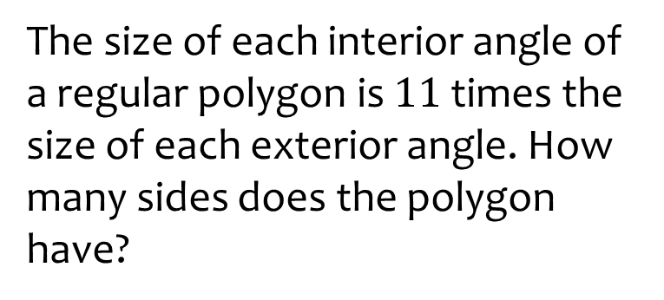
Worked example
Your turn
The size of each interior angle of a regular polygon is $9$ times the size of each exterior angle. How many sides does the polygon have?
The size of each interior angle of a regular polygon is $11$ times the size of each exterior angle. How many sides does the polygon have?
12: Dodecagon

Slide 24
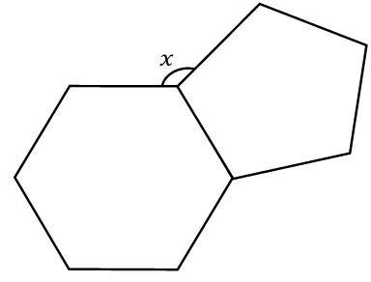
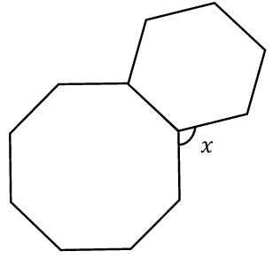



Worked example
Your turn
These are regular polygons.
Find $x$
These are regular polygons.
Find $x$
$$x=105°$$

Slide 25
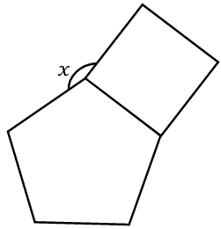
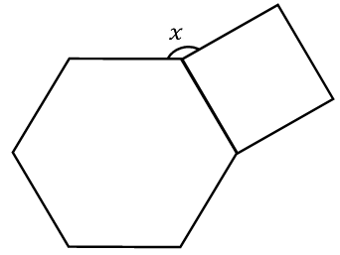

Worked example
Your turn
These are regular polygons.
Find $x$
These are regular polygons.
Find $x$
$$x=150°$$

Slide 26
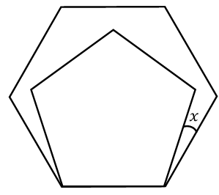
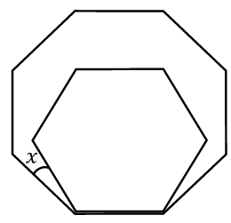

Worked example
Your turn
These are regular polygons.
Find $x$
These are regular polygons.
Find $x$
$$x=15°$$

Slide 27
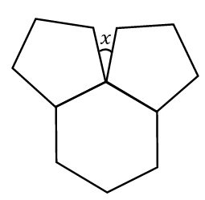


Worked example
Your turn
These are regular polygons.
Find $x$
These are regular polygons.
Find $x$
$$x=54°$$

Slide 28






Worked example
Your turn
Find $x$
Find $x$
$$x=119°$$

Slide 29



Worked example
Your turn
In a quadrilateral, the four angles increase in size by $2$ degrees each time from smallest to largest.
What are the angles?
In a quadrilateral, the four angles increase in size by $4$ degrees each time from smallest to largest.
What are the angles?
$$84°, 88°, 92°, 96°$$

Slide 30

Worked example
Your turn
In a quadrilateral, the four angles are listed from largest to smallest. Each angle is three times the previous angle.
What are the angles?
In a quadrilateral, the four angles are listed from largest to smallest. Each angle is twice the previous angle.
What are the angles?
$$192°, 96°,48°,24°$$

Slide 31
Worked example
Your turn
In a quadrilateral, the four angles are listed from largest to smallest. Each angle is one third of the previous angle.
What are the angles?
In a quadrilateral, the four angles are listed from largest to smallest. Each angle is half the previous angle.
What are the angles?
$$192°, 96°,48°,24°$$

Slide 32







Worked example
Your turn
Calculate $x$ and $y$
Calculate $x$ and $y$
$$47°$$
$$76°$$
$$121°$$
$$x=68$$
$$y=39$$

