Slide 1
Angles in parallel lines
CONTENTS

Slide 2











Worked example
Your turn
Find $x$:
Find $x$:
$$x°$$
$$53°$$
$$x°$$
$$135°$$
$$x°$$
$$153°$$
$$x=135$$
$$x°$$
$$35°$$

Slide 3





Worked example
Your turn
Find $x$:
Find $x$:
$$x°$$
$$53°$$
$$x°$$
$$135°$$
$$x°$$
$$153°$$
$$x=135$$
$$x°$$
$$35°$$

Slide 4




Worked example
Your turn
Find $x$:
Find $x$:
$$x°$$
$$53°$$
$$x°$$
$$135°$$
$$x°$$
$$153°$$
$$x=45$$
$$x°$$
$$35°$$

Slide 5








Worked example
Your turn
Find $x$:
Find $x$:
$$x°$$
$$x°$$
$$x°$$
$$153°$$
$$135°$$
$$35°$$
$$x°$$
$$x=135$$
$$x=145$$
$$153°$$
$$x°$$
$$135°$$
$$x°$$
$$153°$$
$$x=135$$

Slide 6
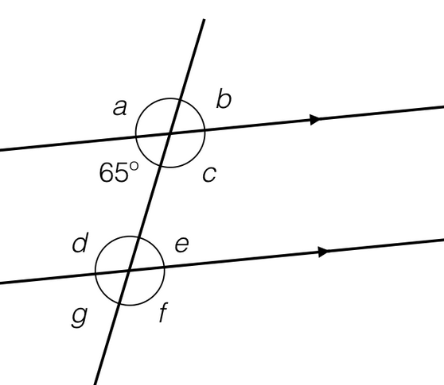









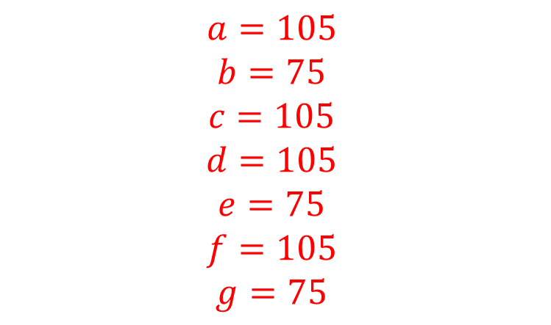
Worked example
Your turn
Find the missing angles:
Find the missing angles:
$$a°$$
$$b°$$
$$a°$$
$$b°$$
$$85°$$
$$c°$$
$$75°$$
$$c°$$
$$d°$$
$$e°$$
$$d°$$
$$e°$$
$$g°$$
$$f°$$
$$g°$$
$$f°$$
$$a=105$$
$$b=75$$
$$c=105$$
$$d=105$$
$$e=75$$
$$f=105$$
$$g=75$$

Slide 7




Worked example
Your turn
Find $x$:
Find $x$:
$$x°$$
$$x°$$
$$35°$$
$$72°$$
$$53°$$
$$27°$$
$$x=81$$

Slide 8


Worked example
Your turn
Find $x$:
Find $x$:
$$x°$$
$$x°$$
$$35°$$
$$72°$$
$$153°$$
$$127°$$
$$x=55$$

Slide 9



Worked example
Your turn
Find $x$:
Find $x$:
$$53°$$
$$72°$$
$$35°$$
$$27°$$
$$x°$$
$$x°$$
$$x=81$$

Slide 10


Worked example
Your turn
Find $x$:
Find $x$:
$$53°$$
$$72°$$
$$35°$$
$$27°$$
$$x°$$
$$x°$$
$$x=99$$

Slide 11
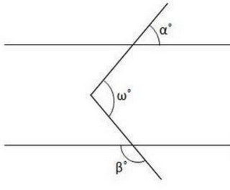







Worked example
Your turn
Find $x$:
Find $x$:
$$50°$$
$$60°$$
$$x°$$
$$x°$$
$$120°$$
$$100°$$
$$x=140°$$

Slide 12
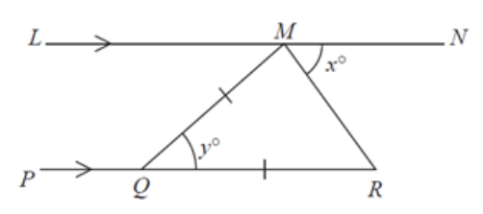
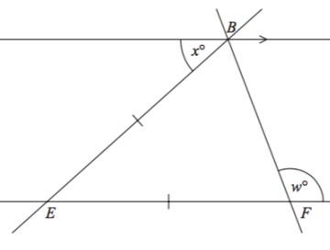
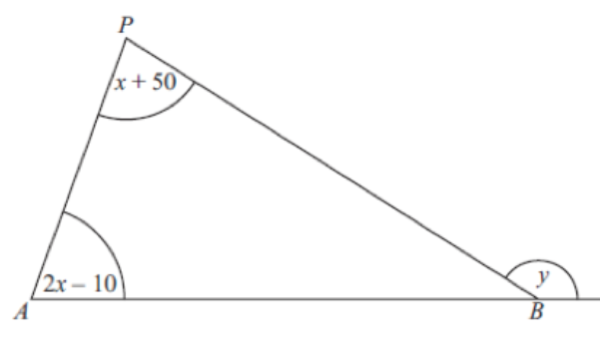
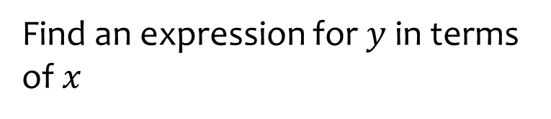
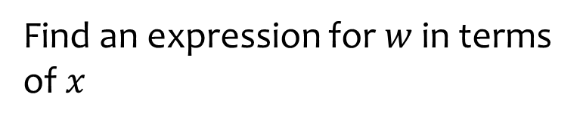

Worked example
Your turn
Find an expression for $y$ in terms of $x$
Find an expression for $w$ in terms of $x$
$$w=90+\frac{1}{2}x$$

