Slide 1
Angle facts (basic)
CONTENTS

Slide 2
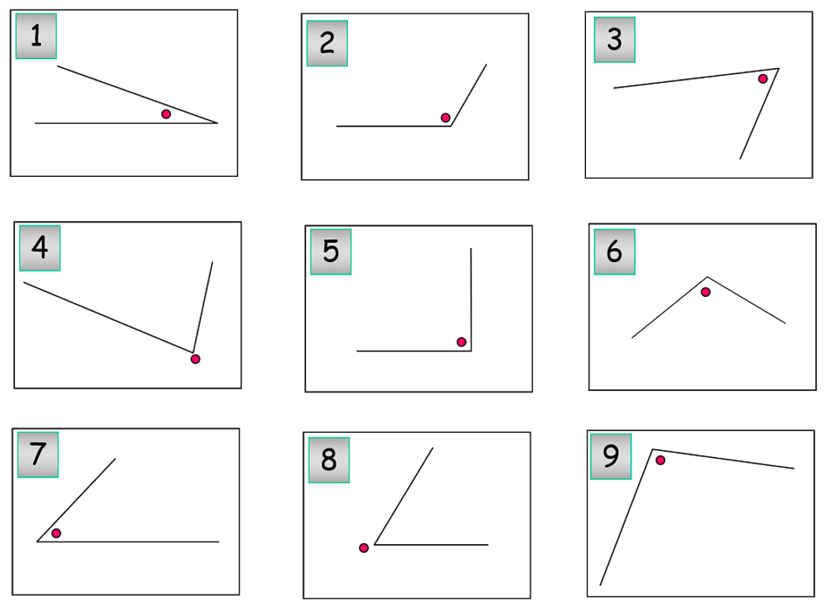
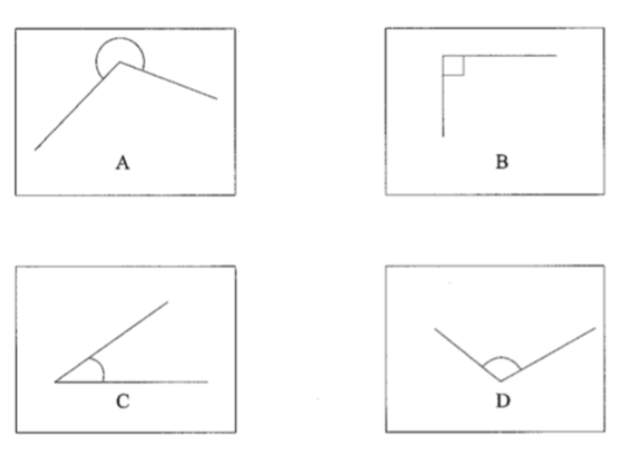
Worked example
Your turn
What type of angles are these?
What type of angles are these?
Reflex
Right
Acute
Obtuse

Slide 3














Worked example
Your turn
Name the angles using three letter notation
Name the angles using three letter notation
$$A$$
$$B$$
$$G$$
$$C$$
$$O$$
$$H$$
$$<GOH$$
$$F$$
$$D$$
$$O$$
$$E$$
$$J$$
$$<IOJ$$
$$I$$

Slide 4
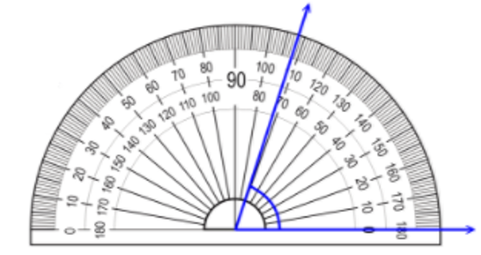
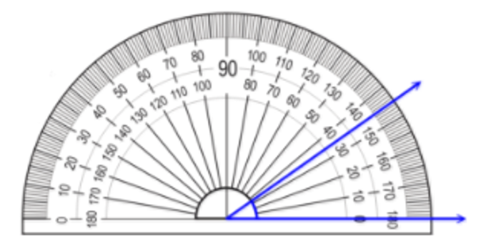

Worked example
Your turn
Measure the angle
Measure the angle
$$82°$$

Slide 5
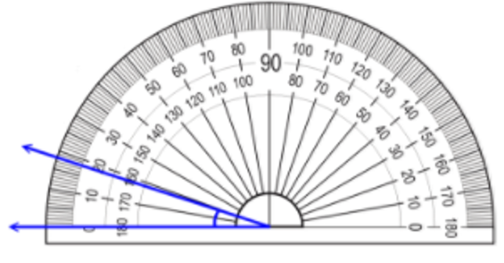
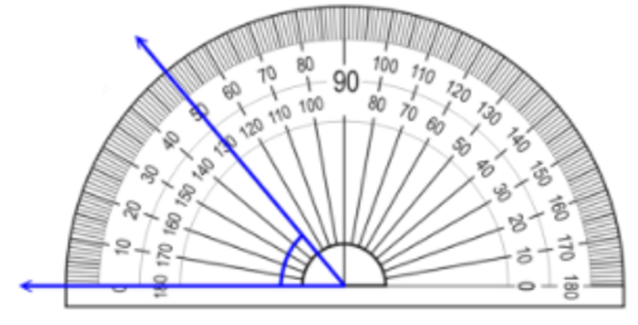

Worked example
Your turn
Measure the angle
Measure the angle
$$50°$$

Slide 6
Worked example
Your turn
Draw and measure:
An acute angle
An obtuse angle
A reflex angle
Draw and measure:
An acute angle
An obtuse angle
A reflex angle
Check carefully with a protractor!

Slide 7
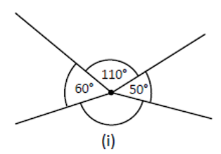
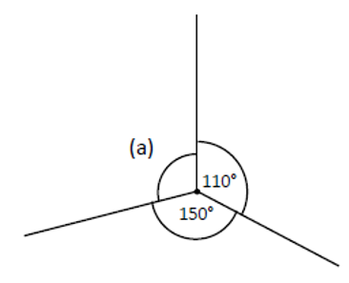
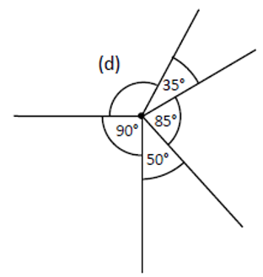
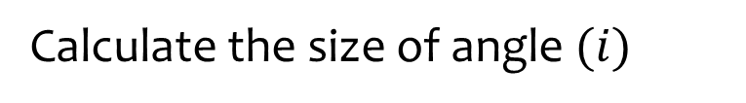

Worked example
Your turn
Calculate the size of the missing angles:
Calculate the size of angle $(i)$
$$i=140°$$

Slide 8
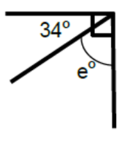
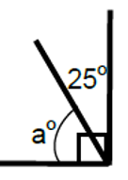
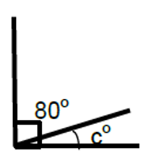
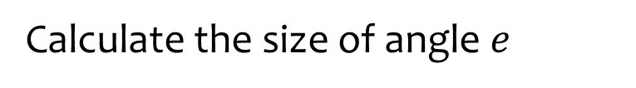

Worked example
Your turn
Calculate the size of the missing angles:
Calculate the size of angle $e$
$$e=56$$

Slide 9
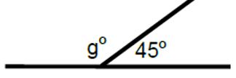

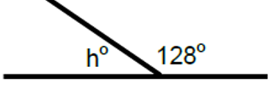
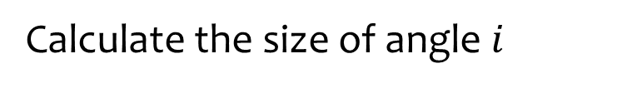

Worked example
Your turn
Calculate the size of the missing angles:
Calculate the size of angle $i$
$$i=76$$

Slide 10
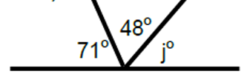

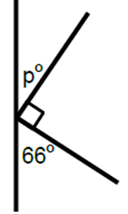
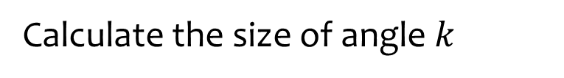

Worked example
Your turn
Calculate the size of the missing angles:
Calculate the size of angle $k$
$$k=79$$

Slide 11
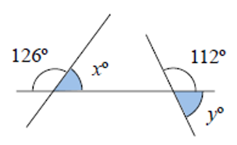
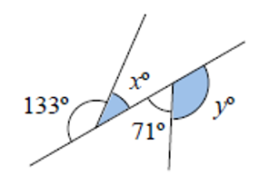
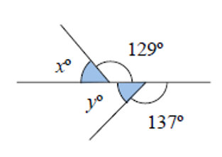

Worked example
Your turn
Calculate the size of the missing angles:
Calculate the size of the missing angles:
$$x=47°$$
$$y=109°$$
Questions used with permission from maths4everyone: https://maths4everyone.com/

Slide 12
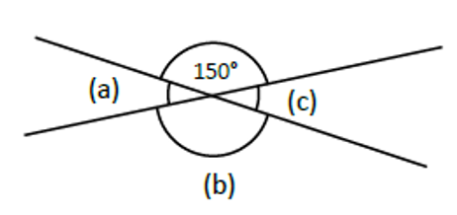
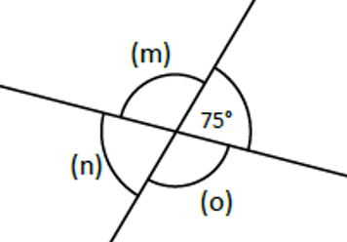
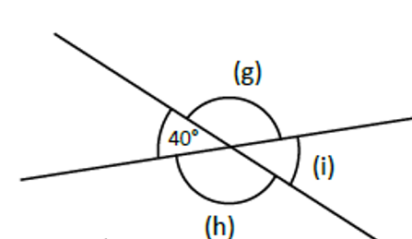

Worked example
Your turn
Calculate the size of the missing angles:
Calculate the size of the missing angles:
$$m=105°$$
$$n=75°$$
$$o=105°$$

Slide 13
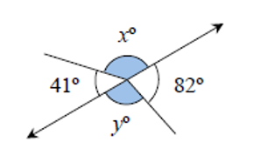
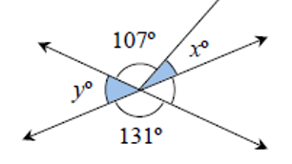
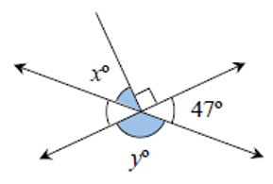

Worked example
Your turn
Calculate the size of the missing angles:
Calculate the size of the missing angles:
$$x=34°$$
$$y=49°$$
Questions used with permission from maths4everyone: https://maths4everyone.com/

Slide 14
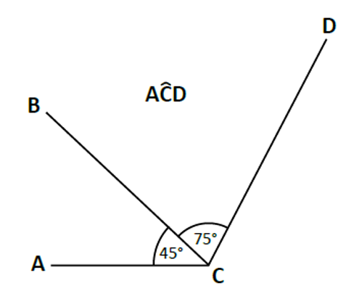
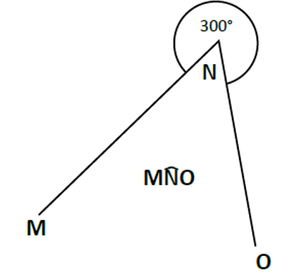
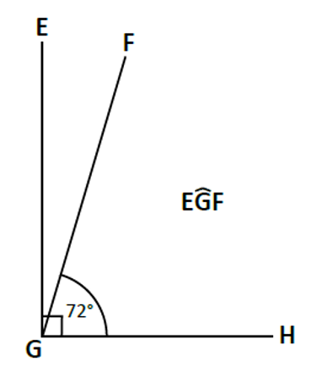

Worked example
Your turn
Calculate the size of the named angle:
Calculate the size of the named angle:
$$60°$$

Slide 15
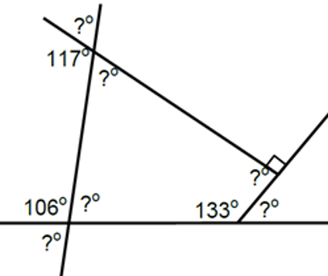
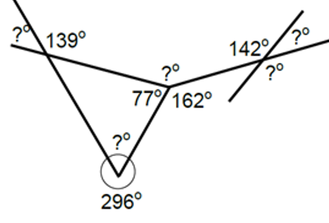





Worked example
Your turn
Find the missing angles:
Find the missing angles:
$$41°$$
$$38°$$
$$121°$$
$$142°$$
$$64°$$

