Slide 1
TRANSFORMATIONS OF GRAPHS
CONTENTS

Slide 2
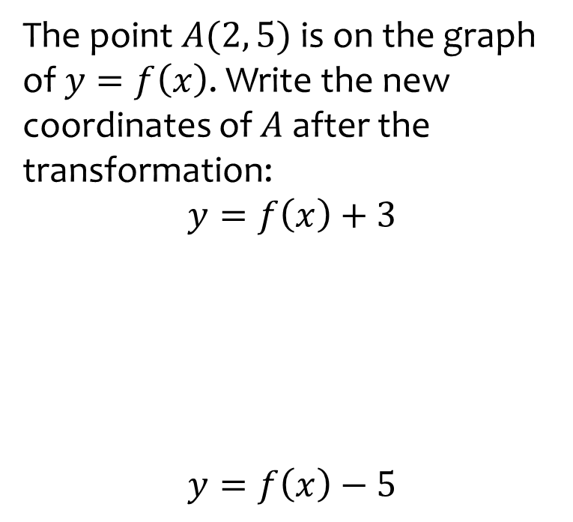
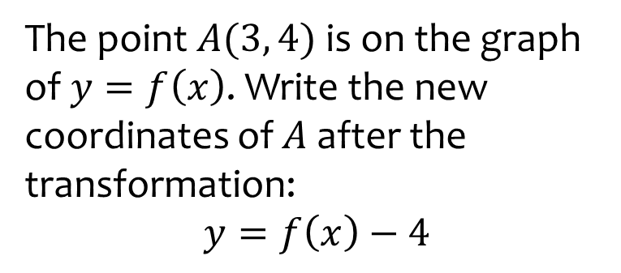

Worked example
Your turn
The point $A(2, 5)$is on the graph of $y=f\left(x\right)$. Write the new coordinates of $A$ after the transformation:
$$y=f\left(x\right)+3$$
$$y=f\left(x\right)−5$$
The point $A(3, 4)$is on the graph of $y=f\left(x\right)$. Write the new coordinates of $A$ after the transformation:
$$y=f\left(x\right)−4$$
$$(3, 0)$$

Slide 3
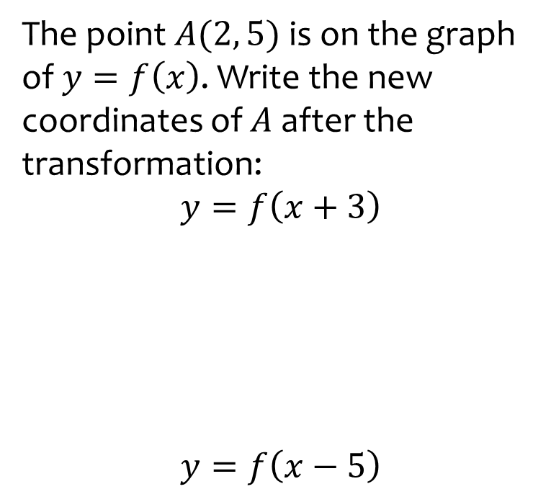
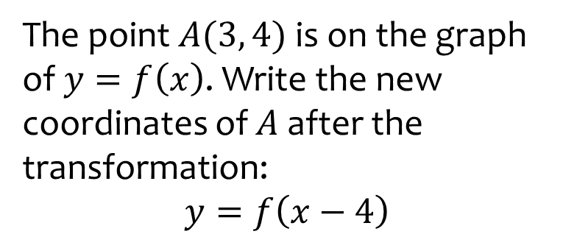

Worked example
Your turn
The point $A(2, 5)$is on the graph of $y=f\left(x\right)$. Write the new coordinates of $A$ after the transformation:
$$y=f\left(x+3\right)$$
$$y=f\left(x−5\right)$$
The point $A(3, 4)$is on the graph of $y=f\left(x\right)$. Write the new coordinates of $A$ after the transformation:
$$y=f\left(x−4\right)$$
$$(7, 4)$$

Slide 4
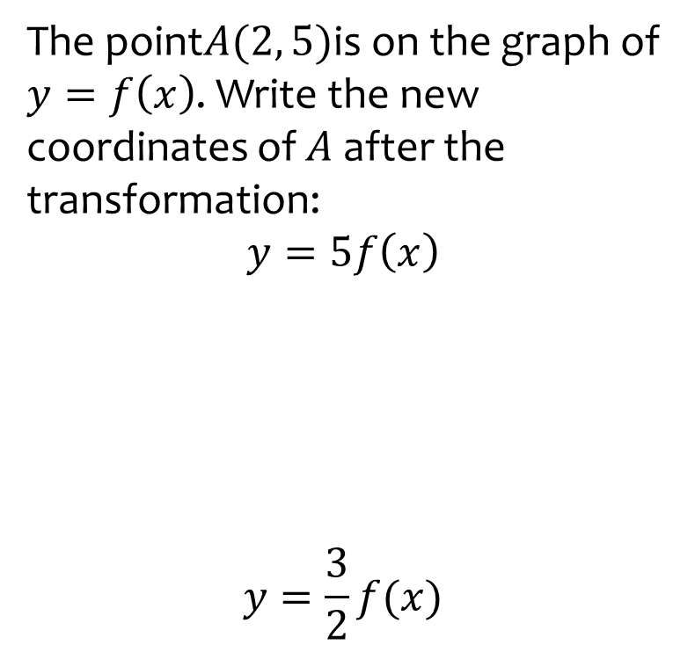
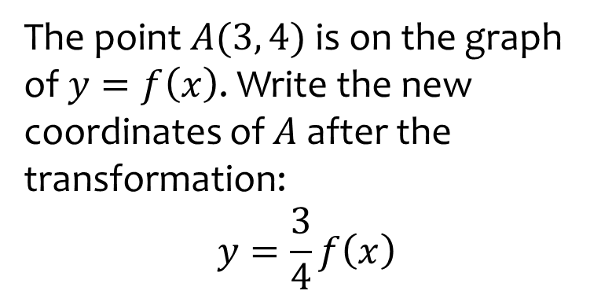

Worked example
Your turn
The point$A(2, 5)$is on the graph of $y=f\left(x\right)$. Write the new coordinates of $A$ after the transformation:
$$y=5f\left(x\right)$$
$$y=\frac{3}{2}f(x)$$
The point $A(3, 4)$is on the graph of $y=f\left(x\right)$. Write the new coordinates of $A$ after the transformation:
$$y=\frac{3}{4}f\left(x\right)$$
$$(3, 3)$$

Slide 5
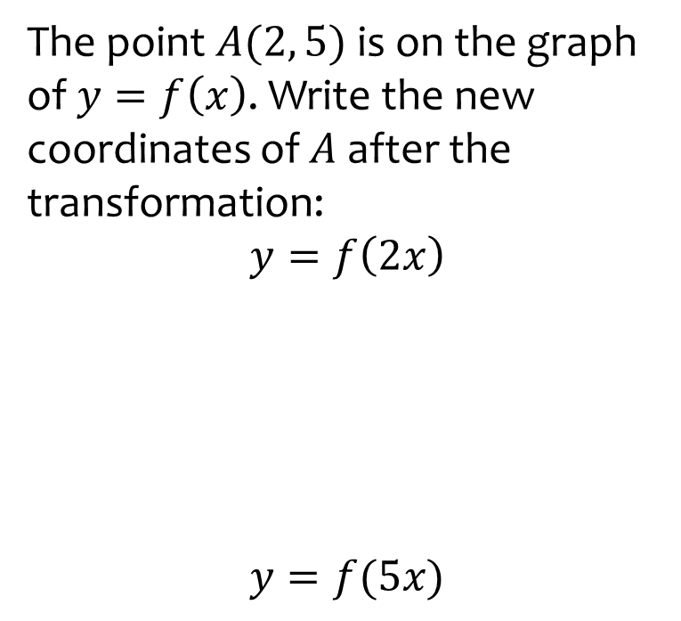
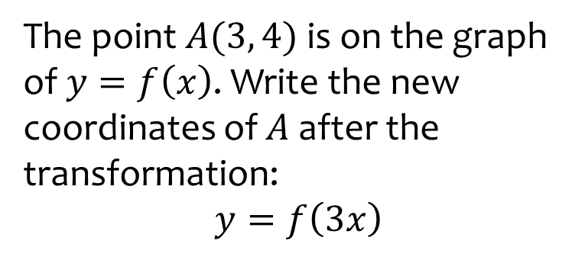

Worked example
Your turn
The point $A(2, 5)$is on the graph of $y=f\left(x\right)$. Write the new coordinates of $A$ after the transformation:
$$y=f\left(2x\right)$$
$$y=f(5x)$$
The point $A(3, 4)$is on the graph of $y=f\left(x\right)$. Write the new coordinates of $A$ after the transformation:
$$y=f\left(3x\right)$$
$$(1, 4)$$

Slide 6
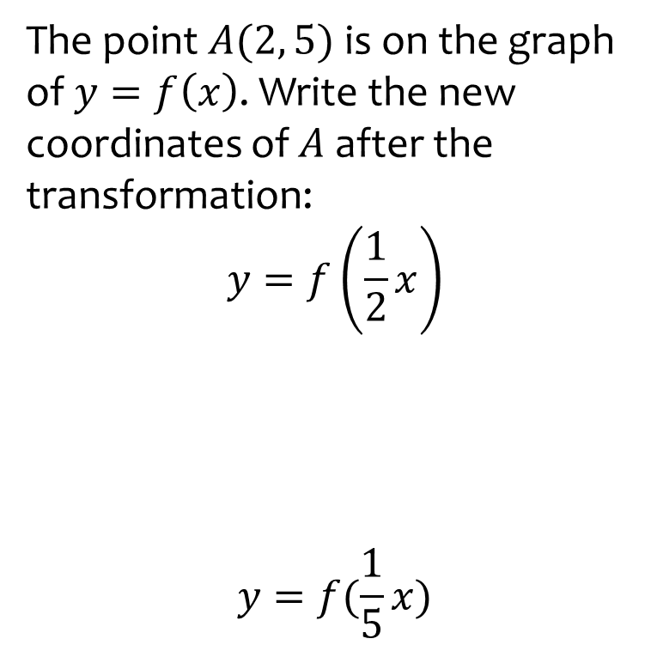
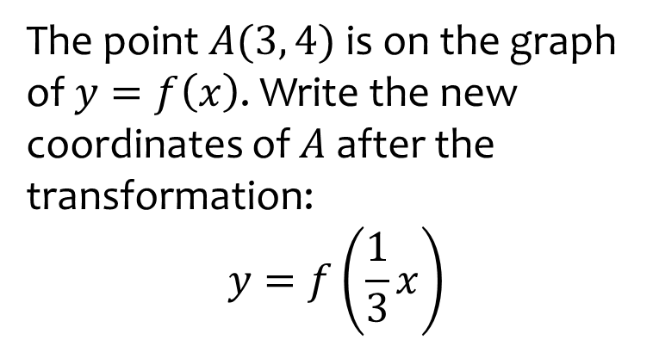

Worked example
Your turn
The point $A(2, 5)$ is on the graph of $y=f\left(x\right)$. Write the new coordinates of $A$ after the transformation:
$$y=f\left(\frac{1}{2}x\right)$$
$$y=f(\frac{1}{5}x)$$
The point $A(3, 4)$is on the graph of $y=f\left(x\right)$. Write the new coordinates of $A$ after the transformation:
$$y=f\left(\frac{1}{3}x\right)$$
$$(9, 4)$$

Slide 7
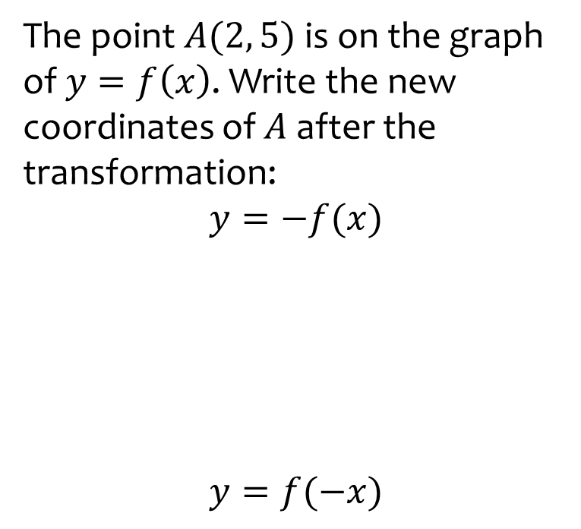
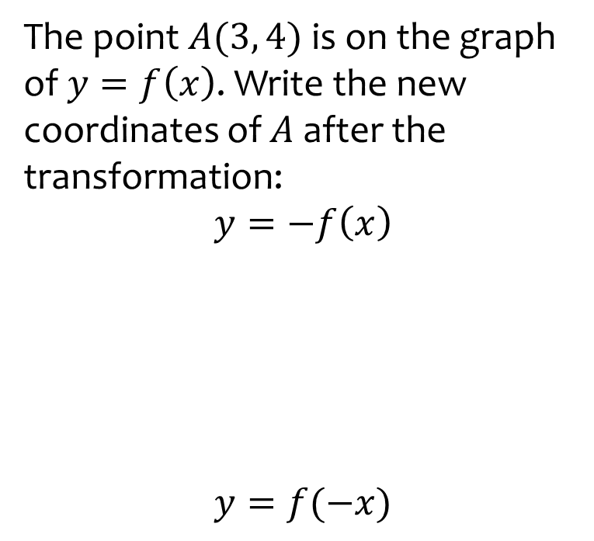
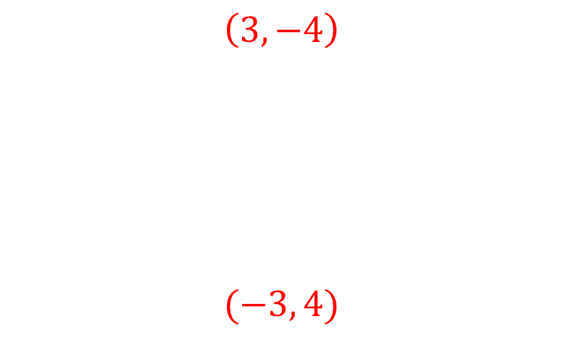
Worked example
Your turn
The point $A(2, 5)$is on the graph of $y=f\left(x\right)$. Write the new coordinates of $A$ after the transformation:
$$y=−f(x)$$
$$y=f(−x)$$
The point $A(3, 4)$is on the graph of $y=f\left(x\right)$. Write the new coordinates of $A$ after the transformation:
$$y=−f\left(x\right)$$
$$y=f(−x)$$
$$\left(3, −4\right)$$
$$(−3, 4)$$

Slide 8
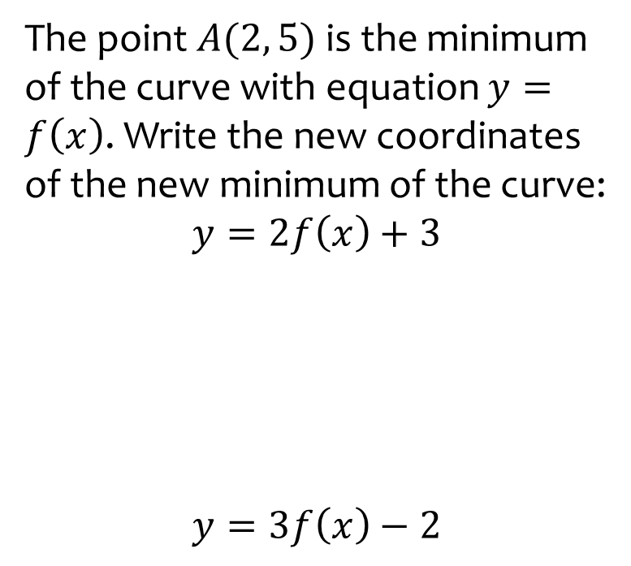
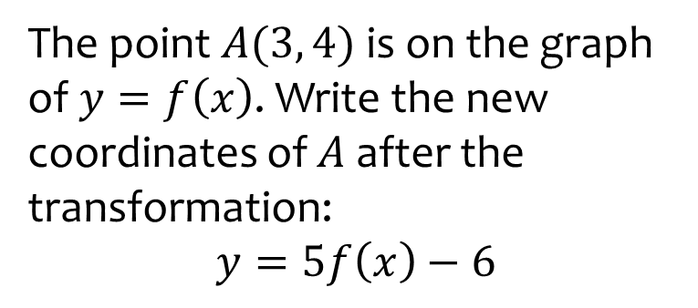

Worked example
Your turn
The point $A(2, 5)$is the minimum of the curve with equation $y=f\left(x\right)$. Write the new coordinates of the new minimum of the curve:
$$y=2f\left(x\right)+3$$
$$y=3f\left(x\right)−2$$
The point $A(3, 4)$is on the graph of $y=f\left(x\right)$. Write the new coordinates of $A$ after the transformation:
$$y=5f\left(x\right)−6$$
$$(3, 14)$$

Slide 9
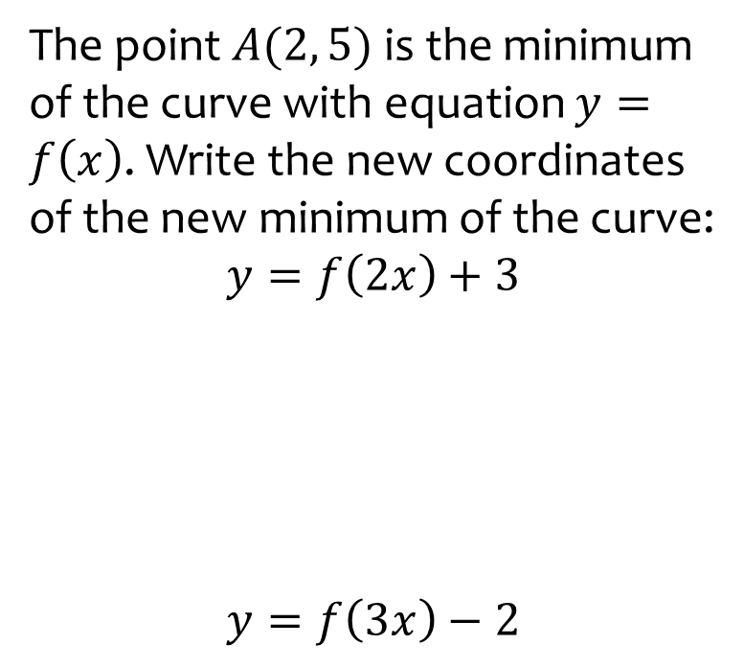
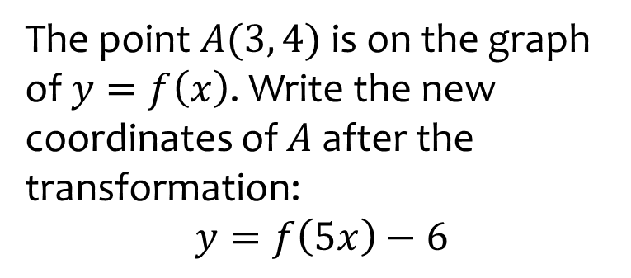

Worked example
Your turn
The point $A(2, 5)$is the minimum of the curve with equation $y=f\left(x\right)$. Write the new coordinates of the new minimum of the curve:
$$y=f\left(2x\right)+3$$
$$y=f\left(3x\right)−2$$
The point $A(3, 4)$is on the graph of $y=f\left(x\right)$. Write the new coordinates of $A$ after the transformation:
$$y=f\left(5x\right)−6$$
$$(\frac{3}{5}, −2)$$

Slide 10
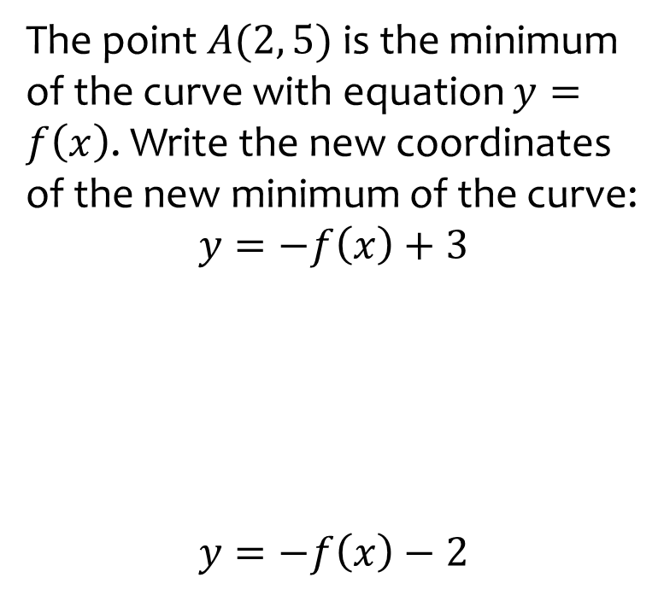
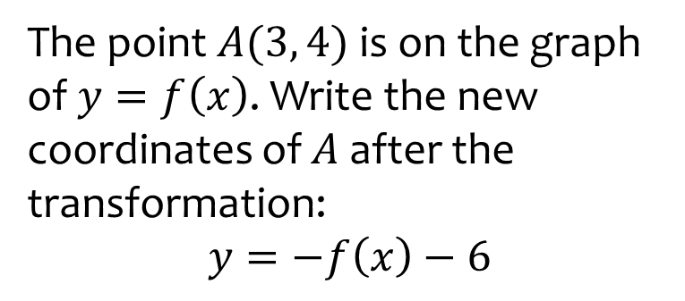

Worked example
Your turn
The point $A(2, 5)$is the minimum of the curve with equation $y=f\left(x\right)$. Write the new coordinates of the new minimum of the curve:
$$y=−f\left(x\right)+3$$
$$y=−f\left(x\right)−2$$
The point $A(3, 4)$is on the graph of $y=f\left(x\right)$. Write the new coordinates of $A$ after the transformation:
$$y=−f\left(x\right)−6$$
$$(3, −10)$$

Slide 11
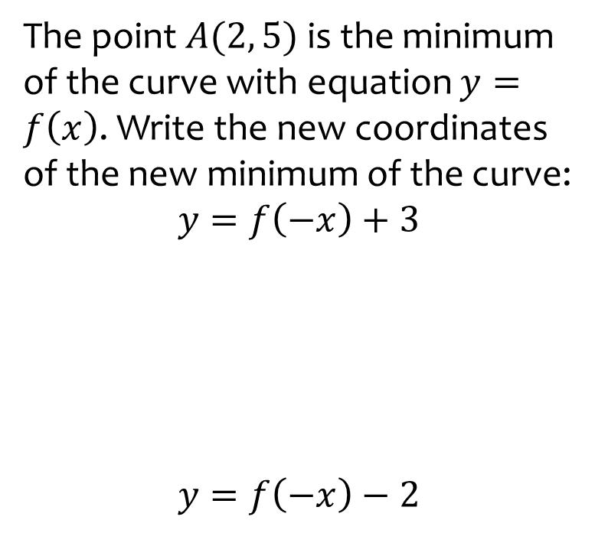
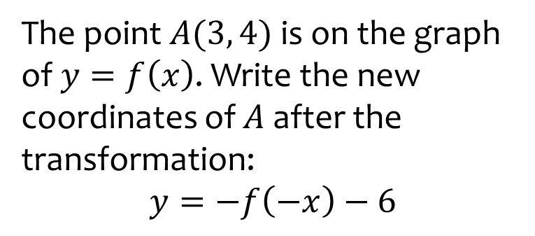

Worked example
Your turn
The point $A(2, 5)$is the minimum of the curve with equation $y=f\left(x\right)$. Write the new coordinates of the new minimum of the curve:
$$y=f\left(−x\right)+3$$
$$y=f\left(−x\right)−2$$
The point $A(3, 4)$is on the graph of $y=f\left(x\right)$. Write the new coordinates of $A$ after the transformation:
$$y=−f\left(−x\right)−6$$
$$(−3, −10)$$

Slide 12
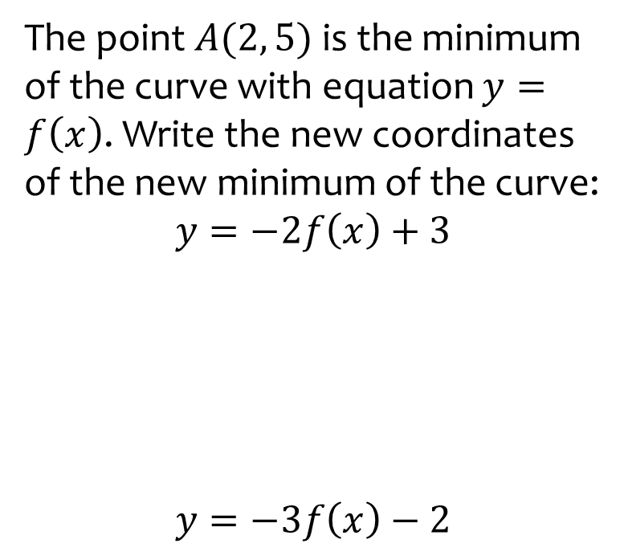
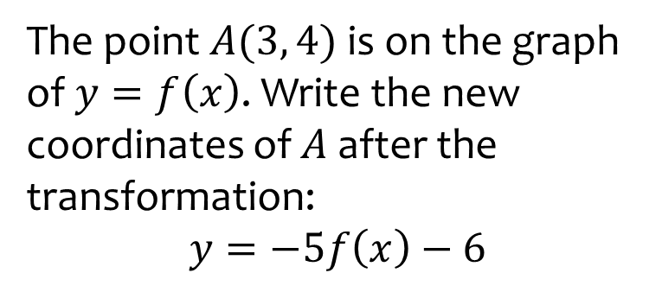

Worked example
Your turn
The point $A(2, 5)$is the minimum of the curve with equation $y=f\left(x\right)$. Write the new coordinates of the new minimum of the curve:
$$y=−2f\left(x\right)+3$$
$$y=−3f\left(x\right)−2$$
The point $A(3, 4)$is on the graph of $y=f\left(x\right)$. Write the new coordinates of $A$ after the transformation:
$$y=−5f\left(x\right)−6$$
$$(3, −26)$$

Slide 13
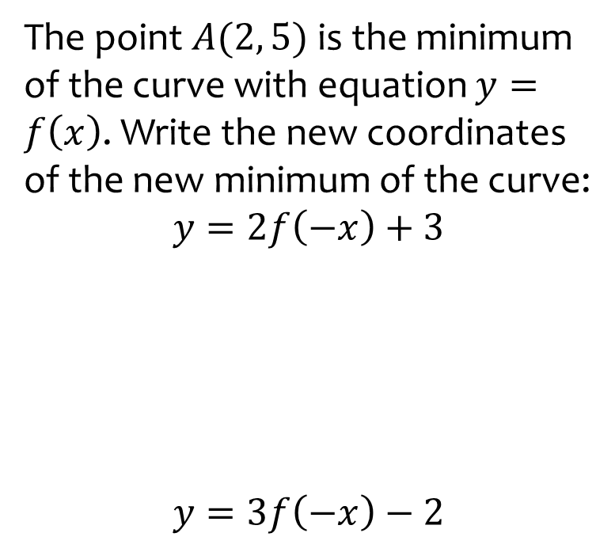
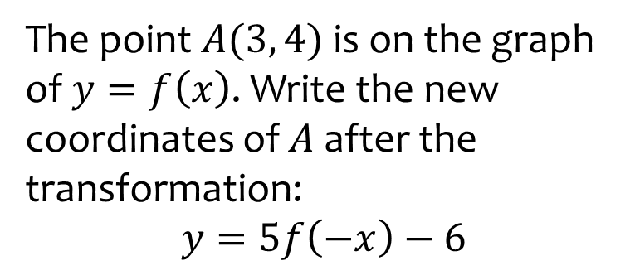

Worked example
Your turn
The point $A(2, 5)$is the minimum of the curve with equation $y=f\left(x\right)$. Write the new coordinates of the new minimum of the curve:
$$y=2f\left(−x\right)+3$$
$$y=3f\left(−x\right)−2$$
The point $A(3, 4)$is on the graph of $y=f\left(x\right)$. Write the new coordinates of $A$ after the transformation:
$$y=5f\left(−x\right)−6$$
$$(−3, 14)$$

Slide 14
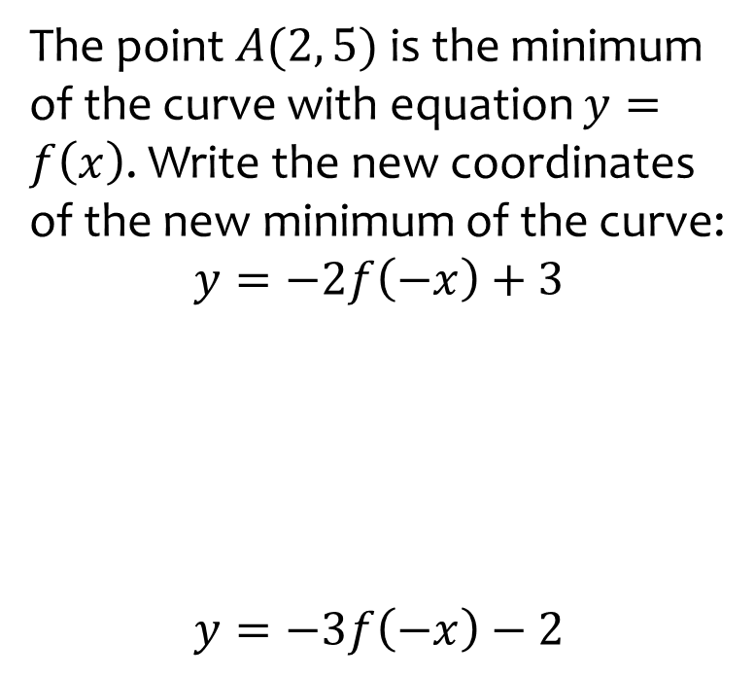
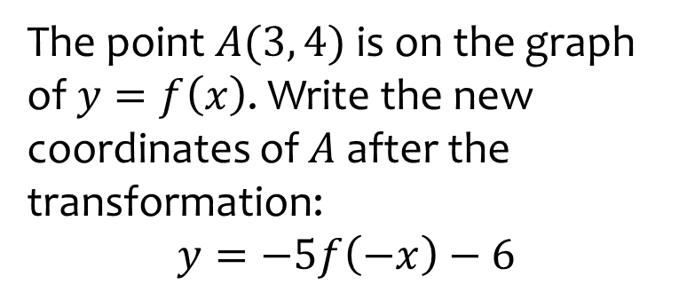

Worked example
Your turn
The point $A(2, 5)$is the minimum of the curve with equation $y=f\left(x\right)$. Write the new coordinates of the new minimum of the curve:
$$y=−2f\left(−x\right)+3$$
$$y=−3f\left(−x\right)−2$$
The point $A(3, 4)$is on the graph of $y=f\left(x\right)$. Write the new coordinates of $A$ after the transformation:
$$y=−5f\left(−x\right)−6$$
$$(−3, −26)$$

Slide 15
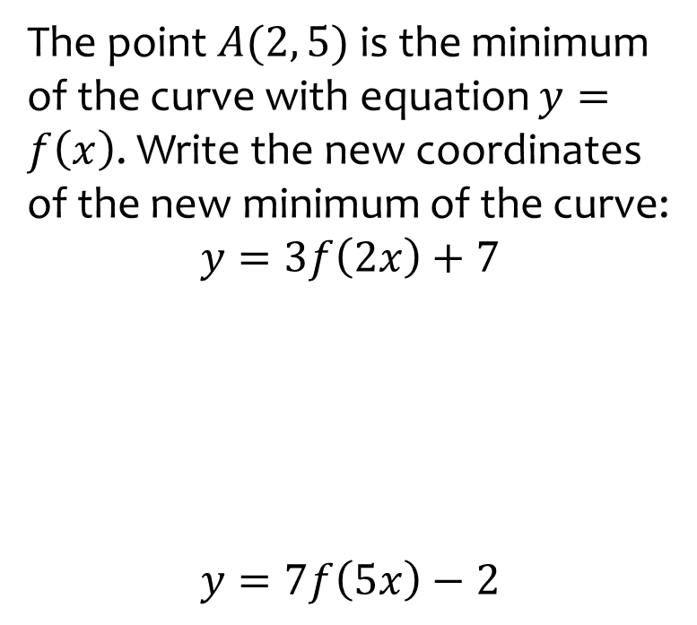
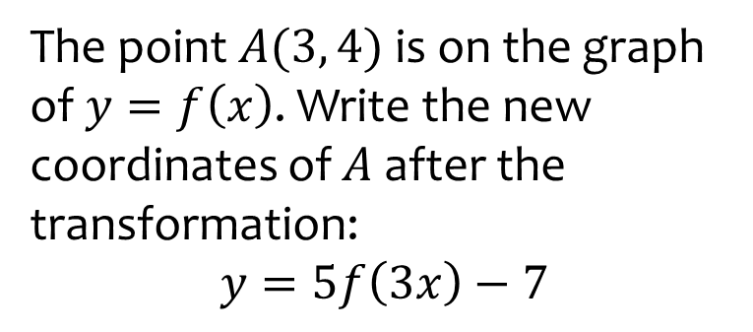

Worked example
Your turn
The point $A(2, 5)$is the minimum of the curve with equation $y=f\left(x\right)$. Write the new coordinates of the new minimum of the curve:
$$y=3f\left(2x\right)+7$$
$$y=7f\left(5x\right)−2$$
The point $A(3, 4)$is on the graph of $y=f\left(x\right)$. Write the new coordinates of $A$ after the transformation:
$$y=5f\left(3x\right)−7$$
$$(1, 13)$$

Slide 16
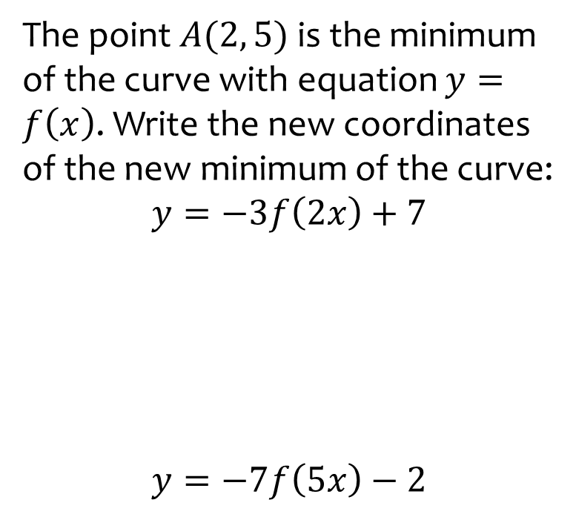
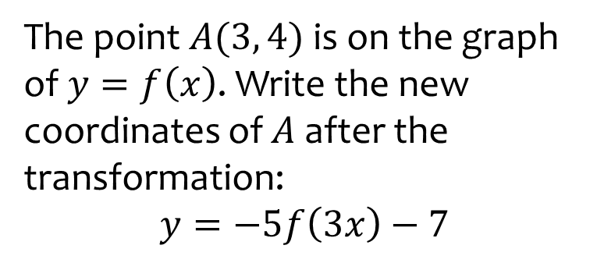

Worked example
Your turn
The point $A(2, 5)$is the minimum of the curve with equation $y=f\left(x\right)$. Write the new coordinates of the new minimum of the curve:
$$y=−3f\left(2x\right)+7$$
$$y=−7f\left(5x\right)−2$$
The point $A(3, 4)$is on the graph of $y=f\left(x\right)$. Write the new coordinates of $A$ after the transformation:
$$y=−5f\left(3x\right)−7$$
$$(1, −27)$$

Slide 17
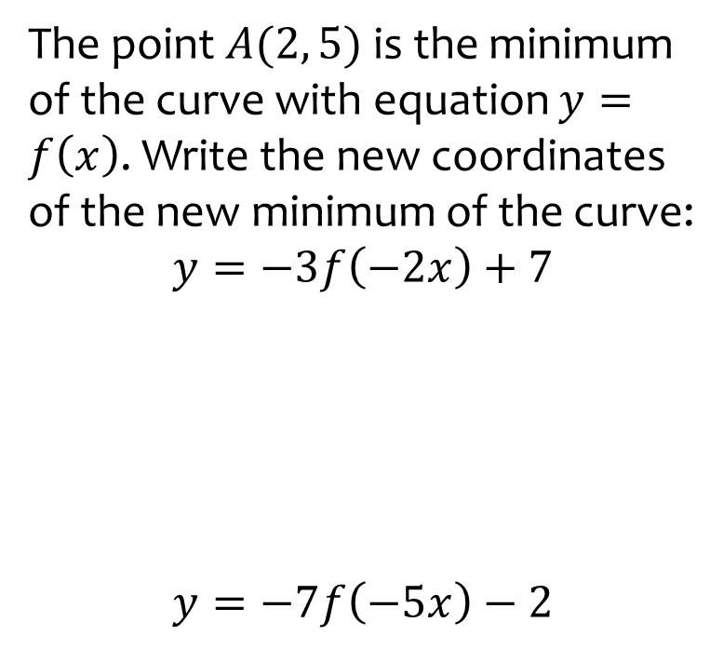
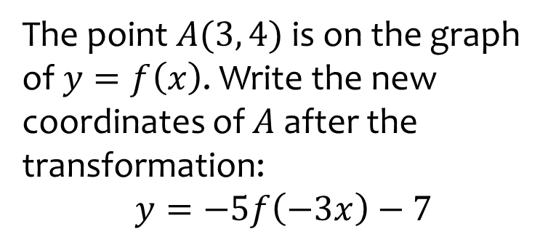

Worked example
Your turn
The point $A(2, 5)$is the minimum of the curve with equation $y=f\left(x\right)$. Write the new coordinates of the new minimum of the curve:
$$y=−3f\left(−2x\right)+7$$
$$y=−7f\left(−5x\right)−2$$
The point $A(3, 4)$is on the graph of $y=f\left(x\right)$. Write the new coordinates of $A$ after the transformation:
$$y=−5f\left(−3x\right)−7$$
$$(−1, −27)$$

