Slide 1
SURDS (most in number)
CONTENTS

Slide 2
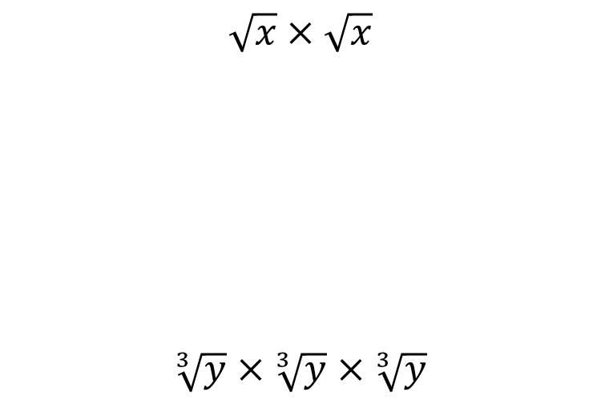


Worked example
Your turn
$$\sqrt{x}×\sqrt{x}$$
$$\sqrt[3]{y}×\sqrt[3]{y}×\sqrt[3]{y}$$
$$\sqrt[4]{z}×\sqrt[4]{z}×\sqrt[4]{z}×\sqrt[4]{z}$$
$$z$$

Slide 3
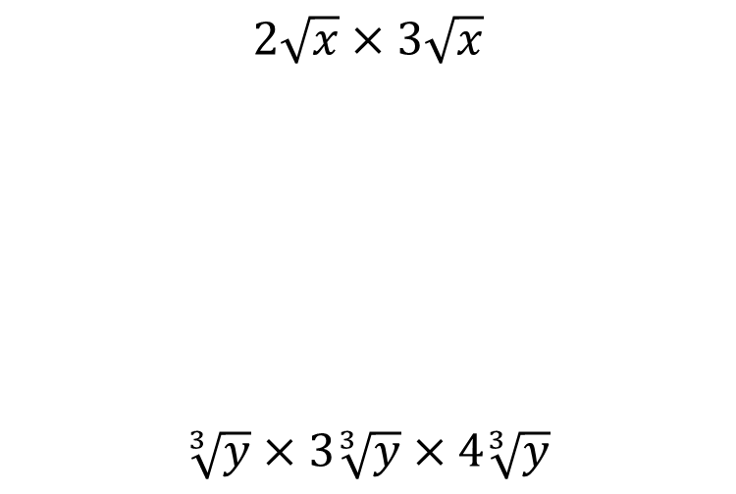


Worked example
Your turn
$$2\sqrt{x}×3\sqrt{x}$$
$$\sqrt[3]{y}×3\sqrt[3]{y}×4\sqrt[3]{y}$$
$$2\sqrt[4]{z}×3\sqrt[4]{z}×4\sqrt[4]{z}×\sqrt[4]{z}$$
$$24z$$

Slide 4
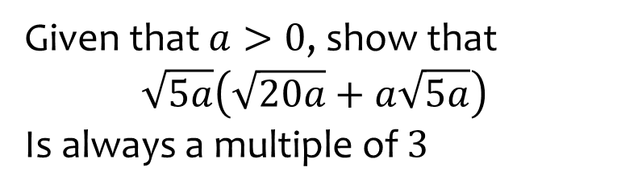
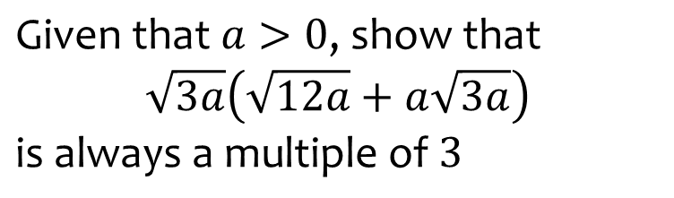
Worked example
Your turn
Given that $a>0$, show that
$$\sqrt{5a}\left(\sqrt{20a}+a\sqrt{5a}\right)$$
Is always a multiple of $3$
$$\text{Given} \text{that} a>0\text{, }\text{show} \text{that}$$
$$\sqrt{3a}\left(\sqrt{12a}+a\sqrt{3a}\right)$$
$$\text{i}\text{s} \text{always} \text{a} \text{multiple} \text{of} 3$$
Shown

Slide 5
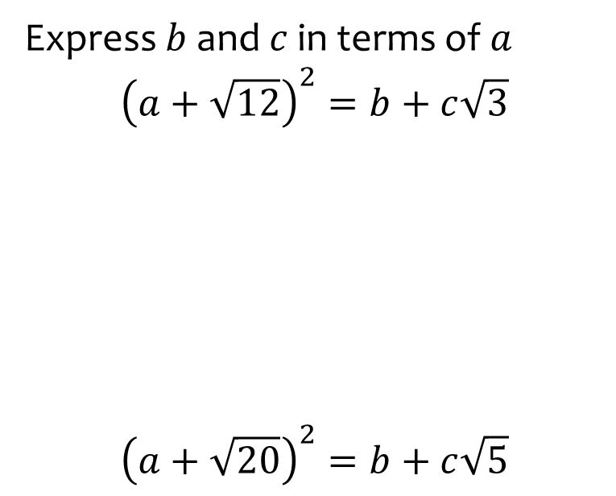
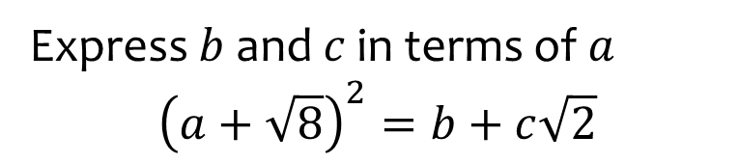

Worked example
Your turn
Express $b$ and $c$ in terms of $a$
$${\left(a+\sqrt{12}\right)}^{2}=b+c\sqrt{3}$$
$${\left(a+\sqrt{20}\right)}^{2}=b+c\sqrt{5}$$
Express $b$ and $c$ in terms of $a$
$${\left(a+\sqrt{8}\right)}^{2}=b+c\sqrt{2}$$
$$b=a^{2}+8$$
$$c=4a$$

Slide 6
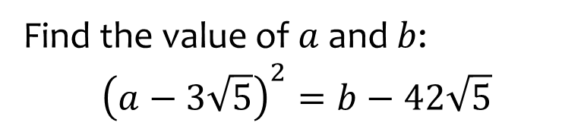
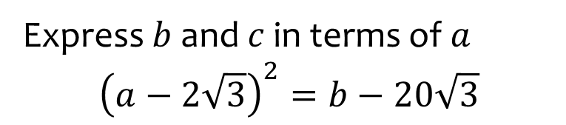

Worked example
Your turn
Find the value of $a$ and $b$:
$${\left(a−3\sqrt{5}\right)}^{2}=b−42\sqrt{5}$$
Express $b$ and $c$ in terms of $a$
$${\left(a−2\sqrt{3}\right)}^{2}=b−20\sqrt{3}$$
$$a=5, b=37$$

Slide 7
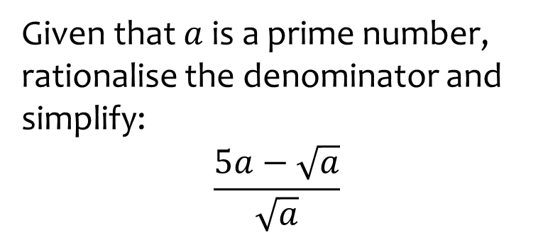
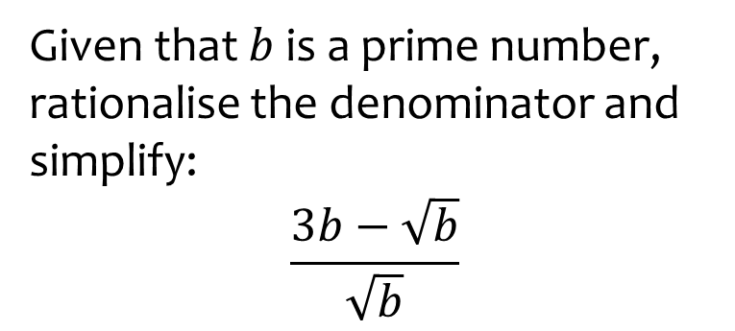

Worked example
Your turn
Given that $a$ is a prime number, rationalise the denominator and simplify:
$$\frac{5a−\sqrt{a}}{\sqrt{a}}$$
Given that $b$ is a prime number, rationalise the denominator and simplify:
$$\frac{3b−\sqrt{b}}{\sqrt{b}}$$
$$3\sqrt{b}−1$$

