Slide 1
SUBSTITUTION
CONTENTS

Slide 2
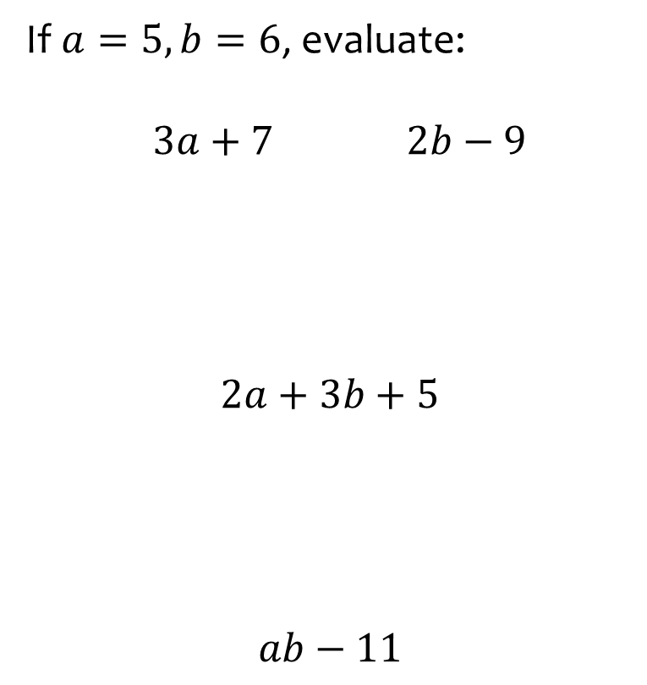
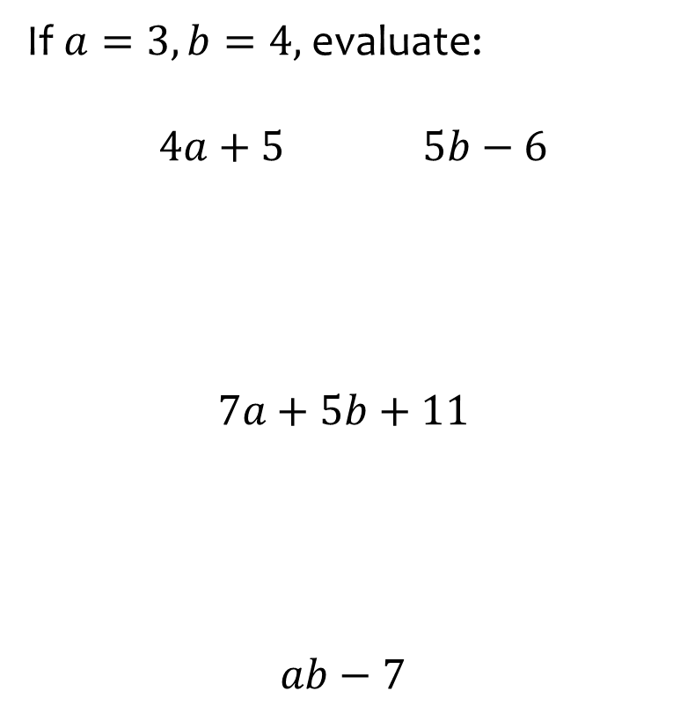



Worked example
Your turn
If $a=5, b=6$, evaluate:
$3a+7$ $2b−9$
$$2a+3b+5$$
$$ab−11$$
If $a=3, b=4,$ evaluate:
$4a+5$ $5b−6$
$$7a+5b+11$$
$$ab−7$$
    $17$ $14$
$$52$$
$$5$$

Slide 3
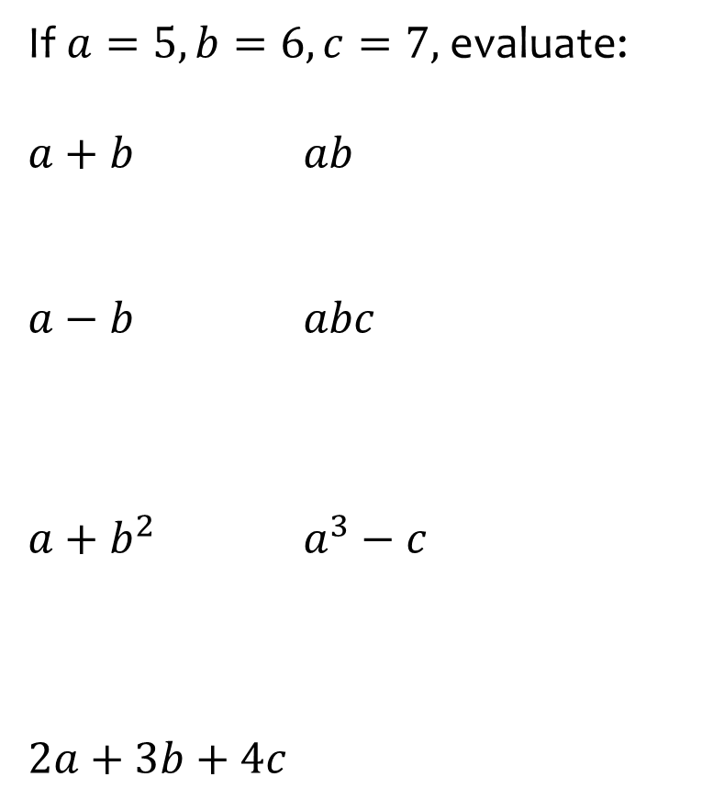
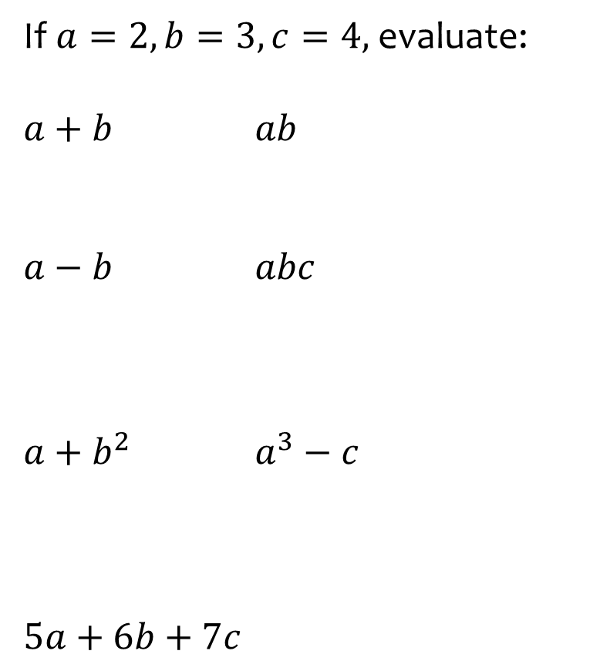




Worked example
Your turn
If $a=5, b=6, c=7,$ evaluate:
$a+b$ $ab$
$a−b$ $abc$
$a+b^{2}$ $a^{3}−c$
$$2a+3b+4c$$
If $a=2, b=3, c=4,$ evaluate:
$a+b$ $ab$
$a−b$ $abc$
$a+b^{2}$ $a^{3}−c$
$$5a+6b+7c$$
$5$ $6$
$−1$ $24$
$11$ $4$
$$56$$

Slide 4
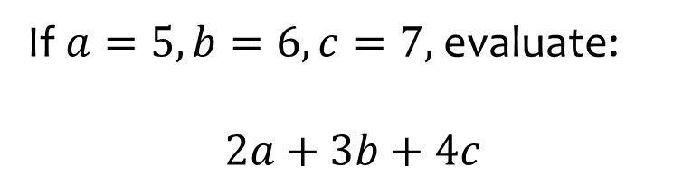
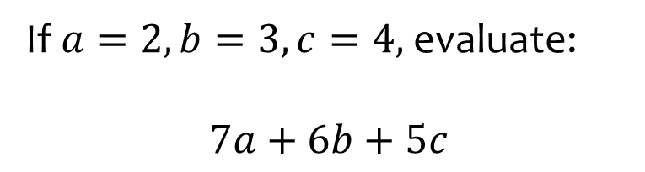

Worked example
Your turn
If $a=5, b=6, c=7,$ evaluate:
$$2a+3b+4c$$
If $a=2, b=3, c=4,$ evaluate:
$$7a+6b+5c$$
$$52$$

Slide 5
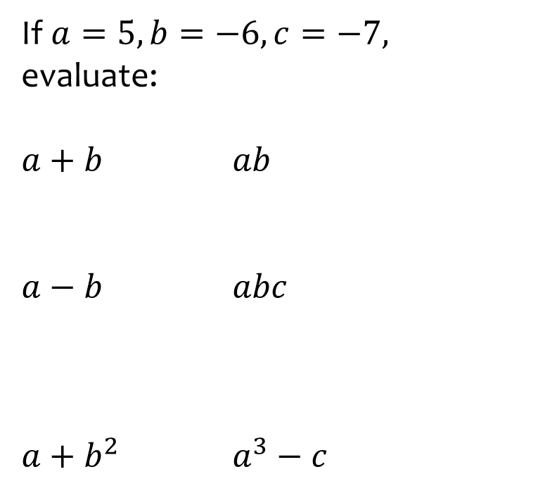
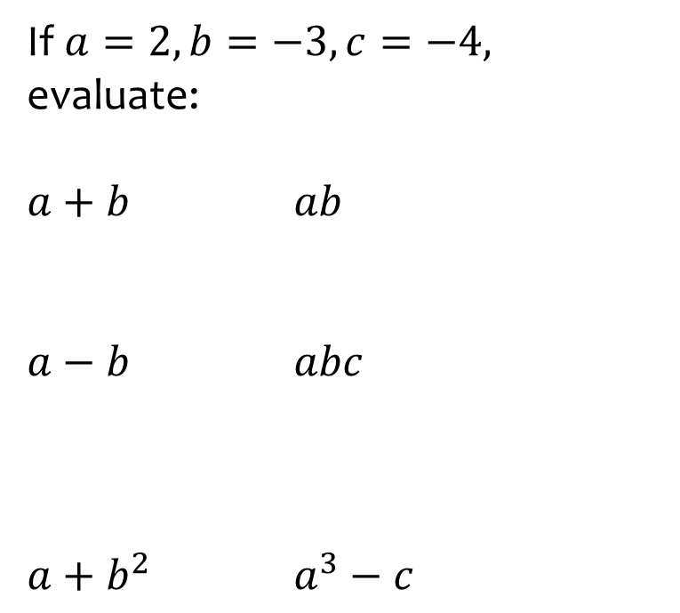



Worked example
Your turn
If $a=5, b=−6, c=−7,$ evaluate:
$a+b$ $ab$
$a−b$ $abc$
$a+b^{2}$ $a^{3}−c$
If $a=2, b=−3, c=−4,$ evaluate:
$a+b$ $ab$
$a−b$ $abc$
$a+b^{2}$ $a^{3}−c$
$−1$ $−6$
$5$ $24$
$11$ $12$

Slide 6
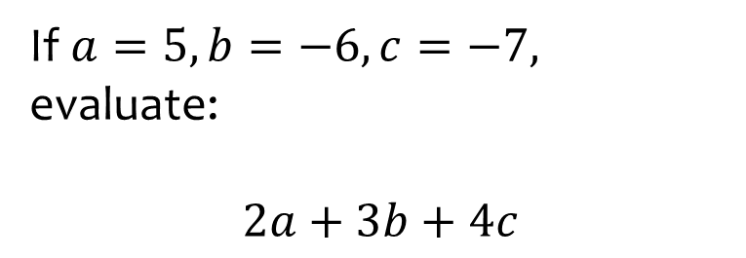
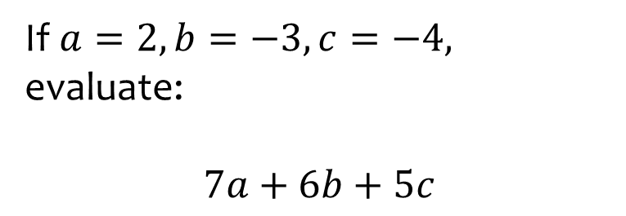

Worked example
Your turn
If $a=5, b=−6, c=−7,$ evaluate:
$$2a+3b+4c$$
If $a=2, b=−3, c=−4,$ evaluate:
$$7a+6b+5c$$
$$−24$$

Slide 7
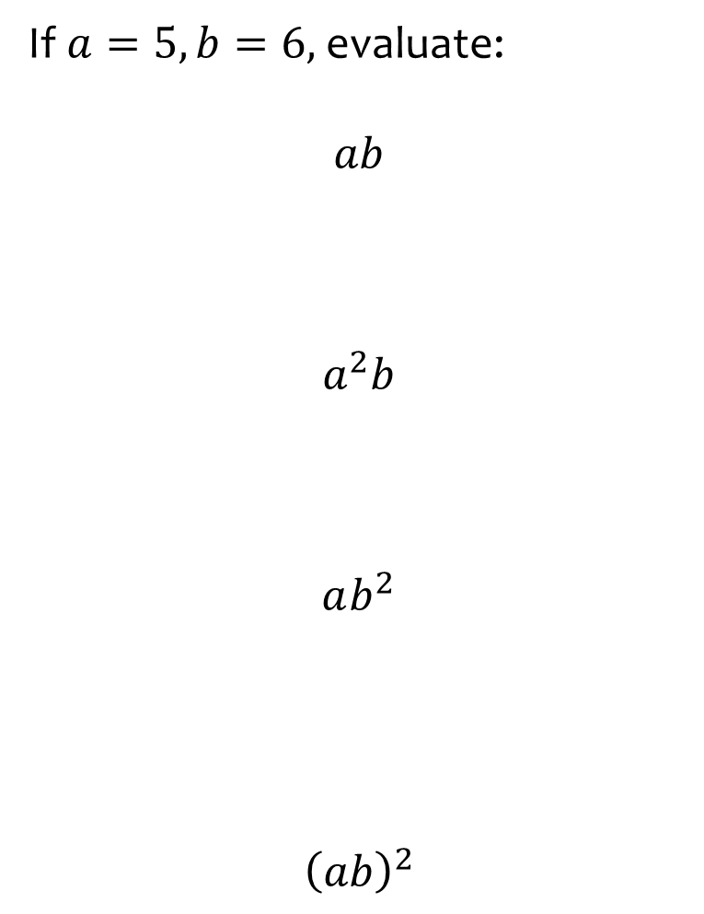
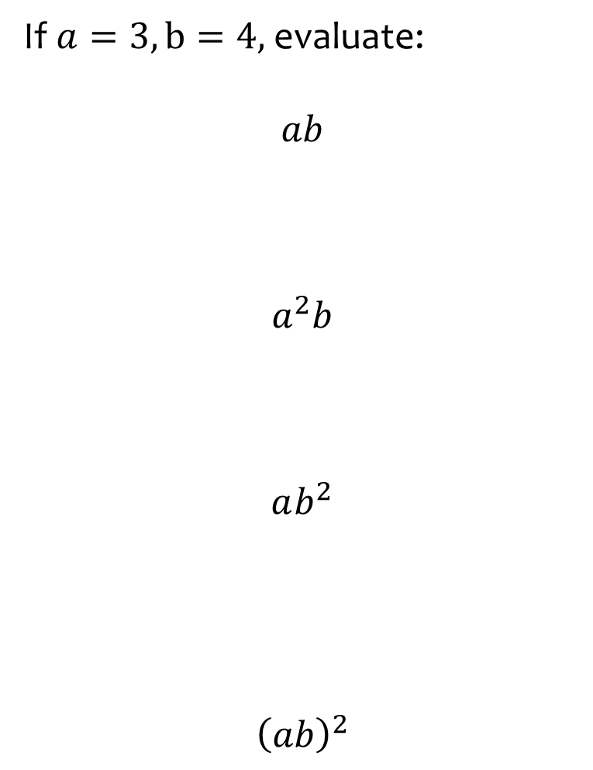




Worked example
Your turn
If $a=5, b=6,$ evaluate:
$$ab$$
$$a^{2}b$$
$$ab^{2}$$
$${\left(ab\right)}^{2}$$
If $a=3, b=4,$ evaluate:
$$ab$$
$$a^{2}b$$
$$ab^{2}$$
$${\left(ab\right)}^{2}$$
$$12$$
$$36$$
$$48$$
$$144$$

Slide 8
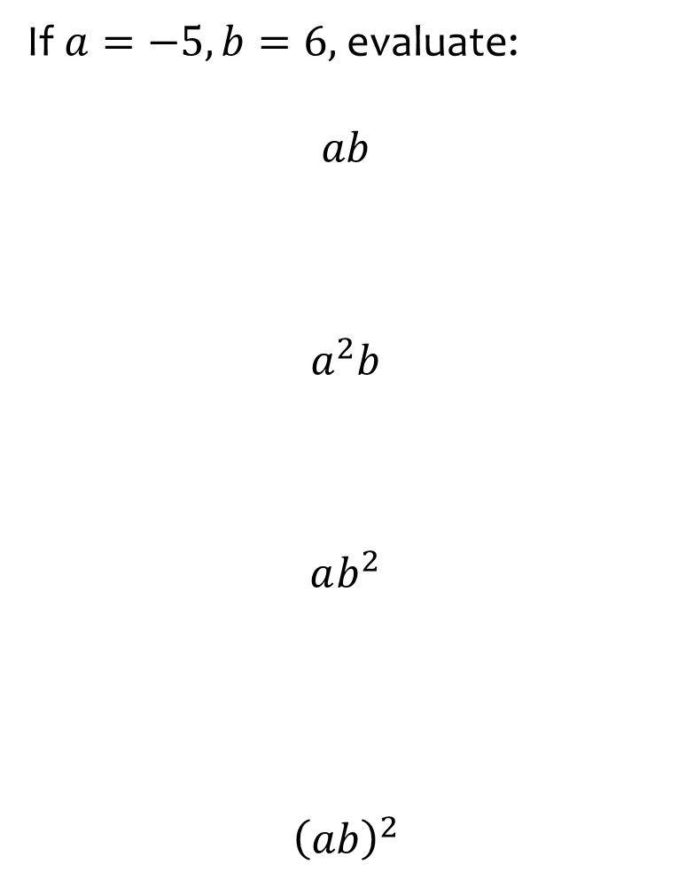
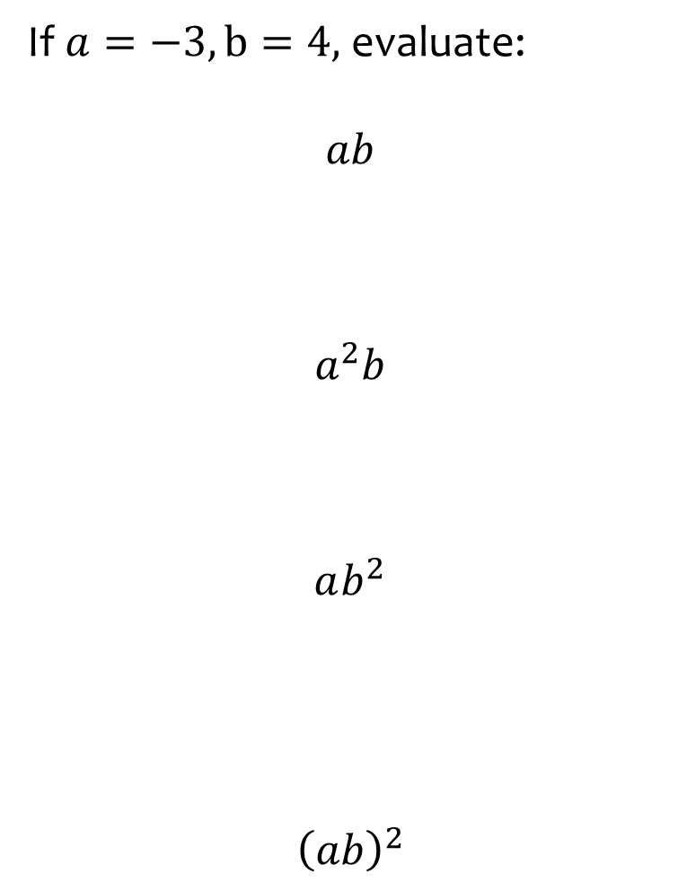




Worked example
Your turn
If $a=−5, b=6,$ evaluate:
$$ab$$
$$a^{2}b$$
$$ab^{2}$$
$${\left(ab\right)}^{2}$$
If $a=−3, b=4,$ evaluate:
$$ab$$
$$a^{2}b$$
$$ab^{2}$$
$${\left(ab\right)}^{2}$$
$$−12$$
$$36$$
$$−48$$
$$144$$

Slide 9
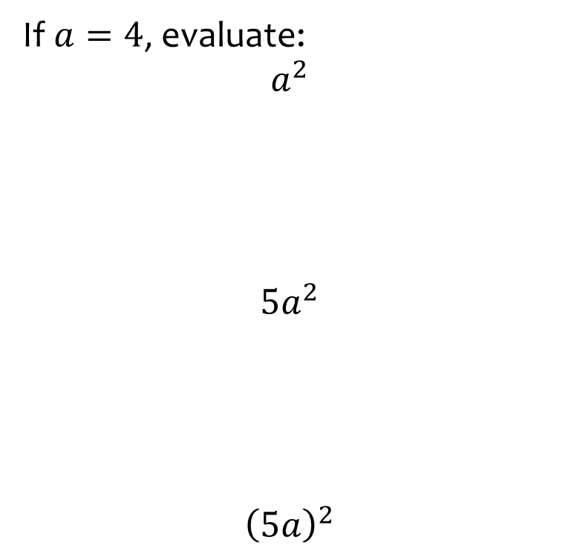
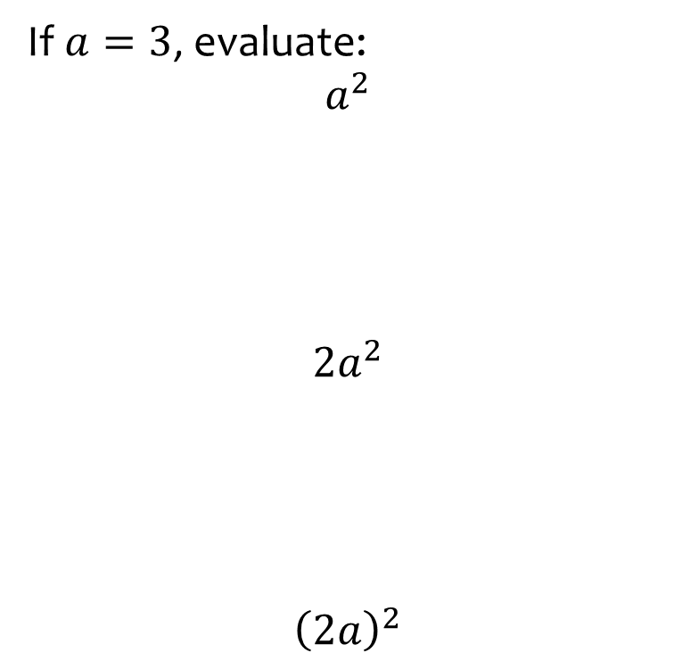



Worked example
Your turn
If $a=4$, evaluate:
$$a^{2}$$
$$5a^{2}$$
$${\left(5a\right)}^{2}$$
If $a=3$, evaluate:
$$a^{2}$$
$$2a^{2}$$
$${\left(2a\right)}^{2}$$
$$9$$
$$18$$
$$36$$

Slide 10
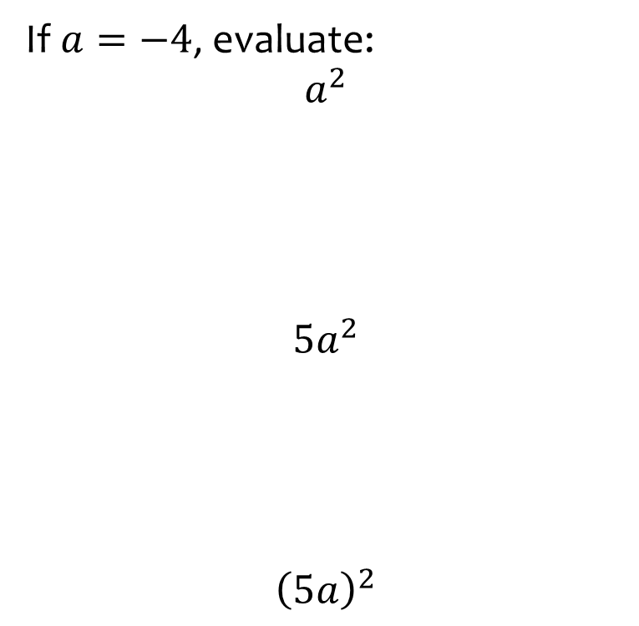
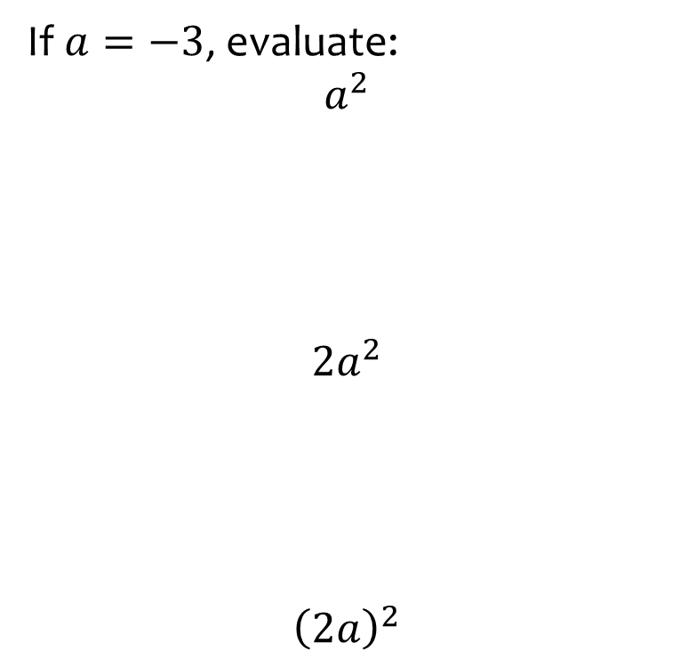


Worked example
Your turn
If $a=−4$, evaluate:
$$a^{2}$$
$$5a^{2}$$
$${\left(5a\right)}^{2}$$
If $a=−3$, evaluate:
$$a^{2}$$
$$2a^{2}$$
$${\left(2a\right)}^{2}$$
$$9$$
$$18$$
$$36$$

Slide 11
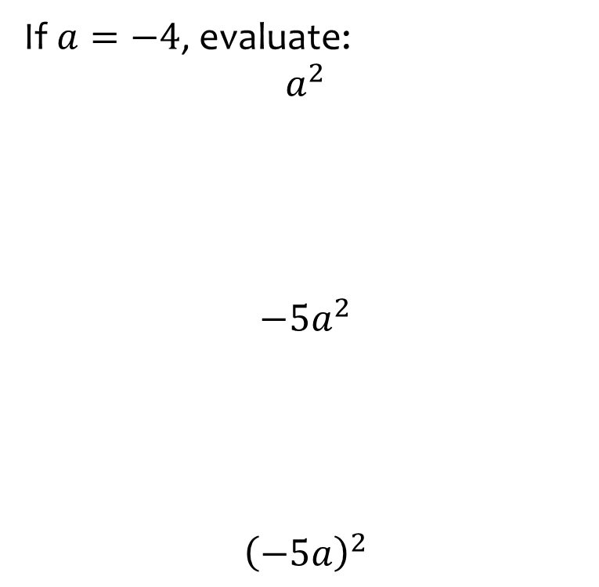
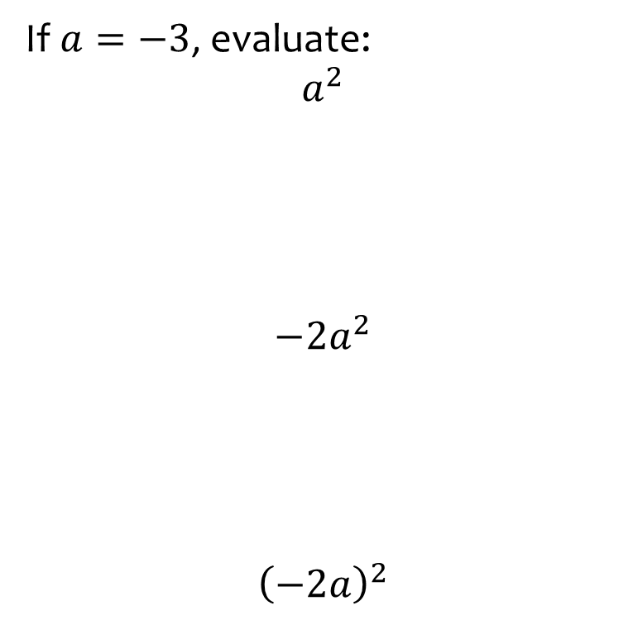

Worked example
Your turn
If $a=−4$, evaluate:
$$a^{2}$$
$$−5a^{2}$$
$${\left(−5a\right)}^{2}$$
If $a=−3$, evaluate:
$$a^{2}$$
$$−2a^{2}$$
$${\left(−2a\right)}^{2}$$
$$9$$
$$−18$$
$$36$$

Slide 12
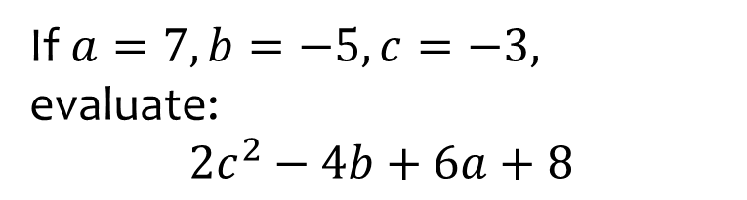
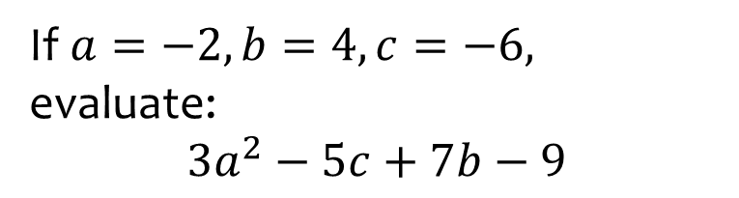

Worked example
Your turn
If $a=7, b=−5, c=−3,$ evaluate:
$$2c^{2}−4b+6a+8$$
If $a=−2, b=4, c=−6,$ evaluate:
$$3a^{2}−5c+7b−9$$
$$61$$

Slide 13
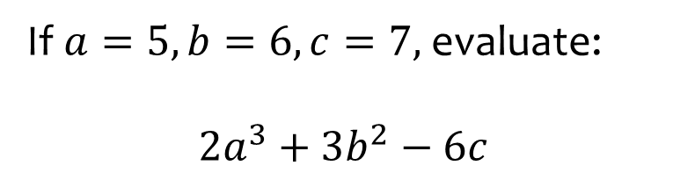
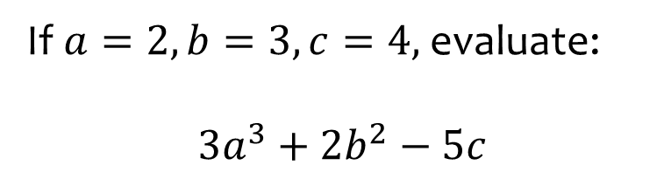

Worked example
Your turn
If $a=5, b=6, c=7,$ evaluate:
$$2a^{3}+3b^{2}−6c$$
If $a=2, b=3, c=4,$ evaluate:
$$3a^{3}+2b^{2}−5c$$
$$22$$

Slide 14
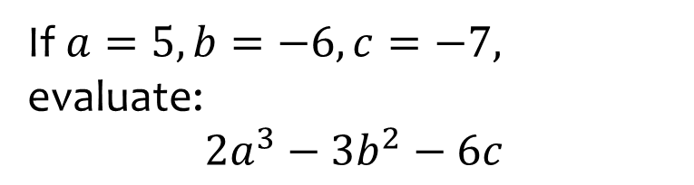
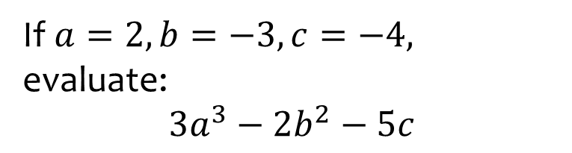

Worked example
Your turn
If $a=5, b=−6, c=−7,$ evaluate:
$$2a^{3}−3b^{2}−6c$$
If $a=2, b=−3, c=−4,$ evaluate:
$$3a^{3}−2b^{2}−5c$$
$$26$$

