Slide 1
STRAIGHT LINE GRAPHS
CONTENTS

Slide 2
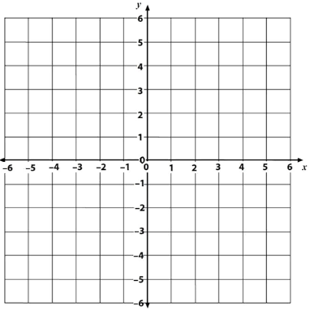
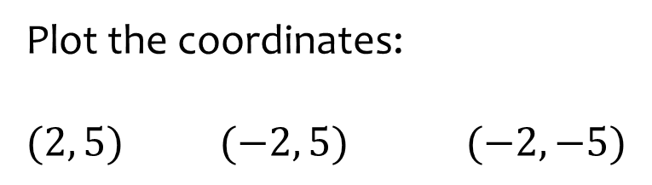
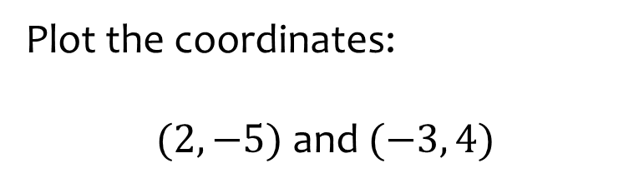
Worked example
Your turn
Plot the coordinates:
$(2, 5)$ $(−2, 5)$ $(−2, −5)$
Plot the coordinates:
$(2, −5)$ and $(−3, 4)$
x
x

Slide 3

Worked example
Your turn
Find the equation of the lines:
Find the equation of the line:
L₁
L₂
L₃
L₄
$$y=−5$$

Slide 4

Worked example
Your turn
Find the equation of the lines:
Find the equation of the line:
L₁
L₂
L₃
L₄
$$x=−3$$

Slide 5
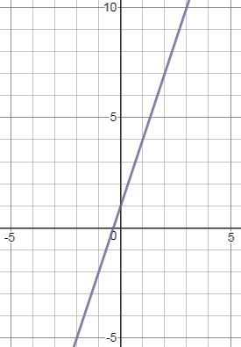
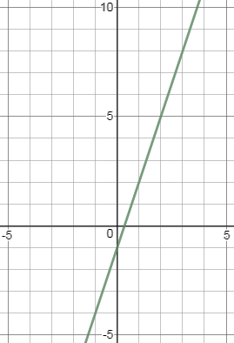

Worked example
Your turn
Find the equation of the line:
Find the equation of the line:
$$y=3x−1$$
Graphs used with permission from DESMOS: https://www.desmos.com/

Slide 6
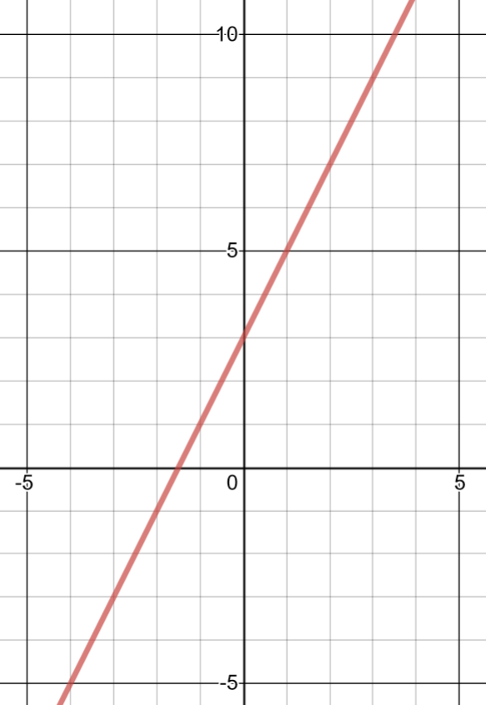
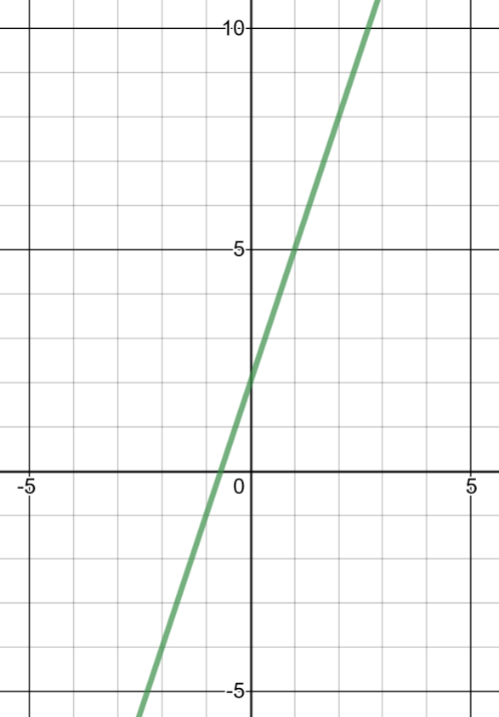

Worked example
Your turn
Find the equation of the line:
Find the equation of the line:
$$y=3x+2$$
Graphs used with permission from DESMOS: https://www.desmos.com/

Slide 7
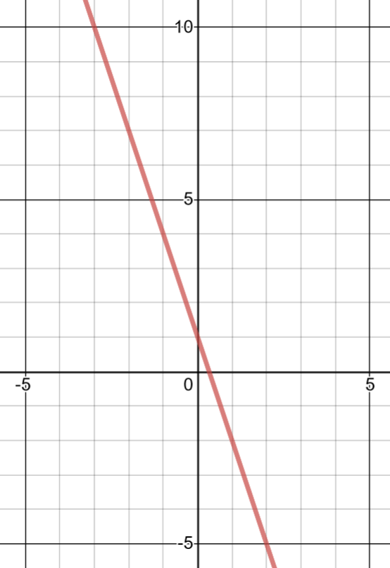
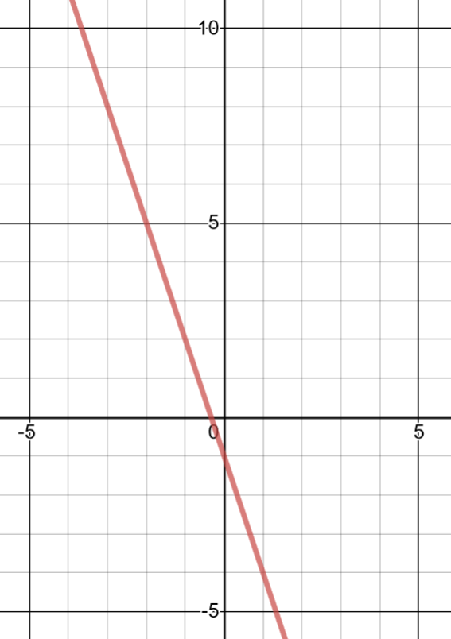

Worked example
Your turn
Find the equation of the line:
Find the equation of the line:
$$y=−3x−1$$
Graphs used with permission from DESMOS: https://www.desmos.com/

Slide 8
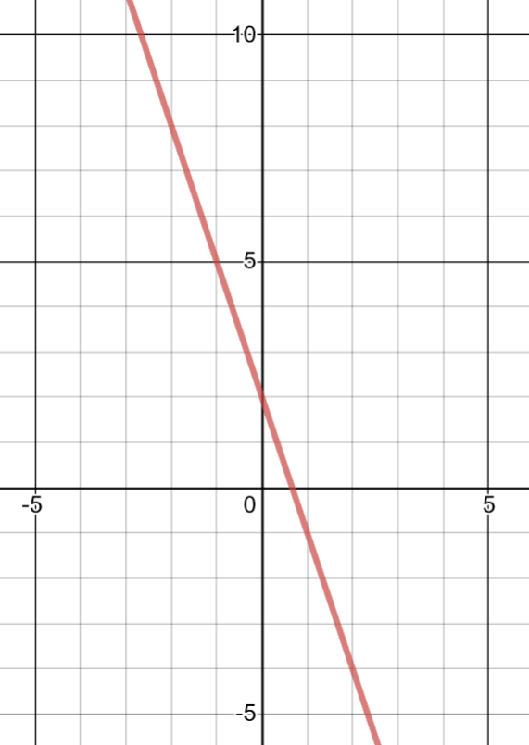
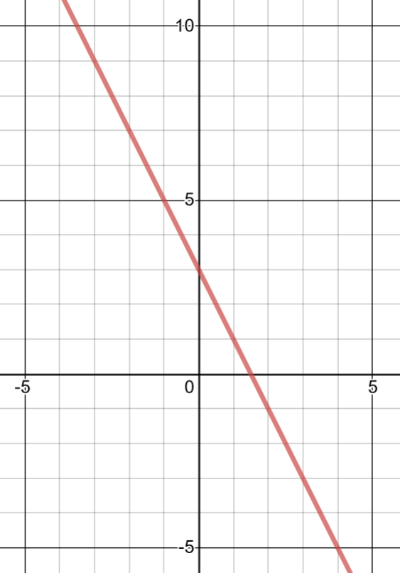

Worked example
Your turn
Find the equation of the line:
Find the equation of the line:
$$y=−2x+3$$
Graphs used with permission from DESMOS: https://www.desmos.com/

Slide 9
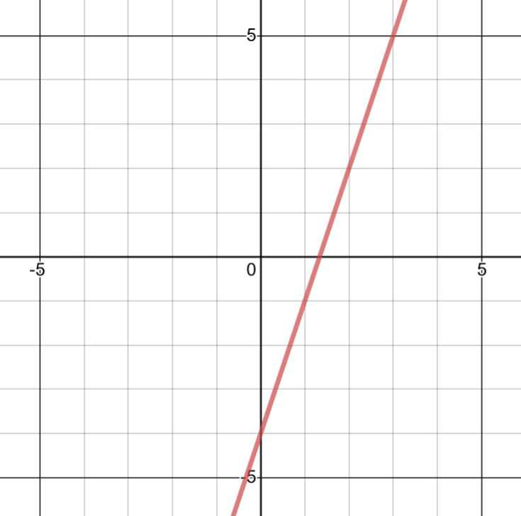
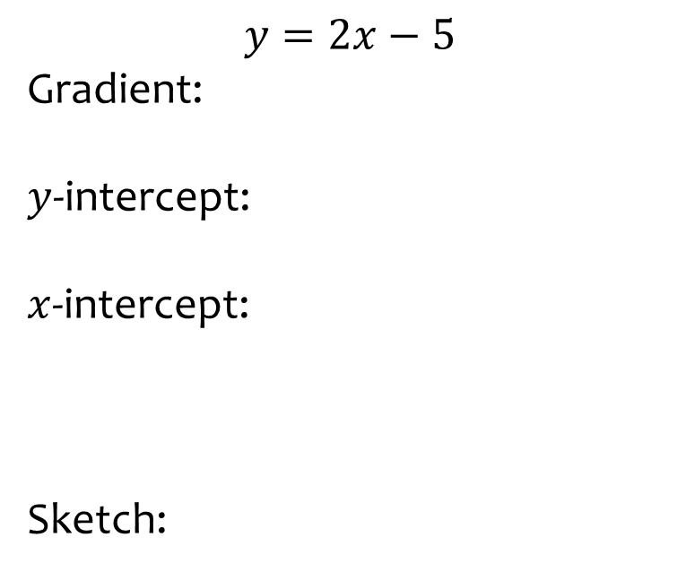
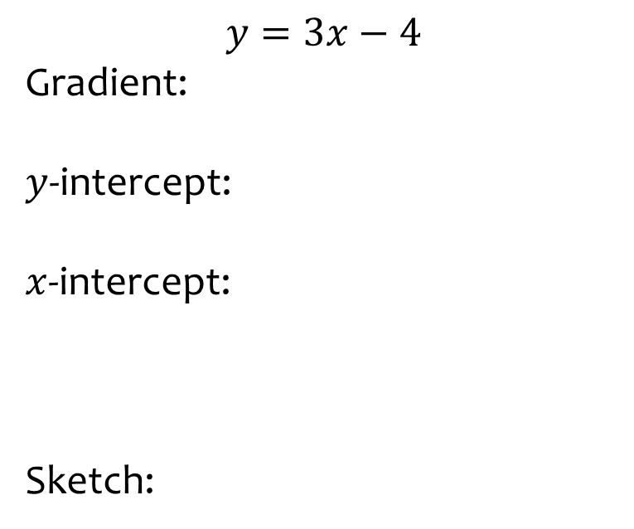
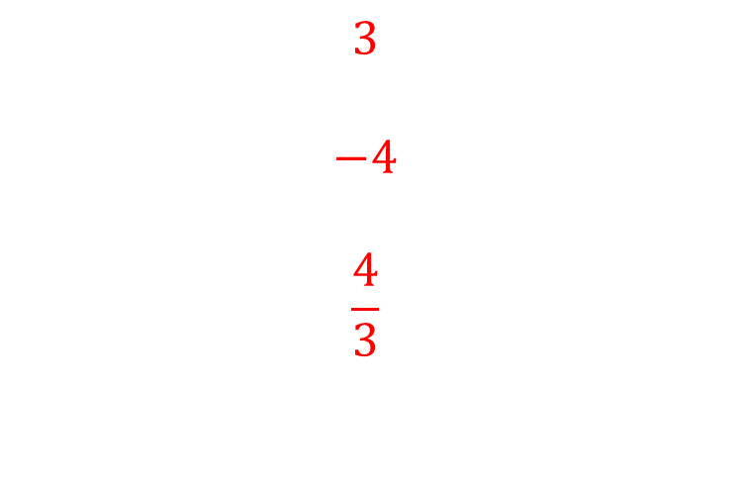
Worked example
Your turn
$$y=2x−5$$
Gradient:
$y$-intercept:
$x$-intercept:
Sketch:
$$y=3x−4$$
Gradient:
$y$-intercept:
$x$-intercept:
Sketch:
$$3$$
$$−4$$
$$\frac{4}{3}$$
Graph used with permission from DESMOS: https://www.desmos.com/

Slide 10
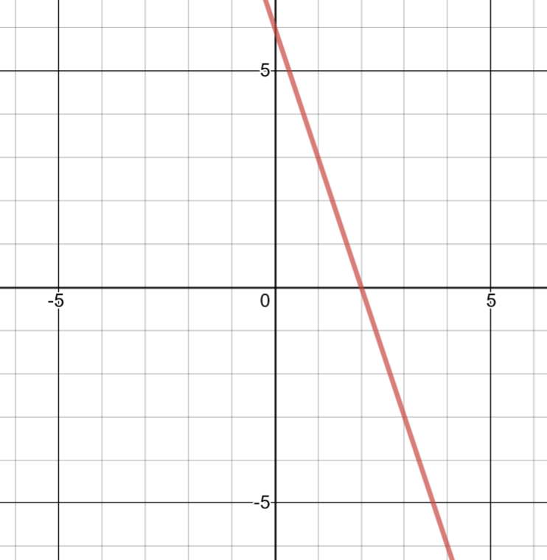
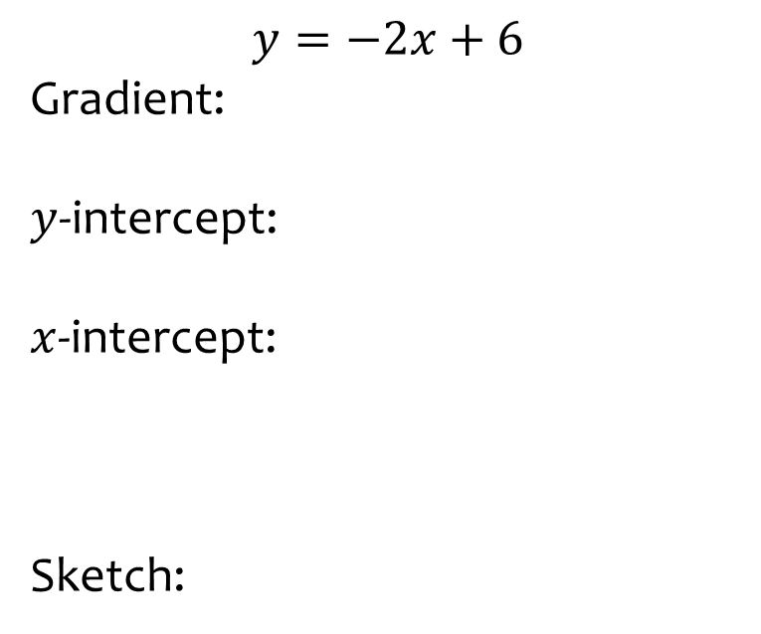
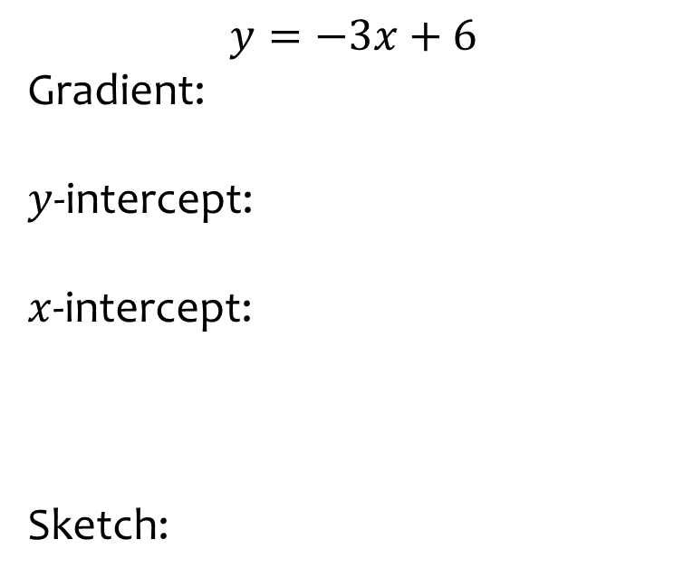
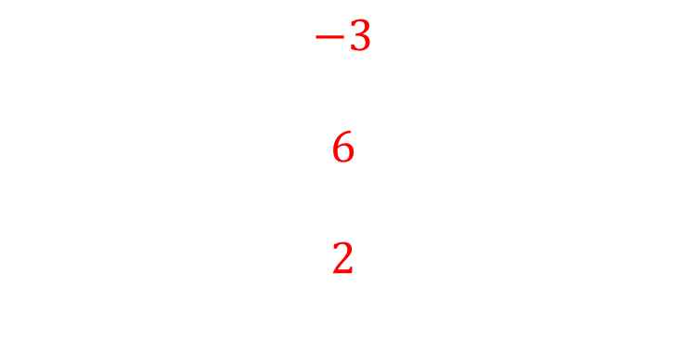
Worked example
Your turn
$$y=−2x+6$$
Gradient:
$y$-intercept:
$x$-intercept:
Sketch:
$$y=−3x+6$$
Gradient:
$y$-intercept:
$x$-intercept:
Sketch:
$$−3$$
$$6$$
$$2$$
Graph used with permission from DESMOS: https://www.desmos.com/

Slide 11
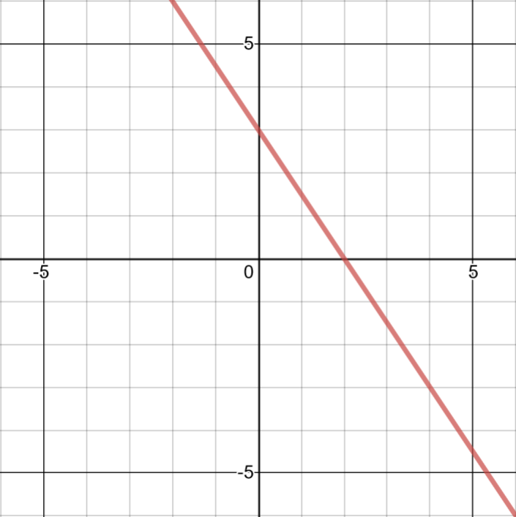
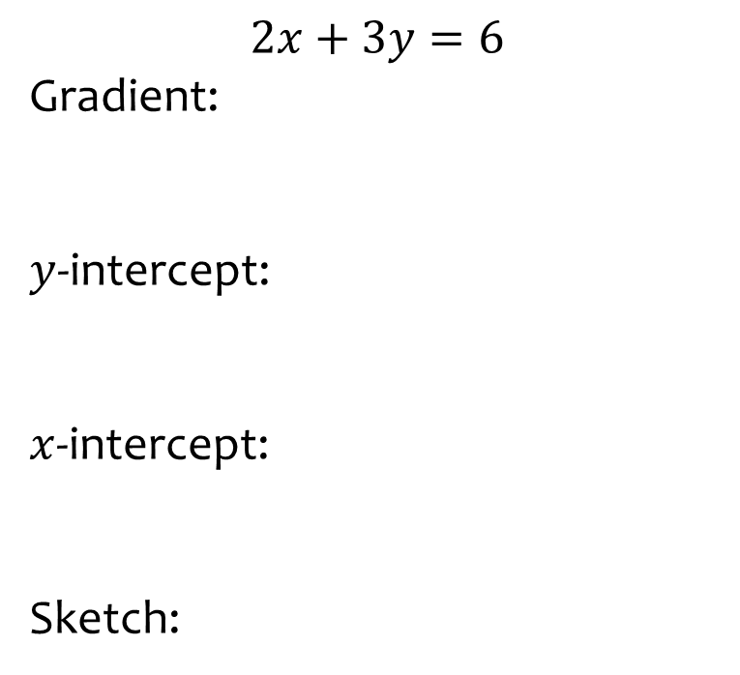
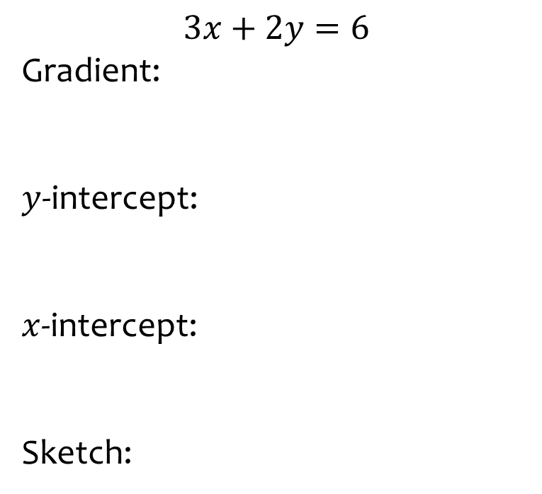
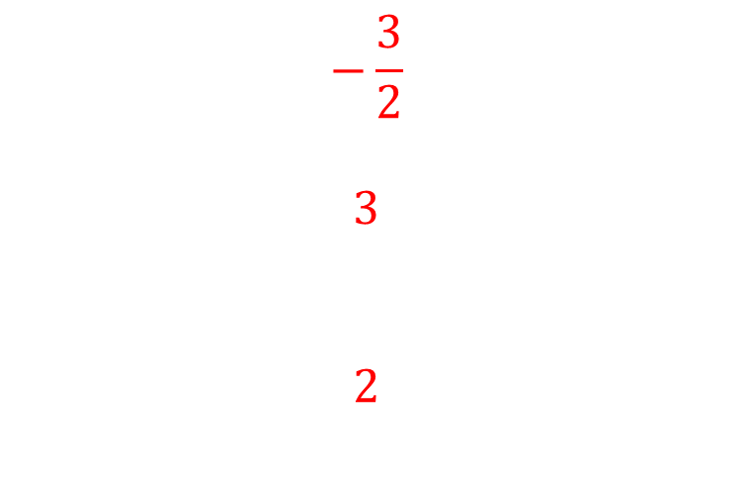
Worked example
Your turn
$$2x+3y=6$$
Gradient:
$y$-intercept:
$x$-intercept:
Sketch:
$$3x+2y=6$$
Gradient:
$y$-intercept:
$x$-intercept:
Sketch:
$$−\frac{3}{2}$$
$$3$$
$$2$$
Graph used with permission from DESMOS: https://www.desmos.com/

Slide 12
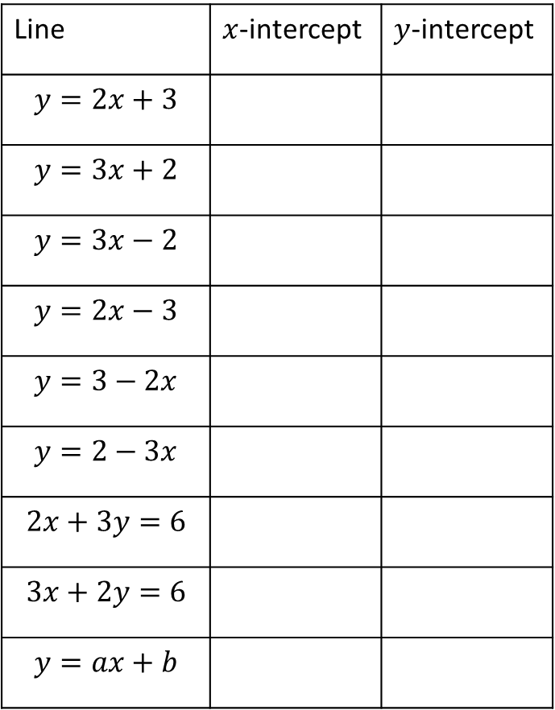
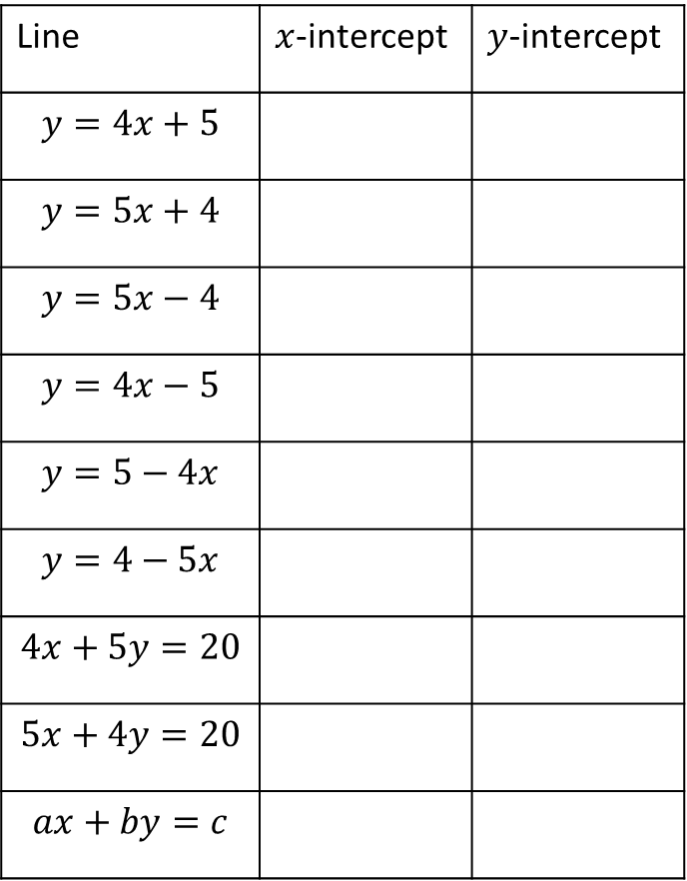
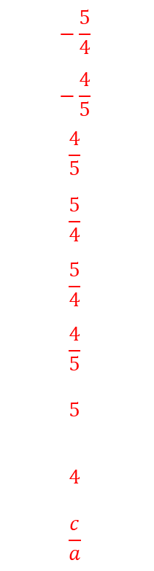
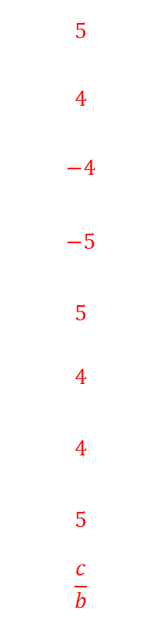
Worked example
Your turn
Find where the line intercepts the axes:
Find where the line intercepts the axes:
Line | $x$-intercept | $y$-intercept
$$y=2x+3$$
$$y=3x+2$$
$$y=3x−2$$
$$y=2x−3$$
$$y=3−2x$$
$$y=2−3x$$
$$2x+3y=6$$
$$3x+2y=6$$
$$y=ax+b$$
Line | $x$-intercept | $y$-intercept
$$y=4x+5$$
$$y=5x+4$$
$$y=5x−4$$
$$y=4x−5$$
$$y=5−4x$$
$$y=4−5x$$
$$4x+5y=20$$
$$5x+4y=20$$
$$ax+by=c$$
$$−\frac{5}{4}$$
$$−\frac{4}{5}$$
$$\frac{4}{5}$$
$$\frac{5}{4}$$
$$\frac{5}{4}$$
$$\frac{4}{5}$$
$$5$$
$$4$$
$$\frac{c}{a}$$
$$5$$
$$4$$
$$−4$$
$$−5$$
$$5$$
$$4$$
$$4$$
$$5$$
$$\frac{c}{b}$$

Slide 13
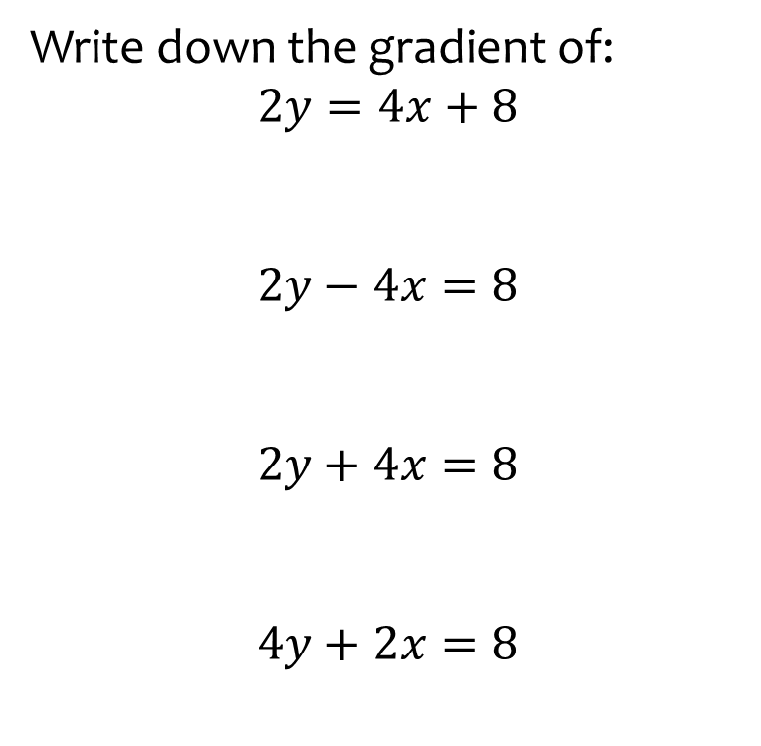
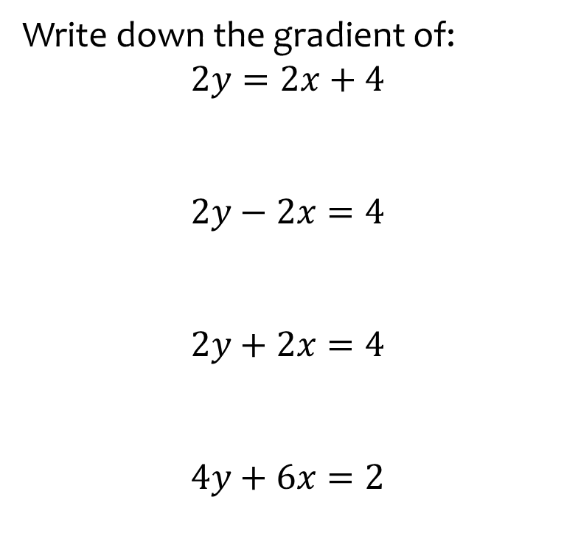
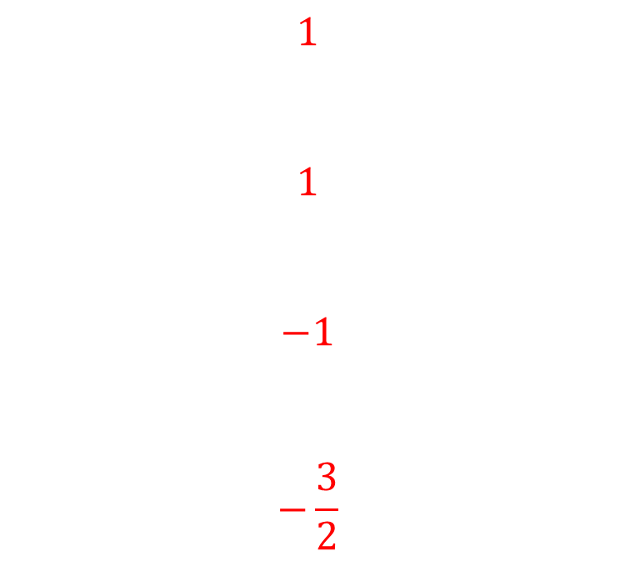
Worked example
Your turn
Write down the gradient of:
$$2y=4x+8$$
$$2y−4x=8$$
$$2y+4x=8$$
$$4y+2x=8$$
Write down the gradient of:
$$2y=2x+4$$
$$2y−2x=4$$
$$2y+2x=4$$
$$4y+6x=2$$
$$1$$
$$1$$
$$−1$$
$$−\frac{3}{2}$$

Slide 14
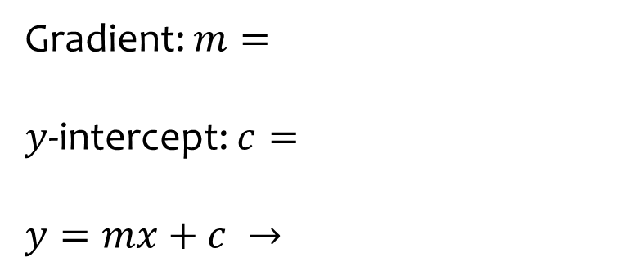
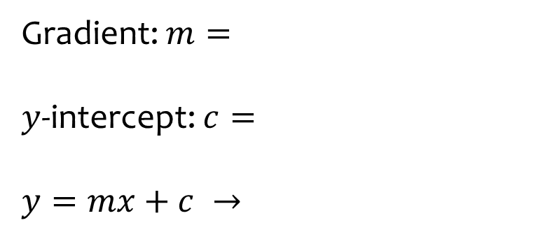
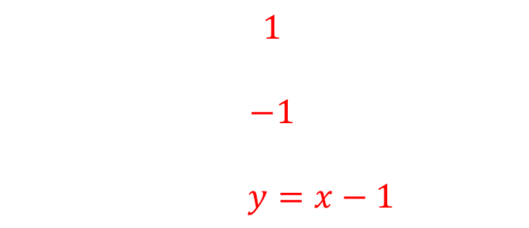
Worked example
Your turn
Gradient: $m=$
$y$-intercept: $c=$
$$y=mx+c →$$
Gradient: $m=$
$y$-intercept: $c=$
$$y=mx+c →$$
$1$
$−1$
$y=x−1$

Slide 15
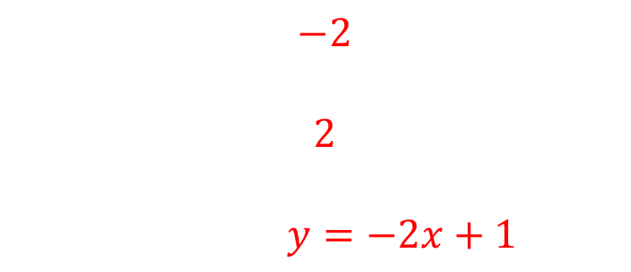
Worked example
Your turn
Gradient: $m=$
$y$-intercept: $c=$
$$y=mx+c →$$
Gradient: $m=$
$y$-intercept: $c=$
$$y=mx+c →$$
$−2$
$2$
$y=−2x+1$

Slide 16
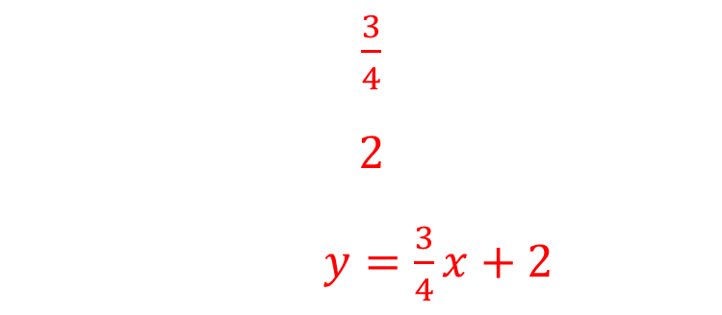
Worked example
Your turn
Gradient: $m=$
$y$-intercept: $c=$
$$y=mx+c →$$
Gradient: $m=$
$y$-intercept: $c=$
$$y=mx+c →$$
$\frac{3}{4}$
$2$
$y=\frac{3}{4}x+2$

Slide 17
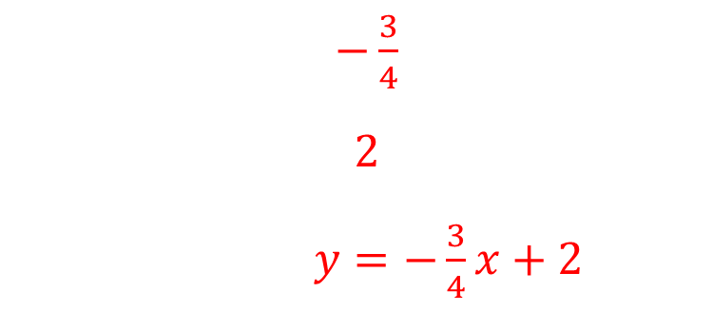
Worked example
Your turn
Gradient: $m=$
$y$-intercept: $c=$
$$y=mx+c →$$
Gradient: $m=$
$y$-intercept: $c=$
$$y=mx+c →$$
$−\frac{3}{4}$
$2$
$y=−\frac{3}{4}x+2$

Slide 18
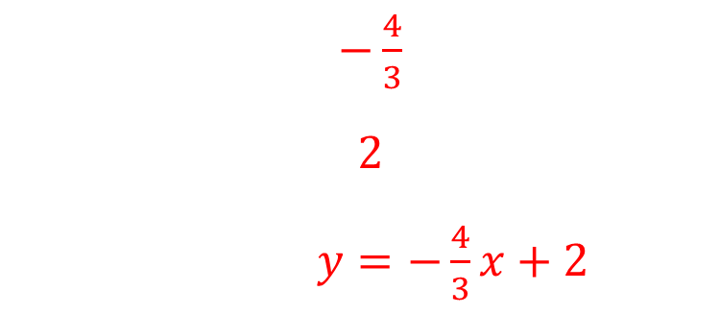
Worked example
Your turn
Gradient: $m=$
$y$-intercept: $c=$
$$y=mx+c →$$
Gradient: $m=$
$y$-intercept: $c=$
$$y=mx+c →$$
$−\frac{4}{3}$
$2$
$y=−\frac{4}{3}x+2$

Slide 19
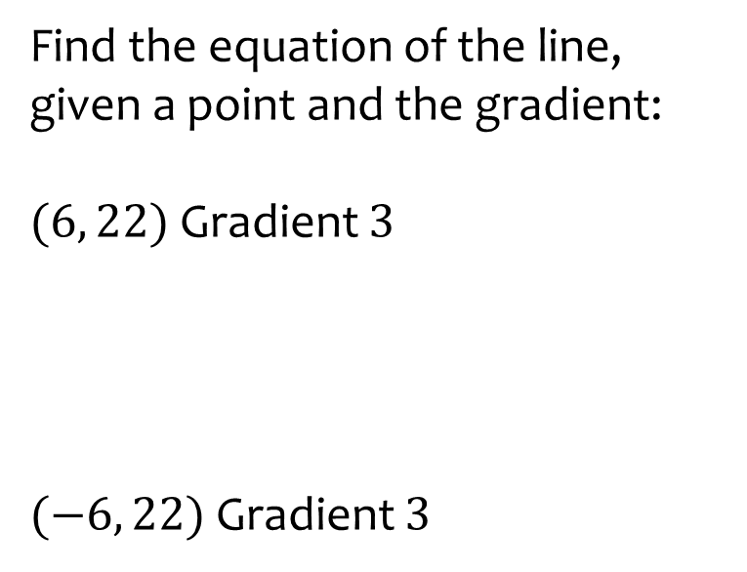
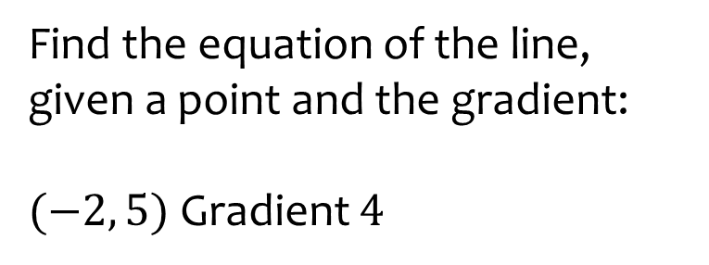

Worked example
Your turn
Find the equation of the line, given a point and the gradient:
$(6, 22)$ Gradient $3$
$(−6, 22)$ Gradient $3$
Find the equation of the line, given a point and the gradient:
$(−2, 5)$ Gradient $4$
$$y=4x+13$$

Slide 20
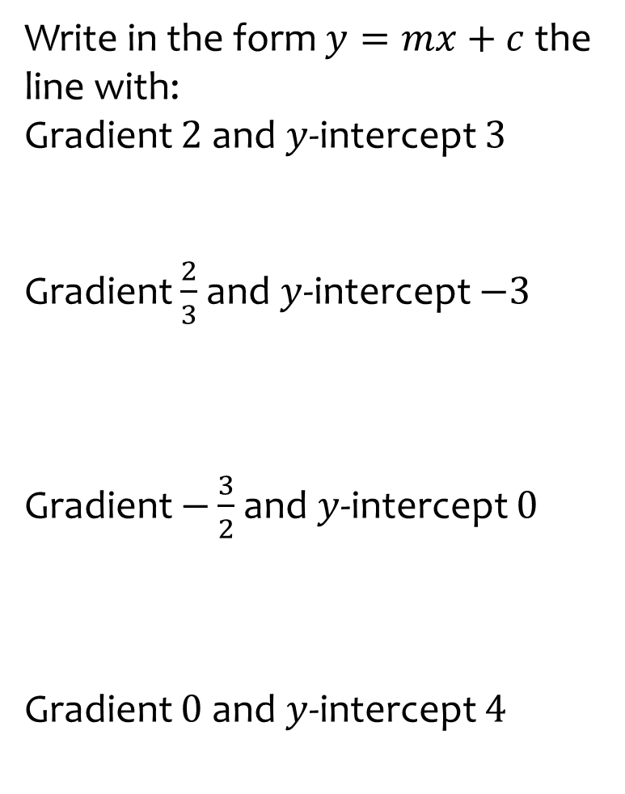
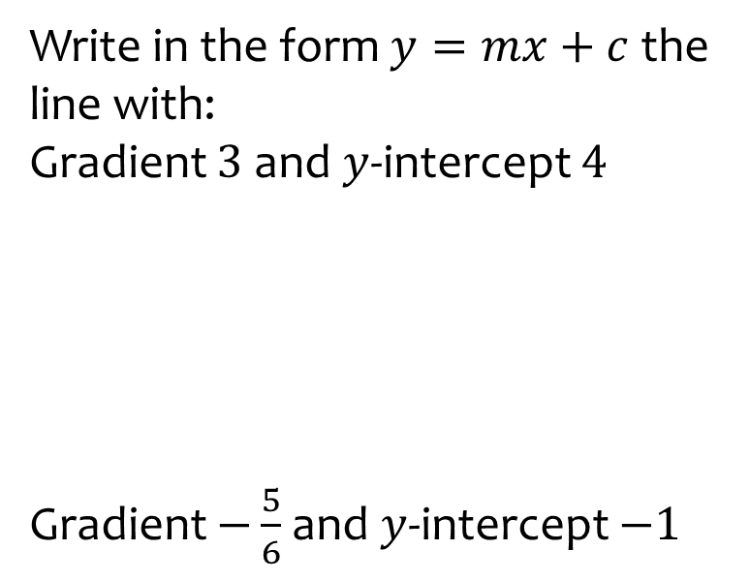
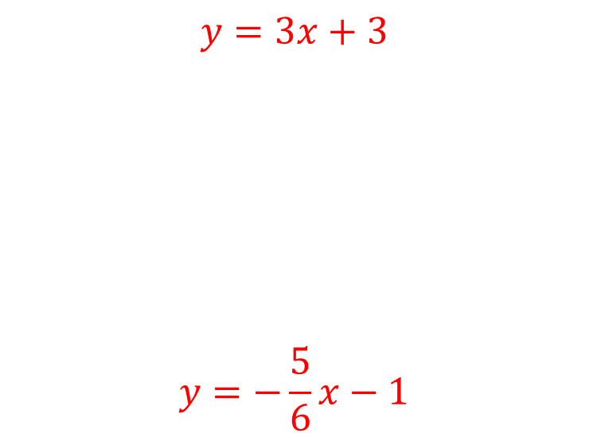
Worked example
Your turn
Write in the form $y=mx+c$ the line with:
Gradient $2$and $y$-intercept $3$
Gradient $\frac{2}{3}$ and $y$-intercept $−3$
Gradient $−\frac{3}{2}$ and $y$-intercept $0$
Gradient $0$ and $y$-intercept $4$
Write in the form $y=mx+c$ the line with:
Gradient $3$ and $y$-intercept $4$
Gradient $−\frac{5}{6}$and $y$-intercept $−1$
$$y=3x+3$$
$$y=−\frac{5}{6}x−1$$

Slide 21
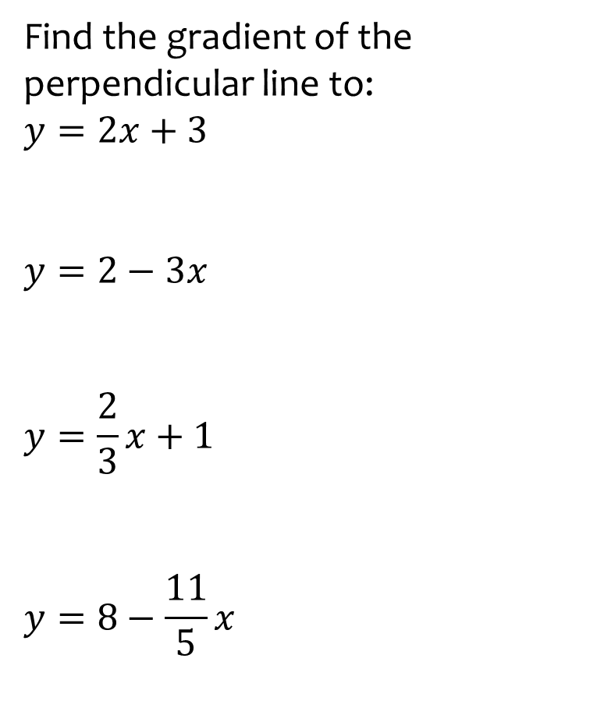
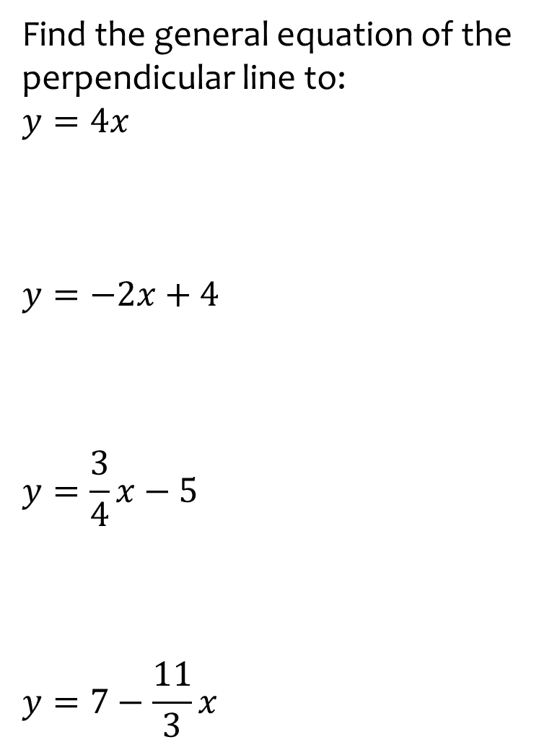
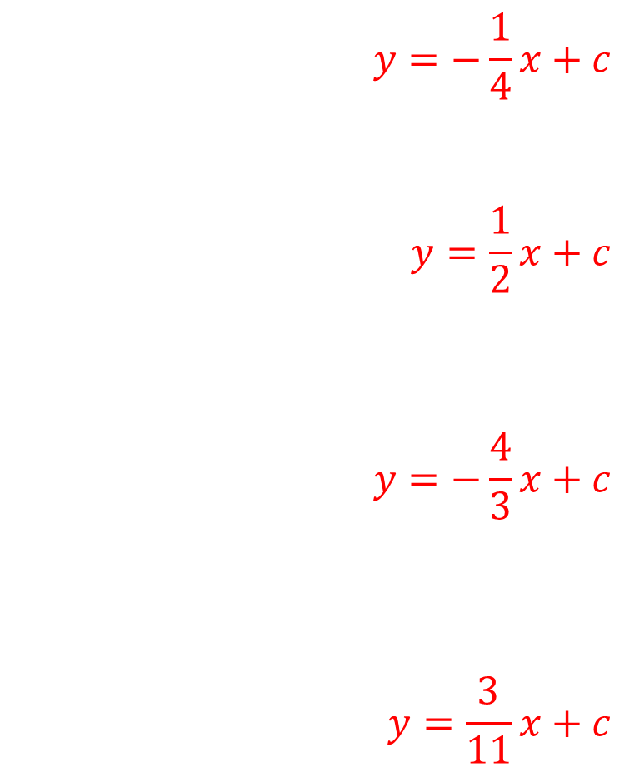
Worked example
Your turn
Find the gradient of the perpendicular line to:
$$y=2x+3$$
$$y=2−3x$$
$$y=\frac{2}{3}x+1$$
$$y=8−\frac{11}{5}x$$
Find the general equation of the perpendicular line to:
$$y=4x$$
$$y=−2x+4$$
$$y=\frac{3}{4}x−5$$
$$y=7−\frac{11}{3}x$$
$$y=−\frac{1}{4}x+c$$
$$y=\frac{1}{2}x+c$$
$$y=−\frac{4}{3}x+c$$
$$y=\frac{3}{11}x+c$$

Slide 22
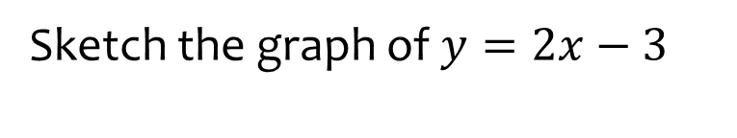
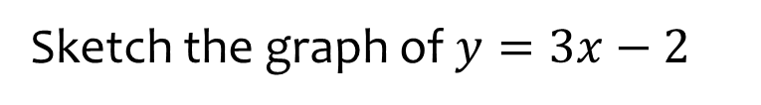
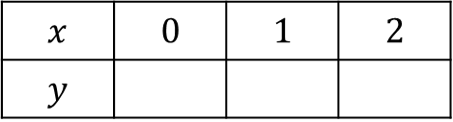
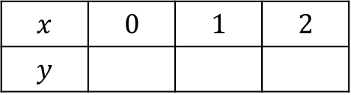

Worked example
Your turn
Sketch the graph of $y=2x−3$
Sketch the graph of $y=3x−2$
$$x$$ | $$0$$ | $$1$$ | $$2$$
$$y$$
$$x$$ | $$0$$ | $$1$$ | $$2$$
$$y$$
$$−2 1 4$$

Slide 23
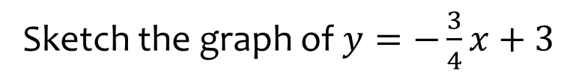


Worked example
Your turn
Sketch the graph of $y=−\frac{3}{4}x+3$
Sketch the graph of $y=−\frac{1}{2}x+5$
$$x$$ | $$0$$ | $$1$$ | $$2$$
$$y$$
$$x$$ | $$0$$ | $$1$$ | $$2$$
$$y$$
$$5 4.5 4$$

Slide 24







Worked example
Your turn
Sketch the graph of $x+y=6$
Sketch the graph of $x+y=5$
$$x$$ | $$0$$ |  | $$1$$
$$y$$ |  | $$0$$
$$5$$
$$x$$ | $$0$$ |  | $$1$$
$$y$$ |  | $$0$$
$$5$$
$$4$$

Slide 25





Worked example
Your turn
Sketch the graph of $4x+3y=12$
Sketch the graph of $3x+4y=12$
$$x$$ | $$0$$ |  | $$1$$
$$y$$ |  | $$0$$
$$4$$
$$x$$ | $$0$$ |  | $$1$$
$$y$$ |  | $$0$$
$$3$$
$$2.25$$

Slide 26





Worked example
Your turn
Sketch the graph of $4x−3y=12$
Sketch the graph of $3x−4y=12$
$$x$$ | $$0$$ |  | $$1$$
$$y$$ |  | $$0$$
$$4$$
$$x$$ | $$0$$ |  | $$1$$
$$y$$ |  | $$0$$
$$−3$$
$$−2.25$$

Slide 27



Worked example
Your turn
Sketch using the table of values:
Sketch using the table of values:
$$x$$ | $$−1$$ | $$0$$ | $$1$$ | $$2$$ | $$3$$
$$y$$ | $$1$$ | $$3$$ | $$5$$ | $$7$$ | $$9$$
$$x$$ | $$−1$$ | $$0$$ | $$1$$ | $$2$$ | $$3$$
$$y$$ | $$−1$$ | $$2$$ | $$5$$ | $$8$$ | $$11$$

Slide 28



Worked example
Your turn
Find the equation of the line parallel to $y=3x+5$ that passes through $(−2, 5)$
Find the equation of the line parallel to $y=−\frac{1}{3}x−4$ that passes through $(−2, 5)$
Find the equation of the line parallel to $y=−\frac{1}{2}x−3$ that passes through $(−2, 5)$
$$y=−\frac{1}{2}x+4$$

Slide 29



Worked example
Your turn
Find the equation of the line perpendicular to $y=2x−4$ that passes through $(−2, 5)$
Find the equation of the line perpendicular to $y=4x+5$ that passes through $(−2, 5)$
Find the equation of the line perpendicular to $y=3x+2$ that passes through $(9, −7)$
$$y=−\frac{1}{3}x−4$$

Slide 30



Worked example
Your turn
Find the equation of the line perpendicular to $y=\frac{1}{2}x−4$ that passes through $(−2, 5)$
Find the equation of the line perpendicular to $y=−\frac{2}{3}x+5$ that passes through $(−2, 5)$
Find the equation of the line perpendicular to $y=−\frac{4}{3}x+3$ that passes through $(−12, −5)$
$$y=\frac{3}{4}x+4$$

Slide 31



Worked example
Your turn
Find the equation of the line perpendicular to $x+2y=5$ which passes through the point $(3, 7)$
Find the equation of the line perpendicular to $3x+2y=5$ which passes through the point $(3, 7)$
Find the equation of the line perpendicular to $2x+3y=5$ which passes through the point $(4, 7)$
$$y=\frac{3}{2}x+1$$

Slide 32



Worked example
Your turn
Write down an equation of a line parallel to $y=3x−4$ which passes through the origin.
Write down an equation of a line parallel to $y=3−4x$which passes through the origin.
Write down an equation of a line parallel to $y=−2x+5$ which passes through the origin.
$$y=−2x$$

Slide 33



Worked example
Your turn
Calculate the gradient between the coordinates:
$\left(2, 1\right)$ and $(5, 7)$
$(−2, −1)$ and $(5, 7)$
Calculate the gradient between the coordinates:
$\left(−4, 2\right)$ and $(6, 8)$
$$\frac{3}{5}$$

Slide 34



Worked example
Your turn
Calculate the gradient between the coordinates:
$\left(2, 1\right)$ and $(5, −7)$
$(2, −1)$ and $(−5, −7)$
Calculate the gradient between the coordinates:
$\left(−4, 2\right)$ and $(−6, −8)$
$$5$$

Slide 35



Worked example
Your turn
Write the equation of the line in the form $y=mx+c$ which passes through the points $(2, 3)$ and $(5, 9)$
Write the equation of the line in the form $y=mx+c$ which passes through the points $(2, 3)$ and $(5, −9)$
Write the equation of the line in the form $y=mx+c$ which passes through the points $(3, 10)$ and $(−5, 18)$
$$y=−x−7$$

Slide 36



Worked example
Your turn
Write the equation of the line in the form $y=mx+c$ which passes through the points $(2, −3)$ and $(7, −5)$
Write the equation of the line in the form $y=mx+c$ which passes through the points $(3, −2)$ and $(−7, 5)$
$$y=−\frac{3}{10}x−\frac{11}{10}$$

Slide 37



Worked example
Your turn
Find the point of intersection of
$y=2x−2$and $y=5x+1$
Find the point of intersection of
$y=2x+3$and $y=x+4$
$$(1, 5)$$

Slide 38



Worked example
Your turn
Find the point of intersection of
$y=2x−4$and $3x+2y=6$
Find the point of intersection of
$y=x−3$and $2x+3y=6$
$$(3, 0)$$

Slide 39


Worked example
Your turn
Find the point of intersection of
$y=2x−2$and $y=2x+3$
Find the point of intersection of
$y=3x−2$and $y=3x−4$
No point of intersection - the lines are parallel

Slide 40



Worked example
Your turn
Find the distance between the line segment connecting:
$(2, 4)$and$(8, 8)$
$(−2, 4)$ and $(−9, 9)$
Find the distance between the line segment connecting:
$(2, −4)$ and $(11, 8)$
$$15$$

Slide 41



Worked example
Your turn
Find the midpoint of the line segment between:
$(2, 4)$and$(8, 8)$
$(−2, 4)$ and $(−9, 9)$
Find the midpoint of the line segment between:
$(2, −4)$ and $(11, 8)$
$$(6.5, 2)$$

Slide 42



Worked example
Your turn
A is the point $\left(3, 8\right)$
$B$ is the point $(1, −2)$
$C$ is the midpoint of $AB$.
Find the equation of the line perpendicular to $AB$ which passes through $C$
A is the point $\left(3, 8\right)$
$B$ is the point $(1, 4)$
$C$ is the midpoint of $AB$.
Find the equation of the line perpendicular to $AB$ which passes through $C$
$$y=−\frac{1}{2}x+7$$

Slide 43




Worked example
Your turn
ABCD is a rhombus.
A has coordinates $\left(5, 10\right)$
The equation of $DB$ is $y=\frac{1}{2}x+5$.
Find an equation of diagonal $AC$
ABCD is a rhombus.
A has coordinates $\left(5, 11\right)$
The equation of $DB$ is $y=\frac{1}{2}x+6$.
Find an equation of diagonal $AC$
$$y=−2x+21$$

Slide 44



Worked example
Your turn
Calculate the gradient between the coordinates:
$(7, 9a)$ and $(10, 4a)$
$(2a, 5)$ and $(7a, 8)$
Calculate the gradient between the coordinates:
$(4, 8a)$ and $(11, 2a)$
$$−\frac{6a}{7}$$

Slide 45



Worked example
Your turn
The gradient connecting the two points $(2a, 5)$ and $(7a, 8)$ is $6$. Solve for $a$
The gradient connecting the two points $(3a, 7)$ and $(5a, 12)$ is $6$. Solve for $a$
$$a=\frac{5}{12}$$

Slide 46



Worked example
Your turn
The gradient connecting the two points $(2, −5)$ and $(a, b)$ is $4$. Find an expression for $b$ in terms of $a$
The gradient connecting the two points $(−3, 4)$ and $(a, b)$ is $2$. Find an expression for $b$ in terms of $a$
$$b=2a+10$$

