Slide 1
SOLVING EQUATIONS (WITH SQUARES)
CONTENTS

Slide 2
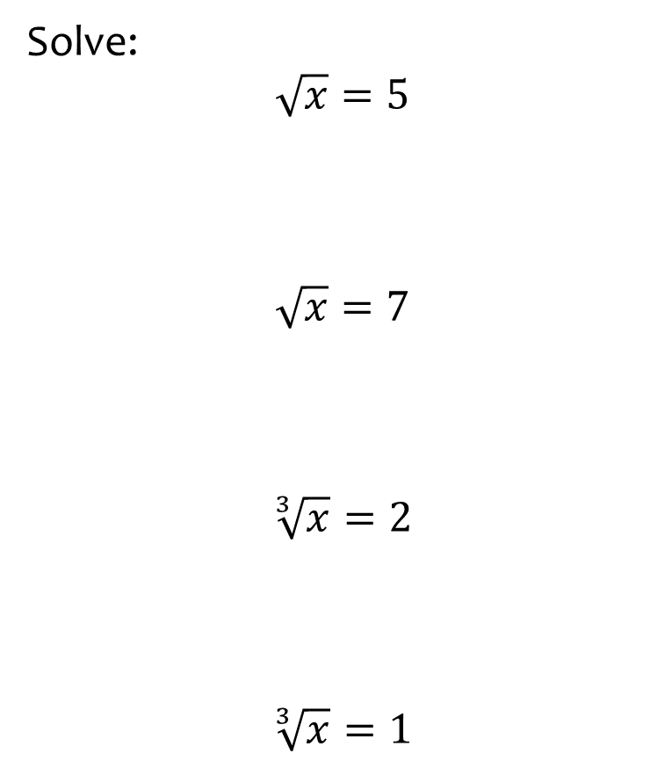
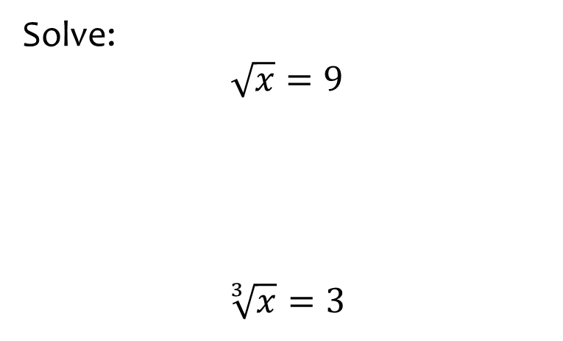
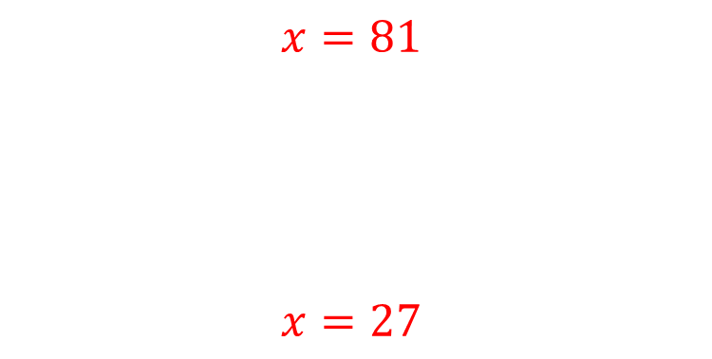
Worked example
Your turn
Solve:
$$\sqrt{x}=5$$
$$\sqrt{x}=7$$
$$\sqrt[3]{x}=2$$
$$\sqrt[3]{x}=1$$
Solve:
$$\sqrt{x}=9$$
$$\sqrt[3]{x}=3$$
$$x=81$$
$$x=27$$

Slide 3
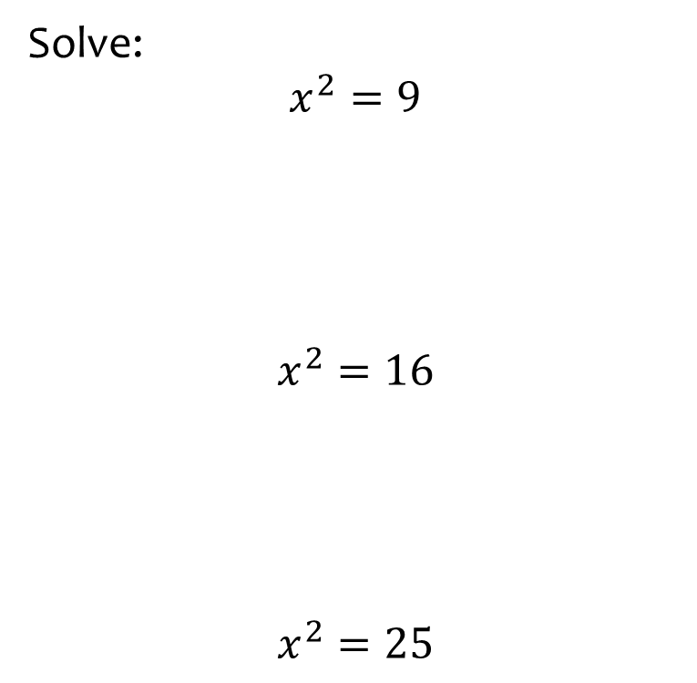
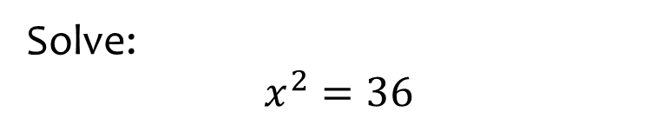

Worked example
Your turn
Solve:
$$x^{2}=9$$
$$x^{2}=16$$
$$x^{2}=25$$
Solve:
$$x^{2}=36$$
$$x=±2$$

Slide 4
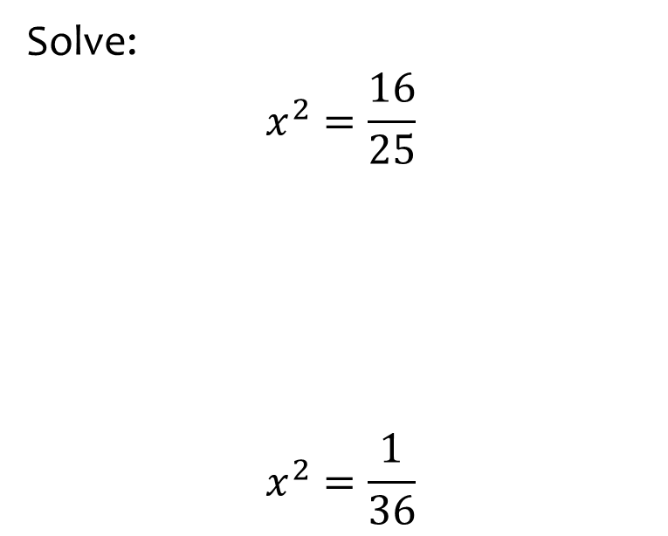
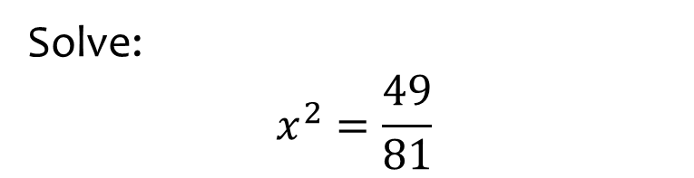

Worked example
Your turn
Solve:
$$x^{2}=\frac{16}{25}$$
$$x^{2}=\frac{1}{36}$$
Solve:
$$x^{2}=\frac{49}{81}$$
$$x=±\frac{7}{9}$$

Slide 5
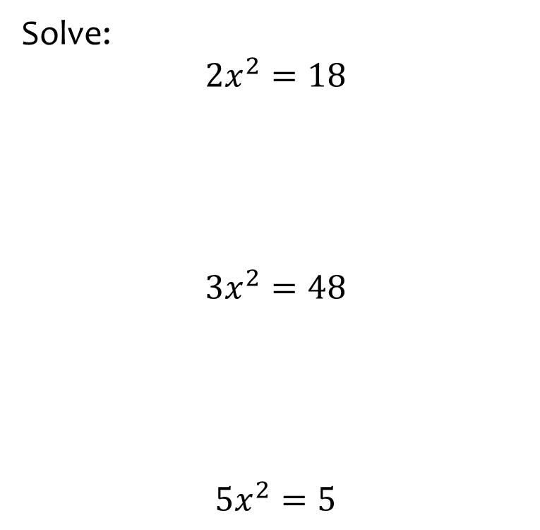
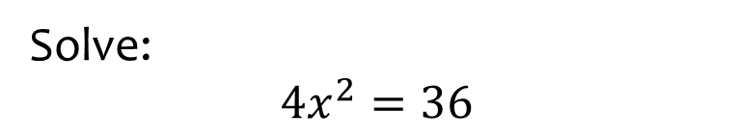

Worked example
Your turn
Solve:
$${2x}^{2}=18$$
$${3x}^{2}=48$$
$$5x^{2}=5$$
Solve:
$${4x}^{2}=36$$
$$x=±3$$

Slide 6
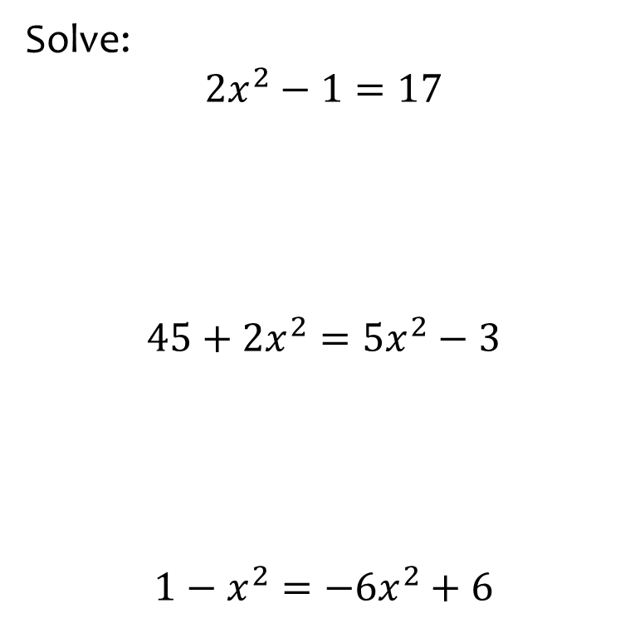
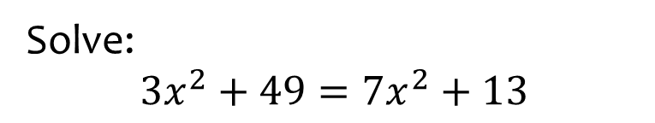
Worked example
Your turn
Solve:
$${2x}^{2}−1=17$$
$$45+2x^{2}=5x^{2}−3$$
$$1−x^{2}=−6x^{2}+6$$
Solve:
$${3x}^{2}+49=7x^{2}+13$$
$$x=±3$$

Slide 7
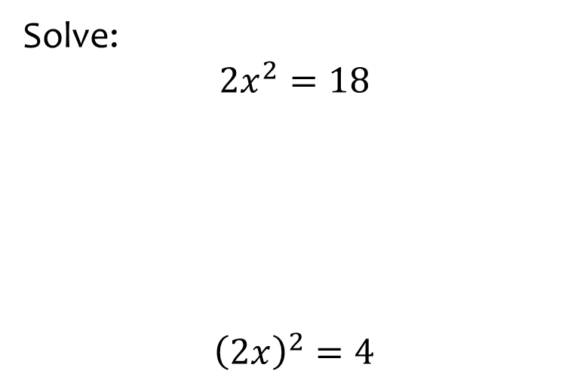
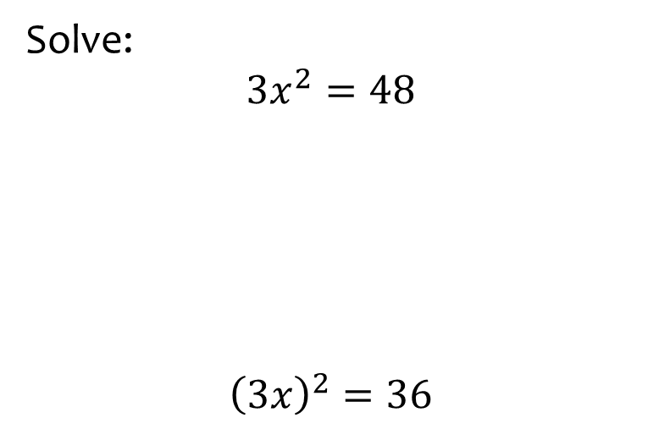


Worked example
Your turn
Solve:
$$2x^{2}=18$$
$${\left(2x\right)}^{2}=4$$
Solve:
$$3x^{2}=48$$
$${\left(3x\right)}^{2}=36$$
$$x=±4$$
$$x=±2$$

Slide 8
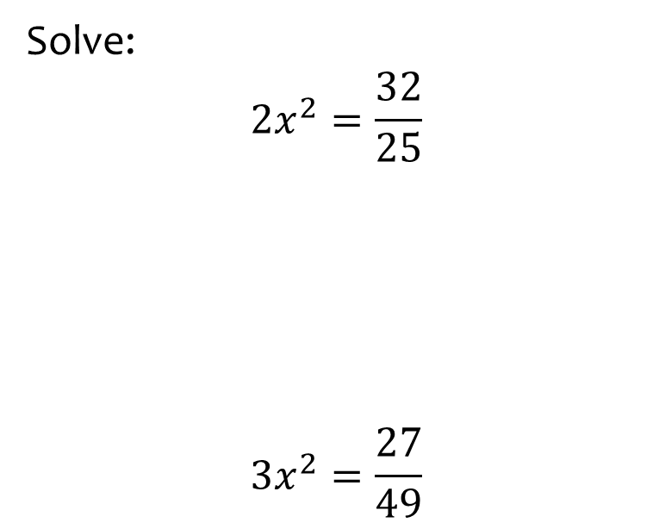
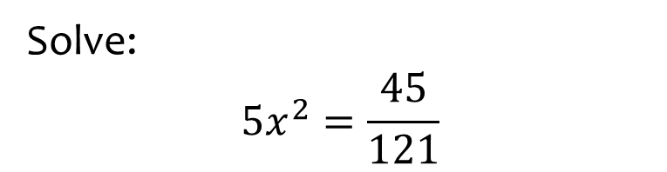

Worked example
Your turn
Solve:
$$2x^{2}=\frac{32}{25}$$
$$3x^{2}=\frac{27}{49}$$
Solve:
$$5x^{2}=\frac{45}{121}$$
$$x=±\frac{3}{11}$$

