Slide 1
SOLVING EQUATIONS (QUADRATICS HIDDEN)
CONTENTS

Slide 2
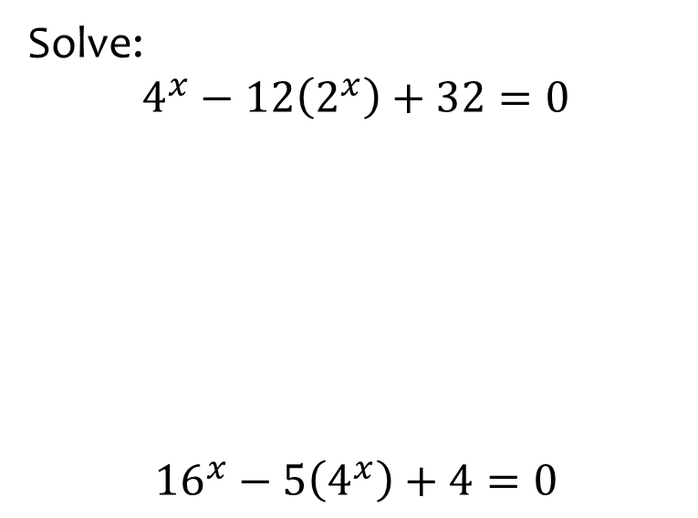
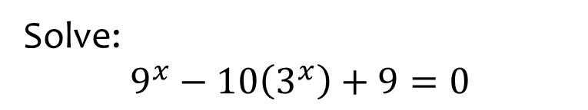

Worked example
Your turn
Solve:
$$4^{x}−12\left(2^{x}\right)+32=0$$
$${16}^{x}−5\left(4^{x}\right)+4=0$$
Solve:
$$9^{x}−10\left(3^{x}\right)+9=0$$
$$x=2, x=0$$

Slide 3
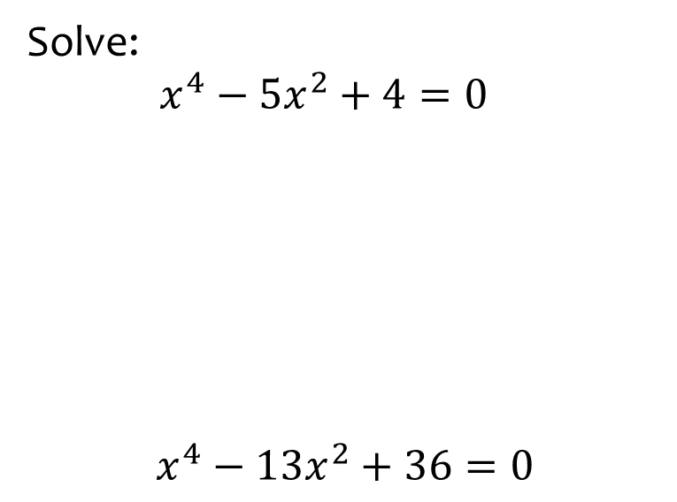
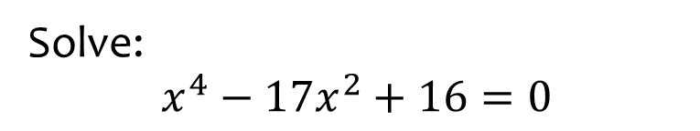

Worked example
Your turn
Solve:
$x^{4}−5x^{2}+4=0$
$$x^{4}−13x^{2}+36=0$$
Solve:
$$x^{4}−17x^{2}+16=0$$
$$x=±4, x=±1$$

Slide 4
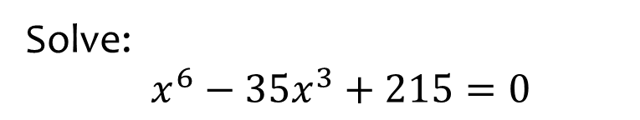
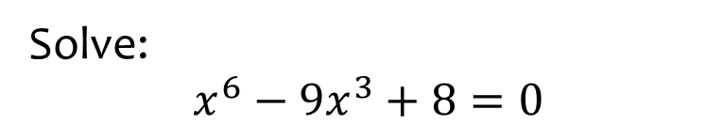

Worked example
Your turn
Solve:
$x^{6}−35x^{3}+215=0$
Solve:
$$x^{6}−9x^{3}+8=0$$
$$x=2, x=1$$

Slide 5
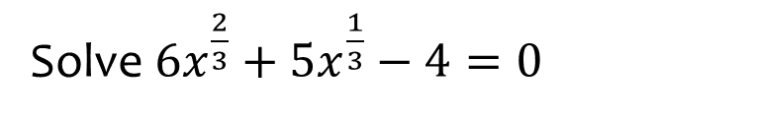
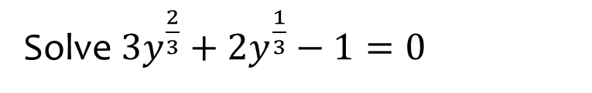

Worked example
Your turn
Solve $6x^{\frac{2}{3}}+5x^{\frac{1}{3}}−4=0$
Solve ${3y}^{\frac{2}{3}}+2y^{\frac{1}{3}}−1=0$
$$y=\frac{1}{27}, y=−1$$

Slide 6
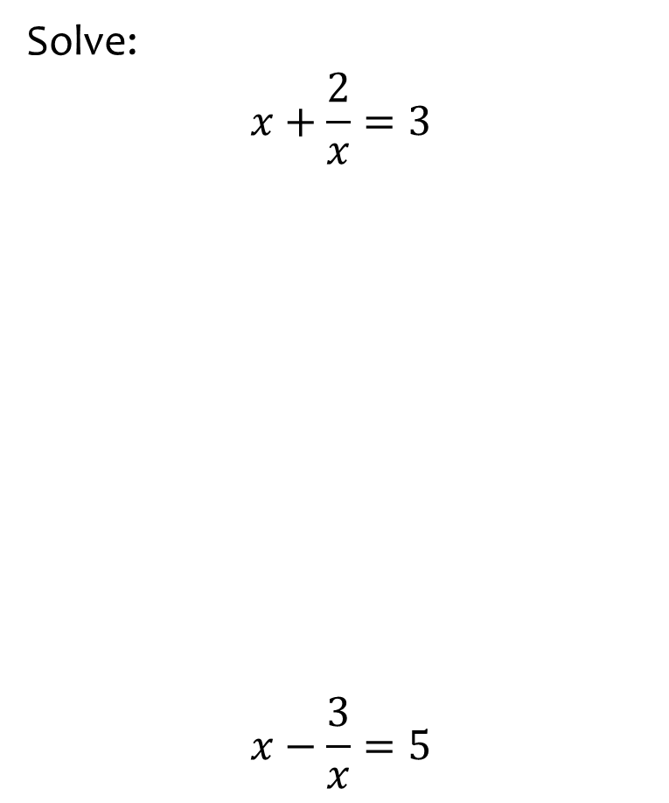
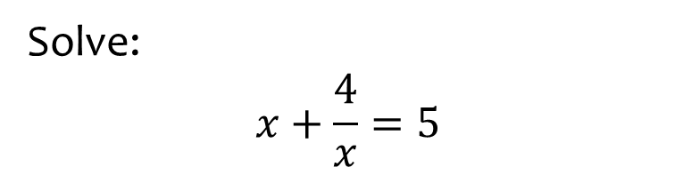

Worked example
Your turn
Solve:
$$x+\frac{2}{x}=3$$
$$x−\frac{3}{x}=5$$
Solve:
$$x+\frac{4}{x}=5$$
$$x=4, x=1$$

Slide 7
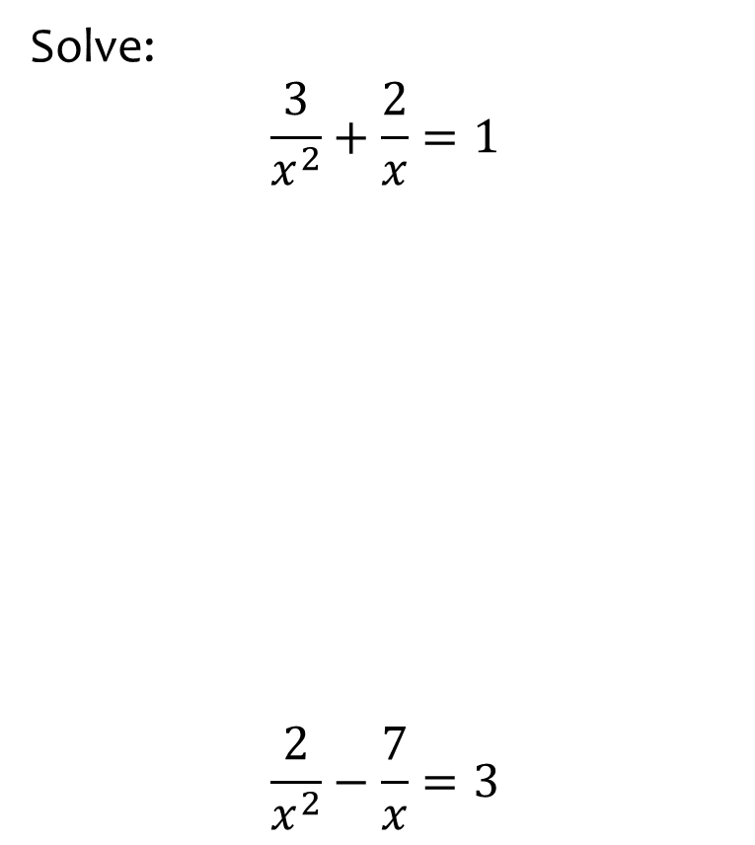
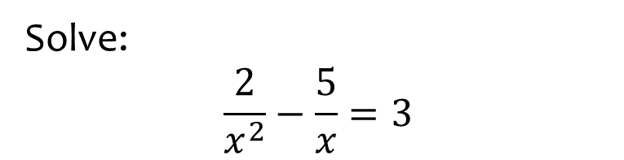

Worked example
Your turn
Solve:
$$\frac{3}{x^{2}}+\frac{2}{x}=1$$
$$\frac{2}{x^{2}}−\frac{7}{x}=3$$
Solve:
$$\frac{2}{x^{2}}−\frac{5}{x}=3$$
$$x=\frac{1}{3}, x=−2$$

