Slide 1
SOLVING EQUATIONS (QUADRATIC)
CONTENTS

Slide 2
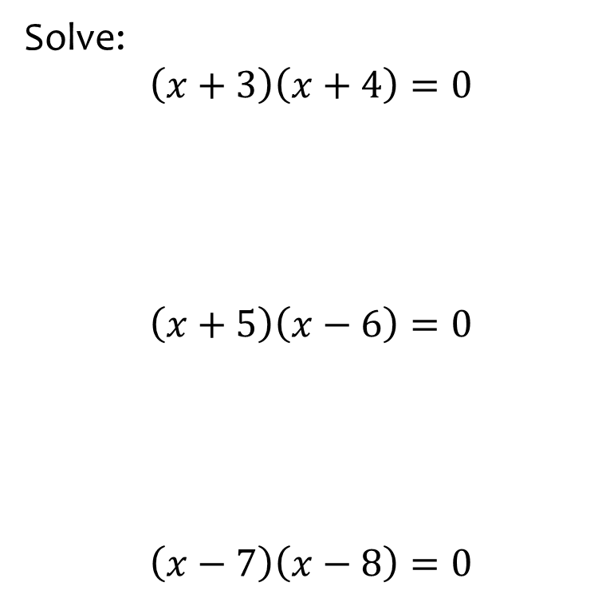
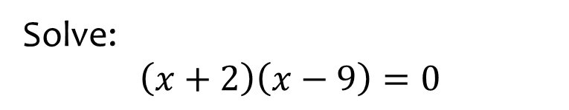

Worked example
Your turn
Solve:
$$\left(x+3\right)\left(x+4\right)=0$$
$$\left(x+5\right)\left(x−6\right)=0$$
$$\left(x−7\right)\left(x−8\right)=0$$
Solve:
$$\left(x+2\right)\left(x−9\right)=0$$
$$x=−2, x=9$$

Slide 3
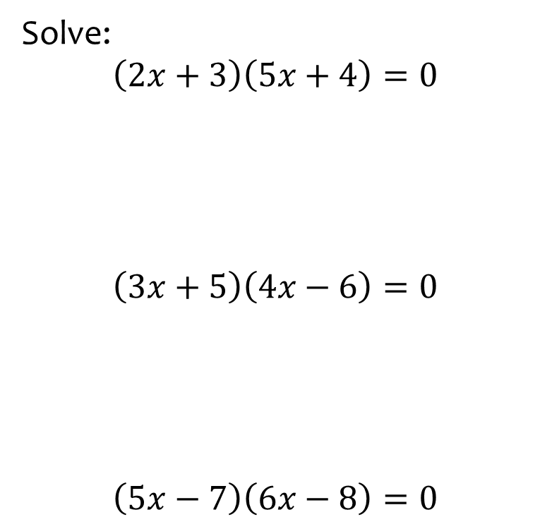
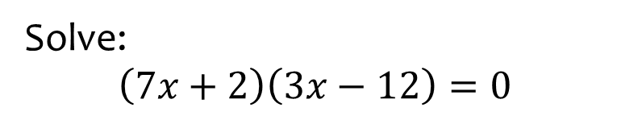

Worked example
Your turn
Solve:
$$\left(2x+3\right)\left(5x+4\right)=0$$
$$\left(3x+5\right)\left(4x−6\right)=0$$
$$\left(5x−7\right)\left(6x−8\right)=0$$
Solve:
$$\left(7x+2\right)\left(3x−12\right)=0$$
$$x=−\frac{2}{7}, x=4$$

Slide 4
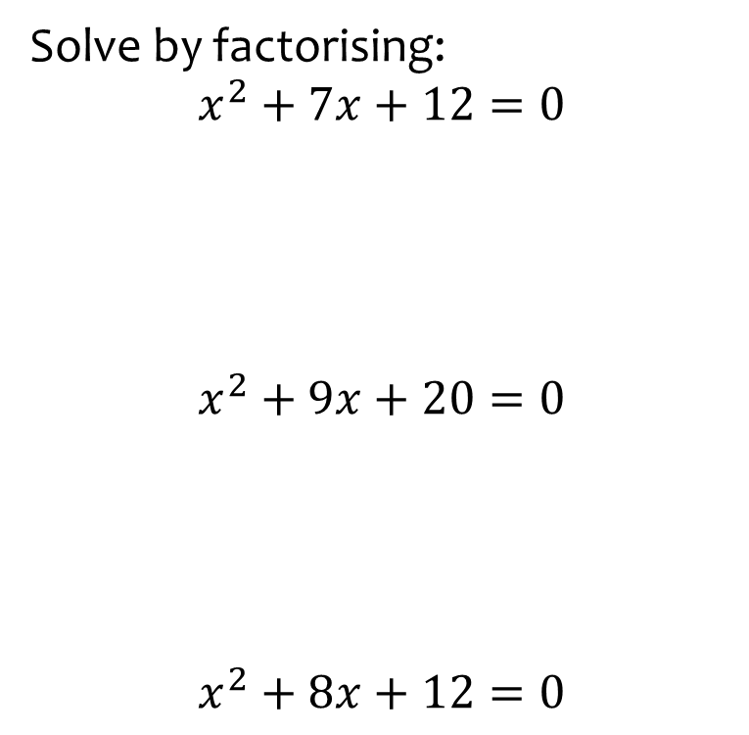
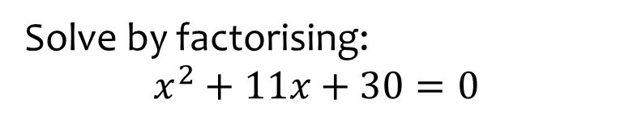

Worked example
Your turn
Solve by factorising:
$$x^{2}+7x+12=0$$
$$x^{2}+9x+20=0$$
$$x^{2}+8x+12=0$$
Solve by factorising:
$$x^{2}+11x+30=0$$
$$x=−5, x=−6$$

Slide 5
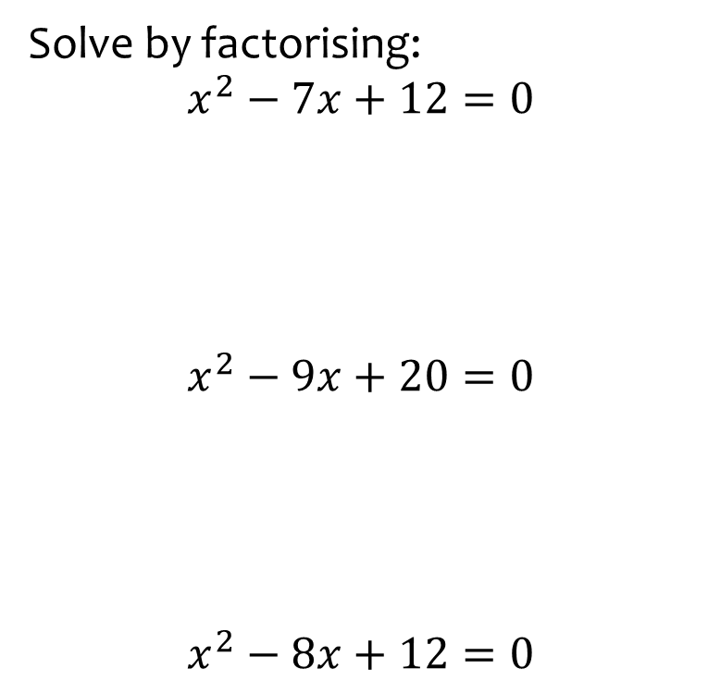
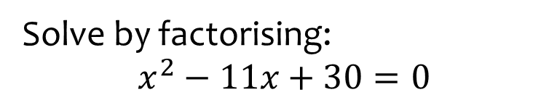

Worked example
Your turn
Solve by factorising:
$$x^{2}−7x+12=0$$
$$x^{2}−9x+20=0$$
$$x^{2}−8x+12=0$$
Solve by factorising:
$$x^{2}−11x+30=0$$
$$x=5, x=6$$

Slide 6
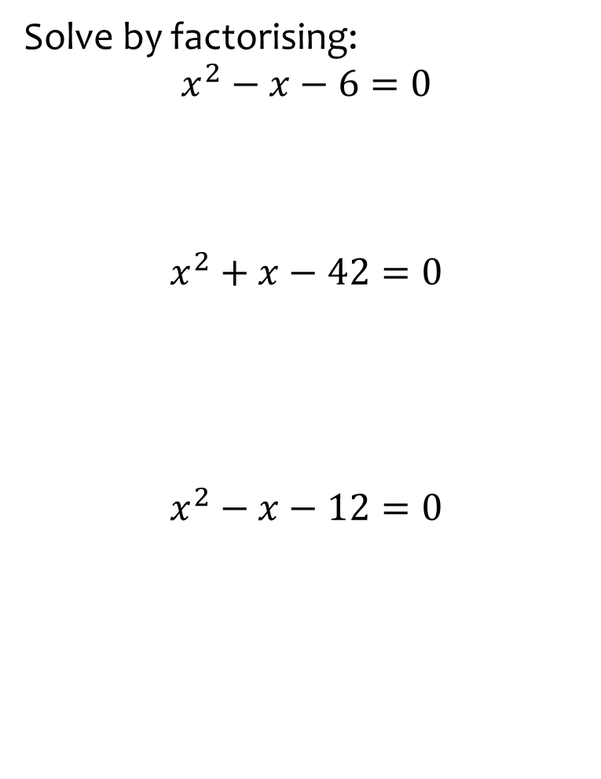
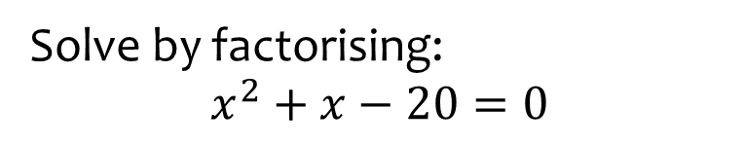

Worked example
Your turn
Solve by factorising:
$$x^{2}−x−6=0$$
$$x^{2}+x−42=0$$
$$x^{2}−x−12=0$$
Solve by factorising:
$$x^{2}+x−20=0$$
$$x=−5, x=4$$

Slide 7
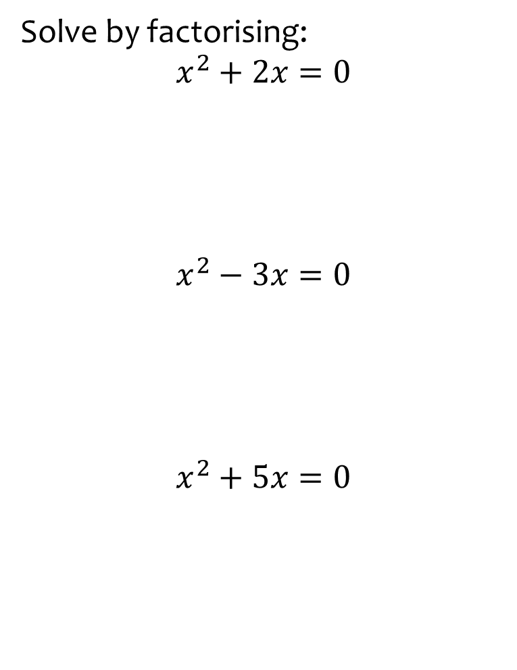
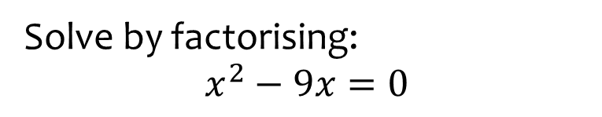

Worked example
Your turn
Solve by factorising:
$$x^{2}+2x=0$$
$$x^{2}−3x=0$$
$$x^{2}+5x=0$$
Solve by factorising:
$$x^{2}−9x=0$$
$$x=0, x=9$$

Slide 8
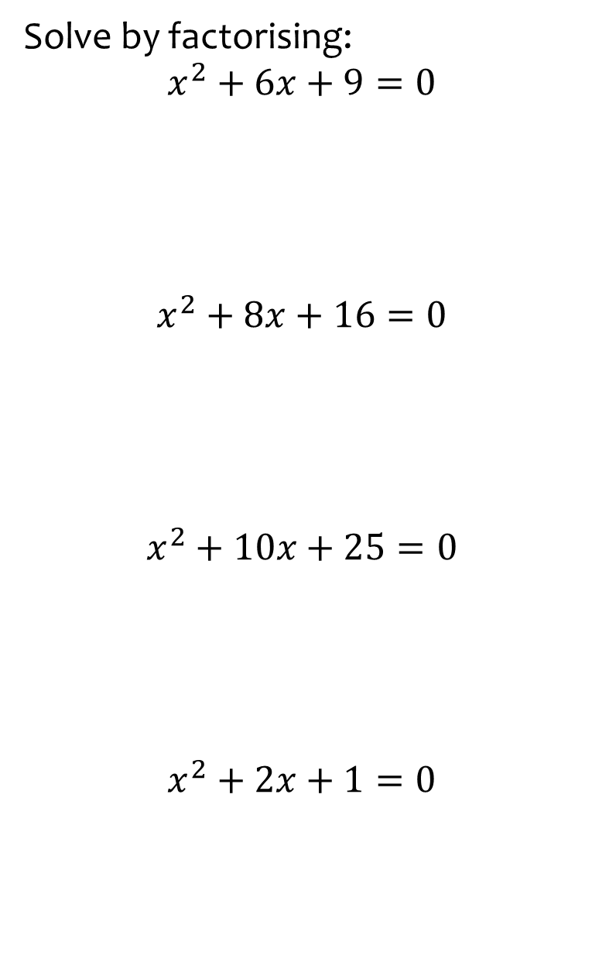
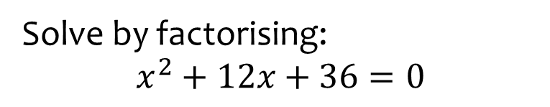

Worked example
Your turn
Solve by factorising:
$$x^{2}+6x+9=0$$
$$x^{2}+8x+16=0$$
$$x^{2}+10x+25=0$$
$$x^{2}+2x+1=0$$
Solve by factorising:
$$x^{2}+12x+36=0$$
$$x=−6$$

Slide 9
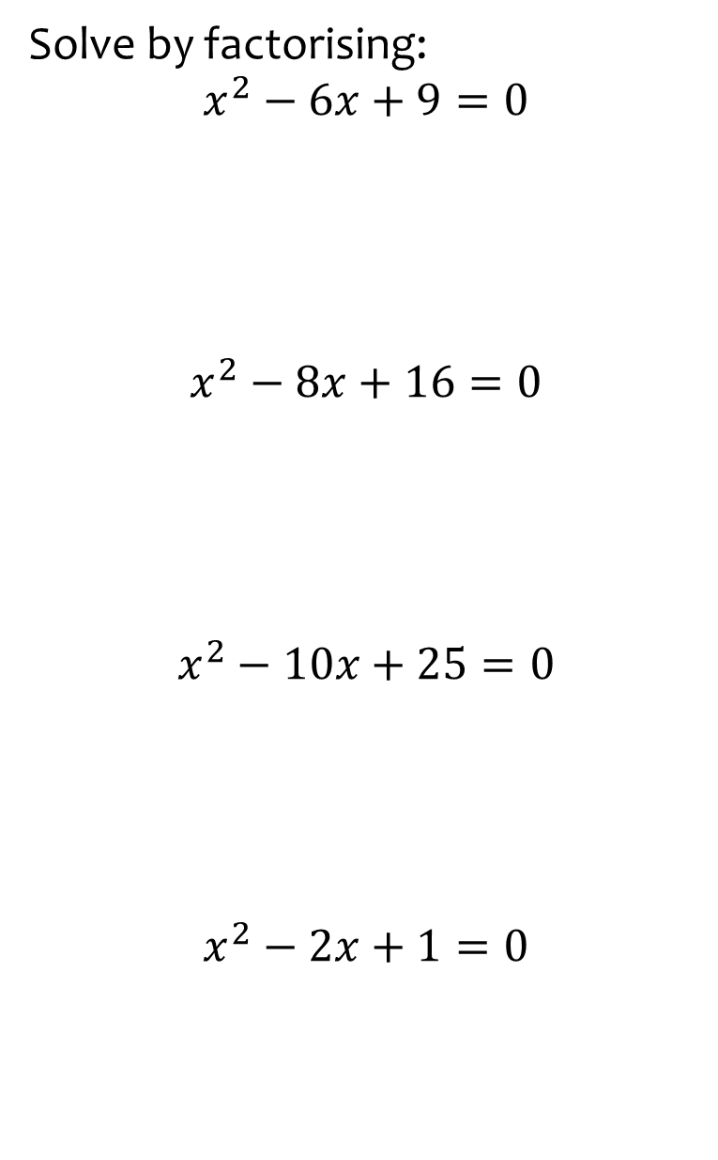
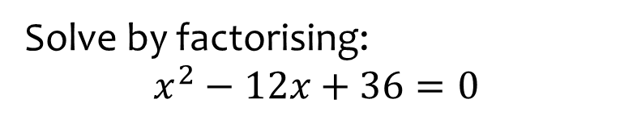

Worked example
Your turn
Solve by factorising:
$$x^{2}−6x+9=0$$
$$x^{2}−8x+16=0$$
$$x^{2}−10x+25=0$$
$$x^{2}−2x+1=0$$
Solve by factorising:
$$x^{2}−12x+36=0$$
$$x=6$$

Slide 10
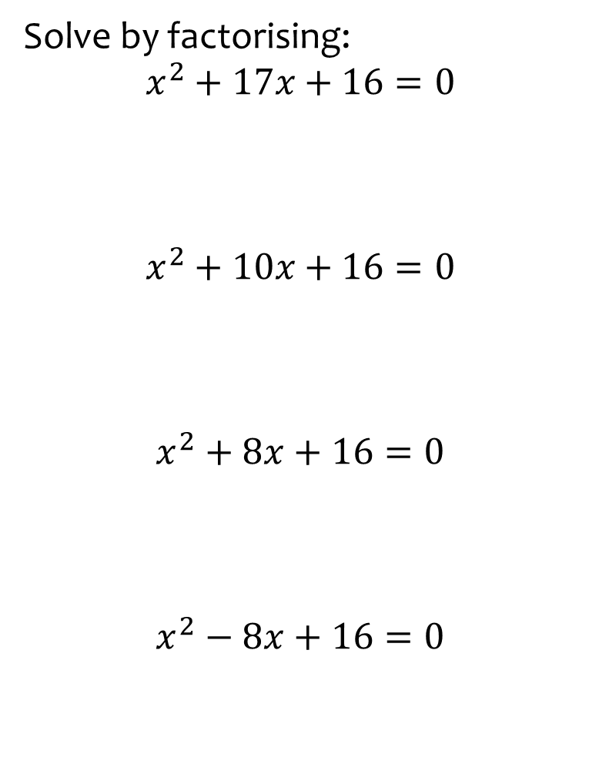
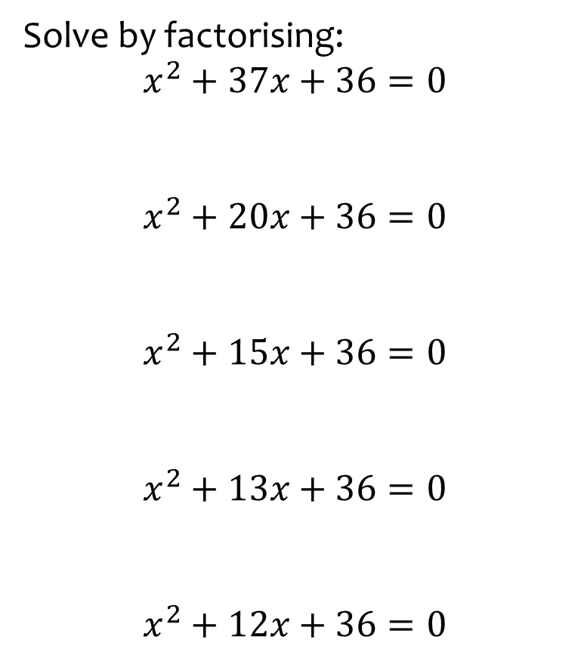
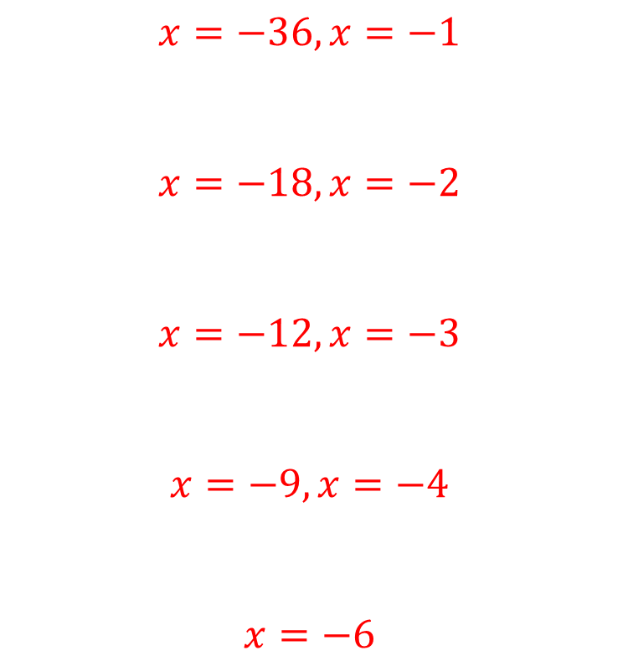
Worked example
Your turn
Solve by factorising:
$$x^{2}+17x+16=0$$
$$x^{2}+10x+16=0$$
$$x^{2}+8x+16=0$$
$$x^{2}−8x+16=0$$
Solve by factorising:
$$x^{2}+37x+36=0$$
$$x^{2}+20x+36=0$$
$$x^{2}+15x+36=0$$
$$x^{2}+13x+36=0$$
$$x^{2}+12x+36=0$$
$$x=−36, x=−1$$
$$x=−18, x=−2$$
$$x=−12, x=−3$$
$$x=−9, x=−4$$
$$x=−6$$

Slide 11
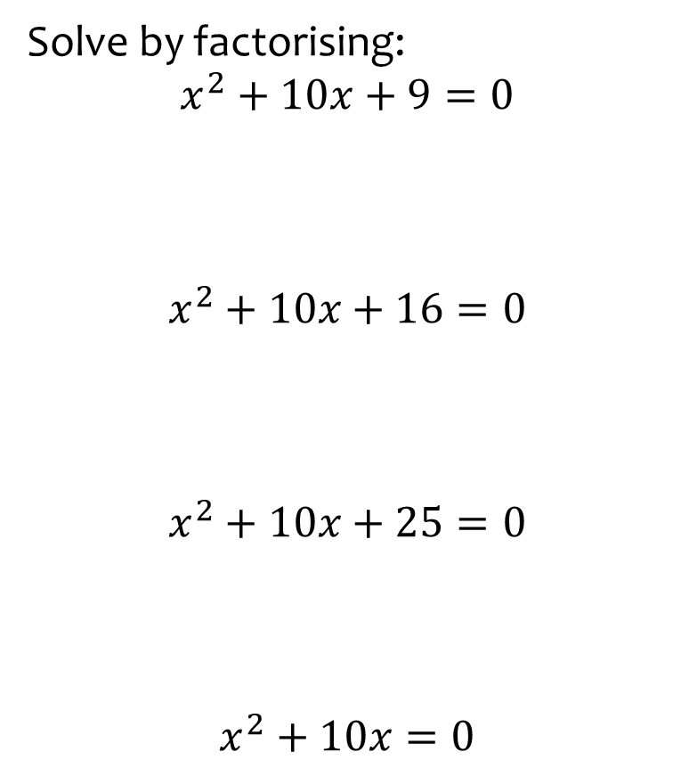
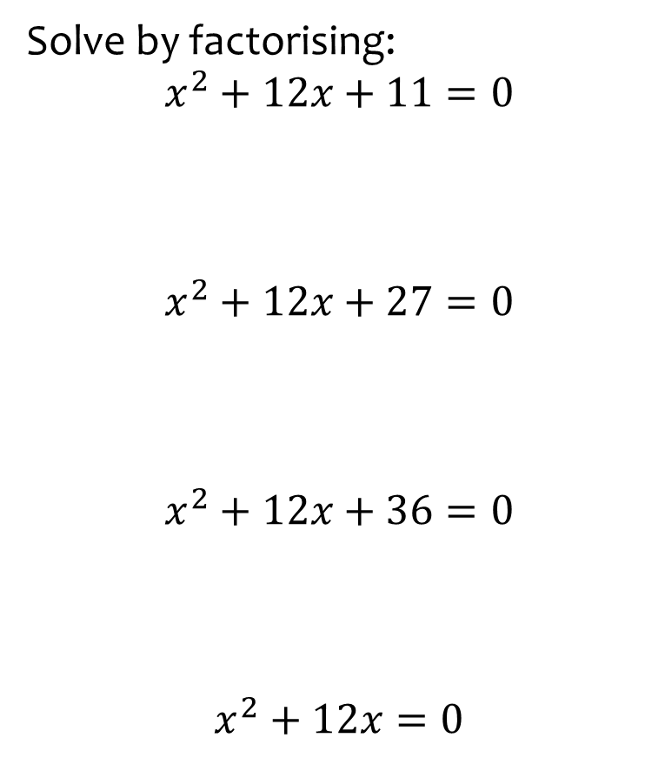
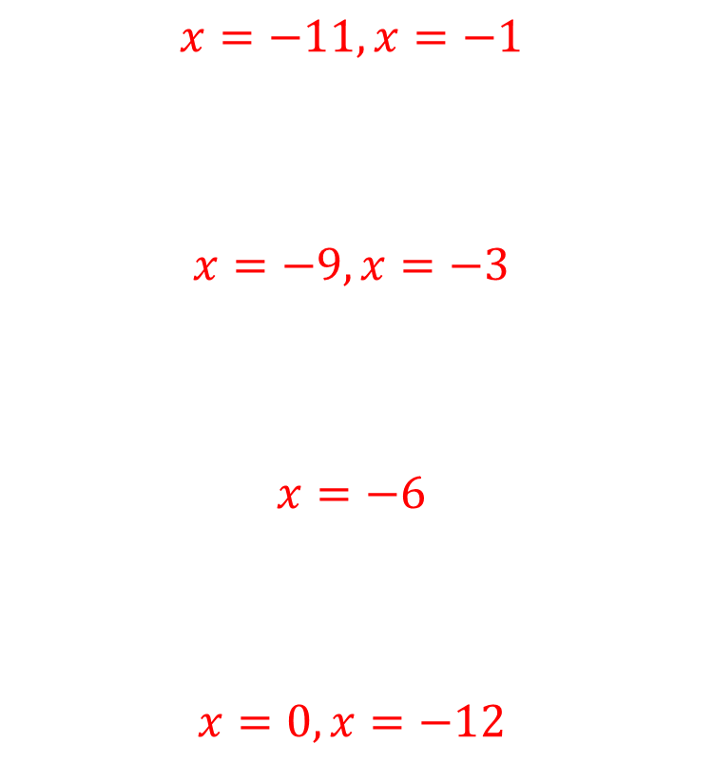
Worked example
Your turn
Solve by factorising:
$$x^{2}+10x+9=0$$
$$x^{2}+10x+16=0$$
$$x^{2}+10x+25=0$$
$$x^{2}+10x=0$$
Solve by factorising:
$$x^{2}+12x+11=0$$
$$x^{2}+12x+27=0$$
$$x^{2}+12x+36=0$$
$$x^{2}+12x=0$$
$$x=−11, x=−1$$
$$x=−9, x=−3$$
$$x=−6$$
$$x=0, x=−12$$

Slide 12
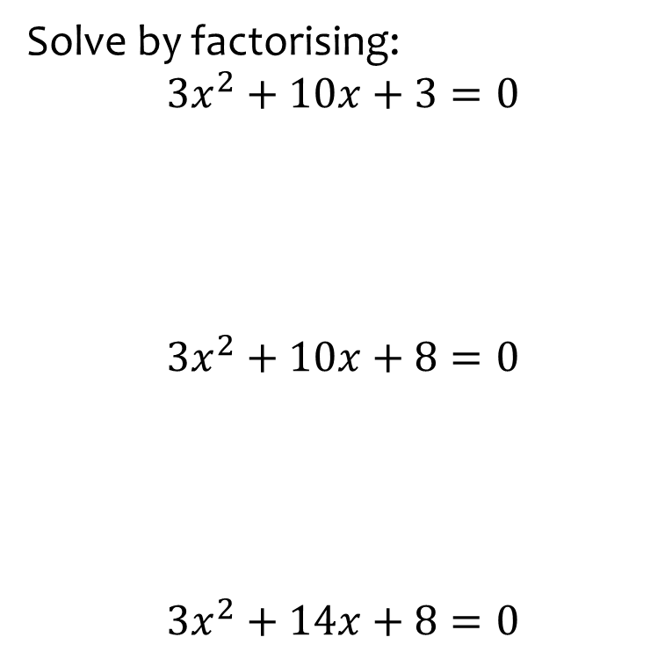
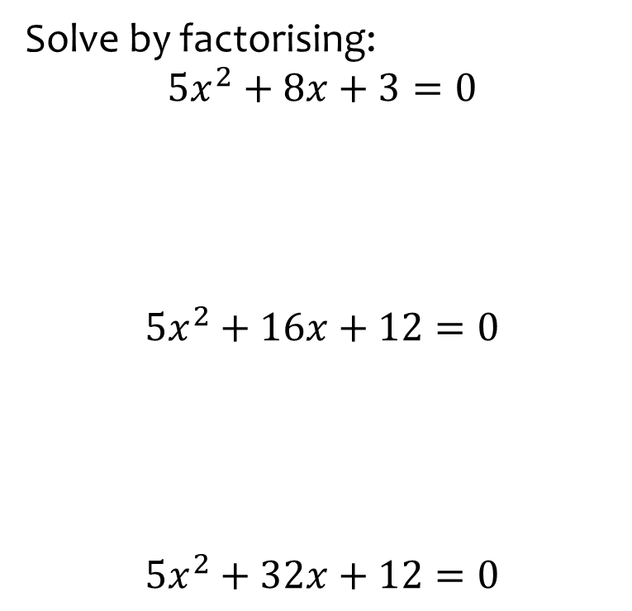
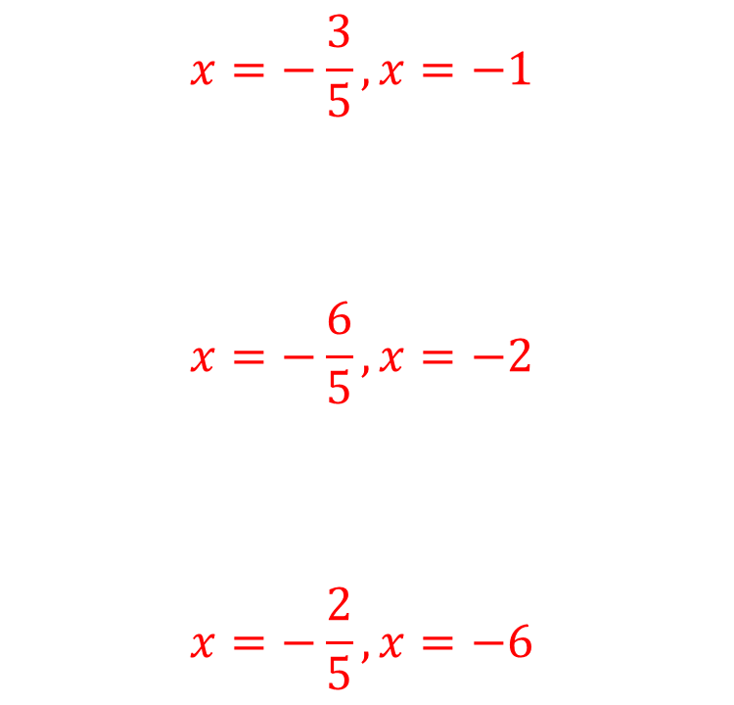
Worked example
Your turn
Solve by factorising:
$$3x^{2}+10x+3=0$$
$$3x^{2}+10x+8=0$$
$$3x^{2}+14x+8=0$$
Solve by factorising:
$$5x^{2}+8x+3=0$$
$$5x^{2}+16x+12=0$$
$$5x^{2}+32x+12=0$$
$$x=−\frac{3}{5}, x=−1$$
$$x=−\frac{6}{5}, x=−2$$
$$x=−\frac{2}{5}, x=−6$$

Slide 13
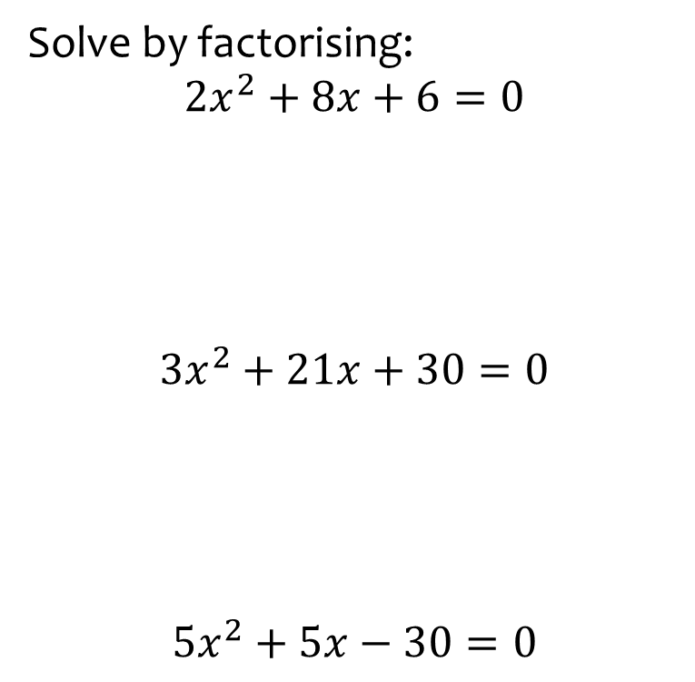
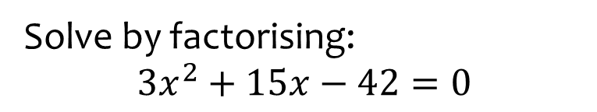

Worked example
Your turn
Solve by factorising:
$$2x^{2}+8x+6=0$$
$$3x^{2}+21x+30=0$$
$$5x^{2}+5x−30=0$$
Solve by factorising:
$$3x^{2}+15x−42=0$$
$$x=−7, x=2$$

Slide 14
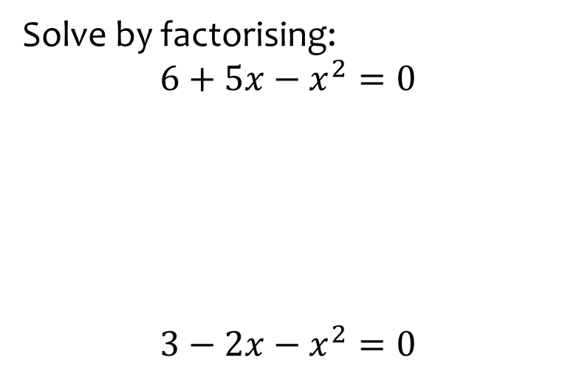
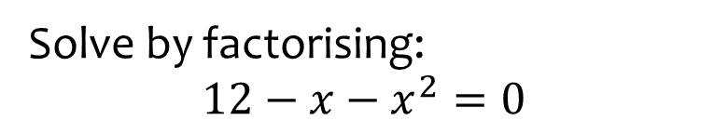

Worked example
Your turn
Solve by factorising:
$$6+5x−x^{2}=0$$
$$3−2x−x^{2}=0$$
Solve by factorising:
$$12−x−x^{2}=0$$
$$x=3, x=−4$$

Slide 15
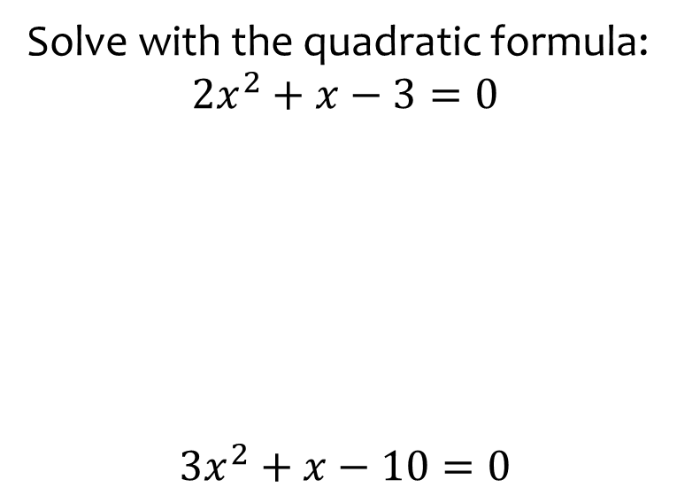
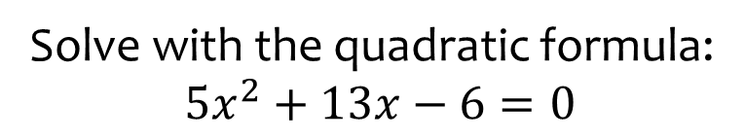

Worked example
Your turn
Solve with the quadratic formula:
$${2x}^{2}+x−3=0$$
$$3x^{2}+x−10=0$$
Solve with the quadratic formula:
$$5x^{2}+13x−6=0$$
$$x=\frac{2}{5}, x=−3$$

Slide 16
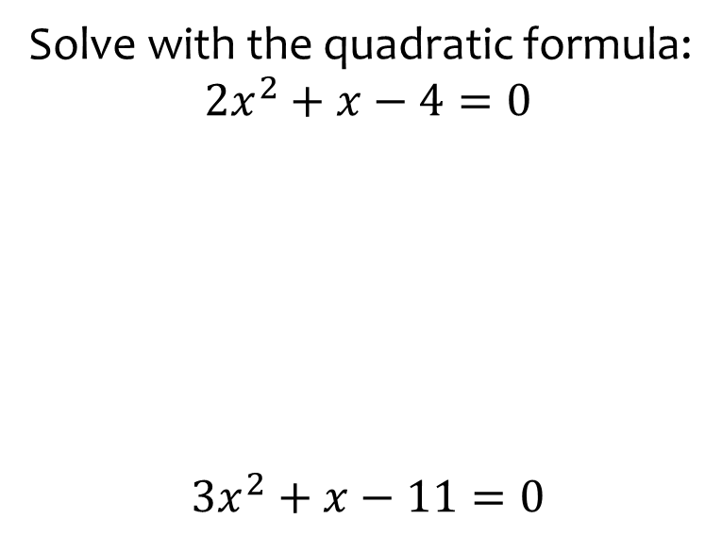
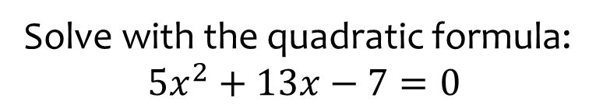
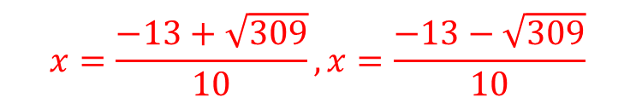
Worked example
Your turn
Solve with the quadratic formula:
$${2x}^{2}+x−4=0$$
$$3x^{2}+x−11=0$$
Solve with the quadratic formula:
$$5x^{2}+13x−7=0$$
$$x=\frac{−13+\sqrt{309}}{10}, x=\frac{−13−\sqrt{309}}{10}$$

Slide 17
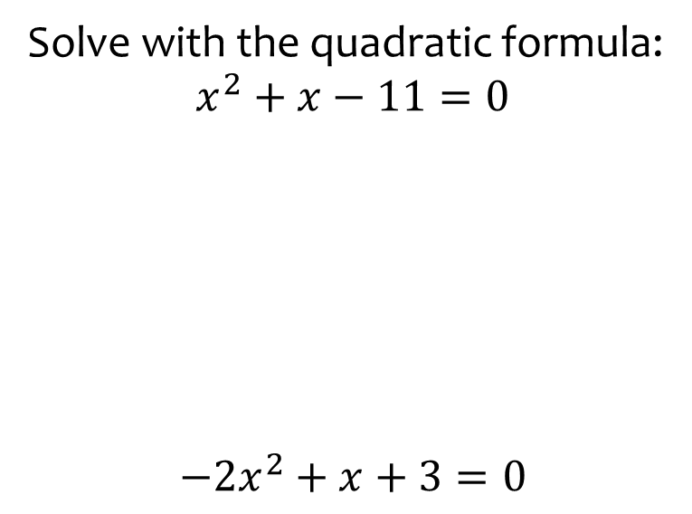
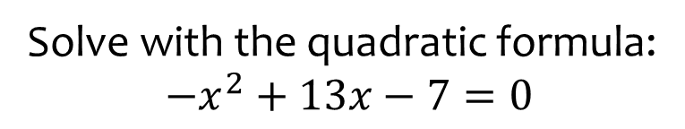
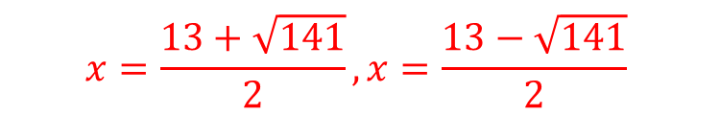
Worked example
Your turn
Solve with the quadratic formula:
$$x^{2}+x−11=0$$
$$−{2x}^{2}+x+3=0$$
Solve with the quadratic formula:
$$−x^{2}+13x−7=0$$
$$x=\frac{13+\sqrt{141}}{2}, x=\frac{13−\sqrt{141}}{2}$$

Slide 18
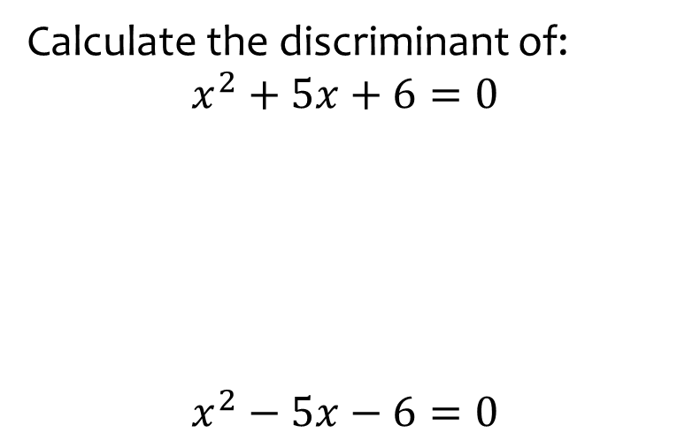
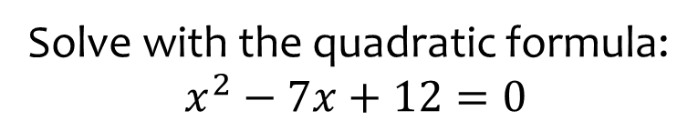

Worked example
Your turn
Calculate the discriminant of:
$$x^{2}+5x+6=0$$
$$x^{2}−5x−6=0$$
Solve with the quadratic formula:
$$x^{2}−7x+12=0$$
$$x=3, x=4$$

Slide 19
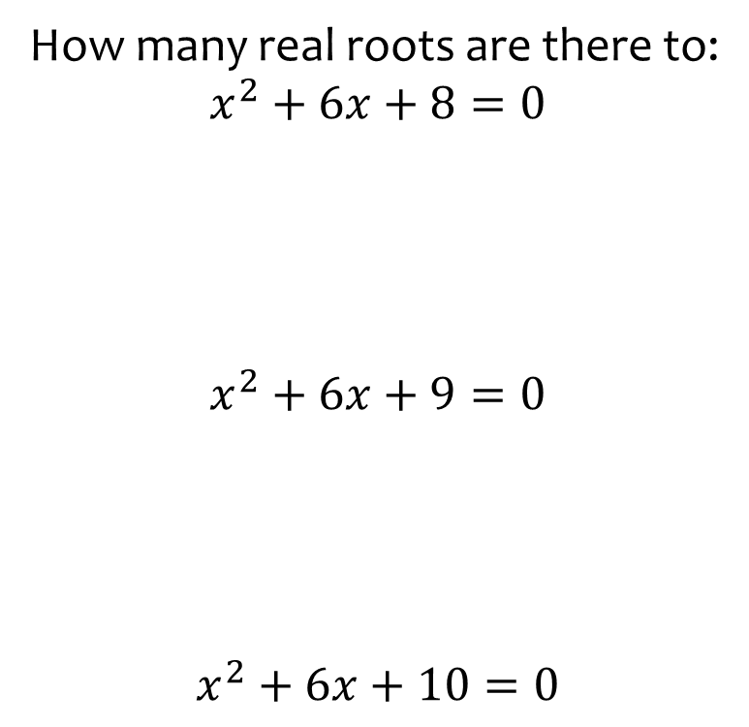
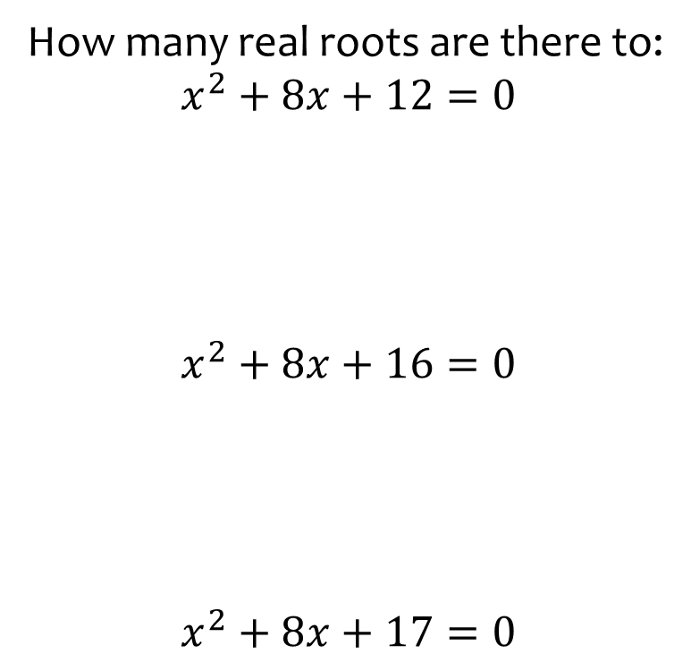
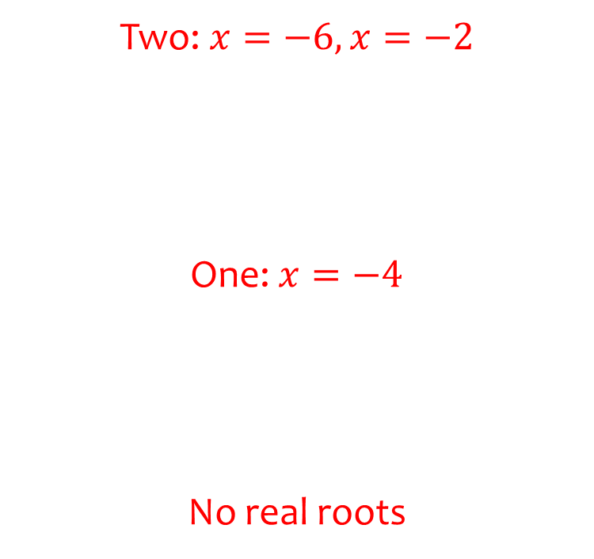
Worked example
Your turn
How many real roots are there to:
$$x^{2}+6x+8=0$$
$$x^{2}+6x+9=0$$
$$x^{2}+6x+10=0$$
How many real roots are there to:
$$x^{2}+8x+12=0$$
$$x^{2}+8x+16=0$$
$$x^{2}+8x+17=0$$
Two: $x=−6, x=−2$
One: $x=−4$
No real roots

Slide 20
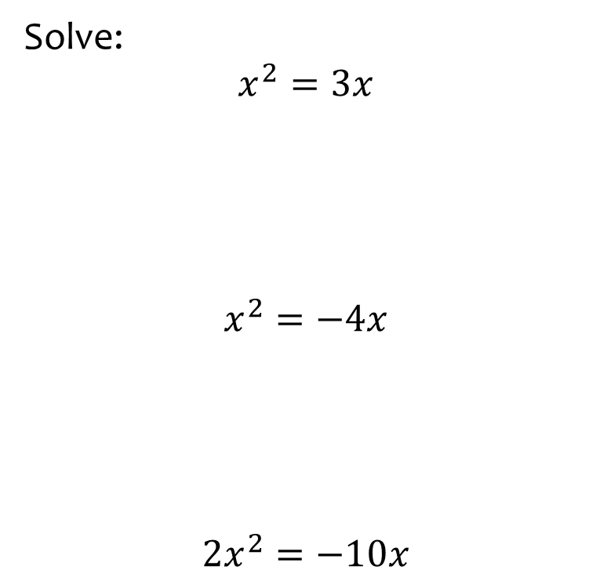
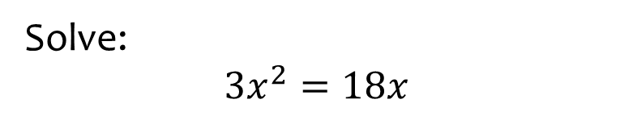

Worked example
Your turn
Solve:
$$x^{2}=3x$$
$$x^{2}=−4x$$
$$2x^{2}=−10x$$
Solve:
$$3x^{2}=18x$$
$$x=0, x=6$$

Slide 21
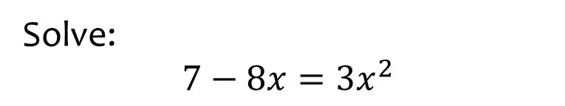
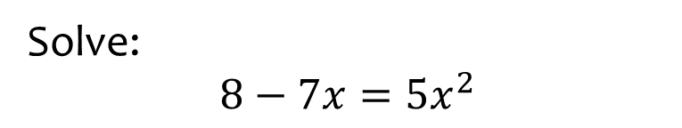
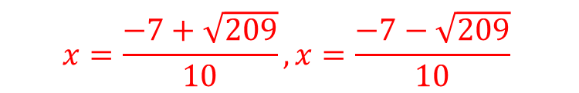
Worked example
Your turn
Solve:
$$7−8x=3x^{2}$$
Solve:
$$8−7x=5x^{2}$$
$$x=\frac{−7+\sqrt{209}}{10}, x=\frac{−7−\sqrt{209}}{10}$$

Slide 22
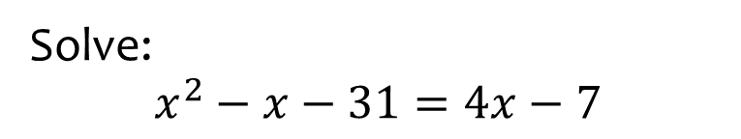
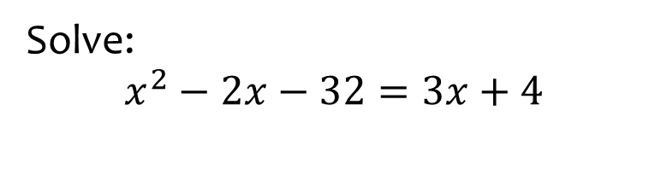

Worked example
Your turn
Solve:
$$x^{2}−x−31=4x−7$$
Solve:
$$x^{2}−2x−32=3x+4$$
$$x=9, x=−4$$

Slide 23
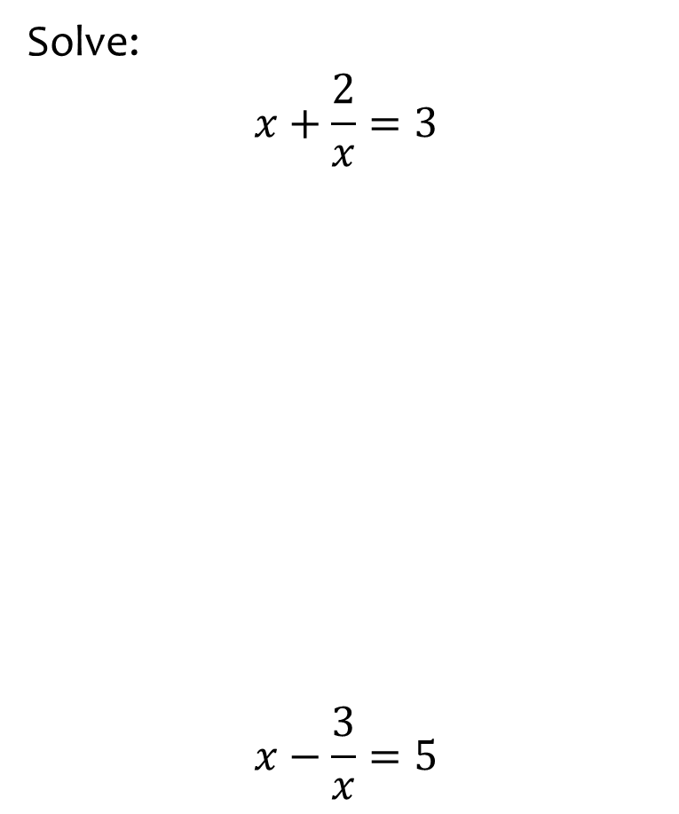


Worked example
Your turn
Solve:
$$x+\frac{2}{x}=3$$
$$x−\frac{3}{x}=5$$
Solve:
$$x+\frac{4}{x}=5$$
$$x=4, x=1$$

Slide 24



Worked example
Your turn
Solve:
$$\frac{3}{x^{2}}+\frac{2}{x}=1$$
$$\frac{2}{x^{2}}−\frac{7}{x}=3$$
Solve:
$$\frac{2}{x^{2}}−\frac{5}{x}=3$$
$$x=\frac{1}{3}, x=−2$$

Slide 25



Worked example
Your turn
Solve by completing the square:
$$x^{2}+8x+3=0$$
$$x^{2}+10x−4=0$$
Solve by completing the square:
$$x^{2}+6x+4=0$$
$$x=−3+\sqrt{5}, x=−3−\sqrt{5}$$

Slide 26



Worked example
Your turn
Solve by completing the square:
$$2x^{2}−8x+3=0$$
$${3x}^{2}−10x−4=0$$
Solve by completing the square:
$${5x}^{2}−6x−2=0$$
$$x=\frac{3+\sqrt{19}}{5}, x=\frac{3−\sqrt{19}}{5}$$

Slide 27



Worked example
Your turn
Solve using three methods:
$$x^{2}+6x+8=0$$
$$x^{2}+6x+8=0$$
$$x^{2}+6x+8=0$$
Solve using three methods:
$$x^{2}+6x+5=0$$
$$x=−5, x=−1$$

Slide 28







Worked example
Your turn
The area of the rectangle is equal to $18$ square units. Find $x$
The area of the rectangle is equal to $30$ square units. Find $x$
$$x+4$$
$$x−3$$
$$x−4$$
$$x+3$$
$$x=7$$

Slide 29







Worked example
Your turn
The area of the rectangle is equal to $28$ square units. Find $x$
The area of the rectangle is equal to $10$ square units. Find $x$
$$2x$$
$$x−5$$
$$2x+8$$
$$x$$
$$x=1$$

Slide 30






Worked example
Your turn
The area of the rectangle is equal to $32$ square units. Find $x$
The area of the rectangle is equal to $28$square units. Find $x$
$$x−3$$
$$x−7$$
$$x−5$$
$$x−2$$
$$x=9$$

Slide 31









Worked example
Your turn
The area of the triangle is equal to $16$square units. Find $x$
The area of the triangle is equal to $14$ square units. Find $x$
$$4\sqrt{5}$$
$$\sqrt{65}$$
$$x−7$$
$$x−5$$
$$x−3$$
$$x−2$$
$$x=7$$

Slide 32






Worked example
Your turn
The area of the triangle is equal to $16$square units. Find $x$
The area of the triangle is equal to $24$square units. Find $x$
$$4\sqrt{5}$$
$$10$$
$$2x−8$$
$$x−1$$
$$x+2$$
$$2x−6$$
$$x=7$$

Slide 33












Worked example
Your turn
The area of the compound shape is $24$. Find $x$
The area of the compound shape is $13$. Find $x$
$$x−7$$
$$x+8$$
$$x$$
$$x$$
$$x−8$$
$$x+6$$
$$x+6$$
$$2x+1$$
$$x=1$$

Slide 34



Worked example
Your turn
Two numbers have a difference of $3$ and a product of $88$. Find the two numbers.
Two numbers have a difference of $5$ and a product of $14$. Find the two numbers.
Two numbers have a difference of $4$ and a product of $12$. Find the two numbers.
$$x=6, y=2$$
$$x=−2, y=−6$$

