Slide 1
SOLVING EQUATIONS (LINEAR)
CONTENTS

Slide 2
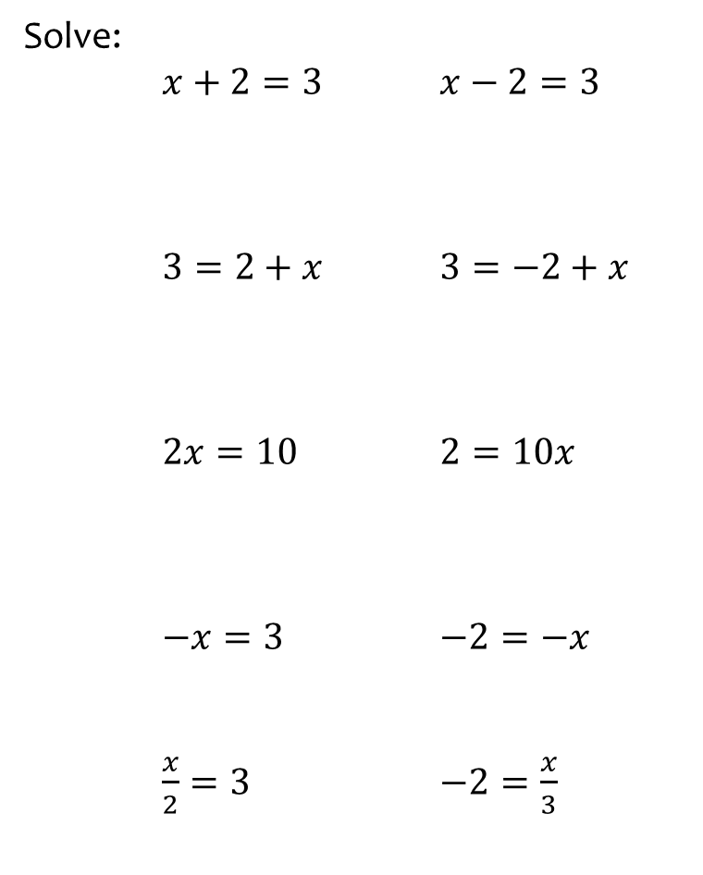
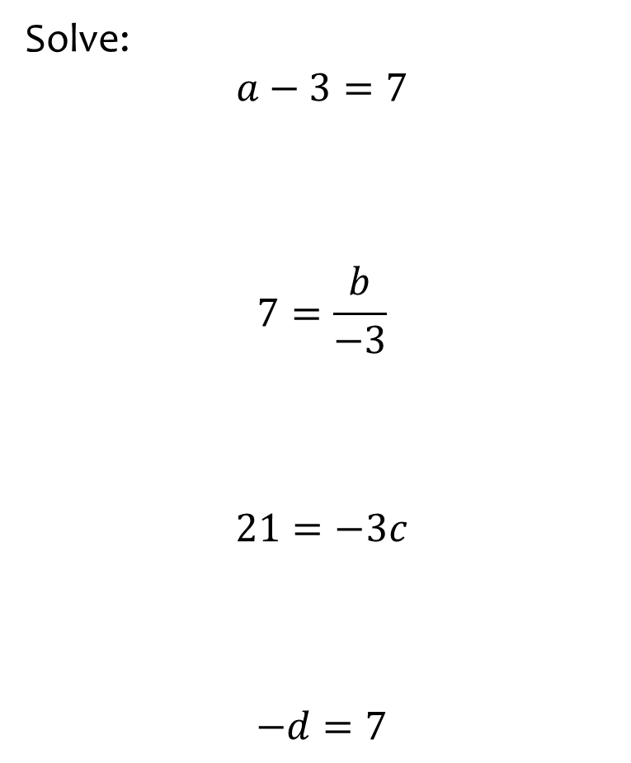
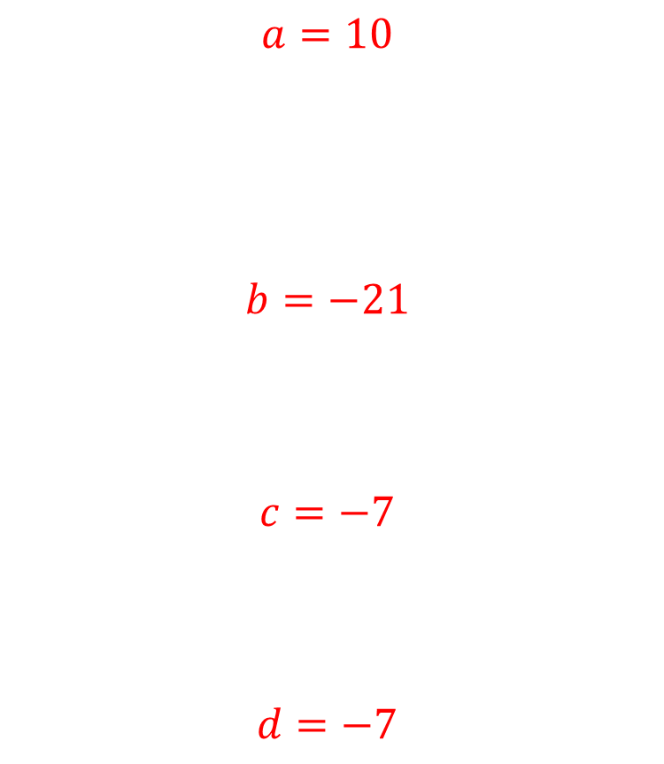
Worked example
Your turn
Solve:
$x+2=3$ $x−2=3$
$3=2+x$ $3=−2+x$
$2x=10$ $2=10x$
$−x=3$ $−2=−x$
$\frac{x}{2}=3$ $−2=\frac{x}{3}$
Solve:
$$a−3=7$$
$$7=\frac{b}{−3}$$
$$21=−3c$$
$$−d=7$$
$$a=10$$
$$b=−21$$
$$c=−7$$
$$d=−7$$

Slide 3
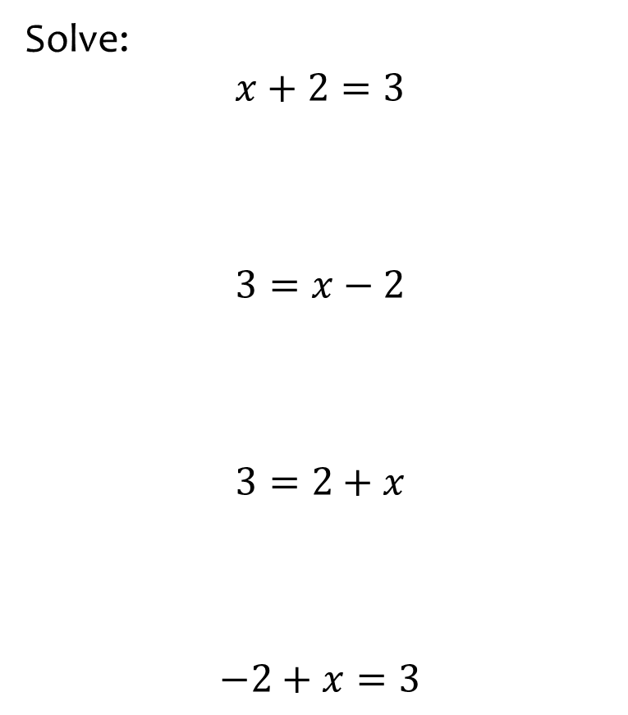
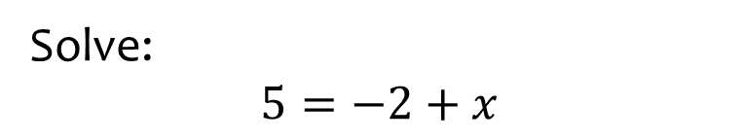

Worked example
Your turn
Solve:
$$x+2=3$$
$$3=x−2$$
$$3=2+x$$
$$−2+x=3$$
Solve:
$$5=−2+x$$
$$x=7$$

Slide 4
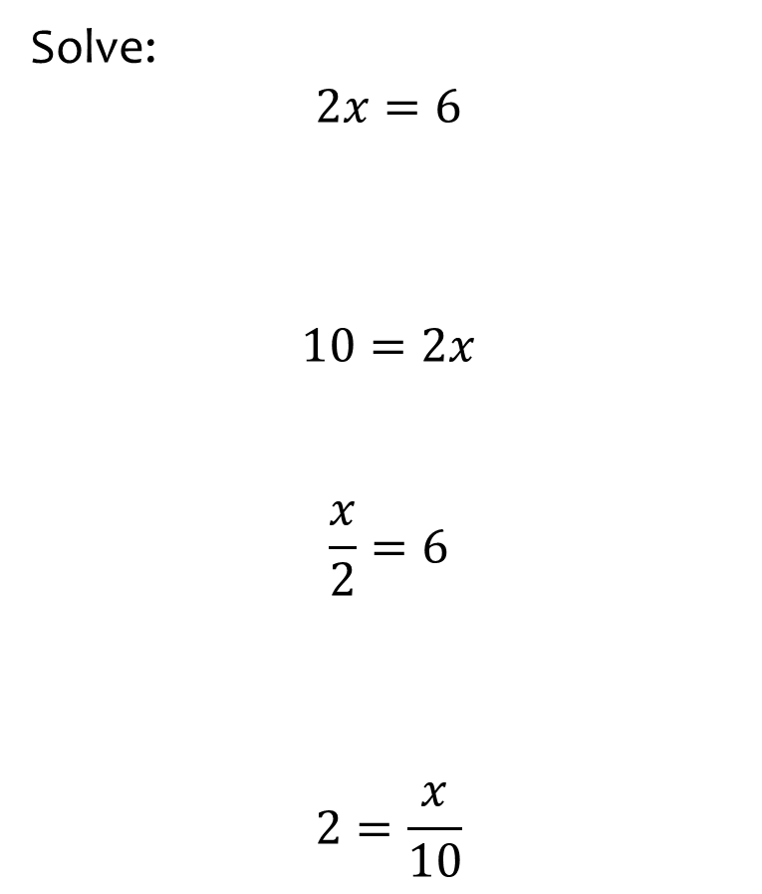
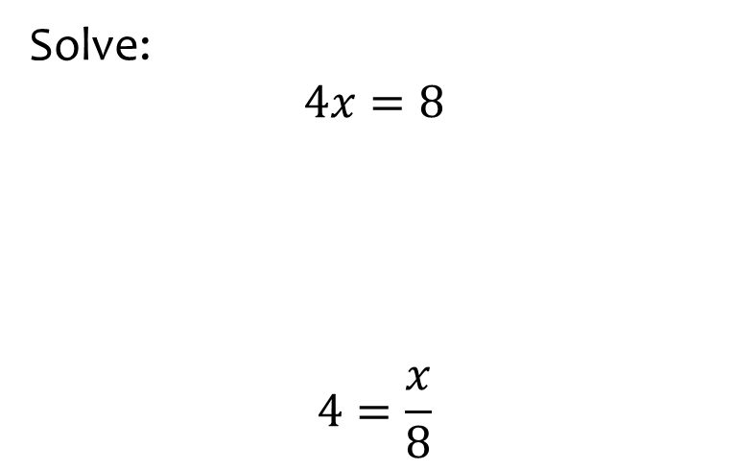
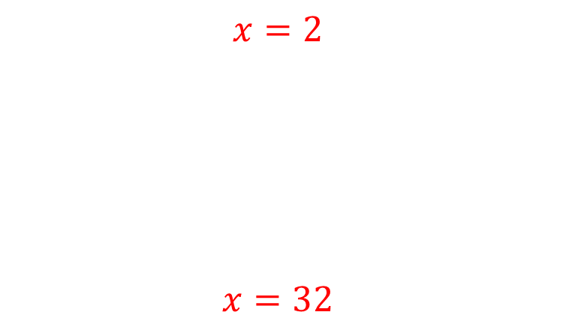
Worked example
Your turn
Solve:
$$2x=6$$
$$10=2x$$
$$\frac{x}{2}=6$$
$$2=\frac{x}{10}$$
Solve:
$$4x=8$$
$$4=\frac{x}{8}$$
$$x=2$$
$$x=32$$

Slide 5
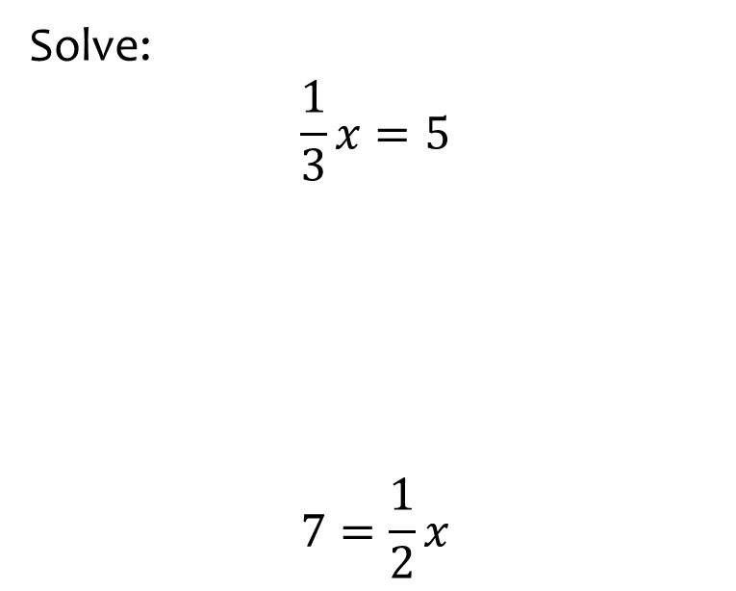
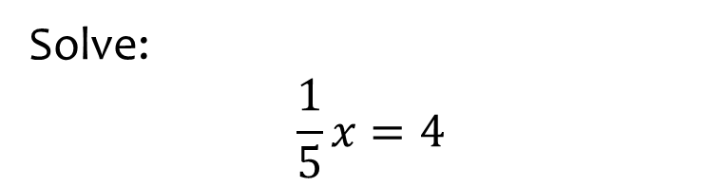

Worked example
Your turn
Solve:
$$\frac{1}{3}x=5$$
$$7=\frac{1}{2}x$$
Solve:
$$\frac{1}{5}x=4$$
$$x=20$$

Slide 6
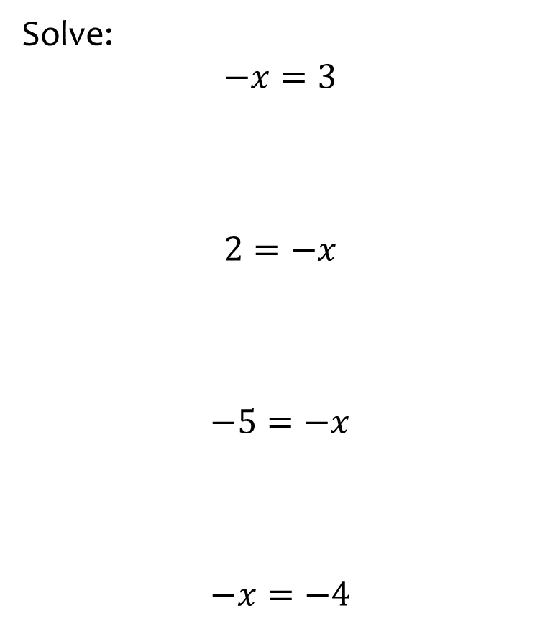
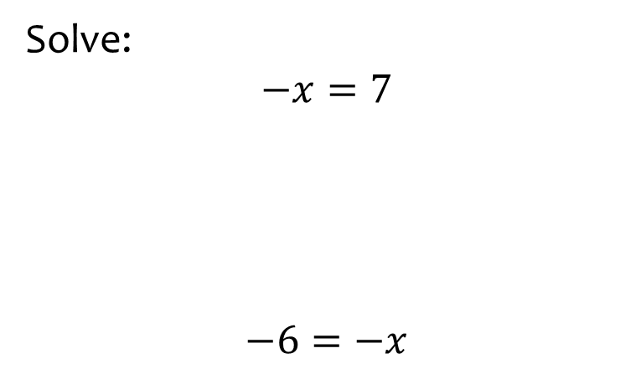
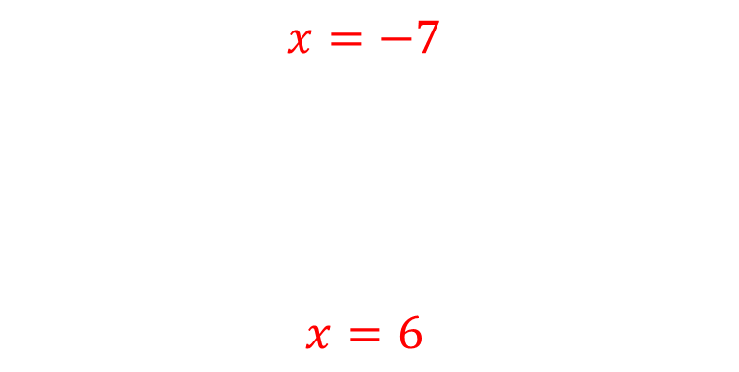
Worked example
Your turn
Solve:
$$−x=3$$
$$2=−x$$
$$−5=−x$$
$$−x=−4$$
Solve:
$$−x=7$$
$$−6=−x$$
$$x=−7$$
$$x=6$$

Slide 7
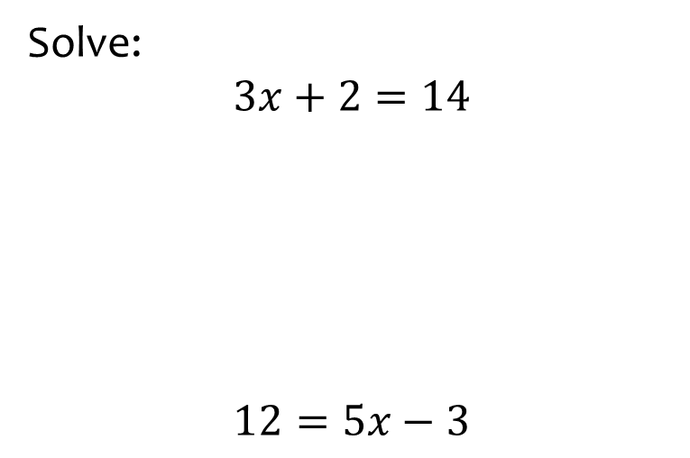
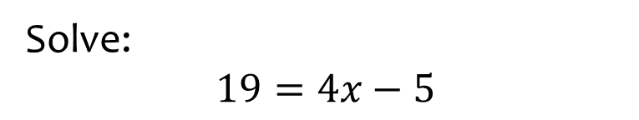

Worked example
Your turn
Solve:
$$3x+2=14$$
$$12=5x−3$$
Solve:
$$19=4x−5$$
$$x=6$$

Slide 8
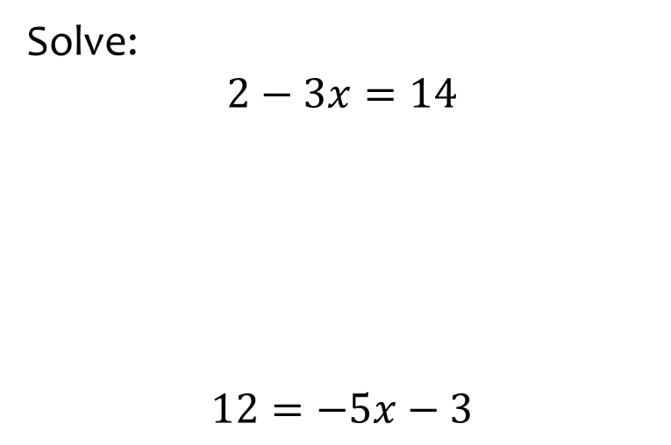
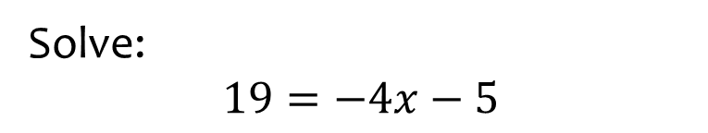

Worked example
Your turn
Solve:
$$2−3x=14$$
$$12=−5x−3$$
Solve:
$$19=−4x−5$$
$$x=−6$$

Slide 9
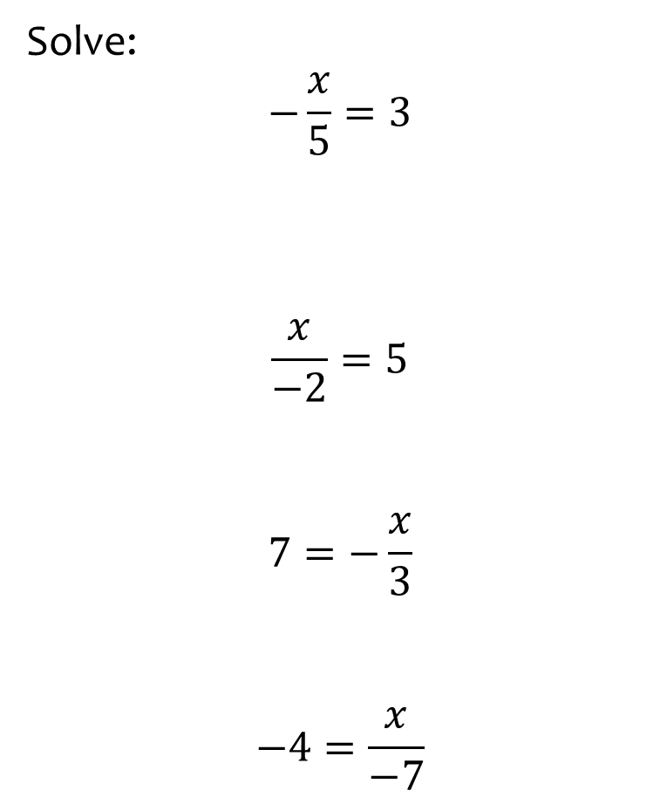
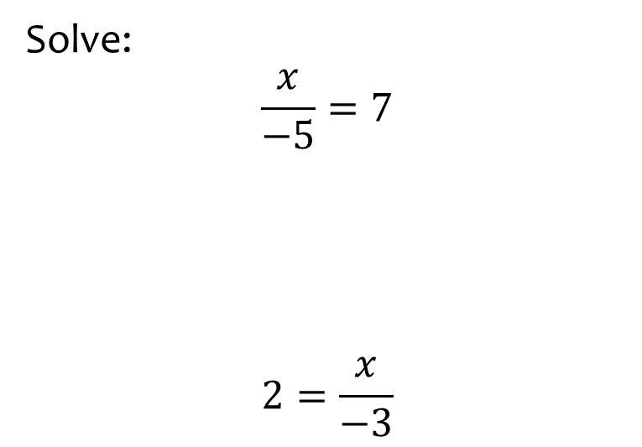
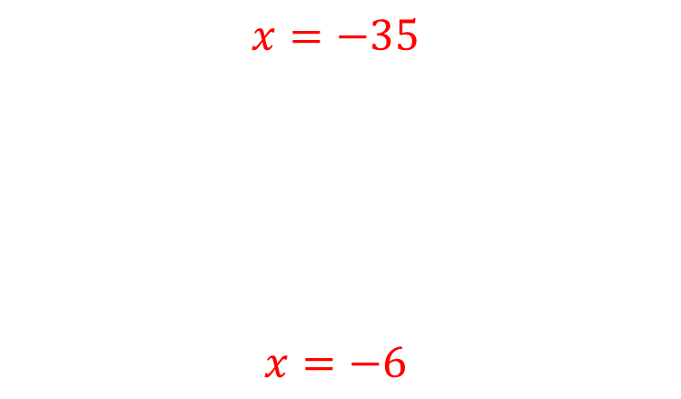
Worked example
Your turn
Solve:
$$−\frac{x}{5}=3$$
$$\frac{x}{−2}=5$$
$$7=−\frac{x}{3}$$
$$−4=\frac{x}{−7}$$
Solve:
$$\frac{x}{−5}=7$$
$$2=\frac{x}{−3}$$
$$x=−35$$
$$x=−6$$

Slide 10
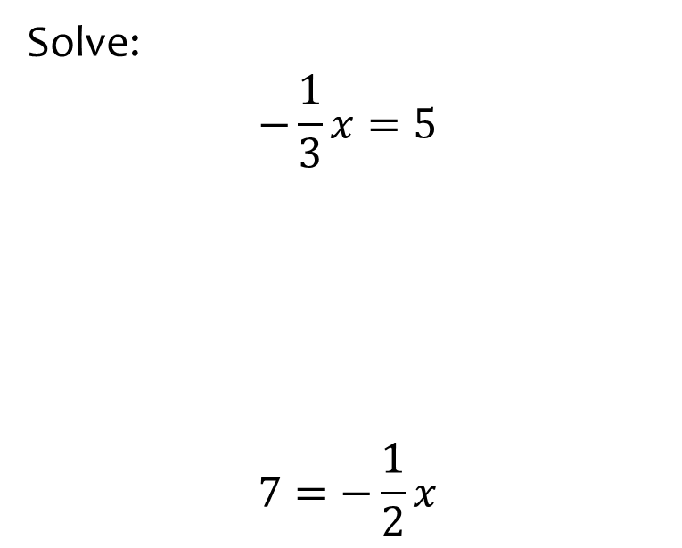
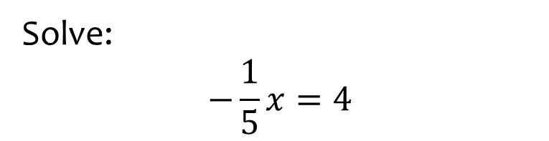

Worked example
Your turn
Solve:
$$−\frac{1}{3}x=5$$
$$7=−\frac{1}{2}x$$
Solve:
$$−\frac{1}{5}x=4$$
$$x=−20$$

Slide 11
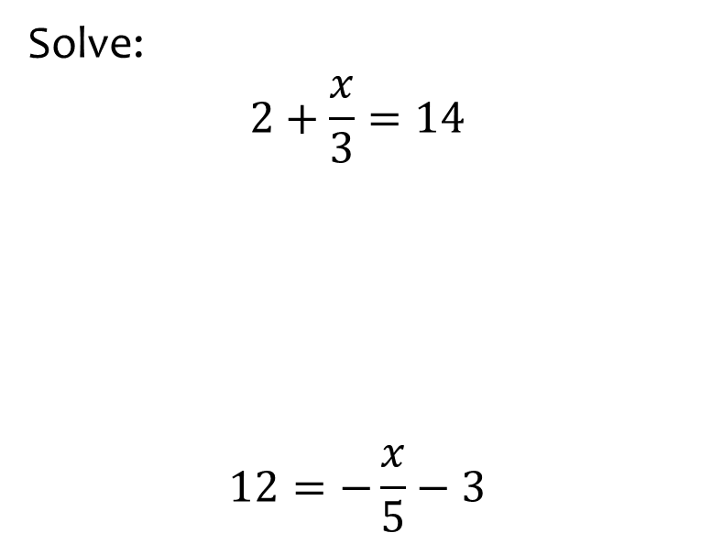
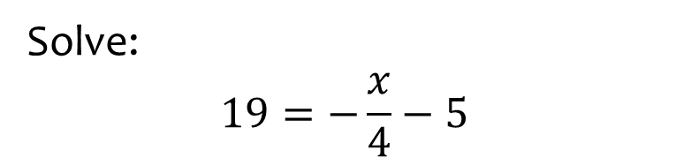

Worked example
Your turn
Solve:
$$2+\frac{x}{3}=14$$
$$12=−\frac{x}{5}−3$$
Solve:
$$19=−\frac{x}{4}−5$$
$$x=−96$$

Slide 12
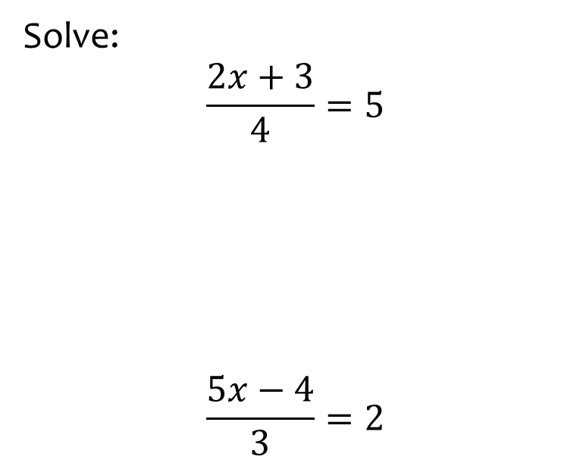
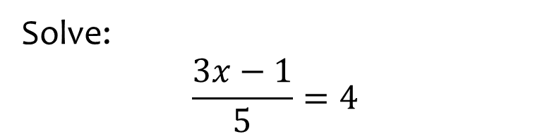

Worked example
Your turn
Solve:
$$\frac{2x+3}{4}=5$$
$$\frac{5x−4}{3}=2$$
Solve:
$$\frac{3x−1}{5}=4$$
$$x=7$$

Slide 13
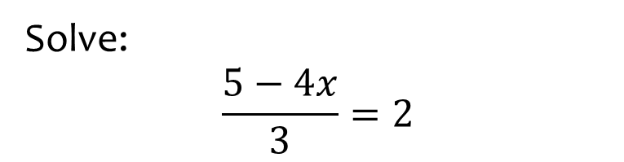
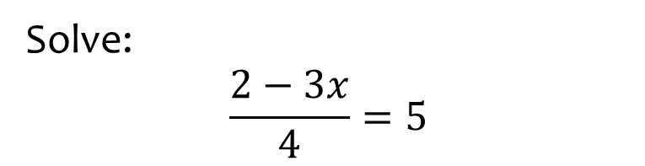

Worked example
Your turn
Solve:
$$\frac{5−4x}{3}=2$$
Solve:
$$\frac{2−3x}{4}=5$$
$$x=−6$$

Slide 14
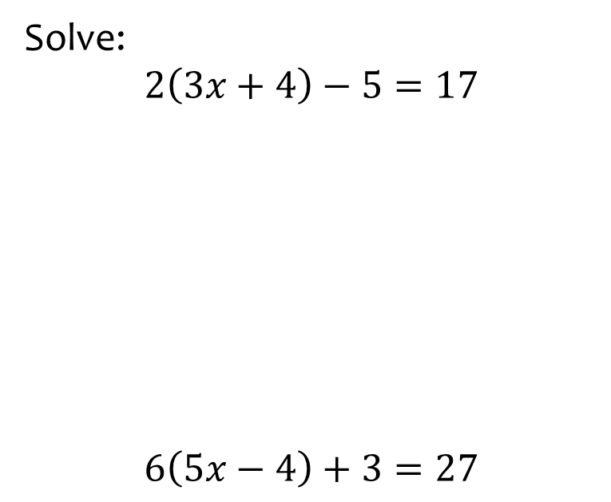
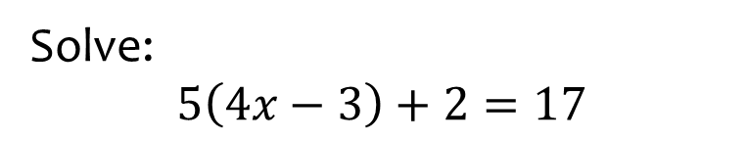

Worked example
Your turn
Solve:
$$2\left(3x+4\right)−5=17$$
$$6\left(5x−4\right)+3=27$$
Solve:
$$5\left(4x−3\right)+2=17$$
$$x=\frac{3}{2}$$

Slide 15
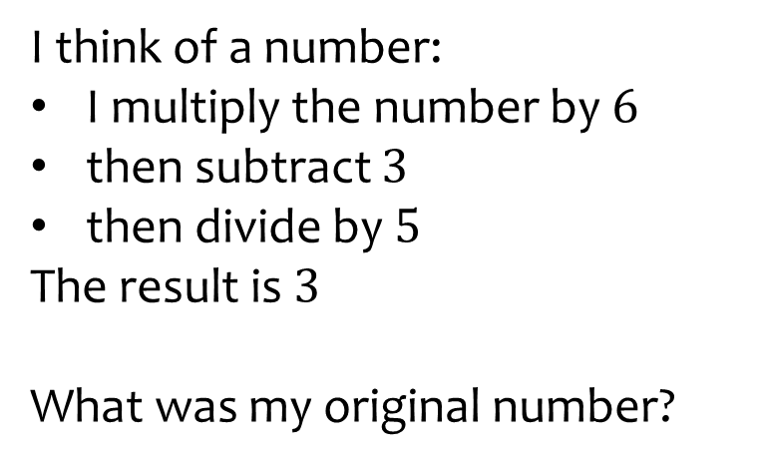
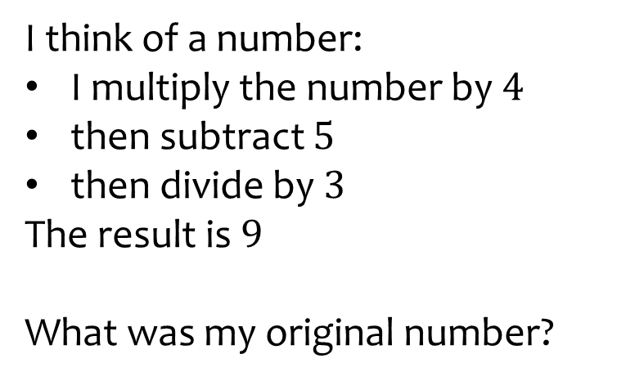

Worked example
Your turn
I think of a number:
I multiply the number by $6$
then subtract $3$
then divide by $5$
The result is $3$
What was my original number?
I think of a number:
I multiply the number by $4$
then subtract $5$
then divide by $3$
The result is $9$
What was my original number?
$$8$$

Slide 16
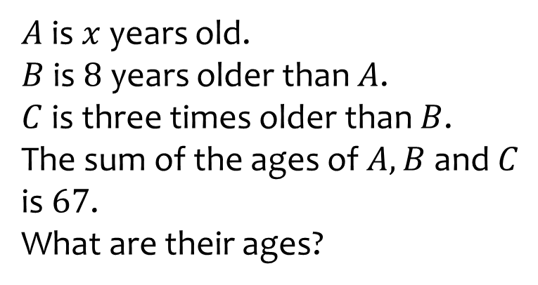
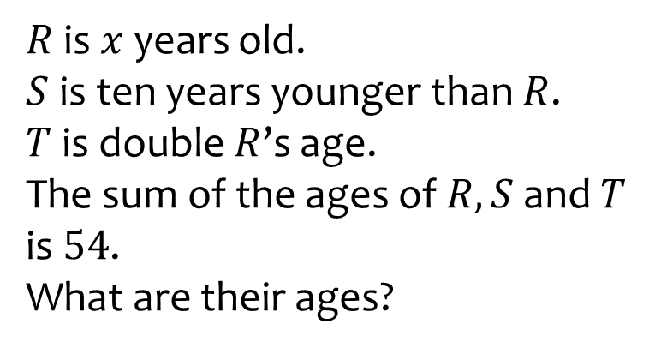
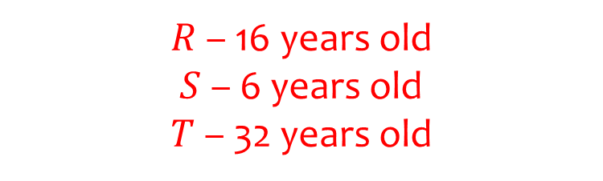
Worked example
Your turn
$A$ is $x$ years old.
$B$ is $8$ years older than $A$.
$C$ is three times older than $B$.
The sum of the ages of $A, B$ and $C$ is $67$.
What are their ages?
$R$ is $x$ years old.
$S$ is ten years younger than $R$.
$T$ is double $R$’s age.
The sum of the ages of $R, S$and $T$ is $54$.
What are their ages?
$R$ – 16 years old
$S$ – 6 years old
$T$ – 32 years old

Slide 17
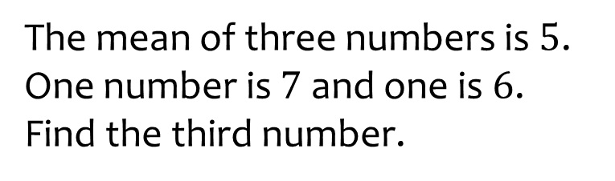
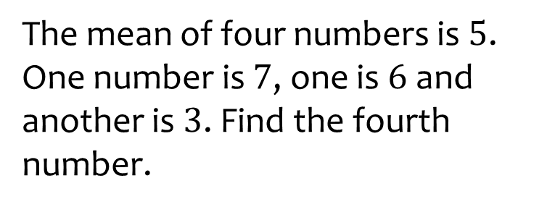

Worked example
Your turn
The mean of three numbers is $5$. One number is $7$ and one is $6$. Find the third number.
The mean of four numbers is $5$. One number is $7$, one is $6$ and another is $3$. Find the fourth number.
$$4$$

Slide 18
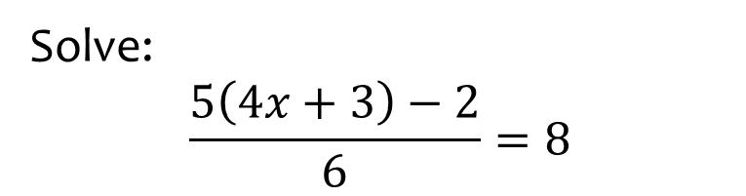
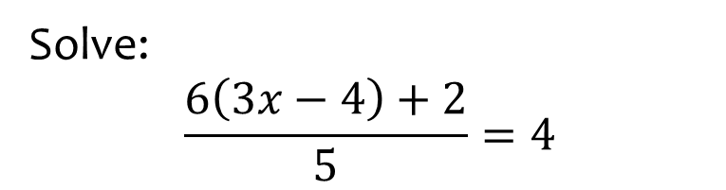

Worked example
Your turn
Solve:
$$\frac{5\left(4x+3\right)−2}{6}=8$$
Solve:
$$\frac{6\left(3x−4\right)+2}{5}=4$$
$$x=\frac{7}{3}$$

Slide 19
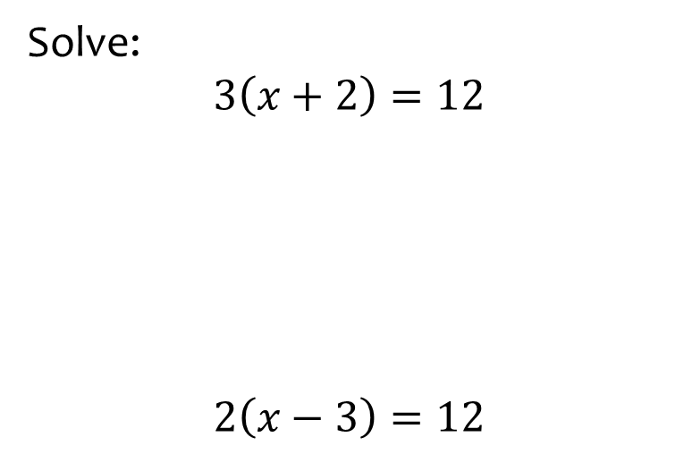
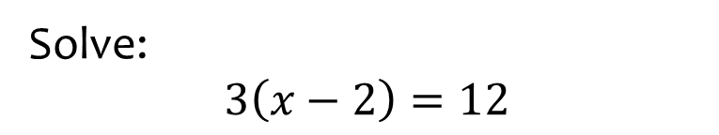
Worked example
Your turn
Solve:
$$3\left(x+2\right)=12$$
$$2\left(x−3\right)=12$$
Solve:
$$3\left(x−2\right)=12$$
$$x=6$$

Slide 20
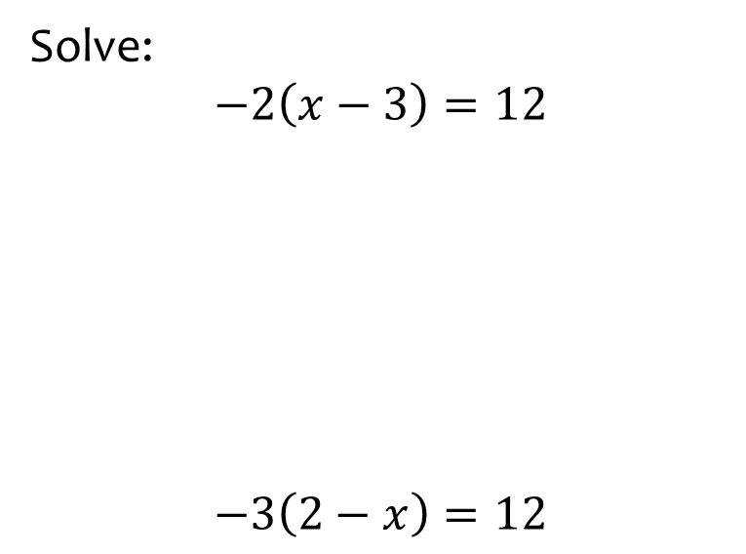
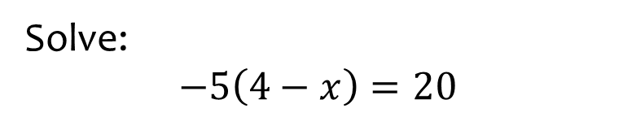

Worked example
Your turn
Solve:
$$−2\left(x−3\right)=12$$
$$−3\left(2−x\right)=12$$
Solve:
$$−5\left(4−x\right)=20$$
$$x=8$$

Slide 21
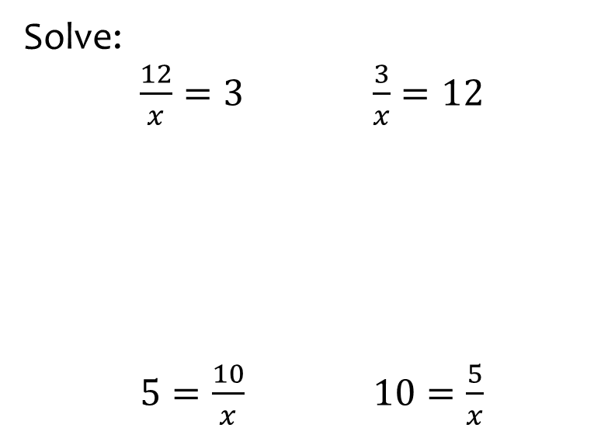
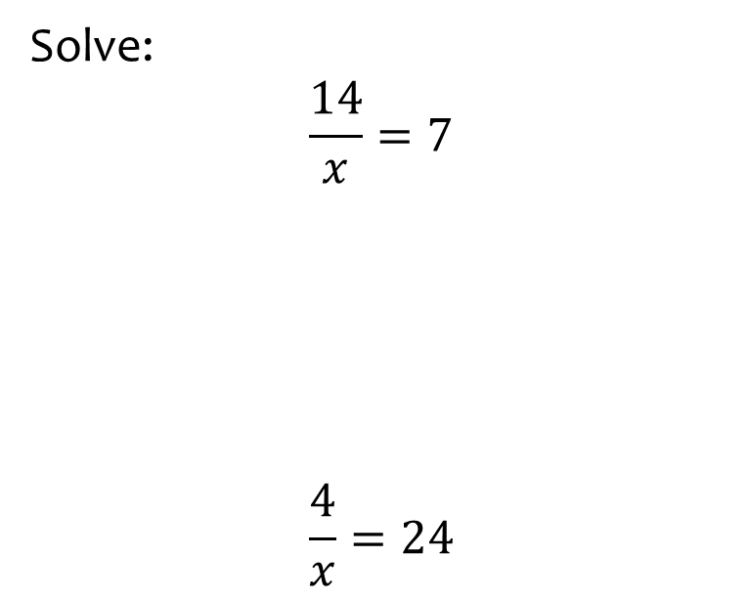
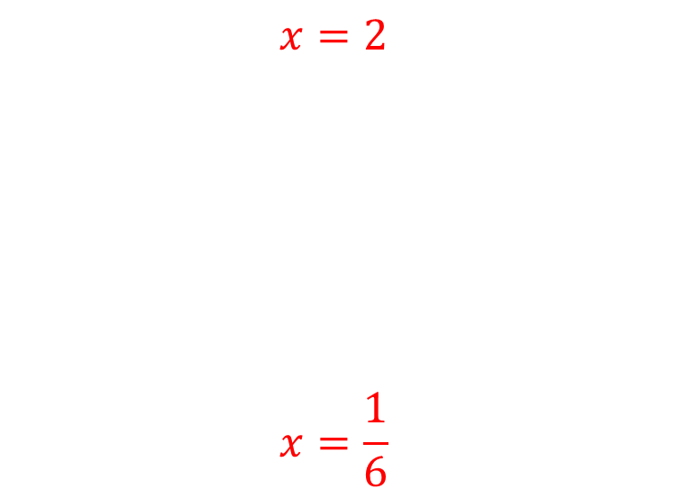
Worked example
Your turn
Solve:
$\frac{12}{x}=3$ $\frac{3}{x}=12$
$5=\frac{10}{x}$ $10=\frac{5}{x}$
Solve:
$$\frac{14}{x}=7$$
$$\frac{4}{x}=24$$
$$x=2$$
$$x=\frac{1}{6}$$

Slide 22
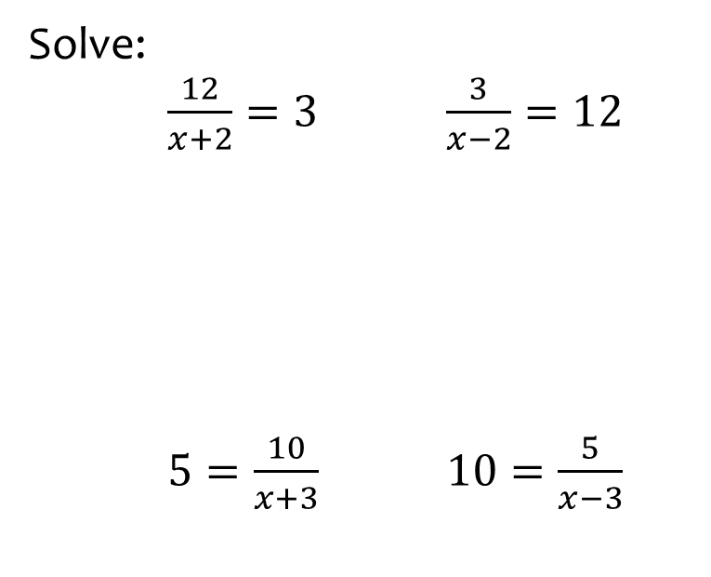
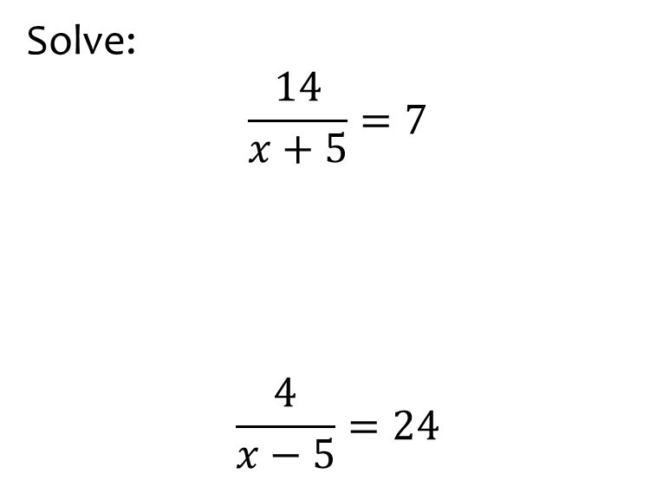
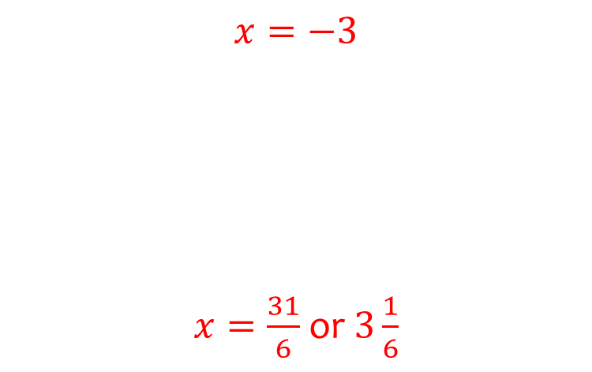
Worked example
Your turn
Solve:
$\frac{12}{x+2}=3$ $\frac{3}{x−2}=12$
$5=\frac{10}{x+3}$ $10=\frac{5}{x−3}$
Solve:
$$\frac{14}{x+5}=7$$
$$\frac{4}{x−5}=24$$
$$x=−3$$
$x=\frac{31}{6}$or $3\frac{1}{6}$

Slide 23
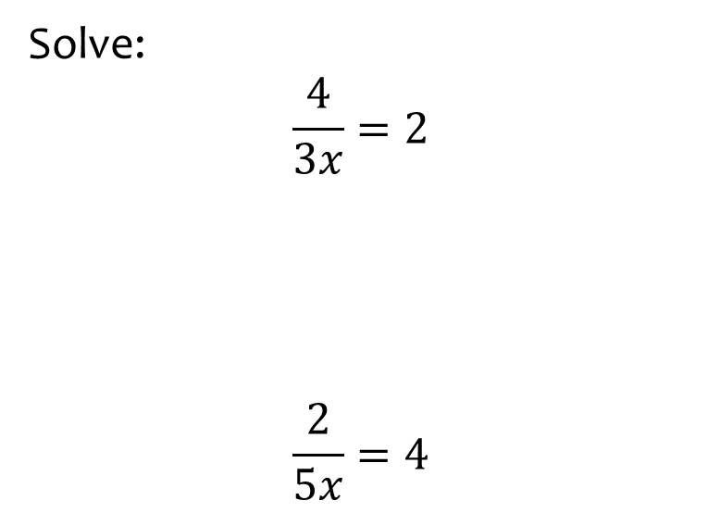


Worked example
Your turn
Solve:
$$\frac{4}{3x}=2$$
$$\frac{2}{5x}=4$$
Solve:
$$\frac{3}{4x}=2$$
$$x=\frac{3}{8}$$

Slide 24



Worked example
Your turn
Solve:
$$\frac{4}{3x−1}=2$$
$$\frac{2}{5x+3}=4$$
Solve:
$$\frac{3}{4x−5}=2$$
$$x=\frac{13}{8}$$

Slide 25



Worked example
Your turn
Solve:
$$2x+3=x+5$$
$$2x−3=3x+5$$
$$2x−3=4x+5$$
Solve:
$$3x−2=7x−10$$
$$x=2$$

Slide 26


Worked example
Your turn
Solve:
$$1−x=3x−7$$
$$3x−5=5−2x$$
$$4−2x=x+1$$
Solve:
$$2x−3=11−5x$$
$$x=2$$

Slide 27



Worked example
Your turn
Solve:
$$−2x+1=−5x+3$$
$$−4x−2=−3x+5$$
$$4−x=−6x+3$$
Solve:
$$−5x+4=−2x+8$$
$$x=−\frac{4}{3}$$

Slide 28



Worked example
Your turn
Solve:
$$\frac{1}{4}x+5=\frac{1}{3}x+2$$
$$\frac{1}{2}x−5=\frac{2}{3}x+4$$
Solve:
$$\frac{1}{2}x+3=\frac{1}{5}x−2$$
$$x=−\frac{50}{3}$$

Slide 29



Worked example
Your turn
Solve:
$$7x=5x+2$$
$$5x+8=6x$$
Solve:
$$6x=2x+12$$
$$x=3$$

Slide 30



Worked example
Your turn
Solve:
$$7x=−5x+2$$
$$−5x+8=6x$$
Solve:
$$6x=−2x+12$$
$$x=\frac{3}{2}$$

Slide 31



Worked example
Your turn
Solve:
$$7x+3=5x+11$$
$$3x+7=7x+3$$
Solve:
$$5x+2=2x+17$$
$$x=5$$

Slide 32



Worked example
Your turn
Solve:
$$7x+3=−5x+11$$
$$3x+7=−7x+3$$
Solve:
$$5x+2=−2x+17$$
$$x=\frac{15}{7}$$

Slide 33



Worked example
Your turn
Solve:
$$−7x+3=−5x+11$$
$$−3x+7=−7x+3$$
Solve:
$$−5x+2=−2x+17$$
$$x=−5$$

Slide 34



Worked example
Your turn
Solve:
$$2\left(x+3\right)=4x−5$$
$$2x+1=5\left(4x−3\right)$$
Solve:
$$3\left(2x−5\right)=x−4$$
$$x=\frac{11}{5}$$

Slide 35



Worked example
Your turn
Solve:
$$3\left(4x−2\right)=5\left(x−6\right)$$
$$6\left(2−3x\right)=4(x+5)$$
Solve:
$$3\left(5−2x\right)=4(x+6)$$
$$x=−\frac{9}{10}$$

Slide 36



Worked example
Your turn
Solve:
$$2\left(3x+4\right)+5\left(6x−7\right)=8$$
Solve:
$$8\left(7x−6\right)+5\left(4x+3\right)=2$$
$$x=\frac{35}{76}$$

Slide 37









Worked example
Your turn
Find $x$
Find $x$
$$27°$$
$$x°$$
$$72°$$
$$x°$$
$$x=108$$
$$157°$$
$$x°$$

Slide 38




Worked example
Your turn
Find $x$
Find $x$
$$72°$$
$$x°$$
$$127°$$
$$127°$$
$$x°$$
$$x=161$$

Slide 39



Worked example
Your turn
Find $x$
Find $x$
$$72°$$
$$3x°$$
$$127°$$
$$127°$$
$$7x°$$
$$x=23$$

Slide 40





Worked example
Your turn
Find $x$
Find $x$
$$7x$$
$$3x$$
$$5x+18$$
$$5x−70$$
$$x=20°$$

Slide 41







Worked example
Your turn
Find $x$
Find $x$
$$3x+59$$
$$4x+8$$
$$8x+13$$
$$10x+3$$
$$5x+2$$
$$6x−10$$
$$x=12°$$

Slide 42





Worked example
Your turn
Find $x$
Find $x$
$$2x−1$$
$$4x−3$$
$$5x−7$$
$$2x+9$$
$$x=6$$

Slide 43







Worked example
Your turn
Find $y$
Find $y$
$$2x−1$$
$$4x−3$$
$$y+8$$
$$3y−4$$
$$3y−8$$
$$y+12$$
$$5x−7$$
$$2x+9$$
$$y=10$$

Slide 44







Worked example
Your turn
The area of the rectangle is equal to $24$ square units. Find $x$
The area of the rectangle is equal to $72$ square units. Find $x$
$$2x−1$$
$$6$$
$$6$$
$$3x−2$$
$$x=\frac{14}{3}$$

Slide 45



Worked example
Your turn
The perimeter of the rectangle is equal to $24$ square units. Find $x$
The perimeter of the rectangle is equal to $72$ square units. Find $x$
$$2x−1$$
$$6$$
$$6$$
$$3x−2$$
$$x=\frac{32}{3}$$

Slide 46







Worked example
Your turn
Find $x$:
Find $x$:
$$7x+3$$
$$4x+18$$
$$5x+2$$
$$2x+14$$
$$x=4$$

Slide 47









Worked example
Your turn
The area of the triangle is equal to $24$ units. Find $x$:
The area of the triangle is equal to $12$ units. Find $x$:
$$10$$
$$8.54$$
$$6$$
$$3$$
$$2x+1$$
$$3x−2$$
$$x=\frac{10}{3}$$

Slide 48




Worked example
Your turn
The perimeter of the triangle is equal to $24$ units. Find $x$:
The perimeter of the triangle is equal to $12$ units. Find $x$:
$$10$$
$$5$$
$$6$$
$$3$$
$$2x+1$$
$$3x−2$$
$$x=2$$

Slide 49













Worked example
Your turn
The area of the trapezium is equal to $36$ square units. Find $x:$
The area of the trapezium is equal to $72$ square units. Find $x:$
$$2x$$
$$4x+1$$
>
>
$$5$$
$$4$$
$$5$$
$$10$$
$$8$$
$$10$$
>
>
$$5x−3$$
$$x−3$$
$$x=4$$

