Slide 1
SOLVING EQUATIONS (CUBIC + OTHER)
CONTENTS

Slide 2
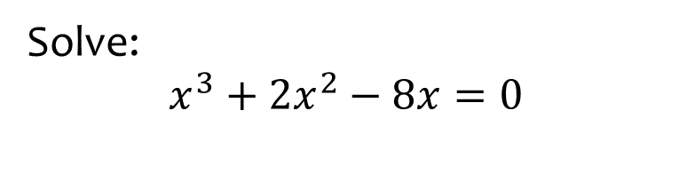
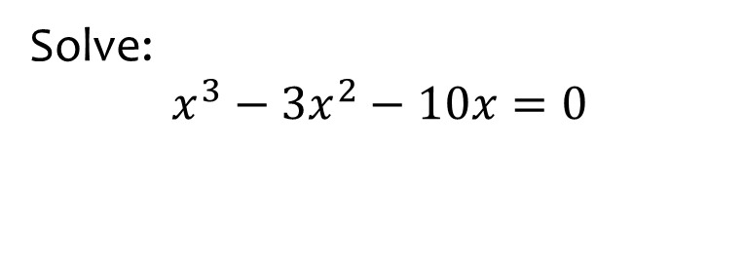

Worked example
Your turn
Solve:
$$x^{3}+2x^{2}−8x=0$$
Solve:
$$x^{3}−3x^{2}−10x=0$$
$$x=0, x=5, x=−2$$

Slide 3
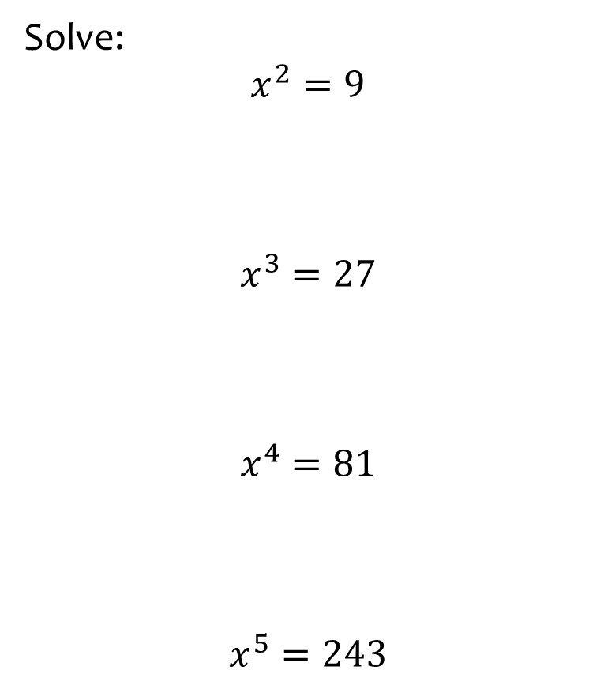
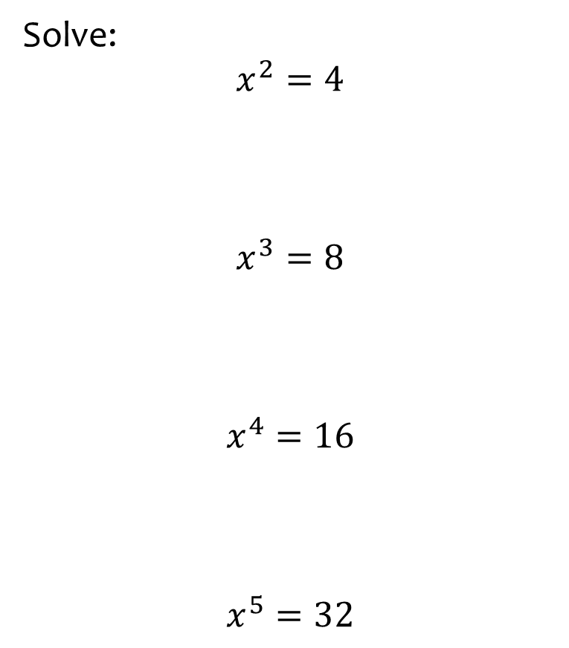
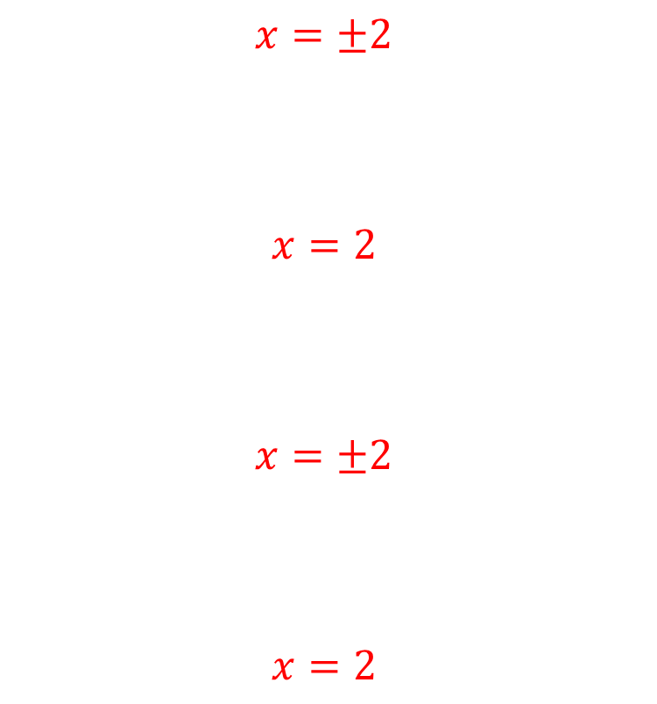
Worked example
Your turn
Solve:
$$x^{2}=9$$
$$x^{3}=27$$
$$x^{4}=81$$
$$x^{5}=243$$
Solve:
$$x^{2}=4$$
$$x^{3}=8$$
$$x^{4}=16$$
$$x^{5}=32$$
$$x=±2$$
$$x=2$$
$$x=±2$$
$$x=2$$

Slide 4
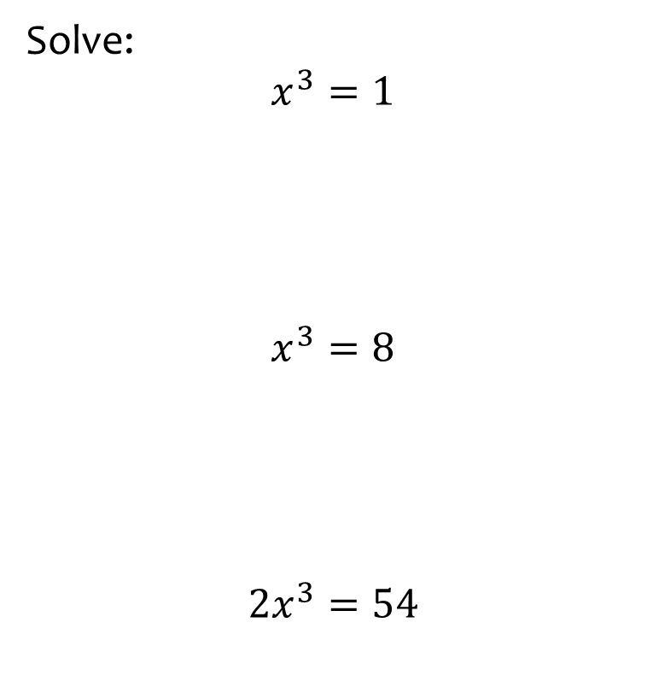
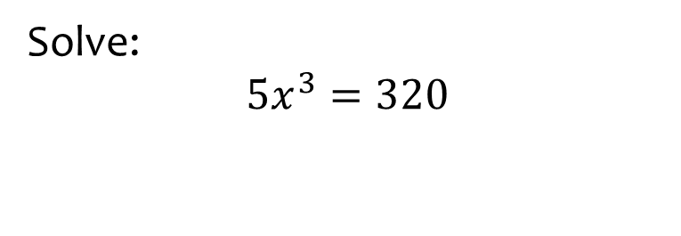

Worked example
Your turn
Solve:
$$x^{3}=1$$
$$x^{3}=8$$
$$2x^{3}=54$$
Solve:
$$5x^{3}=320$$
$$x=4$$

Slide 5
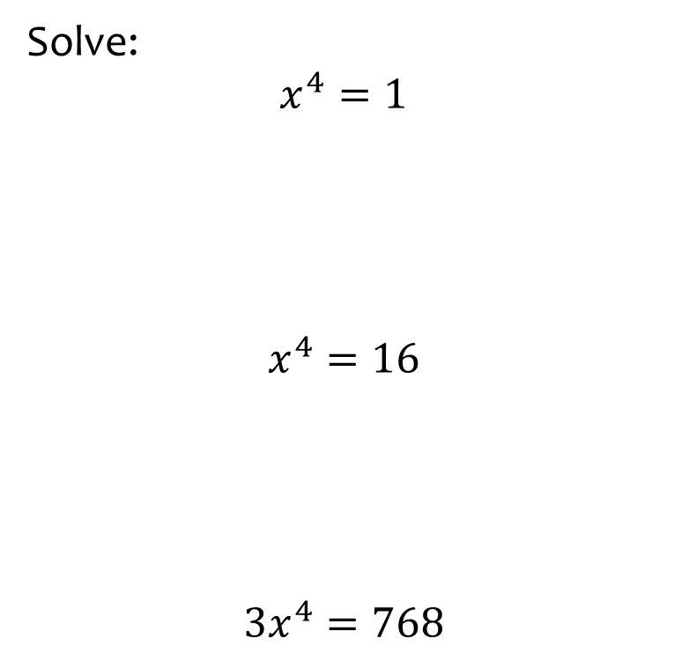
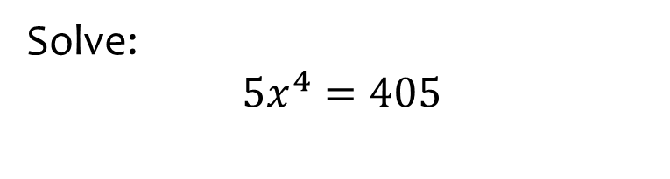

Worked example
Your turn
Solve:
$$x^{4}=1$$
$$x^{4}=16$$
$$3x^{4}=768$$
Solve:
$$5x^{4}=405$$
$$x=±3$$

Slide 6
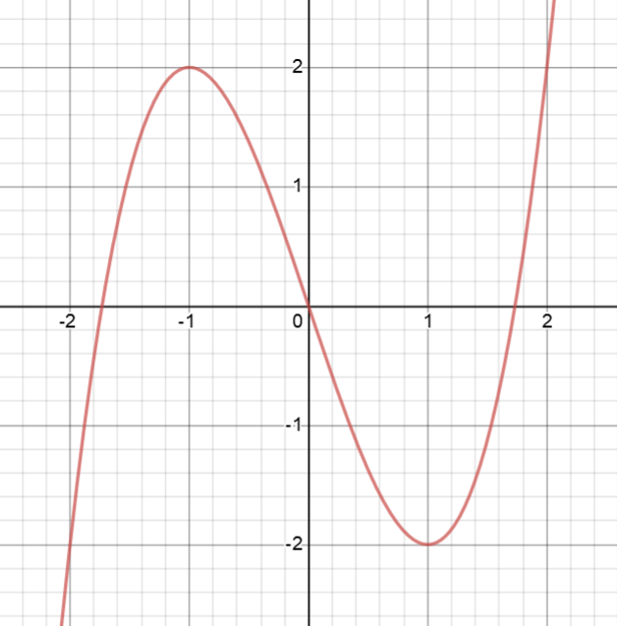
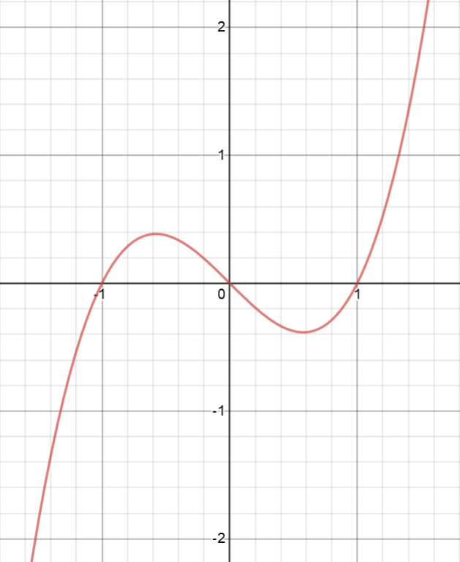
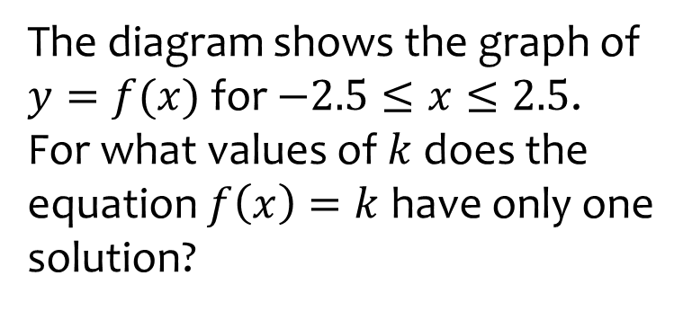
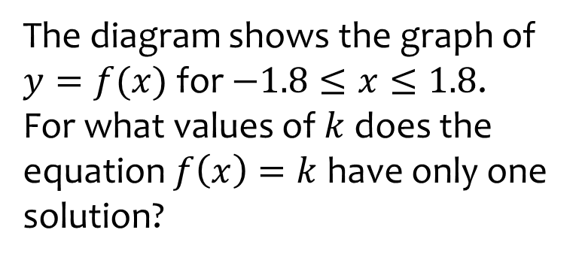

Worked example
Your turn
The diagram shows the graph of $y=f(x)$ for $−2.5≤x≤2.5$.
For what values of $k$ does the equation $f\left(x\right)=k$ have only one solution?
The diagram shows the graph of $y=f(x)$ for $−1.8≤x≤1.8$.
For what values of $k$ does the equation $f\left(x\right)=k$ have only one solution?
$$k<−0.4 ∪k>0.4$$
Graphs used with permission from DESMOS: https://www.desmos.com/

Slide 7
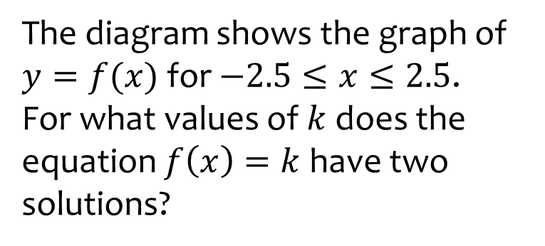
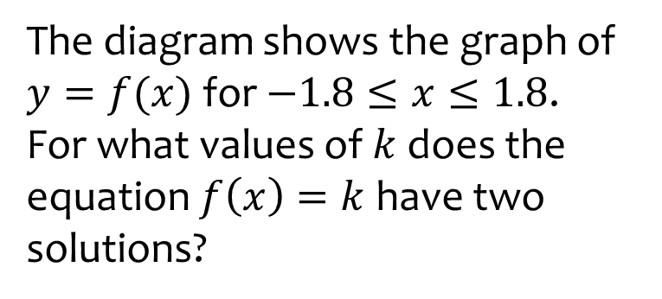

Worked example
Your turn
The diagram shows the graph of $y=f(x)$ for $−2.5≤x≤2.5$.
For what values of $k$ does the equation $f\left(x\right)=k$ have two solutions?
The diagram shows the graph of $y=f(x)$ for $−1.8≤x≤1.8$.
For what values of $k$ does the equation $f\left(x\right)=k$ have two solutions?
$$k=−0.4, k=0.4$$
Graphs used with permission from DESMOS: https://www.desmos.com/

Slide 8
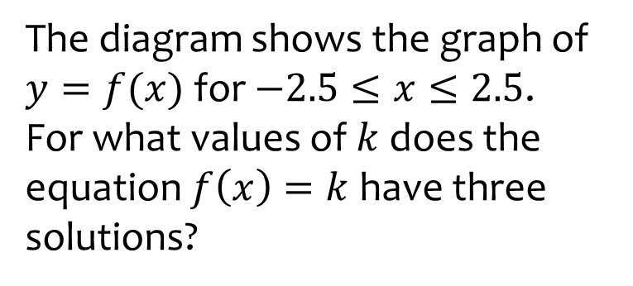
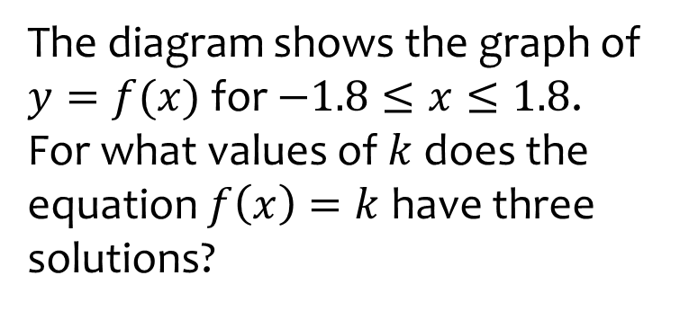

Worked example
Your turn
The diagram shows the graph of $y=f(x)$ for $−2.5≤x≤2.5$.
For what values of $k$ does the equation $f\left(x\right)=k$ have three solutions?
The diagram shows the graph of $y=f(x)$ for $−1.8≤x≤1.8$.
For what values of $k$ does the equation $f\left(x\right)=k$ have three solutions?
$$−0.4<k<0.4$$
Graphs used with permission from DESMOS: https://www.desmos.com/

