Slide 1
SIMULTANEOUS EQUATIONS LINEAR (SUBSTITUTION)
CONTENTS

Slide 2
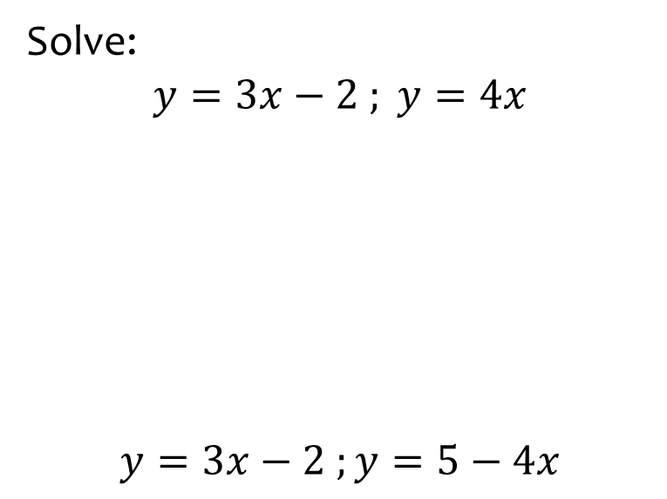
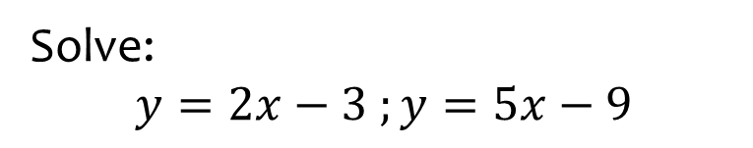

Worked example
Your turn
Solve:
$$y=3x−2 ; y=4x$$
$$y=3x−2 ;y=5−4x$$
Solve:
$$y=2x−3 ;y=5x−9$$
$$x=2, y=1$$

Slide 3
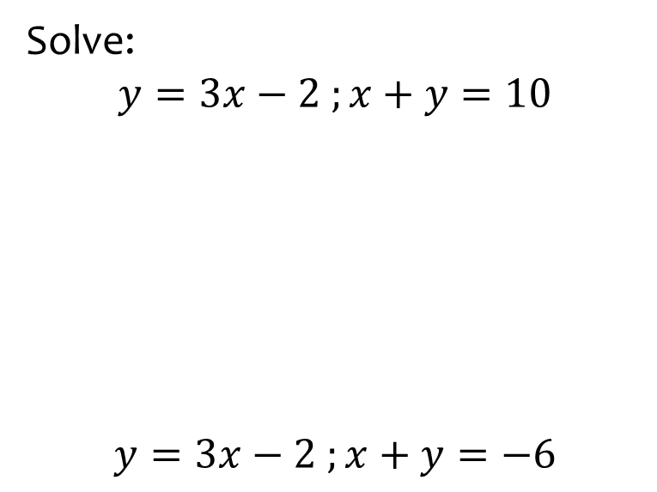
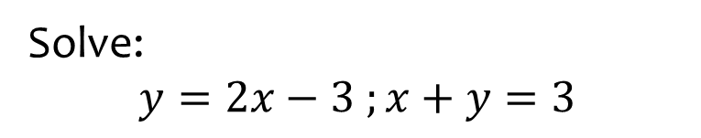
Worked example
Your turn
Solve:
$$y=3x−2 ;x+y=10$$
$$y=3x−2 ;x+y=−6$$
Solve:
$$y=2x−3 ;x+y=3$$
$$x=2, y=1$$

Slide 4
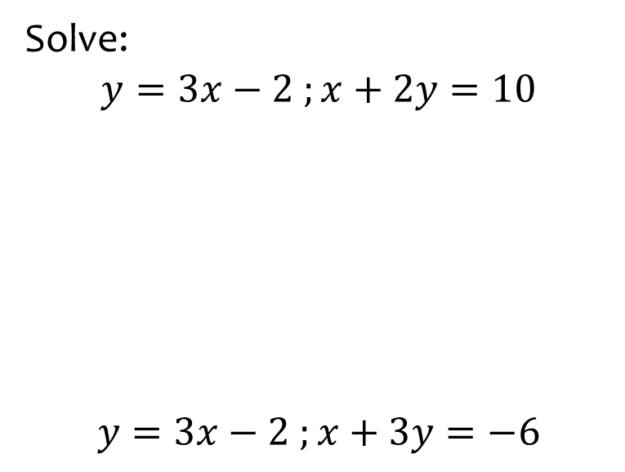
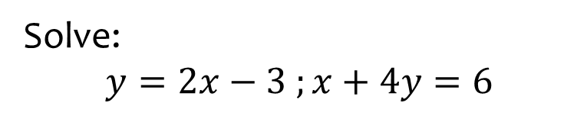
Worked example
Your turn
Solve:
$$y=3x−2 ;x+2y=10$$
$$y=3x−2 ;x+3y=−6$$
Solve:
$$y=2x−3 ;x+4y=6$$
$$x=2, y=1$$

Slide 5
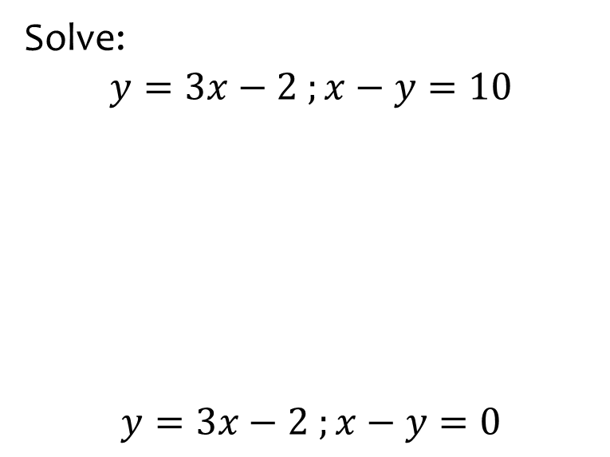
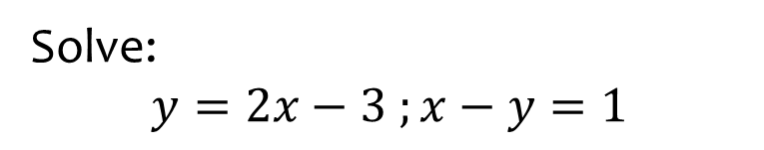
Worked example
Your turn
Solve:
$$y=3x−2 ;x−y=10$$
$$y=3x−2 ;x−y=0$$
Solve:
$$y=2x−3 ;x−y=1$$
$$x=2, y=1$$

Slide 6
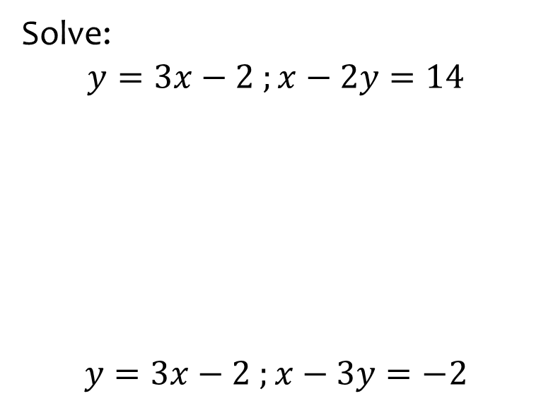
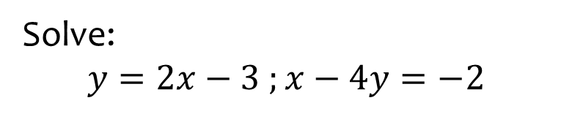
Worked example
Your turn
Solve:
$$y=3x−2 ;x−2y=14$$
$$y=3x−2 ;x−3y=−2$$
Solve:
$$y=2x−3 ;x−4y=−2$$
$$x=2, y=1$$

Slide 7
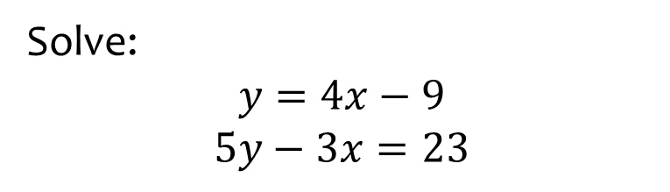
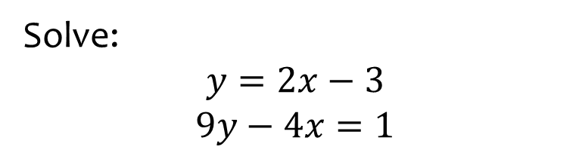

Worked example
Your turn
Solve:
$$y=4x−9$$
$$5y−3x=23$$
Solve:
$$y=2x−3$$
$$9y−4x=1$$
$$x=2, y=1$$

Slide 8
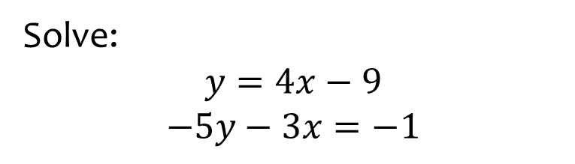
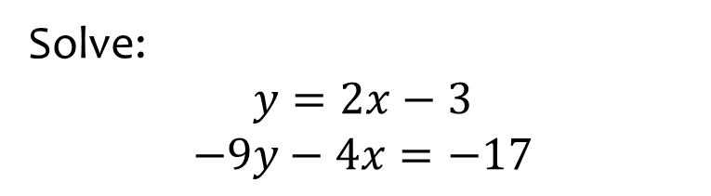
Worked example
Your turn
Solve:
$$y=4x−9$$
$$−5y−3x=−1$$
Solve:
$$y=2x−3$$
$$−9y−4x=−17$$
$$x=2, y=1$$

