Slide 1
SIMULTANEOUS EQUATIONS LINEAR (ELIMINATION)
Where elimination is the quicker option
CONTENTS

Slide 2
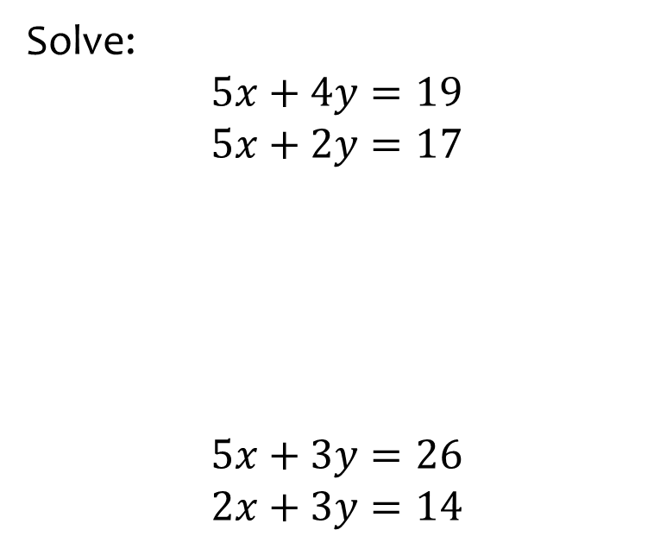
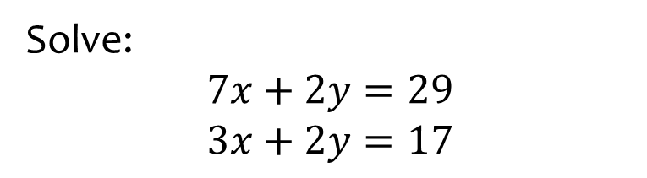

Worked example
Your turn
Solve:
$$5x+4y=19$$
$$5x+2y=17$$
$$5x+3y=26$$
$$2x+3y=14$$
Solve:
$$7x+2y=29$$
$$3x+2y=17$$
$$x=3, y=4$$

Slide 3
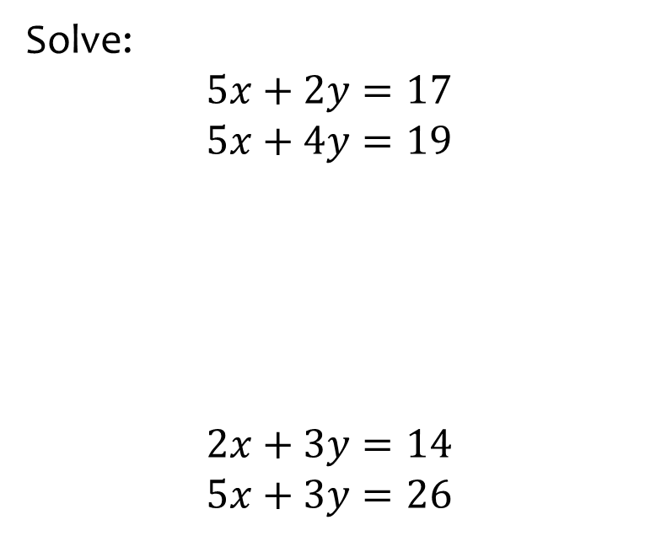
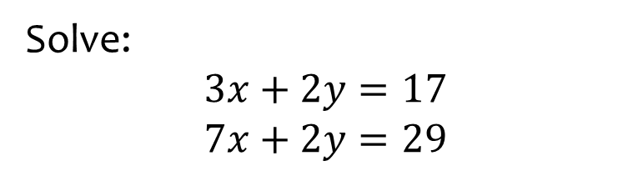
Worked example
Your turn
Solve:
$$5x+2y=17$$
$$5x+4y=19$$
$$2x+3y=14$$
$$5x+3y=26$$
Solve:
$$3x+2y=17$$
$$7x+2y=29$$
$$x=3, y=4$$

Slide 4
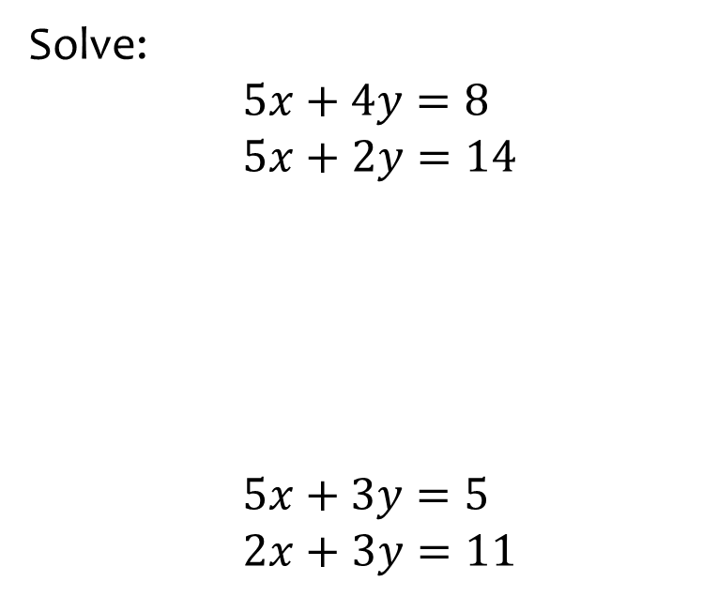
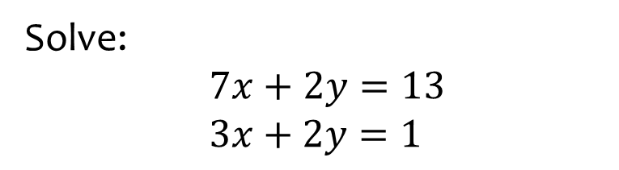

Worked example
Your turn
Solve:
$$5x+4y=8$$
$5x+2y=14$
$$5x+3y=5$$
$2x+3y=11$
Solve:
$7x+2y=13$
$$3x+2y=1$$
$$x=3, y=−4$$

Slide 5
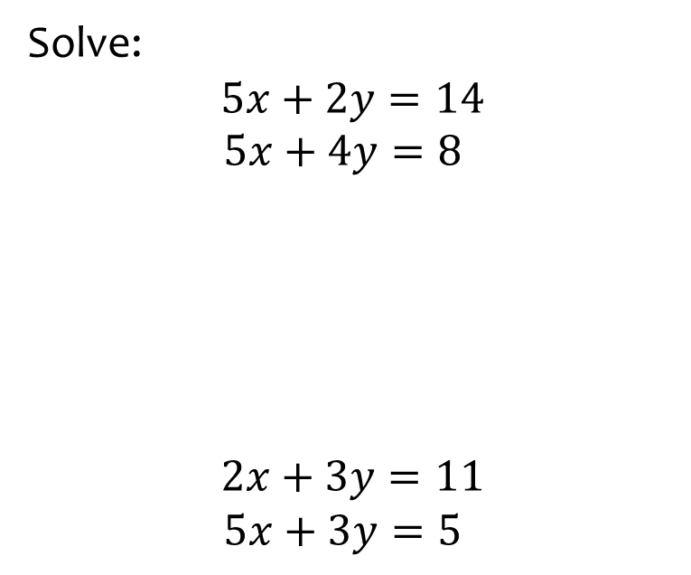
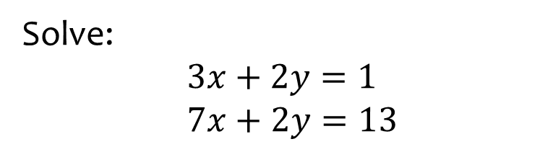
Worked example
Your turn
Solve:
$$5x+2y=14$$
$5x+4y=8$
$$2x+3y=11$$
$5x+3y=5$
Solve:
$$3x+2y=1$$
$7x+2y=13$
$$x=3, y=−4$$

Slide 6
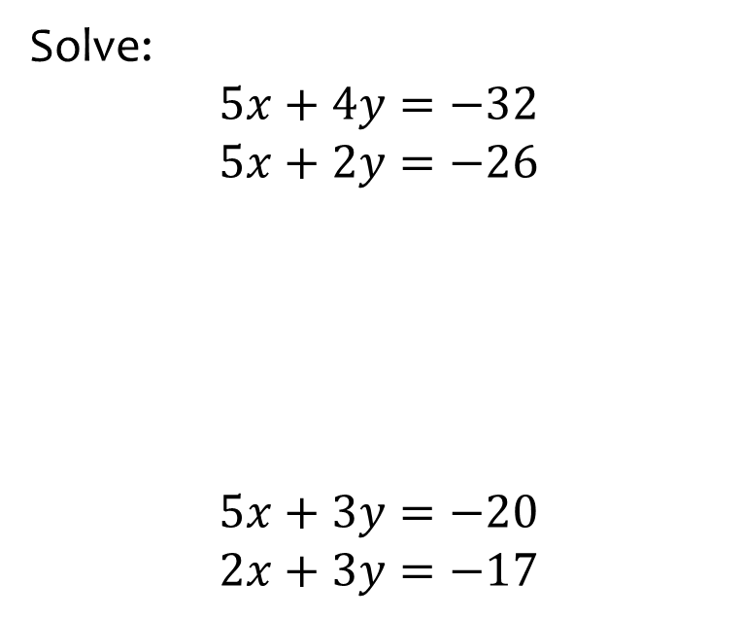
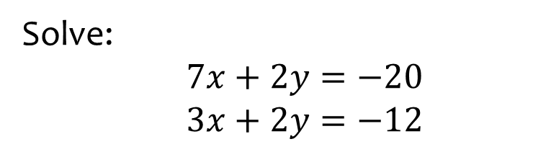

Worked example
Your turn
Solve:
$$5x+4y=−32$$
$$5x+2y=−26$$
$$5x+3y=−20$$
$$2x+3y=−17$$
Solve:
$7x+2y=−20$
$3x+2y=−12$
$$x=−2, y=−3$$

Slide 7
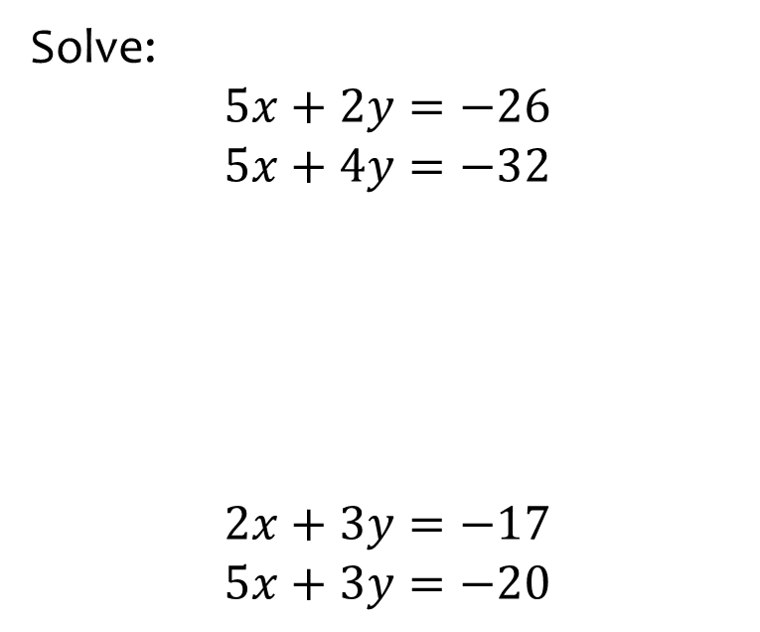
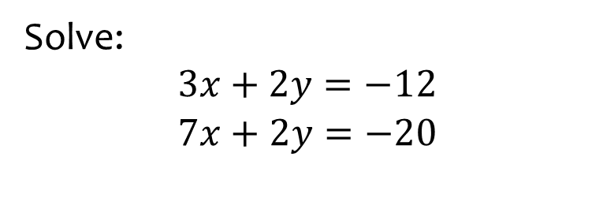
Worked example
Your turn
Solve:
$$5x+2y=−26$$
$$5x+4y=−32$$
$$2x+3y=−17$$
$$5x+3y=−20$$
Solve:
$3x+2y=−12$
$$7x+2y=−20$$
$$x=−2, y=−3$$

Slide 8
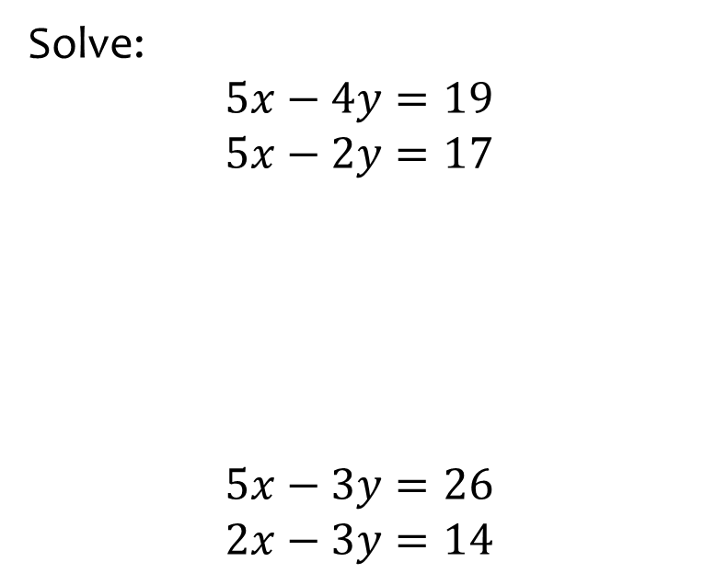
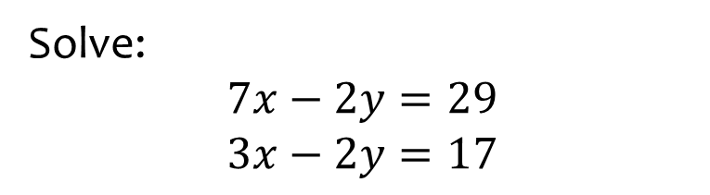
Worked example
Your turn
Solve:
$$5x−4y=19$$
$$5x−2y=17$$
$$5x−3y=26$$
$$2x−3y=14$$
Solve:
$$7x−2y=29$$
$$3x−2y=17$$
$$x=3, y=−4$$

Slide 9
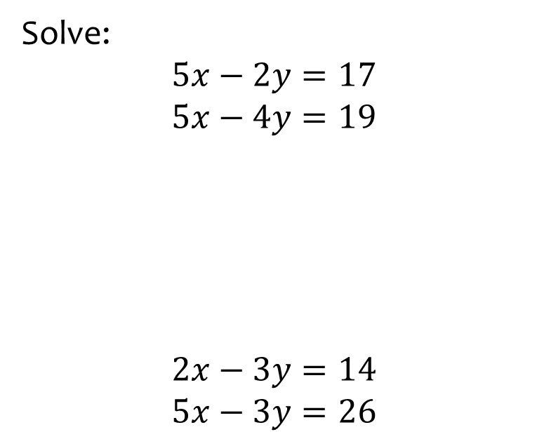
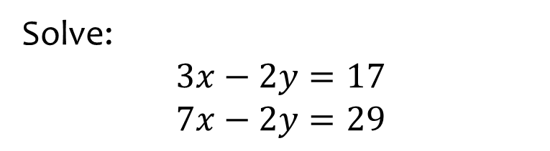
Worked example
Your turn
Solve:
$$5x−2y=17$$
$$5x−4y=19$$
$$2x−3y=14$$
$$5x−3y=26$$
Solve:
$$3x−2y=17$$
$$7x−2y=29$$
$$x=3, y=−4$$

Slide 10
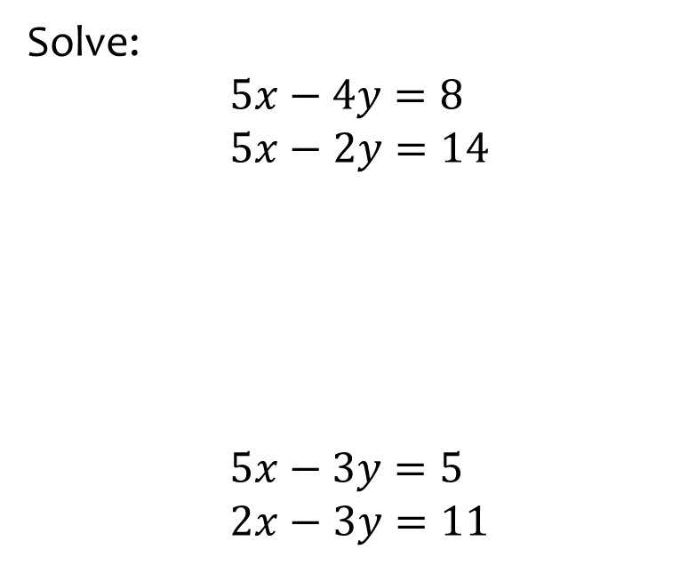
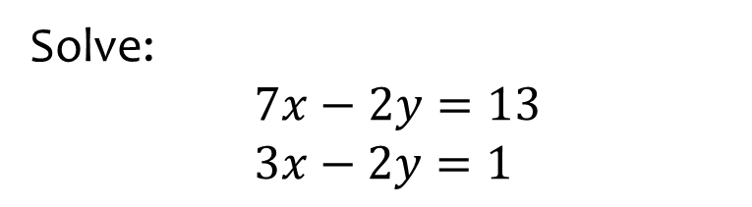
Worked example
Your turn
Solve:
$$5x−4y=8$$
$5x−2y=14$
$$5x−3y=5$$
$2x−3y=11$
Solve:
$7x−2y=13$
$$3x−2y=1$$
$$x=3, y=4$$

Slide 11
Worked example
Your turn
Solve:
$$5x−2y=17$$
$$5x−4y=19$$
$$2x−3y=14$$
$$5x−3y=26$$
Solve:
$$3x−2y=17$$
$$7x−2y=29$$
$$x=3, y=−4$$

Slide 12
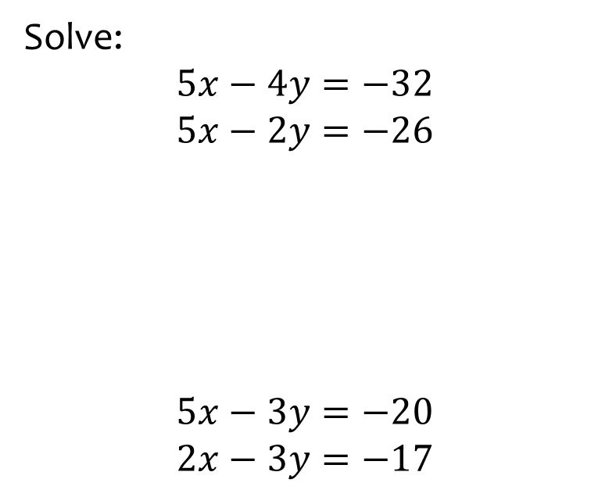
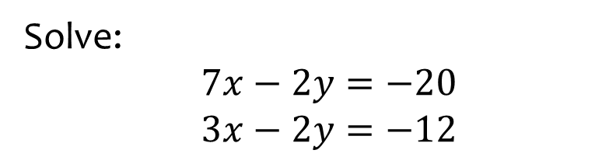

Worked example
Your turn
Solve:
$$5x−4y=−32$$
$$5x−2y=−26$$
$$5x−3y=−20$$
$$2x−3y=−17$$
Solve:
$7x−2y=−20$
$3x−2y=−12$
$$x=−2, y=3$$

Slide 13
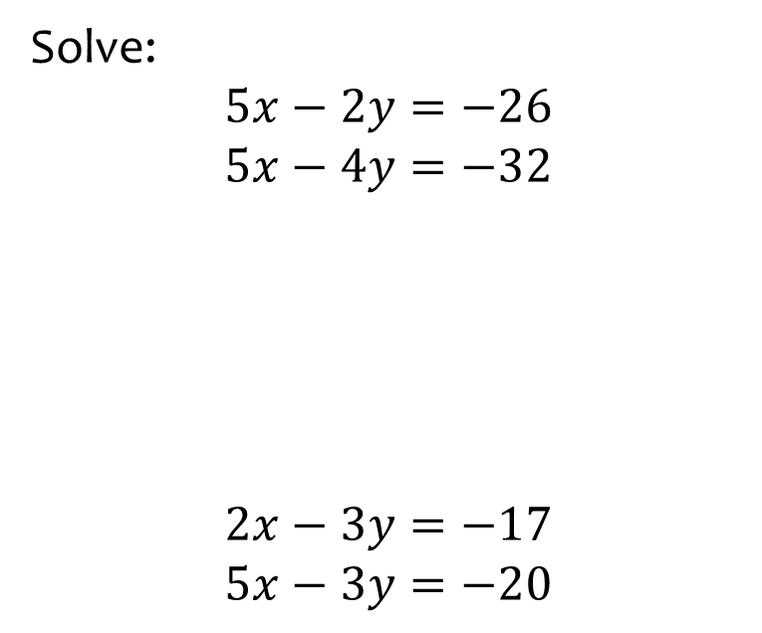
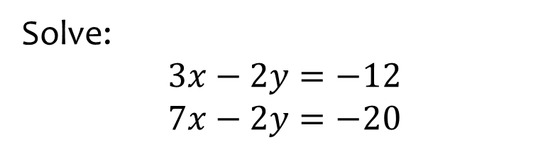
Worked example
Your turn
Solve:
$$5x−2y=−26$$
$$5x−4y=−32$$
$$2x−3y=−17$$
$$5x−3y=−20$$
Solve:
$3x−2y=−12$
$7x−2y=−20$
$$x=−2, y=3$$

Slide 14
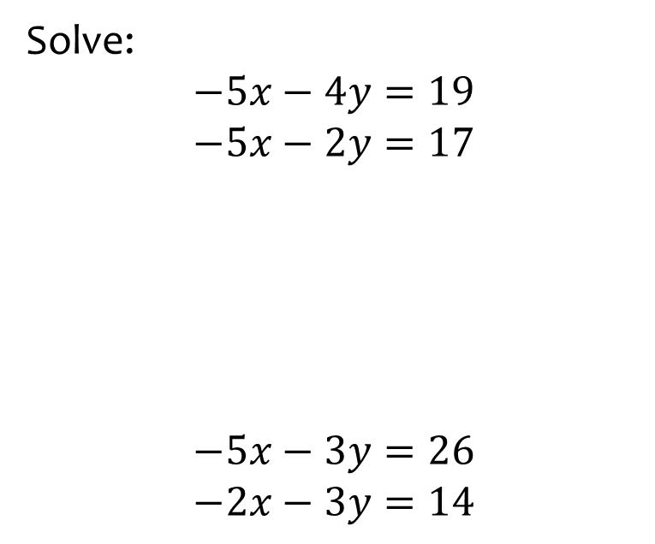
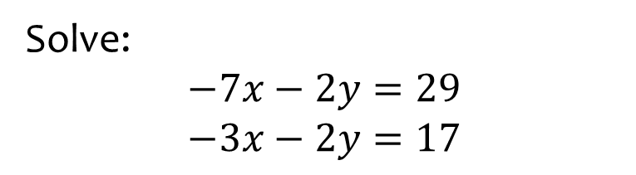

Worked example
Your turn
Solve:
$$−5x−4y=19$$
$$−5x−2y=17$$
$$−5x−3y=26$$
$$−2x−3y=14$$
Solve:
$$−7x−2y=29$$
$$−3x−2y=17$$
$$x=−3, y=4$$

Slide 15
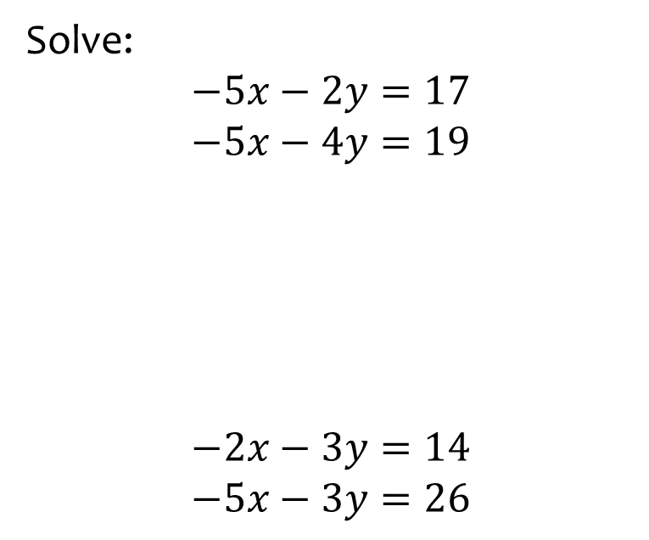
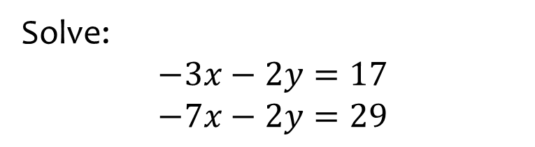
Worked example
Your turn
Solve:
$$−5x−2y=17$$
$$−5x−4y=19$$
$$−2x−3y=14$$
$$−5x−3y=26$$
Solve:
$$−3x−2y=17$$
$$−7x−2y=29$$
$$x=−3, y=4$$

Slide 16
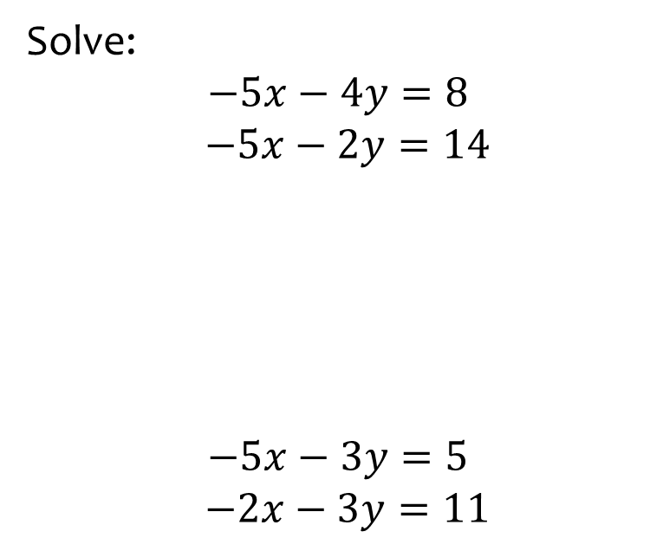
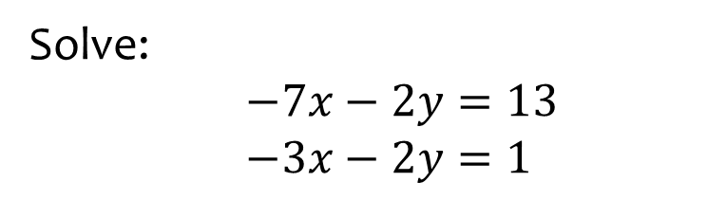
Worked example
Your turn
Solve:
$$−5x−4y=8$$
$−5x−2y=14$
$$−5x−3y=5$$
$−2x−3y=11$
Solve:
$−7x−2y=13$
$−3x−2y=1$
$$x=−3, y=4$$

Slide 17
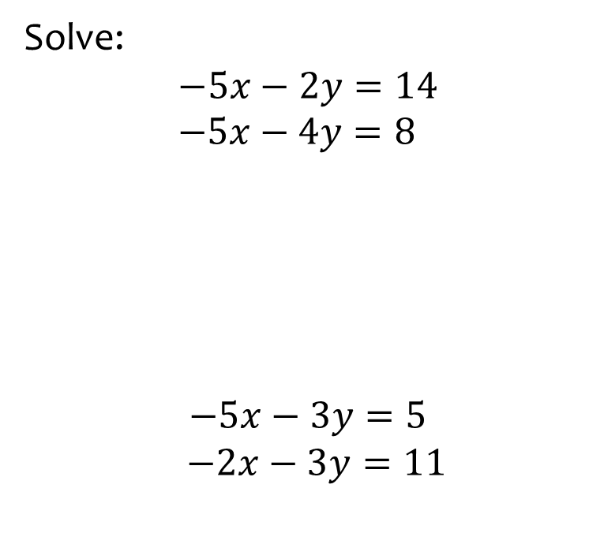
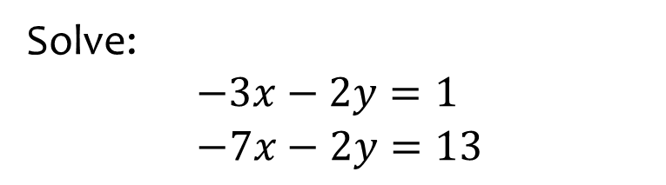
Worked example
Your turn
Solve:
$$−5x−2y=14$$
$−5x−4y=8$
$$−5x−3y=5$$
$−2x−3y=11$
Solve:
$−3x−2y=1$
$$−7x−2y=13$$
$$x=−3, y=4$$

Slide 18
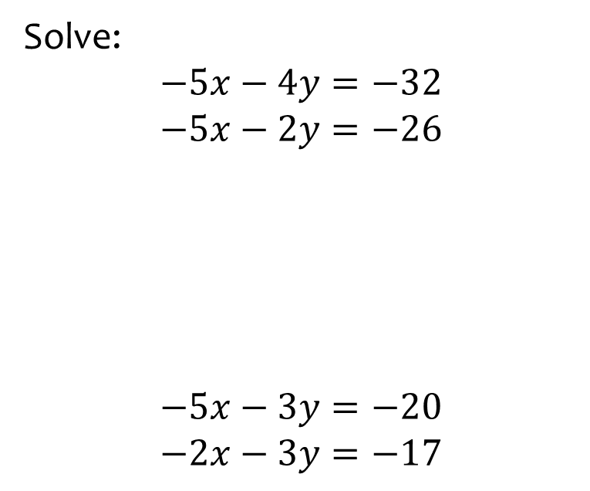
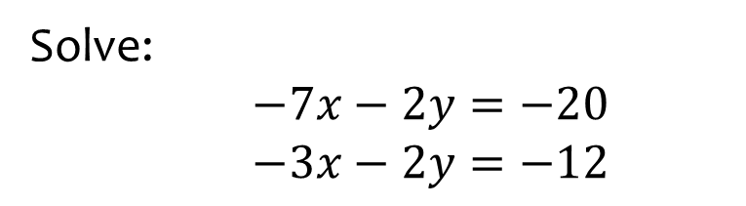

Worked example
Your turn
Solve:
$$−5x−4y=−32$$
$$−5x−2y=−26$$
$$−5x−3y=−20$$
$$−2x−3y=−17$$
Solve:
$−7x−2y=−20$
$−3x−2y=−12$
$$x=2, y=3$$

Slide 19
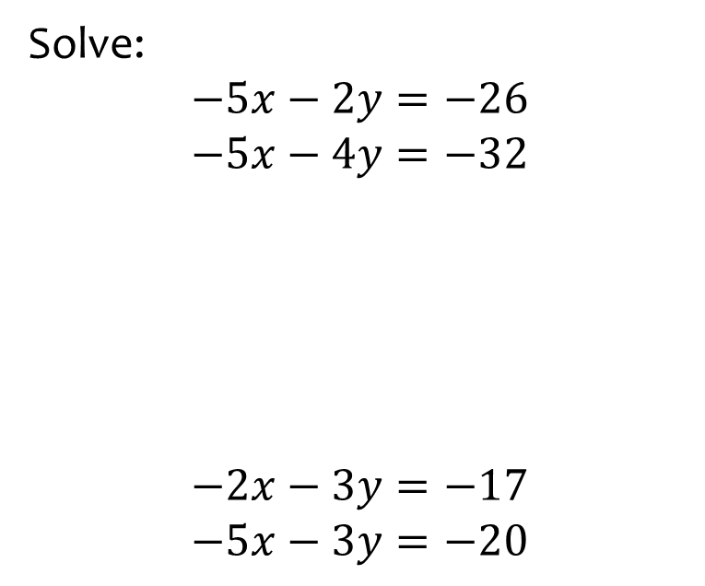
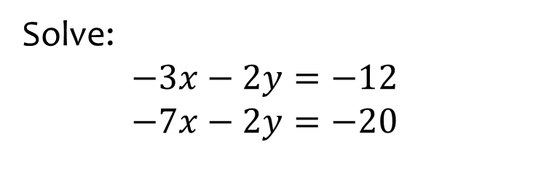
Worked example
Your turn
Solve:
$$−5x−2y=−26$$
$$−5x−4y=−32$$
$$−2x−3y=−17$$
$$−5x−3y=−20$$
Solve:
$−3x−2y=−12$
$−7x−2y=−20$
$$x=2, y=3$$

Slide 20
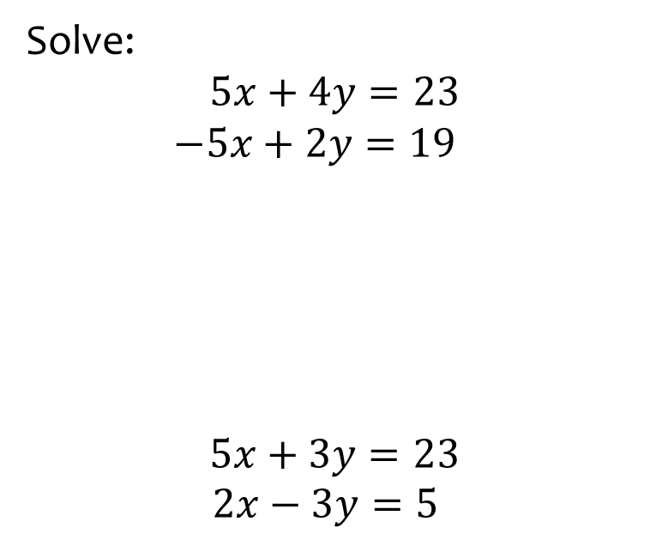
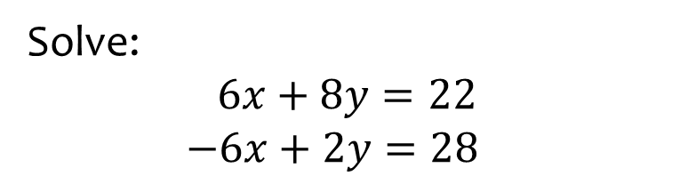

Worked example
Your turn
Solve:
$$5x+4y=23$$
$−5x+2y=19$
$$5x+3y=23$$
$2x−3y=5$
Solve:
$$6x+8y=22$$
$−6x+2y=28$
$$x=−3 , y=5$$

Slide 21
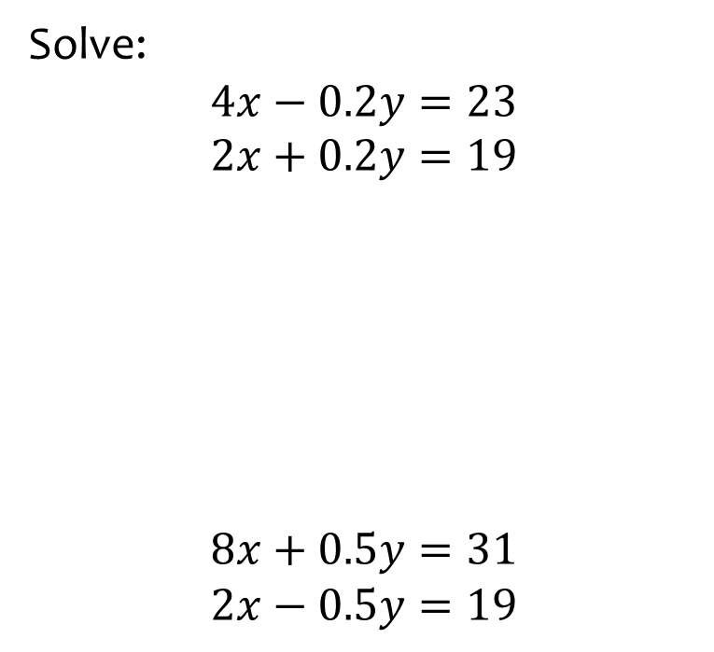
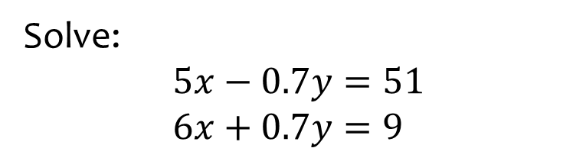

Worked example
Your turn
Solve:
$$4x−0.2y=23$$
$$2x+0.2y=19$$
$$8x+0.5y=31$$
$$2x−0.5y=19$$
Solve:
$$5x−0.7y=51$$
$6x+0.7y=9$
$$x=5 , y=−30$$

Slide 22
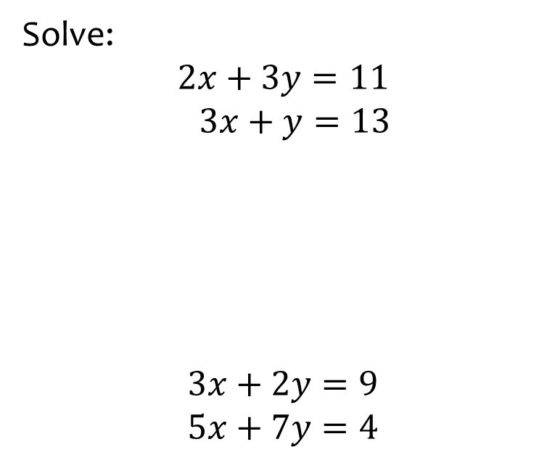
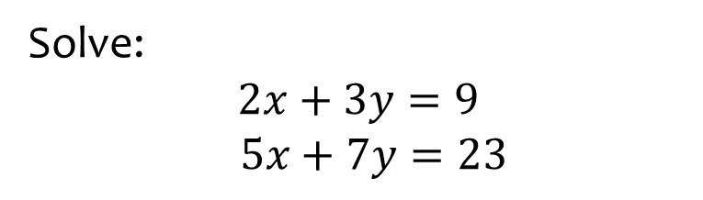

Worked example
Your turn
Solve:
$$2x+3y=11$$
$$3x+y=13$$
$$3x+2y=9$$
$$5x+7y=4$$
Solve:
$$2x+3y=9$$
$$5x+7y=23$$
$$x=6 , y=−1$$

