Slide 1
SIMULTANEOUS EQUATIONS (GRAPHICAL)
CONTENTS

Slide 2
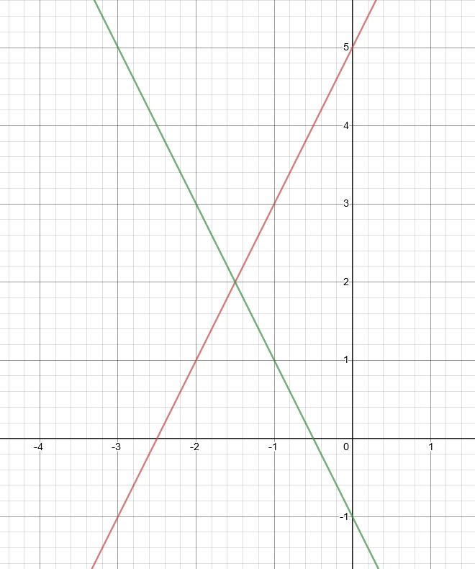
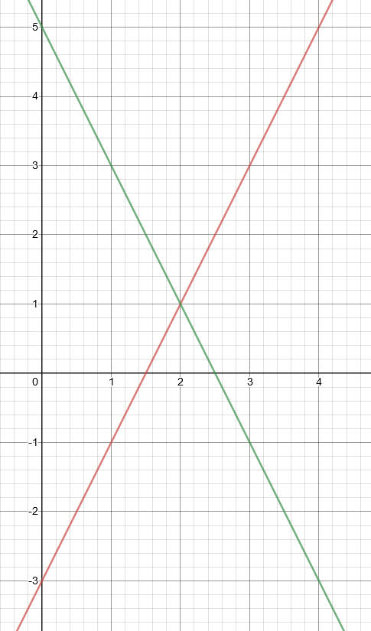
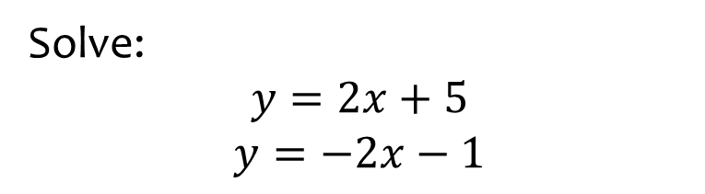
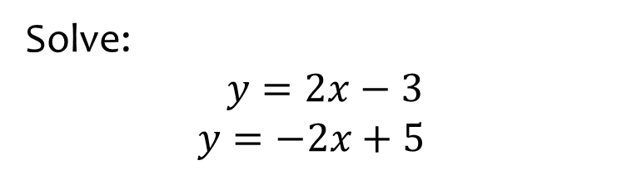

Worked example
Your turn
Solve:
$$y=2x+5$$
$$y=−2x−1$$
Solve:
$$y=2x−3$$
$$y=−2x+5$$
$$x=2, y=1$$

Slide 3
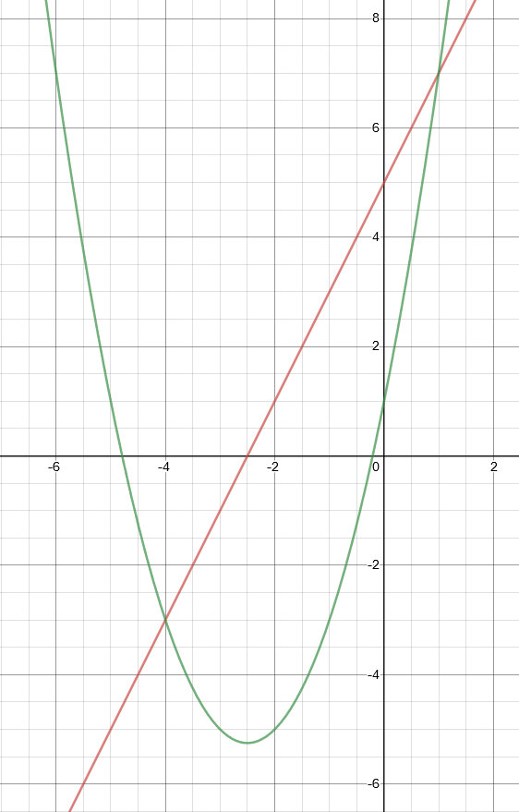
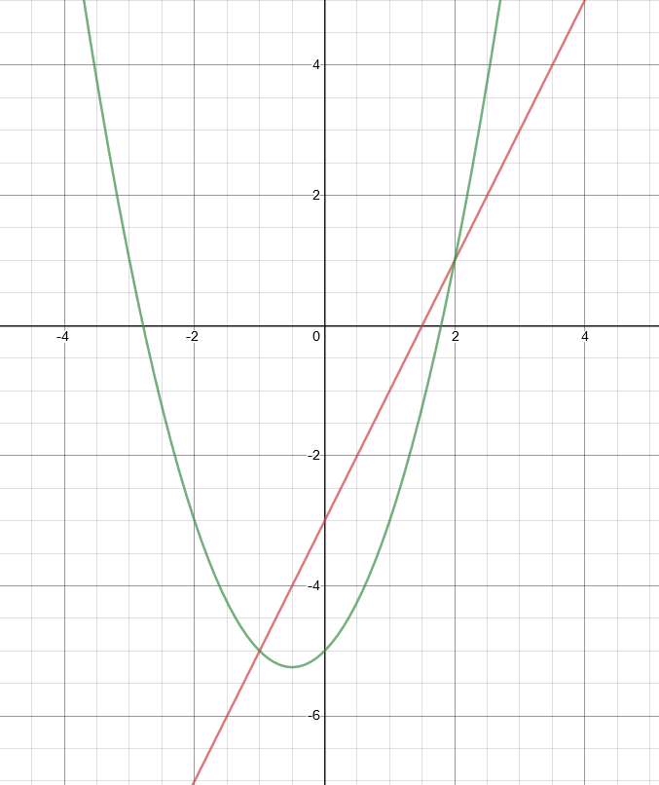
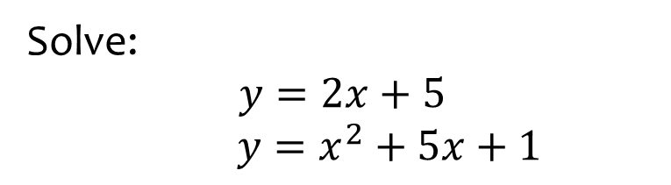
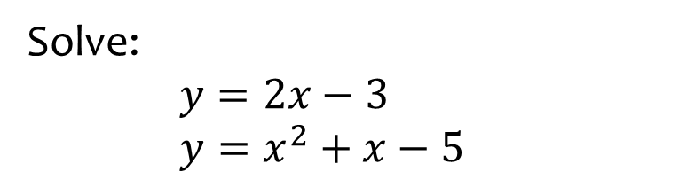

Worked example
Your turn
Solve:
$$y=2x+5$$
$y=x^{2}+5x+1$
Solve:
$y=2x−3$
$y=x^{2}+x−5$
$$x=2, y=1$$
$$x=−1, y=−5$$

Slide 4
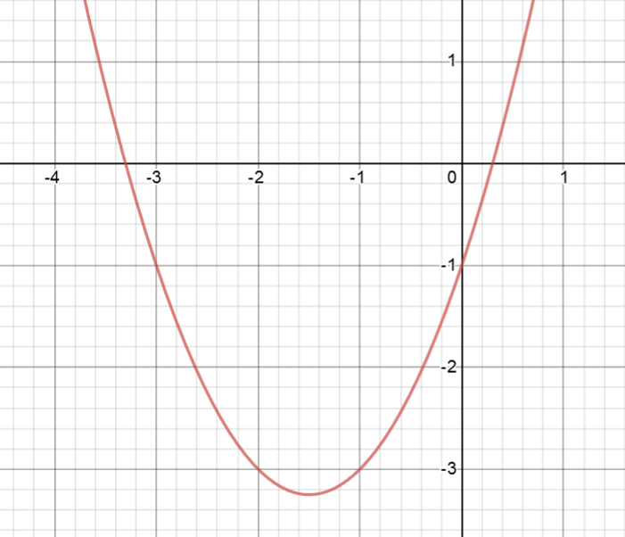
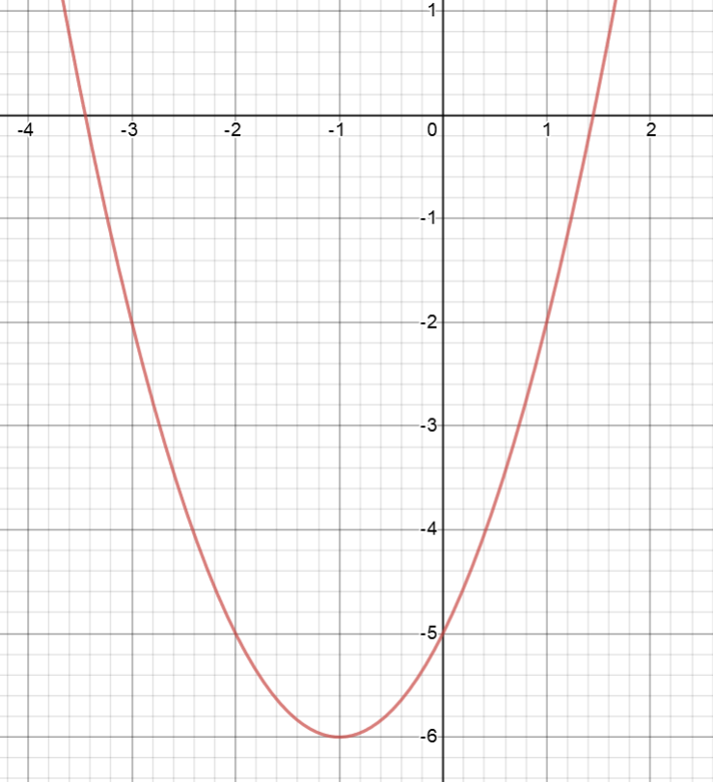
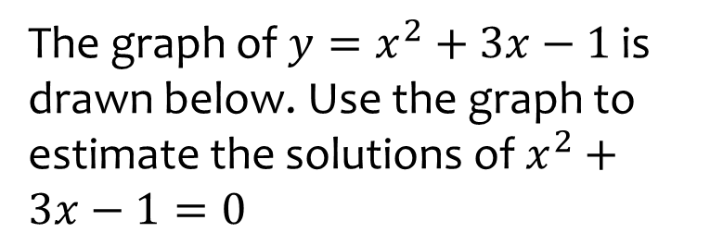
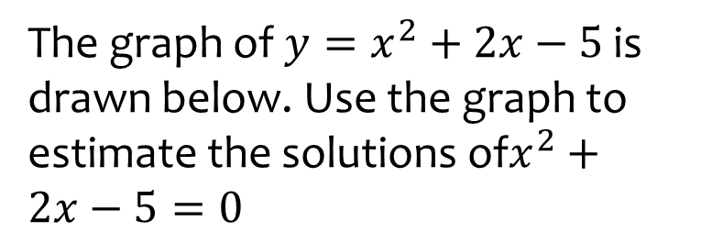
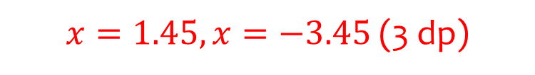
Worked example
Your turn
The graph of $y=x^{2}+3x−1$ is drawn below. Use the graph to estimate the solutions of $x^{2}+3x−1=0$
The graph of $y=x^{2}+2x−5$ is drawn below. Use the graph to estimate the solutions of$x^{2}+2x−5=0$
$x=1.45, x=−3.45$(3 dp)
Graphs used with permission from DESMOS: https://www.desmos.com/

Slide 5
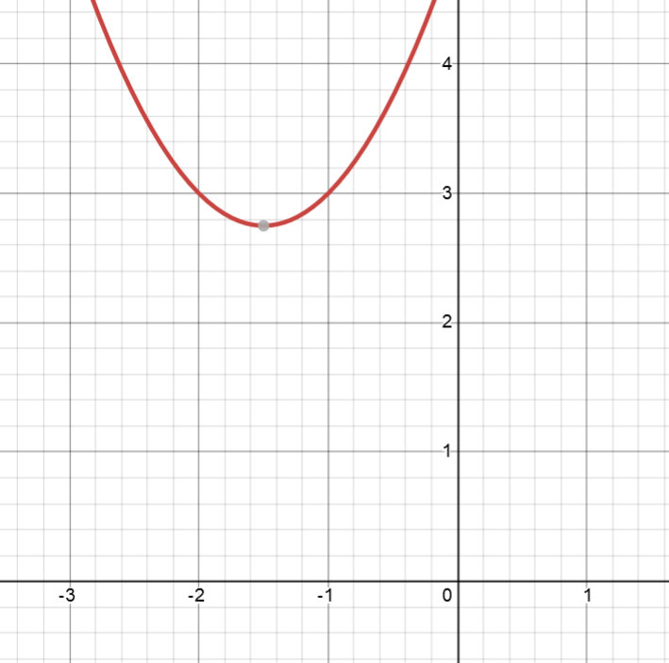
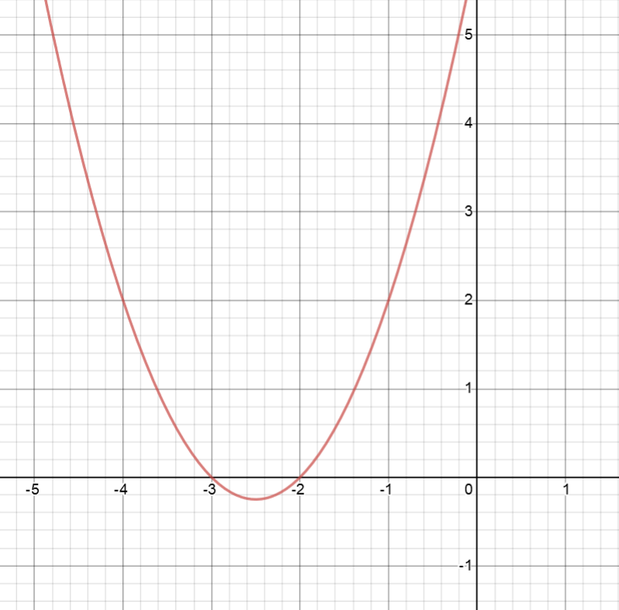
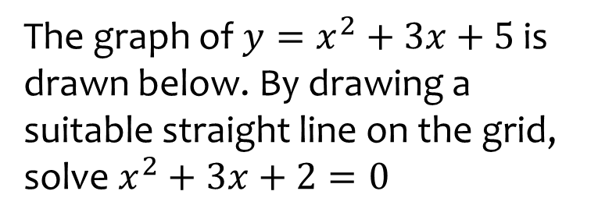
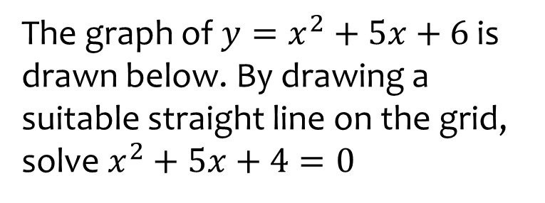

Worked example
Your turn
The graph of $y=x^{2}+3x+5$ is drawn below. By drawing a suitable straight line on the grid, solve $x^{2}+3x+2=0$
The graph of $y=x^{2}+5x+6$ is drawn below. By drawing a suitable straight line on the grid, solve $x^{2}+5x+4=0$
$$x=−4, x=−1$$
Graphs used with permission from DESMOS: https://www.desmos.com/

Slide 6
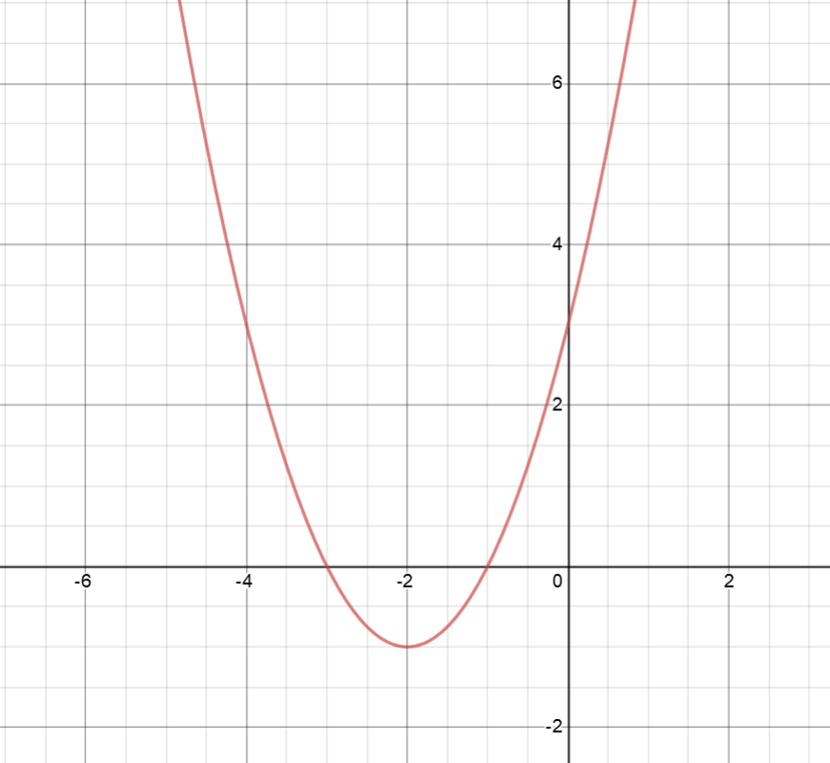
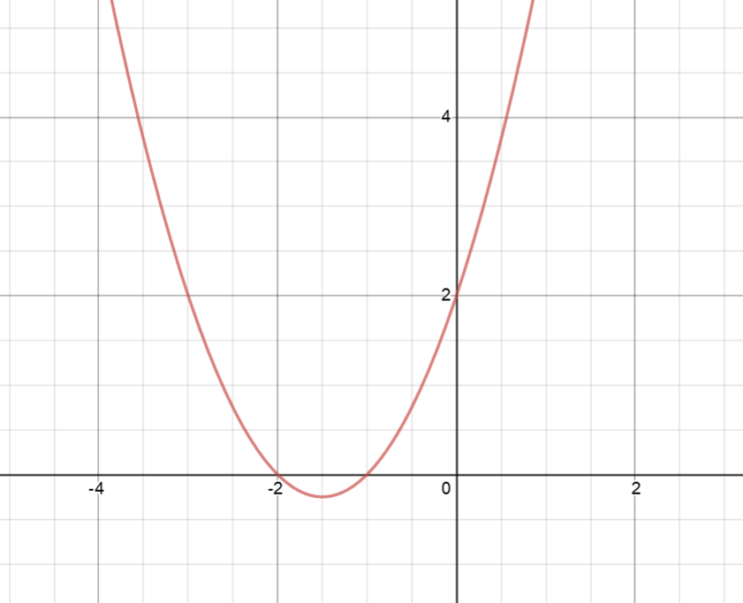
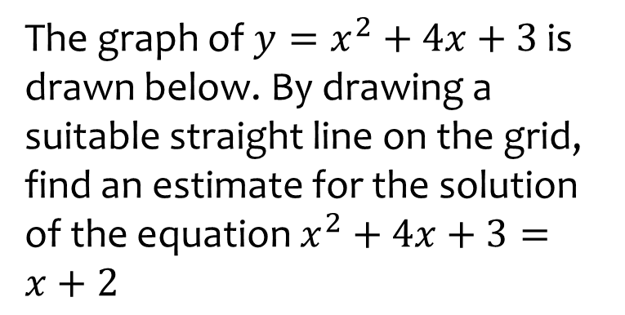
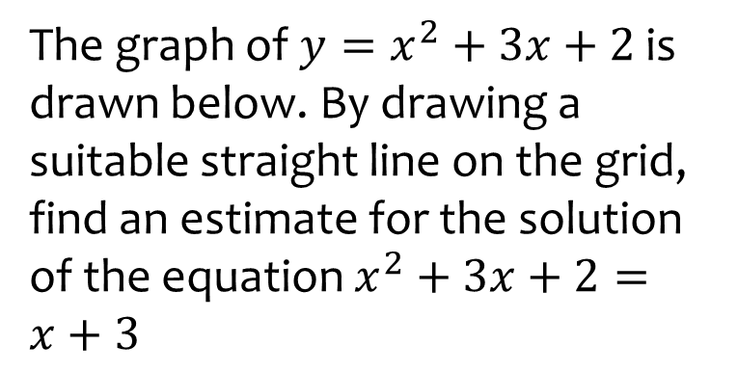

Worked example
Your turn
The graph of $y=x^{2}+4x+3$ is drawn below. By drawing a suitable straight line on the grid, find an estimate for the solution of the equation $x^{2}+4x+3=x+2$
The graph of $y=x^{2}+3x+2$ is drawn below. By drawing a suitable straight line on the grid, find an estimate for the solution of the equation $x^{2}+3x+2=x+3$
$x=0.4, x=−2.4$(1 dp)
Graphs used with permission from DESMOS: https://www.desmos.com/

Slide 7
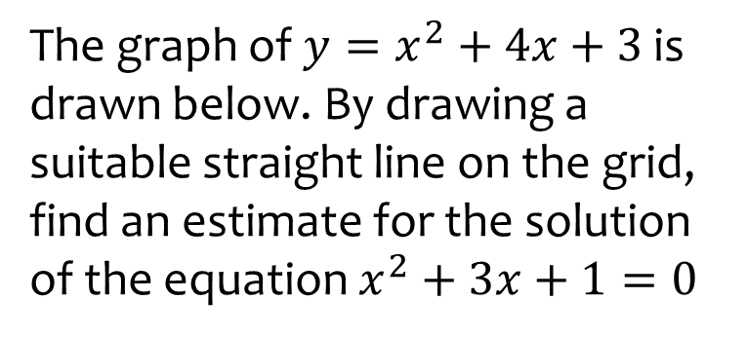
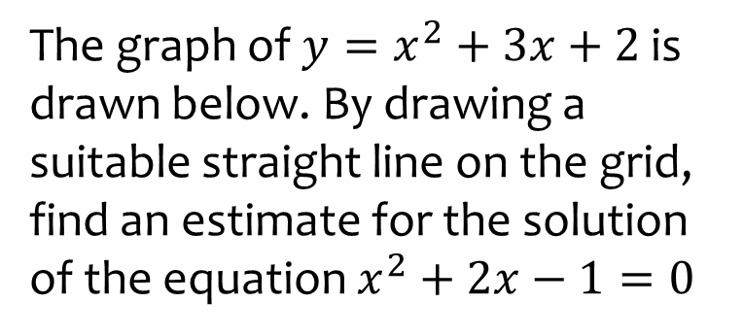

Worked example
Your turn
The graph of $y=x^{2}+4x+3$ is drawn below. By drawing a suitable straight line on the grid, find an estimate for the solution of the equation $x^{2}+3x+1=0$
The graph of $y=x^{2}+3x+2$ is drawn below. By drawing a suitable straight line on the grid, find an estimate for the solution of the equation $x^{2}+2x−1=0$
$x=0.4, x=−2.4$(1 dp)
Graphs used with permission from DESMOS: https://www.desmos.com/

Slide 8
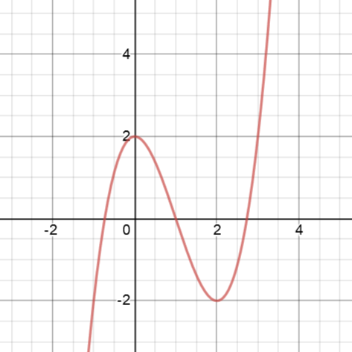
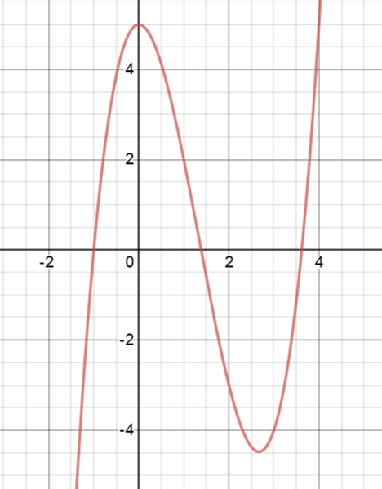
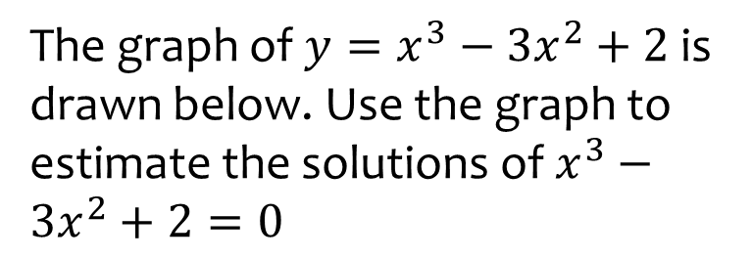
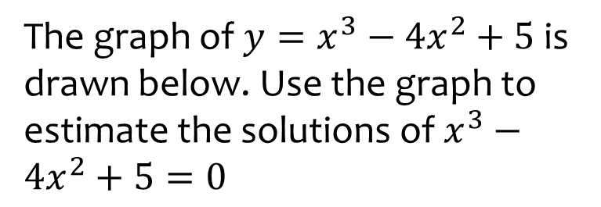
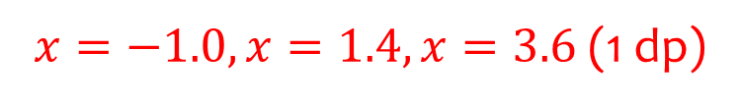
Worked example
Your turn
The graph of $y=x^{3}−3x^{2}+2$ is drawn below. Use the graph to estimate the solutions of $x^{3}−3x^{2}+2=0$
The graph of $y=x^{3}−4x^{2}+5$ is drawn below. Use the graph to estimate the solutions of $x^{3}−4x^{2}+5=0$
$x=−1.0, x=1.4, x=3.6$(1 dp)
Graphs used with permission from DESMOS: https://www.desmos.com/

Slide 9
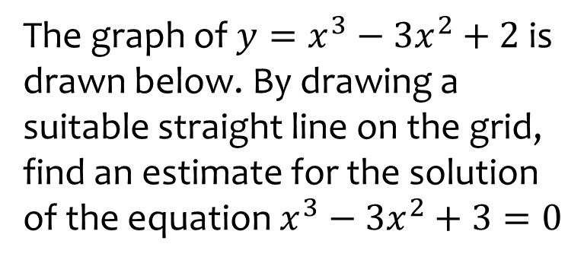
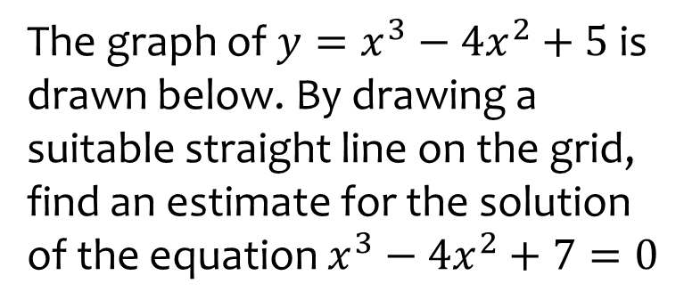
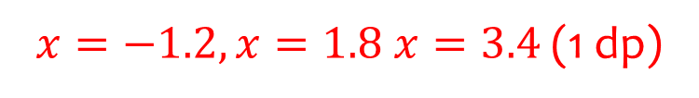
Worked example
Your turn
The graph of $y=x^{3}−3x^{2}+2$ is drawn below. By drawing a suitable straight line on the grid, find an estimate for the solution of the equation $x^{3}−3x^{2}+3=0$
The graph of $y=x^{3}−4x^{2}+5$ is drawn below. By drawing a suitable straight line on the grid, find an estimate for the solution of the equation $x^{3}−4x^{2}+7=0$
$x=−1.2, x=1.8 x=3.4$ (1 dp)
Graphs used with permission from DESMOS: https://www.desmos.com/

Slide 10
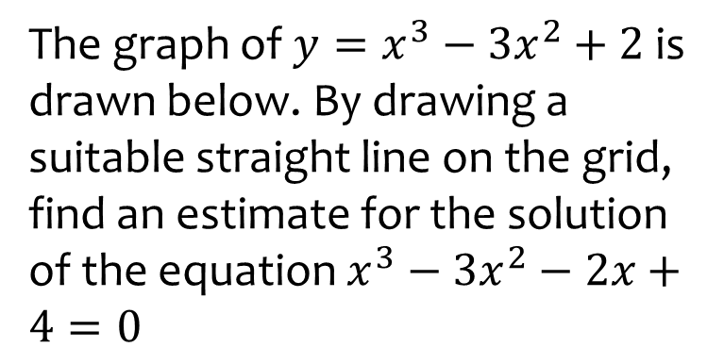
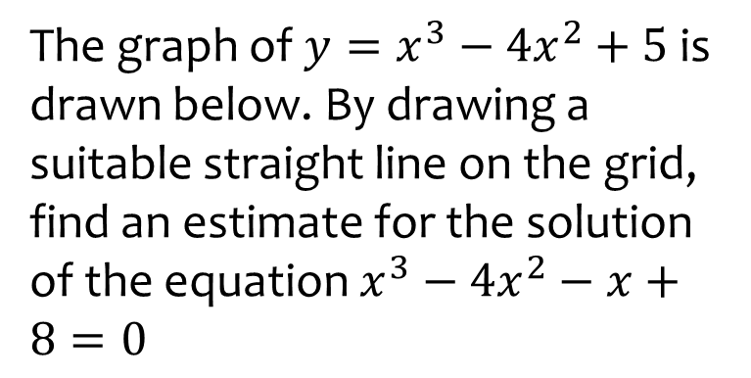

Worked example
Your turn
The graph of $y=x^{3}−3x^{2}+2$ is drawn below. By drawing a suitable straight line on the grid, find an estimate for the solution of the equation $x^{3}−3x^{2}−2x+4=0$
The graph of $y=x^{3}−4x^{2}+5$ is drawn below. By drawing a suitable straight line on the grid, find an estimate for the solution of the equation $x^{3}−4x^{2}−x+8=0$
$$x=−1.3, x=1.6, x=3.7$$
Graphs used with permission from DESMOS: https://www.desmos.com/

