Slide 1
RATIO
CONTENTS

Slide 2
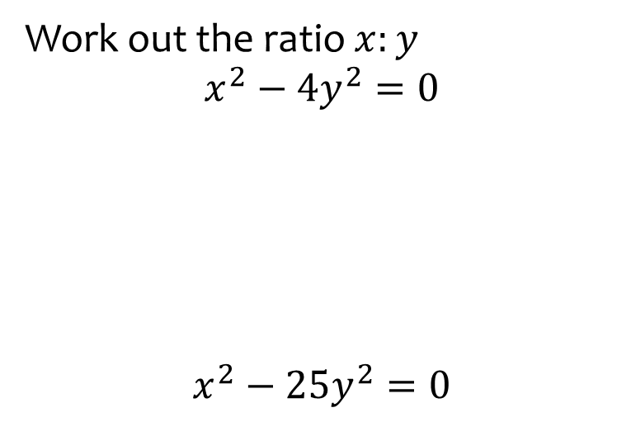


Worked example
Your turn
Work out the ratio $x:y$
$$x^{2}−4y^{2}=0$$
$$x^{2}−25y^{2}=0$$
Work out the ratio $x:y$
$$x^{2}−9y^{2}=0$$
$$3:1$$

Slide 3
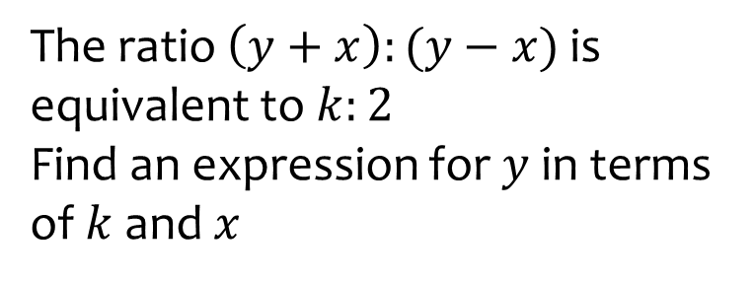
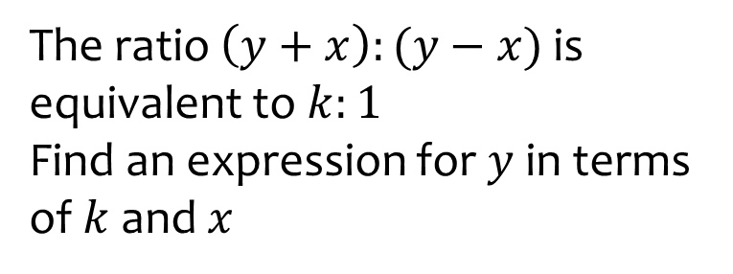

Worked example
Your turn
The ratio $\left(y+x\right):(y−x)$ is equivalent to $k:2$
Find an expression for $y$ in terms of $k$ and $x$
The ratio $\left(y+x\right):(y−x)$ is equivalent to $k:1$
Find an expression for $y$ in terms of $k$ and $x$
$$y=\frac{x\left(k+1\right)}{k−1}$$

