Slide 1
QUADRATIC (+ OTHER) GRAPHS
CONTENTS

Slide 2
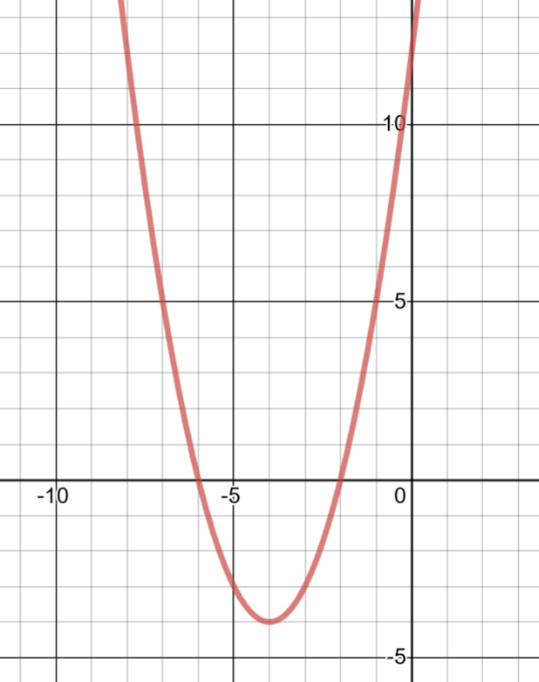
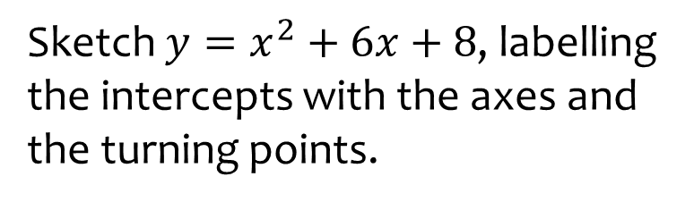
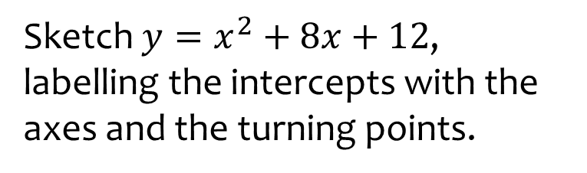



Worked example
Your turn
Sketch $y=x^{2}+6x+8$, labelling the intercepts with the axes and the turning points.
Sketch $y=x^{2}+8x+12$, labelling the intercepts with the axes and the turning points.
$$−6$$
$$−2$$
$$(−4, −4)$$
Graph used with permission from DESMOS: https://www.desmos.com/

Slide 3
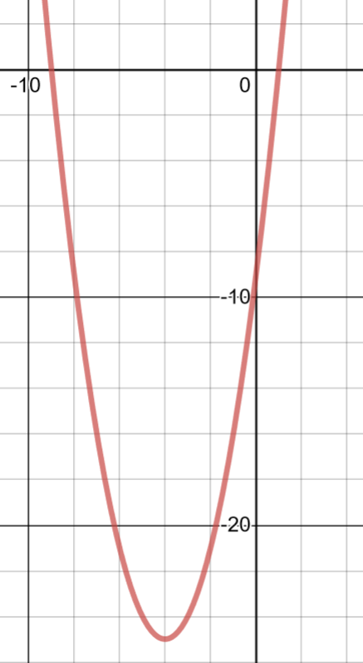
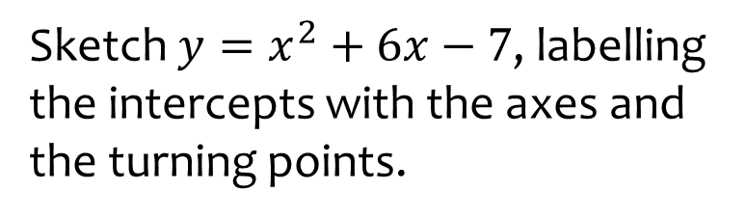
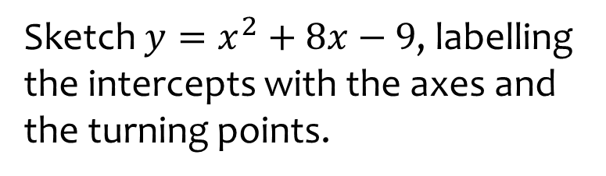



Worked example
Your turn
Sketch $y=x^{2}+6x−7$, labelling the intercepts with the axes and the turning points.
Sketch $y=x^{2}+8x−9$, labelling the intercepts with the axes and the turning points.
$$−9$$
$$1$$
$$(−4, −25)$$
Graph used with permission from DESMOS: https://www.desmos.com/

Slide 4
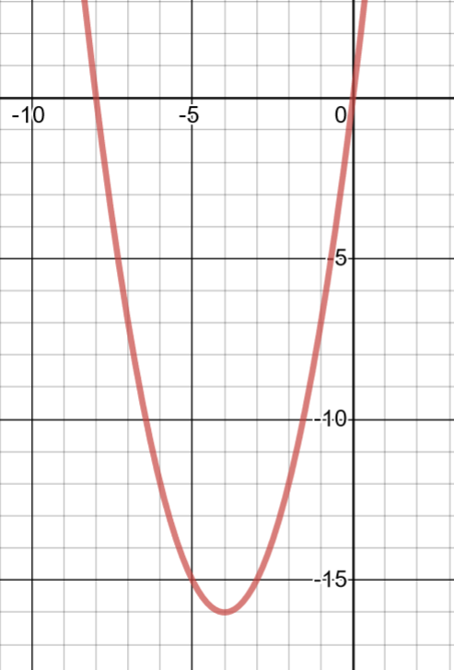
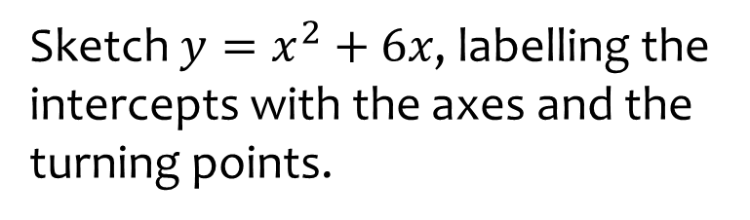
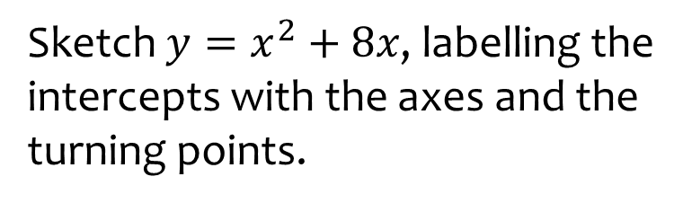


Worked example
Your turn
Sketch $y=x^{2}+6x$, labelling the intercepts with the axes and the turning points.
Sketch $y=x^{2}+8x$, labelling the intercepts with the axes and the turning points.
$$−8$$
$$(−4, −16)$$
Graph used with permission from DESMOS: https://www.desmos.com/

Slide 5
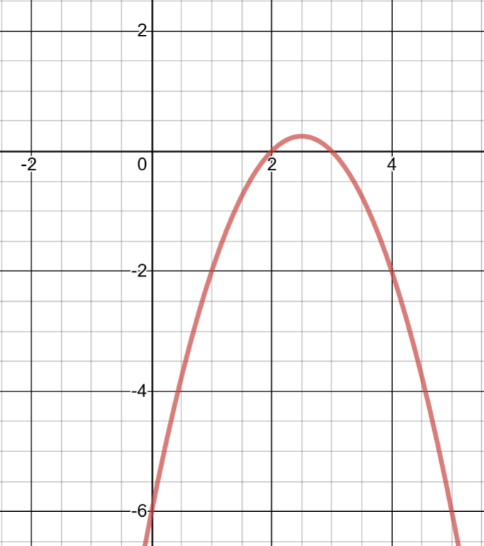
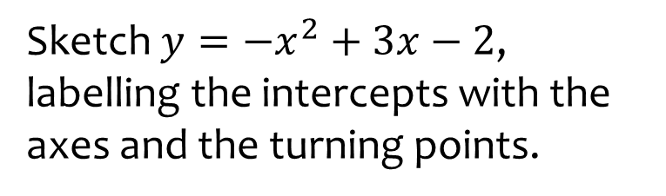
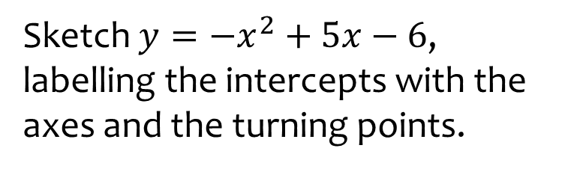


Worked example
Your turn
Sketch $y=−x^{2}+3x−2$, labelling the intercepts with the axes and the turning points.
Sketch $y=−x^{2}+5x−6$, labelling the intercepts with the axes and the turning points.
$$(\frac{5}{2},\frac{1}{4})$$
$$3$$
Graph used with permission from DESMOS: https://www.desmos.com/

Slide 6
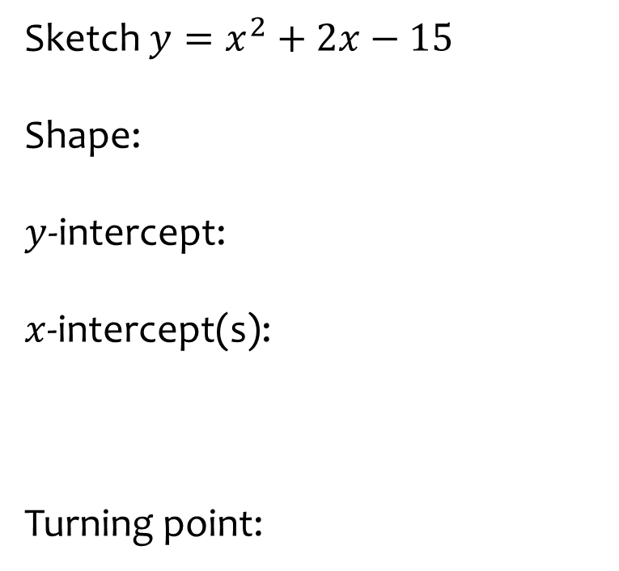
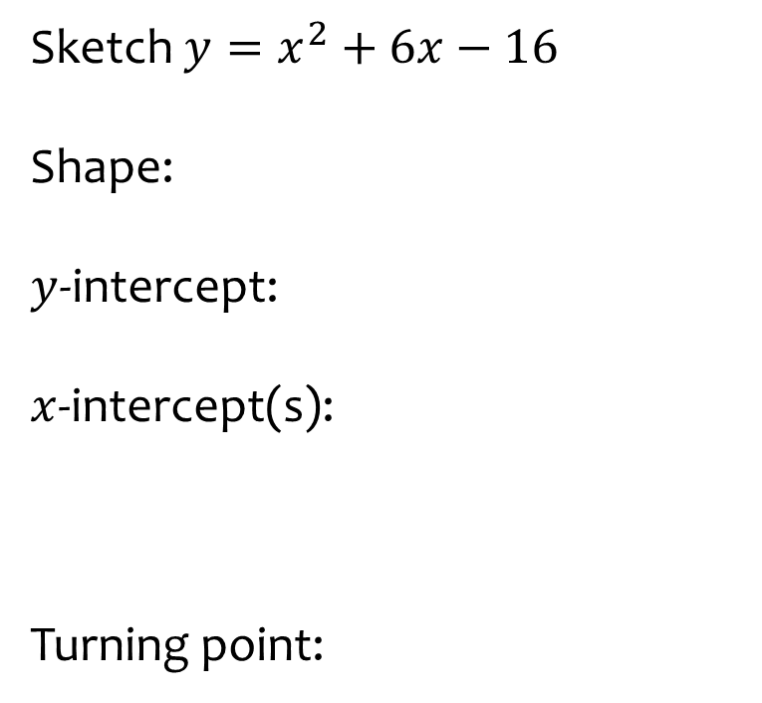
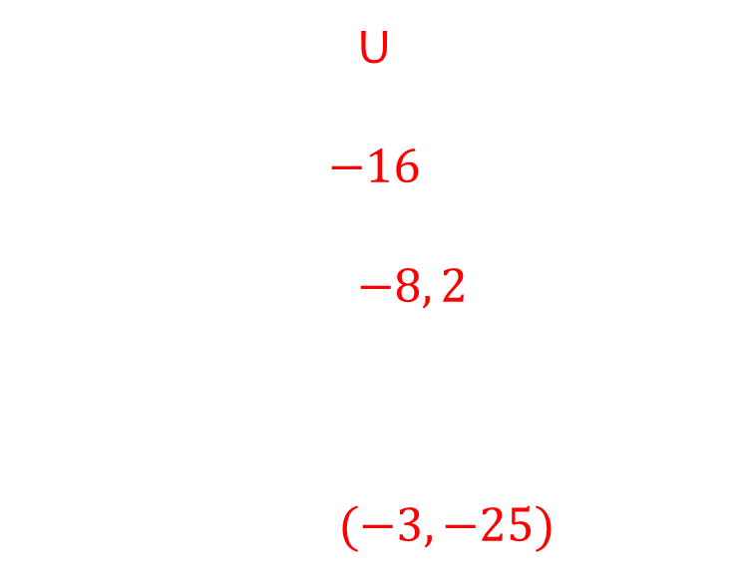
Worked example
Your turn
Sketch $y=x^{2}+2x−15$
Shape:
$y$-intercept:
$x$-intercept(s):
Turning point:
Sketch $y=x^{2}+6x−16$
Shape:
$y$-intercept:
$x$-intercept(s):
Turning point:
U
$$−16$$
$$−8, 2$$
$(−3, −25)$

Slide 7
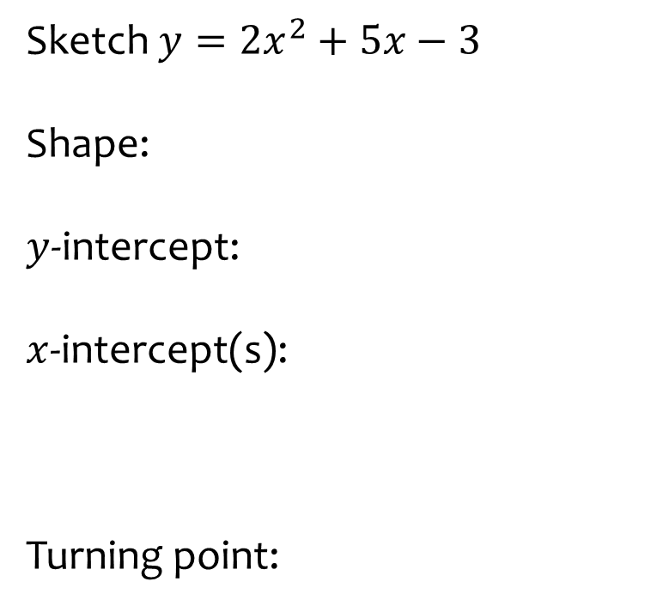
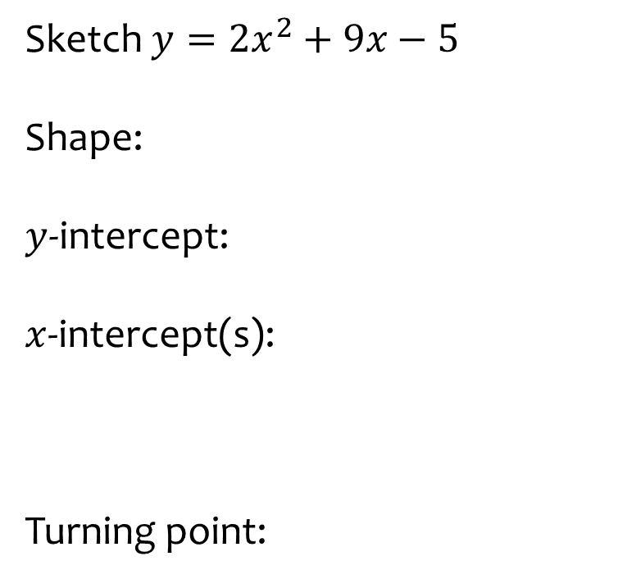
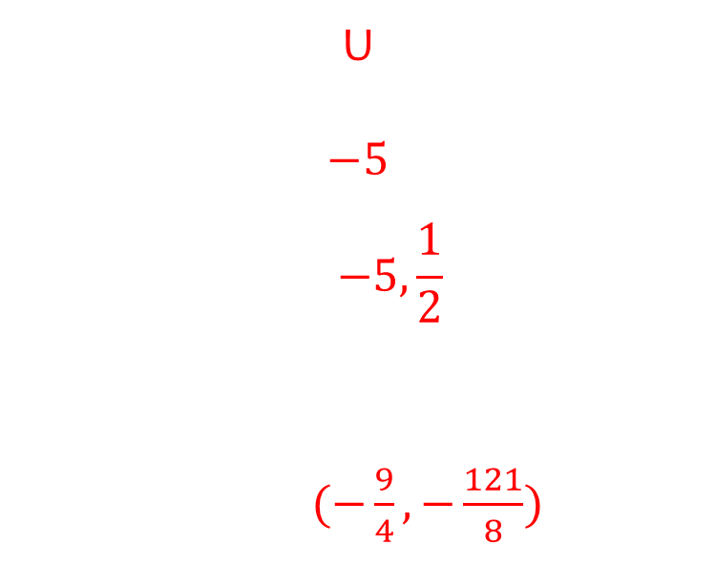
Worked example
Your turn
Sketch $y={2x}^{2}+5x−3$
Shape:
$y$-intercept:
$x$-intercept(s):
Turning point:
Sketch $y={2x}^{2}+9x−5$
Shape:
$y$-intercept:
$x$-intercept(s):
Turning point:
U
$$−5$$
$$−5,\frac{1}{2}$$
$(−\frac{9}{4}, −\frac{121}{8})$

Slide 8
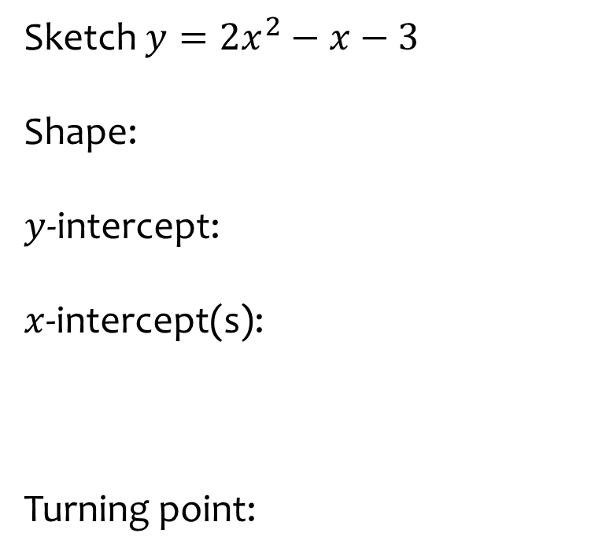
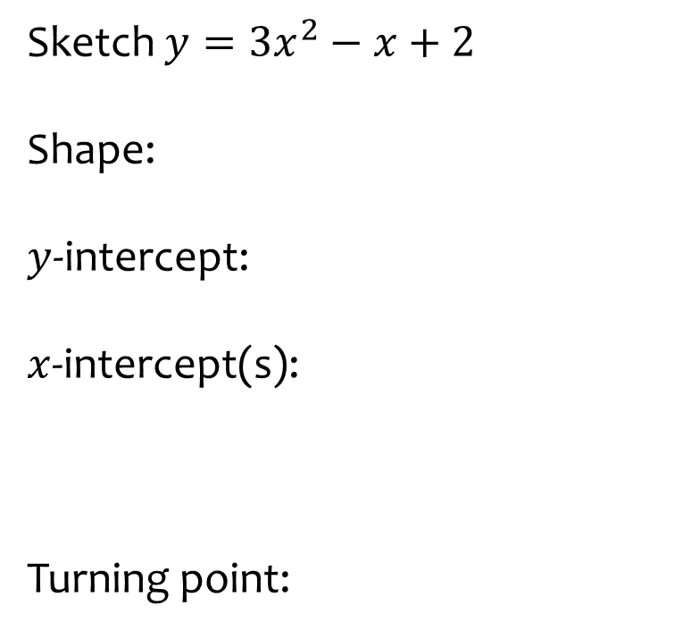
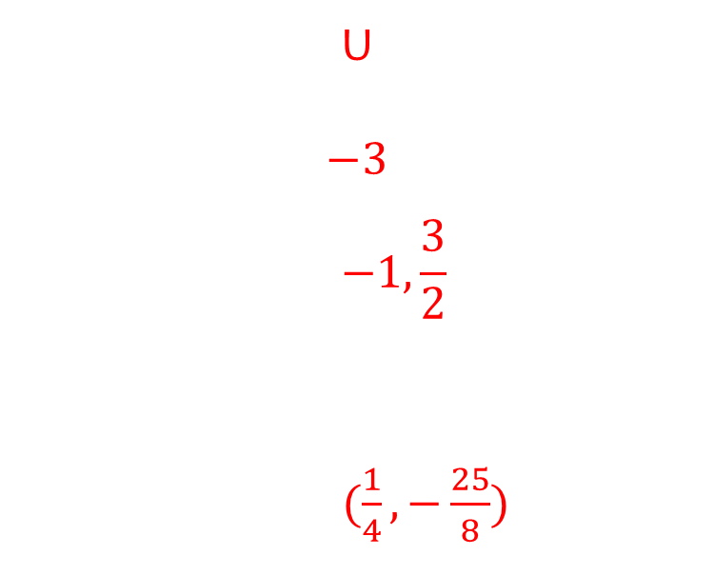
Worked example
Your turn
Sketch $y={3x}^{2}−x+2$
Shape:
$y$-intercept:
$x$-intercept(s):
Turning point:
Sketch $y={2x}^{2}−x−3$
Shape:
$y$-intercept:
$x$-intercept(s):
Turning point:
U
$$−3$$
$$−1,\frac{3}{2}$$
$(\frac{1}{4}, −\frac{25}{8})$

Slide 9
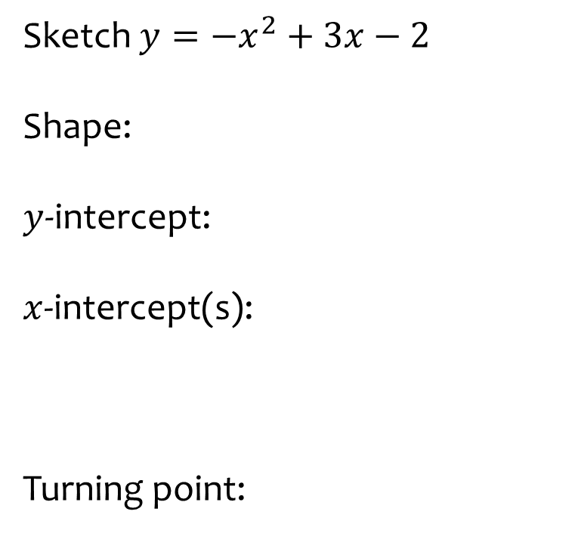
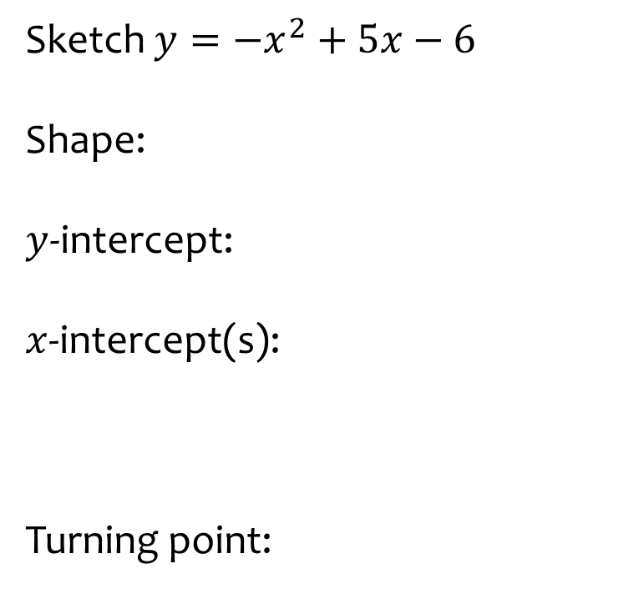
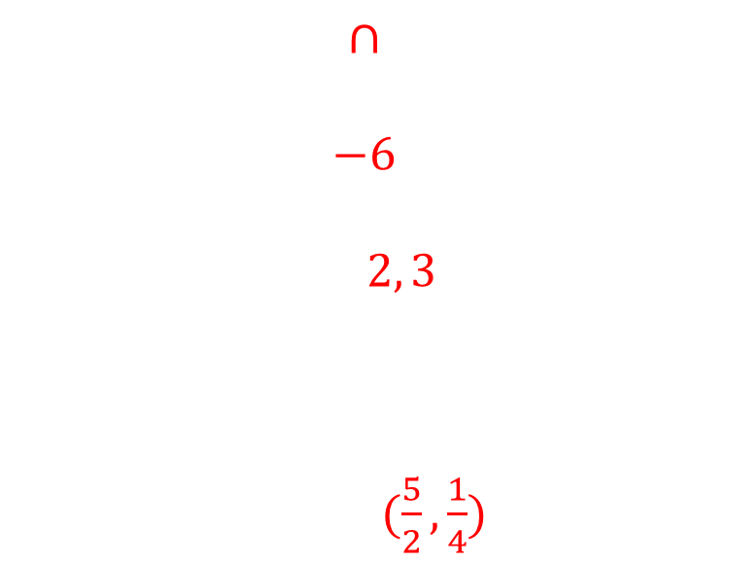
Worked example
Your turn
Sketch $y={−x}^{2}+3x−2$
Shape:
$y$-intercept:
$x$-intercept(s):
Turning point:
Sketch $y={−x}^{2}+5x−6$
Shape:
$y$-intercept:
$x$-intercept(s):
Turning point:
$$∩$$
$$−6$$
$$2, 3$$
$(\frac{5}{2},\frac{1}{4})$

Slide 10
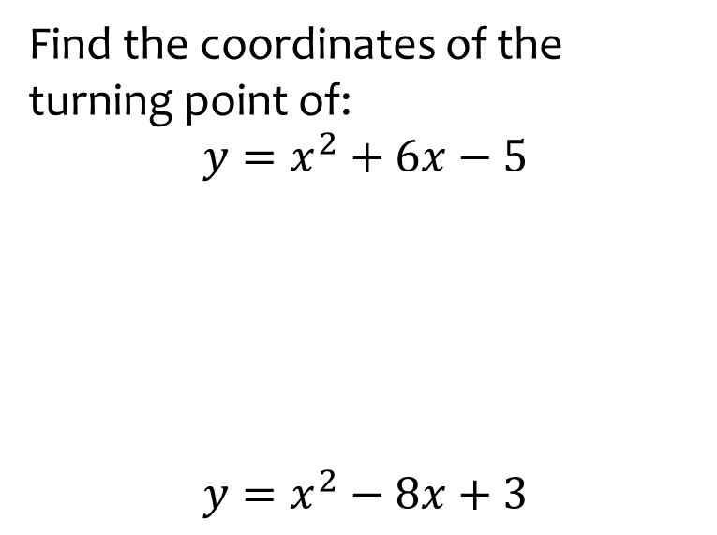
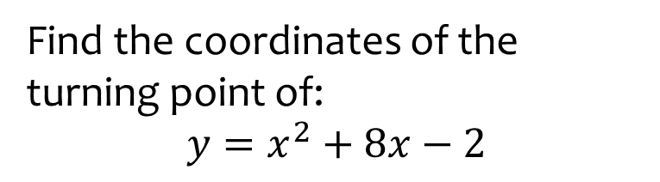

Worked example
Your turn
Find the coordinates of the turning point of:
$$y=x^{2}+6x−5$$
$${y=x}^{2}−8x+3$$
Find the coordinates of the turning point of:
$$y=x^{2}+8x−2$$
$$(−4, −18)$$

Slide 11
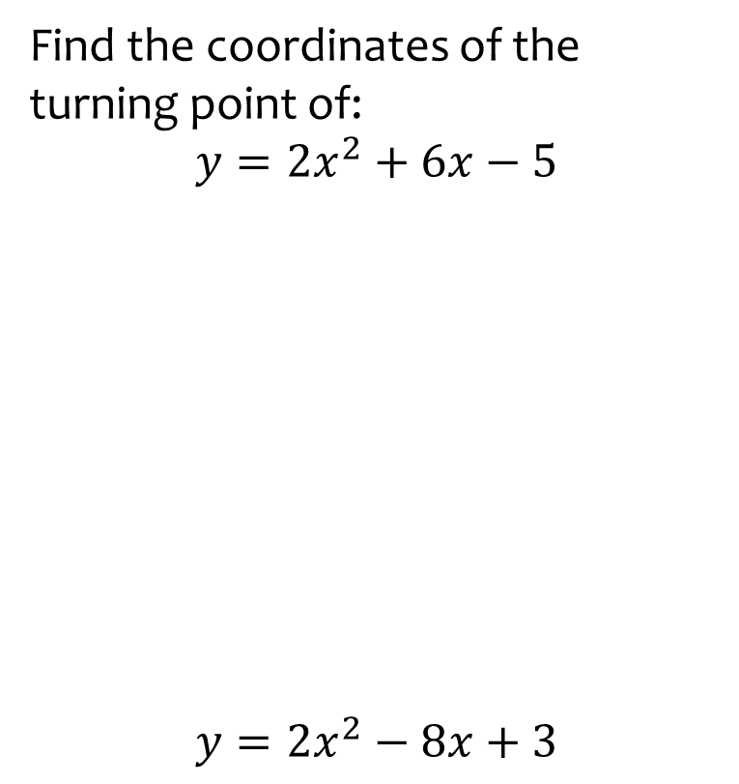
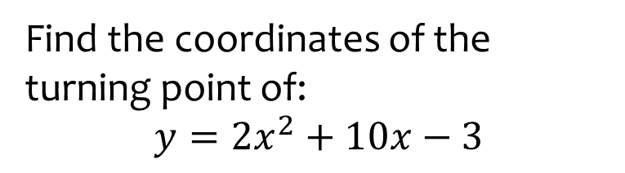

Worked example
Your turn
Find the coordinates of the turning point of:
$$y={2x}^{2}+6x−5$$
$${y=2x}^{2}−8x+3$$
Find the coordinates of the turning point of:
$$y=2x^{2}+10x−3$$
$$(−\frac{5}{2}, −\frac{31}{2})$$

Slide 12
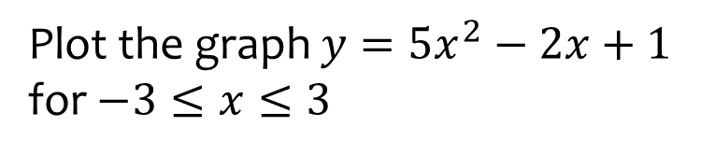
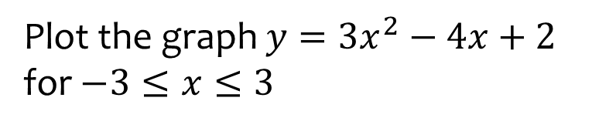
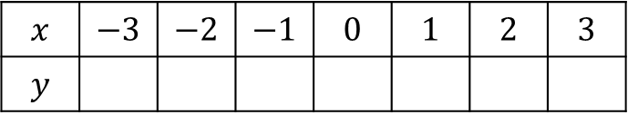
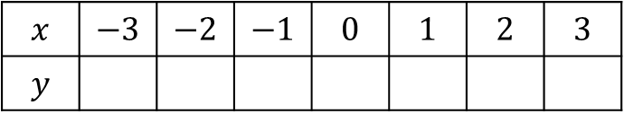
Worked example
Your turn
Plot the graph $y=5x^{2}−2x+1$ for $−3≤x≤3$
Plot the graph $y=3x^{2}−4x+2$ for $−3≤x≤3$
$$x$$ | $$−3$$ | $$−2$$ | $$−1$$ | $$0$$ | $$1$$ | $$2$$ | $$3$$
$$y$$
$$x$$ | $$−3$$ | $$−2$$ | $$−1$$ | $$0$$ | $$1$$ | $$2$$ | $$3$$
$$y$$
$41$ $22$ $9$ $2$ $1$ $6$ $17$

Slide 13
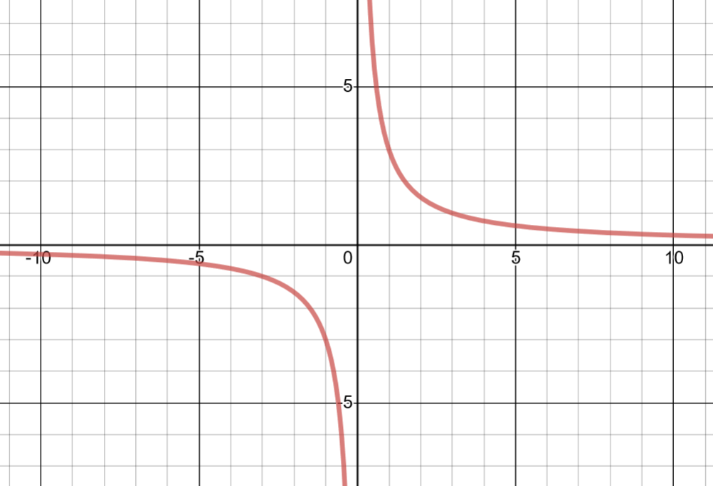
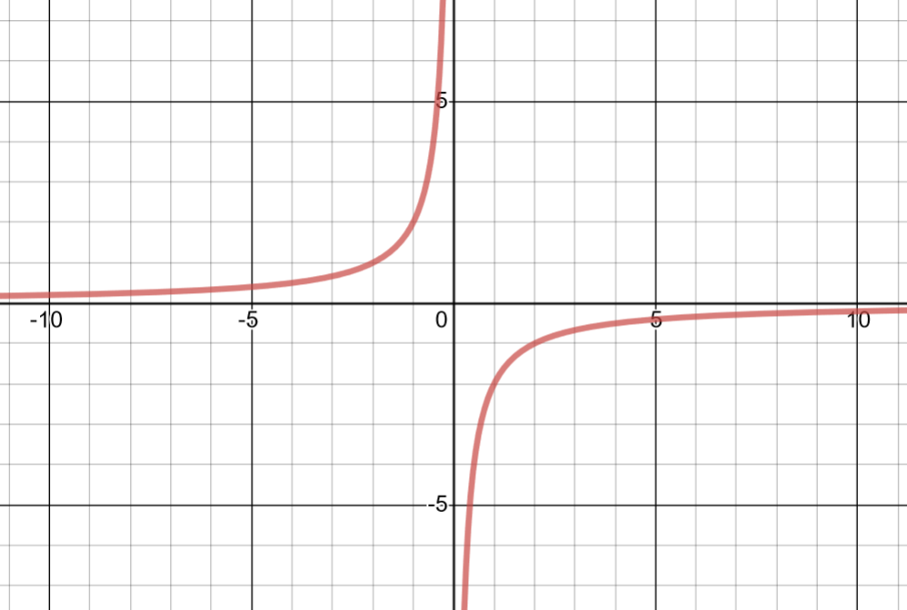
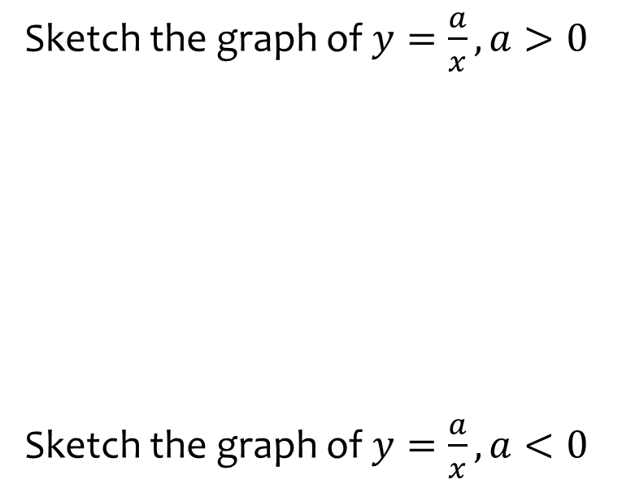
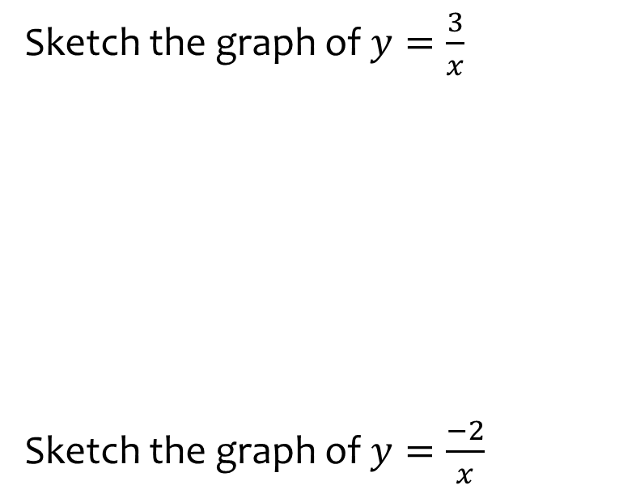
Worked example
Your turn
Sketch the graph of $y=\frac{a}{x}, a>0$
Sketch the graph of $y=\frac{a}{x}, a<0$
Sketch the graph of $y=\frac{3}{x}$
Sketch the graph of $y=\frac{−2}{x}$
Graphs used with permission from DESMOS: https://www.desmos.com/

Slide 14
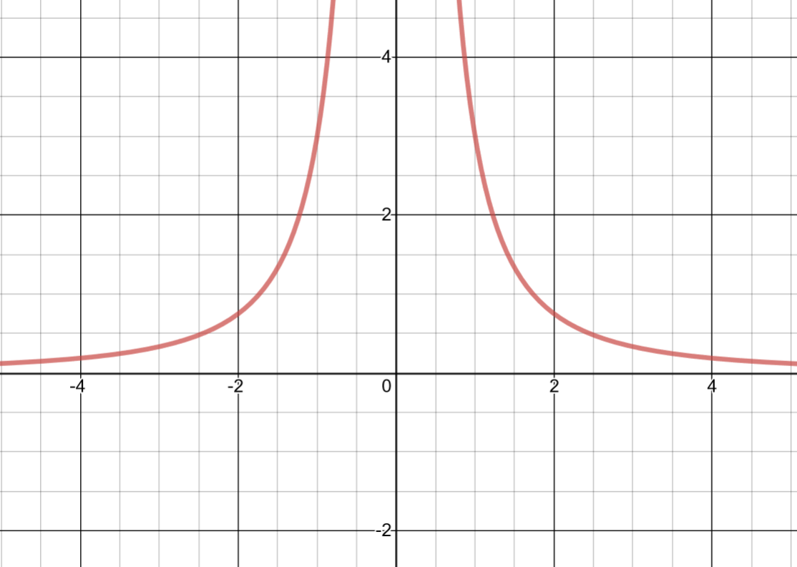
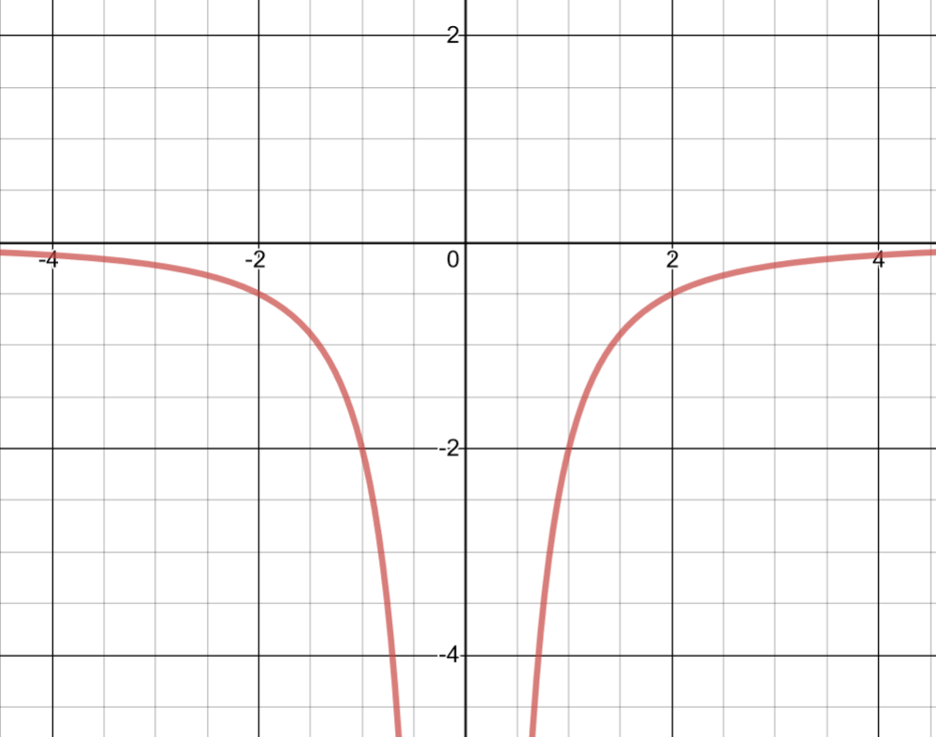
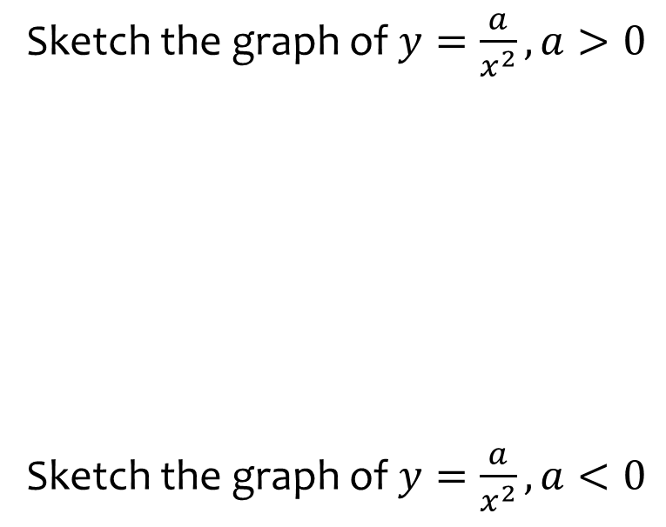
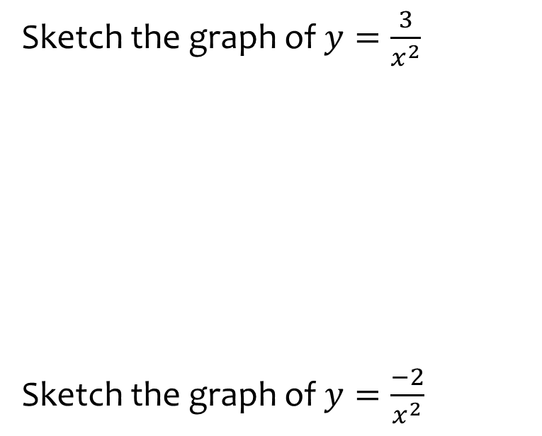
Worked example
Your turn
Sketch the graph of $y=\frac{a}{x^{2}}, a>0$
Sketch the graph of $y=\frac{a}{x^{2}}, a<0$
Sketch the graph of $y=\frac{3}{x^{2}}$
Sketch the graph of $y=\frac{−2}{x^{2}}$
Graphs used with permission from DESMOS: https://www.desmos.com/

Slide 15
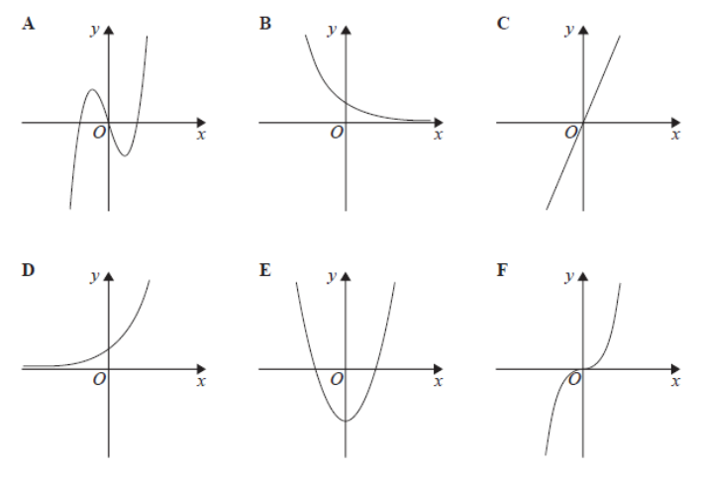
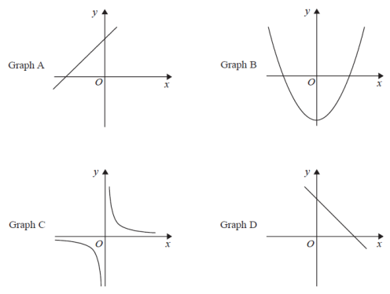
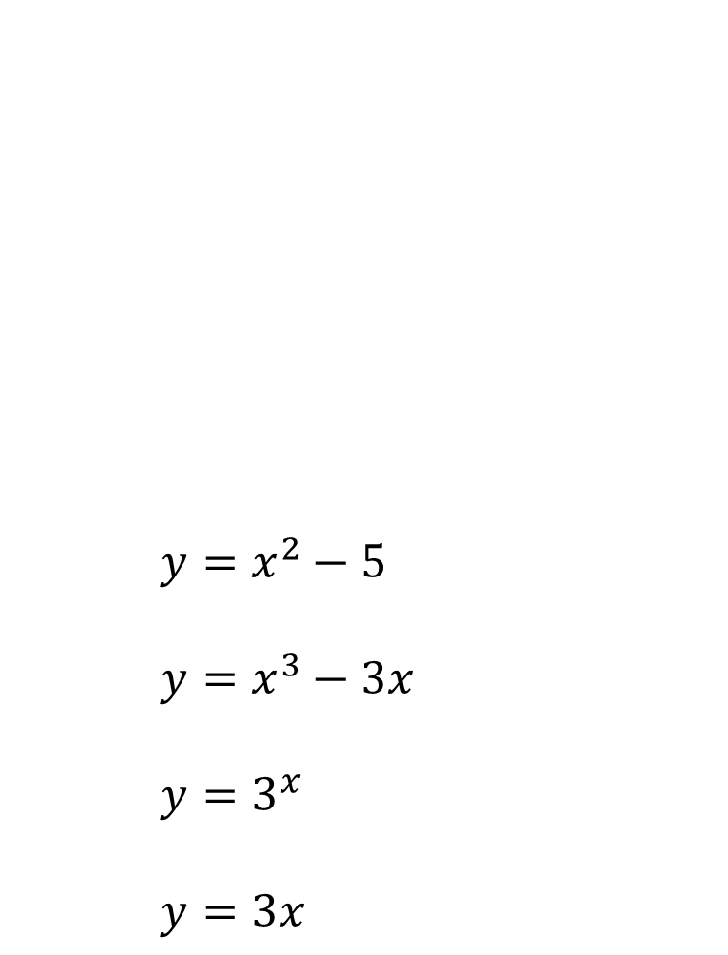
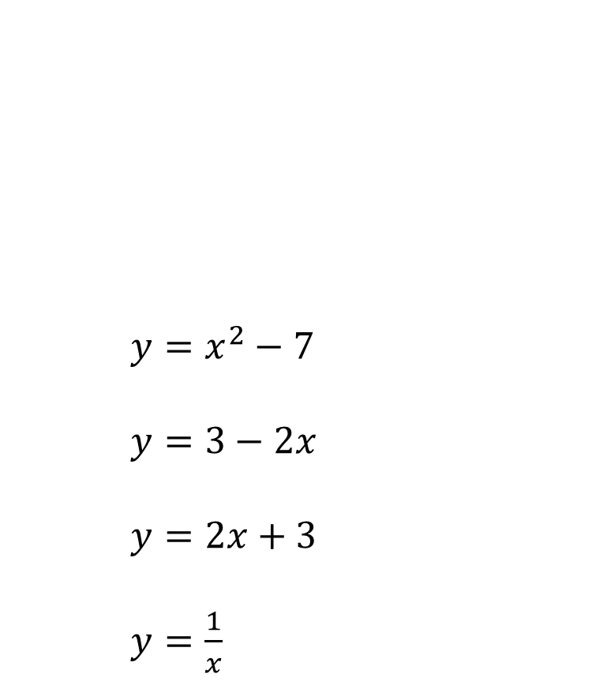




Worked example
Your turn
$y=x^{2}−5$
$y=x^{3}−3x$
$y=3^{x}$
$y=3x$
$$y=2x−3$$
$$y=x^{2}−7$$
$y=x^{2}−7$
$y=3−2x$
$y=2x+3$
$y=\frac{1}{x}$
$$y=\frac{1}{x}$$
$$y=3−2x$$

Slide 16
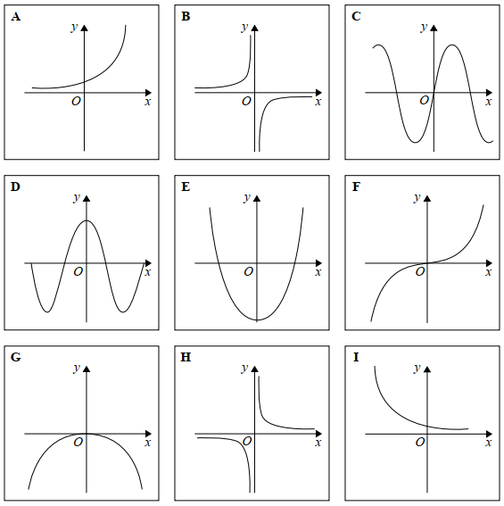
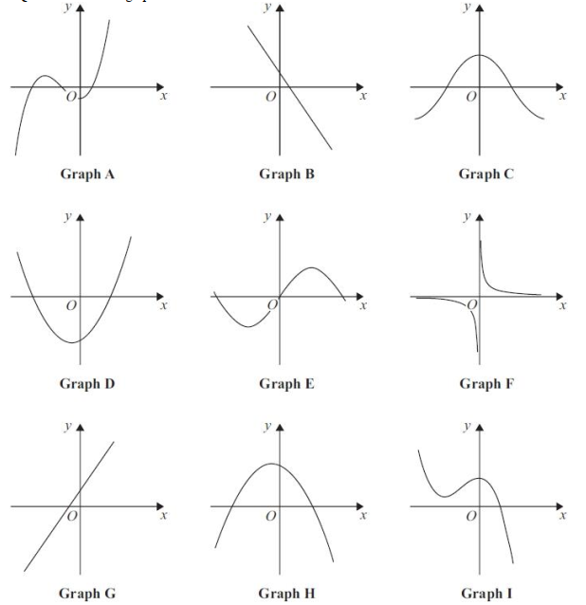
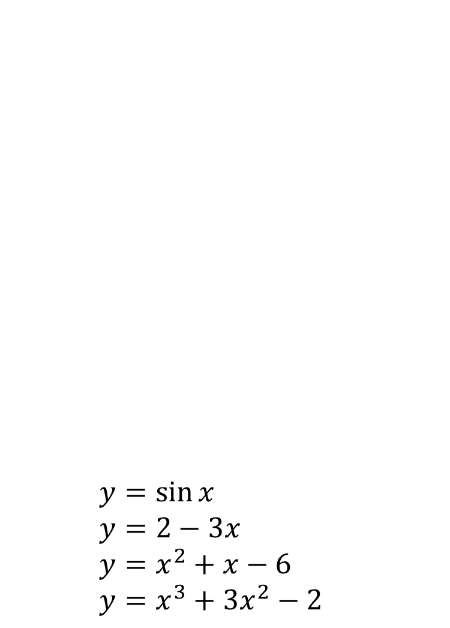
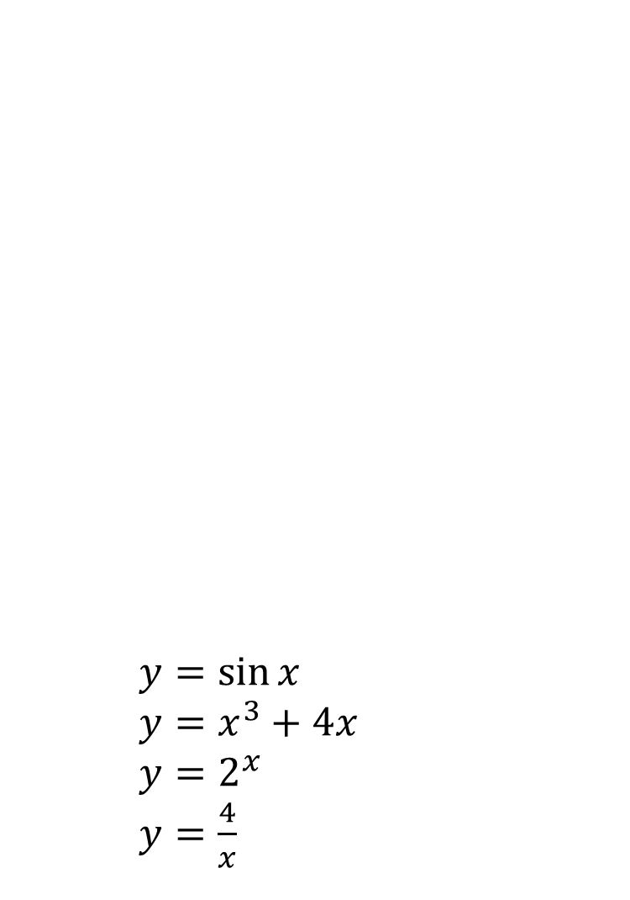




Worked example
Your turn
$y=\sin{x}$
$y=x^{3}+4x$
$y=2^{x}$
$y=\frac{4}{x}$
$y=\sin{x}$
$y=2−3x$
$y=x^{2}+x−6$
$y=x^{3}+3x^{2}−2$
$$y=x^{3}+3x^{2}−2$$
$$y=2−3x$$
$$y=x^{2}+x−6$$
$$y=\sin{x}$$

Slide 17
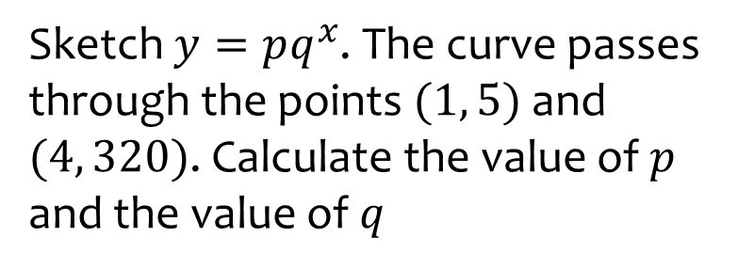
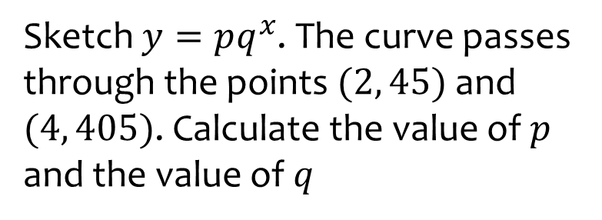

Worked example
Your turn
Sketch $y=pq^{x}$. The curve passes through the points $(2, 45)$ and $(4, 405)$. Calculate the value of $p$ and the value of $q$
Sketch $y=pq^{x}$. The curve passes through the points $(1, 5)$ and $(4, 320)$. Calculate the value of $p$ and the value of $q$
$$p=\frac{5}{4}, q=4$$

Slide 18



Worked example
Your turn
A circle has centre at the origin, and radius $3$. Write the equation of the circle
A circle has centre $(0, 0)$, and radius $4$. Write the equation of the circle
A circle has centre at the origin, and radius $5$. Write the equation of the circle
$$x^{2}+y^{2}=25$$

