Slide 1
INEQUALITIES
CONTENTS

Slide 2
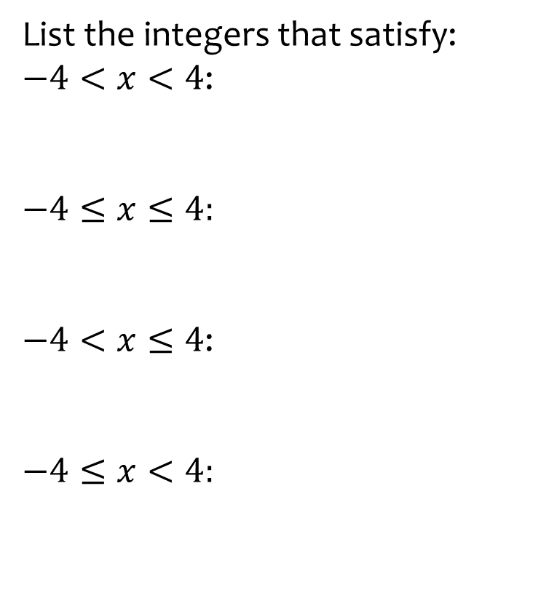


Worked example
Your turn
List the integers that satisfy:
$−4<x<4$:
$$−4≤x≤4:$$
$−4<x≤4$:
$$−4≤x<4:$$
List the integers that satisfy:
$$−3<y≤2$$
$$\left\{−2, 1, 0, 1, 2 \right\}$$

Slide 3
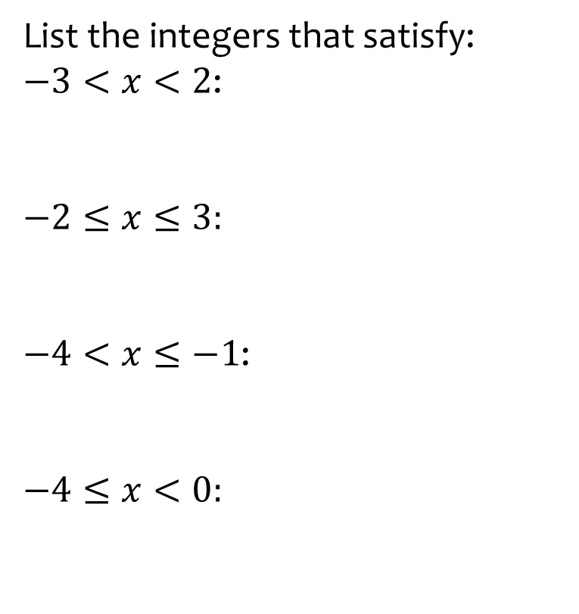


Worked example
Your turn
List the integers that satisfy:
$−3<x<2$:
$$−2≤x≤3:$$
$−4<x≤−1$:
$$−4≤x<0:$$
List the integers that satisfy:
$$−7<y≤2$$
$$\left\{−6, −5, −4, −3, −2, −1, 0, 1, 2 \right\}$$

Slide 4

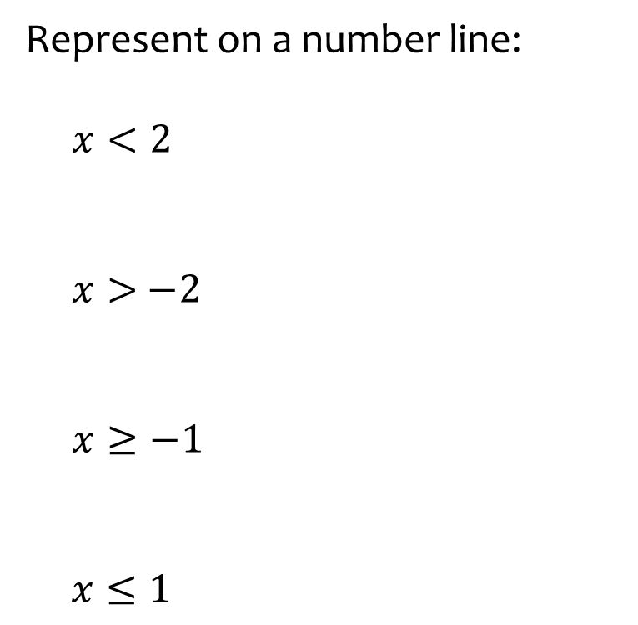
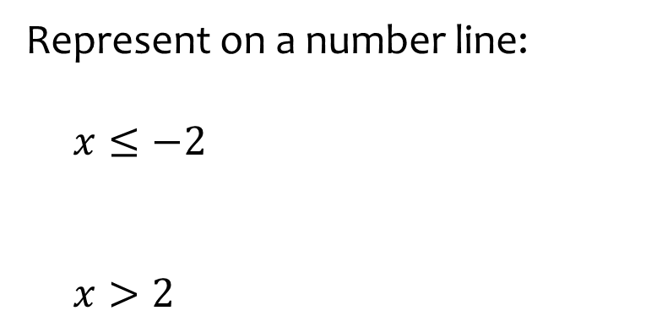
Worked example
Your turn
Represent on a number line:
$x<2$
$x>$ $−2$
$x≥−1$
$$x≤1$$
Represent on a number line:
$x≤−2$
$x>2$

Slide 5
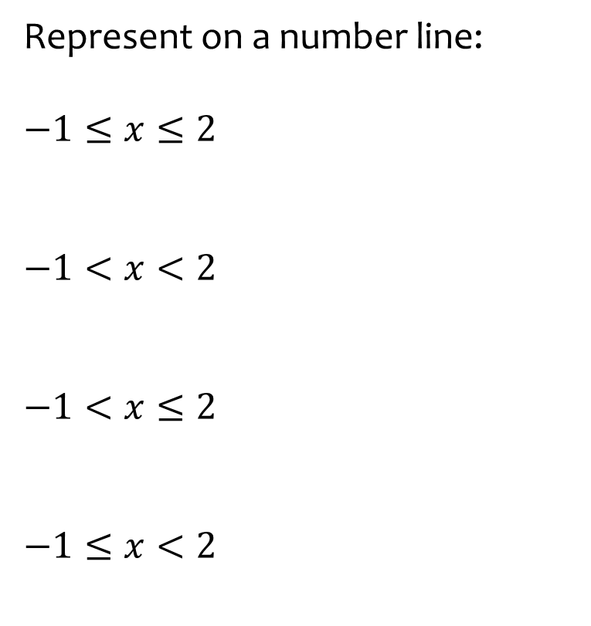
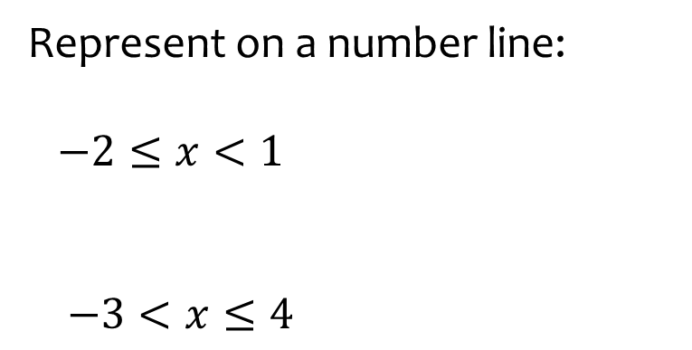
Worked example
Your turn
Represent on a number line:
$$−1≤x≤2$$
$$−1<x<2$$
$$−1<x≤2$$
$$−1≤x<2$$
Represent on a number line:
$−2≤x<1$
$$−3<x≤4$$

Slide 6
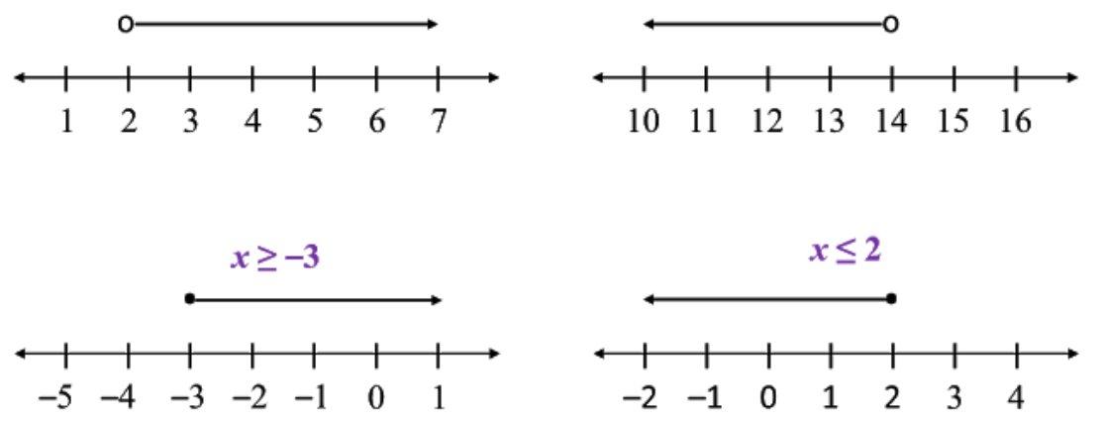
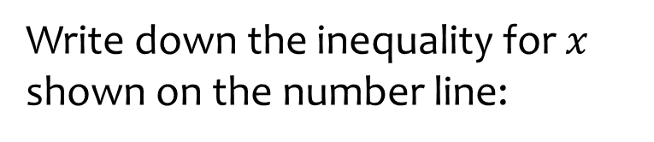
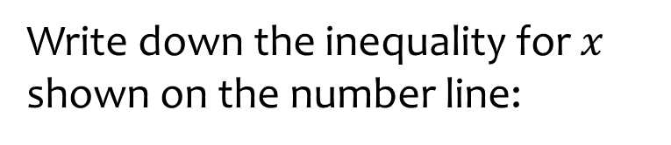

Worked example
Your turn
Write down the inequality for $x$ shown on the number line:
Write down the inequality for $x$ shown on the number line:
$$x≤2$$
Notes:
Images from http://pt3mathematics.blog.onlinetuition.com.my/2018/05/121-linear-inequalities.html

Slide 7
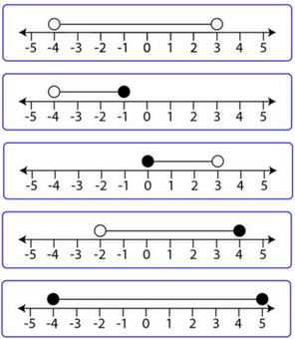
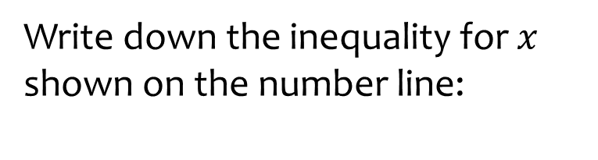
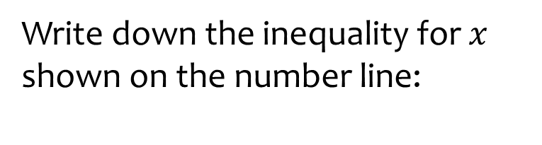

Worked example
Your turn
Write down the inequality for $x$ shown on the number line:
Write down the inequality for $x$ shown on the number line:
$$−2<x≤4$$
Notes:
Images from https://mr-mathematics.com/solving-inequalities-using-a-number-line/

Slide 8
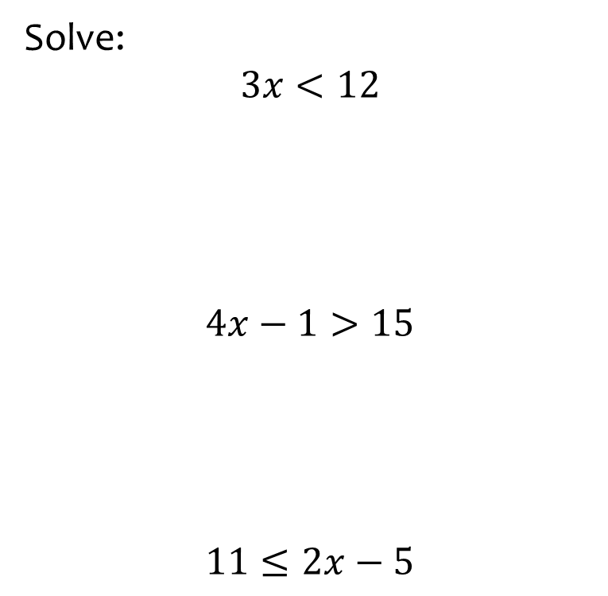


Worked example
Your turn
Solve:
$$3x<12$$
$$4x−1>15$$
$$11≤2x−5$$
Solve:
$$15≥3x−6$$
$$x≤7$$

Slide 9
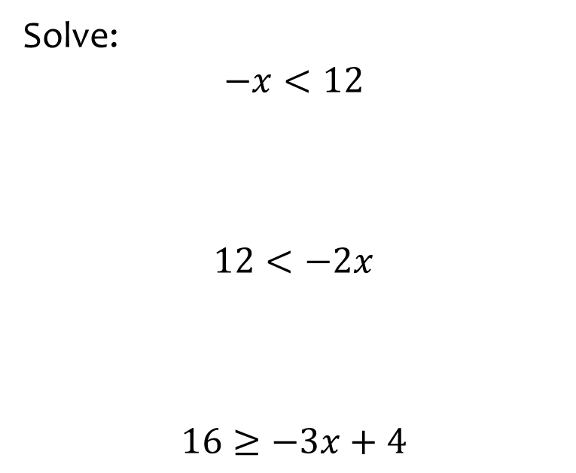


Worked example
Your turn
Solve:
$$−x<12$$
$$12<−2x$$
$$16≥−3x+4$$
Solve:
$$−4x+5≤17$$
$$x≥−3$$

Slide 10
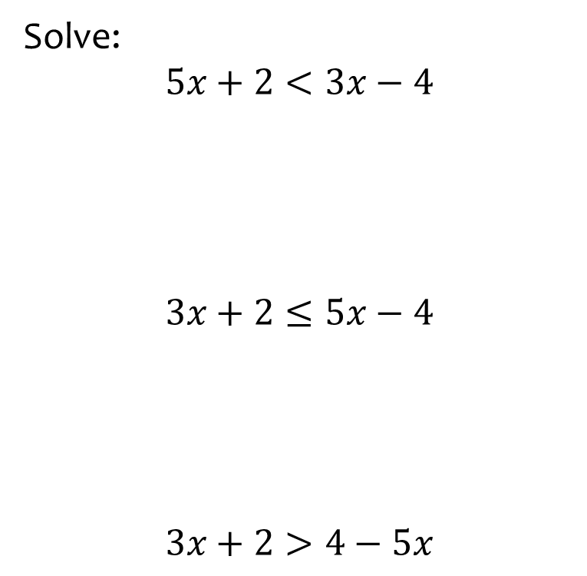


Worked example
Your turn
Solve:
$$5x+2<3x−4$$
$$3x+2≤5x−4$$
$$3x+2>4−5x$$
Solve:
$$4x−3≥2−x$$
$$x≥1$$

Slide 11
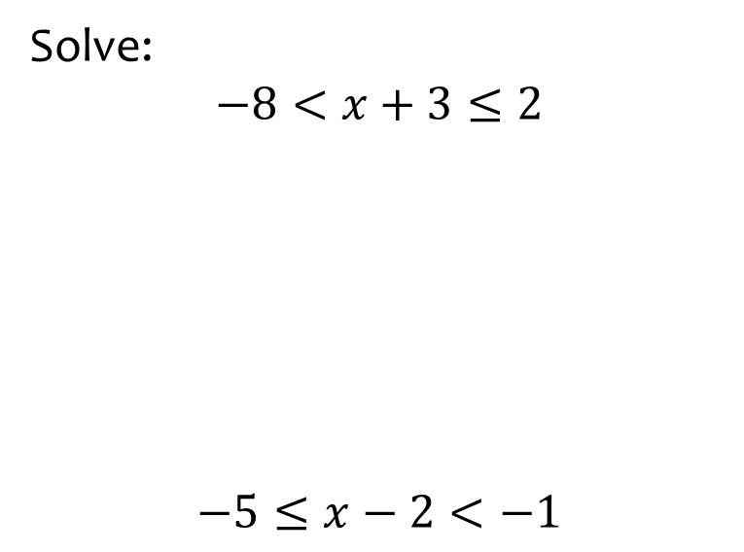


Worked example
Your turn
Solve:
$$−8<x+3≤2$$
$$−5≤x−2<−1$$
Solve:
$$−7<x+7<5$$
$$−14<x<−2$$

Slide 12
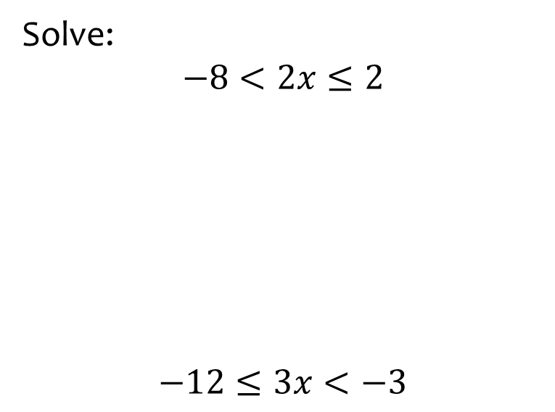


Worked example
Your turn
Solve:
$$−8<2x≤2$$
$$−12≤3x<−3$$
Solve:
$$−4<4x<20$$
$$−3<x<5$$

Slide 13
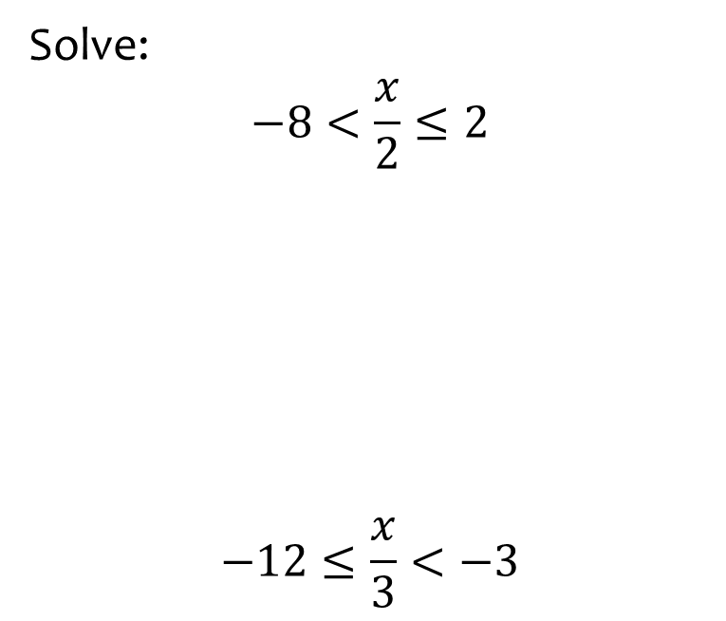
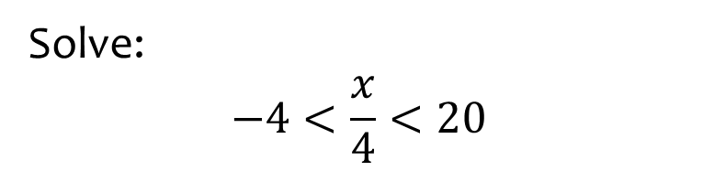

Worked example
Your turn
Solve:
$$−8<\frac{x}{2}≤2$$
$$−12≤\frac{x}{3}<−3$$
Solve:
$$−4<\frac{x}{4}<20$$
$$−16<x<80$$

Slide 14
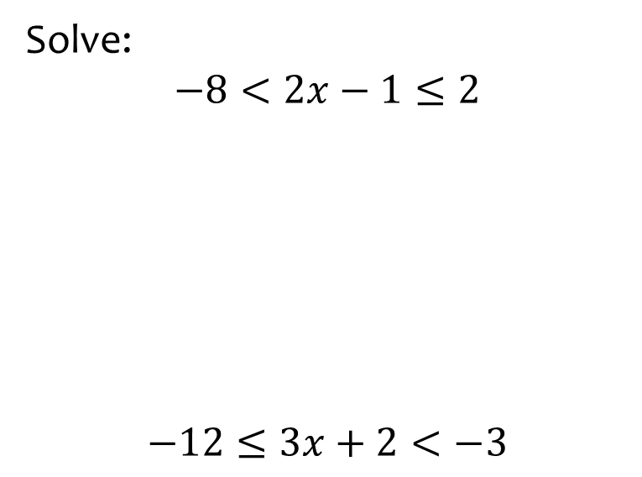


Worked example
Your turn
Solve:
$$−8<2x−1≤2$$
$$−12≤3x+2<−3$$
Solve:
$$−4<4x−3<20$$
$$−\frac{1}{4}<x<\frac{23}{4}$$

Slide 15
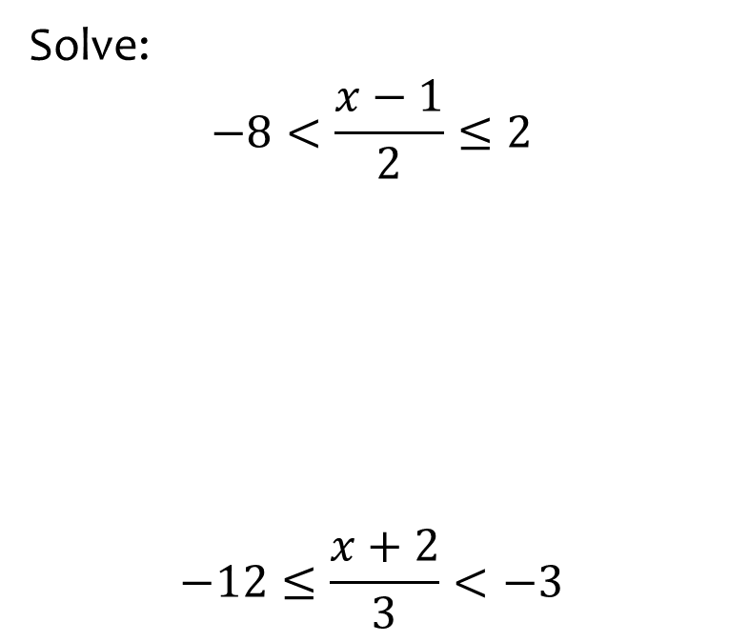
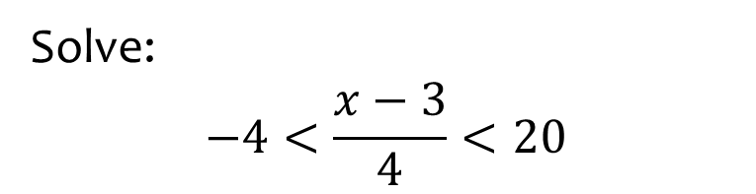

Worked example
Your turn
Solve:
$$−8<\frac{x−1}{2}≤2$$
$$−12≤\frac{x+2}{3}<−3$$
Solve:
$$−4<\frac{x−3}{4}<20$$
$$−13<x<83$$

Slide 16
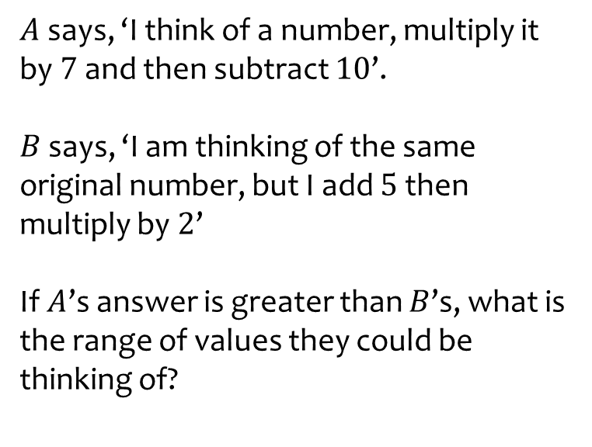
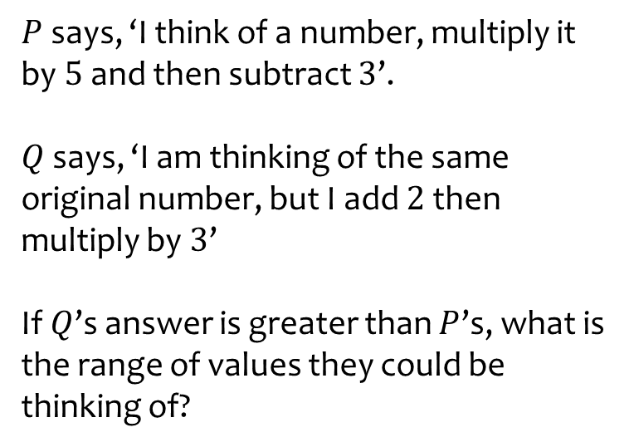

Worked example
Your turn
$A$ says, ‘I think of a number, multiply it by $7$ and then subtract $10$’.
$B$ says, ‘I am thinking of the same original number, but I add $5$ then multiply by $2$’
If $A$’s answer is greater than $B$’s, what is the range of values they could be thinking of?
$P$ says, ‘I think of a number, multiply it by $5$ and then subtract $3$’.
$Q$ says, ‘I am thinking of the same original number, but I add $2$ then multiply by $3$’
If $Q$’s answer is greater than $P$’s, what is the range of values they could be thinking of?
$$x<\frac{9}{2}$$

Slide 17
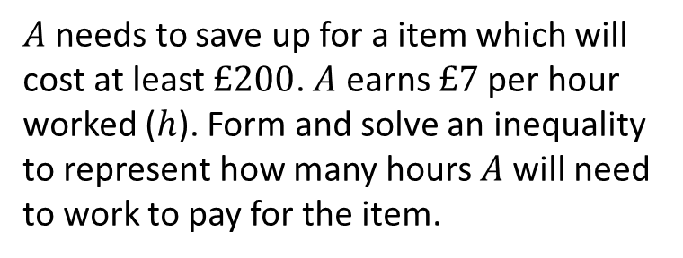
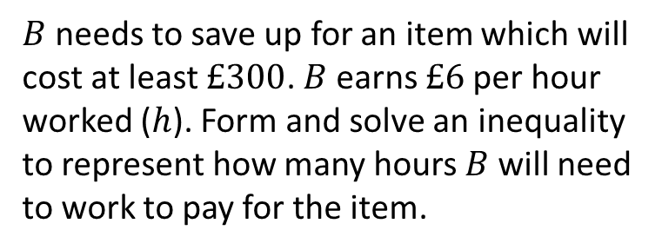

Worked example
Your turn
$A$ needs to save up for a item which will cost at least $£200$. $A$ earns $£7$per hour worked ($h$). Form and solve an inequality to represent how many hours $A$will need to work to pay for the item.
$B$needs to save up for an item which will cost at least $£300$. $B$ earns $£6$per hour worked ($h$). Form and solve an inequality to represent how many hours $B$will need to work to pay for the item.
$$h≥50$$

Slide 18
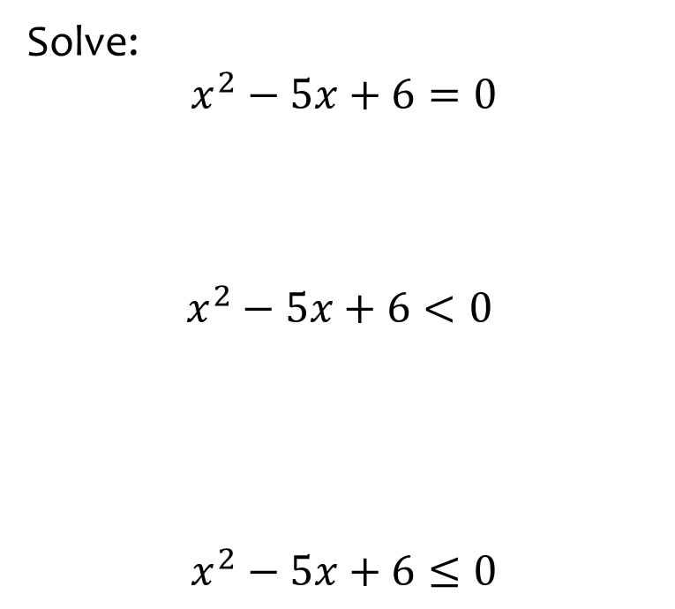


Worked example
Your turn
Solve:
$$x^{2}−5x+6=0$$
$$x^{2}−5x+6<0$$
$$x^{2}−5x+6≤0$$
Solve:
$$x^{2}−4x+3<0$$
$$1<x<3$$

Slide 19
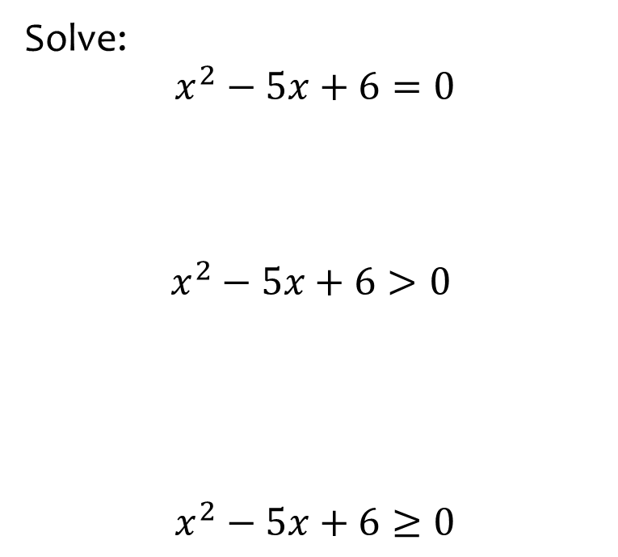


Worked example
Your turn
Solve:
$$x^{2}−5x+6=0$$
$$x^{2}−5x+6>0$$
$$x^{2}−5x+6≥0$$
Solve:
$$x^{2}−4x+3>0$$
$$x<1∪x>3$$

Slide 20
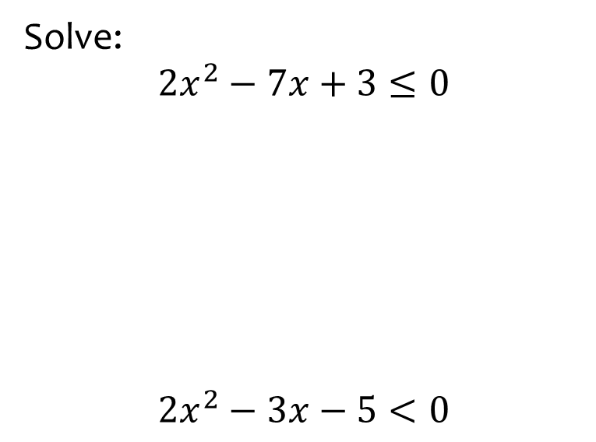


Worked example
Your turn
Solve:
$$2x^{2}−7x+3≤0$$
$$2x^{2}−3x−5<0$$
Solve:
$$2x^{2}−7x+6≤0$$
$$\frac{3}{2}≤x≤2$$

Slide 21
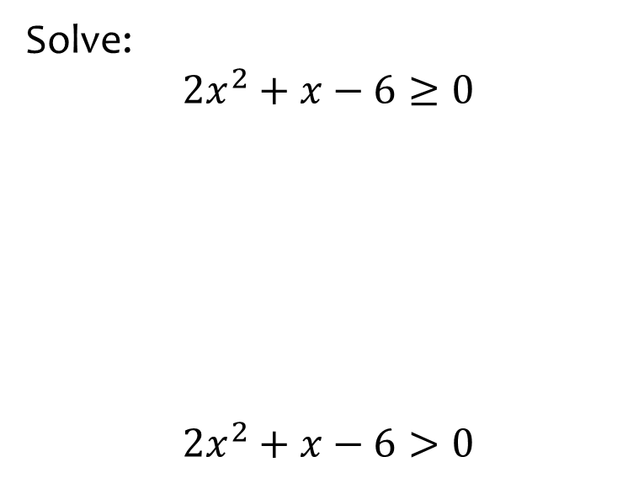


Worked example
Your turn
Solve:
$$2x^{2}+x−6≥0$$
$$2x^{2}+x−6>0$$
Solve:
$$3x^{2}+x−2≥0$$
$$x≤−1∪x≥\frac{2}{3}$$

Slide 22
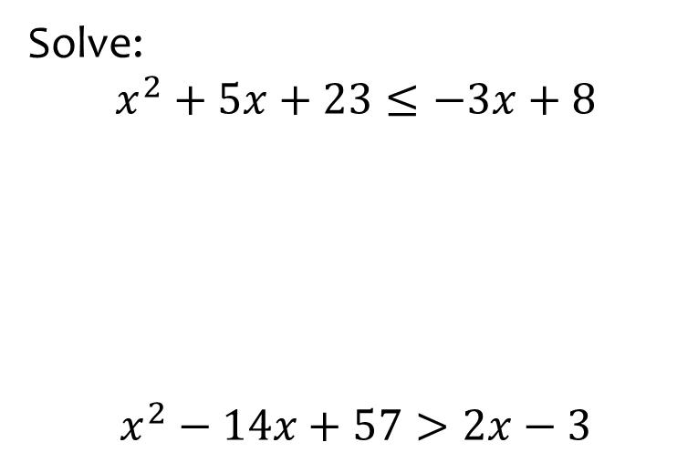
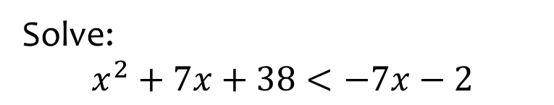

Worked example
Your turn
Solve:
$$x^{2}+5x+23≤−3x+8$$
$$x^{2}−14x+57>2x−3$$
Solve:
$$x^{2}+7x+38<−7x−2$$
$$−10<x<−4$$

Slide 23
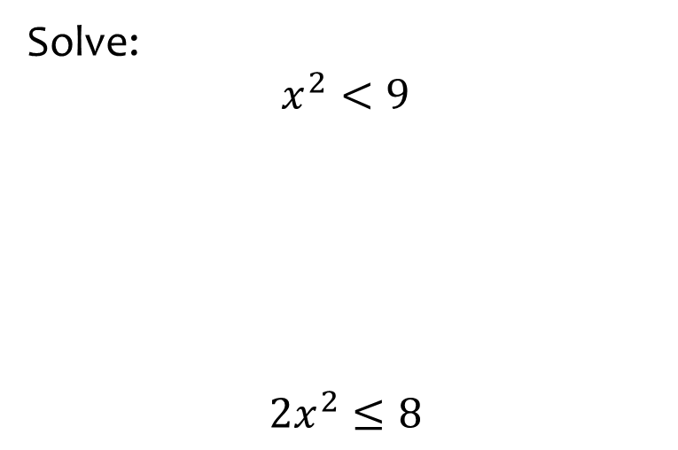


Worked example
Your turn
Solve:
$$x^{2}<9$$
$${2x}^{2}≤8$$
Solve:
$$x^{2}<16$$
$$−4<x<4$$

Slide 24
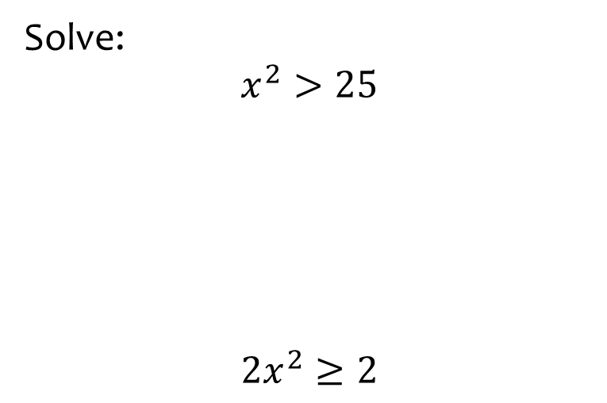


Worked example
Your turn
Solve:
$$x^{2}>25$$
$${2x}^{2}≥2$$
Solve:
$$x^{2}>36$$
$$x<−6∪x>6$$

Slide 25
Worked example
Your turn
Solve:
$$x^{2}>25$$
$${2x}^{2}≥2$$
Solve:
$$x^{2}>36$$
$$x<−6∪x>6$$

Slide 26
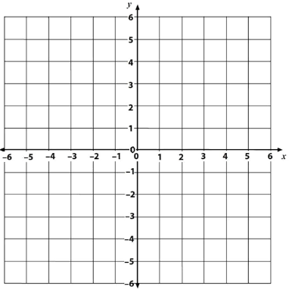
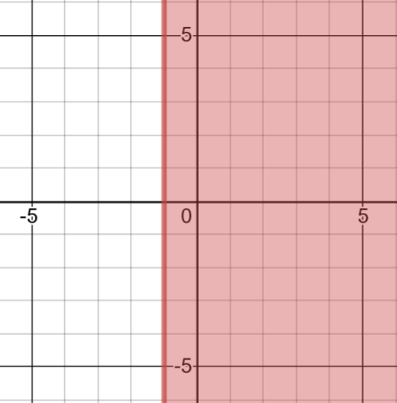
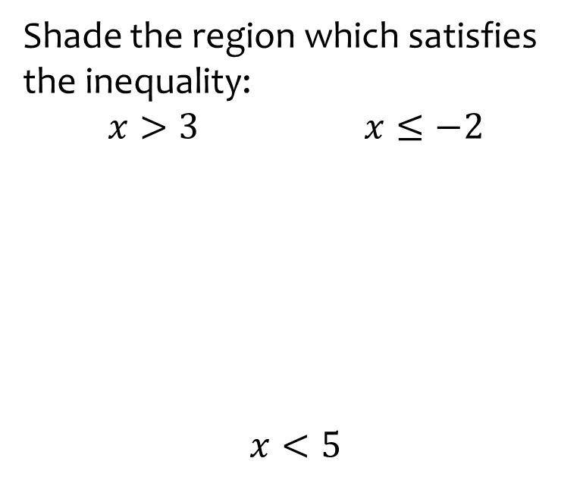
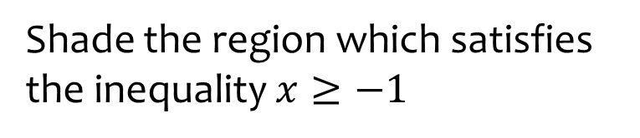
Worked example
Your turn
Shade the region which satisfies the inequality:
$x>3$ $x≤−2$
$$x<5$$
Shade the region which satisfies the inequality $x≥−1$
Graphs used with permission from DESMOS: https://www.desmos.com/

Slide 27
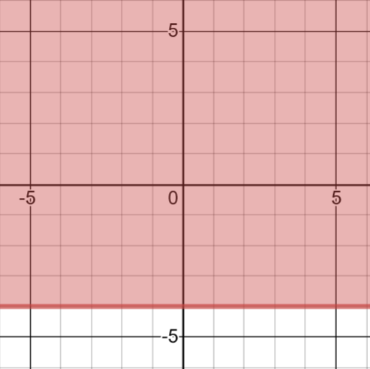
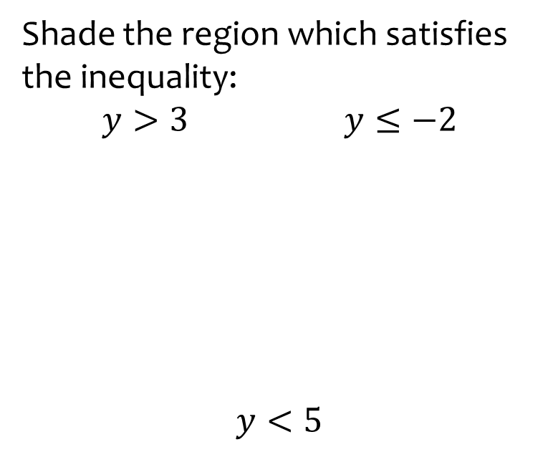
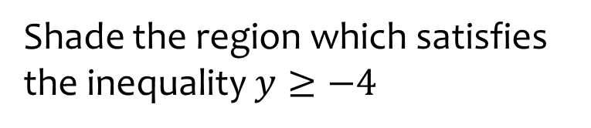
Worked example
Your turn
Shade the region which satisfies the inequality:
$y>3$ $y≤−2$
$$y<5$$
Shade the region which satisfies the inequality $y≥−4$
Graphs used with permission from DESMOS: https://www.desmos.com/

Slide 28
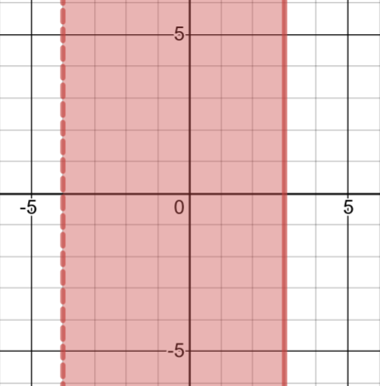

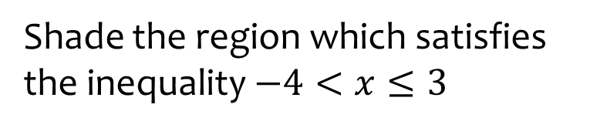
Worked example
Your turn
Shade the region which satisfies the inequality $−2≤x<5$
Shade the region which satisfies the inequality $−4<x≤3$
Graphs used with permission from DESMOS: https://www.desmos.com/

Slide 29
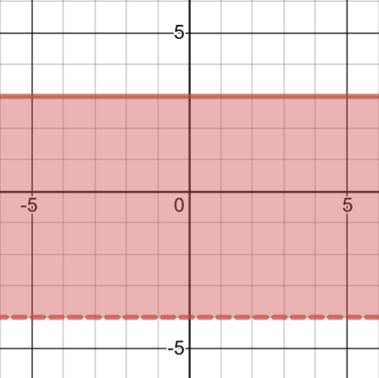

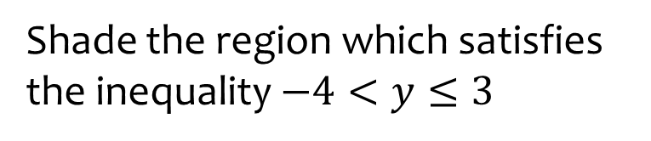
Worked example
Your turn
Shade the region which satisfies the inequality $−2≤y<5$
Shade the region which satisfies the inequality $−4<y≤3$
Graphs used with permission from DESMOS: https://www.desmos.com/

Slide 30
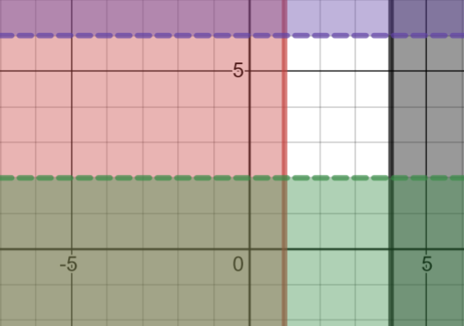
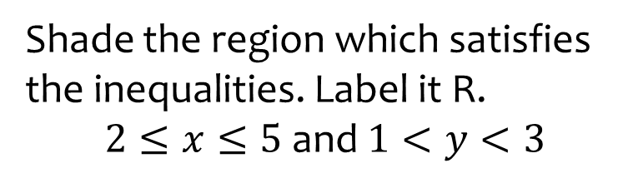
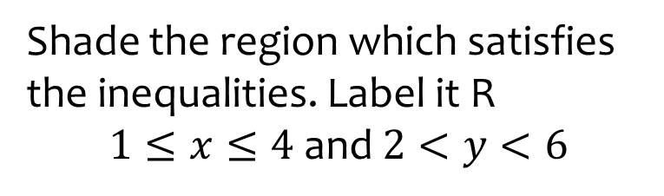

Worked example
Your turn
Shade the region which satisfies the inequalities. Label it R.
$2≤x≤5$ and $1<y<3$
Shade the region which satisfies the inequalities. Label it R
$1≤x≤4$ and $2<y<6$
$$R$$
Graphs used with permission from DESMOS: https://www.desmos.com/

Slide 31
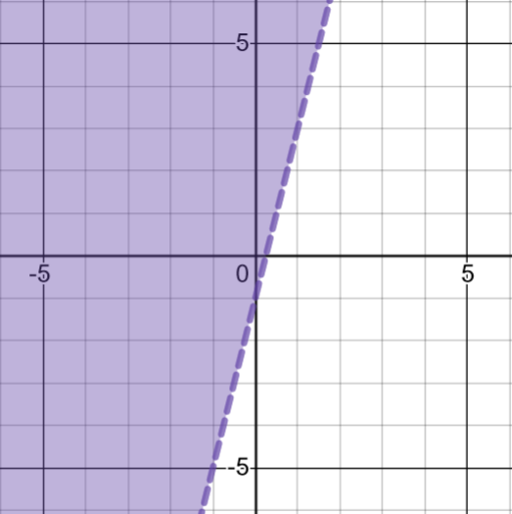
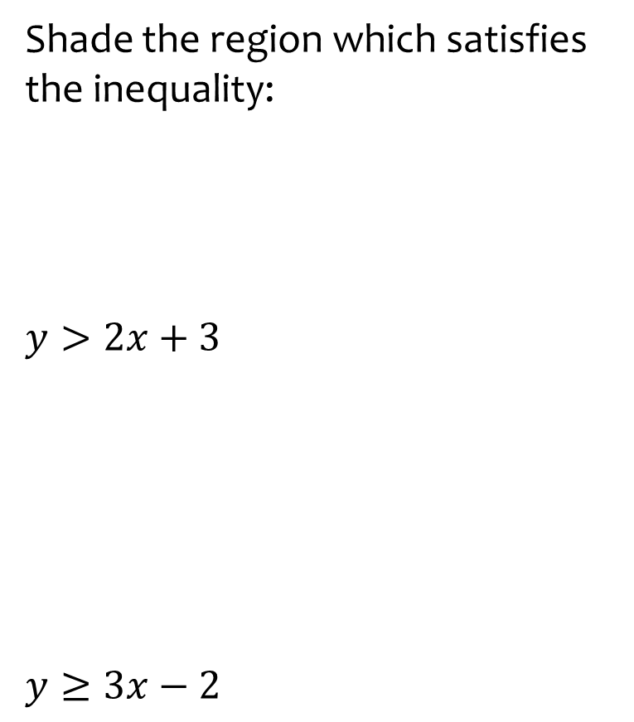

Worked example
Your turn
Shade the region which satisfies the inequality:
$$y>2x+3$$
$$y≥3x−2$$
Shade the region which satisfies the inequality $y>4x−1$
Graphs used with permission from DESMOS: https://www.desmos.com/

Slide 32



Worked example
Your turn
Shade the region which satisfies the inequality:
$$y<2x+3$$
$$y≤3x−2$$
Shade the region which satisfies the inequality $y<4x−1$
Graphs used with permission from DESMOS: https://www.desmos.com/

Slide 33



Worked example
Your turn
Shade the region which satisfies the inequality:
$$y<−2x+3$$
$$y≤−2−3x$$
Shade the region which satisfies the inequality $y<−1−4x$
Graphs used with permission from DESMOS: https://www.desmos.com/

Slide 34



Worked example
Your turn
Shade the region which satisfies the inequality:
$$y>−2x+3$$
$$y≥−2−3x$$
Shade the region which satisfies the inequality $y>−1−4x$
Graphs used with permission from DESMOS: https://www.desmos.com/

Slide 35




Worked example
Your turn
Shade the region which satisfies the inequalities. Label it R
$x≤3$, $y>1$ and $y≥x+3$
Shade the region which satisfies the inequalities. Label it R.
$$x<4,y≥3,y≥x+2$$
$$R$$
Graphs used with permission from DESMOS: https://www.desmos.com/

Slide 36




Worked example
Your turn
Shade the region which satisfies the inequalities:
$x≥−2$, $y<1$ and $y<x−1$
Shade the region which satisfies the inequalities. Label it R.
$$x>−3,y≤4 \text{and} y<x−2$$
$$R$$
Graphs used with permission from DESMOS: https://www.desmos.com/

Slide 37




Worked example
Your turn
Shade the region which satisfies the inequalities:
$x≥2,y>−1$ and $x+y≤5$
Shade the region which satisfies the inequalities. Label it R.
$x≥2,y>1$ and $x+y≤6$
$$R$$
Graphs used with permission from DESMOS: https://www.desmos.com/

Slide 38




Worked example
Your turn
Write the inequality that defines the red region:
Write the inequality that defines the red region:
$$x<4$$
Graphs used with permission from DESMOS: https://www.desmos.com/

Slide 39




Worked example
Your turn
Write the inequality that defines the red region:
Write the inequality that defines the red region:
$$x>−4$$
Graphs used with permission from DESMOS: https://www.desmos.com/

Slide 40




Worked example
Your turn
Write the inequality that defines the red region:
Write the inequality that defines the red region:
$$y<5$$
Graphs used with permission from DESMOS: https://www.desmos.com/

Slide 41




Worked example
Your turn
Write the inequality that defines the red region:
Write the inequality that defines the red region:
$$y>−1$$
Graphs used with permission from DESMOS: https://www.desmos.com/

Slide 42



Worked example
Your turn
Write the inequality that defines the red region:
Write the inequality that defines the red region:
$$y≥x$$
Graphs used with permission from DESMOS: https://www.desmos.com/

Slide 43



Worked example
Your turn
Write the inequality that defines the red region:
Write the inequality that defines the red region:
$$y<x$$
Graphs used with permission from DESMOS: https://www.desmos.com/

Slide 44



Worked example
Your turn
Write the inequality that defines the red region:
Write the inequality that defines the red region:
$$y>x+3$$
Graphs used with permission from DESMOS: https://www.desmos.com/

Slide 45



Worked example
Your turn
Write the inequality that defines the red region:
Write the inequality that defines the red region:
$$y≤2x+3$$
Graphs used with permission from DESMOS: https://www.desmos.com/

Slide 46



Worked example
Your turn
Write the inequality that defines the red region:
Write the inequality that defines the red region:
$$y≤1−3x$$
Graphs used with permission from DESMOS: https://www.desmos.com/

Slide 47



Worked example
Your turn
Write the inequality that defines the red region:
Write the inequality that defines the red region:
$$y>−\frac{1}{2}x−4$$
Graphs used with permission from DESMOS: https://www.desmos.com/

Slide 48



Worked example
Your turn
Write the inequalities that define the unshaded region:
Write the inequalities that define the unshaded region:
$$x<1$$
$$y<3$$
$$y>−2x+3$$
Graphs used with permission from DESMOS: https://www.desmos.com/

Slide 49



Worked example
Your turn
Write the inequalities that define the unshaded region:
Write the inequalities that define the unshaded region:
$$x≤3$$
$$y>−1$$
$$y<x−2$$
Graphs used with permission from DESMOS: https://www.desmos.com/

