Slide 1
FUNCTIONS
CONTENTS

Slide 2
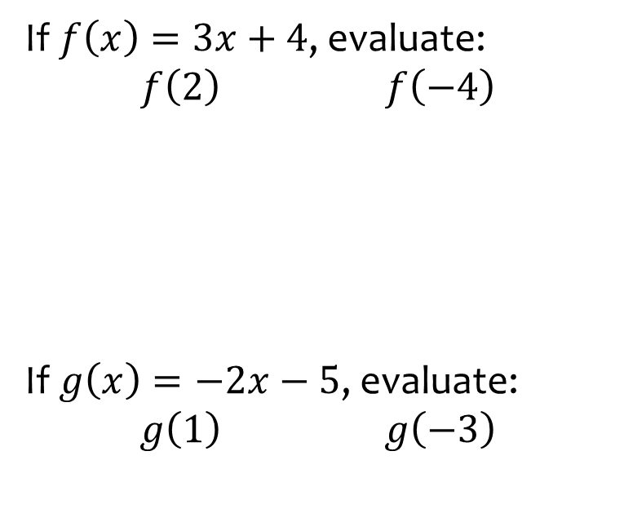
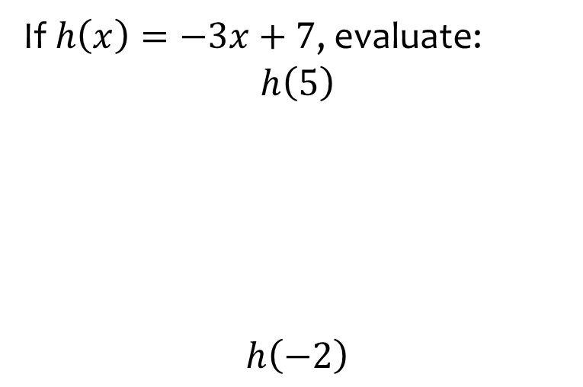
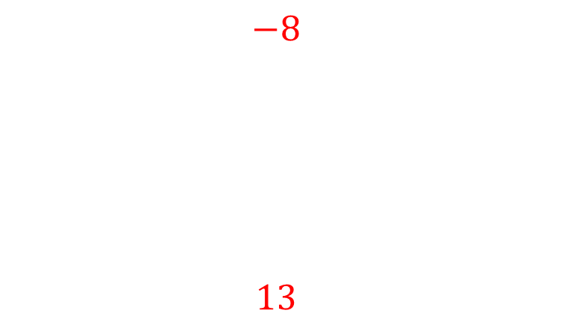
Worked example
Your turn
If $f\left(x\right)=3x+4$, evaluate:
$f\left(2\right)$ $f\left(−4\right)$
If $g\left(x\right)=−2x−5$, evaluate:
$g\left(1\right)$ $g\left(−3\right)$
If $h\left(x\right)=−3x+7$, evaluate:
$$h\left(5\right)$$
$$h\left(−2\right)$$
$$−8$$
$$13$$

Slide 3
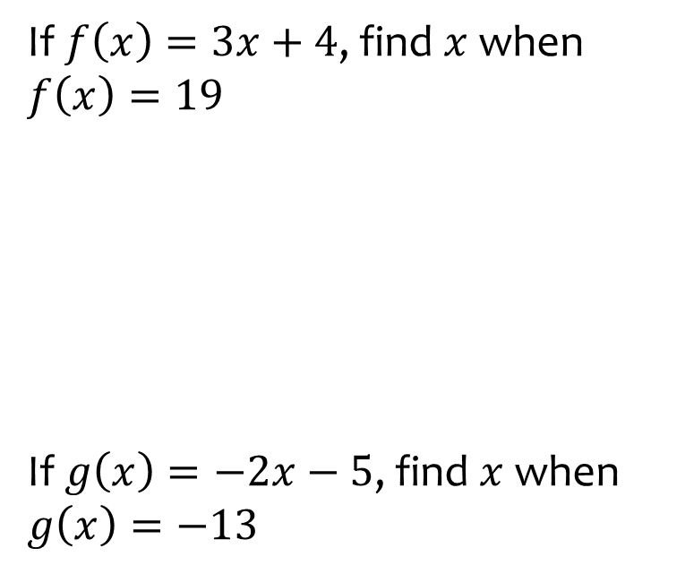
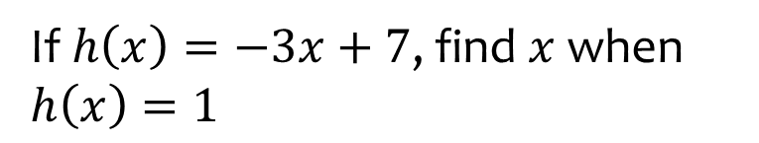

Worked example
Your turn
If $f\left(x\right)=3x+4$, find $x$ when $f\left(x\right)=19$
If $g\left(x\right)=−2x−5$, find $x$ when $g\left(x\right)=−13$
If $h\left(x\right)=−3x+7$, find $x$ when $h\left(x\right)=1$
$$x=2$$

Slide 4
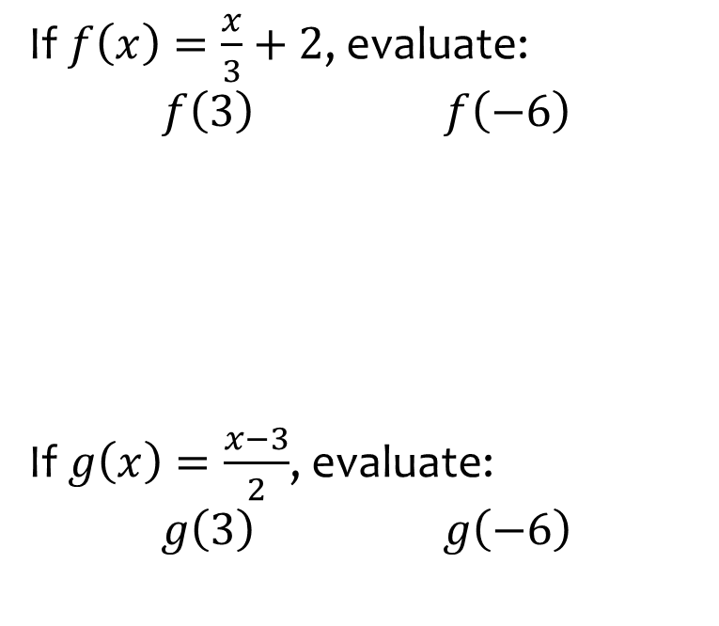
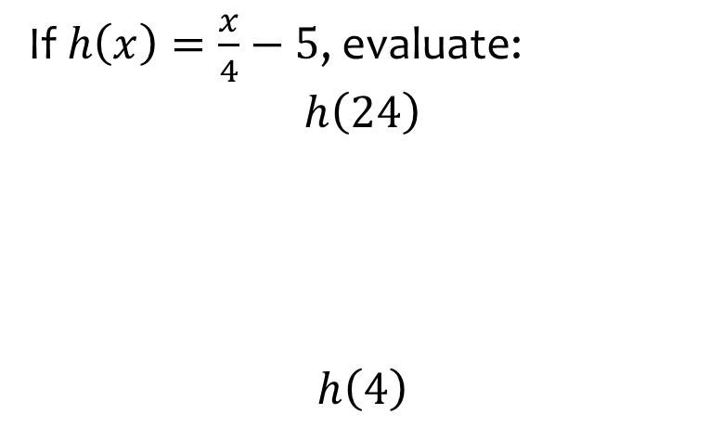
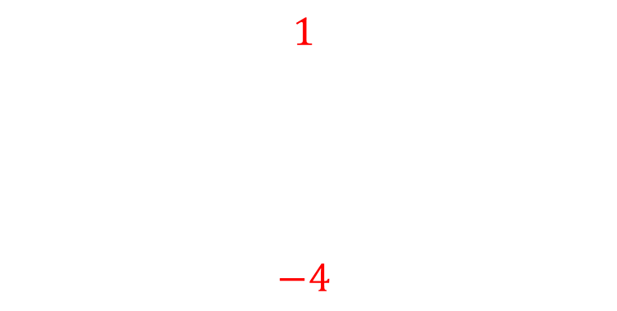
Worked example
Your turn
If $f\left(x\right)=\frac{x}{3}+2$, evaluate:
$f\left(3\right)$ $f\left(−6\right)$
If $g\left(x\right)=\frac{x−3}{2}$, evaluate:
$g\left(3\right)$ $g\left(−6\right)$
If $h\left(x\right)=\frac{x}{4}−5$, evaluate:
$$h\left(24\right)$$
$$h\left(4\right)$$
$$1$$
$$−4$$

Slide 5
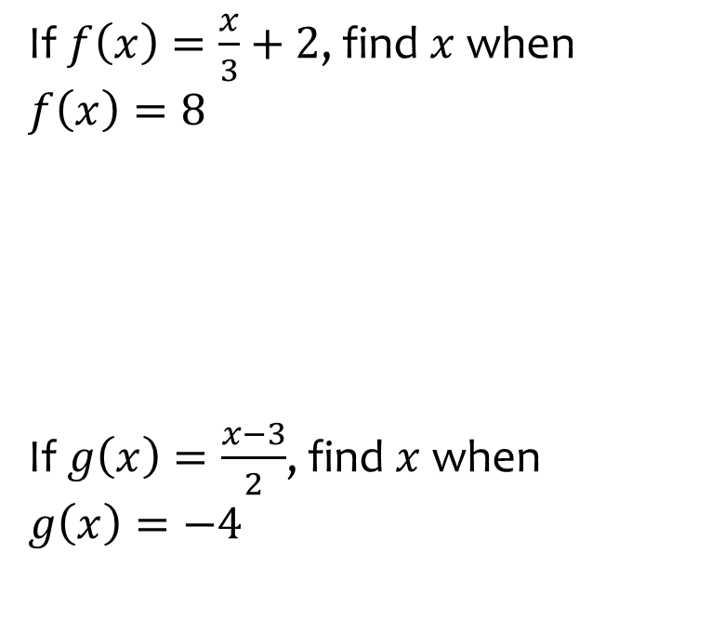
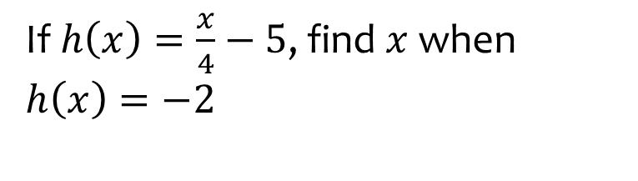

Worked example
Your turn
If $f\left(x\right)=\frac{x}{3}+2$, find $x$ when $f\left(x\right)=8$
If $g\left(x\right)=\frac{x−3}{2}$, find $x$ when $g\left(x\right)=−4$
If $h\left(x\right)=\frac{x}{4}−5$, find $x$ when $h\left(x\right)=−2$
$$x=12$$

Slide 6
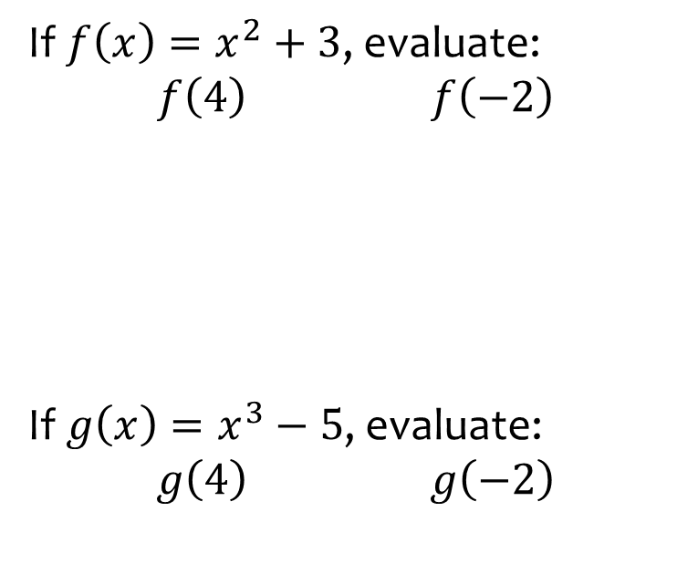
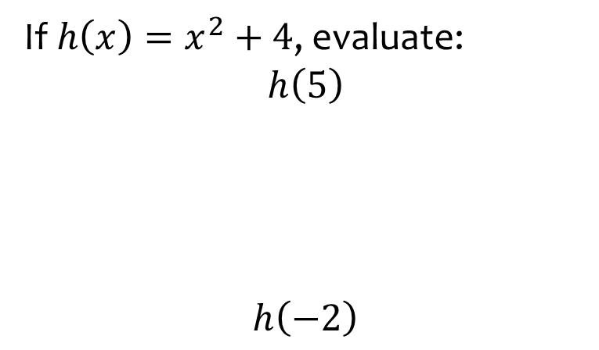
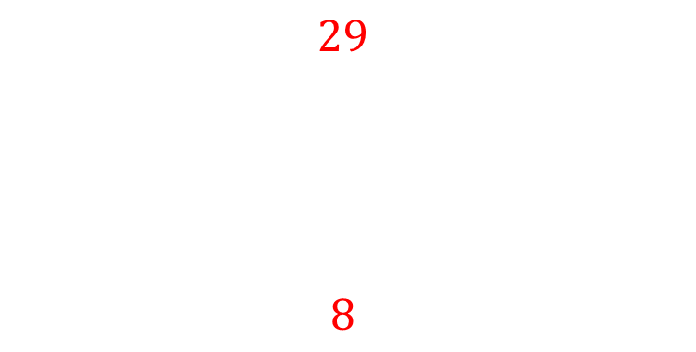
Worked example
Your turn
If $f\left(x\right)=x^{2}+3$, evaluate:
$f\left(4\right)$ $f\left(−2\right)$
If $g\left(x\right)=x^{3}−5$, evaluate:
$g\left(4\right)$ $g\left(−2\right)$
If $h\left(x\right)=x^{2}+4$, evaluate:
$$h\left(5\right)$$
$$h\left(−2\right)$$
$$29$$
$$8$$

Slide 7
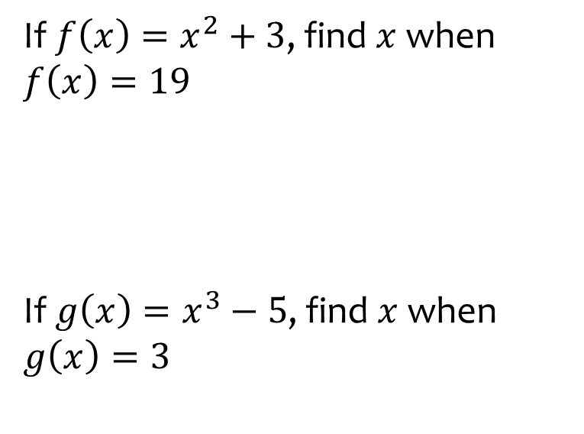
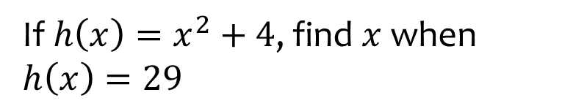

Worked example
Your turn
If $f\left(x\right)=x^{2}+3$, find $x$ when $f\left(x\right)=19$
If $g\left(x\right)=x^{3}−5$, find $x$ when $g\left(x\right)=3$
If $h\left(x\right)=x^{2}+4$, find $x$ when $h\left(x\right)=29$
$$x=±5$$

Slide 8
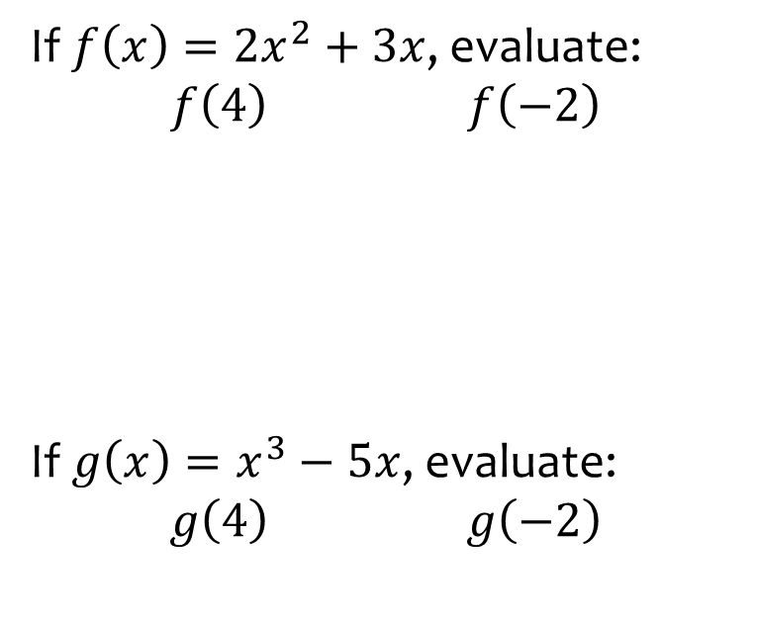
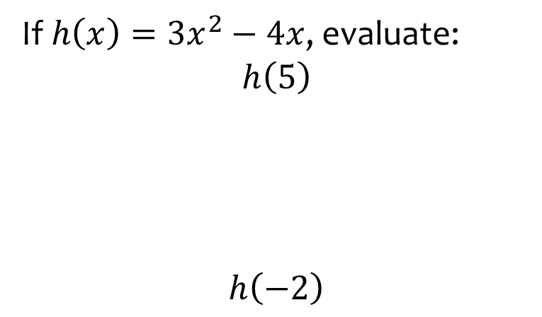
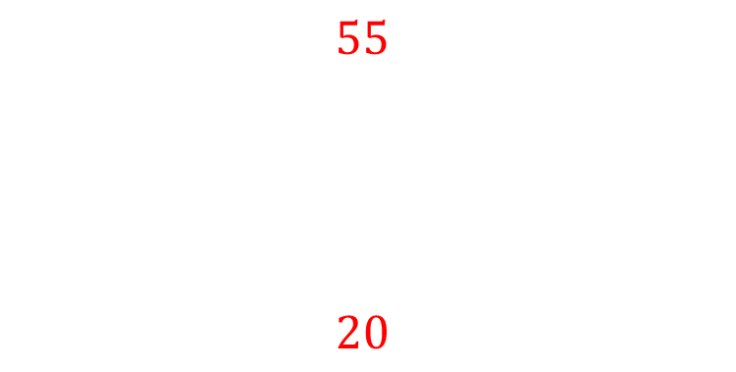
Worked example
Your turn
If $f\left(x\right)=2x^{2}+3x$, evaluate:
$f\left(4\right)$ $f\left(−2\right)$
If $g\left(x\right)=x^{3}−5x$, evaluate:
$g\left(4\right)$ $g\left(−2\right)$
If $h\left(x\right)=3x^{2}−4x$, evaluate:
$$h\left(5\right)$$
$$h\left(−2\right)$$
$$55$$
$$20$$

Slide 9
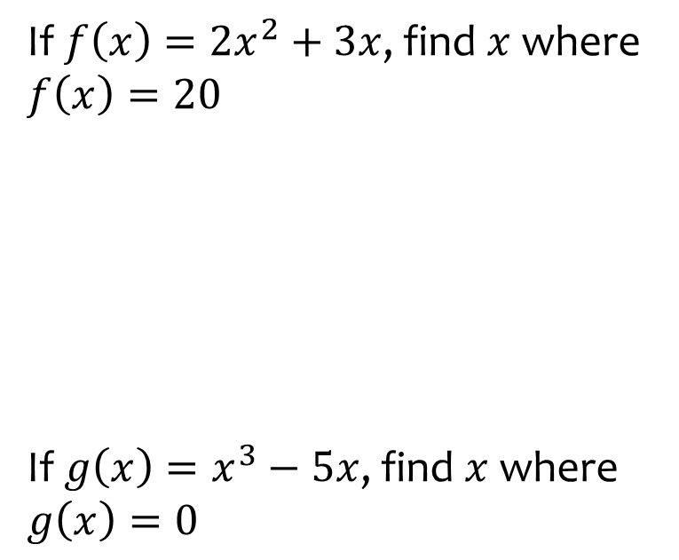
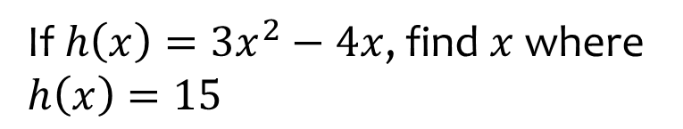

Worked example
Your turn
If $f\left(x\right)=2x^{2}+3x$, find $x$ where $f\left(x\right)=20$
If $g\left(x\right)=x^{3}−5x$, find $x$ where $g\left(x\right)=0$
If $h\left(x\right)=3x^{2}−4x$, find $x$ where $h\left(x\right)=15$
$$x=3, x=−\frac{5}{3}$$

Slide 10
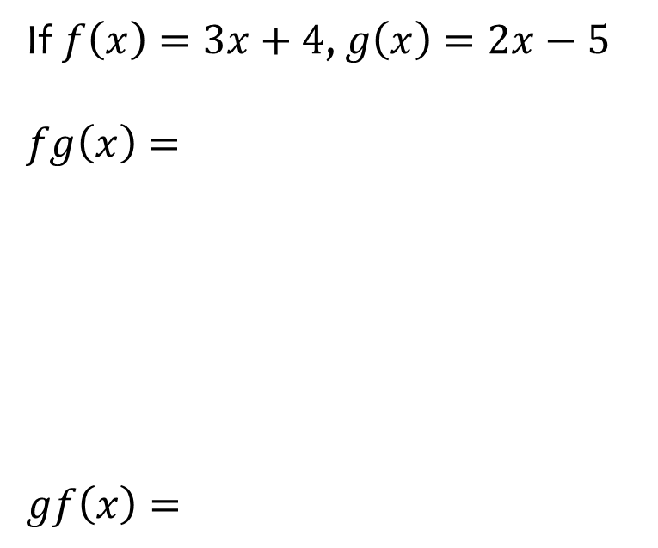
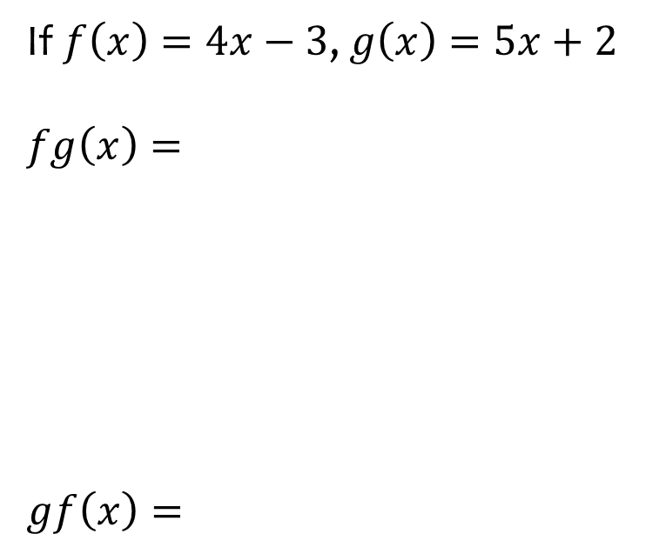
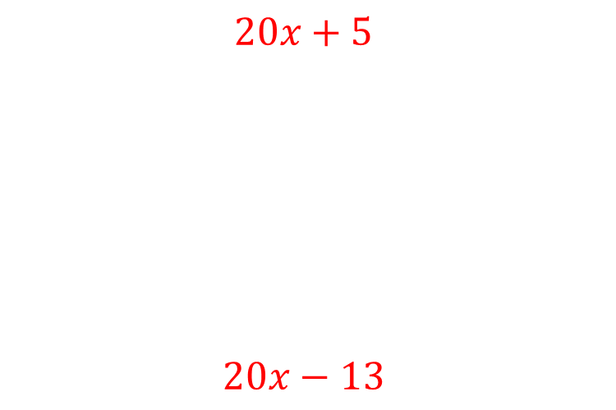
Worked example
Your turn
If $f\left(x\right)=3x+4$, $g\left(x\right)=2x−5$
$$fg\left(x\right)=$$
$$gf\left(x\right)=$$
If $f\left(x\right)=4x−3$, $g\left(x\right)=5x+2$
$$fg\left(x\right)=$$
$$gf\left(x\right)=$$
$$20x+5$$
$$20x−13$$

Slide 11
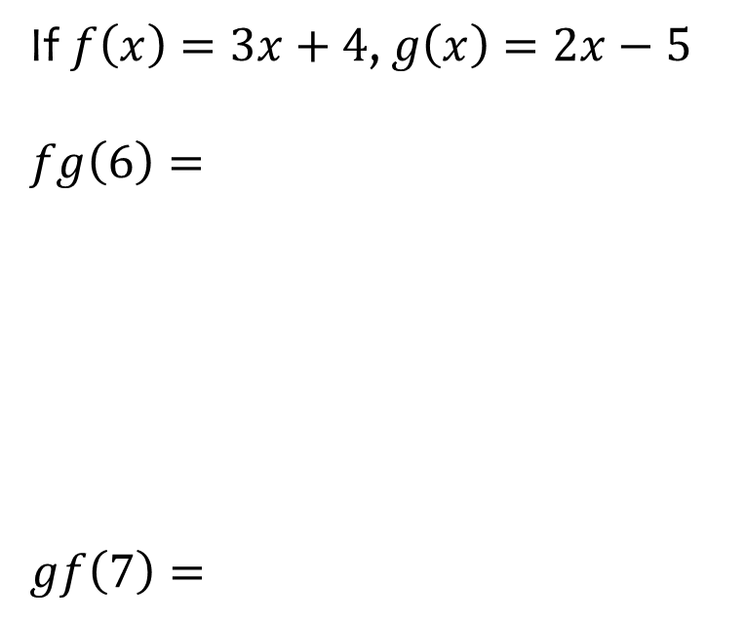
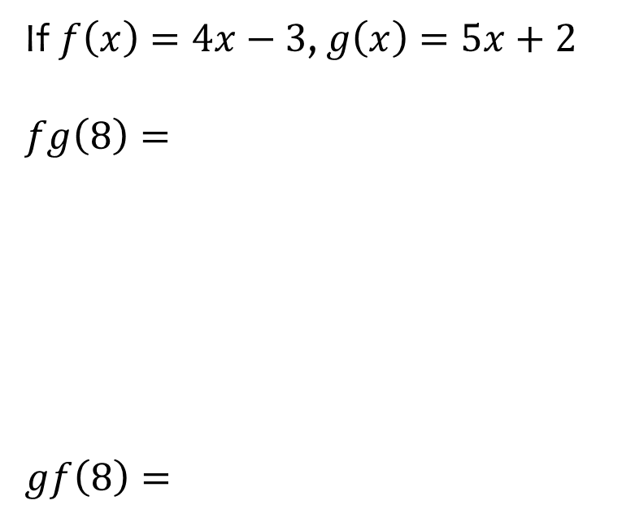
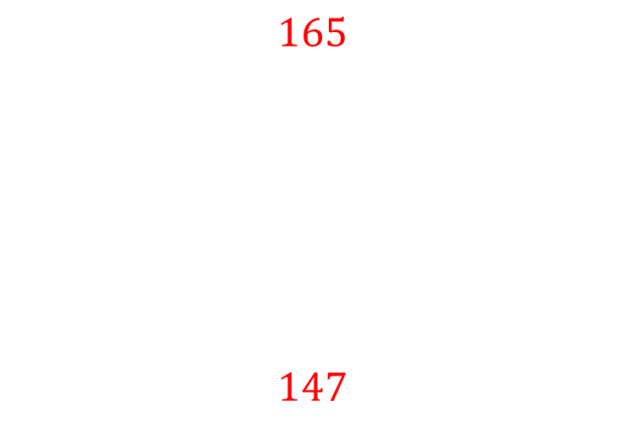
Worked example
Your turn
If $f\left(x\right)=3x+4$, $g\left(x\right)=2x−5$
$$fg\left(6\right)=$$
$$gf\left(7\right)=$$
If $f\left(x\right)=4x−3$, $g\left(x\right)=5x+2$
$$fg\left(8\right)=$$
$$gf\left(8\right)=$$
$$165$$
$$147$$

Slide 12
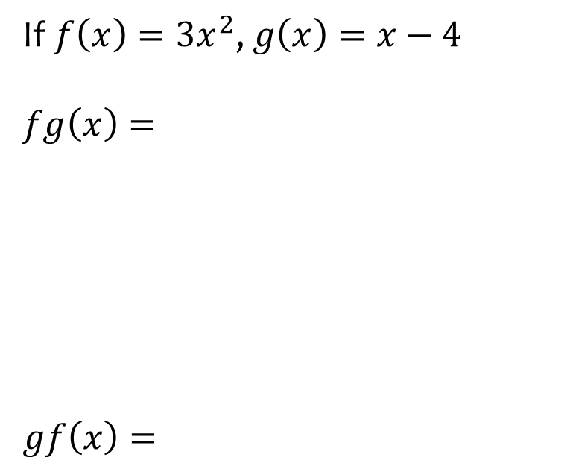
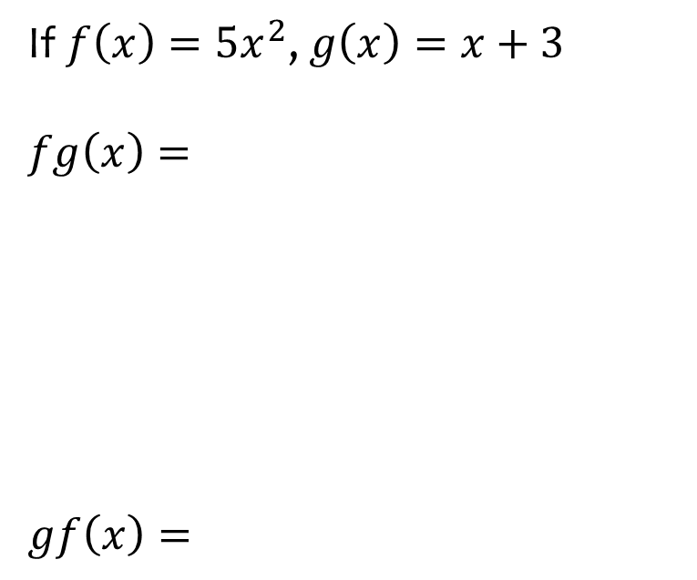
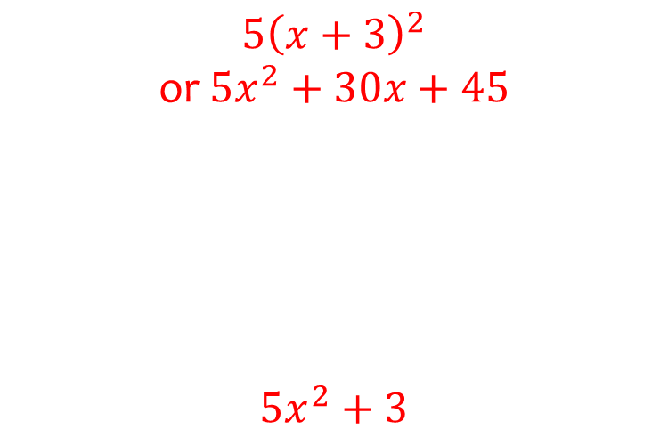
Worked example
Your turn
If $f\left(x\right)=3x^{2}$, $g\left(x\right)=x−4$
$$fg\left(x\right)=$$
$$gf\left(x\right)=$$
If $f\left(x\right)=5x^{2}$, $g\left(x\right)=x+3$
$$fg\left(x\right)=$$
$$gf\left(x\right)=$$
$$5{\left(x+3\right)}^{2}$$
or $5x^{2}+30x+45$
$$5x^{2}+3$$

Slide 13
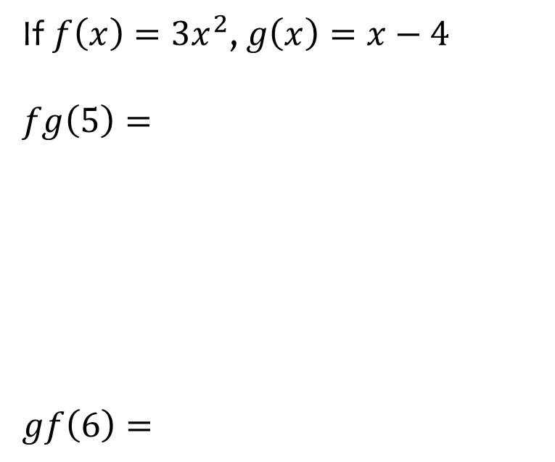
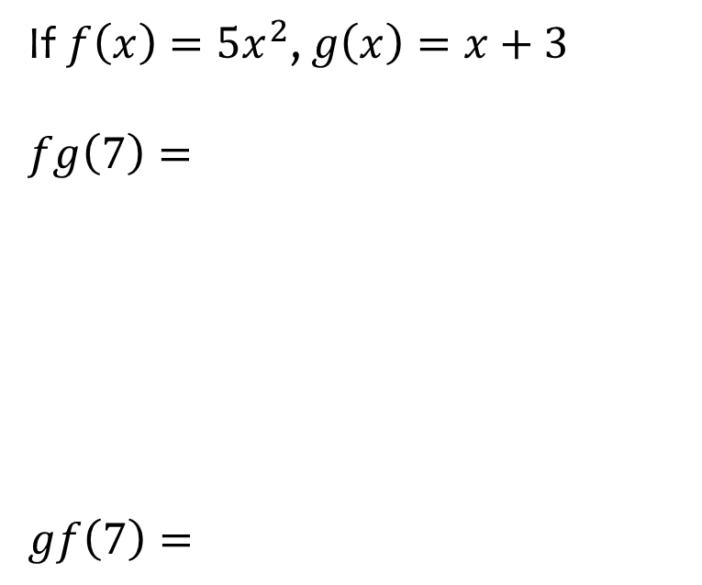
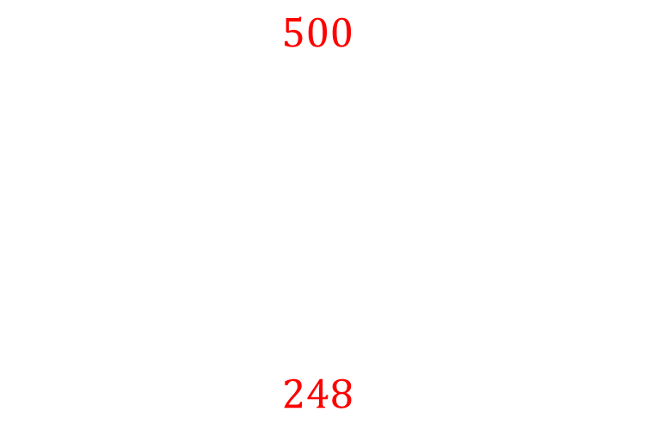
Worked example
Your turn
If $f\left(x\right)=3x^{2}$, $g\left(x\right)=x−4$
$$fg\left(5\right)=$$
$$gf\left(6\right)=$$
If $f\left(x\right)=5x^{2}$, $g\left(x\right)=x+3$
$$fg\left(7\right)=$$
$$gf\left(7\right)=$$
$$500$$
$$248$$

Slide 14
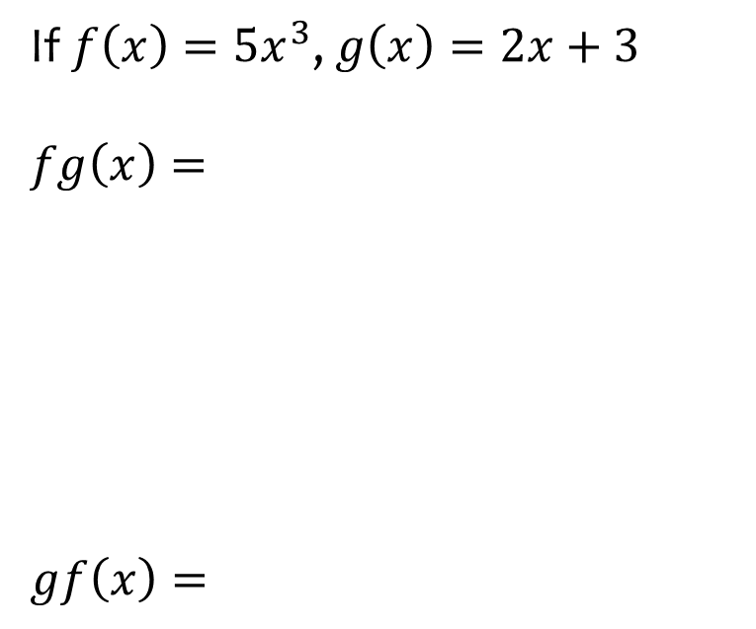
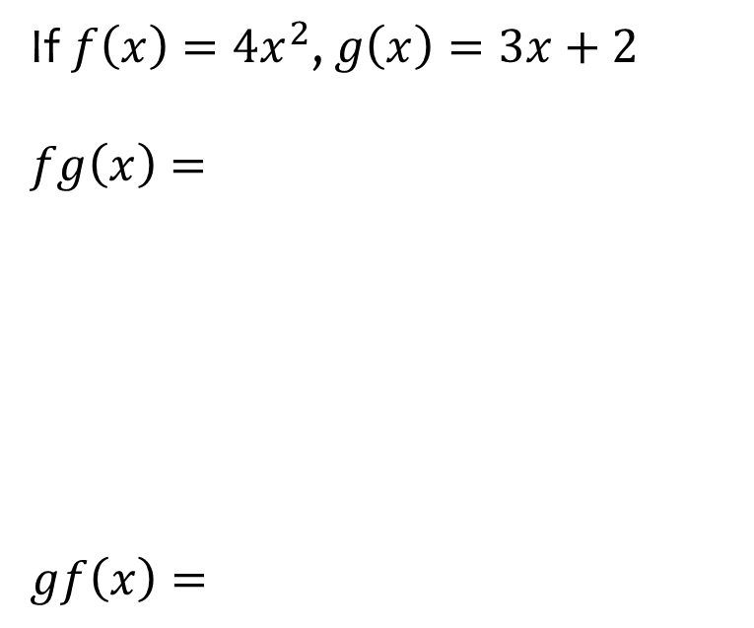
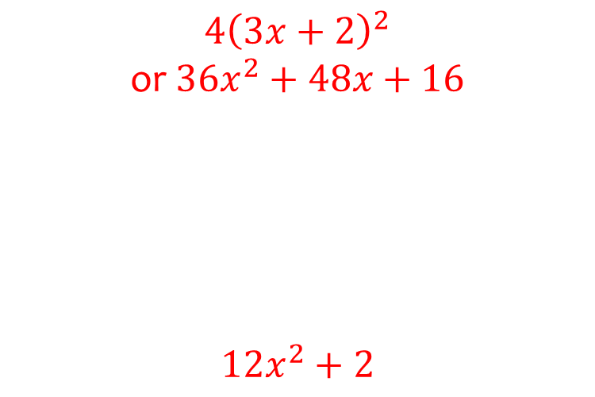
Worked example
Your turn
If $f\left(x\right)={5x}^{3}$, $g\left(x\right)=2x+3$
$$fg\left(x\right)=$$
$$gf\left(x\right)=$$
If $f\left(x\right)=4x^{2}$, $g\left(x\right)=3x+2$
$$fg\left(x\right)=$$
$$gf\left(x\right)=$$
$$4{\left(3x+2\right)}^{2}$$
or $36x^{2}+48x+16$
$$12x^{2}+2$$

Slide 15
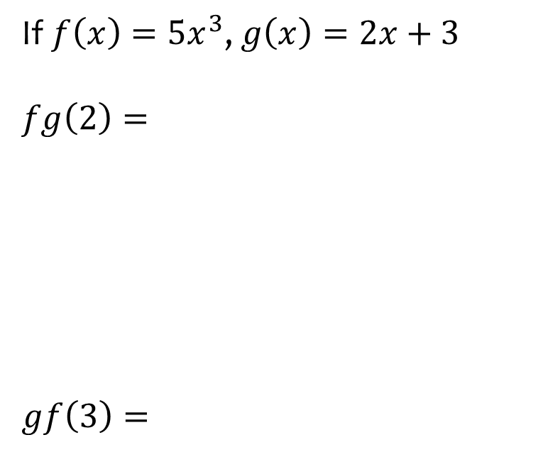
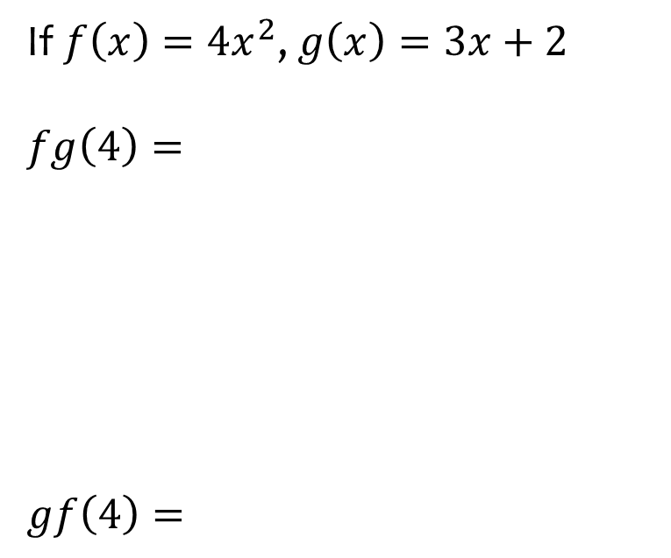
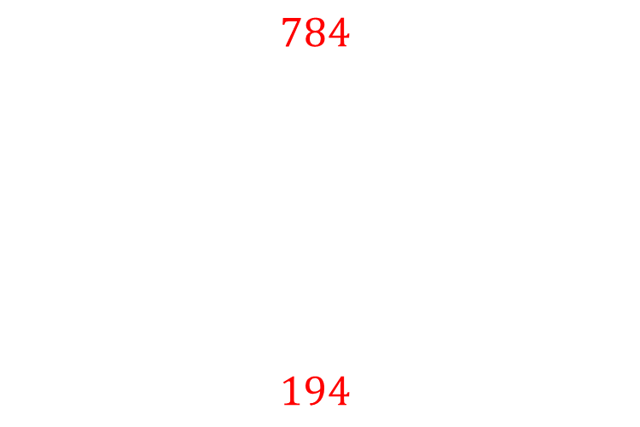
Worked example
Your turn
If $f\left(x\right)={5x}^{3}$, $g\left(x\right)=2x+3$
$$fg\left(2\right)=$$
$$gf\left(3\right)=$$
If $f\left(x\right)=4x^{2}$, $g\left(x\right)=3x+2$
$$fg\left(4\right)=$$
$$gf\left(4\right)=$$
$$784$$
$$194$$

Slide 16
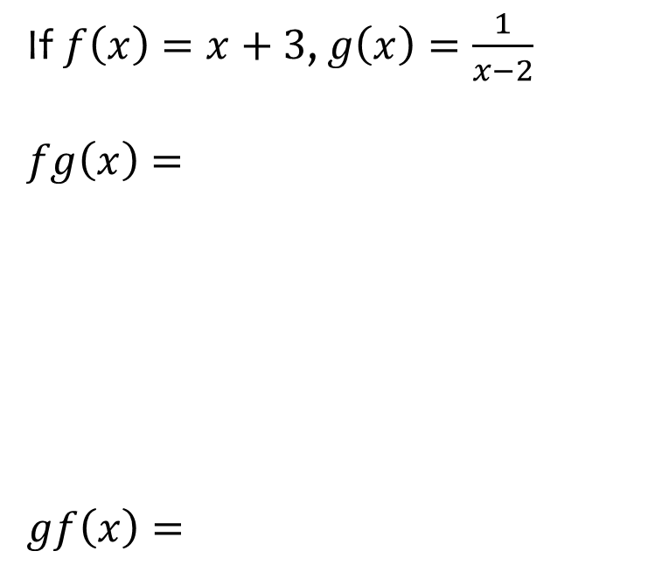
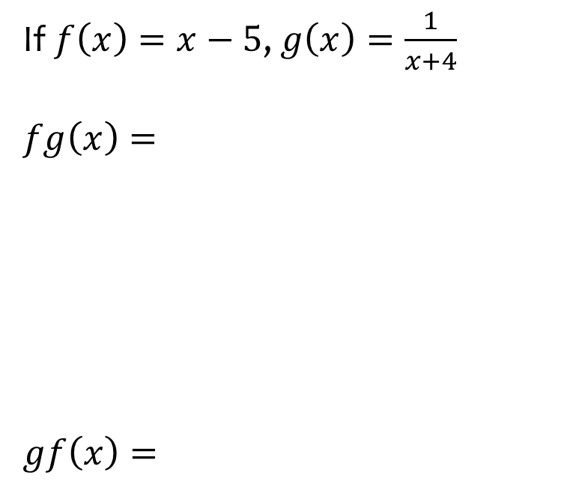
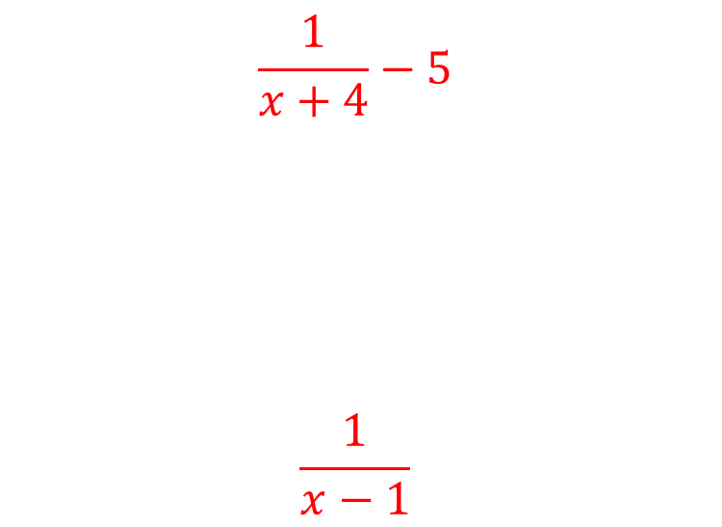
Worked example
Your turn
If $f\left(x\right)=x+3$, $g\left(x\right)=\frac{1}{x−2}$
$$fg\left(x\right)=$$
$$gf\left(x\right)=$$
If $f\left(x\right)=x−5$, $g\left(x\right)=\frac{1}{x+4}$
$$fg\left(x\right)=$$
$$gf\left(x\right)=$$
$$\frac{1}{x+4}−5$$
$$\frac{1}{x−1}$$

Slide 17
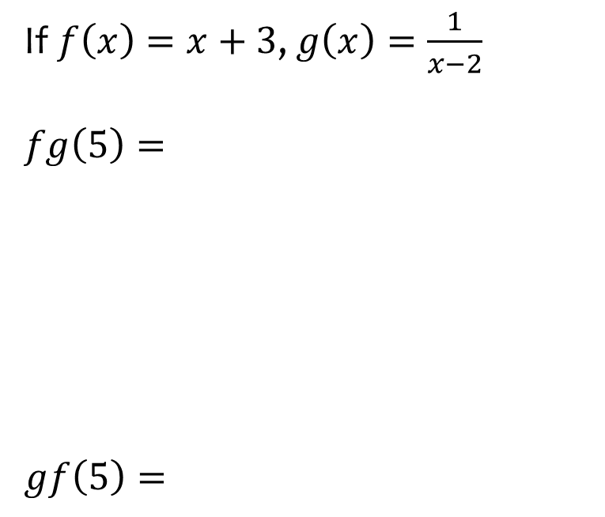
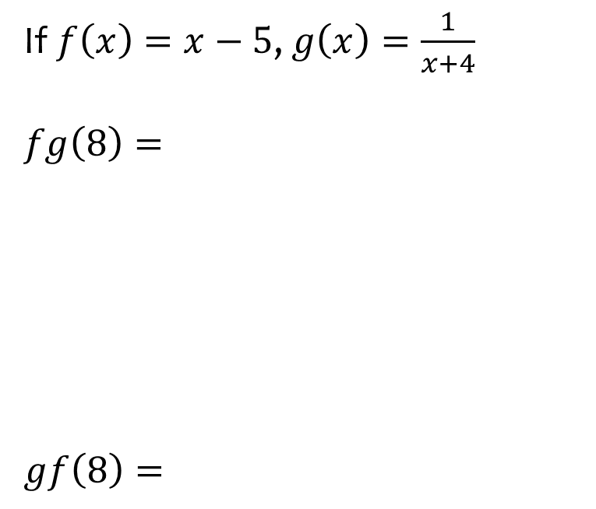
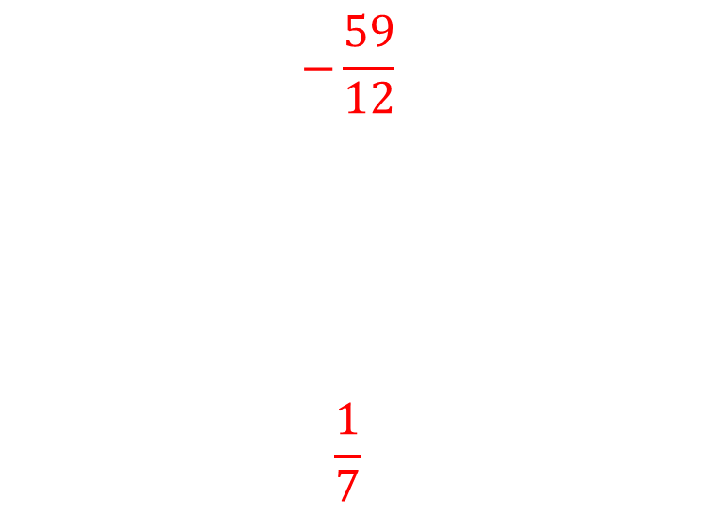
Worked example
Your turn
If $f\left(x\right)=x+3$, $g\left(x\right)=\frac{1}{x−2}$
$$fg\left(5\right)=$$
$$gf\left(5\right)=$$
If $f\left(x\right)=x−5$, $g\left(x\right)=\frac{1}{x+4}$
$$fg\left(8\right)=$$
$$gf\left(8\right)=$$
$$−\frac{59}{12}$$
$$\frac{1}{7}$$

Slide 18
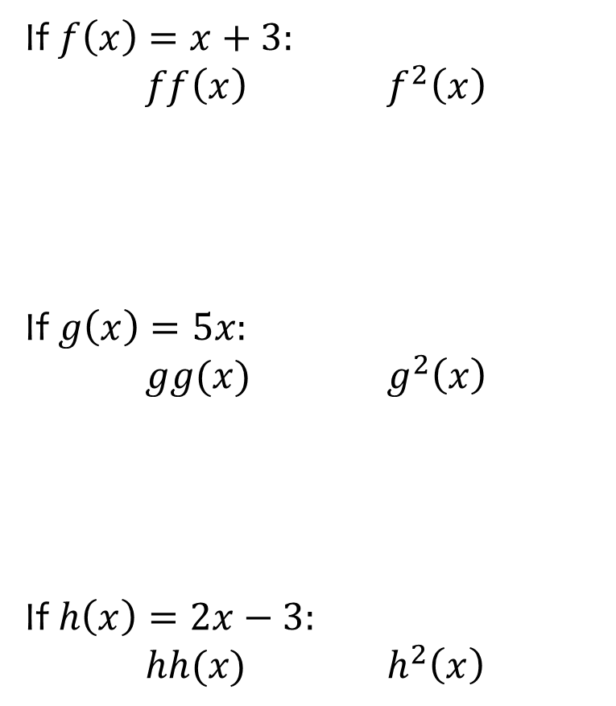
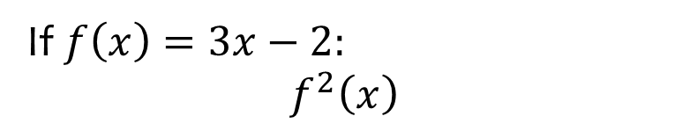

Worked example
Your turn
If $f\left(x\right)=x+3:$
$ff\left(x\right)$ $f^{2}\left(x\right)$
If $g\left(x\right)=5x:$
$gg(x)$ $g^{2}\left(x\right)$
If $h\left(x\right)=2x−3:$
$hh(x)$ $h^{2}\left(x\right)$
If $f\left(x\right)=3x−2:$
$$f^{2}\left(x\right)$$
$$9x−8$$

Slide 19
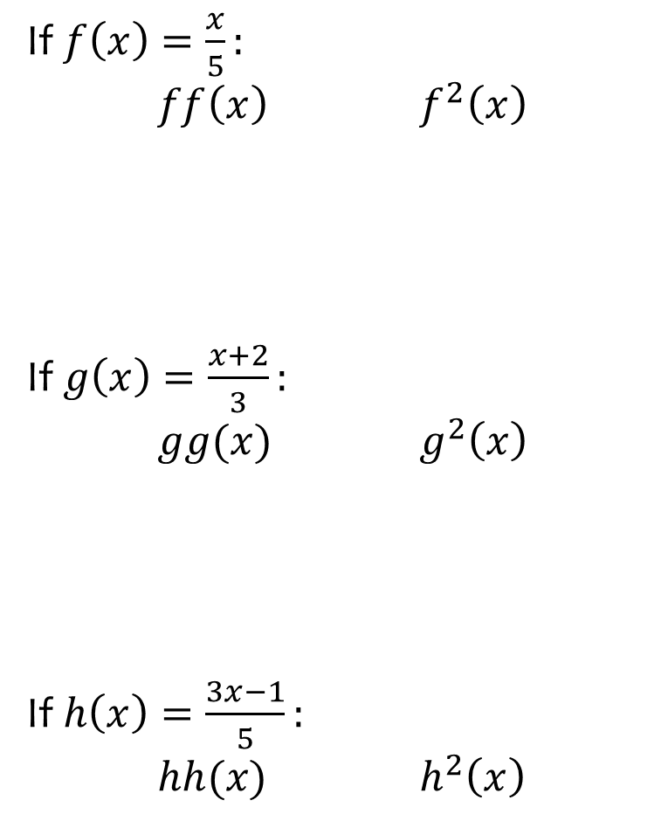
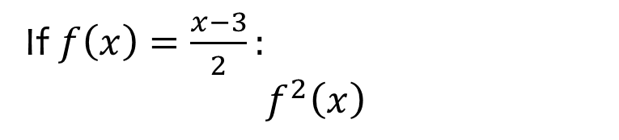

Worked example
Your turn
If $f\left(x\right)=\frac{x}{5}:$
$ff\left(x\right)$ $f^{2}\left(x\right)$
If $g\left(x\right)=\frac{x+2}{3}:$
$gg(x)$ $g^{2}\left(x\right)$
If $h\left(x\right)=\frac{3x−1}{5}:$
$hh(x)$ $h^{2}\left(x\right)$
If $f\left(x\right)=\frac{x−3}{2}:$
$$f^{2}\left(x\right)$$
$$\frac{x−9}{4}$$

Slide 20
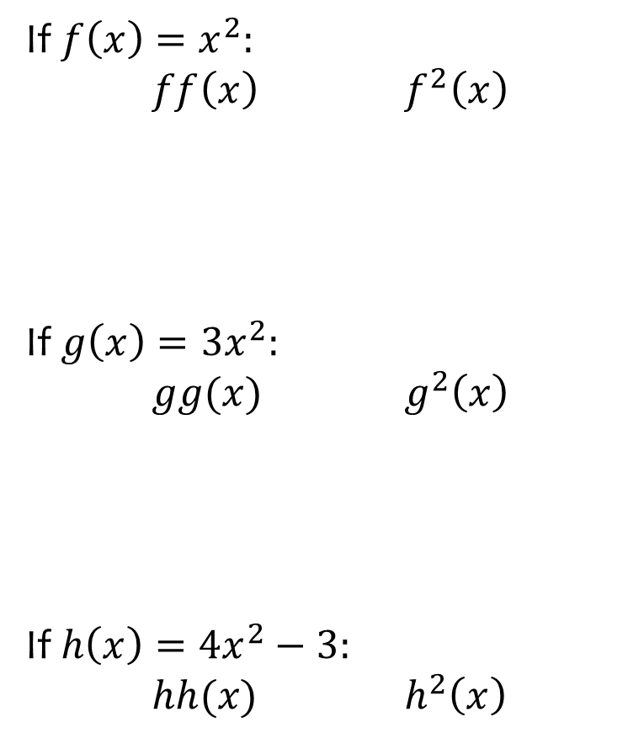
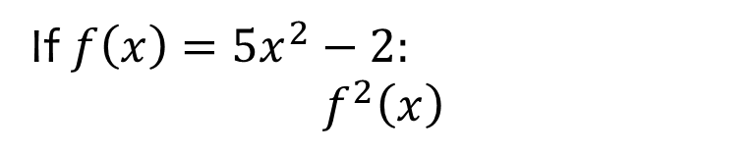

Worked example
Your turn
If $f\left(x\right)=x^{2}:$
$ff\left(x\right)$ $f^{2}\left(x\right)$
If $g\left(x\right)=3x^{2}:$
$gg(x)$ $g^{2}\left(x\right)$
If $h\left(x\right)=4x^{2}−3:$
$hh(x)$ $h^{2}\left(x\right)$
If $f\left(x\right)=5x^{2}−2:$
$$f^{2}\left(x\right)$$
$$100x^{4}−100x^{2}+18$$

Slide 21



Worked example
Your turn
If $f\left(x\right)=x^{2}$, $g\left(x\right)=2x+3$, solve $f\left(x\right)=g\left(x\right)$
If $p(x)=3x^{2}$, $q\left(x\right)=7x−2$,
solve $p\left(x\right)=q(x)$
If $f\left(x\right)=x^{2}$, $g\left(x\right)=3x−2$, solve $f\left(x\right)=g\left(x\right)$
$$x=1, x=2$$

Slide 22



Worked example
Your turn
Find the inverse function:
$$f\left(x\right)=x+7$$
$$g\left(x\right)=3x−5$$
Find the inverse function:
$$h\left(x\right)=4x+2$$
$$h^{−1}\left(x\right)=\frac{x−2}{4}$$

Slide 23



Worked example
Your turn
Find the inverse function:
$$f\left(x\right)=\frac{2x+3}{4}$$
$$g\left(x\right)=\frac{3x−2}{5}$$
Find the inverse function:
$$h\left(x\right)=\frac{4x−3}{2}$$
$$h^{−1}\left(x\right)=\frac{2x+3}{4}$$

Slide 24



Worked example
Your turn
Find the inverse function:
$$f\left(x\right)=\frac{x}{2}−3$$
$$g\left(x\right)=2+\frac{x}{3}$$
Find the inverse function:
$$h\left(x\right)=5+\frac{x}{4}$$
$$h^{−1}\left(x\right)=4(x−5)$$

Slide 25



Worked example
Your turn
Find the inverse function:
$$f\left(x\right)=\frac{x}{2}−3$$
$$g\left(x\right)=\frac{x−3}{2}$$
Find the inverse function:
$$h\left(x\right)=\frac{x}{5}+4$$
$$h^{−1}\left(x\right)=5(x−4)$$

Slide 26



Worked example
Your turn
Find the inverse function:
$$f\left(x\right)=3(x−2)$$
$$g\left(x\right)=2(x+3)$$
Find the inverse function:
$$h\left(x\right)=5(x+4)$$
$$h^{−1}\left(x\right)=\frac{x}{5}−4$$

Slide 27



Worked example
Your turn
Find the inverse function:
$$f\left(x\right)=2+\frac{3}{x}$$
$$g\left(x\right)=\frac{2}{x}−3$$
Find the inverse function:
$$h\left(x\right)=\frac{5}{x}+4$$
$$h^{−1}\left(x\right)=\frac{5}{x−4}$$

Slide 28



Worked example
Your turn
Find the inverse function:
$$f\left(x\right)=\frac{2}{x−3}$$
$$g\left(x\right)=\frac{3}{x+2}$$
Find the inverse function:
$$h\left(x\right)=\frac{5}{x−4}$$
$$h^{−1}\left(x\right)=\frac{5}{x}+4$$

Slide 29



Worked example
Your turn
Find the inverse function:
$$f\left(x\right)=\frac{2}{4x−3}$$
$$g\left(x\right)=\frac{3}{2−5x}$$
Find the inverse function:
$$h\left(x\right)=\frac{4}{5−3x}$$
$$h^{−1}\left(x\right)=\frac{5x−4}{3x}$$

Slide 30



Worked example
Your turn
Find the inverse function:
$$f\left(x\right)=3\sqrt{x}$$
$$g\left(x\right)=5\sqrt[3]{x}$$
Find the inverse function:
$$h\left(x\right)=4\sqrt{x}$$
$$h^{−1}\left(x\right)=\frac{x^{2}}{16}$$

Slide 31



Worked example
Your turn
Find the inverse function:
$$f\left(x\right)=3\sqrt{x}−2$$
$$g\left(x\right)=5\sqrt[3]{x}+3$$
Find the inverse function:
$$h\left(x\right)=4\sqrt{x}−5$$
$$h^{−1}\left(x\right)=\frac{{\left(x+5\right)}^{2}}{16}$$

Slide 32



Worked example
Your turn
Find the inverse function:
$$f\left(x\right)=\frac{x+2}{x−3}$$
$$g\left(x\right)=\frac{2x−3}{x+2}$$
Find the inverse function:
$$h\left(x\right)=\frac{4x−5}{x−3}$$
$$h^{−1}\left(x\right)=\frac{3x−5}{x−4}$$

Slide 33



Worked example
Your turn
Find the inverse function:
$$f\left(x\right)=\sqrt{\frac{x−2}{x+3}}$$
$$g\left(x\right)=\sqrt[3]{\frac{3x−2}{x−4}}$$
Find the inverse function:
$$h\left(x\right)=\sqrt{\frac{5x−4}{x+3}}$$
$$h^{−1}\left(x\right)=\frac{3x^{2}+4}{5−x^{2}}$$

Slide 34



Worked example
Your turn
Find the inverse function:
$$f\left(x\right)=x^{2}+4x−5$$
$$g\left(x\right)=x^{2}−6x+3$$
Find the inverse function:
$$h\left(x\right)=x^{2}+8x−5$$
$$h^{−1}\left(x\right)=−4+\sqrt{x+21}$$
Notes:
Discuss presence of inverse function only if original function one-to-one

Slide 35



Worked example
Your turn
Find the inverse function:
$$f\left(x\right)=2x^{2}−10x+9$$
$$g\left(x\right)=3x^{2}−8x+2$$
Find the inverse function:
$$h\left(x\right)=2x^{2}−12x+3$$
$$h^{−1}\left(x\right)=3+\sqrt{\frac{x+15}{2}}$$
Notes:
Discuss presence of inverse function only if original function one-to-one

Slide 36






Worked example
Your turn
$$f\left(x\right)=3x^{2}−2$$
$f\left(x+2\right)$ $f(x−2)$
$f\left(2x\right)$ $f(\frac{1}{2}x)$
$$g\left(x\right)=5x^{2}+3$$
$g\left(x+4\right)$ $f(x−4)$
$g\left(3x\right)$ $g(\frac{1}{3}x)$
$$5{\left(x+4\right)}^{2}+3$$
$$=5x^{2}+40x+83$$
$$5{\left(x−4\right)}^{2}+3$$
$$=5x^{2}−40x+83$$
$$5{(3x)}^{2}+3$$
$$=45x^{2}+3$$
$$5{\left(\frac{1}{3}x\right)}^{2}+3$$
$$=\frac{5}{9}x^{2}+3$$

Slide 37






Worked example
Your turn
$$f\left(x\right)=3x^{2}−5x−2$$
$f\left(x+2\right)$ $f(x−2)$
$f\left(2x\right)$ $f(\frac{1}{2}x)$
$$g\left(x\right)=5x^{2}−2x+3$$
$g\left(x+4\right)$ $f(x−4)$
$g\left(3x\right)$ $g(\frac{1}{3}x)$
$$5{\left(x+4\right)}^{2}−2\left(x+4\right)+3$$
$$=5x^{2}+38x+75$$
$$5{\left(x−4\right)}^{2}−2\left(x−4\right)+3$$
$$=5x^{2}−42x+91$$
$$5{\left(3x\right)}^{2}−2\left(3x\right)+3$$
$$=45x^{2}−6x+3$$
$$5{\left(\frac{1}{3}x\right)}^{2}−2\left(\frac{1}{3}x\right)+3$$
$$=\frac{5}{9}x^{2}−\frac{2}{3}x+3$$

Slide 38



Worked example
Your turn
Write the valid domain for:
$$f\left(x\right)=\sqrt{x}$$
$$g\left(x\right)=\frac{3}{x+2}$$
$$h\left(x\right)=\frac{\sqrt{x}}{x−4}$$
Write the valid domain for:
$$h\left(x\right)=\frac{\sqrt{x}}{x−3}$$
$$x≥0, x≠3$$

Slide 39



Worked example
Your turn
$$f\left(x\right)=2\sqrt{x}+3$$
The domain of $f(x)$ is $\{1, 4, 9, 16\}$.
What is the range?
$$g\left(x\right)=3x^{2}−2$$
The domain of $f(x)$ is $\{1, 2, 3, 4\}$.
What is the range?
$$h\left(x\right)=2x^{3}+1$$
The domain of $h(x)$ is $\{1, 2, 3, 4\}$.
What is the range?
$$\left\{3, 17, 55, 129\right\}$$

