Slide 1
FORMING EXPRESSIONS
CONTENTS

Slide 2
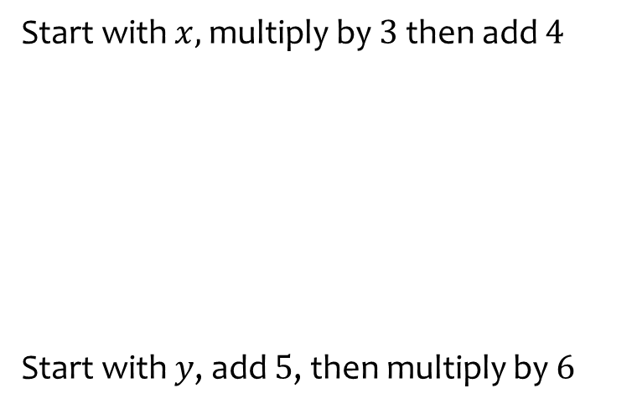
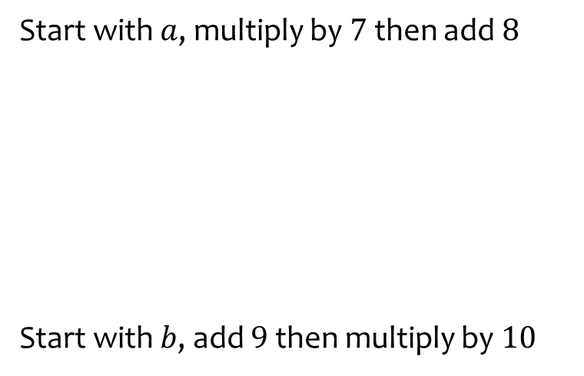


Worked example
Your turn
Start with $x,$multiply by $3$ then add $4$
Start with $y$, add $5$, then multiply by $6$
Start with $a$, multiply by $7$ then add $8$
Start with $b$, add $9$ then multiply by $10$
$$7a+8$$
$10\left(b+9\right)$ or $10b+90$

Slide 3
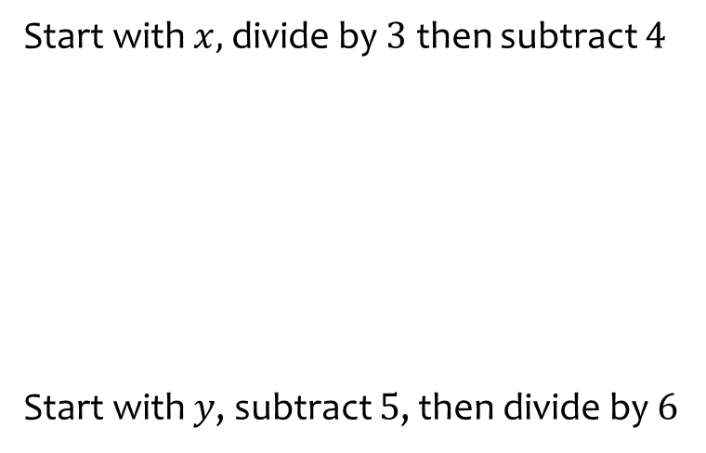
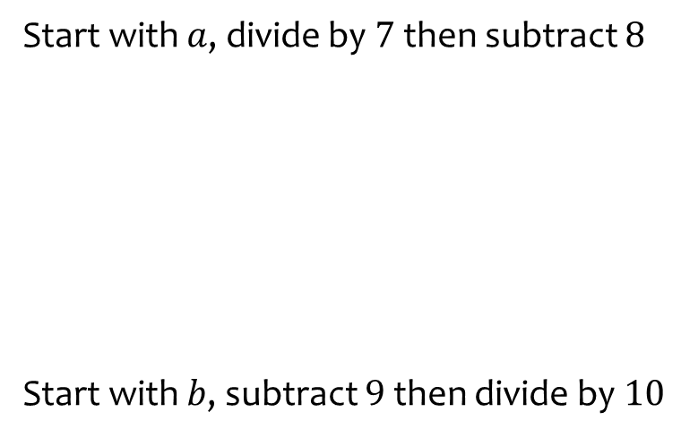


Worked example
Your turn
Start with $x,$divide by $3$ then subtract $4$
Start with $y$, subtract $5$, then divide by $6$
Start with $a$, divide by $7$ then subtract $8$
Start with $b$, subtract $9$then divide by $10$
$$\frac{a}{7}−8$$
$$\frac{b−9}{10}$$

Slide 4
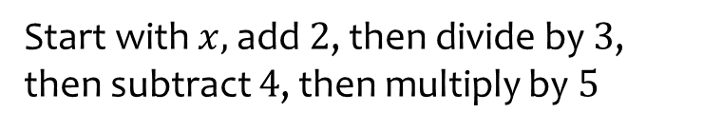
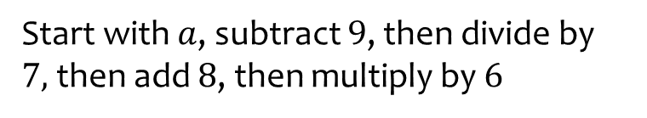

Worked example
Your turn
Start with $x,$ add $2$, then divide by $3$, then subtract $4$, then multiply by $5$
Start with $a$, subtract $9$, then divide by $7,$then add $8$, then multiply by $6$
$$6\left(\frac{a−9}{7}+8\right)$$

