Slide 1
FACTORISING QUADRATICS
CONTENTS

Slide 2
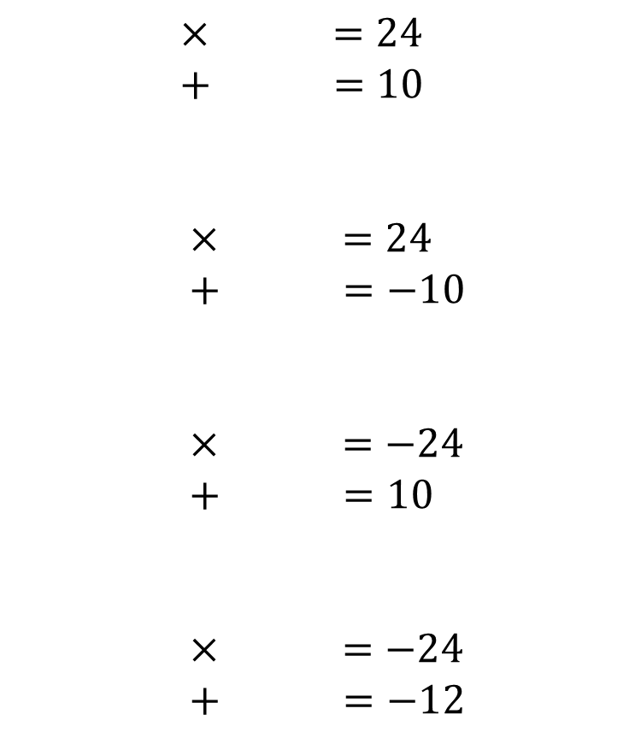
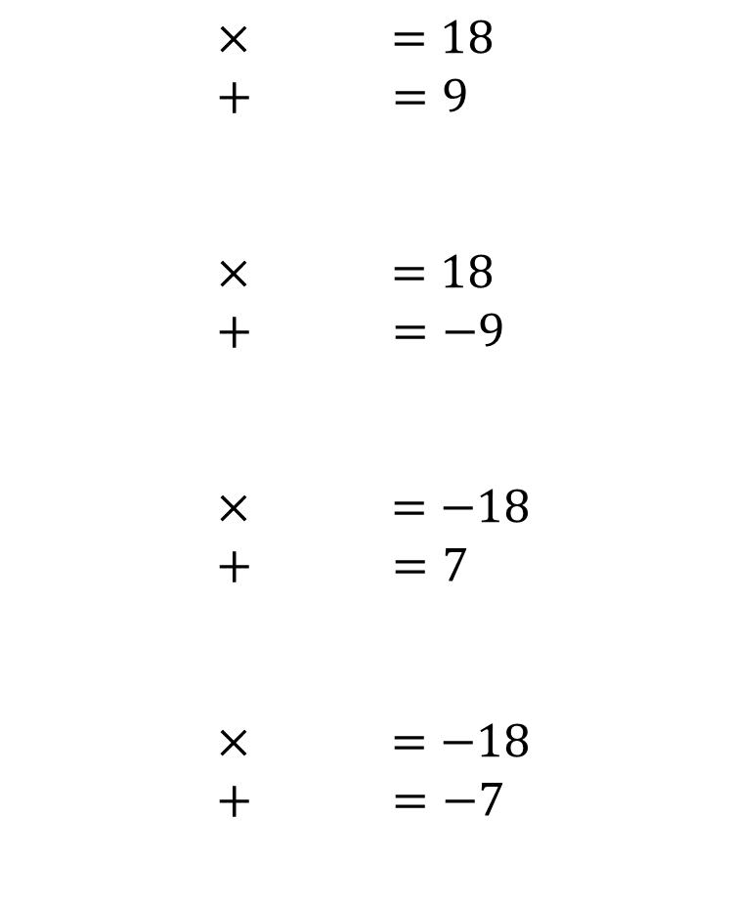
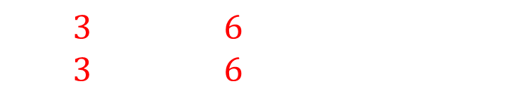

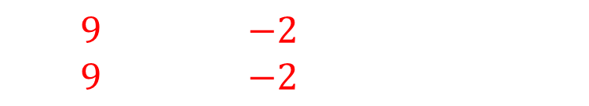

Worked example
Your turn
$× =24$
$+ =10$
$× =24$
$+ =−10$
$× =−24$
$+ =10$
$× =−24$
$+ =−12$
$× =18$
$+ =9$
$× =18$
$+ =−9$
$× =−18$
$+ =7$
$× =−18$
$+ =−7$
$3$ $6$
$3$ $6$
$−3$ $−6$
$−3$ $−6$
$9$ $−2$
$9$ $−2$
$−9$ $2$
$−9$ $2$

Slide 3
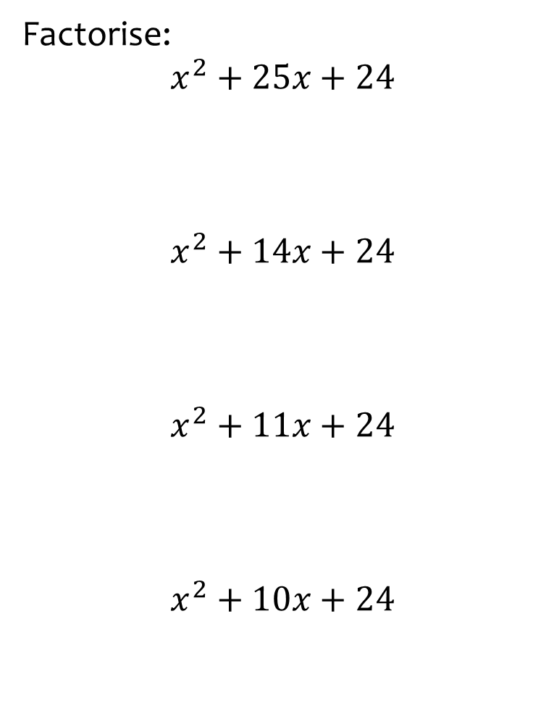
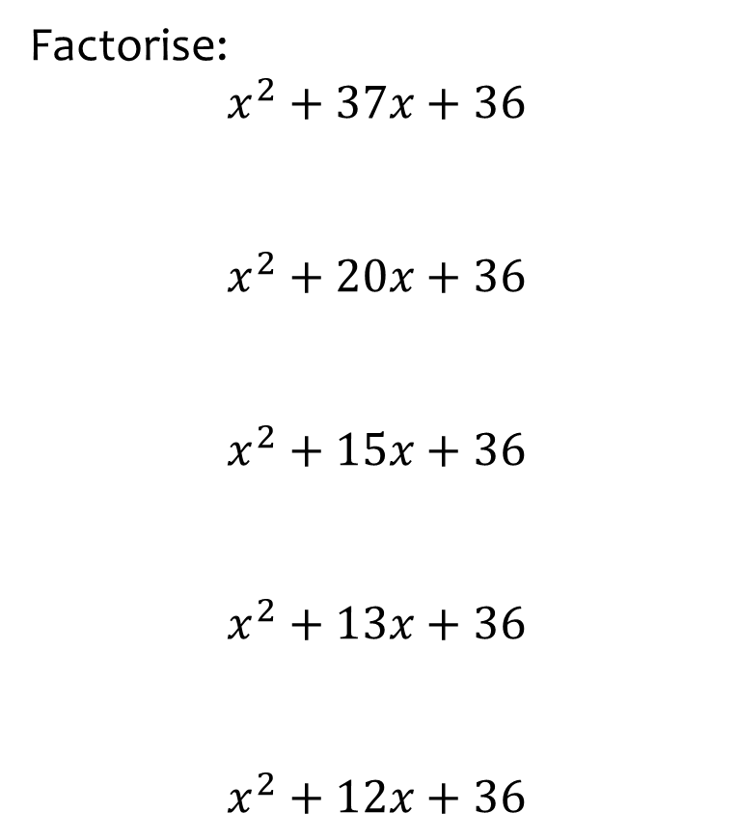
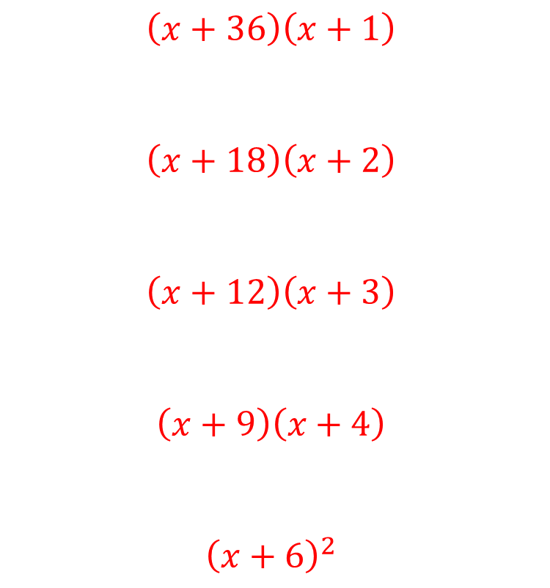
Worked example
Your turn
Factorise:
$$x^{2}+25x+24$$
$$x^{2}+14x+24$$
$$x^{2}+11x+24$$
$$x^{2}+10x+24$$
Factorise:
$$x^{2}+37x+36$$
$$x^{2}+20x+36$$
$$x^{2}+15x+36$$
$$x^{2}+13x+36$$
$$x^{2}+12x+36$$
$$\left(x+36\right)\left(x+1\right)$$
$$\left(x+18\right)\left(x+2\right)$$
$$\left(x+12\right)\left(x+3\right)$$
$$\left(x+9\right)\left(x+4\right)$$
$${\left(x+6\right)}^{2}$$

Slide 4
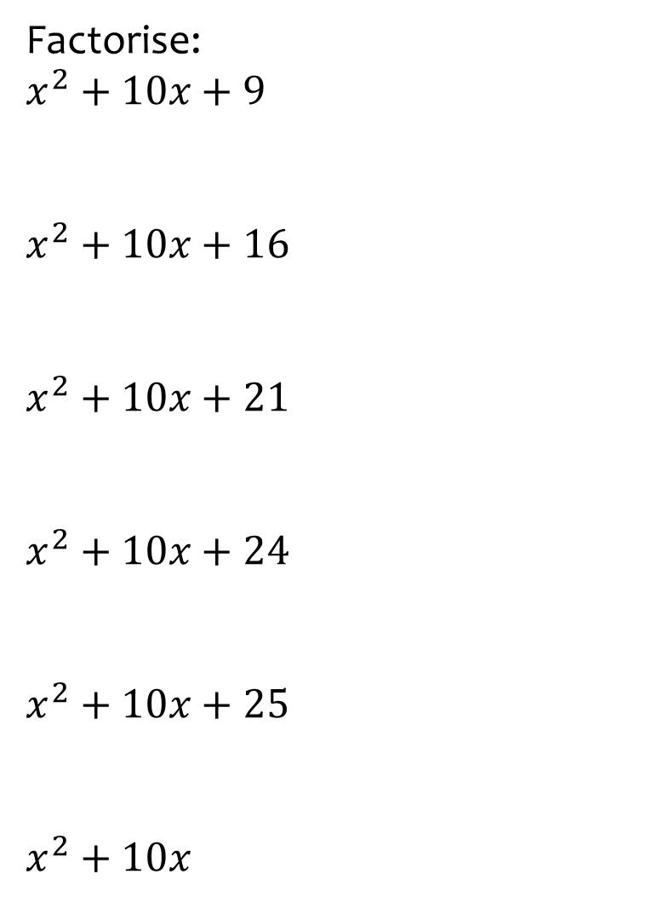
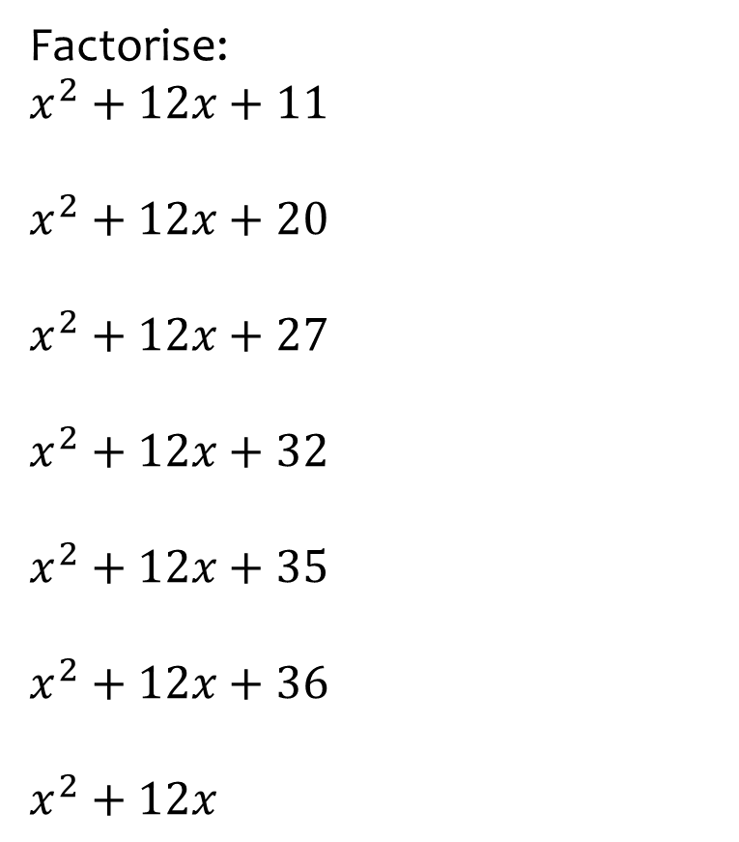
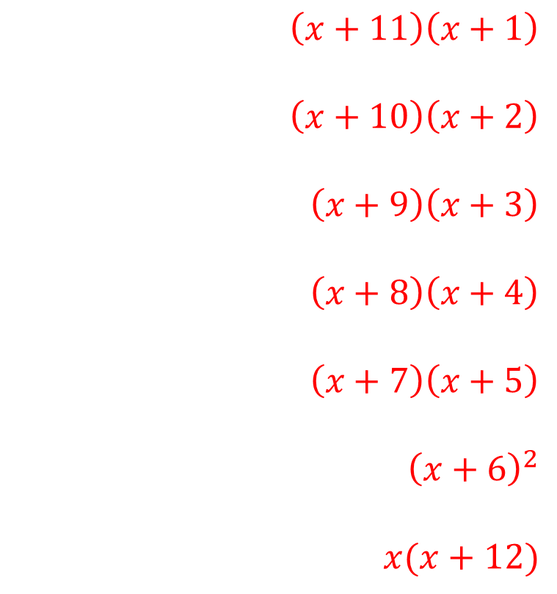
Worked example
Your turn
Factorise:
$$x^{2}+10x+9$$
$$x^{2}+10x+16$$
$$x^{2}+10x+21$$
$$x^{2}+10x+24$$
$$x^{2}+10x+25$$
$$x^{2}+10x$$
Factorise:
$$x^{2}+12x+11$$
$$x^{2}+12x+20$$
$$x^{2}+12x+27$$
$$x^{2}+12x+32$$
$$x^{2}+12x+35$$
$$x^{2}+12x+36$$
$$x^{2}+12x$$
$$\left(x+11\right)\left(x+1\right)$$
$$\left(x+10\right)\left(x+2\right)$$
$$\left(x+9\right)\left(x+3\right)$$
$$\left(x+8\right)\left(x+4\right)$$
$$\left(x+7\right)\left(x+5\right)$$
$${\left(x+6\right)}^{2}$$
$$x(x+12)$$

Slide 5
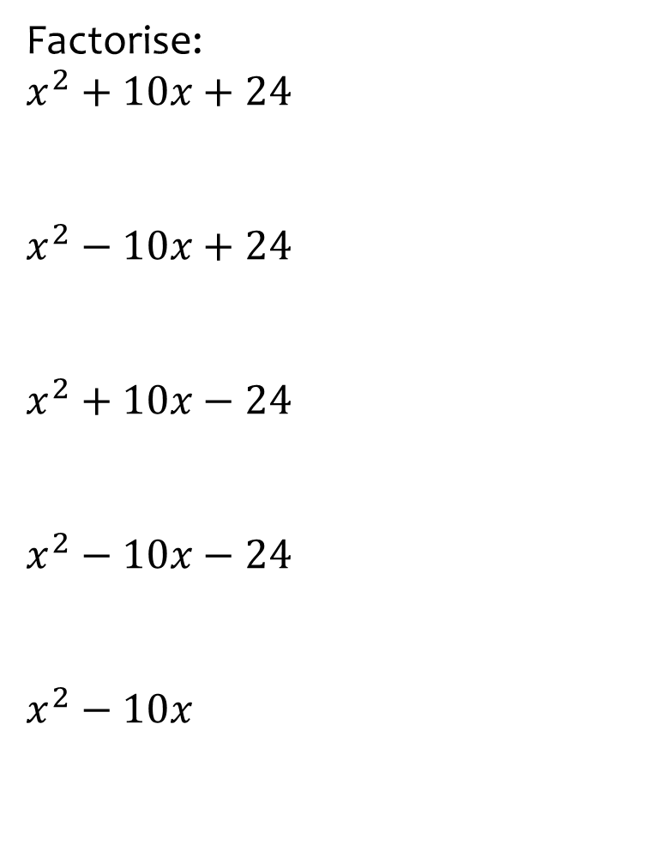
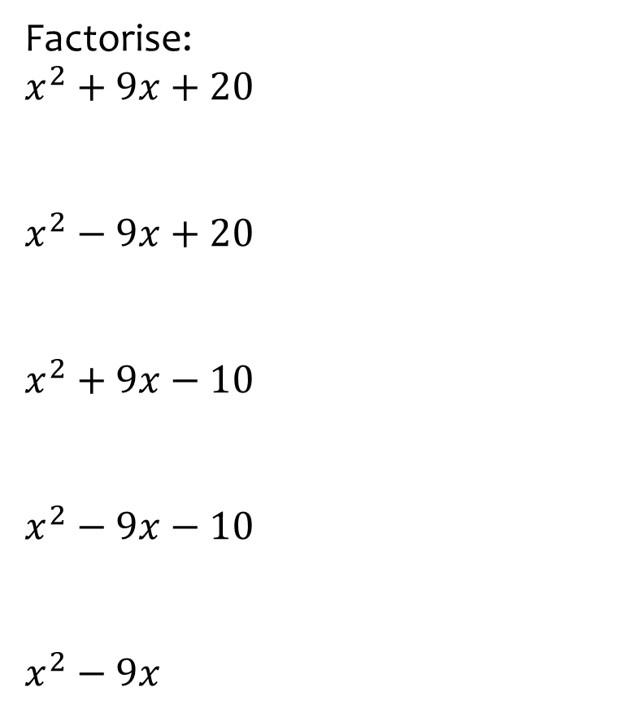
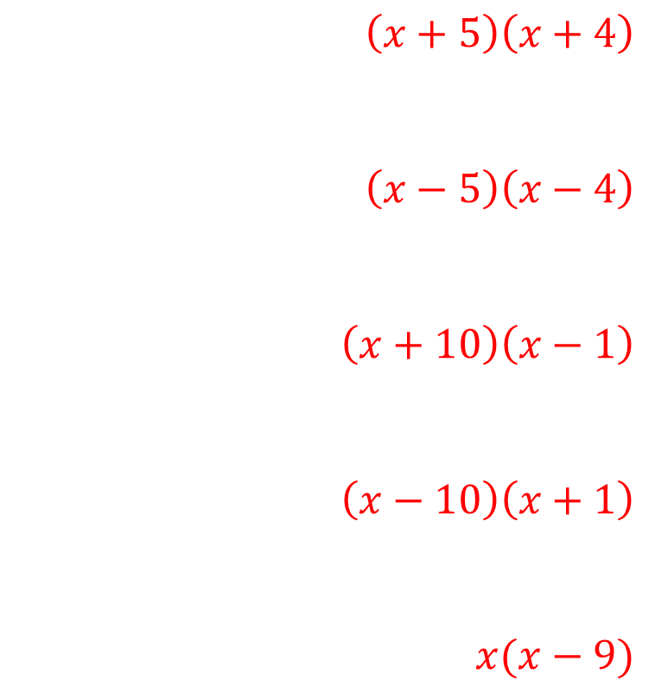
Worked example
Your turn
Factorise:
$$x^{2}+10x+24$$
$$x^{2}−10x+24$$
$$x^{2}+10x−24$$
$$x^{2}−10x−24$$
$$x^{2}−10x$$
Factorise:
$$x^{2}+9x+20$$
$$x^{2}−9x+20$$
$$x^{2}+9x−10$$
$$x^{2}−9x−10$$
$$x^{2}−9x$$
$$\left(x+5\right)\left(x+4\right)$$
$$\left(x−5\right)\left(x−4\right)$$
$$\left(x+10\right)\left(x−1\right)$$
$$\left(x−10\right)\left(x+1\right)$$
$$x(x−9)$$

Slide 6
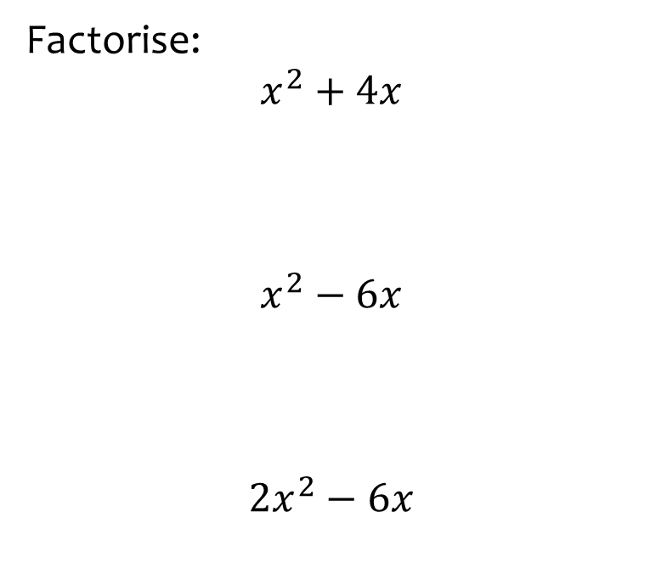


Worked example
Your turn
Factorise:
$$x^{2}+4x$$
$$x^{2}−6x$$
$${2x}^{2}−6x$$
Factorise:
$${3x}^{2}−12x$$
$$3x(x−4)$$

Slide 7
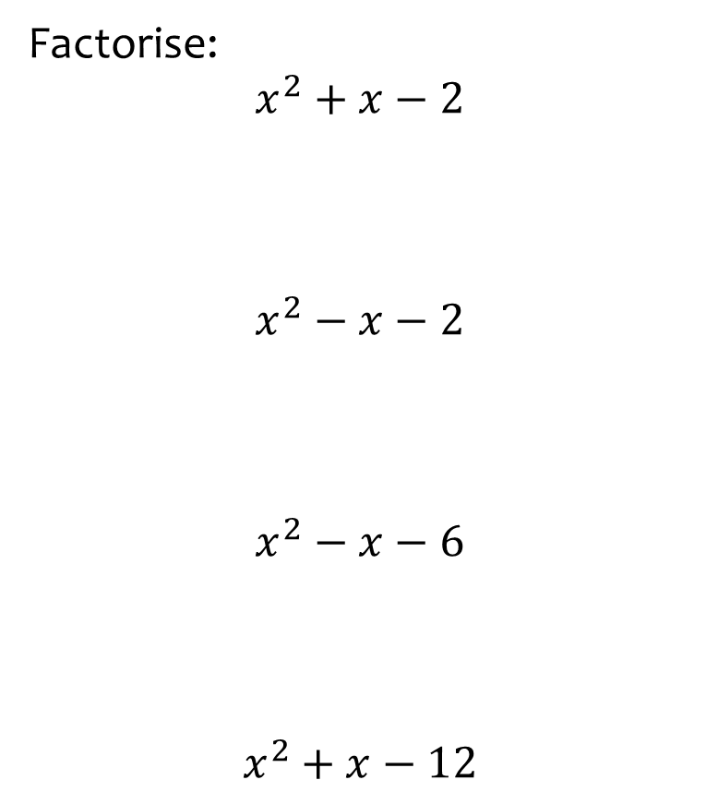


Worked example
Your turn
Factorise:
$$x^{2}+x−2$$
$$x^{2}−x−2$$
$$x^{2}−x−6$$
$$x^{2}+x−12$$
Factorise:
$$x^{2}−x−20$$
$$(x−5)(x+4)$$

Slide 8
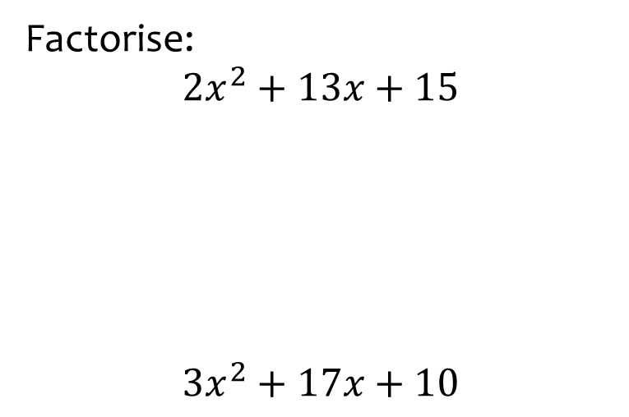


Worked example
Your turn
Factorise:
$$2x^{2}+13x+15$$
$$3x^{2}+17x+10$$
Factorise:
$$3x^{2}+11x+10$$
$$(3x+5)(x+2)$$

Slide 9
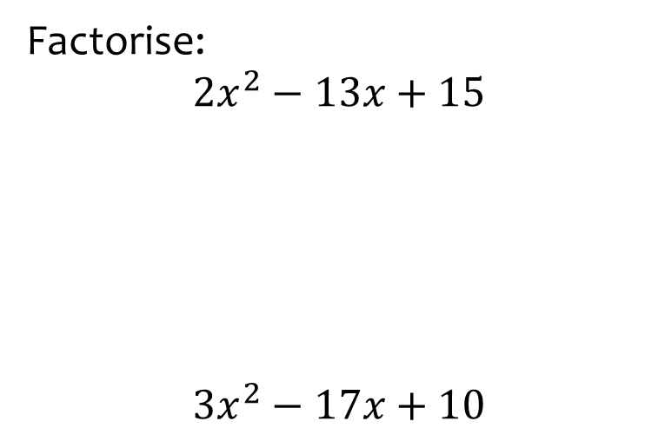


Worked example
Your turn
Factorise:
$$2x^{2}−13x+15$$
$$3x^{2}−17x+10$$
Factorise:
$$3x^{2}−11x+10$$
$$(3x−5)(x−2)$$

Slide 10
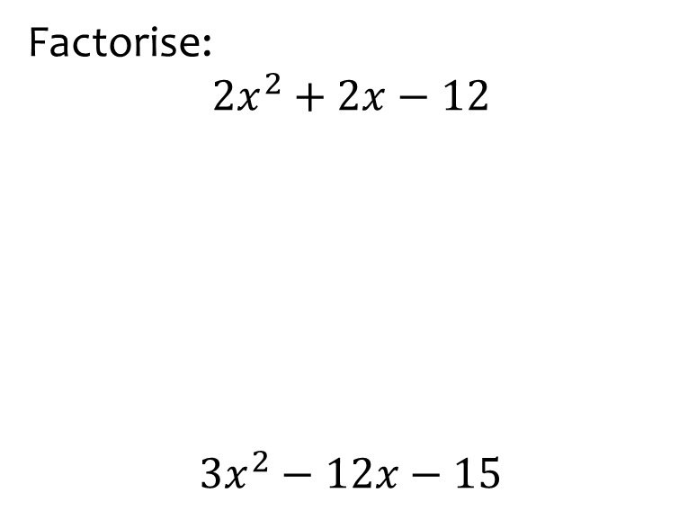


Worked example
Your turn
Factorise:
$$2x^{2}+2x−12$$
$$3x^{2}−12x−15$$
Factorise:
$$5x^{2}−15x+10$$
$$5(x−2)(x−1)$$

Slide 11
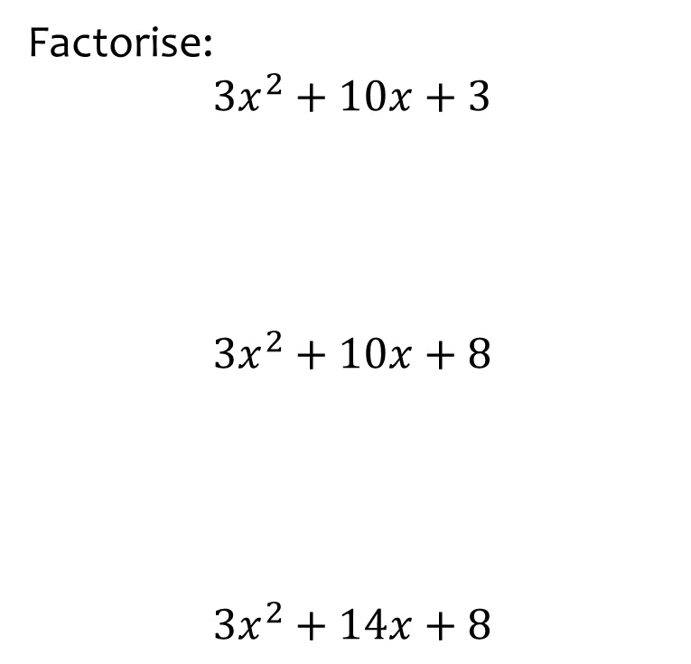
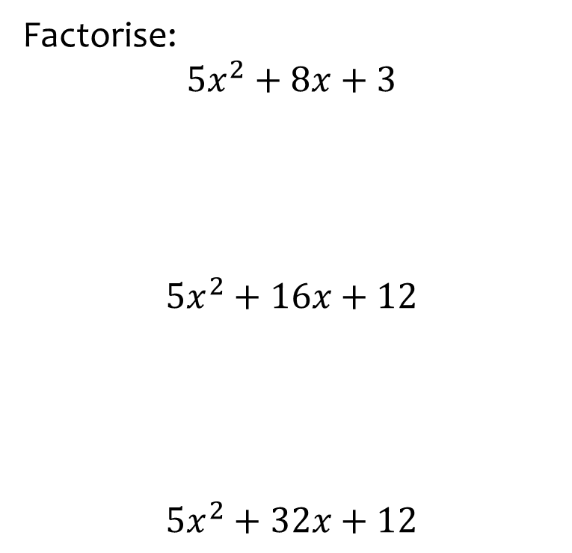
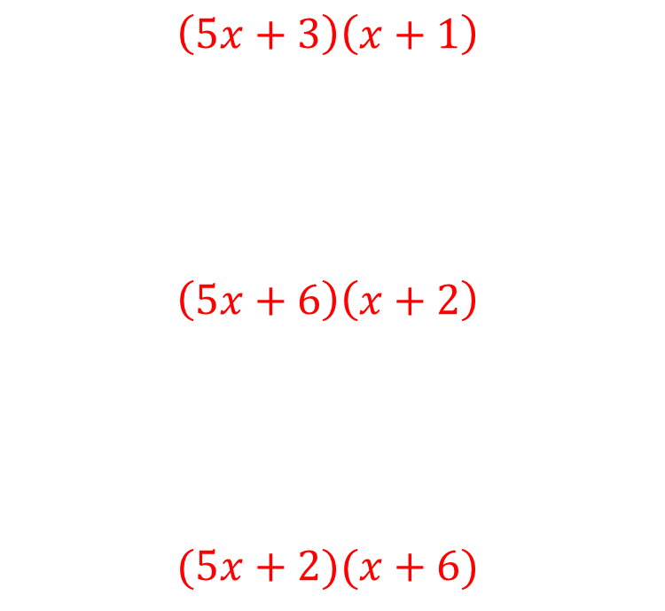
Worked example
Your turn
Factorise:
$$3x^{2}+10x+3$$
$$3x^{2}+10x+8$$
$$3x^{2}+14x+8$$
Factorise:
$$5x^{2}+8x+3$$
$$5x^{2}+16x+12$$
$$5x^{2}+32x+12$$
$$\left(5x+3\right)\left(x+1\right)$$
$$\left(5x+6\right)\left(x+2\right)$$
$$(5x+2)(x+6)$$

Slide 12



Worked example
Your turn
Factorise:
$$\left(x^{2}−y^{2}\right)−{\left(x−y\right)}^{2}$$
Factorise:
$$\left(n^{2}−a^{2}\right)−{\left(n−a\right)}^{2}$$
$$2a(n−a)$$

Slide 13
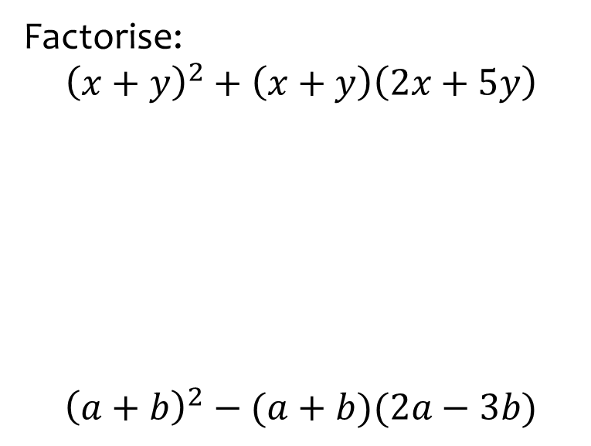
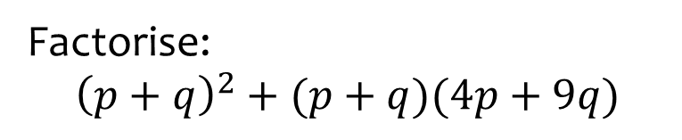

Worked example
Your turn
Factorise:
$${\left(x+y\right)}^{2}+\left(x+y\right)\left(2x+5y\right)$$
$${\left(a+b\right)}^{2}−(a+b)(2a−3b)$$
Factorise:
$${\left(p+q\right)}^{2}+(p+q)(4p+9q)$$
$$5(p+q)(p+2q)$$

