Slide 1
FACTORISING (DIFFERENCE OF TWO SQUARES)
CONTENTS

Slide 2
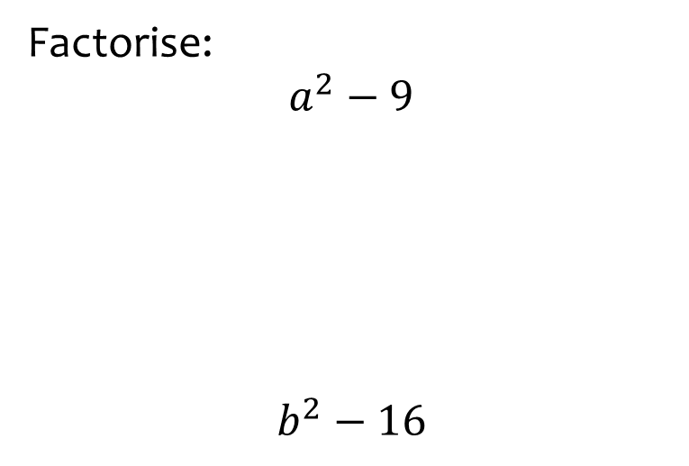


Worked example
Your turn
Factorise:
$$a^{2}−9$$
$$b^{2}−16$$
Factorise:
$$c^{2}−25$$
$$(c+5)(c−5)$$

Slide 3
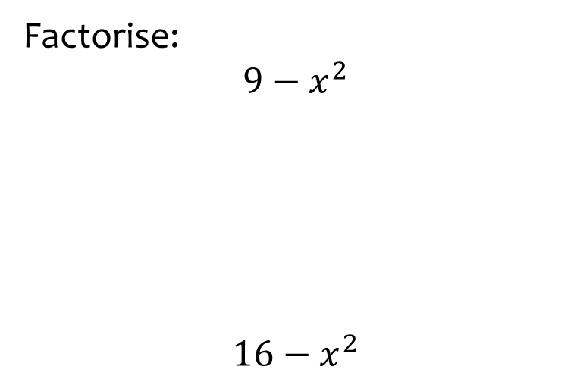


Worked example
Your turn
Factorise:
$$9−x^{2}$$
$$16−x^{2}$$
Factorise:
$$25−x^{2}$$
$$(5+x)(5−x)$$

Slide 4
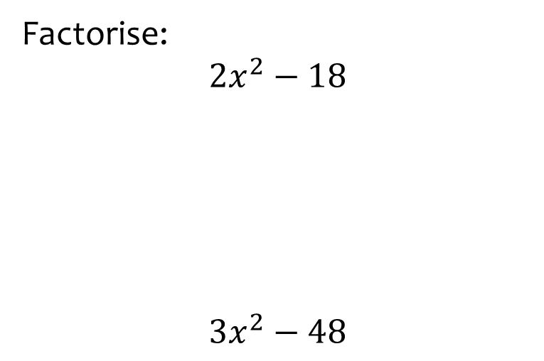


Worked example
Your turn
Factorise:
$${2x}^{2}−18$$
$$3x^{2}−48$$
Factorise:
$${4x}^{2}−100$$
$$4(x+5)(x−5)$$

Slide 5
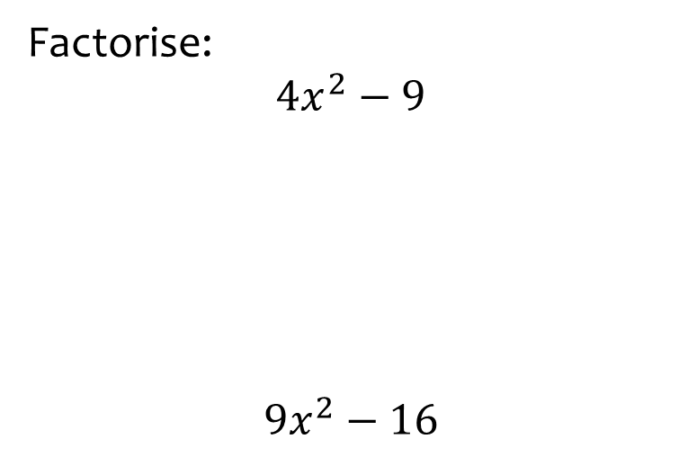


Worked example
Your turn
Factorise:
$$4x^{2}−9$$
$$9x^{2}−16$$
Factorise:
$$25x^{2}−36$$
$$(5x+6)(5x−6)$$

Slide 6
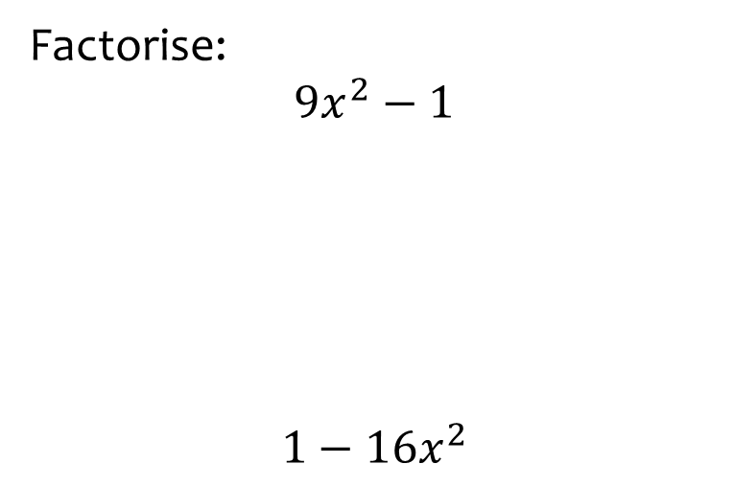


Worked example
Your turn
Factorise:
$$9x^{2}−1$$
$$1−16x^{2}$$
Factorise:
$$25x^{2}−1$$
$$(5x+1)(5x−1)$$

Slide 7
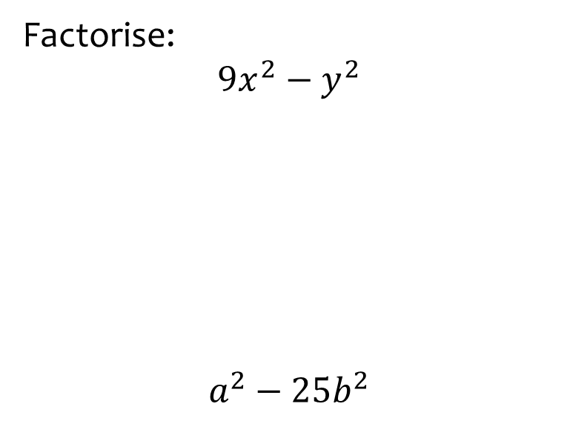


Worked example
Your turn
Factorise:
$$9x^{2}−y^{2}$$
$$a^{2}−25b^{2}$$
Factorise:
$$16c^{2}−d^{2}$$
$$(4c+d)(4c−d)$$

Slide 8
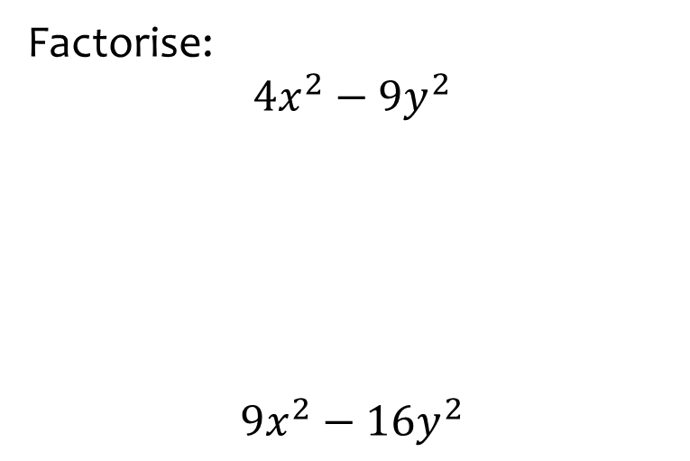


Worked example
Your turn
Factorise:
$$4x^{2}−9y^{2}$$
$$9x^{2}−16y^{2}$$
Factorise:
$$25x^{2}−36y^{2}$$
$$\left(5x+6y\right)(5x−6y)$$

Slide 9
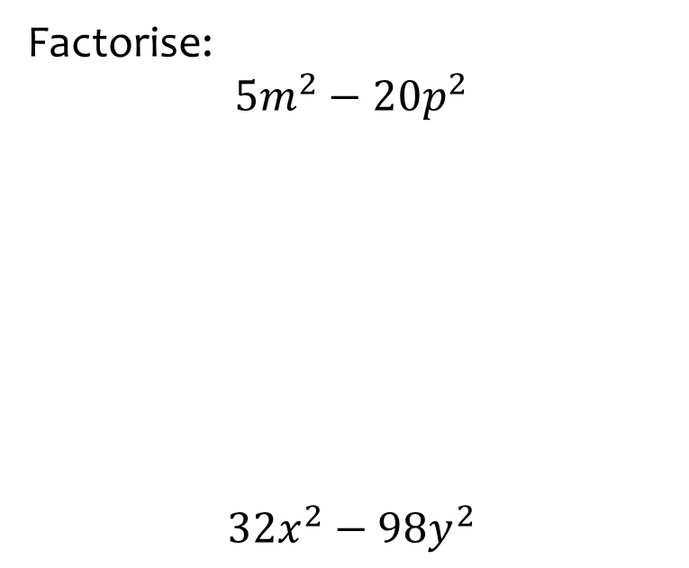


Worked example
Your turn
Factorise:
$$5m^{2}−20p^{2}$$
$$32x^{2}−98y^{2}$$
Factorise:
$$50a^{2}−72b^{2}$$
$$2(5a+6b)(5a−6b)$$

Slide 10
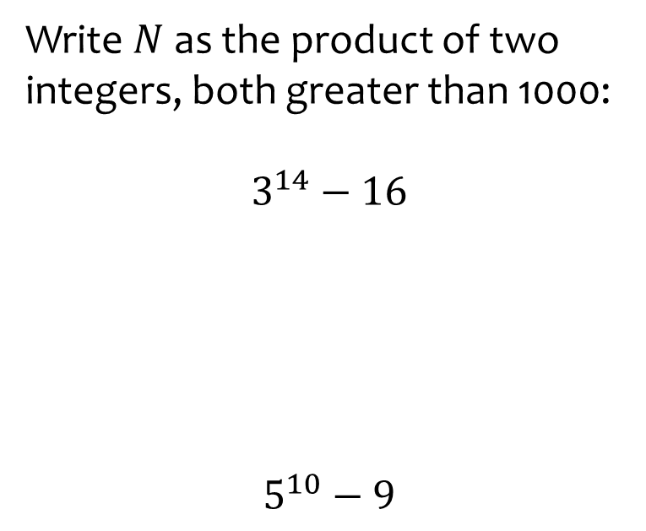
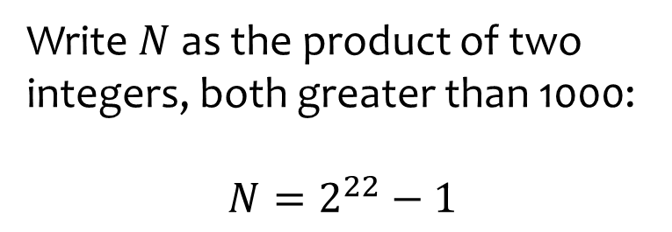

Worked example
Your turn
Write $N$as the product of two integers, both greater than 1000:
$$3^{14}−16$$
$$5^{10}−9$$
Write $N$as the product of two integers, both greater than 1000:
$$N=2^{22}−1$$
$$2049×2047$$

Slide 11
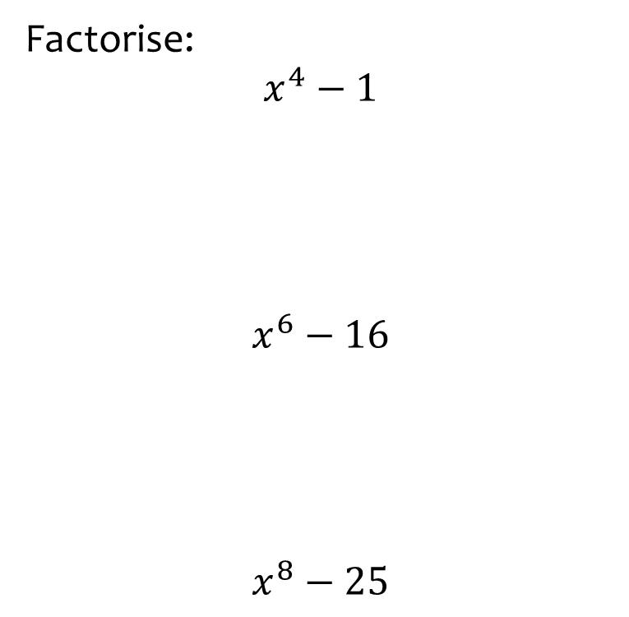


Worked example
Your turn
Factorise:
$$x^{4}−1$$
$$x^{6}−16$$
$$x^{8}−25$$
Factorise:
$$x^{10}−49$$
$$(x^{5}+7)(x^{5}−7)$$

Slide 12
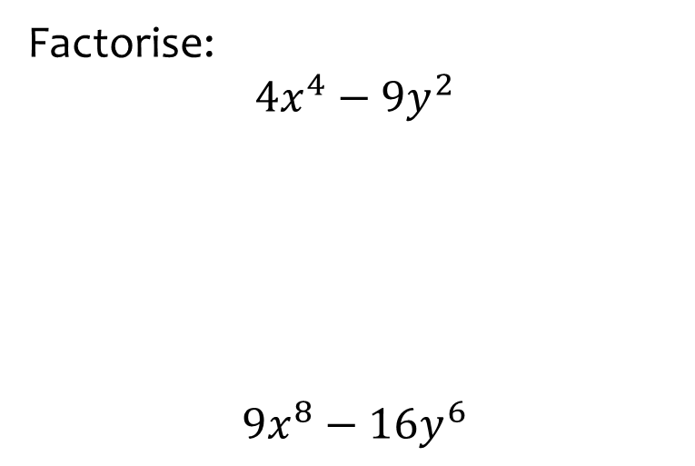


Worked example
Your turn
Factorise:
$$4x^{4}−9y^{2}$$
$$9x^{8}−16y^{6}$$
Factorise:
$$25x^{12}−36y^{6}$$
$$(5x^{6}+6y^{3})(5x^{6}−6y^{3})$$

