Slide 1
FACTORISING (BASIC)
CONTENTS

Slide 2
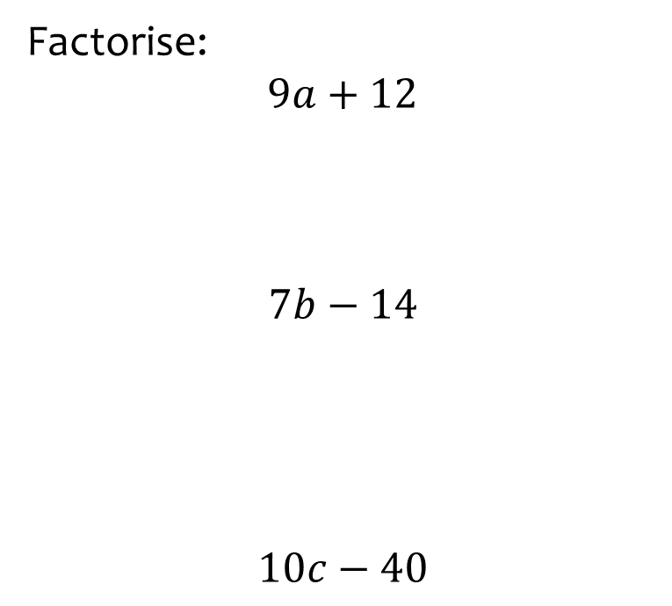


Worked example
Your turn
Factorise:
$$9a+12$$
$$7b−14$$
$$10c−40$$
Factorise:
$$8x−24$$
$$8(x−3)$$

Slide 3
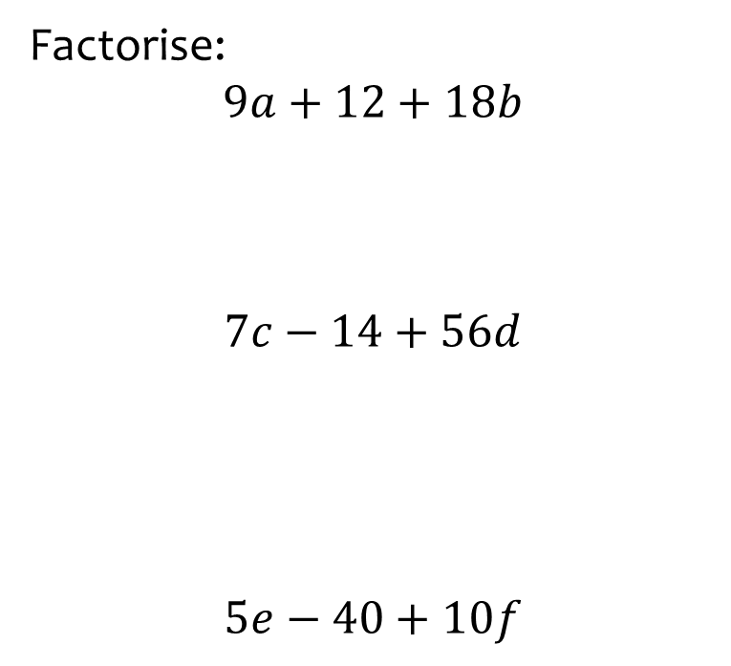


Worked example
Your turn
Factorise:
$$9a+12+18b$$
$$7c−14+56d$$
$$5e−40+10f$$
Factorise:
$$8x−24+48y$$
$$8(x−3+6y)$$

Slide 4
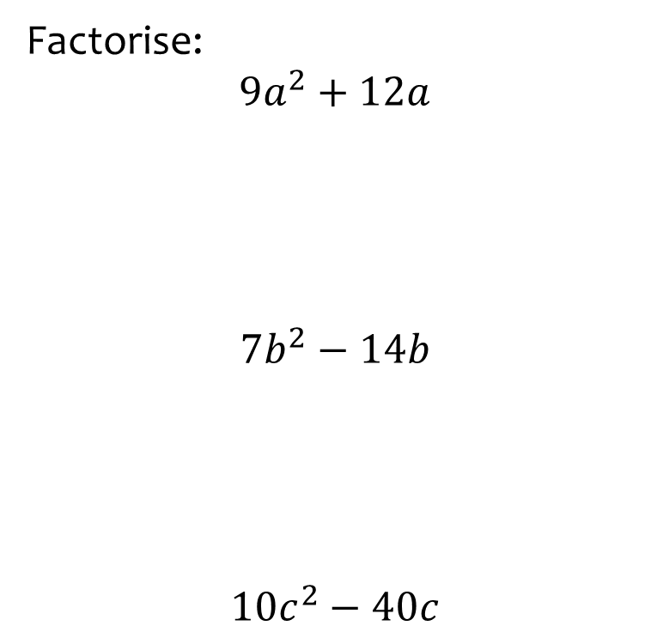


Worked example
Your turn
Factorise:
$$9a^{2}+12a$$
$$7b^{2}−14b$$
$$10c^{2}−40c$$
Factorise:
$$8x^{2}−24x$$
$$8x(x−3)$$

Slide 5



Worked example
Your turn
Factorise:
$$9a−18+45b−6c$$
Factorise:
$$8x−24+48y−6z$$
$$2(4x−6+24y−3z)$$

Slide 6
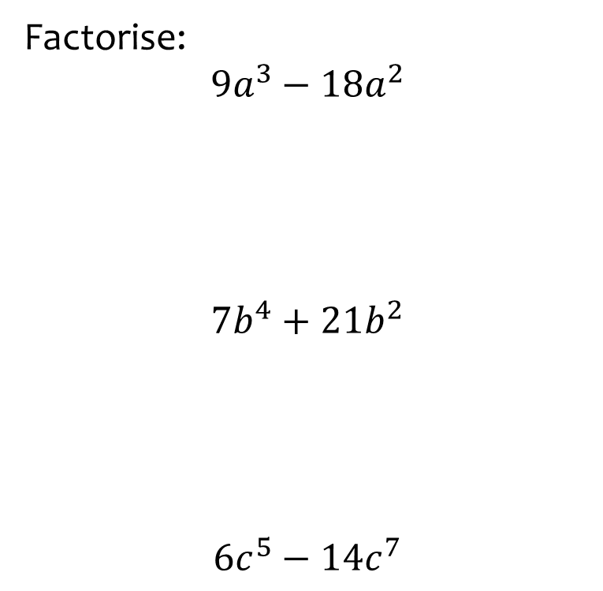


Worked example
Your turn
Factorise:
$$9a^{3}−18a^{2}$$
$$7b^{4}+21b^{2}$$
$$6c^{5}−14c^{7}$$
Factorise:
$$6x^{7}−10x^{4}$$
$$2x^{4}(3x^{3}−5)$$

Slide 7
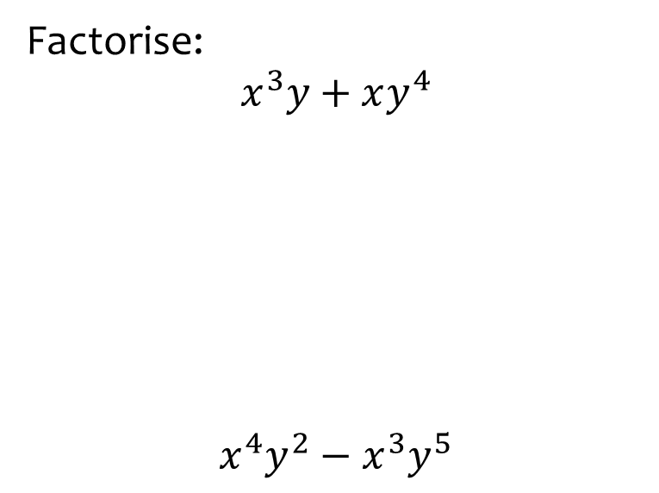


Worked example
Your turn
Factorise:
$$x^{3}y+xy^{4}$$
$$x^{4}y^{2}−x^{3}y^{5}$$
Factorise:
$$x^{2}y^{5}−xy^{3}$$
$$xy^{3}(xy^{2}−1)$$

Slide 8
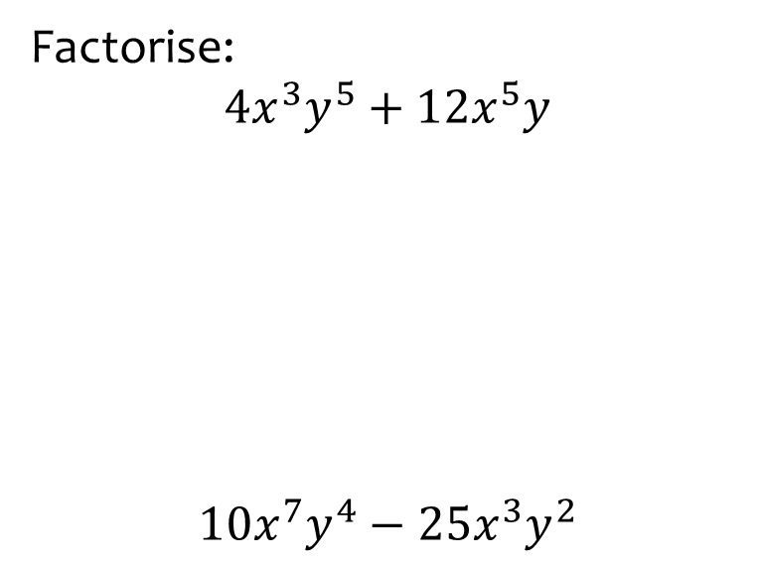


Worked example
Your turn
Factorise:
$$4x^{3}y^{5}+12x^{5}y$$
$$10x^{7}y^{4}−25x^{3}y^{2}$$
Factorise:
$$20e^{5}f^{2}−12e^{2}f$$
$$4e^{2}f(5e^{3}f−3)$$

Slide 9
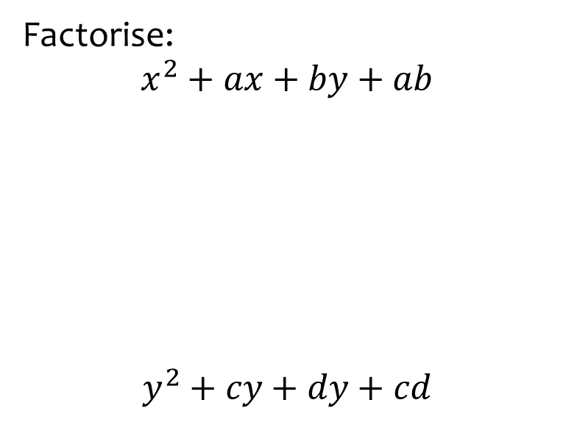


Worked example
Your turn
Factorise:
$$x^{2}+ax+by+ab$$
$$y^{2}+cy+dy+cd$$
Factorise:
$$x^{2}+px+qx+pq$$
$$(x+p)(x+q)$$

Slide 10
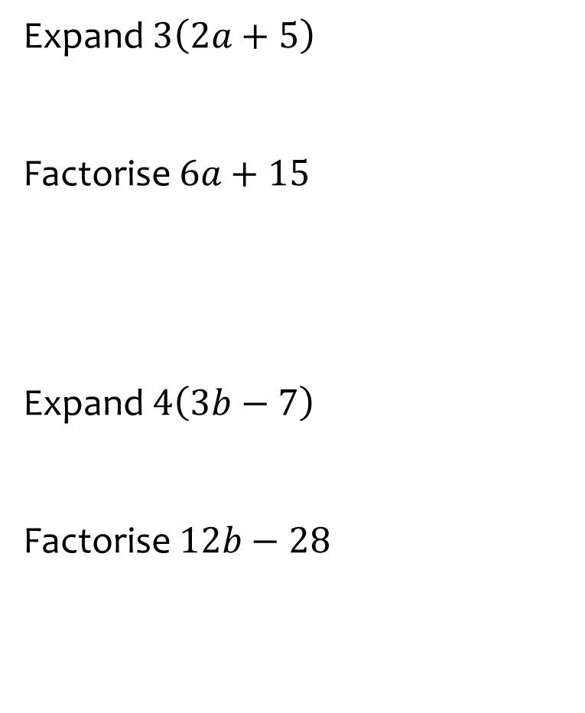
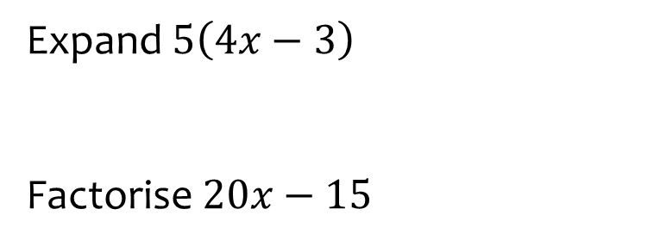

Worked example
Your turn
Expand $3\left(2a+5\right)$
Factorise $6a+15$
Expand $4\left(3b−7\right)$
Factorise $12b−28$
Expand $5\left(4x−3\right)$
Factorise $20x−15$
$$20x−15$$
$$5(4x−3)$$

