Slide 1
EXPANDING BRACKETS (TRIPLE)
CONTENTS

Slide 2
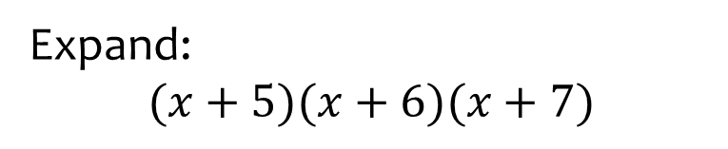
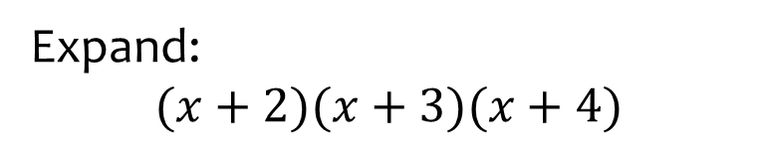

Worked example
Your turn
Expand:
$$(x+5)(x+6)(x+7)$$
Expand:
$$(x+2)(x+3)(x+4)$$
$$x^{3}+9x^{2}+26x+24$$

Slide 3
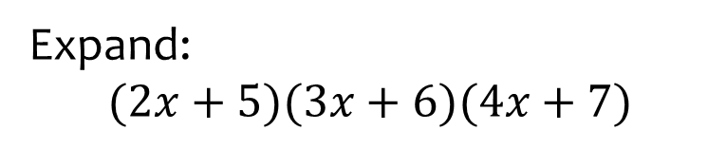
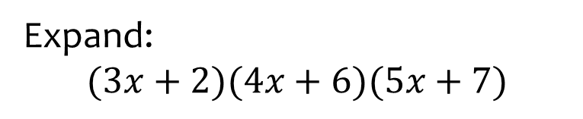

Worked example
Your turn
Expand:
$$(2x+5)(3x+6)(4x+7)$$
Expand:
$$(3x+2)(4x+6)(5x+7)$$
$$60x^{3}+214x^{2}+242x+84$$

Slide 4
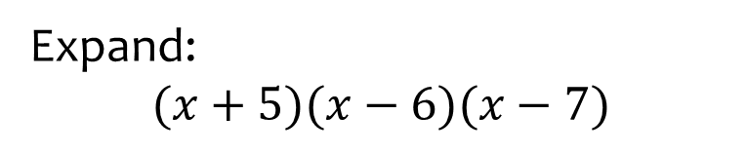
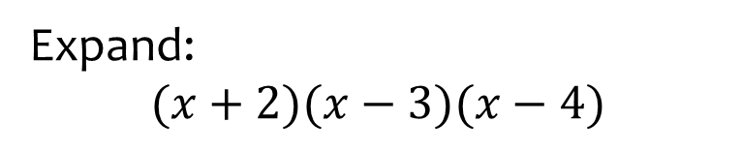

Worked example
Your turn
Expand:
$$(x+5)(x−6)(x−7)$$
Expand:
$$(x+2)(x−3)(x−4)$$
$$x^{3}−5x^{2}−2x+24$$

Slide 5
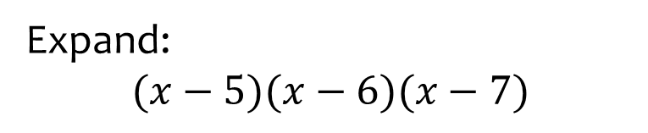
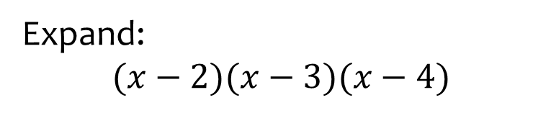

Worked example
Your turn
Expand:
$$(x−5)(x−6)(x−7)$$
Expand:
$$(x−2)(x−3)(x−4)$$
$$x^{3}−9x^{2}+26x−24$$

Slide 6
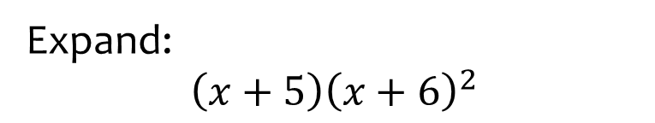
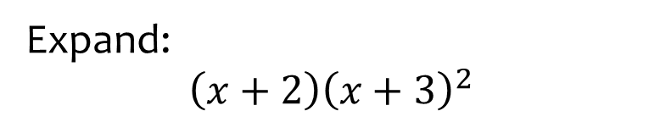

Worked example
Your turn
Expand:
$$\left(x+5\right){\left(x+6\right)}^{2}$$
Expand:
$$\left(x+2\right){\left(x+3\right)}^{2}$$
$$x^{3}+8x^{2}+21x+18$$

Slide 7
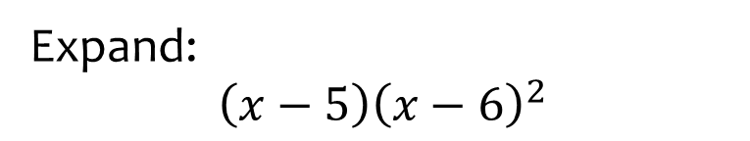
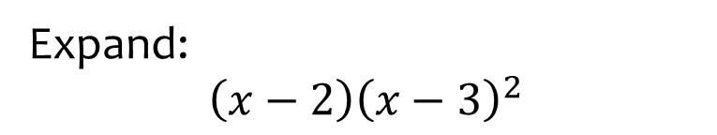

Worked example
Your turn
Expand:
$$\left(x−5\right){\left(x−6\right)}^{2}$$
Expand:
$$\left(x−2\right){\left(x−3\right)}^{2}$$
$$x^{3}−8x^{2}+21x−18$$

Slide 8
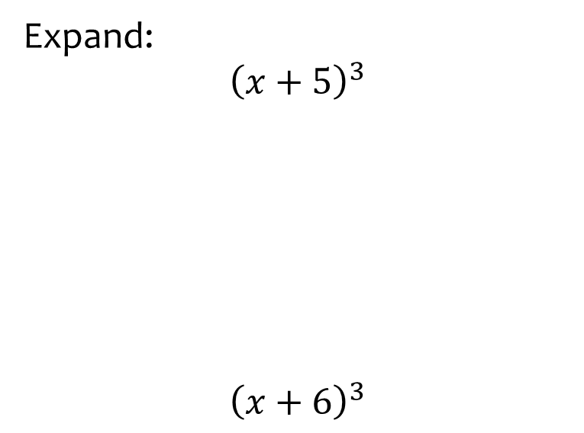
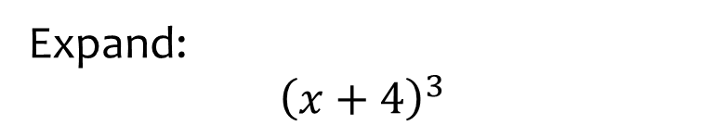

Worked example
Your turn
Expand:
$${\left(x+5\right)}^{3}$$
$${\left(x+6\right)}^{3}$$
Expand:
$${\left(x+4\right)}^{3}$$
$$x^{3}+12x^{2}+48x+64$$

Slide 9
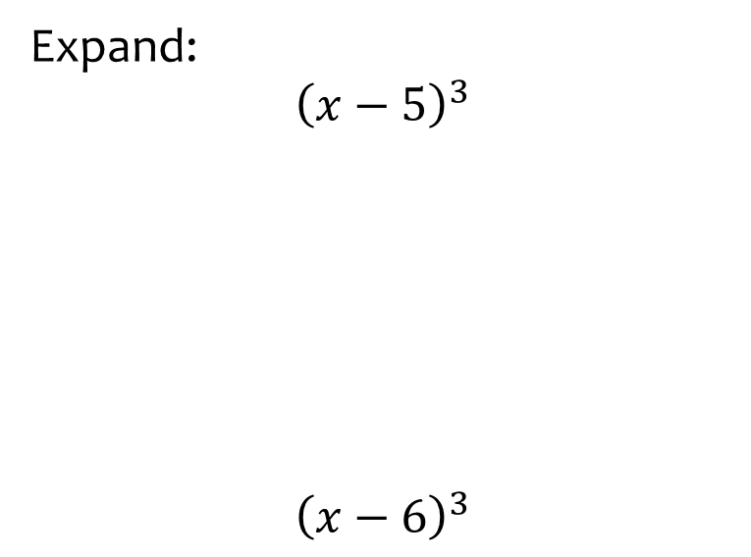
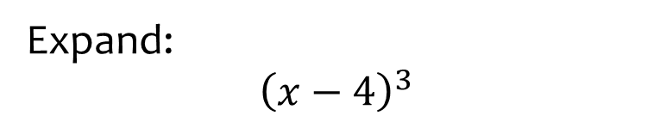

Worked example
Your turn
Expand:
$${\left(x−5\right)}^{3}$$
$${\left(x−6\right)}^{3}$$
Expand:
$${\left(x−4\right)}^{3}$$
$$x^{3}−12x^{2}+48x−64$$

Slide 10
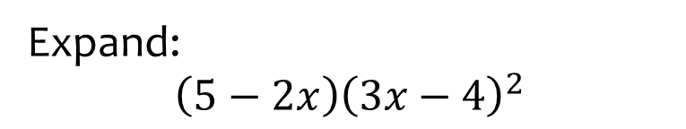
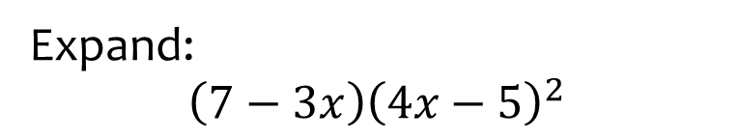

Worked example
Your turn
Expand:
$$\left(5−2x\right){\left(3x−4\right)}^{2}$$
Expand:
$$\left(7−3x\right){\left(4x−5\right)}^{2}$$
$$−48x^{3}+232x^{2}−355x+175$$

